Slide 1


How To Abstract Over Context
Martin Odersky
D-Conf
Munich, May 2018
Notes:
OPEN GAMBIT
Multicore. Cloud computing. Containers. You’ll likely agree that the infrastructure for amazing scalability is in place, it’s been well funded. It’s the underpinning that’s required for enterprises to movie en masse to the cloud. But what are they moving?
Applications.
Applications that run their business, engage their customers, allow them to innovate and enter new markets.
Without applications, this infinitely scalable infrastructure is nothing.

Slide 2
Con-text
what comes with the text, but is not in the text

Slide 3
Context is all around us
the current configuration
the current scope
the meaning of “<” on this type
the user on behalf of which the operation is performed
the security level in effect
…

Slide 4
Traditional ways to express context
globals
rigid if immutable,
unsafe if mutable
monkey patching
dependency injection
at runtime (Spring, Guice)
or with macros (MacWire)
cake pattern
close coupling + recursion

Slide 5
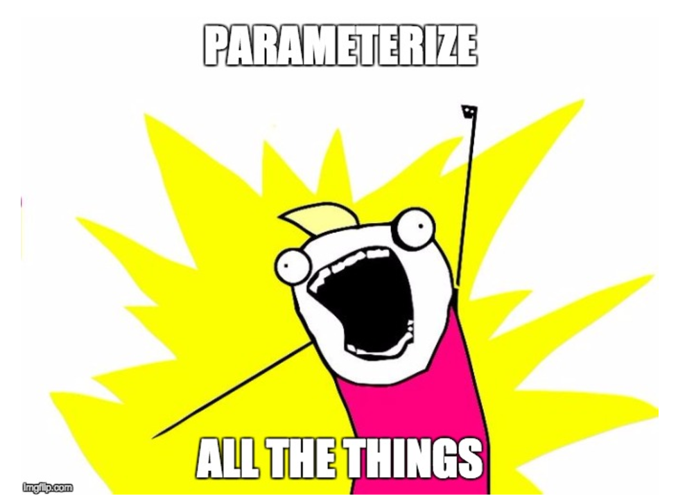
The Functional Way
“Parameterize all the things”

Slide 6
Functional is Good
- no side effects
- type safe
- fine-grained control

Slide 7
But sometimes it’s too much of a good thing …
- sea of parameters
- most of which hardly ever change
- repetitive, boring, prone to mistakes

Slide 8
A more direct approach
If passing a lot of parameters gets tedious, leave some of them implicit.

Slide 9
A more direct approach
If passing a lot of parameters gets tedious, leave some of them implicit.
“Trade types for terms”: We provide the type and have the compiler synthesize a matching term.

Slide 10
Essence of Scala
Types
If there’s one feature that makes Scala “Scala”, I would pick implicits.
Synthesis
Implicits
Functions
Objects

Slide 11
This Talk
shows a large range of use cases where implicits can be applied.
shows a natural generalization of implicits: implicit function types.
argues that these constructs are the right way to abstract over context.
t

Slide 12
Ground Rules
If you do not give an argument to an implicit parameter, one will be provided for you.
Eligible are all implicit values that are visible at the point of call.
If there are more than one eligible candidate, the most specific one is chosen.
If there’s no unique most specific candidate, an ambiguity error Is reported.

Slide 13
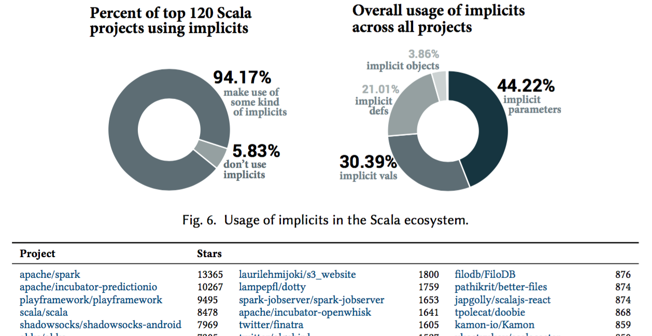
Implicits are Ubiquitous

Slide 14
Implicit Conversions
are a cousin of implicit parameters.
If the type A of an expression does not match the expected type B … … the compiler tries to find an implicit conversion method from A to B.
Same rules as for implicit parameters apply.

Slide 15
Historically …
… implicit conversions came first in Scala.
Original motivation: Provide a way for a class to implement new interfaces.
Implicit conversions were at first adopted enthusiastically, but nowadays are mostly discouraged.
Scala 3 will restrict use of implicit conversions.
(requires a special import to enable implicit conversions that are not co-defined with their target type)
I will ignore them in the rest of this talk.

Slide 16
Implicit Parameters - Use Cases
Implicit parameters can
prove theorems
implement type classes
establish context
set configurations
inject dependencies
model capabilities

Slide 17
Prove Theorems
Wanted: A List method flatten so that
if xs : List[List[T]]
then xs.flatten : List[T]
Easy to define as a global function.
But how to define it as an instance method of class List?
C.f. Kennedy & Russo: “Generalized Type Constraints”, OOPSLA 2004

Slide 18
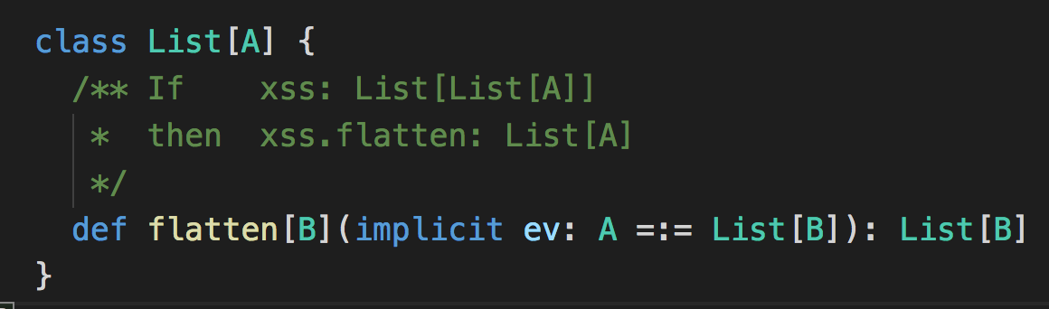
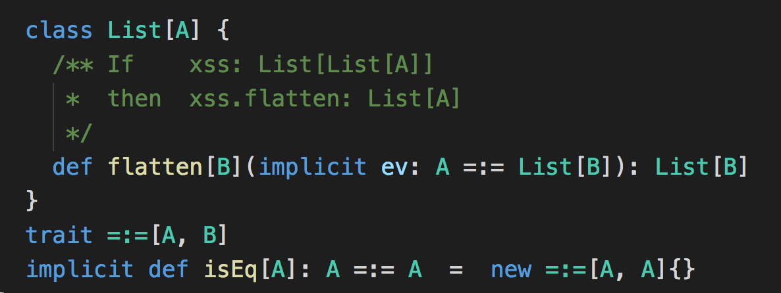
Prove Theorems
Curry Howard isomorphism:
Types = Theorems
Programs = Proofs
C.f. Kennedy & Russo: “Generalized Type Constraints”, OOPSLA 2004

Slide 19
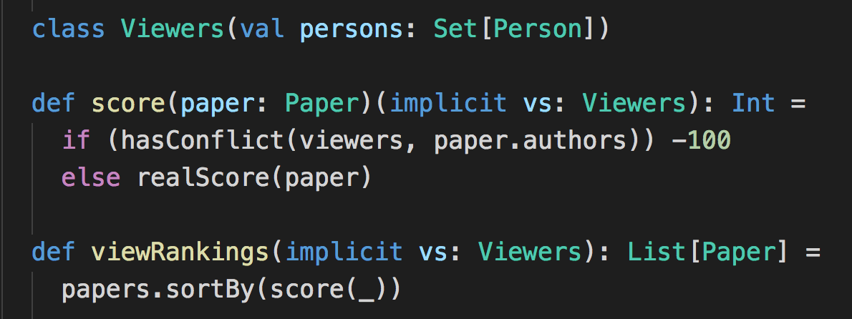
Establish Context
Example: conference management system. Reviewers should only see (directly or indirectly) the scores of papers where they have no conflict with an author.

Slide 20
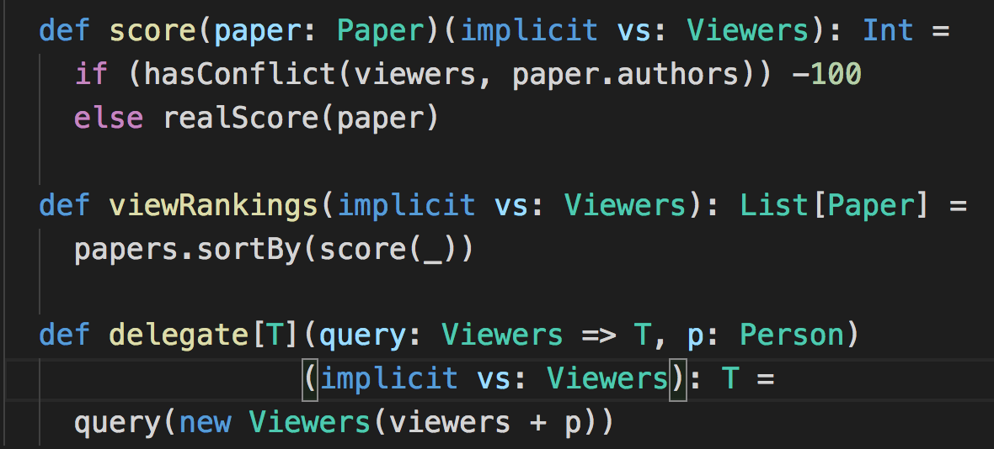
Establish Context
Example: conference management system. Context is usually stable, can change at specific points.

Slide 21
Configuration &
Dependency Management
are special cases of context passing.
see also: Dick Wall: The parfait pattern

Slide 22
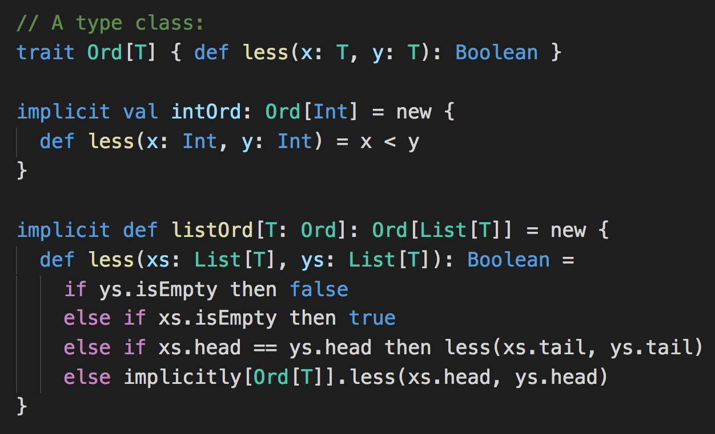
Implement Type Classes

Slide 23
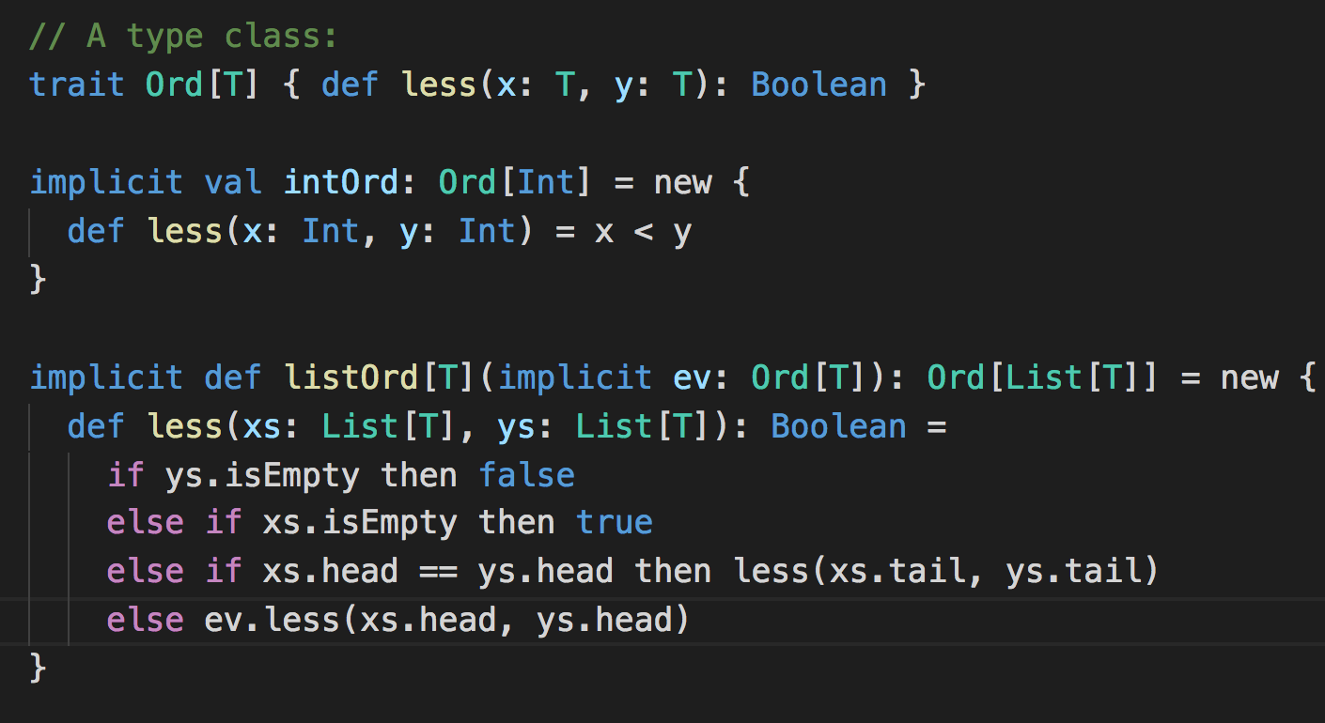
Implement Type Classes

Slide 24
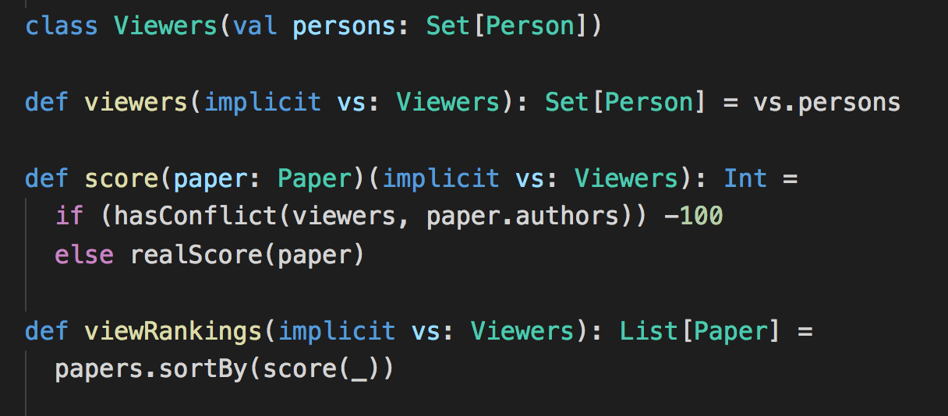
Establish Context
Example*: conference management system. Reviewers should only see (directly or indirectly) the scores of papers where they have no conflict with an author.
*Suggested by Nadia Polikarpova.

Slide 25
Establish Context
Example: conference management system. Context is usually stable, can change at specific points.
But it gets tedious to write all these implicit Viewers parameters!

Slide 26


Can we do better?
Having to write
a couple of times does not look so bad.
But in the new Scala compiler dotc there are > 2600 occurrences of the parameter
Would it not be nice to get rid of them?

Slide 27
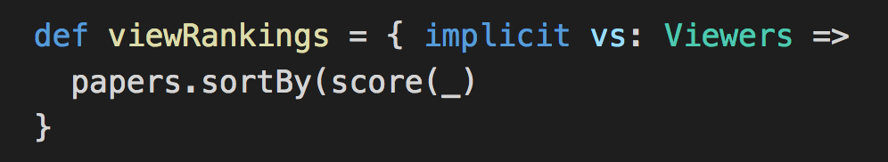
Implicit Function Types
Let’s massage the definition of viewRankings a bit:
What is its type?
So far: Viewers => List[Paper]
From now on: implicit Viewers => List[Paper]

Slide 28
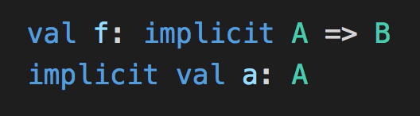


Two Rules for Typing
Implicit functions get implicit arguments just like implicit methods. Given:
f expands to f(a).
Implicit functions get created on demand. If the expected type of b is implicit A => B, then b expands to implicit (_: A) => b
Analogously for all other arities.

Slide 29

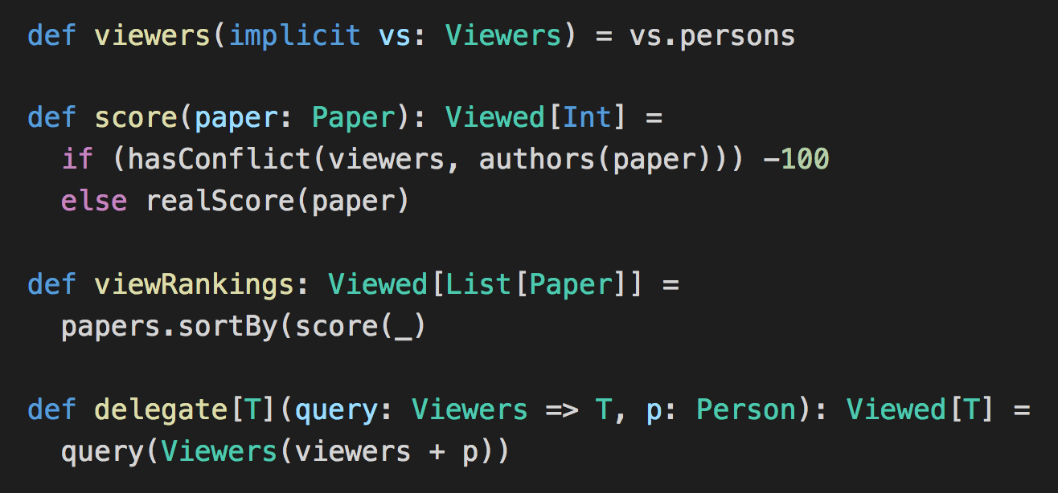
Using Implicit Function Types
Assume:
Then reformulate:
“Trade types for parameters”

Slide 30
Trade Types for Parameters
By specifying a type of an expression e, we can provide in a very general way a context for e.
Types can be declared directly, or be inferred with local type inference.

Slide 31

Efficiency
Implicit function result types can be optimized
Instead of creating a closure like this: we can simply create a curried function like this:
This brings the cost of implicit functions down to simple implicit parameters.

Slide 32
The Reader Monad
The reader monad is a somewhat popular method to pass context.
Essentially, it wraps the implicit reading in a monad.
One advantage: The reading is abstracted in a type.
But I believe this is shooting sparrows with cannons.
Monads are about sequencing, they have have nothing to do with passing context.

Slide 33
Comparison with the Reader Monad
Implicit functions are more lightweight, since they don’t force you into monadic style.
They also compose better. For instance:
implicit A => implicit B => R and
implicit B => implicit A => R are compatible.
They are also much faster: More than 7x in simple experiments.

Slide 34
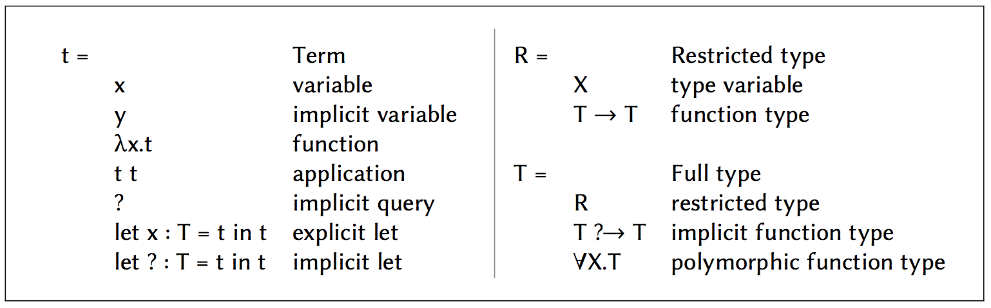
A Formalization
Bidirectional typing rules:
Γ ⊢ t :▷ T (Synthesis)
Γ ⊢ t ◁: T (Checking)

Slide 35
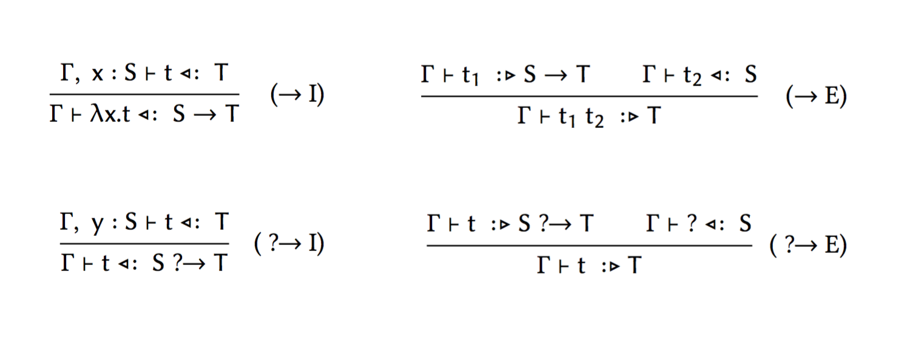
SI Typing Rules: Functions

Slide 36
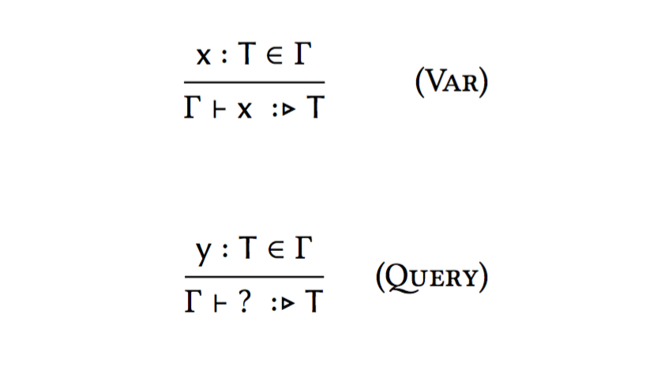
SI Typing Rules: Variables

Slide 37
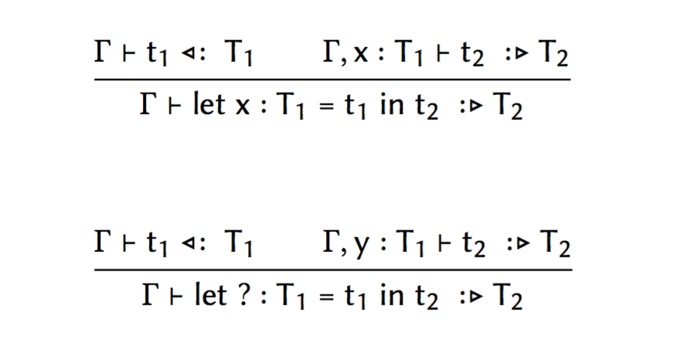
SI Typing Rules: Let

Slide 38
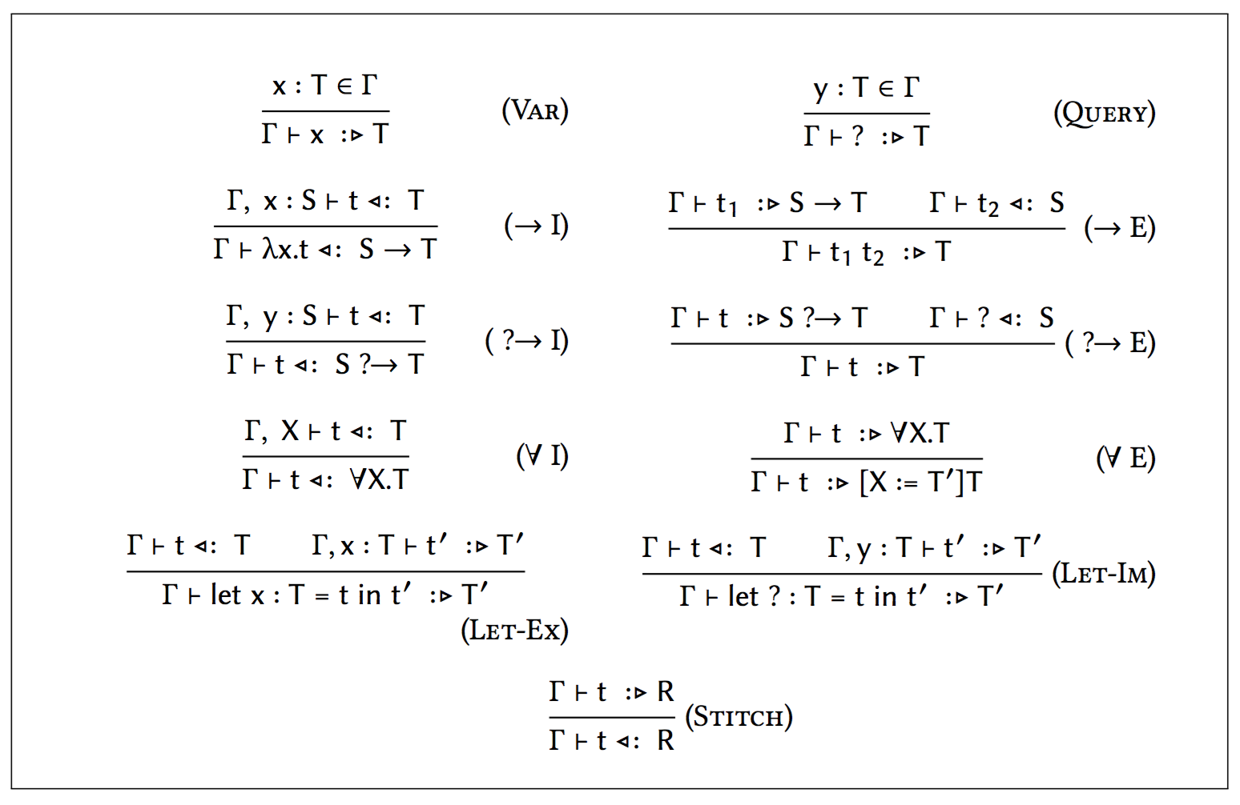
SI Typing Rules: Everything

Slide 39
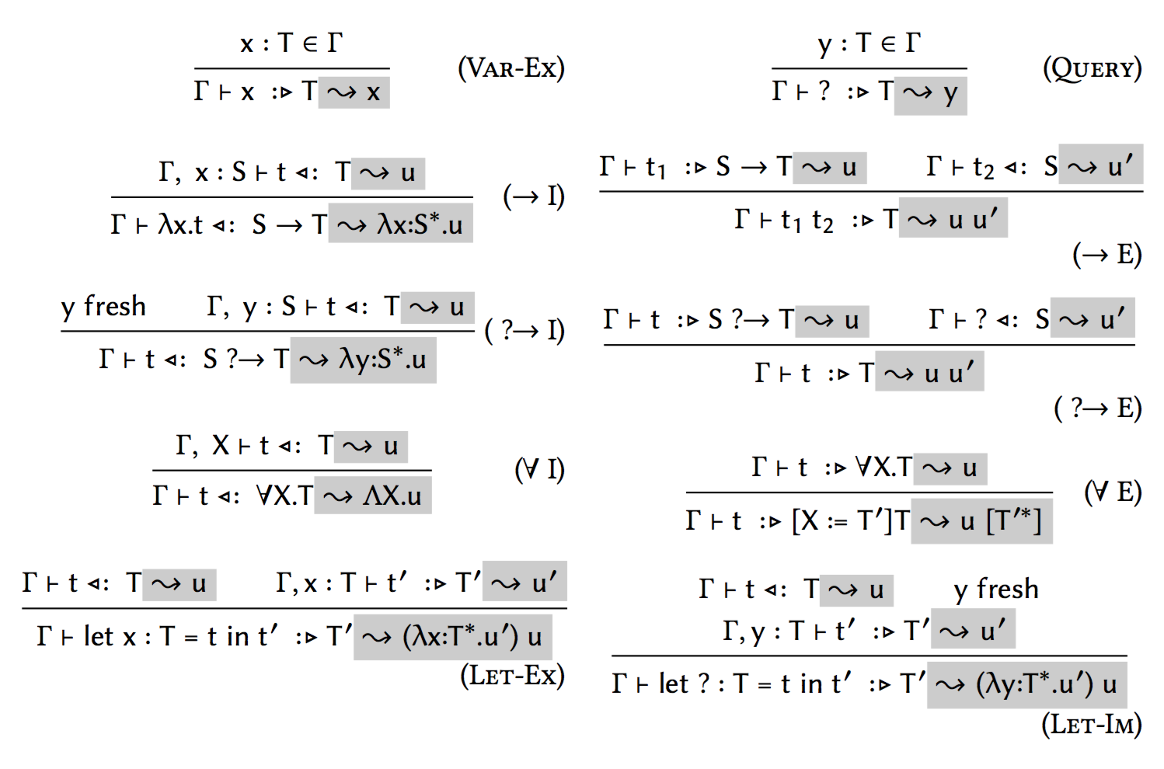
Translation to System F

Slide 40
Other Applications
Builder pattern
Tagless interpreters
Algebraic effects (Brachthäuser, Schuster, Scala Symp. 2017)

Slide 41
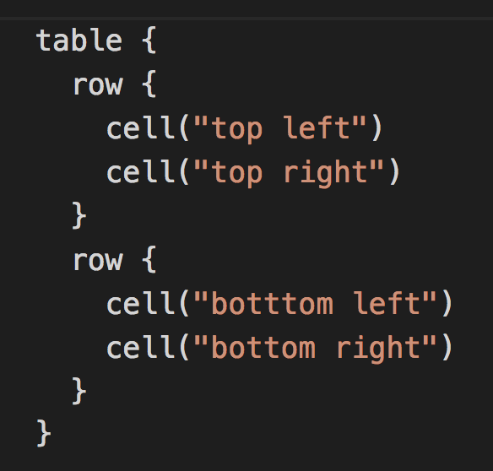
An Encore: The Builder Pattern
Neat way to define structure-building DSLs, like this:
Natively supported in Groovy and in Kotlin via “receiver functions”.

Slide 42
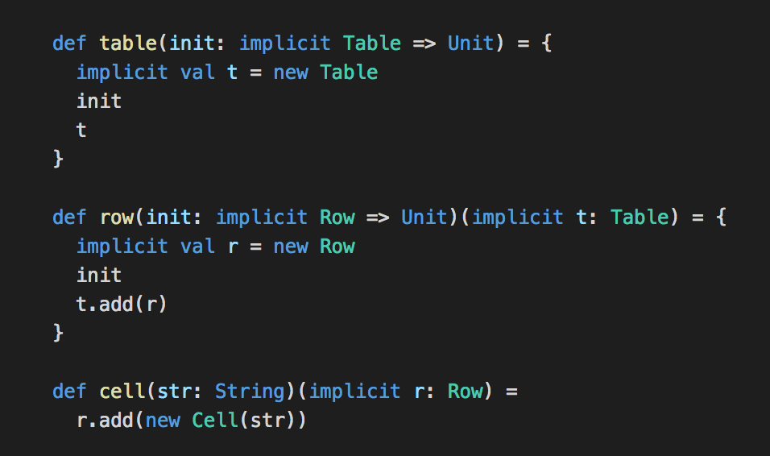
Scala Implementation

Slide 43
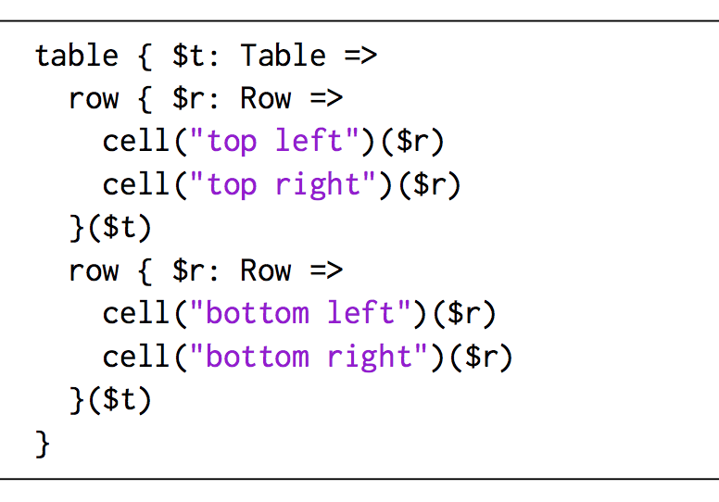
Expansion

Slide 44
References
Implicit parameters in Haskell (Lewis et al, 2000)
Modular implicits in OCaml (White, Bour, Yallop, 2015)
Agda’s implicit instances (Devriese and Piessens, 2011)
- very similar to implicit function types.
Implicit Calculus by (Olivera, Schrjvers, Wadler et al., 2012, 2017)
a bit further removed from Scala than SI.
Simplicity (our work) POPL 2018

Slide 45
Credits
Dotty: Dmitry Petrashko Nicolas Stucki Guillaume Martres Felix Mulder Ondrej Lhotak Aggelos Biboudis Liu Fengyun Vera Salvis Olivier Blanvillain Enno Runne Sebastien Douraene … and many others
DOT: Nada Amin Tiark Rompf Sandro Stucki Samuel Grütter
scalac at Adriaan Moors Seth Tisue Lightbend: Jason Zaugg Stefan Zeiger Lukas Rytz
Scala Heather Miller Julien Richard-Foy Center: Jorge Cantero Olafur Geirsson Guillaume Massé Martin Duheim Travis Lee
Thank You

