Slide 1
D for a @safer Linux Kernel
Alexandru Militaru
University POLITEHNICA of Bucharest
alexandru.cmilitaru@gmail.com

Slide 2
D and Operating Systems
PowerNex - kernel
XOmB - exokernel operating system
Trinix - hybrid operating system
What about D in the Linux Kernel?

Slide 3
Bugs in the Linux Kernel
CVE-2018-10840
“Linux kernel is vulnerable to a heap-based buffer overflow...”
CVE-2018-7566
“The Linux kernel 4.15 has a buffer overflow ...”
CVE-2018-14633
“ Linux kernel: stack-based buffer overflow ...”
Bounds checking? => D

Slide 4
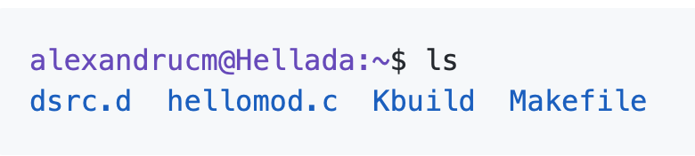
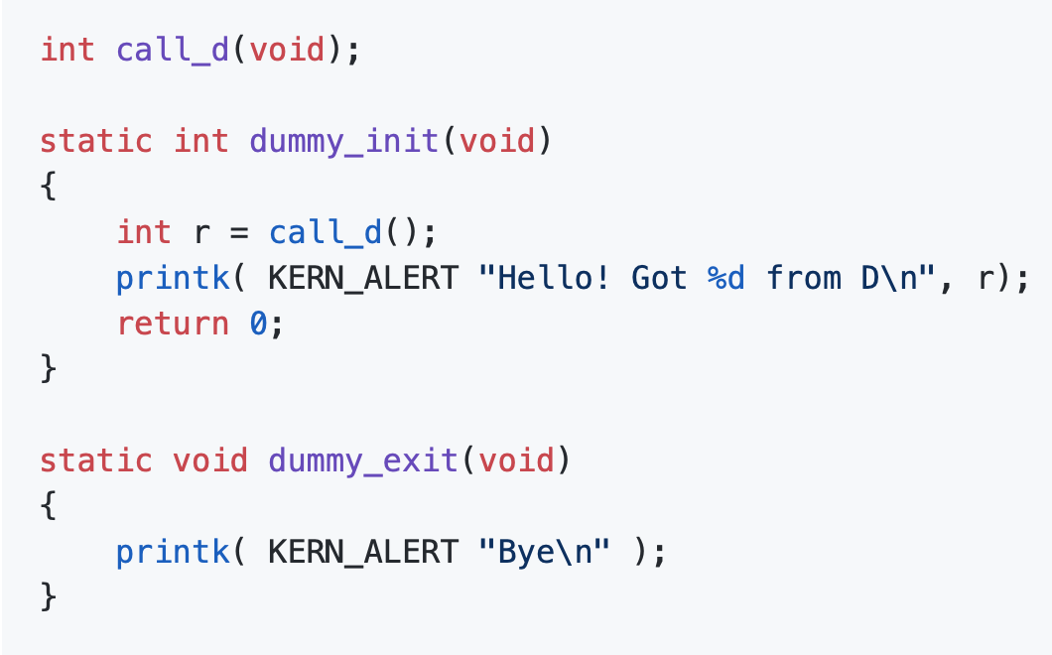
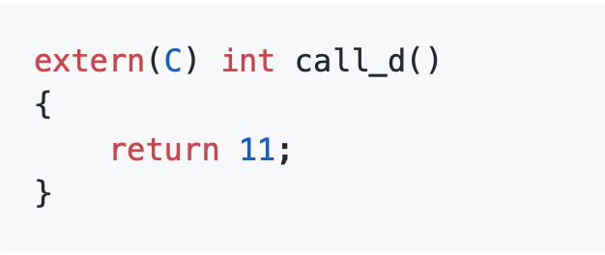
Proof of Concept
workspace
hellomod.c
dsrc.d

Slide 5
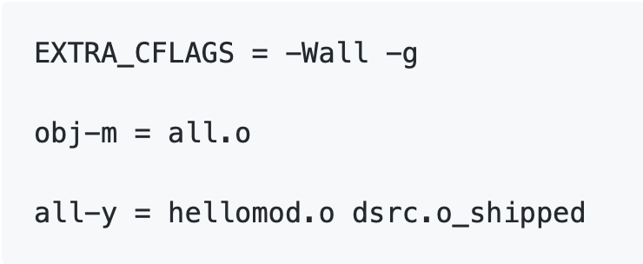
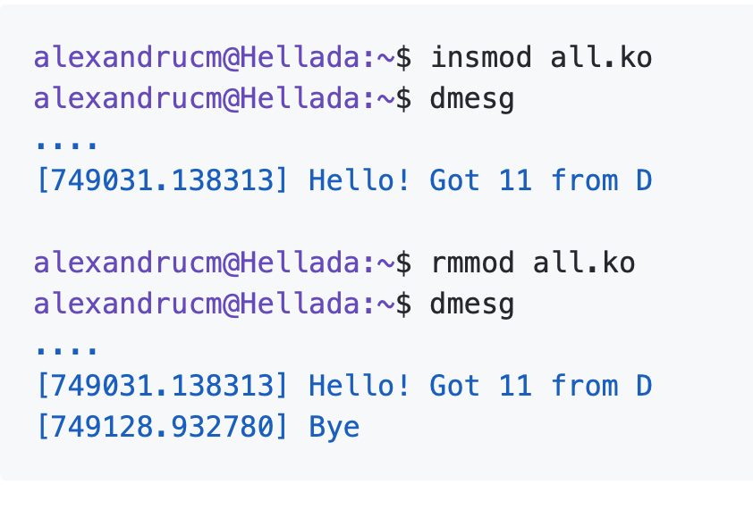
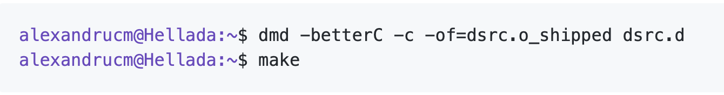
Proof of Concept
Kbuild
C + D = ❤️
Precompiled dsrc.o_shipped

Slide 6
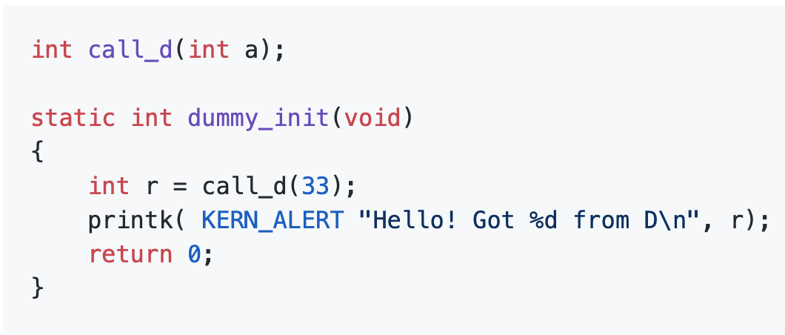
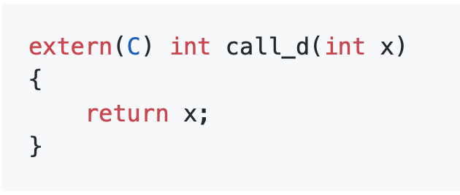
Proof of Concept
hellomod.c - one param added
dsrc.d - one param added

Slide 7
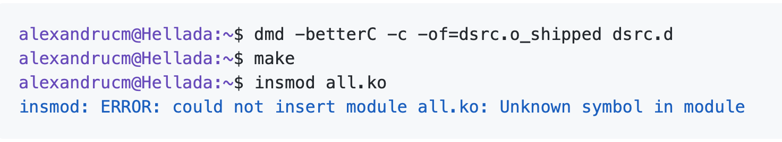
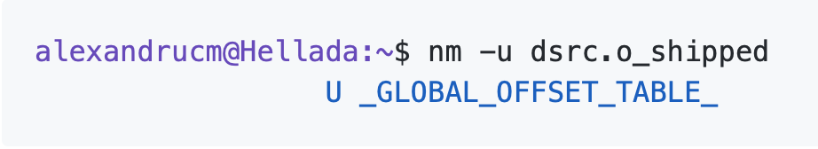
Proof of Concept
Recompiled with one parameter
Unknown symbol 💔

Slide 8
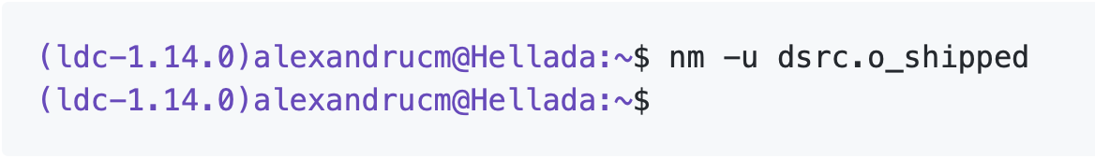
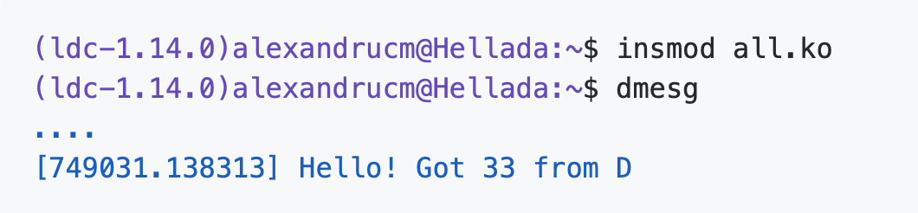
Proof of Concept
No GOT
Works just fine

Slide 9
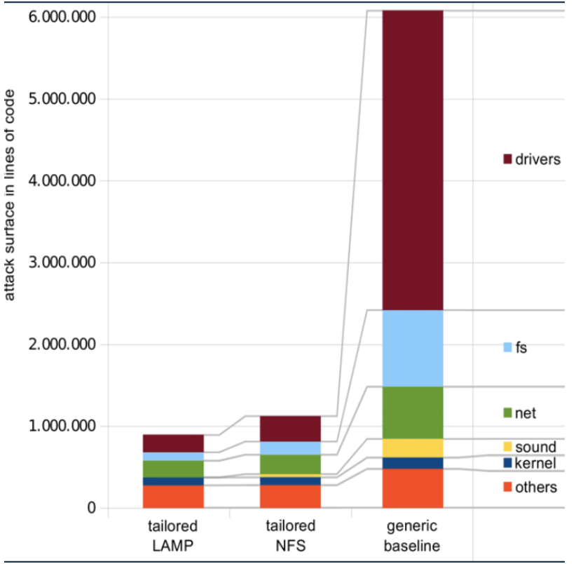
No Place like drivers/
[1] Anil Kurmus et al. “Attack Surface Metrics and Automated Compile-Time OS Kernel Tailoring” In: Proceedings of the 20th Network and Distributed Systems Security Symposium. (San Diego, CA, USA) The Internet Society, 2013.

Slide 10
Seeking a Driver
Three criteria followed:
relevance for the kernel community
easy to test and benchmark
medium size in LoC

Slide 11
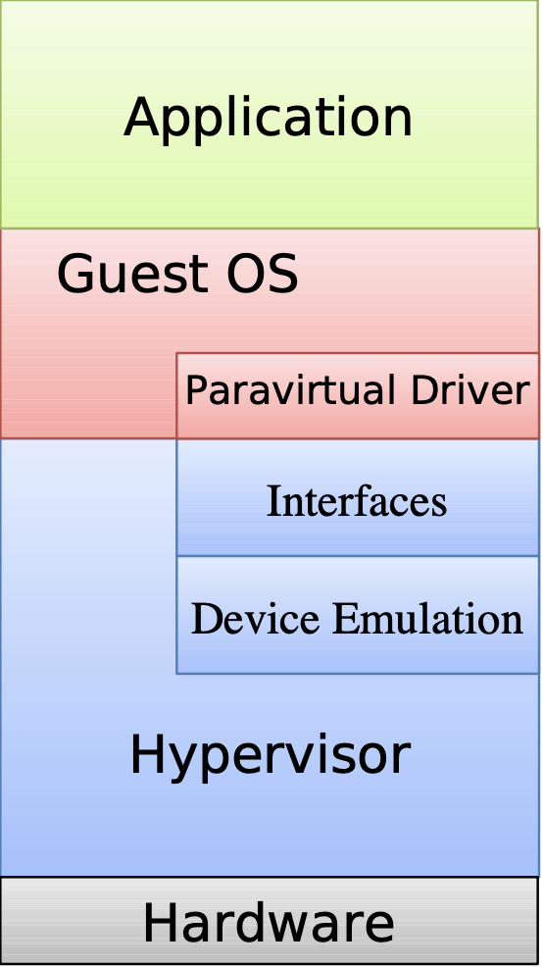
virtio_net.c
virtio

Slide 12
Plan
Port the data structures
Port the functions
First benchmark
D-ify the driver
Second benchmark

Slide 13
1. Porting the Data Structures
endless branching
didn’t manage to use dpp, ported structs by hand
some problems encountered

Slide 14
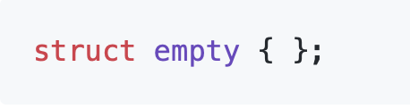
Empty Struct
undefined in C; in GCC its size is 0
defined in D, size 1

Slide 15
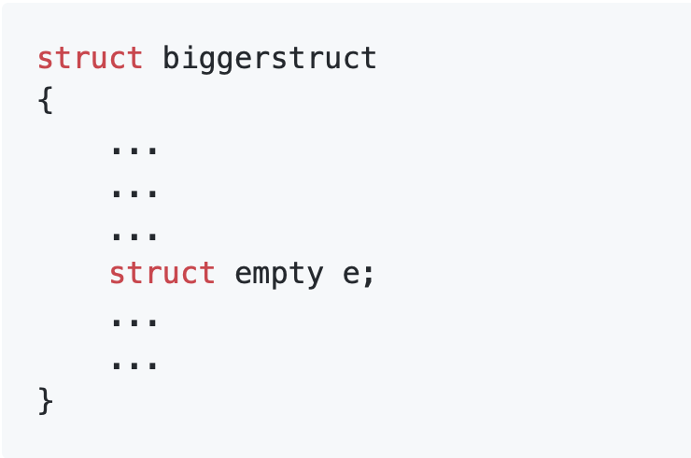
Empty Struct

Slide 16
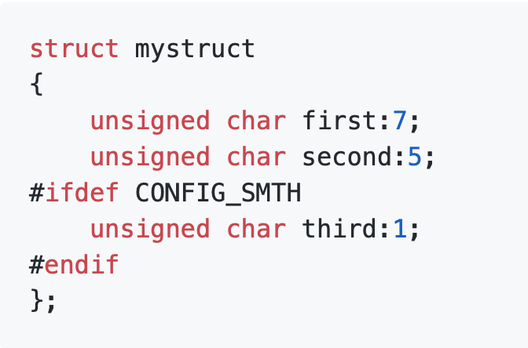
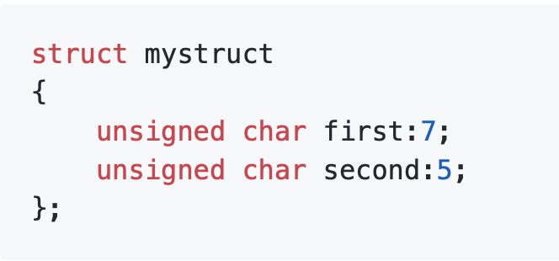
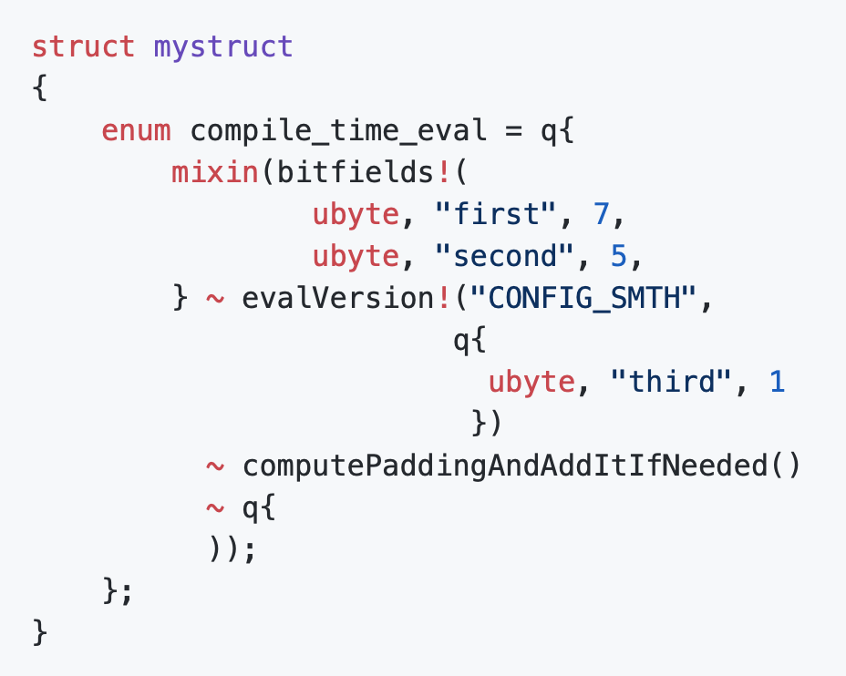
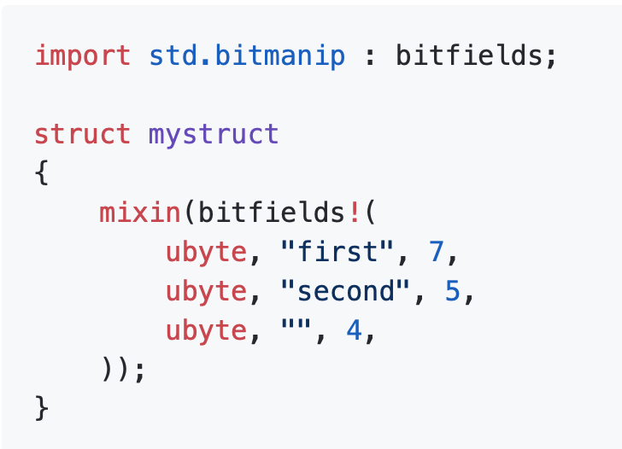
Bitfields
C
D

Slide 17
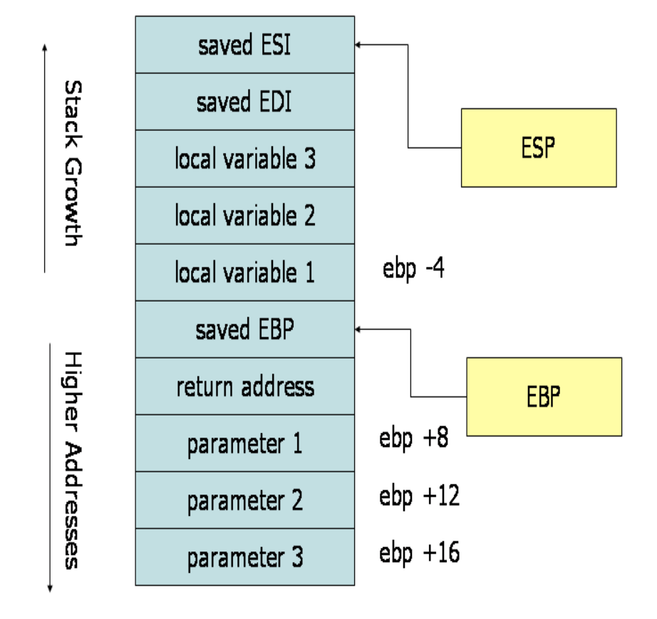
2. Porting Functions
32-bit ABI convention
foo(a, b, c)
push c
push b
push a

Slide 18
Calling Convention
32-bit Linux kernel : first 3 parameters in registers
-mregparm=3
on 64 bits, the kernel and LDC use the same convention

Slide 19
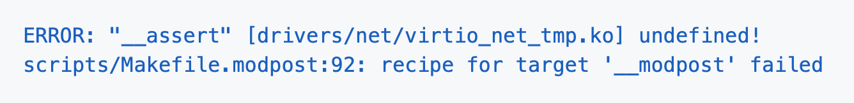
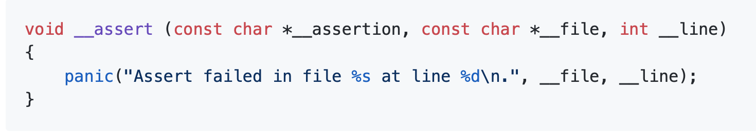
__assert Symbol
-betterC redirects asserts to the C runtime library

Slide 20
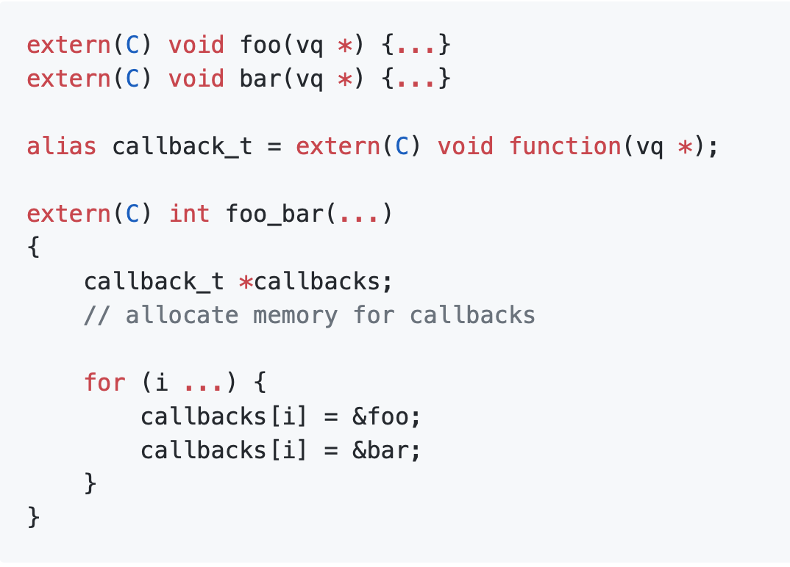
Function Pointers

Slide 21
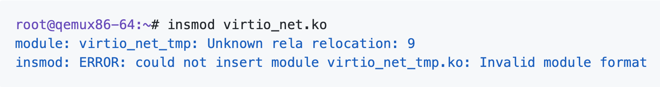
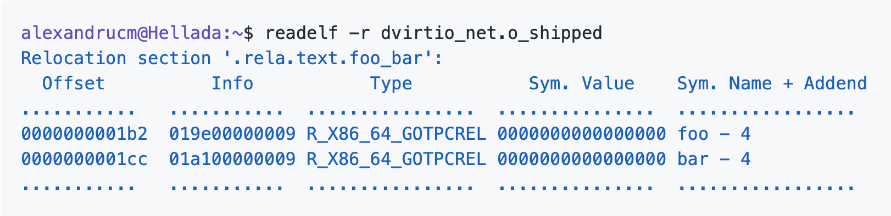
Function Pointers
Unknown relocation
Relocation section

Slide 22
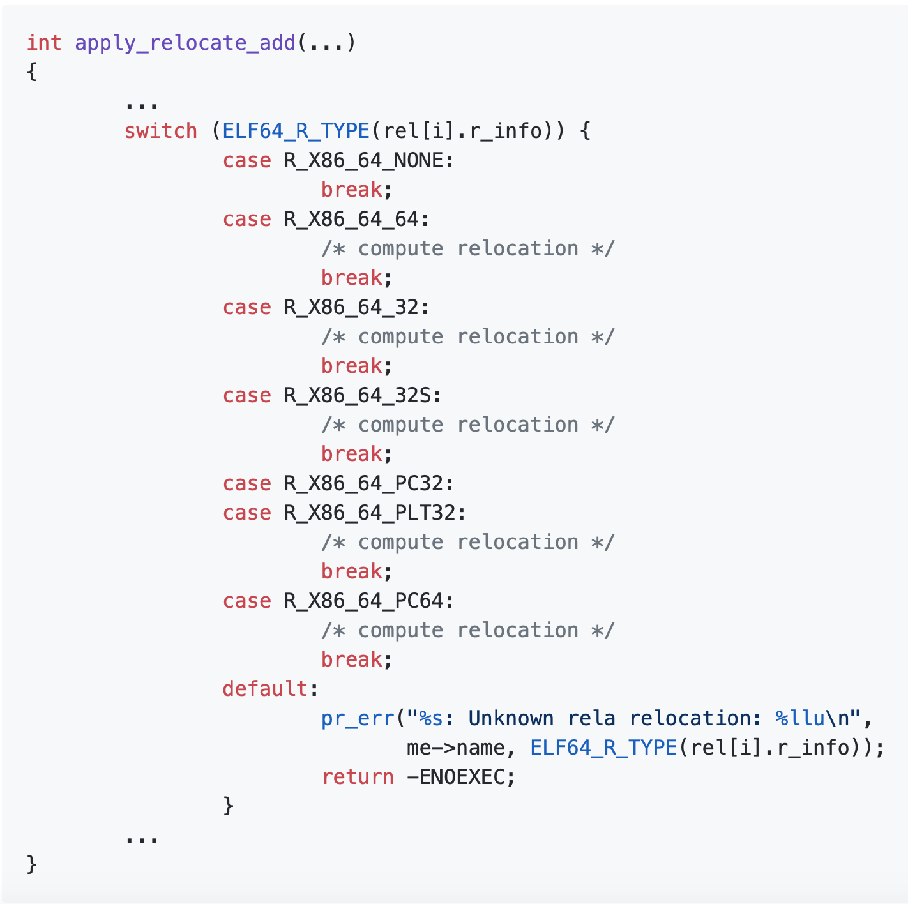
Function Pointers

Slide 23
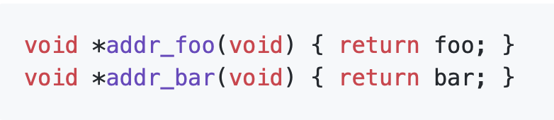
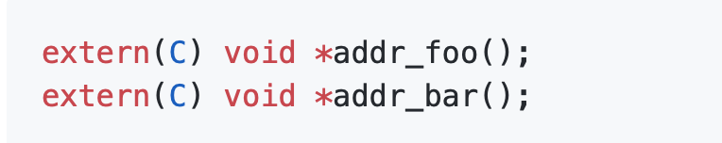
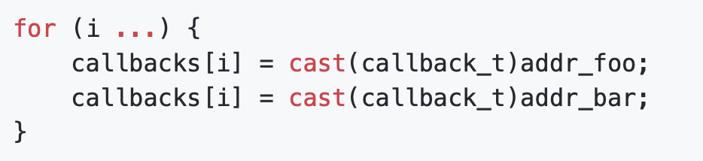
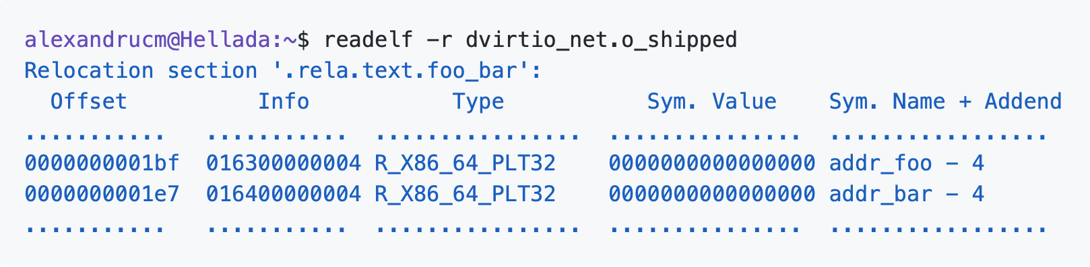
Function Pointers
C
D
Relocation section - new symbol

Slide 24
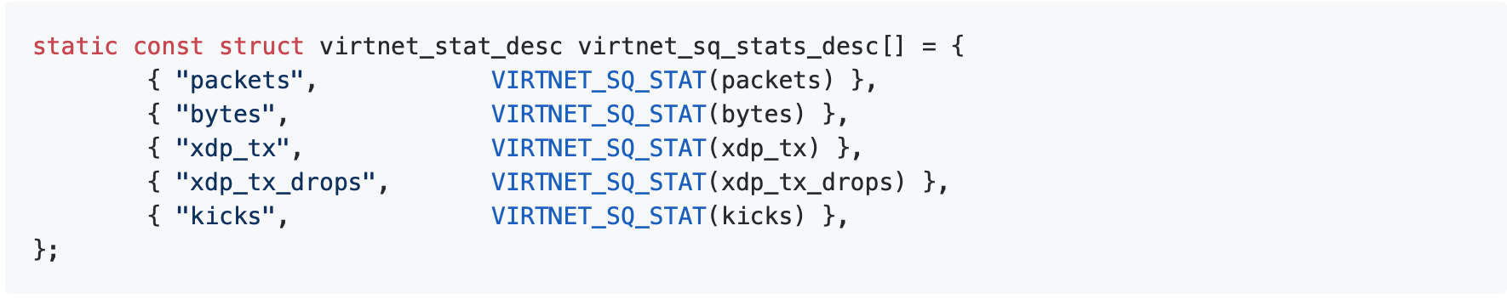
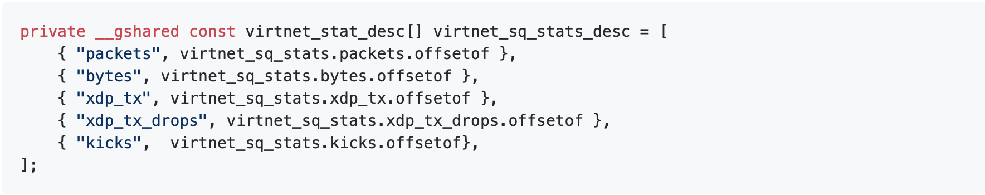
R_X86_64_GOTPCREL again
C – static const
D - private __gshared const

Slide 25
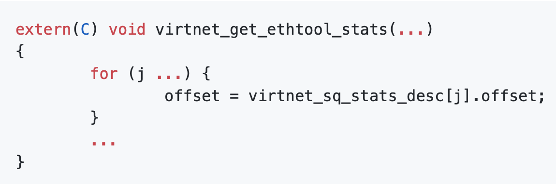
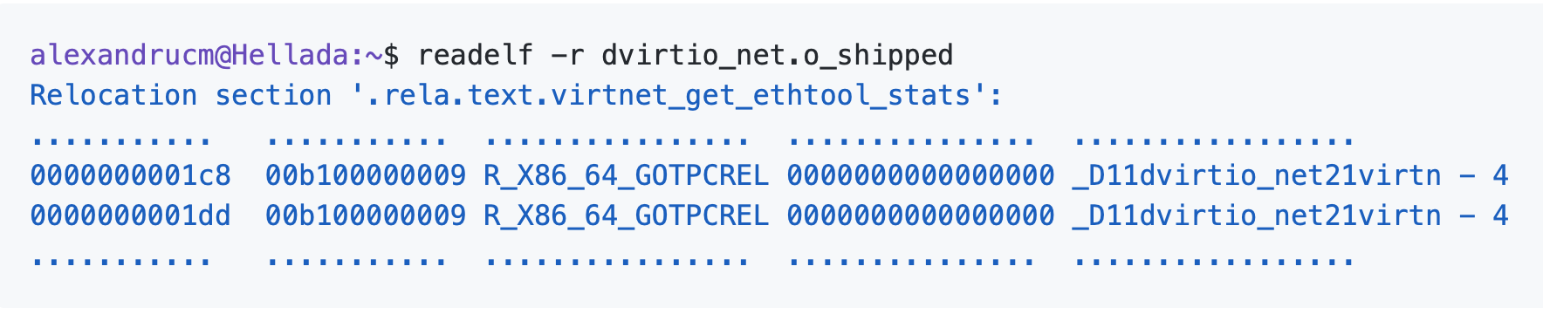
R_X86_64_GOTPCREL again
Relocation section of this function

Slide 26
R_X86_64_GOTPCREL again
immutable enum
enum with size

Slide 27
3. First Benchmark
VM with QEMU
iperf3
3 client-server connection created:
host to guest
guest to host
guest to guest
sent packets and measured bandwidth
compared with C

Slide 28
3. First Benchmark: Results
C Host to Guest: 398 Mbits/sec
D-raw Host to Guest: 394 Mbits/sec
1% decrease
C Guest to Host: 182 Mbits/sec
D-raw Guest to Host: 175 Mbits/sec
4% decrease
C Guest to Guest: 249 Mbits/sec
D-raw Guest to Guest: 245 Mbits/sec
1.7% decrease

Slide 29
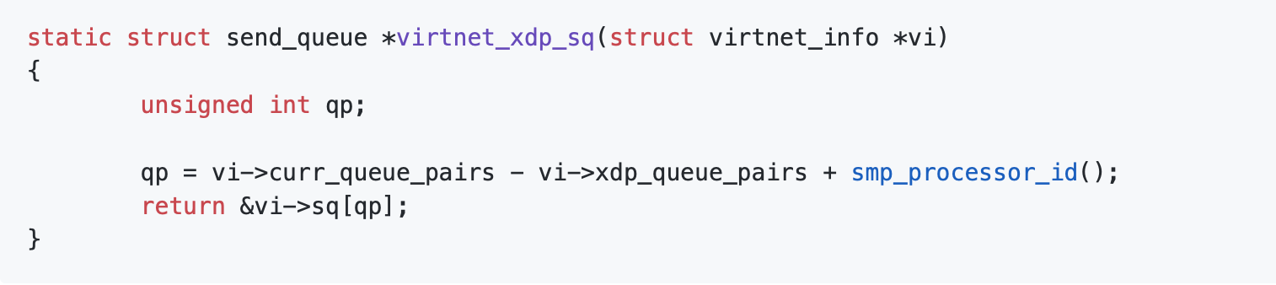
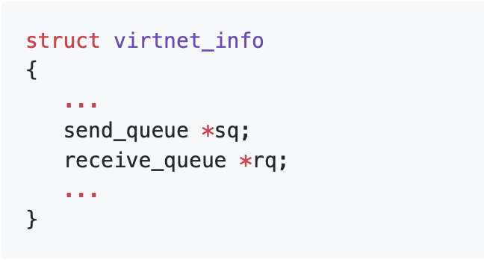
4. D-ifying the Code: Bounds Checking
C unsafe function
parameter’s layout

Slide 30
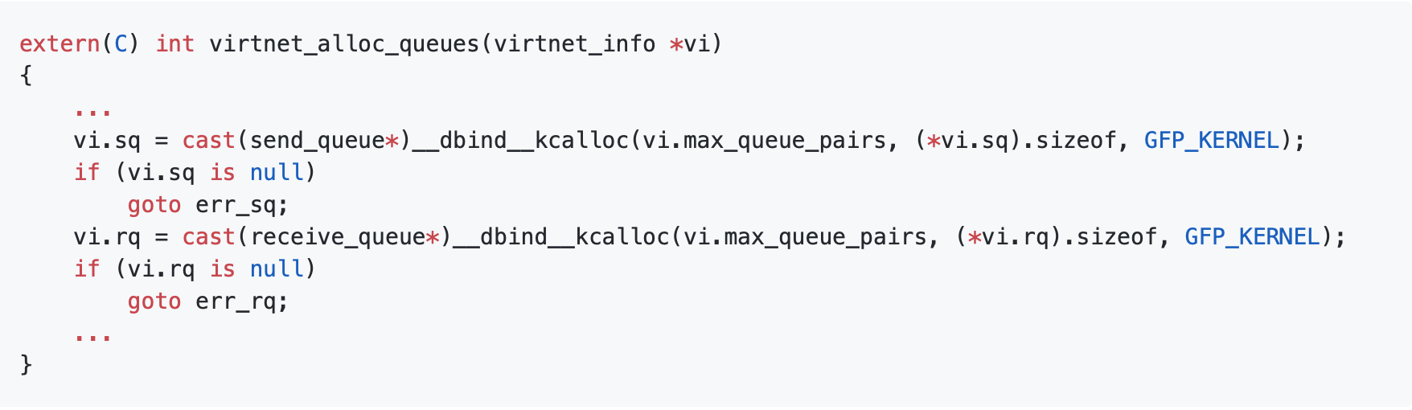
Bounds Checking
function where queues are allocated

Slide 31
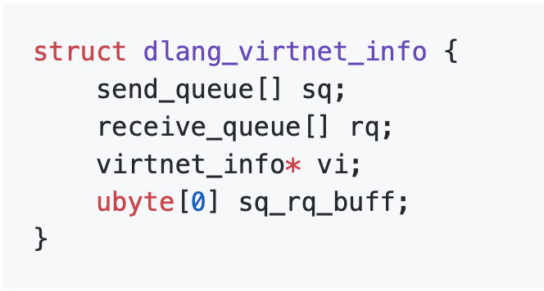
Bounds Checking

Slide 32
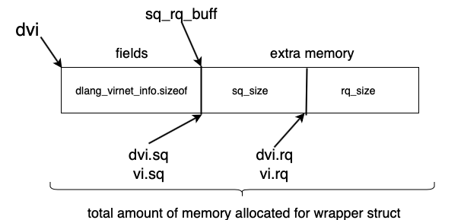
dlang_virnet_info *dvi;
total_size = dlang_virtnet_info.sizeof + sq_size + rq_size;
dvi = allocate_mem(total_size)
dvi.sq = dvi.sq_rq_buff.ptr[0 .. n];
dvi.rq = (dvi.sq_rq_buff.ptr + sq_size)[0 .. m];
vi.sq = dvi.sq.ptr;
vi.rq = dvi.rq.ptr;
dvi.vi = vi;

Slide 33
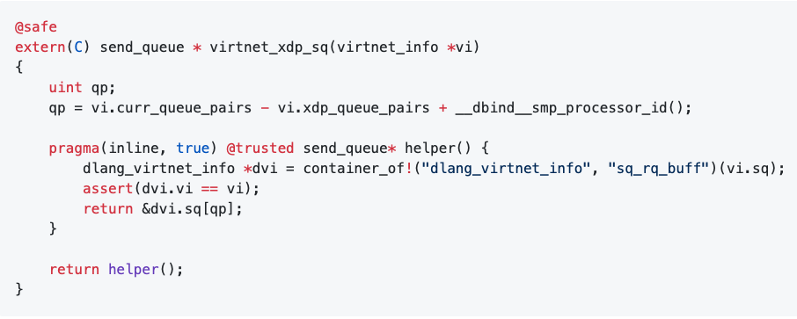
Bounds checking
D safe function

Slide 34
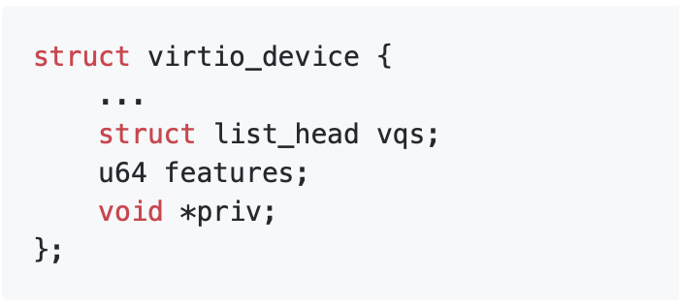
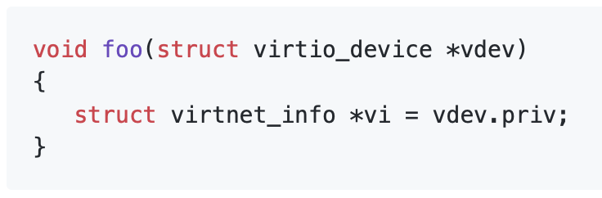
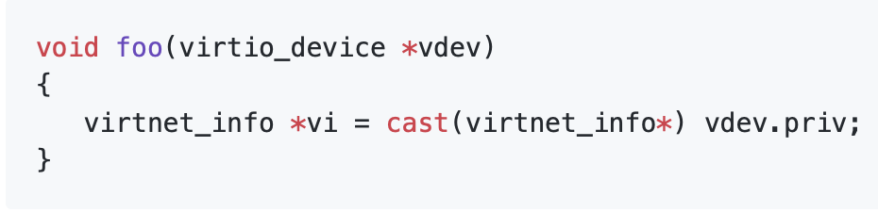
Templates
C uses void * to achieve generics
example
void * used in C
void * used in D

Slide 35
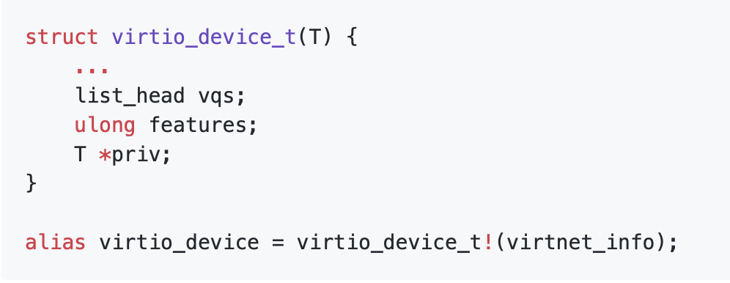
Templates
template instead of void *

Slide 36
Second benchmark
C Host to Guest: 398 Mbits/sec
D-safe Host to Guest: 390 Mbits/sec
2.25% decrease
C Guest to Host: 182 Mbits/sec
D-safe Guest to Host: 175 Mbits/sec
4% decrease
C Guest to Guest: 249 Mbits/sec
D-safe Guest to Guest: 245 Mbits/sec
1.6% decrease

Slide 37
Future work
LLVM Link Time Optimization
draft issues and hand them to the D community
make dpp work on the Linux Kernel

Slide 38
Conclusions
D can keep up with C in the Linux kernel
better write a driver from the ground in D
a compiler switch for the issues encountered

