Slide 1

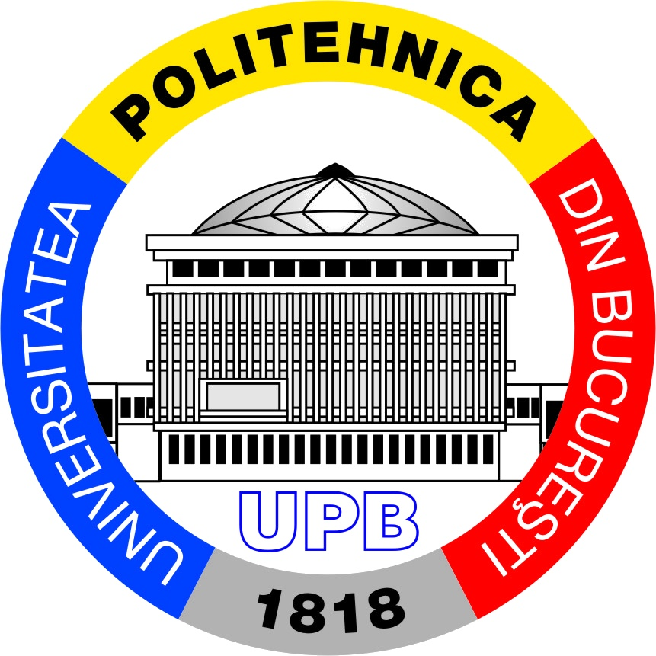
Rethinking the Default Class Hierarchy: an Object’s Tale
Constantin Eduard Stăniloiu
University POLITEHNICA of Bucharest
eduard.c.staniloiu@gmail.com
DConf 2019
London, May 8-11, 2019
Notes:
Hello, everyone. My name is Eduard and I’m pleased to be here. I’m here to put forward a new way o viewing the class hierarchy in D,
Debate the pros and cons

Slide 2
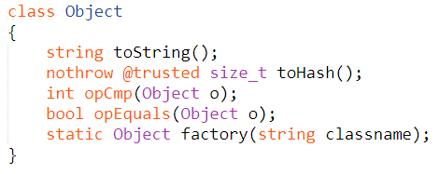
object.Object
Every class defined in the D language has `Object` as the root ancestor
Notes:
Object defines four methods: toString, toHash, opCmp and opEquals; at a fist glance, their presence might not strike you with much, but they are doing more harm than good. Their signatures predate the introduction of the @nogc, nothrow, pure, and @safe function attributes, and also of the const, immutable, and shared type qualifiers. As a consequence, these methods make it difficult to use Object with qualifiers or in code with properties such as @nogc, pure, or @safe.

Slide 3

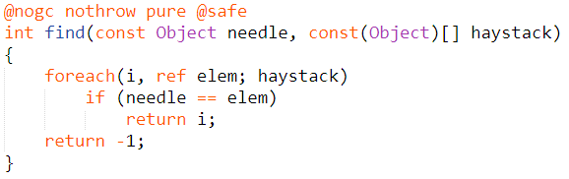
object.Object
Every class defined in the D language has `Object` as the root ancestor
Notes:
Object defines four methods: toString, toHash, opCmp and opEquals; at a fist glance, their presence might not strike you with much, but they are doing more harm than good. Their signatures predate the introduction of the @nogc, nothrow, pure, and @safe function attributes, and also of the const, immutable, and shared type qualifiers. As a consequence, these methods make it difficult to use Object with qualifiers or in code with properties such as @nogc, pure, or @safe.

Slide 4
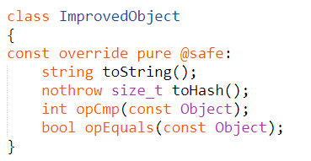
object.Object
Every class defined in the D language has `Object` as the root ancestor
Notes:
Object defines four methods: toString, toHash, opCmp and opEquals; at a fist glance, their presence might not strike you with much, but they are doing more harm than good. Their signatures predate the introduction of the @nogc, nothrow, pure, and @safe function attributes, and also of the const, immutable, and shared type qualifiers. As a consequence, these methods make it difficult to use Object with qualifiers or in code with properties such as @nogc, pure, or @safe.

Slide 5
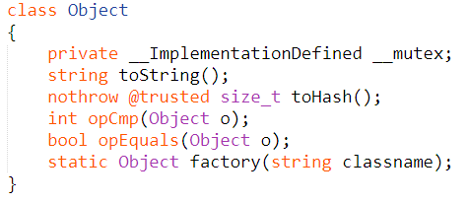
object.Object
Every class defined in the D language has `Object` as the root ancestor
Notes:
Object defines four methods: toString, toHash, opCmp and opEquals; at a fist glance, their presence might not strike you with much, but they are doing more harm than good. Their signatures predate the introduction of the @nogc, nothrow, pure, and @safe function attributes, and also of the const, immutable, and shared type qualifiers. As a consequence, these methods make it difficult to use Object with qualifiers or in code with properties such as @nogc, pure, or @safe.

Slide 6
object.Object
The user must be allowed to chose what methods he or she desires to implement
Root objects must work in attributed code without issues.
Notes:
Object defines four methods: toString, toHash, opCmp and opEquals; at a fist glance, their presence might not strike you with much, but they are doing more harm than good. Their signatures predate the introduction of the @nogc, nothrow, pure, and @safe function attributes, and also of the const, immutable, and shared type qualifiers. As a consequence, these methods make it difficult to use Object with qualifiers or in code with properties such as @nogc, pure, or @safe.

Slide 7
The Search of a Good Design
A peek at Java’s java.lang.Object
Method name | Description
boolean equals(Object o); | Gives generic way to compare objects
int hashCode(); | Returns a hash value that is used to search objects in a collection
Class getClass(); | The Class class gives us more information about the object
String toString(); | Can be used to convert the object to String
protected Object clone() throws CloneNotSupportedException; | Return a new object that are exactly the same as the current object
void wait(); | Used in synchronizing threads
void notify(); | Used in synchronizing threads
void notifyAll(); | Used in synchronizing threads
protected void finalize() throws Throwable; | This method is called just before an object is garbage collected

Slide 8
The Search of a Good Design
A peek at Java’s java.lang.Object
The root of all classes
Defines equals(Object), hashCode() and toString()
Defines getClass() ⬄ typeid()
Defines a clone() method
Has an object monitor
Notes:
Having those goals in mind, we decided to look at how other OOP languages are tackling the same problem:
A root object for all classes
Comparing for equality and ordering polymorphic types

Slide 9
The Search of a Good Design
A peek at C#’s System.Object
The root of all classes
Defines GetHashCode(), GetType() and ToString()
Defines System.Threading.Monitor

Slide 10
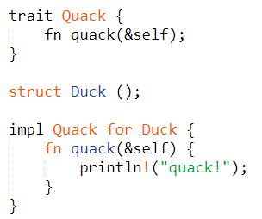
The Search of a Good Design
A peek at Rust
Data aggregates are all unrelated types
No subtyping and no inheritance of data
Relationships between various data types in Rust are established using traits
Rust Traits are like interfaces in OOP languages

Slide 11
Proposed Design
Define an empty root object
Define Interfaces that expose the desired behavior
Notes:
After looking at how Java, C# and Rust have tackled the same problem, we are confident that the proposed solution is a good one: define an empty root object and define Interfaces that expose what is the desired behaviour of the class(es) that implement it. It can be argued that one is not really interested what type an object is, but rather if it can do a certain action (has a certain behaviour). A key requirement in the design is that existing code must continue to work, and new code should start using ProtoObject and reaping the benefits.

Slide 12
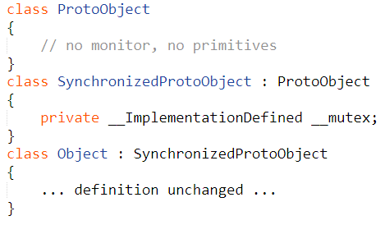
object.ProtoObject

Slide 13
object.ProtoObject
Object has two roles:
The root of all classes
The default supertype of class definitions
Recommended way going forward:
Inherit from ProtoObject
Implement interfaces that expose the desired behaviour
– taken by ProtoObject

Slide 14
Interfaces Introduced
Interface | Method name
Ordered | const @nogc nothrow pure @safe scope int opCmp(scope const ProtoObject);
Equals | const @nogc nothrow pure @safe scope bool opEquals(scope const ProtoObject);
Hash | const @nogc nothrow pure @safe scope size_t toHash();
Stringify | const @nogc nothrow pure @safe scope void toString(scope void delegate(scope const(char)[]));

Slide 15
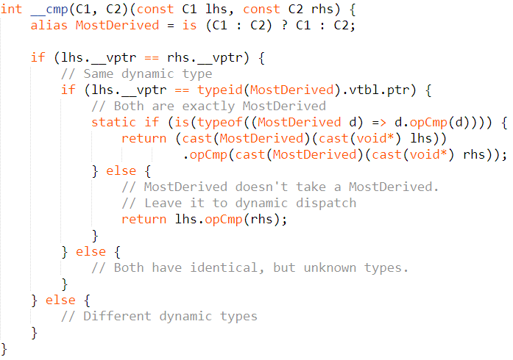
Ordering

Slide 16
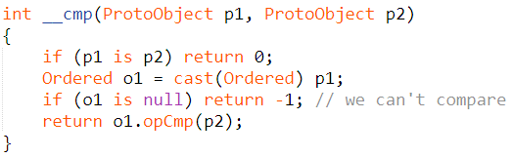
Ordering

Slide 17
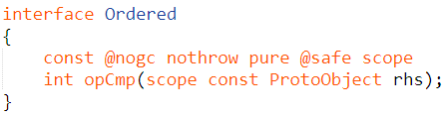
Ordering
Ordered implies that implementing types form a total order
total and antisymmetric: exactly one of a < b, a == b or a > b is true
transitive, a < b and b < c implies a < c

Slide 18
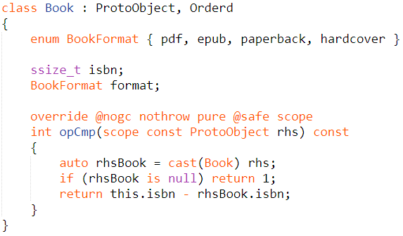
Ordering

Slide 19
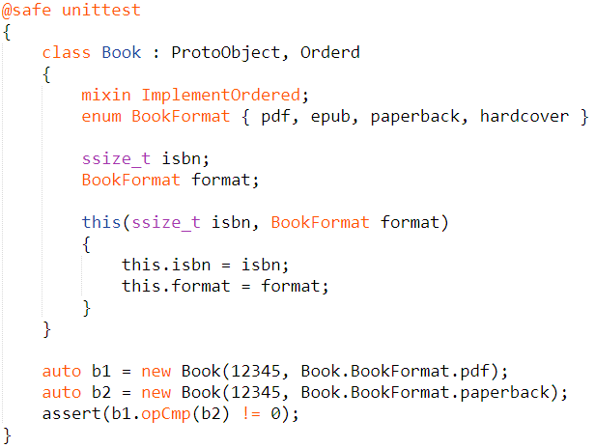
ImplementOrdered(M…)
Notes:
In the case above, comparing the two books, b1 and b2, won't result in an equivalence order (cmp -> 0), even if they should as a book is identified by isbn regardless of the format it's in. This is because, as previously stated, by default ImplementOrdered will go through all the members of the class and compare them.

Slide 20
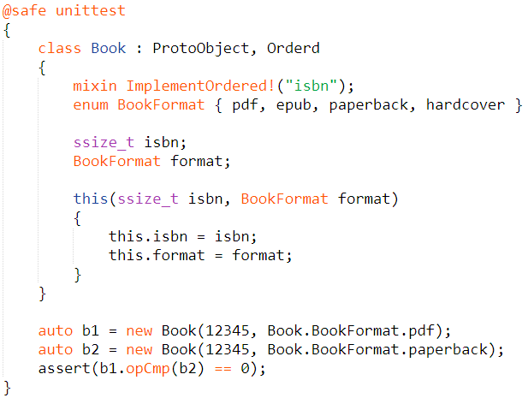
ImplementOrdered(M…)

Slide 21
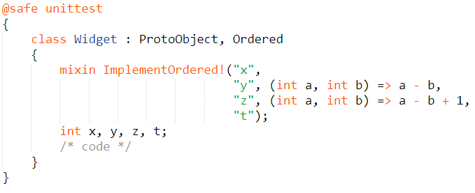
ImplementOrdered(M…)

Slide 22
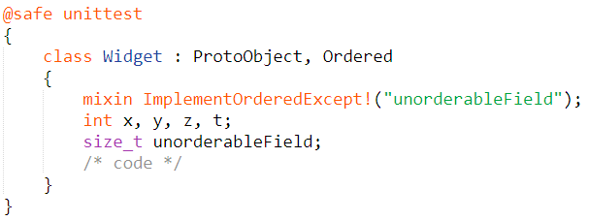
ImplementOrderedExcept(M…)
Notes:
There are cases where it is desirable to implement the default comparison operation on almost all the fields of the aggregate. In such cases, especially if there are a lot of member fields, it would be unpleasant to pass ImplementOrdered the name of all the fields we want to take into account while comparing; it would be cleaner and easier to inform it about the exceptions. This is why we defined ImplementOrderedExcept.

Slide 23
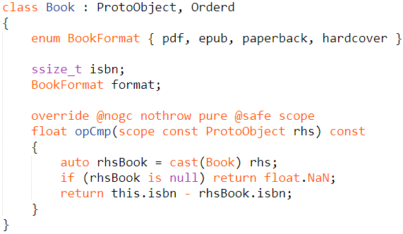
Improving the Ordered interface

Slide 24
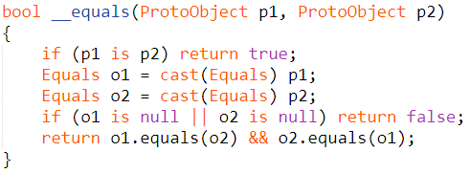
Equality

Slide 25
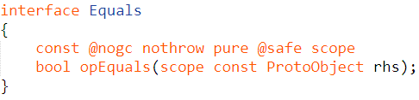
Equality
Equality must respect the following contract:
Reflexivity: a == a
Symmetry: a == b && b == a
Transitivity: a == b && b == c => a == c

Slide 26
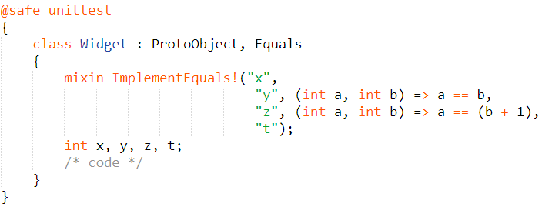
ImplementEquals(M…)

Slide 27
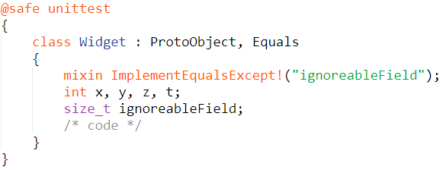
ImplementEqualsExcept(M…)

Slide 28
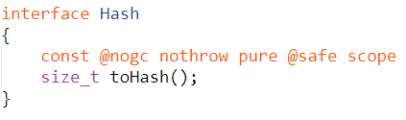
Hashing
ImplementHash(M…)
ImplementHashExcept(M…)
Notes:
Ordered, Equals and Hash must be synchronized with one another

Slide 29
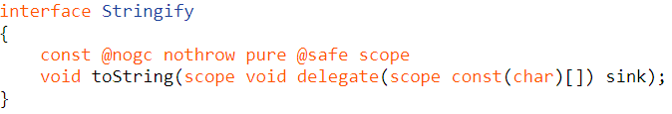
Stringifying

Slide 30
Conclusion
Working objects in attributed code
Increased flexibility
Less code bloat

Slide 31
Check it out
DIP
https://github.com/edi33416/DIPs/blob/ProtoObjectI/DIPs/DIPxxxx.md
Code
https://github.com/edi33416/dmd/tree/dip_ProtoObject
https://github.com/edi33416/druntime/tree/dip_ProtoObject

