Slide 1

sil-cling: A Story of Three Languages
Alexandru Militaru
alexandru.cmilitaru@gmail.com
DConf 2020

Slide 2
Symmetry Integration Language (SIL)
D-based domain specific language of functional flavour
designed from the ground up to be easily interoperable with other languages and systems

Slide 3
sil-cling
SIL plugin that allows transparent calling of C++ libraries

Slide 4
sil-cling: Architecture
SIL
written in D
D’s reflection mechanism
sil-cling
C API
cppyy
Cling
Clang
ROOT project (CERN)
written in C++
LLVM

Slide 5
Cling
C++ interactive compiler, built on top of LLVM and Clang
extends C++ to allow expressions and statements at the global namespace level
can be used as a reflection system

Slide 6
cppyy
C/C++ wrapper around Cling - originally created for calling C++ from Python
Provides:
stable C and C++ reflection APIs
direct interpreter access to compile C++ code
object construction support
generic wrappers for method/function dispatching

Slide 7
sil-cling
SIL plugin, allows interfacing between cppyy and SIL
binds with cppyy through the direct inclusion of the latter’s C header using dpp
exposes wrappers of C++ entities to SIL through D’s reflection mechanism
~ 2.5k SLoC

Slide 8
sil-cling: Interface with SIL
two core types:
CPPNamespace
ClingObj
multiple functions exposed (e.g.):
cppCompile(code) – compile C++ code using Cling
cppLoadLibrary(path) – loads a shared library
cppNamespaceInfo(name) – provides namespace summary

Slide 9
sil-cling: Reflection Information
cppyy represents C++ classes, structs, and namespaces as ‘scopes’
a scope object provides a full description of the C++ entity associated with it
both CPPNamespace and ClingObj classes have a data member that holds a reference to their associated scope object

Slide 10
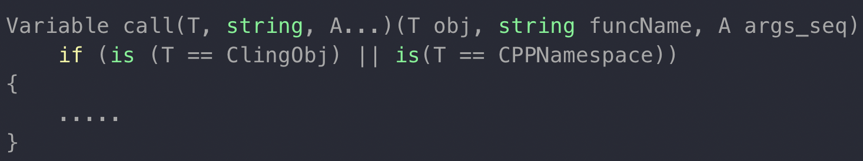
sil-cling: Calling Interface
object construction, method calling, and function calling – all are done through the same interface
the procedure is divided into three separate phases:
Overload resolution
Argument conversion
Calling

Slide 11
sil-cling: Overload Resolution
for a given object or namespace, fetch all the method/function overloads with the given name
it’s a match:
a method overload with the right number of arguments
each SIL Variable provided must have a valid type conversion to its corresponding parameter
two iterations:
first, we allow only ‘exact’ conversions (e.g. long Variable → C++ long)
then we include ‘lossy’ conversions too (e.g. long Variable → C++ int)

Slide 12
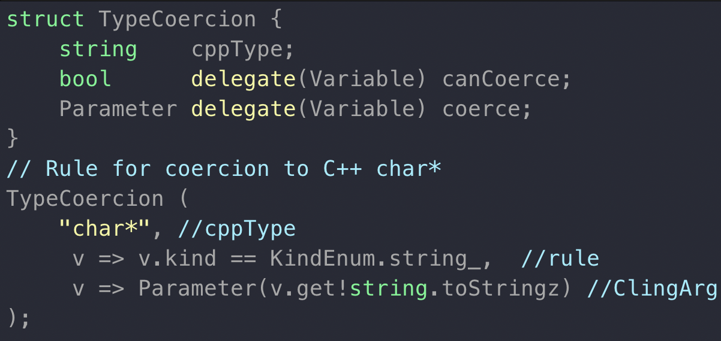
sil-cling: Argument Conversion
depends on whether the SIL Variables provided as arguments hold a a SIL primitive type or a ClingObj
ClingObj -> string comparisons between the type of the C++ object that it wraps and the type of the overload’s parameter
SIL primitive type -> must match one of the predefined TypeCoercion rules

Slide 13
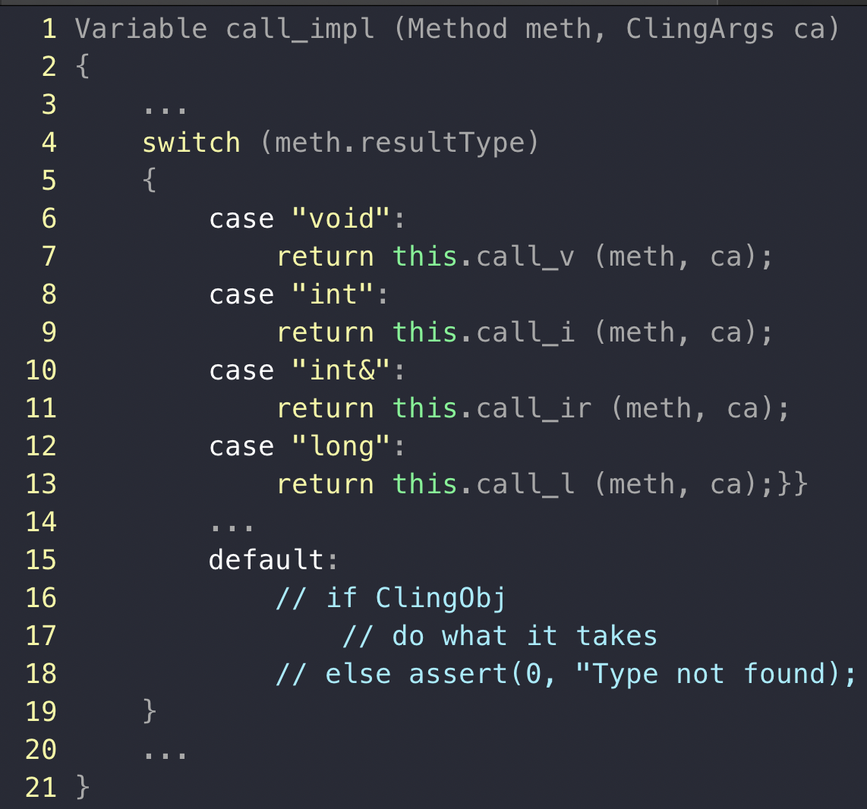
sil-cling: Calling
examine the return value of the selected overload figure out what SIL type should it be converted to
distinguish between primitive types, types that should be wrapped as ClingObjs, and types not supported yet

Slide 14
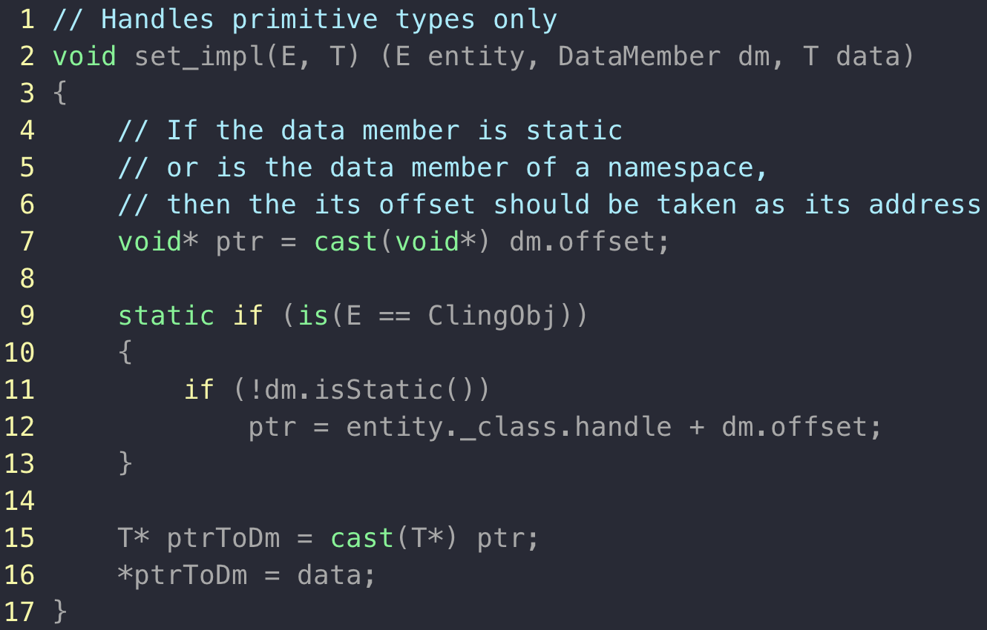
sil-cling: Data Members
involves an offset calculation

Slide 15
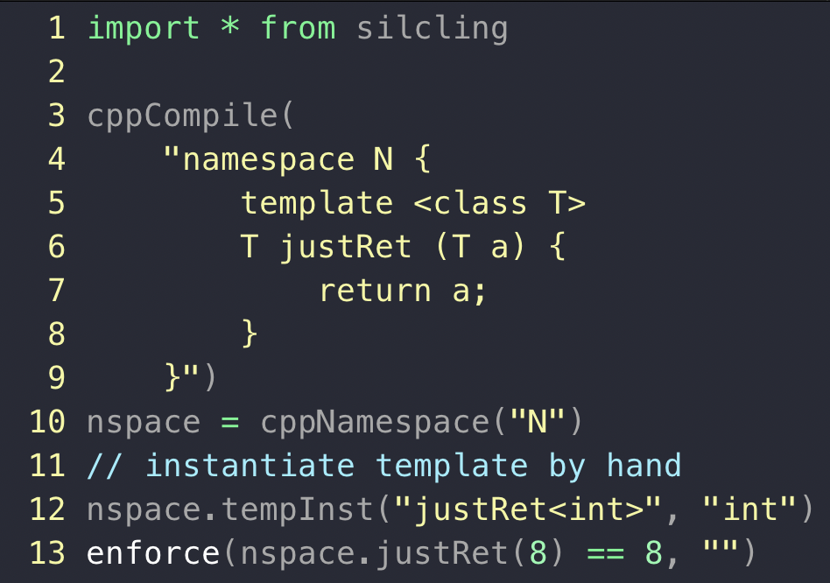
sil-cling: What’s next?
automatic instantiation of templates
direct conversions to/from SIL arrays and std::vector

Slide 16
sil-cling: Summary
a SIL plugin that allows transparent calling of C++ libraries
built using Cling and cppyy
works with C++ Standard Library, Boost.Asio, dlib, Xapian, etc.

Slide 17
…one last thing
Symmetry Investments is hiring D programmers!
More details here.

