Slide 1


Integrating D Language
Compiler in D-Scanner
Danescu Lucian
University POLITEHNICA of Bucharest
DConf 2022
London, August 1-4, 2022

Slide 2
Introduction
There is a need for development tools in the ecosystem
A proper compiler library encourages the development of such tools
2
DConf 2022 London, August 1-4, 2022

Slide 3
Goals
Improve dmd as a library
Integrate dmd as a library in D-Scanner
3
DConf 2022 London, August 1-4, 2022

Slide 4
D-Scanner
D-Scanner is a tool for analyzing D source code
D-Scanner is based on visitors that traverse an AST and do a specific check for a specific node
4
DConf 2022 London, August 1-4, 2022

Slide 5
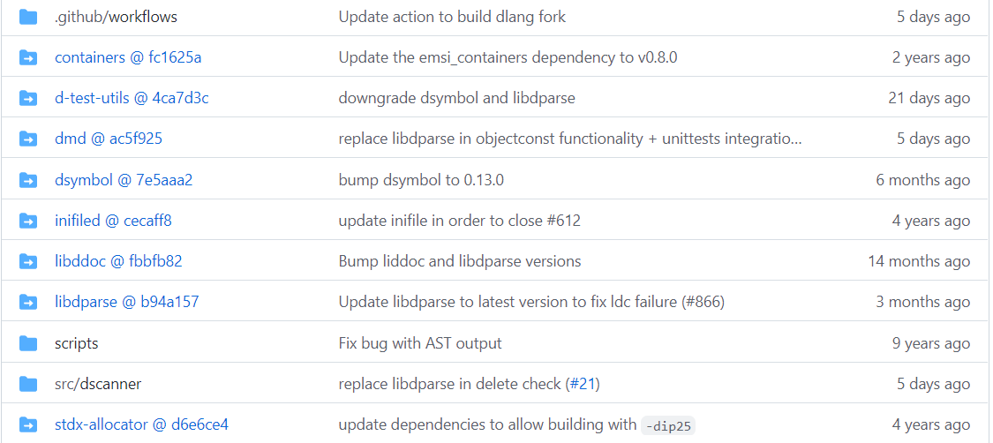
D-Scanner
5
DConf 2022 London, August 1-4, 2022

Slide 6
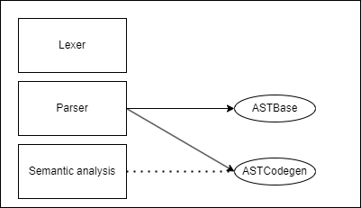
Dmd as a library
6
DConf 2022 London, August 1-4, 2022

Slide 7
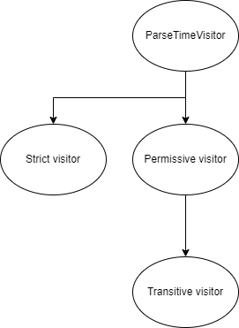
Dmd as a library
7
DConf 2022 London, August 1-4, 2022

Slide 8
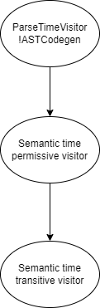
Dmd as a library
8
DConf 2022 London, August 1-4, 2022

Slide 9
ASTBase vs ASTCodegen
ASTBase shall be used when parsing without extensive semantic analysis
ASTCodegen shall be used when also performing semantic analysis
However, some might argue that ASTBase is only a bunch of duplicated code, without serving a specific purpose.
9
DConf 2022 London, August 1-4, 2022

Slide 10
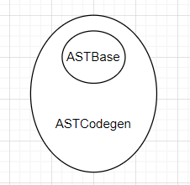
ASTBase vs ASTCodegen
10
DConf 2022 London, August 1-4, 2022

Slide 11
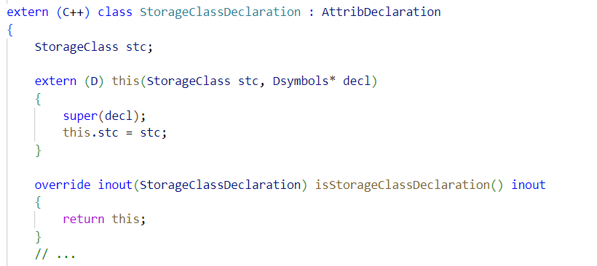
ASTBase vs ASTCodegen
The following code exists both in astbase.d and attrrib.d, and there is a similar situation for all AST nodes.
11
DConf 2022 London, August 1-4, 2022

Slide 12
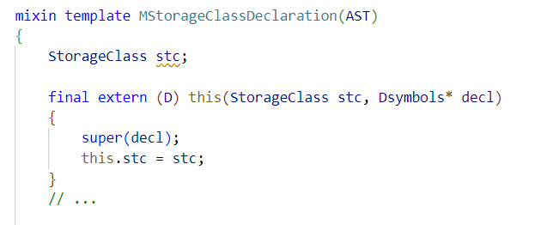
ASTBase vs ASTCodegen
Mixin templates to the rescue!
12
DConf 2022 London, August 1-4, 2022

Slide 13
Visitors
Parse time visitor
Strict visitor
Permissive visitor
Transitive visitor
Semantic time transitive visitor
Semantic time permissive visitor
13
DConf 2022 London, August 1-4, 2022

Slide 14
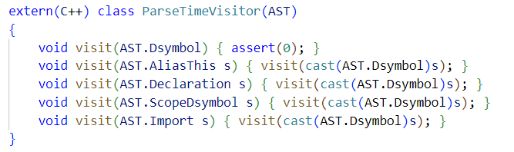
Parse Time Visitor
Basic and dummy visitor which implements a visit method for each AST node implemented in AST
14
DConf 2022 London, August 1-4, 2022

Slide 15
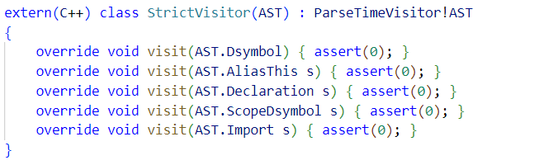
Strict Visitor
The Strict Visitor asserts 0 an all visiting functions in order to make sure all the nodes are visited.
15
DConf 2022 London, August 1-4, 2022

Slide 16
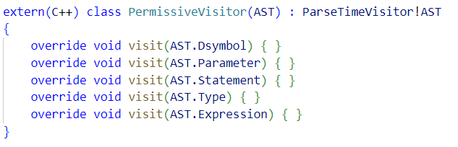
Permissive Visitor
Permissive Visitor overrides all the visit methods in the parent class that assert(0) in order to facilitate the traversal of subsets of the AST
16
DConf 2022 London, August 1-4, 2022

Slide 17
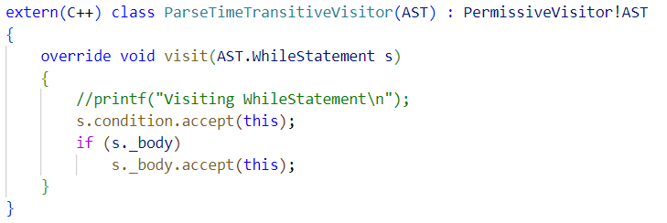
Transitive Visitor
Transitive Visitor implements the AST Traversal logic. Each node accepts it’s children.
17
DConf 2022 London, August 1-4, 2022

Slide 18
Semantic time visitors
Semantic time visitors offer the same functionalities, but are using ASTCodegen
Visitor : ParseTimeVisitor!ASTCodegen { // … } SemanticTimePermissiveVisitor : Visitor { // … } SemanticTimeTransitiveVisitor : SemanticTimePermissiveVisitor { // … }
18
DConf 2022 London, August 1-4, 2022

Slide 19
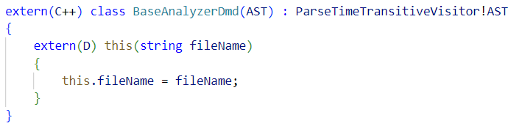
Visitors limitations
All the mentioned visitors are in the shared frontend of dmd, gdc, ldc.
extern(C++) is needed.
19
DConf 2022 London, August 1-4, 2022

Slide 20
Dmd as a library in D-Scanner
No updates needed for 3rd party software as the compiler evolves
Put dmd as a library to the test.
20
DConf 2022 London, August 1-4, 2022

Slide 21
What has been done so far
Visitors for: imports, enum array, delete keyword, const functions, default argument constructor, token dump.
Range interface for the dmd lexer and the ability to tokenize white spaces
Additions where the current interface was lacking(ex: isStorageClassDeclaration method, visit method in transitive visitor for CtorDeclaration)
21
DConf 2022 London, August 1-4, 2022

Slide 22
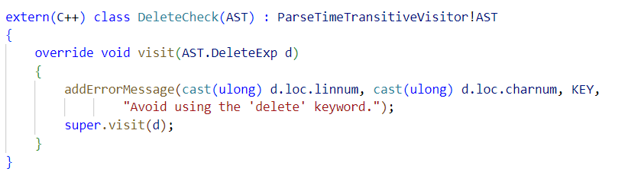
What has been done so far
This check warns against the usage of the delete keyword.
22
DConf 2022 London, August 1-4, 2022

Slide 23
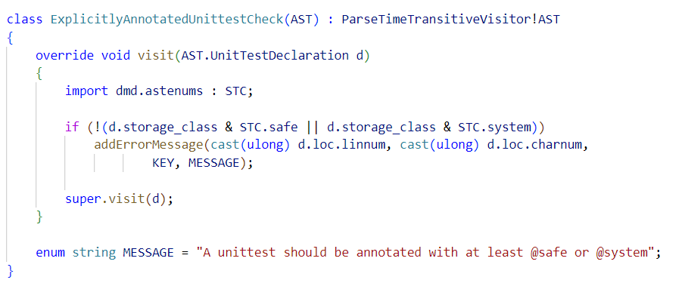
What has been done so far
This check signals that unittests should be annotated either @safe or @system.
23
DConf 2022 London, August 1-4, 2022

Slide 24
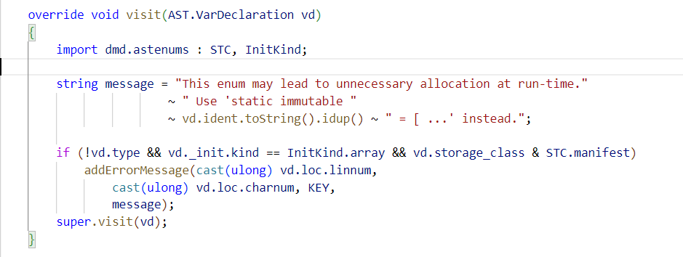
What has been done so far
This check signals unnecessary memory allocations in variables declared like:
enum a = [1, 2, 3];
24
DConf 2022 London, August 1-4, 2022

Slide 25
Difficulties encountered
This is what we expected to find in the wild and this is why this project improves dmd as a library.
The dmd parser makes no difference between: alias a b; and alias b = a;
Transitive visitor was lacking a visit method for CtorDeclaration
Expression class of ASTBase lacks a `toChars` method, which is fundamental in my opinion.
25
DConf 2022 London, August 1-4, 2022

Slide 26
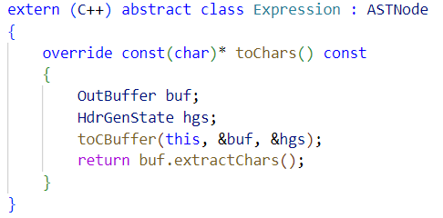
Expression
This is how Expression is defined as part of the ASTCodegen family. Can we do the same for ASTBase?
26
DConf 2022 London, August 1-4, 2022

Slide 27
Next steps
Implement the rest of the visitors in D-Scanner and fill in the gaps of dmd as a library where needed
Most importantly, reach a consensus at a community level on how the dmd interface should ideally look like, so that it can easily be used in other projects as well.
27
DConf 2022 London, August 1-4, 2022

Slide 28
Conclusion
We are using github for development
Contributions are always welcomed!
https://github.com/Dlang-UPB/D-scanner
28
DConf 2022 London, August 1-4, 2022

