Slide 1
A NEW WAY TO WRITE CODE, MADE PURELY IN DLANG

Slide 2
WHAT DOES IT MEAN TO BE A COMPUTER PROGRAMMER?

Slide 3
WHY ARE PROGRAMMING LANGUAGES SO DIFFICULT?

Slide 4
THE EVOLUTION OF PROGRAMMING LANGUAGES

Slide 5
ANY IDIOT WRITES A CODE WHICH CAN BE UNDERSTOOD BY A MACHINE, BUT ONLY A GOOD PROGRAMMER WRITES A CODE WHICH CAN BE UNDERSTOOD BY ANOTHER PERSON

Slide 6
WHAT IS THE MAIN CHALLENGE IN THE FIELD OF CODING?

Slide 7
TO CREATE SELF EVIDENT CODE IS JUST AS IMPOSSIBLE AS TO CREATE SELF EVIDENT MATH

Slide 8
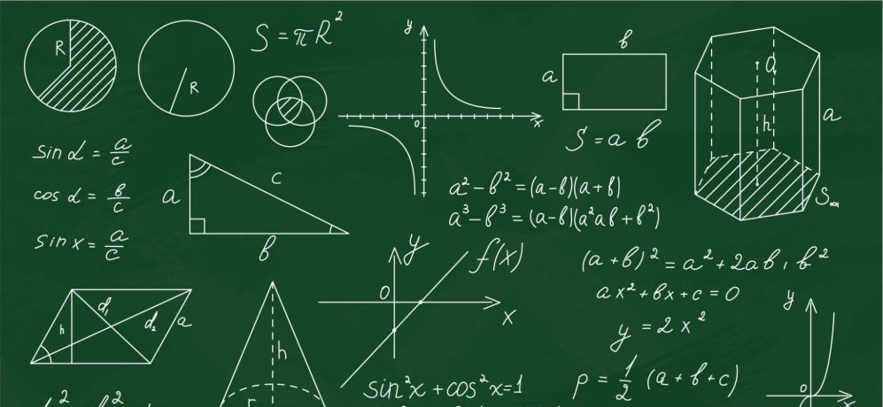

Slide 9
LITERATE PROGRAMMING

Slide 10
MY CODING STYLE

Slide 11
IS CHATGPT A SOLUTION? OF COURSE NOT!

Slide 12
WHY TEXT WHEN WE LIVE IN A WORLD OF ICONS AND VISUAL INTERACTIVE SOFTWARE?

Slide 13
INSPIRED BY MIT’S SCRATCH AND THE CONCEPT OF A FLOWCHART

Slide 14
THE TOOL I’VE INVENTED, WRITTEN IN D AND MADE WITH THE ARSD LIBRARY, HERE IS THE DEMONSTRATION

Slide 15
FOLLOW ME ONLINE TO LEARN MORE

Slide 16
