Slide 1

If I Cannot Dissuade You from Using Atomics, at least Do It Safely
Roy Margalit

Slide 2
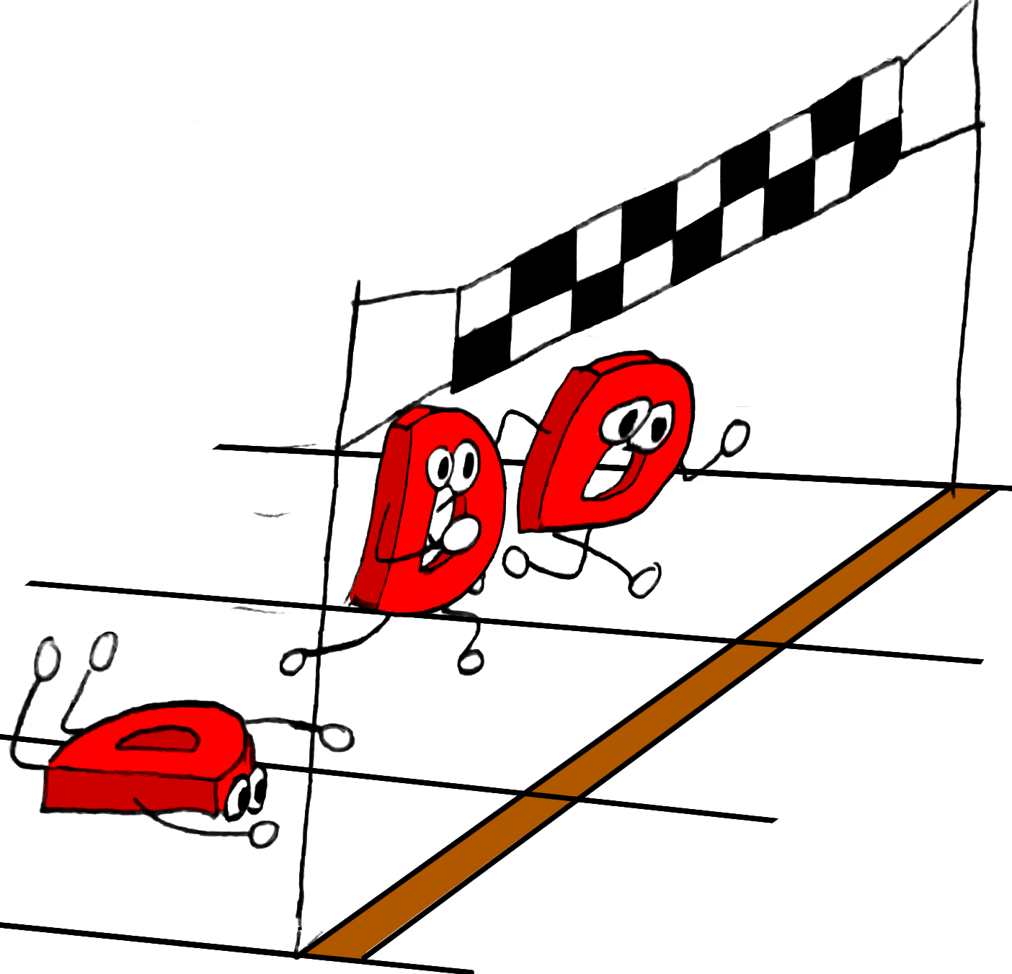
Races Prior To Atomics
Accessing the same memory location from 2 threads where one of them writes is undefined behavior
Undefined behavior
Cache
Optimizations

Slide 3

core.atomic To The Rescue
Defined behavior for race
Sequential Consistency
atomicLoad(foo);
atomicStore(foo);

Slide 4
drm.atomic
shared Atomic!int a;
a = 32;
a += 5;
assert(a == 37);

Slide 5
Sequential Consistency (SC) Access
Can be considered in terms of interleaving the statements from various threads.

Slide 6
Sequential Consistency Example (Store-Buffer)
x = 0; y = 0;
x = 1;
a = y;
y = 1;
b = x;
x, y are global variables; a, b are local

Slide 7
Sequential Consistency Example
Variable | Value
x | 0
y | 0
a | 0
b | 0
x = 1;
a = y;
y = 1;
b = x;
x, y are global variables; a, b are local

Slide 8
Sequential Consistency Example
Variable | Value
x | 1
y | 0
a | 0
b | 0
x = 1;
a = y;
y = 1;
b = x;
x, y are global variables; a, b are local

Slide 9
Sequential Consistency Example
Variable | Value
x | 1
y | 0
a | 0
b | 0
x = 1;
a = y;
y = 1;
b = x;
x, y are global variables; a, b are local

Slide 10
Sequential Consistency Example
Variable | Value
x | 1
y | 1
a | 0
b | 0
x = 1;
a = y;
y = 1;
b = x;
x, y are global variables; a, b are local

Slide 11
Sequential Consistency Example
Variable | Value
x | 1
y | 1
a | 0
b | 1
x = 1;
a = y;
y = 1;
b = x;
x, y are global variables; a, b are local

Slide 12
Sequential Consistency Example
Variable | Value
x | 0
y | 0
a | 0
b | 0
x = 1;
a = y;
y = 1;
b = x;
x, y are global variables; a, b are local

Slide 13
Sequential Consistency Example
Variable | Value
x | 1
y | 0
a | 0
b | 0
x = 1;
a = y;
y = 1;
b = x;
x, y are global variables; a, b are local

Slide 14
Sequential Consistency Example
Variable | Value
x | 1
y | 1
a | 0
b | 0
x = 1;
a = y;
y = 1;
b = x;
x, y are global variables; a, b are local

Slide 15
Sequential Consistency Example
Variable | Value
x | 1
y | 1
a | 1
b | 0
x = 1;
a = y;
y = 1;
b = x;
x, y are global variables; a, b are local

Slide 16
Sequential Consistency Example
Variable | Value
x | 1
y | 1
a | 1
b | 1
x = 1;
a = y;
y = 1;
b = x;
x, y are global variables; a, b are local

Slide 17
Sequential Consistency Example
x = 0; y = 0;
a | b | Possible?
0 | 0 | No
0 | 1 | Yes
1 | 0 | Yes
1 | 1 | Yes
x = 1;
a = y;
y = 1;
b = x;
x, y are global variables; a, b are local

Slide 18

Read-Modify-Write (RMW)
Atomically read the current value and write a new one
Exchange, Fetch & Add, Compare & Swap
A write cannot interject between reading the variable and before it is overwritten
a = x;
x = a+1;
x++;
$$≠$$

Slide 19
Sequential Consistency Access
Can be considered in terms of interleaving the statements from various threads.
Read-Modify-Write operations
Total order over all memory accesses to atomic locations

Slide 20
Lost Performance
SC forces cache flushes
SC prevents reordering of statements

Slide 21
Going Low Level

Slide 22
C++ Memory Model
Weaker memory access that is cheaper
Races are still defined
Price to pay: Less synchronization
Do not mix these with SC access

Slide 23
drm.atomic explicit access
T load(MemoryOrder mo = MemoryOrder.seq)() shared;
void store(MemoryOrder mo = MemoryOrder.seq)(T newVal) shared;
T fadd(MemoryOrder mo = MemoryOrder.seq)(T mod) shared;

Slide 24
Release / Acquire fragment
Total order for writes; each location by itself
Free compilation on x86-TSO

Slide 25
Release / Acquire
Synchronizes threads.
Things before the release happened before the acquire.
x = 0; y = 0;
x = 1;
y = 1;
a = y; // 1
b = x; // 1

Slide 26
Release / Acquire – Message Perspective
Thread | Val X | Val Y | @X | @Y
Left | 0 | 0 | 0 | 0
Right | 0 | 0 | 0 | 0
x = 0; y = 0;
x = 1;
y = 1;
a = y;
b = x;
Message | Time | @X | @Y
X = 0 | 0 | 0 | 0
Y = 0 | 0 | 0 | 0

Slide 27
Release / Acquire – Message Perspective
Thread | Val X | Val Y | @X | @Y
Left | 1 | 0 | 2 | 0
Right | 0 | 0 | 0 | 0
x = 0; y = 0;
x = 1;
y = 1;
a = y;
b = x;
Message | Time | @X | @Y
X = 0 | 0 | 0 | 0
Y = 0 | 0 | 0 | 0
X = 1 | 2 | 2 | 0

Slide 28
Release / Acquire – Message Perspective
Thread | Val X | Val Y | @X | @Y
Left | 1 | 2 | 2 | 1
Right | 0 | 0 | 0 | 0
x = 0; y = 0;
x = 1;
y = 1;
a = y;
b = x;
Message | Time | @X | @Y
X = 0 | 0 | 0 | 0
Y = 0 | 0 | 0 | 0
X = 1 | 2 | 2 | 0
Y = 1 | 1 | 2 | 1

Slide 29
Release / Acquire – Message Perspective
Thread | Val X | Val Y | @X | @Y
Left | 1 | 2 | 2 | 1
Right | 1 | 2 | 2 | 1
x = 0; y = 0;
x = 1;
y = 1;
a = y;
b = x;
Message | Time | @X | @Y
X = 0 | 0 | 0 | 0
Y = 0 | 0 | 0 | 0
X = 1 | 2 | 2 | 0
Y = 1 | 1 | 2 | 1

Slide 30
Release / Acquire – Message Perspective
Thread | Val X | Val Y | @X | @Y
Left | 1 | 2 | 2 | 1
Right | 1 | 2 | 2 | 1
x = 0; y = 0;
x = 1;
y = 1;
a = y;
b = x;
Message | Time | @X | @Y
X = 0 | 0 | 0 | 0
Y = 0 | 0 | 0 | 0
X = 1 | 2 | 2 | 0
Y = 1 | 1 | 2 | 1

Slide 31
Divergence from SC
x = 0; y = 0;
x = 0; y = 0;
x = 1;
a = y;
a = y; // 0
y = 1;
b = x;
a = y; // 0
x = 1;
y = 1;
y = 2;
b = x; // 0
a = y; // 1
a = y; // 2

Slide 32
Sequential Consistency Fence
Every two SC fences will be ordered and synchronize in one direction
SC fence is not equal to flush all buffers. It needs to synchronize with something.
Putting an SC fence between every two (atomic) statements restores sequentially consistency
atomicFence ();

Slide 33
Relaxed (raw in D)
Cheapest atomic
No synchronization
Monotonic (Total order over writes to x)
Can be reordered between different variables
x = 0;
x = 1;
x = 2;
a = x;
assert(x >= a);

Slide 34
Relaxed – No Synchronization
y = 0; x = 0;
x = 1;
y = 1;
a = y; // 1
b = x; // 0

Slide 35
SC fences
The semantics of whether two SC fences synchronize are more complicated
pure nothrow @nogc @safe void atomicFence(MemoryOrder order = MemoryOrder.seq)();

Slide 36
Release / Acquire fences
Synchronize threads
Generally stronger than the equivalent operation over atomic variable

Slide 37
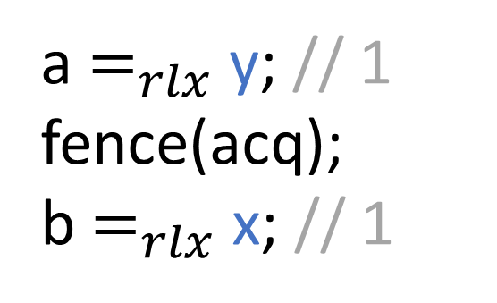
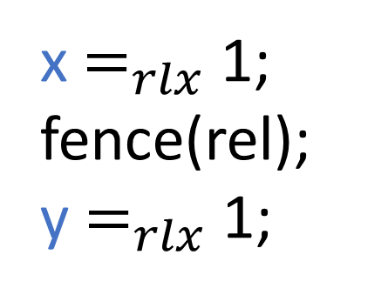
Release/Acquire Fences
Everything past a release fence, releases everything above the fence
Everything before an acquire fence, will acquire at the point of the fence
acq_rel fence both acquires and releases
x = 0; y = 0;
x $=_{rlx}$ 1;
fence(rel);
y $=_{rlx}$ 1;
a $=_{rlx}$ y; // 1
fence(acq);
b $=_{rlx}$ x; // 1

Slide 38
Mixing access types
Do not mix SC access with release / acquire / relaxed accesses
As soon as you have SC access and non-SC access to the same variable, things get even more complicated

Slide 39

Be afraid of incorrect usage

Slide 40

Places to use safely
Sinclair, Matthew D., Johnathan Alsop, and Sarita V. Adve. "Chasing away RAts: Semantics and evaluation for relaxed atomics on heterogeneous systems." Proceedings of the 44th Annual International Symposium on Computer Architecture. 2017.‏

Slide 41
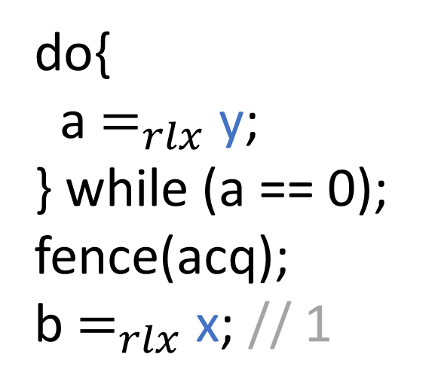
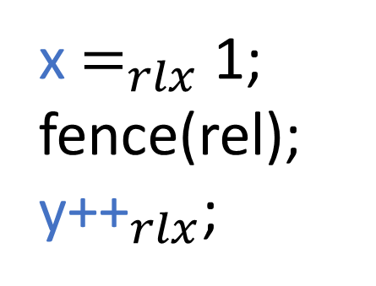
Unpaired Atomics
Wait for jobs with low activity queue
Load relaxed until something is there and only then synchronize
x = 0; y = 0;
x $=_{rlx}$ 1;
fence(rel);
${\text{y}\text{++}}_{rlx}$;
do{
a $=_{rlx}$ y;
} while (a == 0); fence(acq);
b $=_{rlx}$ x; // 1

Slide 42
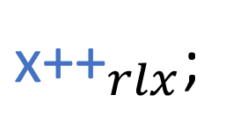

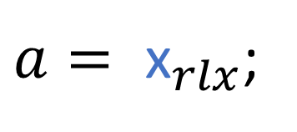

Commutative Atomic
Event counter that doesn't get optimized away.
Only read the final result after full synchronization.
${\text{x}\text{++}}_{rlx}$;
${\text{x}\text{++}}_{rlx}$;
${\text{x}\text{++}}_{rlx}$;
$a= {\text{x}}_{rlx}$;

Slide 43
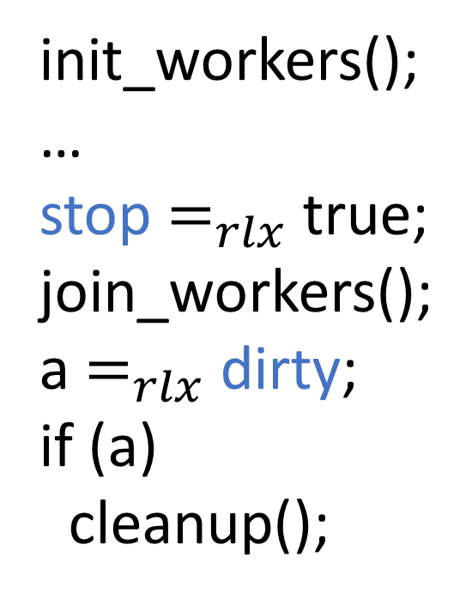
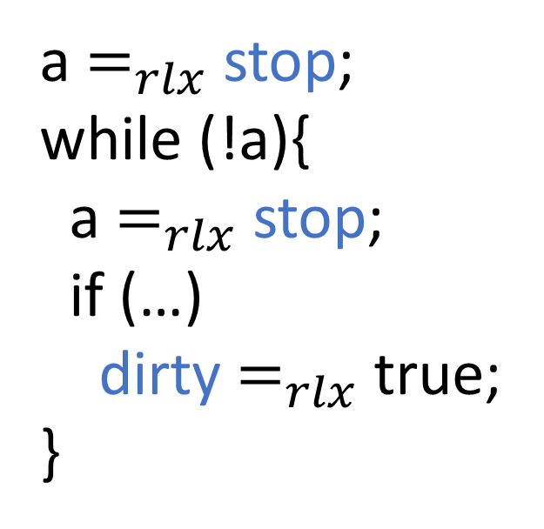
Non-Ordering Atomics (different variables)
Workers:
a $=_{rlx}$ stop; while (!a){
a $=_{rlx}$ stop;
if (…)
dirty $=_{rlx}$ true;
}
init_workers();
…
stop $=_{rlx}$ true;
join_workers();
a $=_{rlx}$ dirty; if (a)
cleanup();

Slide 44
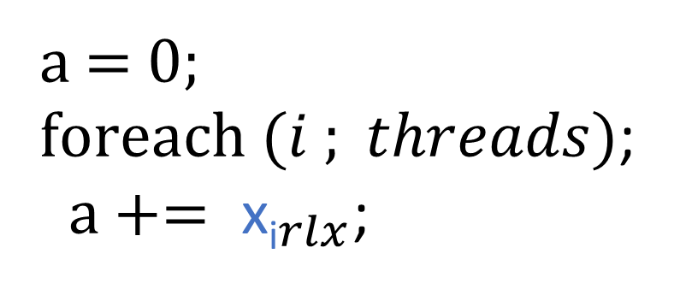
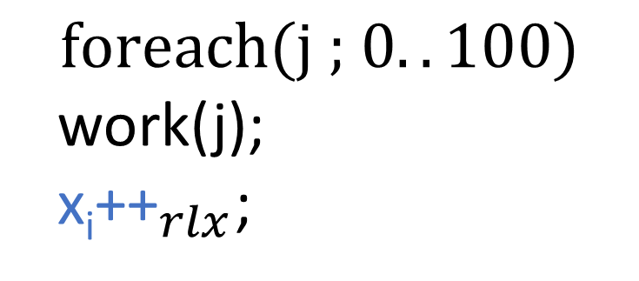
Split Counter
Per thread progress counter
Stale values are fine
Thread i:
a = 0;
$\text{f}\text{oreach}\text{ (}i ; threads)$;
$a+= {\text{x}\text{i}}_{rlx}$;
$$\text{for}\text{each}\text{(}\text{j} \text{;} 0..100)$$
work(j);
${\text{x}\text{i}\text{++}}_{rlx}$;

Slide 45
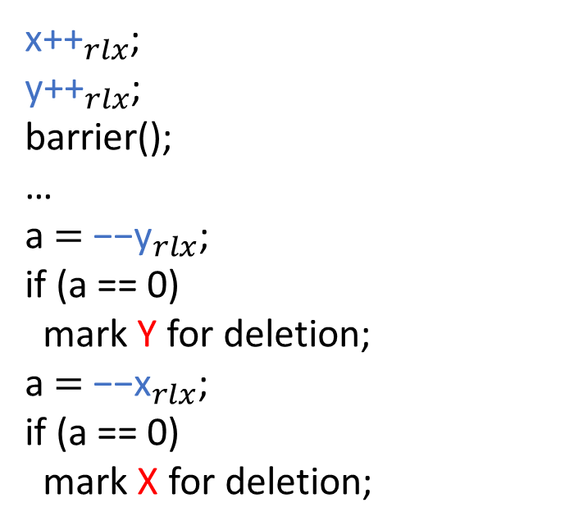
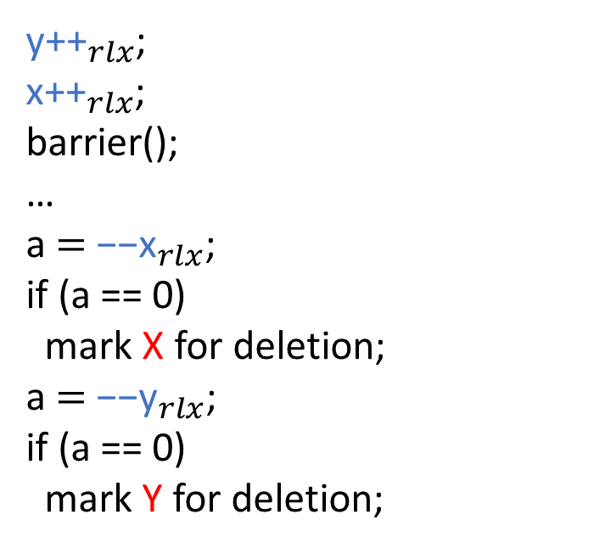
Reference Counter
Reference Counter: Counting usage of (read-only) data.
${\text{y}\text{++}}_{rlx}$;
${\text{x}\text{++}}_{rlx}$;
barrier();
…
a $=$ ${\text{−−}\text{x}}_{rlx}$;
if (a == 0) mark X for deletion;
a $=$ ${\text{−−}\text{y}}_{rlx}$;
if (a == 0) mark Y for deletion;
${\text{x}\text{++}}_{rlx}$;
${\text{y}\text{++}}_{rlx}$;
barrier();
…
a $=$ ${\text{−−}\text{y}}_{rlx}$;
if (a == 0) mark Y for deletion;
a $=$ ${\text{−−}\text{x}}_{rlx}$;
if (a == 0) mark X for deletion;

Slide 46
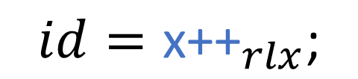

Random data
When random unique number might work just as well!
Atomic relaxed Fetch & Add
$$id=new_id\left(…\right);$$
$$id={\text{x}\text{++}}_{rlx}\text{;}$$

Slide 47
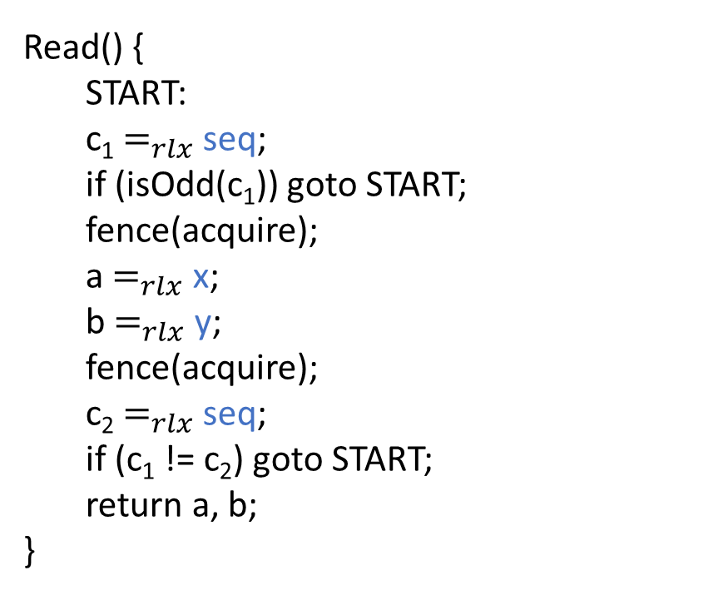

Speculative Atomics: Seqlock
Discard results if the condition is not met
Read() {
START:
c₁ $=_{rlx}$ seq;
if (isOdd(c₁)) goto START;
fence(acquire);
a $=_{rlx}$ x;
b $=_{rlx}$ y;
fence(acquire);
c₂ $=_{rlx}$ seq;
if (c₁ != c₂) goto START;
return a, b;
}
Write(v_{1,} v₂ ) {
seq $=_{rlx}$ c+1;
fence(release);
x $=_{rlx}$ v₁;
y $=_{rlx}$ v₂;
c+=2;
seq $=_{rel}$ c;
}
Boehm, Hans-J. "Can seqlocks get along with programming language memory models?." Proceedings of the 2012 ACM SIGPLAN Workshop on Memory Systems Performance and Correctness. 2012.‏

Slide 48
Thank you!
https://cs.tau.ac.il/~rm/

Slide 49
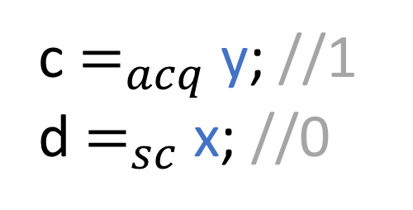
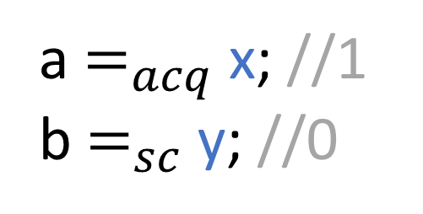
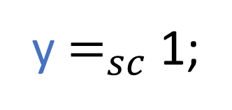
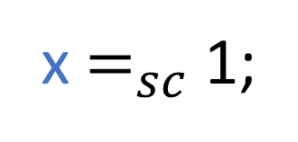
IRIW SC
x = 0; y = 0;
x $=_{sc}$ 1;
a $=_{acq}$ x; //1
b $=_{sc}$ y; //0
c $=_{acq}$ y; //1
d $=_{sc}$ x; //0
y $=_{sc}$ 1;

