Slide 1
THE SEARCH FOR ARTIFICIAL LIFE IN DLANG

Slide 2
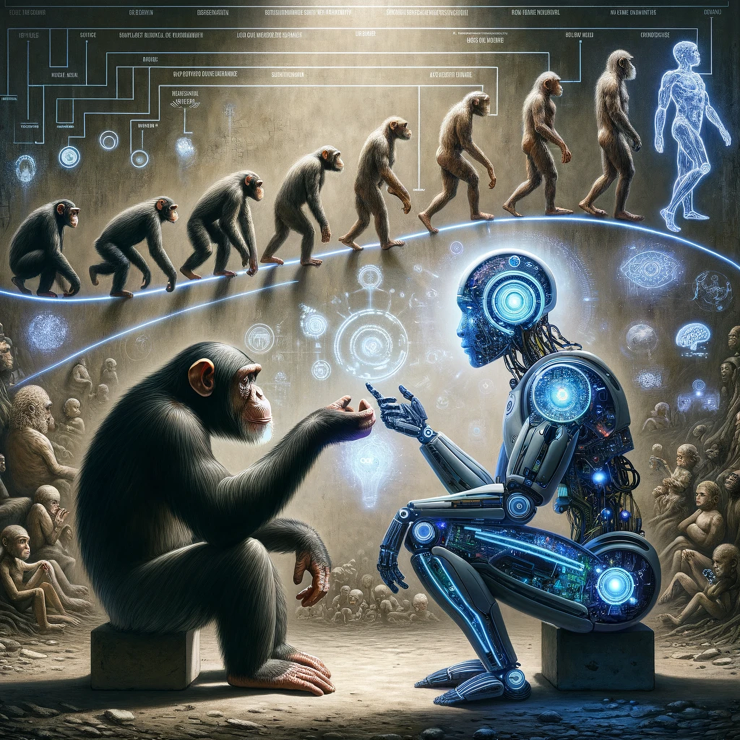


Slide 3
THE DEFINITION OF “LIFE”
AT LEAST 1 CELL
REPRODUCTION
ENERGY

Slide 4
A GREAT PLACE TO START LEARNING: https://www.youtube.com/@PrimerBlobs

Slide 5
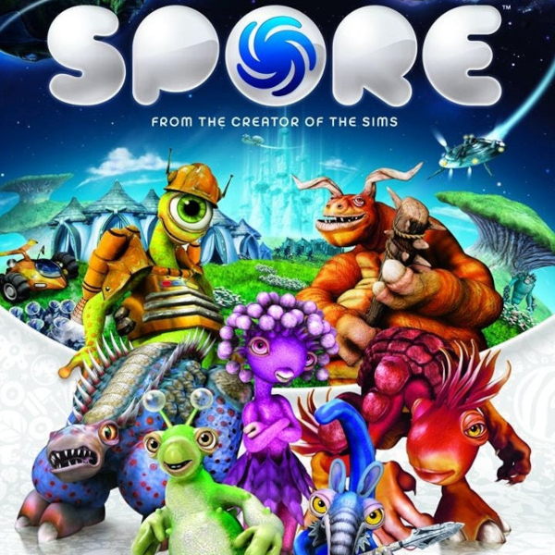
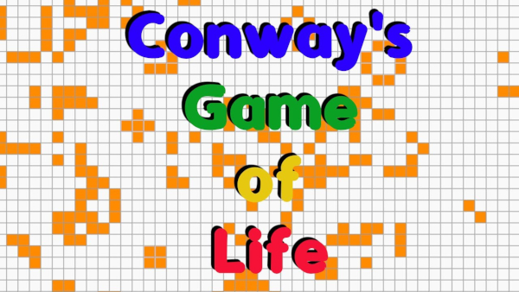
ABOUT OTHER LIFE SIMULATION SOFTWARE

Slide 6
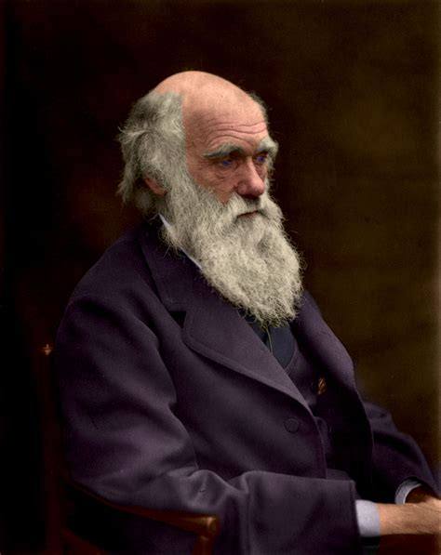
THE GUY WHO FIGURED IT OUT

Slide 7
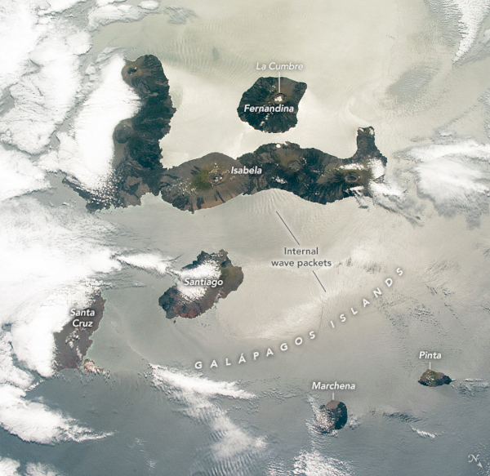

Slide 8
HOW DOES IT ACTUALLY WORK?
IT’S A MAGIC TRICK CALLED NATURAL SELECTION, WHICH HAS NOTHING TO DO WITH THE SMARTEST OR THE STRONGEST

Slide 9
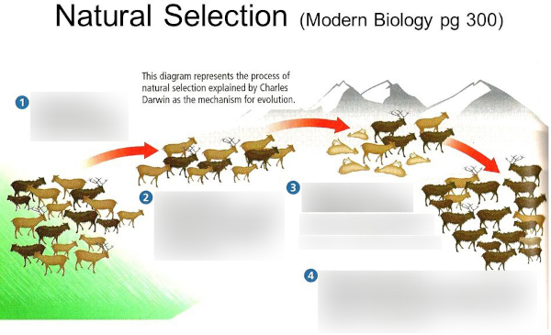

Slide 10
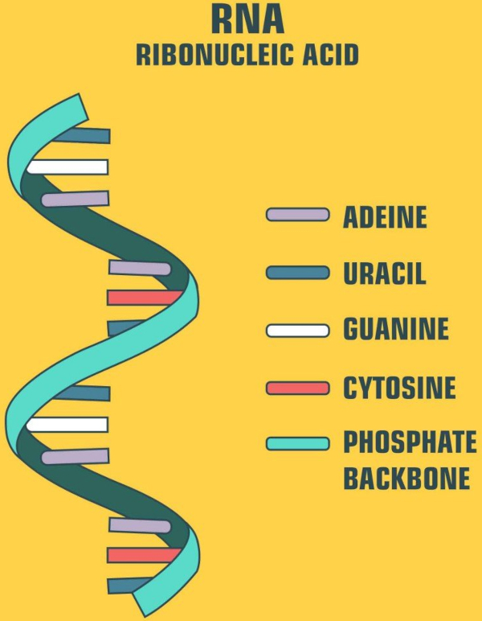
HOW DID IT ALL START?

Slide 11
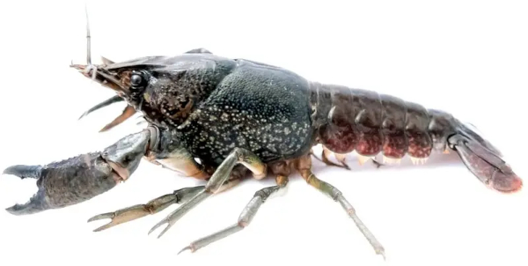
HOW DID SEXUAL REPRODUCTION HELP?

Slide 12
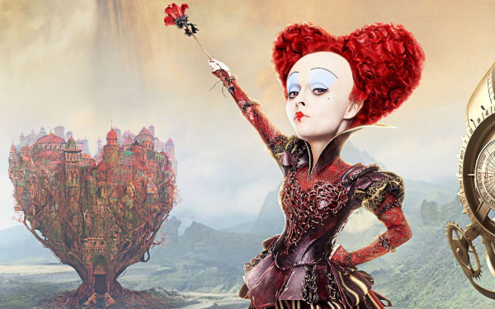
THE RED QUEEN, AND MORE...

Slide 13
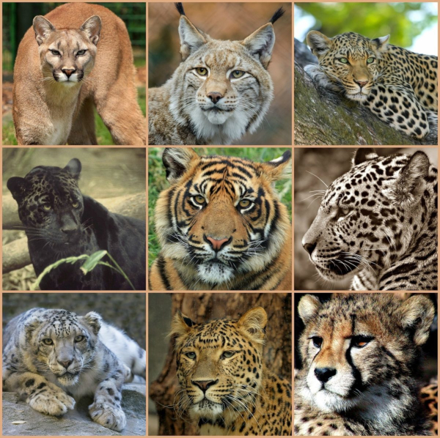
WE ARE SO ALONE

Slide 14
OUR LOST COUSINS
HOMO HEIDELBERGENSIS
HOMO FLORESIENSIS
NEANDERTHAL
DENISOVANS

Slide 15
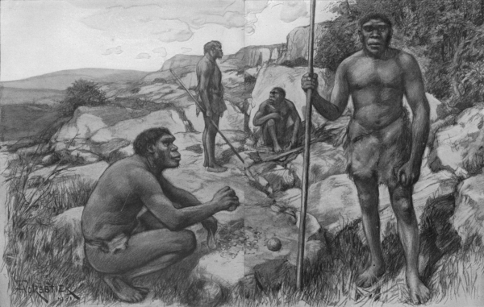
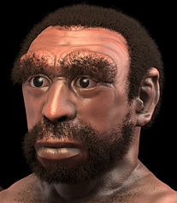
HOMO HEIDELBERGENSIS

Slide 16
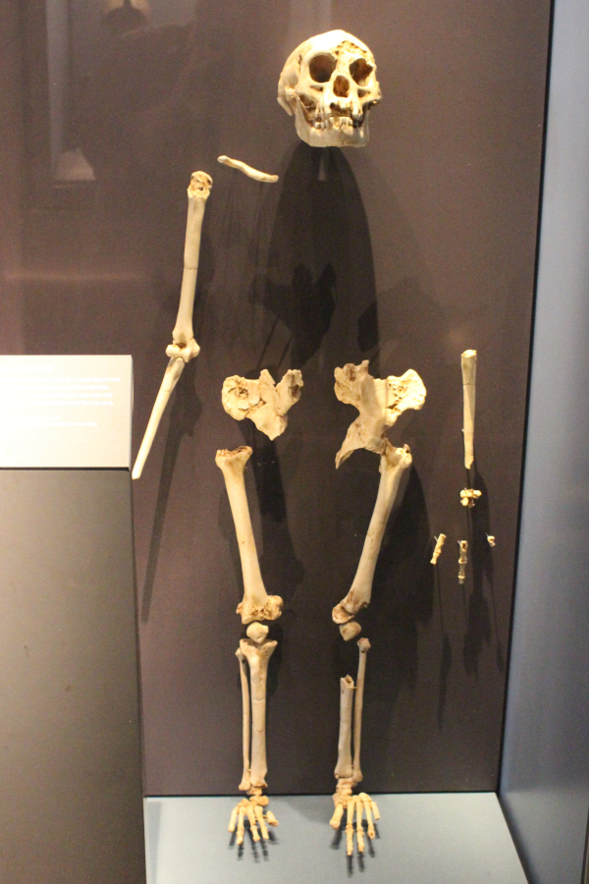
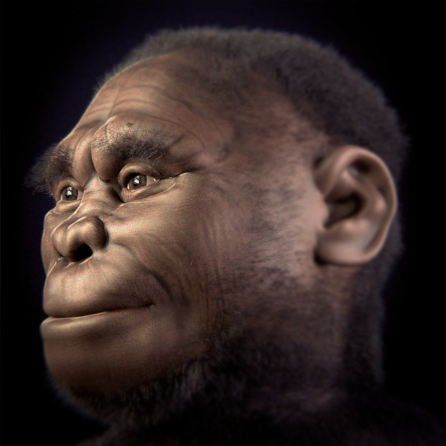
HOMO FLORESIENSIS

Slide 17
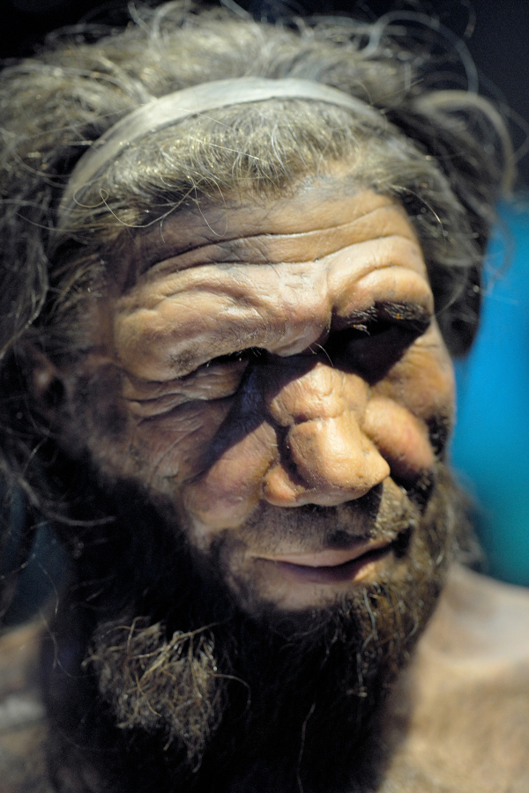
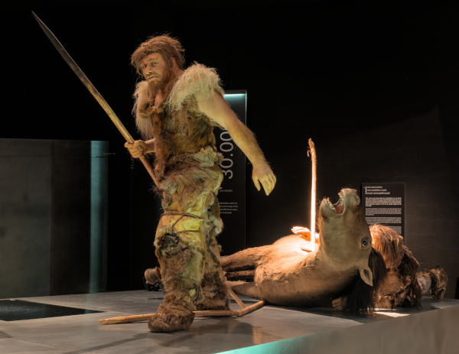
NEANDERTHAL

Slide 18
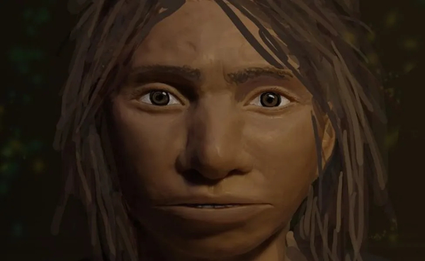
DENISOVAN

Slide 19
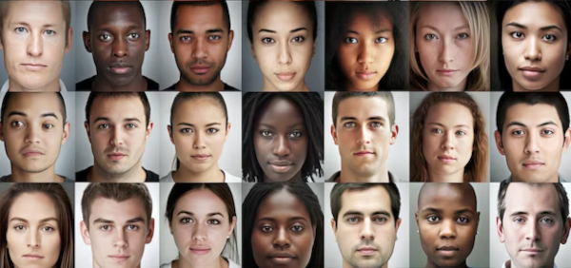
WHY DO WE HAVE DIFFERENT RACES? THERE IS MORE TO IT THEN JUST SUN LIGHT

Slide 20
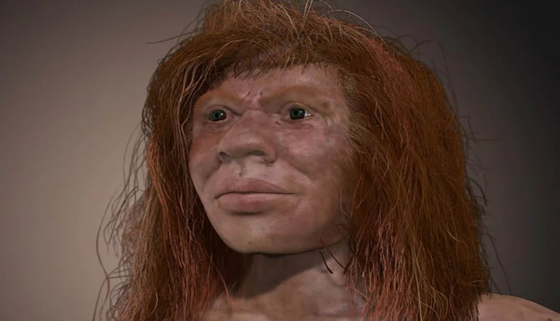
WE ARE HYBRIDS!
MOST OF US CARRY MORE THAN JUST HOMO-SAPIENS GENES

Slide 21
NOW, TO BUSINESS!
ENOUGH BIOLOGY, YOU ALL CAME HERE FOR DLANG, WHERE DOES IT FIT IN?

Slide 22
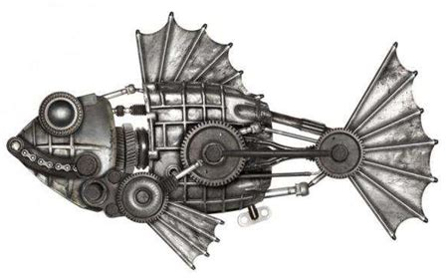
I ALWAYS FOUND BIOLOGICAL SIMULATIONS AMAZING BECAUSE THEY HOLD THE KEY CREATE BETTER MACHINES

Slide 23
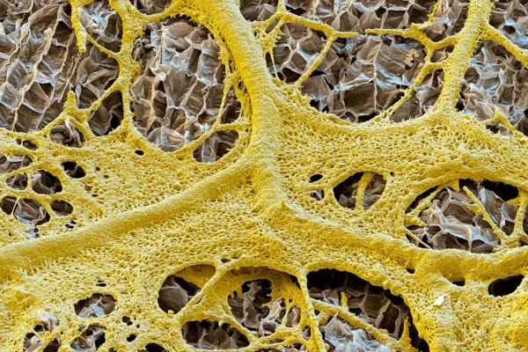
MEET THE AMAZING SLIME MOLD! https://www.youtube.com/watch?v=2e8iwiqhH8w

Slide 24
NOW THE MOMENT YOU'VE ALL BEEN WAITING FOR, I'M GONNA RUN THE BIOLOGICAL SIMULATION SOFTWARE, BUT FIRST, THERE IS A GOOD FRIEND I WANT ALL OF YOU TO MEET.

Slide 25
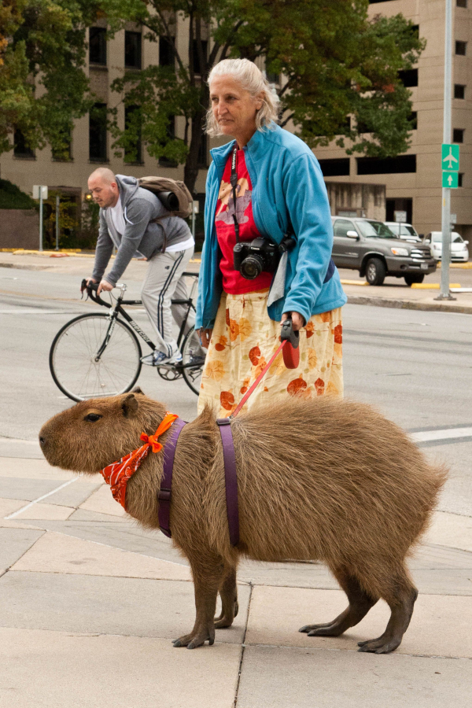
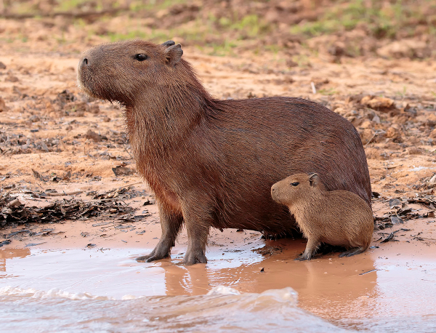
HELLO FRIENDS, I AM THE CAPYBARA https://www.youtube.com/watch?v=93RHBDK0NoM

Slide 26
IF ANYONE HAS MORE QUESTIONS, HERE ARE MY SOCIAL MEDIA
X/Twitter: https://x.com/MuriloM_CS
Facebook: https://www.facebook.com/MuriloMir
Instagram: https://www.instagram.com/murilo_m_cs/

