Slide 1
D-scanner: Migrating from libdparse to DMD-as-a-library
Vlăduţ-Ştefan Riciu
Dconf 2024

Slide 2



About me
Just graduated @ POLITEHNICA Bucharest Computer Science & Engineering
2+ years @ Adobe Mostly in the JVM world
Got into D through D-Scanner

Slide 3
Introduction

Slide 4
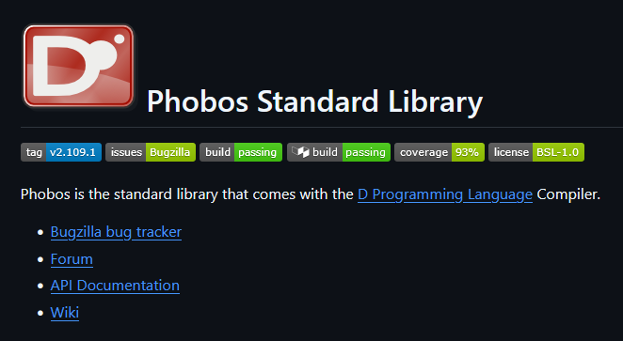
What is D-Scanner?
Static code analysis tool
Bad practices, style checks
50+ code checks

Slide 5

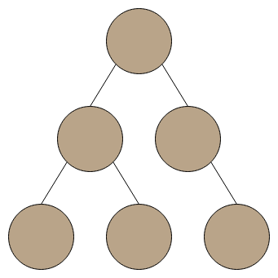



D-Scanner architecture
D-Scanner
Libdparse
Static analysis checks
Lexical Analysis
Warnings
Syntactic Analysis
Source code
AST
Visitors
5
Notes:
Ast outside box, arrows lib -> ast -> static
Static analysis -> box

Slide 6

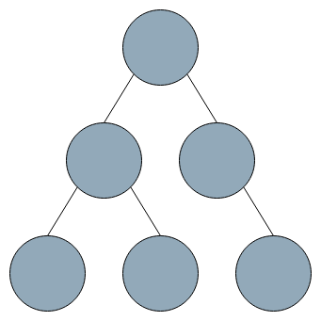

Objective
Dmd as a library
D-Scanner
Libdparse
Static analysis checks
Lexical Analysis
Lexical Analysis
Syntactic Analysis
Warnings
Syntactic Analysis
Source code
Semantic Analysis
AST
Visitors
6
Notes:
Ast outside box, arrows lib -> ast -> static
Static analysis -> box

Slide 7
Why DMD as a library?

Slide 8
Easier to tackle compiler updates
DMD
Implement DIP 9999
Libdparse
Replicate DIP 9999
D-Scanner
Update library version
as a library

Slide 9
Semantic analysis
Hard to perform
Already implemented
Allows more comprehensible checks

Slide 10
Benefits for dmd as a library
Dmd as a library is still in its early stages
The compiler interface changes
Use in an important projects, gain useful insights

Slide 11
What has been done

Slide 12
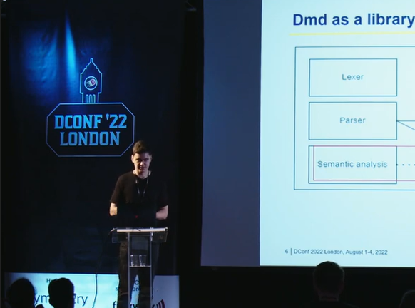
Lucian Dănescu
DConf '22: Integrating the D Compiler as a Library in D-Scanner
https://www.youtube.com/watch?v=JYkb3PjIn4c

Slide 13
Where I started
24 / 54 checks already migrated
A few other checks started with PRs open
Code infrastructure for dmd as a library

Slide 14
What I’ve done
Finished migrating all checks
Some maintenance work

Slide 15
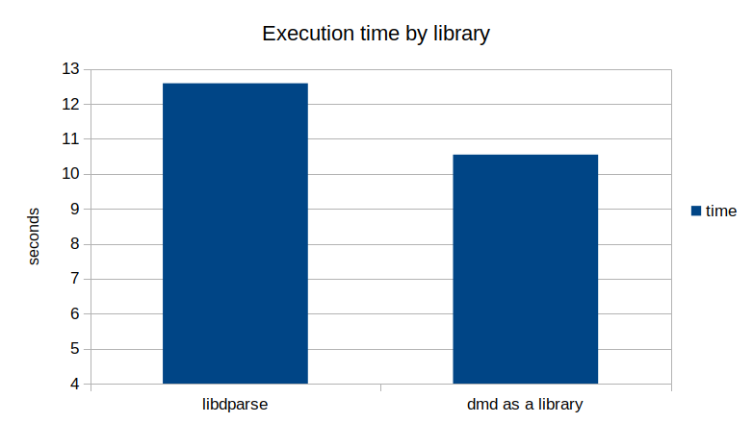
Execution time
~15%

Slide 16
What I’ll show you
Workflow
Dmd as a library challenges
Keeping up with the upstream

Slide 17

Workflow

Slide 18
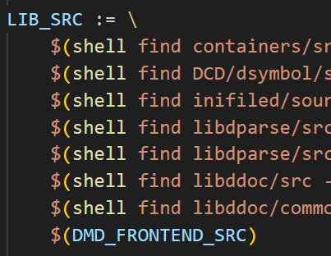
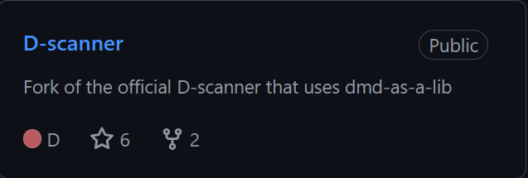
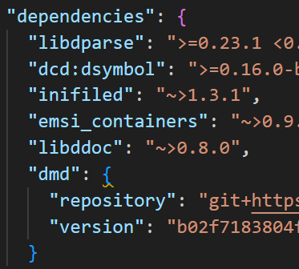
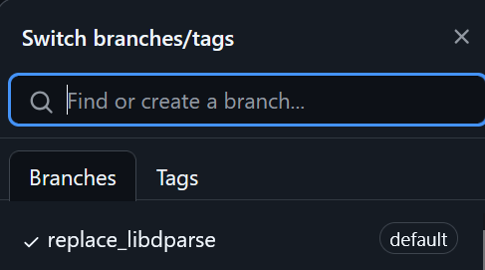
Upstream fork
MAKEFILE
DUB FILE

Slide 19
Migration process
Migrated checks
Other areas
Code
parse module
Select checks
should Run
Run checks
analyze
Code
parse module DMD
Select checks
should Run DMD
Run checks
analyze DMD

Slide 20
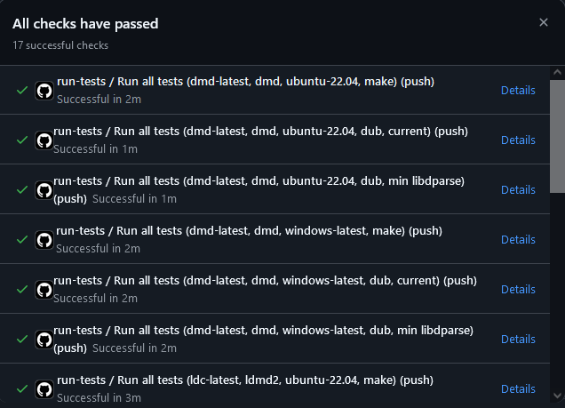
Testing pipeline
Unit tests
Integration tests
Build

Slide 21

Dmd as a library challenges

Slide 22
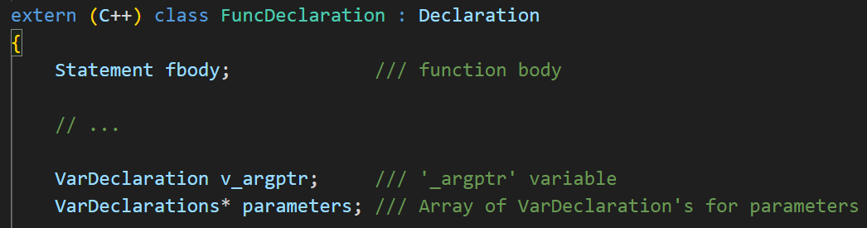
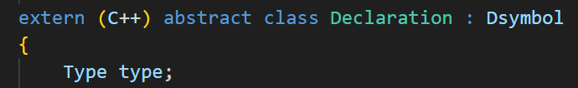
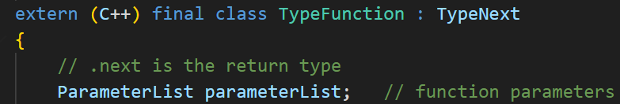
Not always intuitive…
NULL

Slide 23
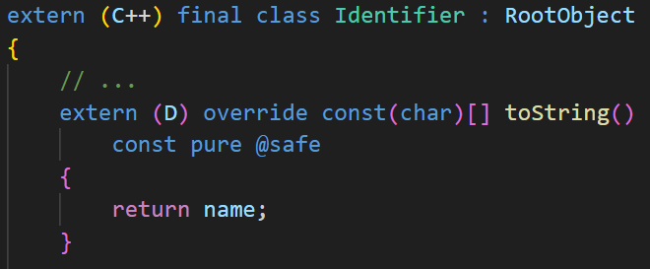




D strings and dmd as a library

Slide 24


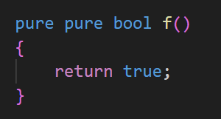
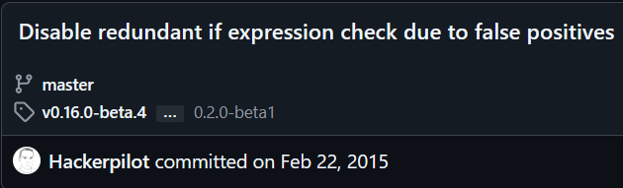
Deleted checks
FloatOperatorCheck
CommaExpressionCheck
DuplicateAttributeCheck
IfStatementCheck

Slide 25

Keeping up with the upstream

Slide 26
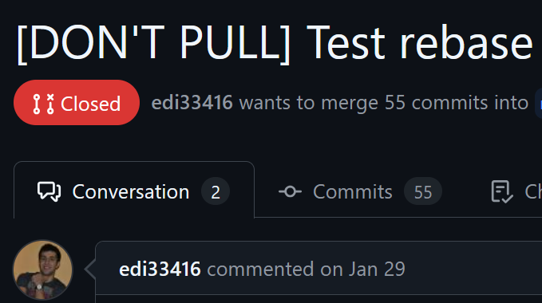
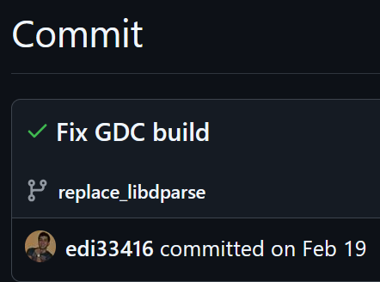

Rebasing

Slide 27
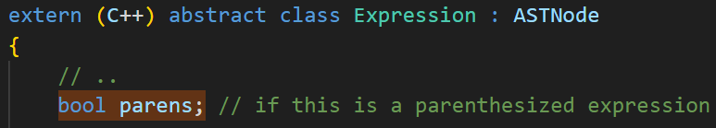
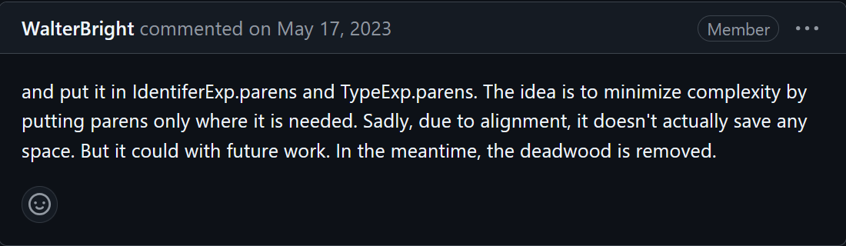
Dmd as a library updates

Slide 28
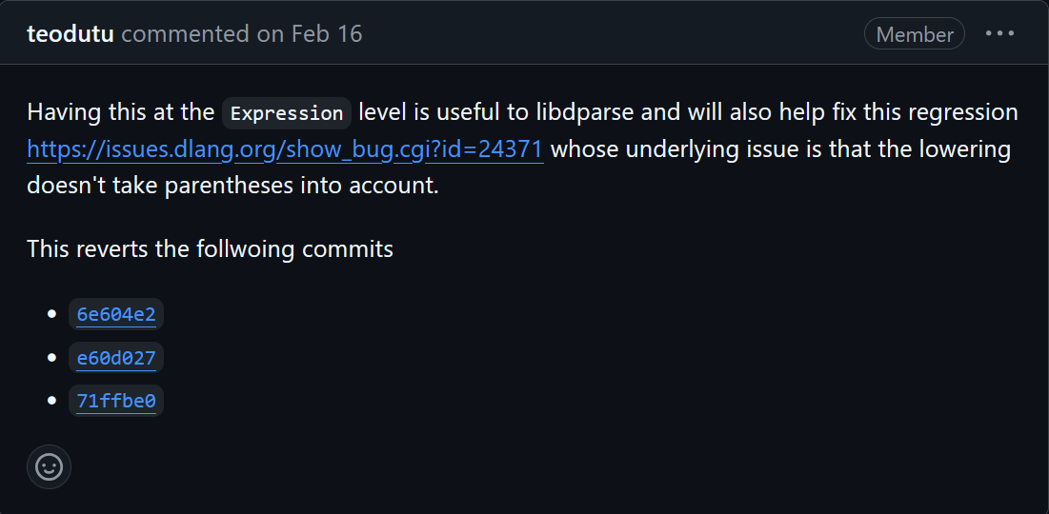
Dmd as a library updates

Slide 29
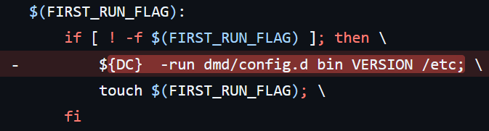
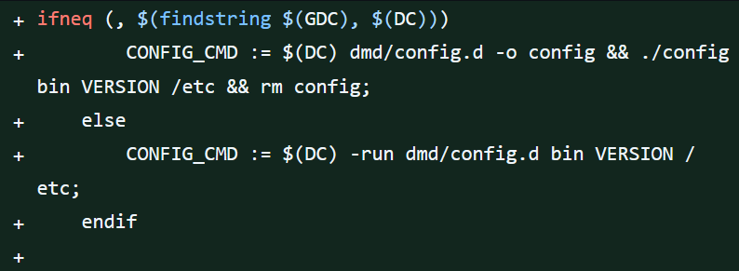
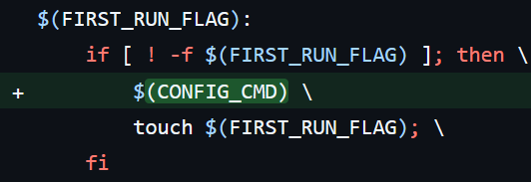
GDC Issue

Slide 30
Conclusions

Slide 31

The missing 1% & future work
@nolint
Autofix
New 100% Semantic analysis

Slide 32

Conclusions
Dmd as a library is usable
Public docs
Test D-Scanner

Slide 33

Conclusions
SCA Tools (compilers) are fun
D is cool
Rebasing is not fun

Slide 34
Is it a good idea to share the same codebase with the compiler?

