Slide 1

A beginner's journey with AI in D
It began as a play, I had no idea how far it would take me.

Slide 2

What I thought about AI
- I imagined what you see in the movies
- Skynet, terminators, androids

Slide 3
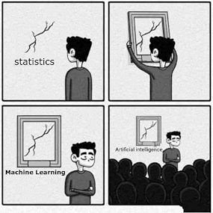
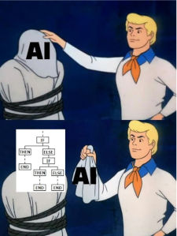
What I have discovered about AI
- our current AIs are far from being truly intelligent
- it is just applied statistics and probability
- sometimes it is just a bunch of “if” statements

Slide 4
Artificial Intelligence is no match for natural stupidity
- the year is 2023 and guess what we are doing with our AI technology…
- https://www.youtube.com/watch?v=CO5ydSJzxLk

Slide 5
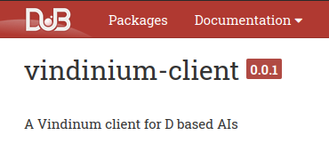
I hope I’m not alone
- there aren’t many D tools for AI out there

Slide 6
How I did it all in D
- I like to do things the same way, with the same tools
- I could use other languages but I liked D better
- I studied the arsd library deeply, now I do everything in D and with this library

Slide 7
My first experiments
- I began by making an agent that could find its way out of a maze with the A* algorithm
- I made an animation showing the Dijkstra algorithm in action
- I intuitively created an OCR program with the same idea used by Emanuel Goldberg

Slide 8
The neural network module I wrote
- I needed a framework to create neural networks
- I wrote my own module with all the classes and functions for me to create neural networks easily

Slide 9
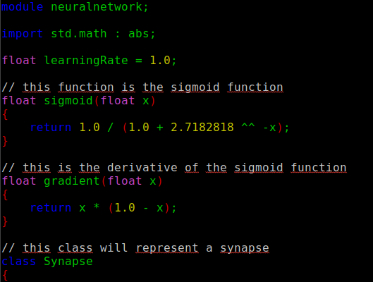

Slide 10
The network creator I made
- a large network requires a large code
- imagine having to write all the neurons and synapses in a deep network
- visualizing your work makes it easier too
- I made a software where you draw your network with the mouse and press Enter to generate the source code

Slide 11
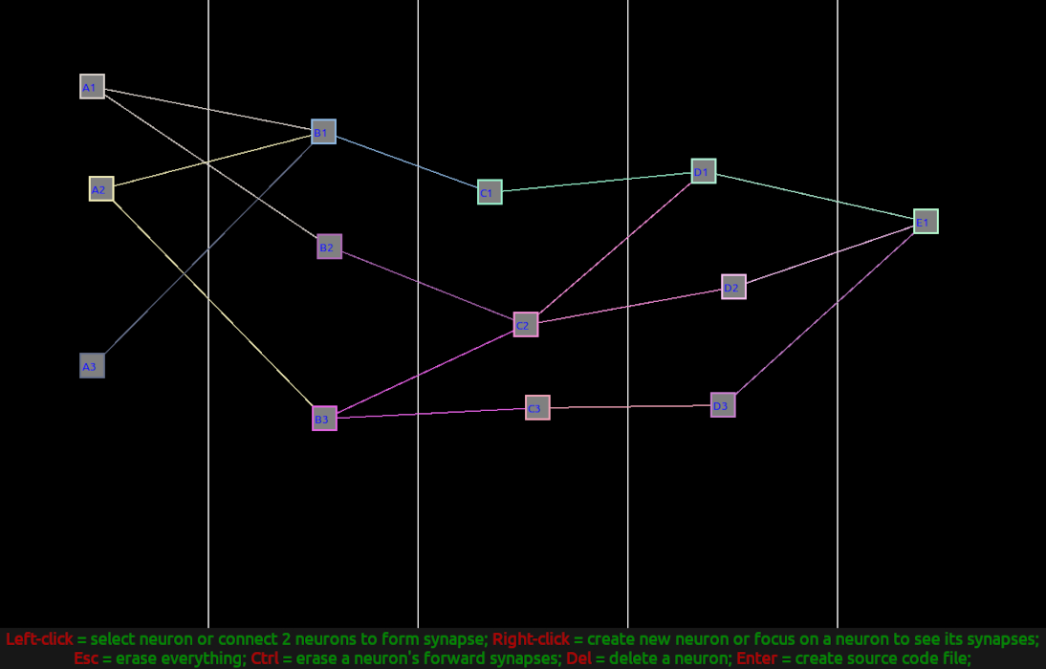

Slide 12
The OCR software I wrote
- I made my own training set with .png images
- the original OCR was crude
- I improved it with the new tools I created
- it turns out to be hard to find something similar

Slide 13
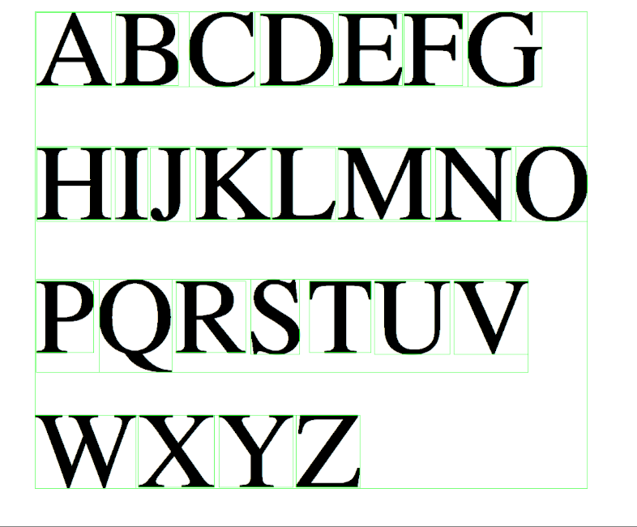

Slide 14
The color classifier software I wrote
- it started simple, then it grew
- I had to try many different networks
- I had to ask my friends for help
- I don’t think there is anything similar for you to download

Slide 15
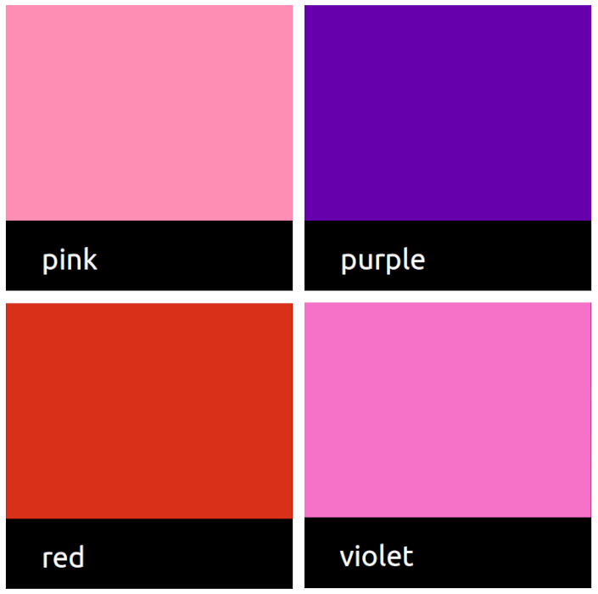

Slide 16
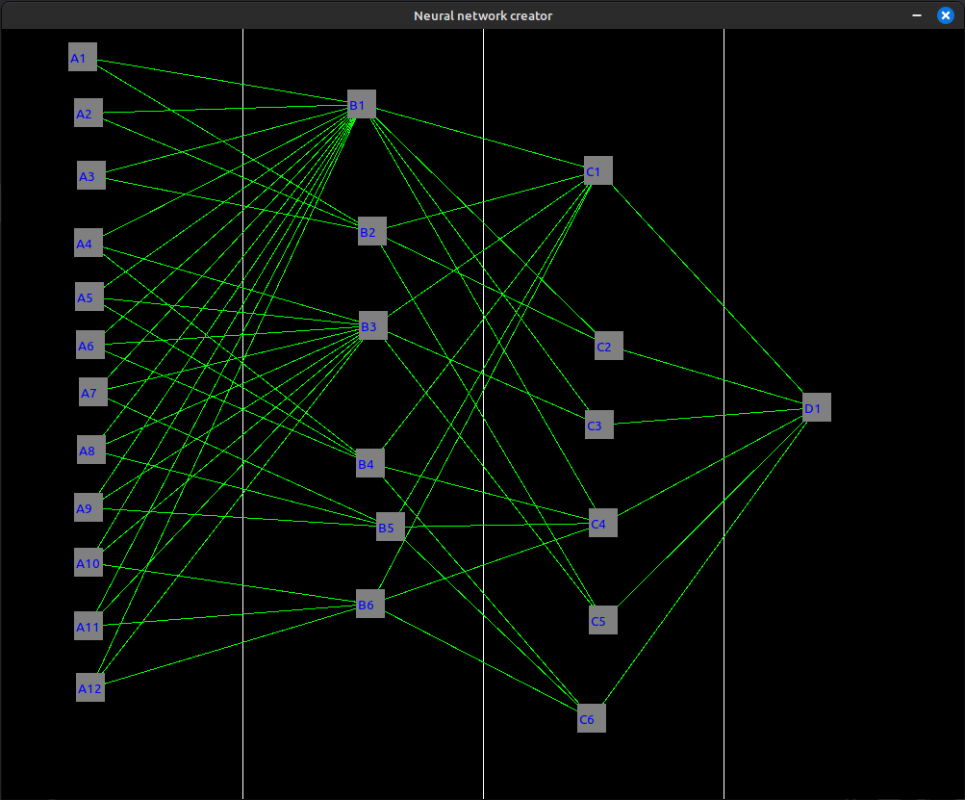
One of the first networks I made to classify the colors

Slide 17
The improvised processing central
- as the networks grew, so did the training time
- you can’t work on an FX-4300 CPU while the networks use 100% of it
- I wouldn’t spend money on another computer
- I turned garbage computers into a central to train the networks 24h a day

Slide 18
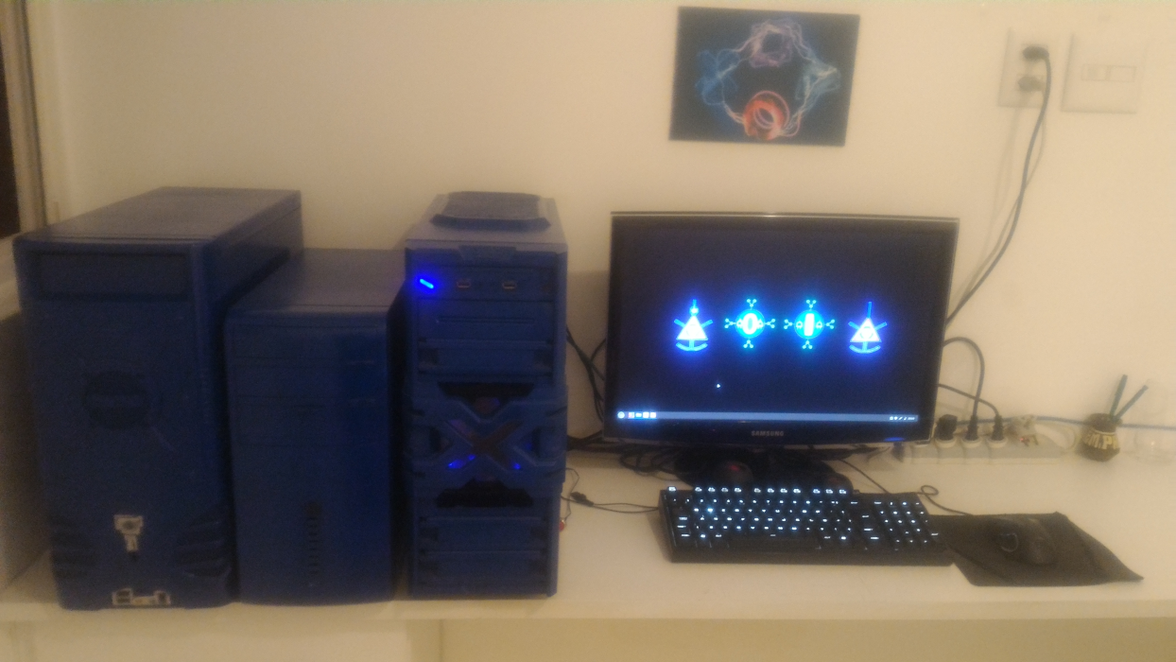

Slide 19
My advice to those who want to learn it
- learn high school math
- know the basics of linear algebra and calculus
- take it slowly, it is indeed hard
- try to learn the intuitive part before learning the math behind it

Slide 20
An example to illustrate it all
- here I will show my own way to create a neural network

Slide 21






My contacts
. https://computingthesciences.blogspot.com
. https://github.com/MuriloMir
. https://twitter.com/MuriloM_CS
. https://www.instagram.com/murilo_m_cs
. https://www.facebook.com/MuriloMir
. murilomiranda92@hotmail.com

