Slide 1
Scott Meyers’
Things that
to me
Matter
Notes:
These are things that I think matter for building systems likely to be successful. They’re not the only things, but they are important things. They don’t guarantee success, but they can help contribute to it. My perspective is as a software person, not a business person.
Text is 180 pt MoolBoran with “Glow and Soft Edges” settings of red with a 150 pt size and 50% transparency. The format has to be applied to the text directly. It doesn’t seem to work if applied to the text box.
Font conventions in this presentation:
Palatino Linotype 22 pt for non-code text.
Consolas for code (22 pt for in-place code, 20 pt for code displays).
Ariel 22 pt for URLs and email addresses.

Slide 2

My Life with Computers
1970
1980
1990
2000
2010
User
Programmer
Teacher
Researcher
Notes:
Started using: 1970
Started programming: 1971
Started teaching: 1972
Research: 1985-1993
Cessation of computer use suggests I developed other interests, which more or less coincides with the timing of my first kiss. That doesn’t seem to have led anywhere, hence my renewed interest in computers a few years later...

Slide 3



My Life with Computers
C++
Notes:
25 years image from https://www.docherman.com/images/Celebrating%2025%20year%20banner.jpg.

Slide 4
Efficiency/Speed
Notes:
Eficient software isn’t the same as fast software, but often efficient software, by virtue of executing fewer instructions, is also fast software.

Slide 5
Not a Niche Requirement
Efficient software can run on less capable hardware
Embedded systems
Mobile devices
Systems software
Libraries
Servers
Simulations
Video games, VR systems
Financial trading systems
Number-crunching applications
Analysis of large data sets
Work done sooner ⇒ system can sleep sooner
Foundational
Never fast enough
Notes:
Mobile devices can be viewed as embedded systems, so the comment about embedded systems applies to them, too.
If the foundational stuff isn’t efficient, the stuff built on it can’t be, either. Servers are also in the “never fast enough” camp on cost grounds (per Andrei’s FB experience).

Slide 6
Interactive Systems!
1/10th second delay affects user behavior.
Amazon:
We tried delaying the page in increments of 100 milliseconds. Even very small delays would result in substantial drops in revenue.
Google:
Latency increase from 400-900ms ⇒ 20% drop in searches.
Patrick Meenan on widespread industry experience:
Overwhelming evidence indicates that a web site’s speed correlates directly to its success.

Slide 7
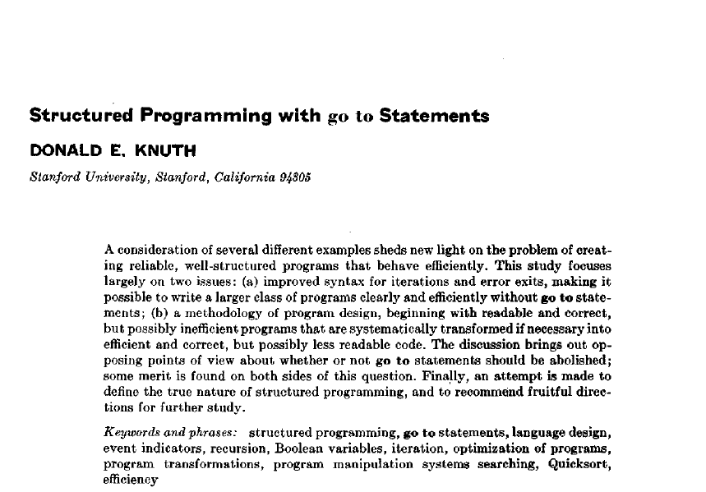
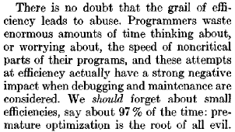
Premature Optimization Paranoia
Yet performance concerns often denigrated.
Donald Knuth:
Premature optimization is the root of all evil.
Notes:
Ask audience how many are familiar with the quote. Ask how many know where it’s from. Ask how many believe the quote is real.
Knuth, Donald E., “Structured Programming with go to Statements,” Computing Surveys, December 1974. The paper is remarkably readable.

Slide 8
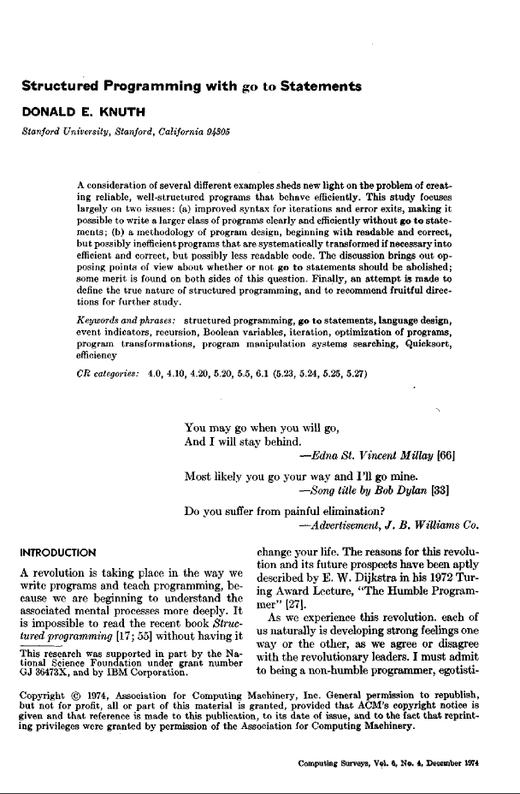
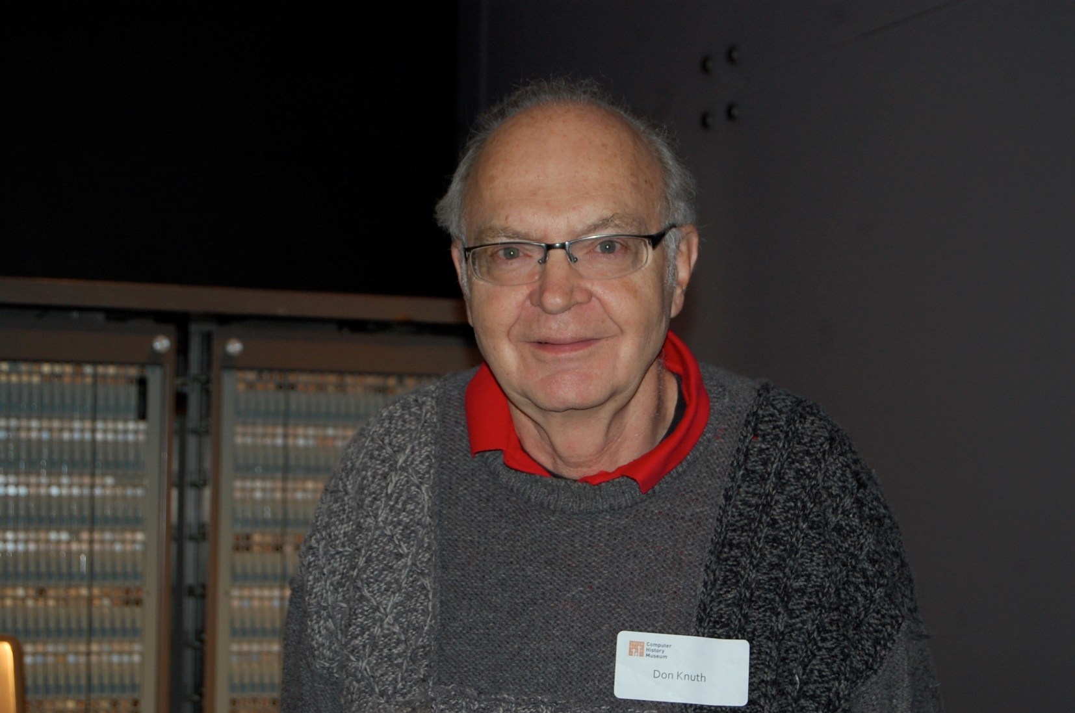


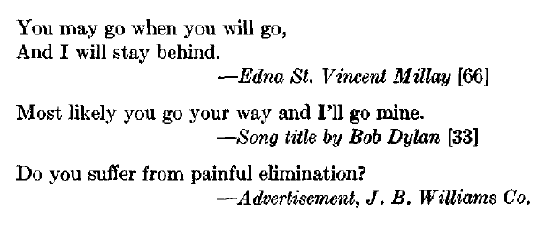
Donald Knuth
The Art of Computer Programming
&
Turing Award Winner
Notes:
Ask audience how many are familiar with Knuth.
TAOCP is currently up to three full volumes and 6 fascicles of volume 4.
Primary goal of this slide is to demonstrate Knuth’s sense of humor.
Image source: https://commons.wikimedia.org/wiki/File:Donald_Ervin_Knuth.jpg

Slide 9
A Closer Look at Knuth
Adding speed late in development often difficult.
Different algorithms, data structures, control flow.
E.g., ST ⇒ MT.
E.g., Undistributed/nonscalable ⇒ distributed/scalable.
Donald Knuth again:
Premature optimization is the root of all evil.

Slide 10
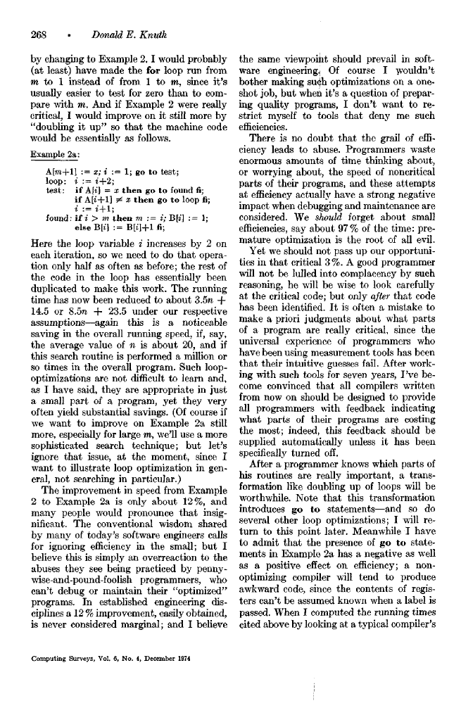
A Closer Look at Knuth
From the same page of the paper:
Ignoring efficiency in the small is an overreaction to abuses by [some] programmers. A 12% improvement, easily obtained, is never considered marginal.
We should forget about small efficiencies.
Premature optimization is the root of all evil.
Easily obtained improvements are never considered marginal.
Notes:
The paper is 41 pages long, so it’s interesting that these two quotes are so close to one another.
The “easily-obtained-improvements are never marginal” comment occurs at the end of a discussion about optimizing “critical inner loops,” but I believe Knuth means for the quote to apply in general, not just to critical loop optimization.

Slide 11
A Closer Look at Knuth
Ignoring efficiency in the small is an overreaction to abuses by [some] programmers. A 12% improvement, easily obtained, is never considered marginal.
...easily obtained...
Notes:
It’s not a strict quote, because I chopped out a lot of words for this slide.
A 12% improvement, easily obtained, is a drive-by optimization.

Slide 12
Summing Matrix Elements
Column-Major Traversal
Row-Major Traversal
Notes:
The two traversals do exactly the same amount of work.

Slide 13
Summing Matrix Elements
sum = 0;
for (unsigned r = 0; r < m.columns(); ++r) { for (unsigned c = 0; c < m.rows(); ++c) { sum += m[r][c]; }
}
sum = 0;
for (unsigned r = 0; r < m.rows(); ++r) { for (unsigned c = 0; c < m.columns(); ++c) { sum += m[r][c]; }
}
Column-Major Traversal
Row-Major Traversal

Slide 14
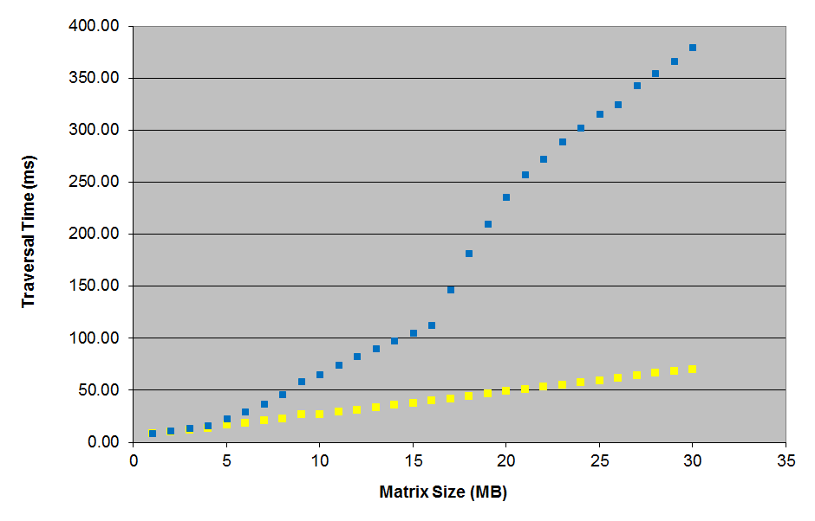
Summing Matrix Elements
Column-Major
Row-Major
Notes:
The performance improvement is easy to obtain, but it’s apparent only if you know about how CPU caches work.

Slide 15
Never Stop Learning
Knowledge begets “easy” optimization, so never stop learning!
Library capabilities
Algorithms and data structures
Hardware and networking characteristics

Slide 16
The Efficiency-Productivity Pendulum
Efficiency!
Productivity!
Changing world
More or less static world
Notes:
During more or less static world times, systems get faster due to better hardware, better algorithms, etc. Eventually systems are considered fast or efficient enough, and companies shift their efforts to improving productivity.
Example of changing world times:
Migration of computation from mainframes and minicomputers to PCs.
Introduction of home Internet access (modems)
Introduction of mobile devices (1G smart phones)
Migration of computaton from end-user devices to servers.
Shift from offline video rendering to realtime rendering and shift from 30fps to 90+fps for VR.

Slide 17
Portability
Notes:
Portability is about designing and implementing a system so as to minimize the difficulty of porting it to (i.e., revising it to run in) new execution environments.

Slide 18

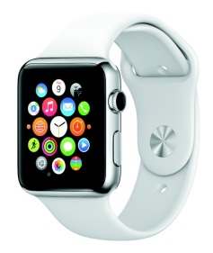
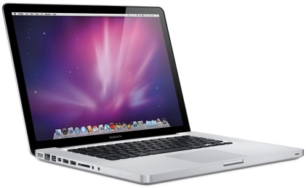




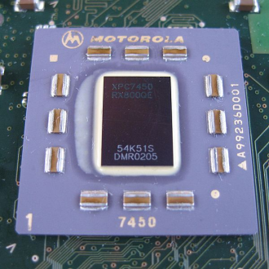

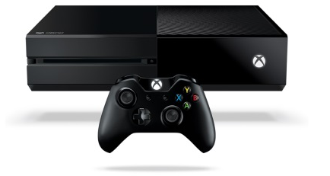


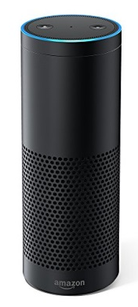
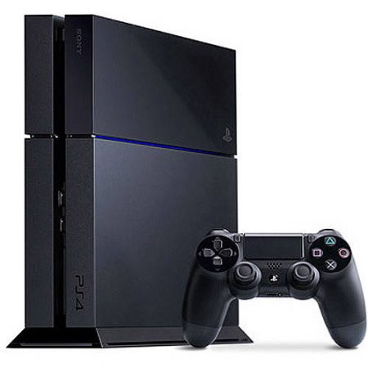
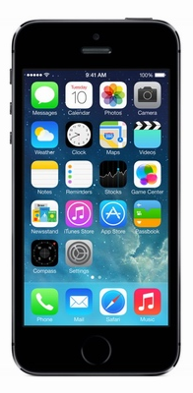
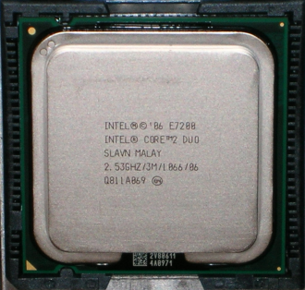


Processors
OSes
Compilers
Devices
Notes:
These are the primary kinds of portability I think systems builders have to deal with.
Processors (top to bottom): Motorola PowerPC, Intel Core 2 Duo. In 2005-2006, Apple moved its Macintoshes from PowerPC to Intel x86.
OSes (top to bottom): Mac OS, Linux, iOS, Android, Windows.
Compilers (top to bottom): LLVM, Visual Studio, GCC.
Devices (top to bottom and left to right): Apple Watch 2, Apple Macbook Pro, generic desktop PC, Amazon Fire HDX, Microsoft Xbox One, Amazon Echo, Sony PS4, Apple iPhone.
Image sources: PowerPC: https://commons.wikimedia.org/wiki/File:XPC7450.jpg, Intel Core 2 Duo: https://commons.wikimedia.org/wiki/File:Core_2_Wolfdale.jpg. Other images may be copyrighted.

Slide 19
Motivations
!
Because you know.
?
Because you never know...
Stock hardware closes gap with custom hardware.
Different platform better serves business needs.
New platforms offer new customers.
Change in compilers.
Notes:
“Because you know” => “Because you know you have to be portable.”
Bullet points:
Cognex exemplifies commodity hardware closing the gap with custom hardware. Cognex had its own hardware, OS, and compiler, so developers there ignored portability.
Apple exemplifies a different hardware platform better serving a business’s needs. Per Wikipedia (https://en.wikipedia.org/wiki/Apple%27s_transition_to_Intel_processors), Intel’s chips offered better performance per watt, had higher clock speeds, and ran cooler than the Power PC chips Apple’d been using. These issues were especially important for laptops, which were the fastest growing segment of the industry.
Temple Run exemplifies multiple platforms reaching more customers.
Per Wikiquote (https://en.wikiquote.org/wiki/Alexander_the_Great), the Alexander quote is only from the character Hans Gruber (played by Alan Rickman) in 1988’s Die Hard.
Changing hardware or OS platform often motivates a change in compiler, e.g., Intel’s compiler on Intel hardware, Microsoft’s compiler on Microsoft’s OSes, etc.
Images are probably copyrighted, sorry.

Slide 20
Architecture for Portability
Minimize!
Maximize!
Platform-Dependent Stuff
Platform-Independent Stuff
Abstraction Layer
Notes:
The “Stuff” need not be source code. It could be, e.g., configuration information for build systems.

Slide 21
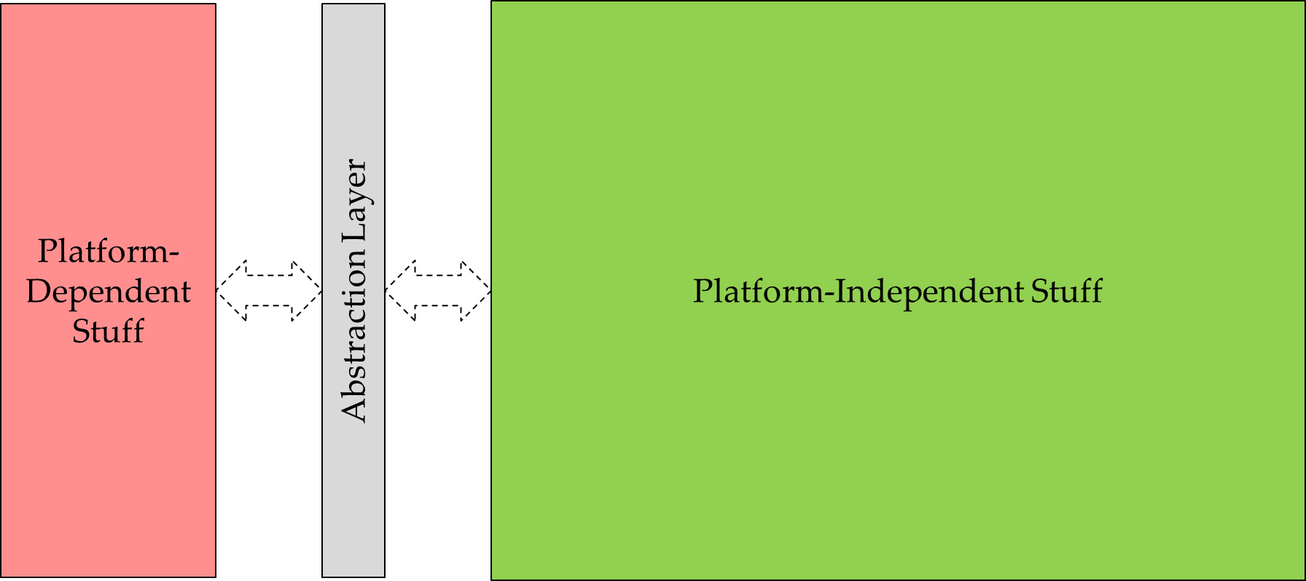
Critical Question #1
???
???
What’s platform-dependent?
Machine word size and endianness; cache levels, sizes, and relative speeds; etc.
OS data type details (e.g., LLP64 vs. LP64).
C & C++ data type details (e.g., bits/signedness of built-in data types).
Standard library implementations.
API availability and quality.
Device capabilities.
Let experience be your guide.
Preferably others’.
Never stop learning!
Notes:
Endianness includes the possibility of byte-swapping, which is covered under the terms “mixed-endian” or “middle-endian”.
MS Windows is LLP64 (32-bit ints and longs, 64-bit long longs and pointers). Most Unix systems are LP64 32-bit ints, 64-bit longs, long longs, and pointers).

Slide 22
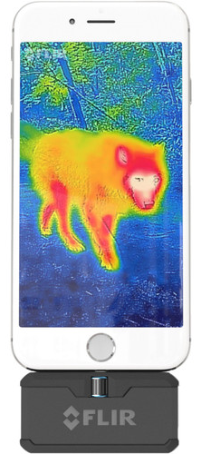
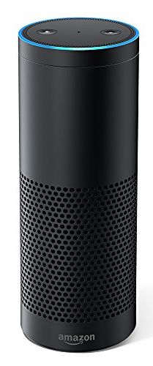
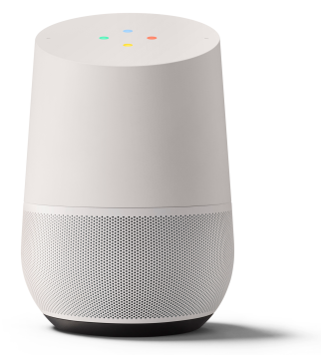

Critical Question #2
How take advantage of unique platform features?
Special hardware instructions.
GPUs.
OS-specific APIs.
End-user features:
Fingerprint sensor.
Color display.
Display at all.
Cameras (front-facing, infrared, etc.).
CD player.
Notes:
Image sources from various product or review pages via Google images search.
Approaches to this problem include compile-time if/then/elses (e.g., #defines or presumably static ifs), runtime if/then/elses (e.g., capability queries), and virtual dispatch.

Slide 23
Toolability

Slide 24
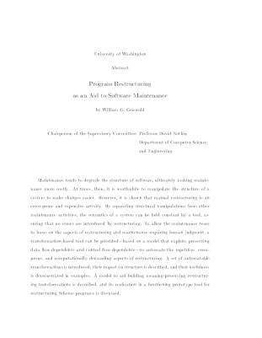
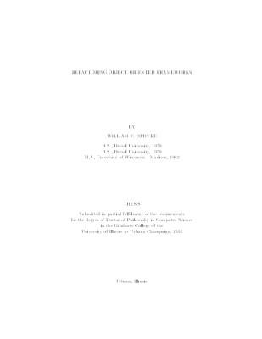
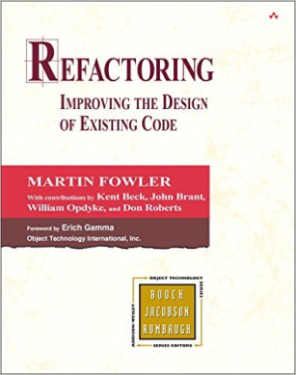
Refactoring
Per Wikipedia:
1991: William Griswold Ph.D. thesis: Program Restructuring as an Aid to Software Maintenance.
1992: William Opdyke Ph.D. thesis: Refactoring Object-Oriented Frameworks.
1999: Martin Fowler book: Refactoring: Improving the Design of Existing Code.
t = 0

Slide 25
Automated Refactoring Tools
For Self:
1996: Guru
For Smalltalk:
1997: Smalltalk Refactoring Browser
For Java:
2001: X-ref, jFactor, IntelliJ
2003: Eclipse
For C#:
2004: Resharper
Δt = -3
Δt = -2
Δt = 2
Δt = 4
Δt = 5
Notes:
Source for references to tools for Self and Smalltalk is http://www.ai.mit.edu/projects/ntt/projects/MIT2001-01/documents/invariants-refactor.pdf.
Source for 2001 Java tools is https://www.martinfowler.com/articles/refactoringRubicon.html.
Source for Resharper is https://www.jetbrains.com/company/press/press-archive/pr_210704.html.

Slide 26


Automated Refactoring Tools
C++
For C++:
2009 StackOverflow post:
Does anybody know a...refactoring tool for C++ that works...with large code bases? I tried again and again over the last years: ...[none] were at all usable.
UPDATE March 2015
...
By my opinion the answer to this question still is "NO".
Δt = 10
Δt = 16
Notes:
URL for SO post is http://stackoverflow.com/questions/1388469/is-there-a-working-c-refactoring-tool .
There’s some apples-and-oranges between this page and the prior one, because I don’t know how well the tools for other languages work for large code bases.

Slide 27
Understanding C++
What is f in this code?
f(x); // “invoke f on x”
Maybe a function (or function pointer or function reference).
Maybe an instance of a class overloading operator().
Maybe an object implicitly convertible to one of the above.
Maybe an overloaded function name.
At any of multiple scopes.
Maybe the name of one or more templates.
At any of multiple scopes.
Maybe the name of one or more template specializations.
Maybe several of the above!
E.g., overloaded function name + overloaded template name + name of template specialization(s).
Let’s not even mention the preprocessor...
Notes:
This list is not exhaustive. For example, f could also be the name of a type that can be used to perform a cast on the type of x.

Slide 28
C++ Complexity
Causes:
Compatibility with C (including preprocessor).
Standardization committee’s lack of concern.
Result:
Creating C++ analysis tools nearly impossible.
Impractical for individual developers.
Impractical for third-parties.
Exacerbating factor:
GCC source code unhelpful:
GPL license.
All but incomprehensible (so I’m told).
Brooks’ Accidental Complexity
Notes:
“Accidental Complexity” from Brooks, F.P., Jr., “No Silver Bullet: Essence and Accidents of Software Engineering,” IEEE Computer, April 1987. In my 2014 DConf talk, I discussed complexity and C++, but I didn’t talk about its impact on C++’s (lack of) toolability.

Slide 29
Lessons
Untoolable artifacts:
Restrict what users can accomplish themselves.
Constrain what outside tool vendors can offer.
Pressure providers for functionality users and outside vendors can’t implement.
Toolable artifacts:
Are inherently easy to parse and analyze or
Offer APIs that mask the complexities of parsing and analysis.
Notes:
“Artifacts” could be source code, configuration files, data files, etc.

Slide 30
Consistency

Slide 31


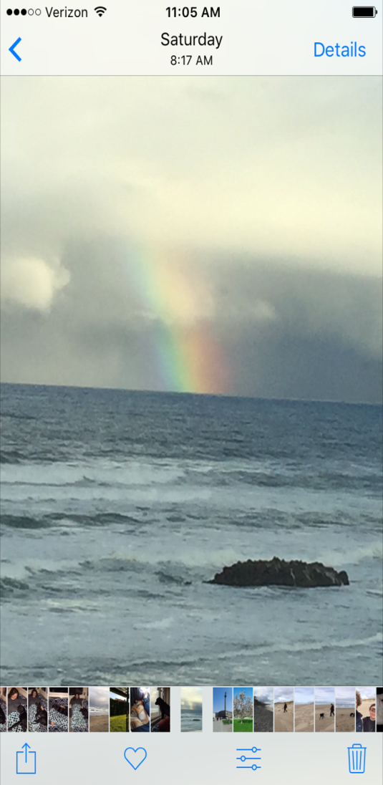
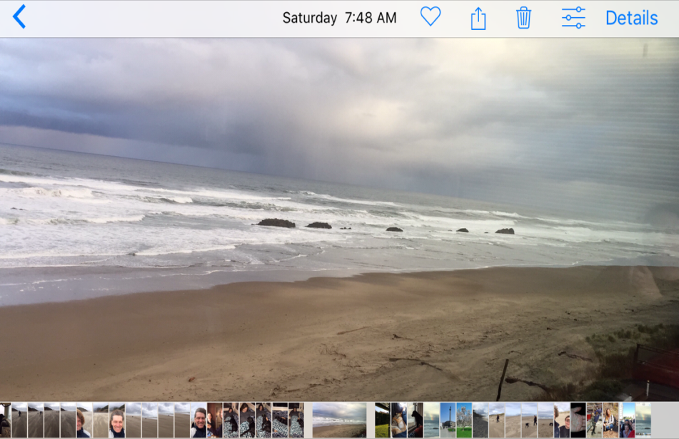
Essential for Useful Abstractions, Inferential Reasoning
Inconsistency annoying, acts as speed bump for users:
Notes
Mail
Photos
Notes:
The slide title is important and you should spend a little time elaborating on it.
Deletion icon is consistently a trash can, but the location is inconsistent.
For Notes and mail, the location and color of the trash can icon is the same in landscape mode as in portrait mode.
All images are from iOS 10. All software ships natively on iPhone.

Slide 32


Wait...What?!
Notes:
Icon order in Photos app is completely inconsistent in portrait and landscape mode.

Slide 33
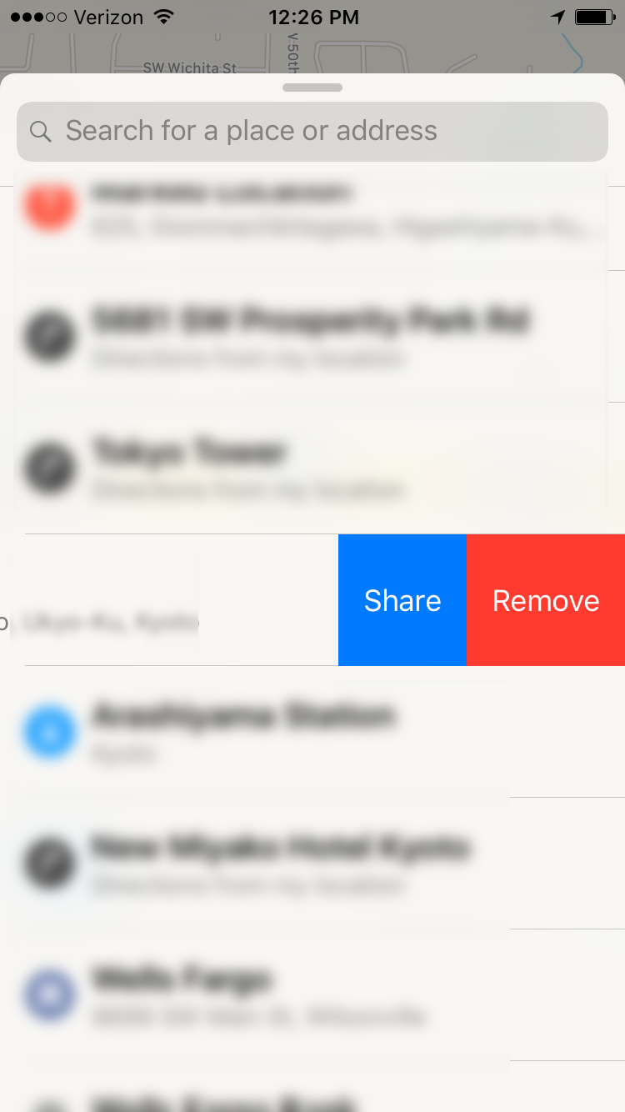

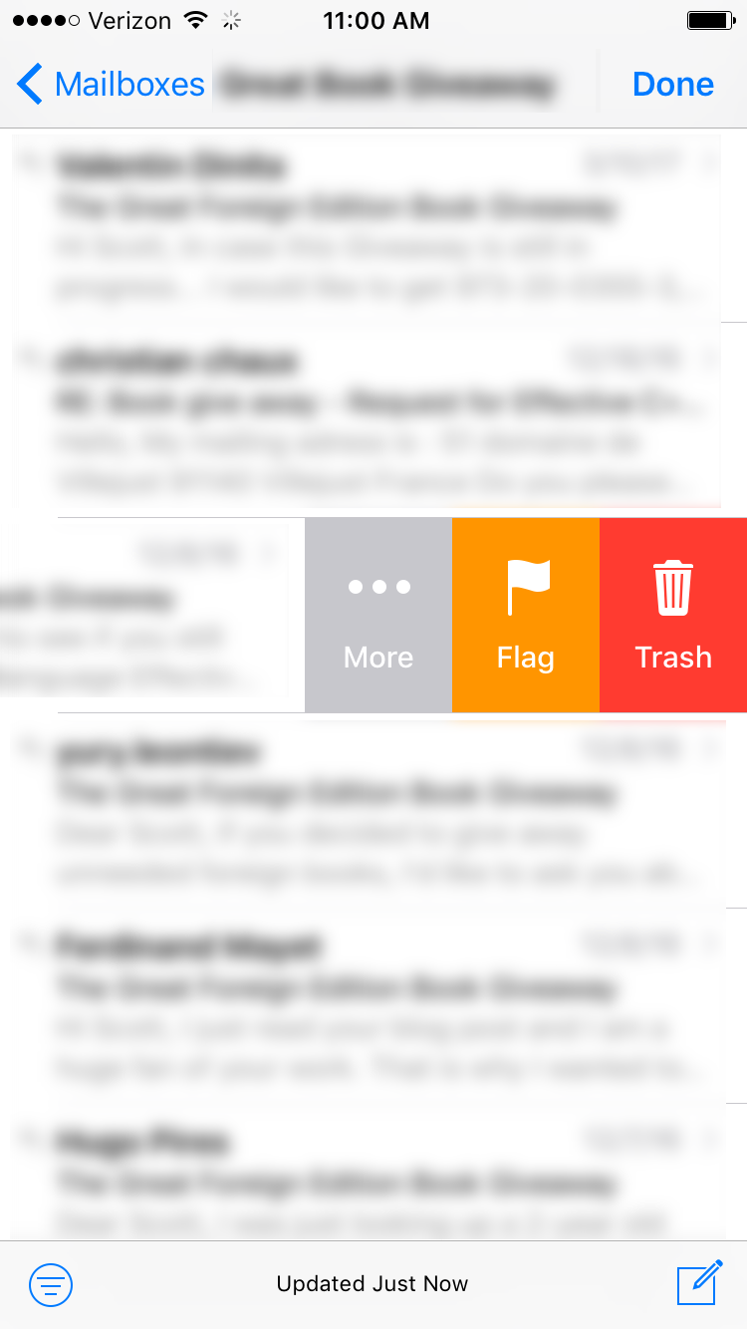
Not Always a Trash Can
Notes
Maps
Mail
Notes:
Notes uses “Delete”, Maps uses “Remove”, Mail uses “Trash.” Only Mail uses icons along with text.
All images are from iOS 10. All software ships natively on iPhone.

Slide 34

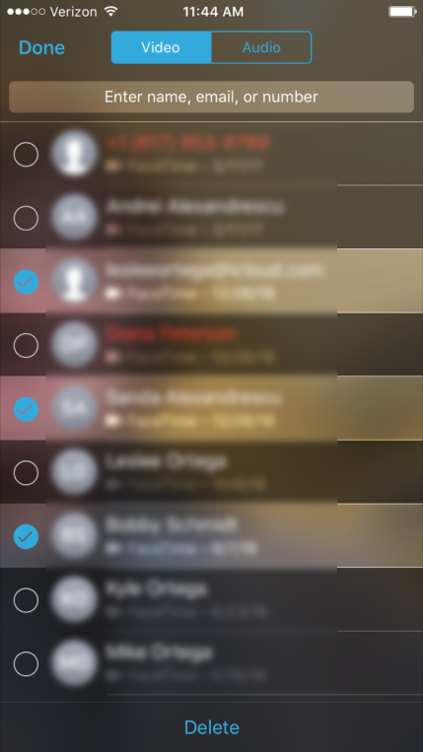
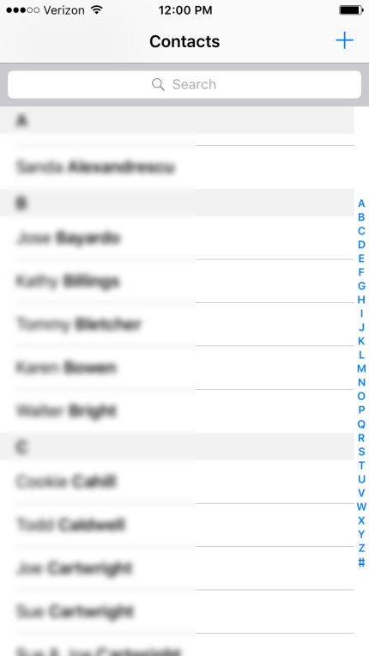

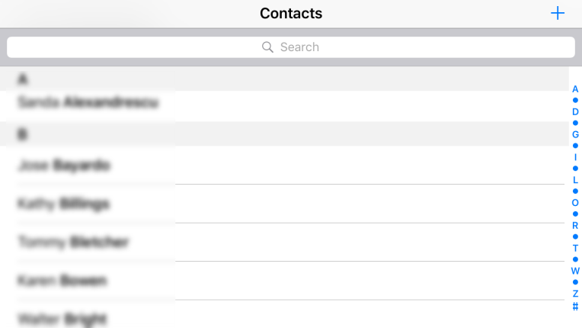
Deleting Multiple Contacts
Function not supported
Landscape not supported
Function not supported
Messages
Facetime
Contacts
Notes:
All images are from iOS 10. All software ships natively on iPhone.

Slide 35
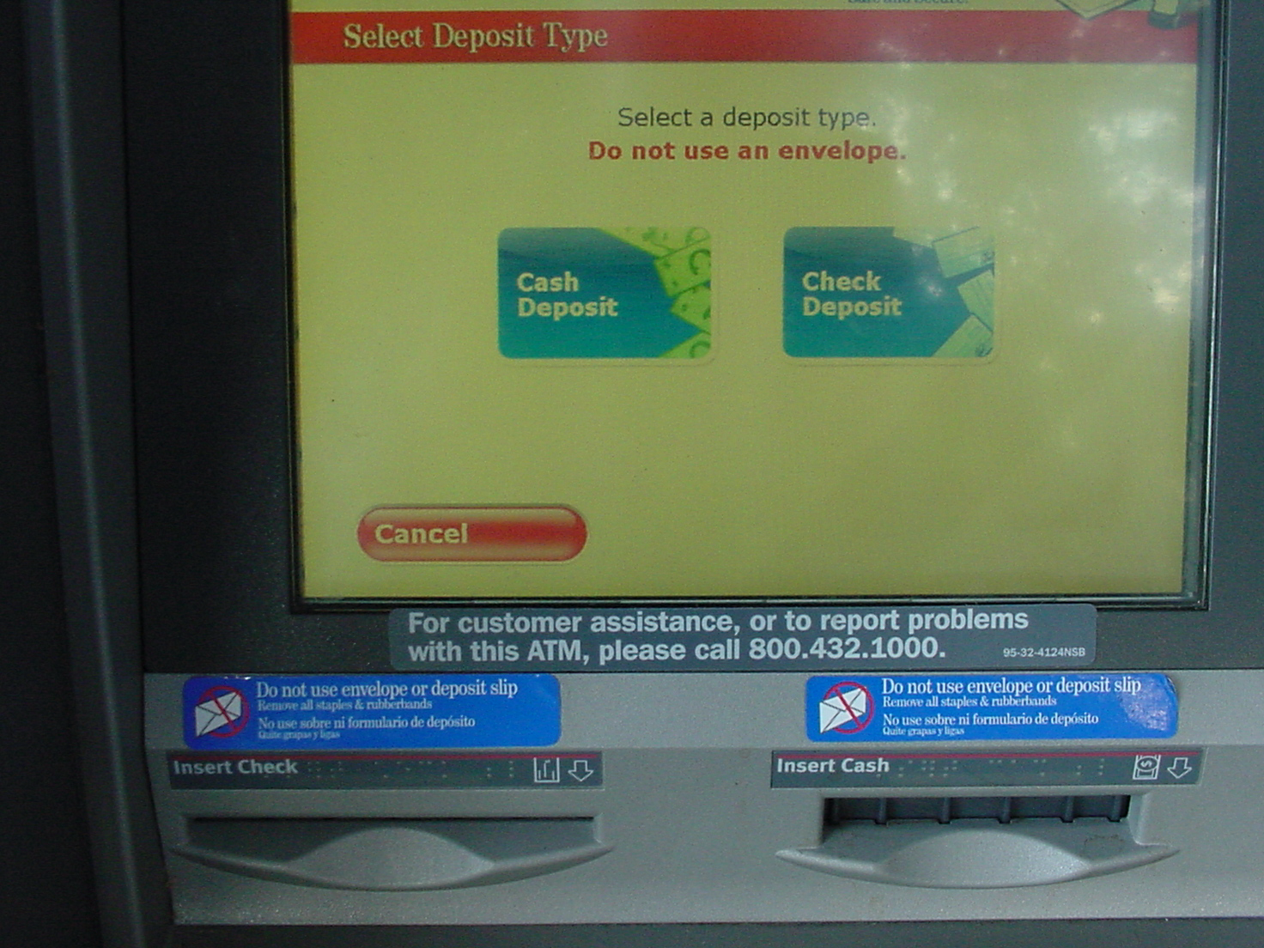
Software Teams vs. Hardware Teams
Notes:
Example and photo courtesy of Ed Strassberger.

Slide 36
Affects Programmers, Too
From the C standard library:
int fscanf(FILE * stream, const char * format, ...);
int fgetpos(FILE * stream, fpos_t * position);
int fseek(FILE * stream, long int offset, int origin);
char * fgets(char * str, int num, FILE * stream);
int fputc(int character, FILE * stream);
FILE * freopen(const char * filename, const char * mode, FILE * stream);
“This inconsistency has frustrated millions of developers for more than 30 years.”
--Ferenc Mihaly
Notes:
Quote source: http://theamiableapi.com/2011/09/14/api-design-best-practice-consistency/ . I took some liberties in reproducing it.

Slide 37
Affects Programmers, Too
From Java and its class library:
How many elements in a container?
array.length
string.length()
List.size()
From the .NET framework library:
How many elements in a container?
Array.Length
ArrayList.Count
Not just an IDE issue – it complicates reflection-based code, too.
Notes:
In .NET, Array can be accessed via the ICollection interface, in which case the Count property can be used on it, but if you know you have an Array, the convention is to use the Length property.

Slide 38

Can Infuriate at a Distance
A recurring experience:
Create account with password.
Confirm password.
Be directed to login page.
Be told password is incorrect.
pwd = pwd
pwd ≠ pwd
Notes:
The slide title refers to how inconsistency in one part of a system can lead to confusing behavior elsewhere.
Ask audience members to guess why this is happening. (Password during account creation isn’t truncated, but during normal login it is.)
Image source: https://pixabay.com/p-460868/

Slide 39
Interfaces

Slide 40

Notes:
Photo credit: https://www.flickr.com/photos/hsivonen/209931447/

Slide 41


Notes:
Goal: Meet the challenge of overcoming obstacles.
Photo credits: Left: http://tinyurl.com/k6jz5pz, Right: https://pixabay.com/p-1209310/

Slide 42
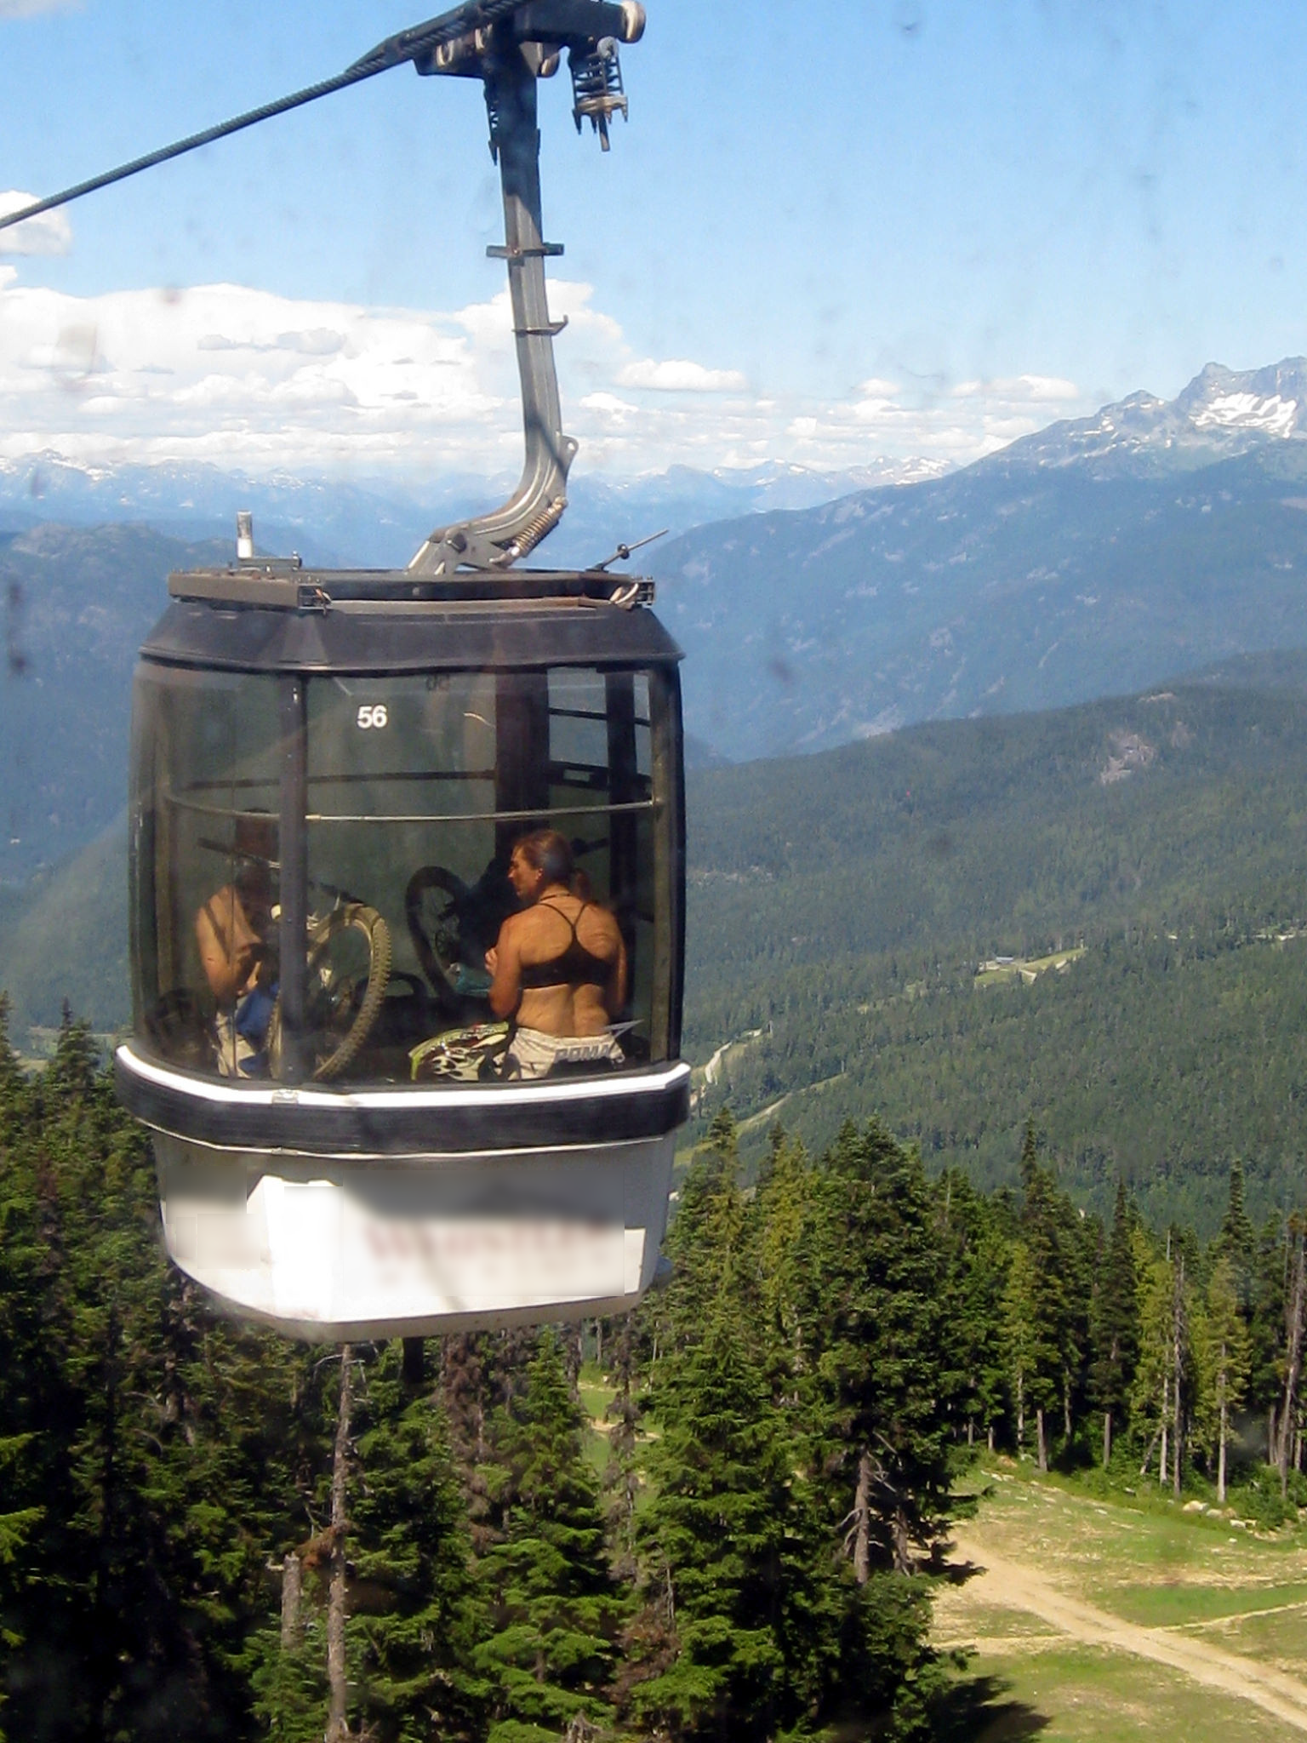

Notes:
Goal: Get the job done quickly with a minimum of fuss.
Photo credits: Left: http://tinyurl.com/lbrud63, Right: https://www.flickr.com/photos/flowcomm/14027538588/

Slide 43


My History
1971
2000
Now
Meet Challenge
Get it Done
Notes:
The “ride” portion looks small, but it’s still some 18 years.

Slide 44
Easy to Use Correctly and Hard to Use Incorrectly
Users typically smart and motivated:
Experienced with software.
Willing to read a little documentation.
Want to use your intefaces correctly.
If they don’t, it’s your fault.
Hence:
Action is possible ⇒ should almost always do what’s expected.
Action unlikely to do what’s expected ⇒ should generally be impossible.
Shoot for Rico Mariani’s “pit of success.”
Consistency!
Notes:
Here’s Rico Mariani’s “The Pit of Success” comment (from Framework Design Guidelines, Addison-Wesley, 2006, page 12):
“In stark contrast to a summit, a peak, or a journey across a desert to find victory through many trials and surprises, we want our customers to simply fall into winning practices by using our platform and frameworks. To the extent that we make it easy to get into trouble we fail. True productivity comes from being able to easily create great products—not from being able to easily create junk. Build a pit of success.”

Slide 45
“They’ll figure it out”
Notes:
“They’ll figure it out” may be okay for a interface or set of interfaces that themselves are generally consistent. It’s not okay as an excuse for gratuitous inconsistency.

Slide 46
Commitment

Slide 47

Insistence vs. Compromise
Notes:
Insistence encourages the development of solutions that don’t require compromises.
Image source: https://clipartfest.com/download/ab18fff14d35492ea0c2c5dd84fb409a2f47508f.html

Slide 48
Global Optimization
Efficient
Consistent
Good Interfaces
Efficient
Consistent
Good Interfaces
Efficient?
Consistent?
Good Interfaces?
Efficient
Consistent
Good Interfaces
Efficient
Consistent
Good Interfaces
Efficient
Consistent
Good Interfaces
Efficient
Consistent
Good Interfaces
System Parts
Complete System
Overall result is everybody’s responsibility.
Notes:
Assembling many locally optimized components need not yield a globally optimized system.

Slide 49
Efficiency/Speed
Portability
Toolability
Consistency
Interfaces
Commitment

