Slide 1


D Language Compiler as a Library
Razvan Nitu
University POLITEHNICA of Bucharest
razvan.nitu1305@gmail.com
DConf 2017
Berlin, May 4-7, 2017

Slide 2
Introduction
Language adoption depends on time-to-market metric
Development tools greatly decrease ttm
D lacks such tools
Compiler library encourages tool development

Slide 3
“The compiler is open source. Hack and slash the code you need”
~ Anonymous Compiler Developer Chuck Norris

Slide 4
The Old Fashioned Way : Example
Create tool to print all imports
Options:
  → mess with the compiler code
  → implement a visitor

Slide 5
Solution 1: Compiler Surgery
Search for the code
Add a print there
Inelegant
Time consuming

Slide 6
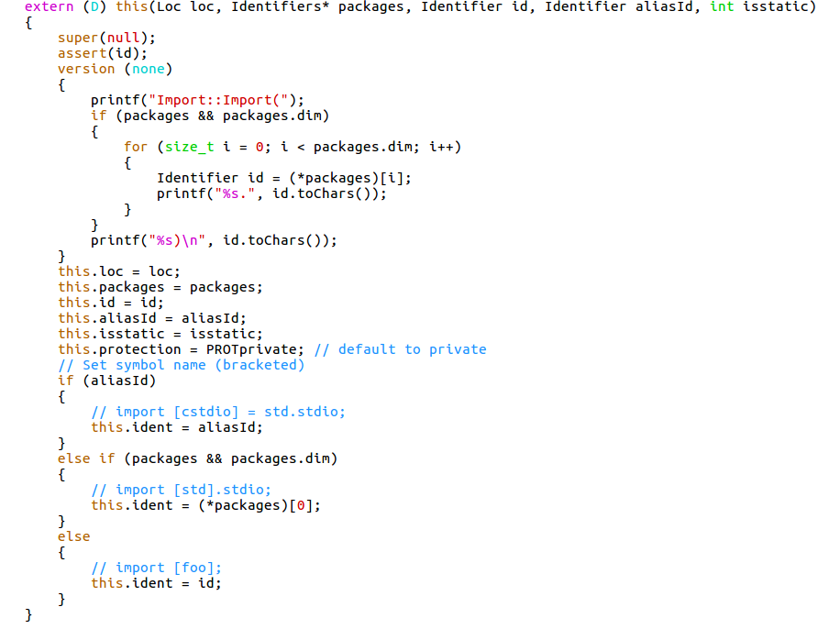

Slide 7
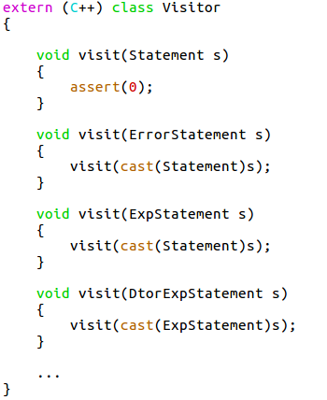
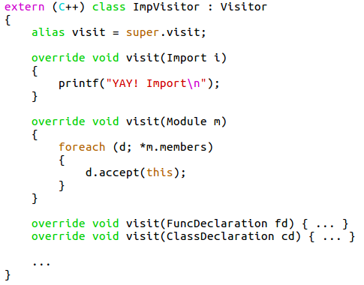
Solution 2: Implement a Visitor

Slide 8
Solution 2: Implement a Visitor
More elegant
A lot of overriding
Requires D AST organization knowledge

Slide 9
Bottom Line
Time consuming
In-depth knowledge
No Flexibility

Slide 10
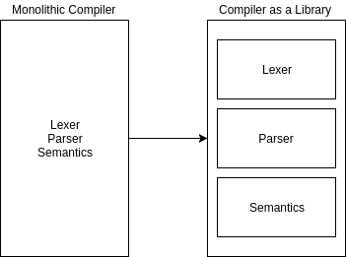
Compiler as a Library

Slide 11
Divide: Lexer
Conquer: get all lexer files and build them as a library
Scarce dependencies

Slide 12
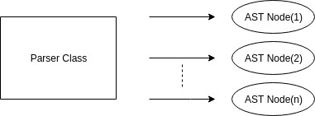
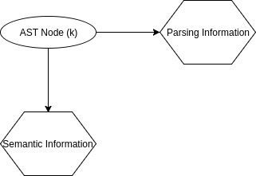
Divide: Parser

Slide 13
Divide: Parser
The Parser class depends on ~95% of the compiler front end code
Tightly coupled
How to break dependency?

Slide 14
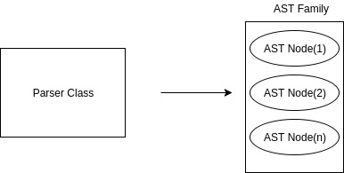
Templated Parser

Slide 15
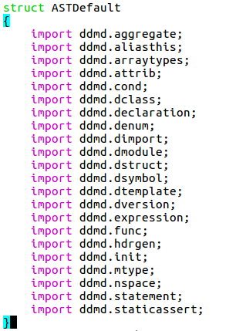
ASTDefault

Slide 16
Pros
Parser Independence
Non-disruptive change
Library and compiler share the same code
Flexibility

Slide 17
Cons

Slide 18
AST Families
ASTNull
  → ASTFamily that does nothing
  → serves as guidance for defining new AST families
ASTBase
  → AST family that stores parsing information

Slide 19
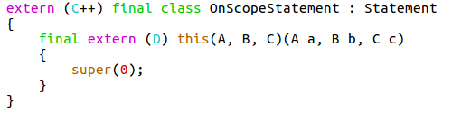
ASTNull
Struct that defines a null AST
No information is stored

Slide 20
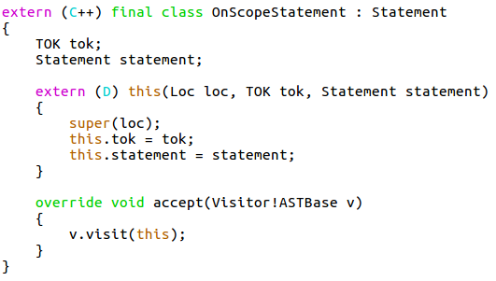
ASTBase
Struct that takes ASTNull further
Defines all functions and variables present in ASTNull and stores parsing information

Slide 21
Visitor Interface
Basic Visitor
Strict Visitor
Permissive Visitor
Transitive Visitor

Slide 22
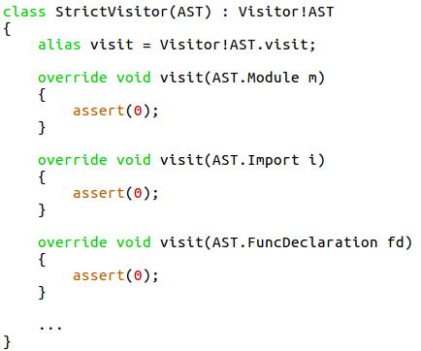
Strict Visitor

Slide 23
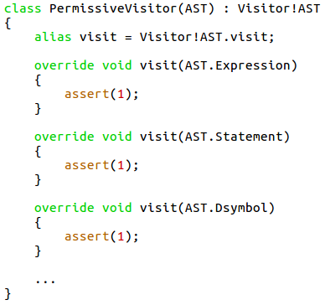
Permissive Visitor

Slide 24
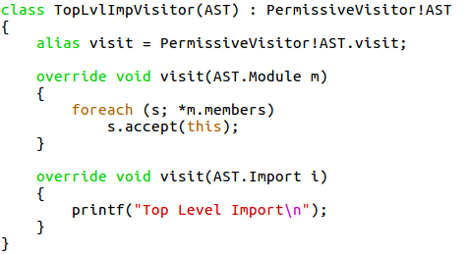
Permissive Visitor: Import Example

Slide 25
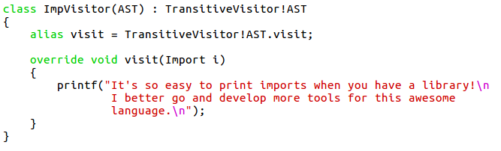
Transitive Visitor

Slide 26
Parser Competing Library
Libdparse
Visitor interface
Built from scratch
Uses phobos

Slide 27
Divide: Semantics
TODO

Slide 28
Current Status
Lexer Library
Parser Library
  → Transitive visitor – work in progress
Semantics – next step

Slide 29
Conclusions
Compiler library makes life easier for tool developers
The parsing library offers flexible visitor interface
We’re halfway there!
Creating a semantic library is going to be awesome

