Slide 1
D GTK
Gerald Nunn
http://www.gexperts.com

Slide 2
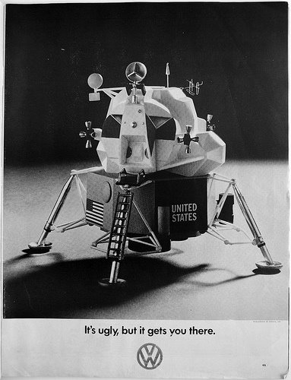
Notes:
Reference Mad Men and love of advertising tag lines, talk about how since you are in Germany you need to mention your favorite ad for the 1969 VW Beetle. Roll into how these slides aren’t pretty but “They’ll get us there”

Slide 3
Bias Check
Started with Borland’s Delphi building Desktop Apps in 90s
Switched to Java and Java Enterprise Edition in 2000
Some experience with Python for IT automation
Work for Red Hat as a Middleware Solution Architect
No formal involvement with GNOME or GTK
Biases
Prefer strongly and statically typed languages
Believe tooling is important
Spaces not Tabs :)
Started using D in late 2015
Notes:
Background is about understanding where I’m coming from and what my biases are when talking about languages
Most used weekend languages, D was #3 (https://medium.com/@hoffa/the-top-weekend-languages-according-to-githubs-code-6022ea2e33e8)

Slide 4
GTK+

Slide 5

What is GTK+?
A cross-platform GUI Toolkit for Linux, Windows and OSX
One of the two primary GUI toolkits for Linux
The toolkit used by the GNOME Desktop Environment
Primarily written in C with multiple language bindings
JavaScript
Python
C++
D
Rust
Vala
Pascal
Haskall
Go (partial)
etc...

Slide 6
GTK+, more than you ever wanted to know
GTK+ is based around the GLib Object System
Aka GObject
It is reference counted
GTK+ 3 is current stable version, GTK+ 4 in development
It uses an object oriented C API
Object state is represented by a class specific struct
Methods follow convention of {prefix}_{class}_{method}
gtk_widget_show
gtk_container_add
g_settings_set_boolean
Relies heavily on inheritance
GIR files available in XML containing GOBject introspection information

Slide 7
Writing a GTK+ App
The Usual Suspects…
… from Middle-Earth

Slide 8
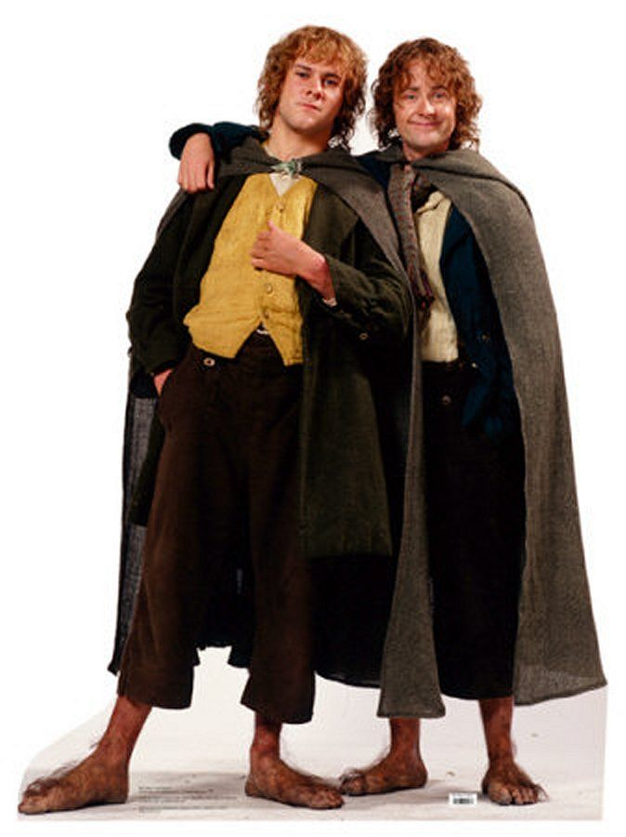
JavaScript
Gjs is the JavaScript binding for GNOME
Based on Mozilla SpiderMonkey
Used extensively in GNOME Shell
Pros | Cons
Large eco-system of tools and libraries | Dynamically and weakly typed language
Easy to learn | Gjs Not widely used outside of GNOME (Shell, Polari, Maps)
Memory usage on par with Python | Slow performance
 | Sub-optimal language design
Notes:
Hobbits - Quirky and under-estimated

Slide 9

Python
Very popular choice for writing GTK applications (Lollypop, Terminator, etc..)
PyGObject provides the GTK language bindings
Pros | Cons
Large eco-system of tools and libraries | Dynamically typed language
Widely used in GTK applications | Reasonably performant but not natively compiled
Highly productive and easy to learn | Whitespace as a delimiter
First class support for creating GObjects
Notes:
Sam Gamgee - Quietly getting shit done

Slide 10
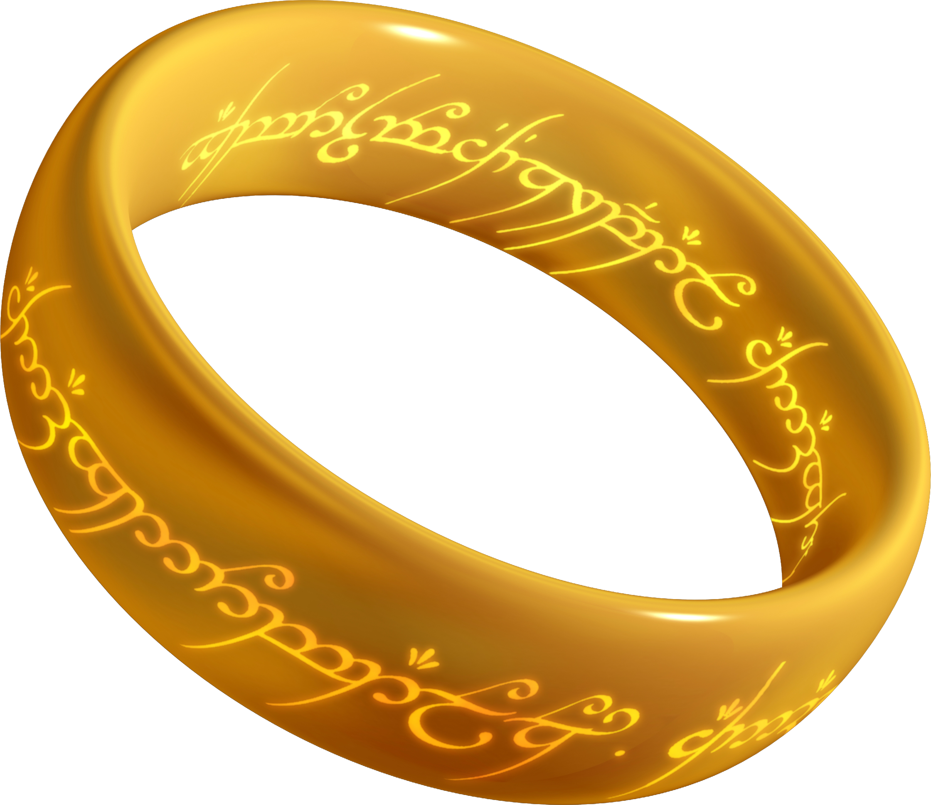
C
The lingua franca of GTK
No bindings required
Pros | Cons
Large eco-system of tools and libraries | Not as productive as alternatives
Very widely used in GTK applications | High learning curve
Native compilation, excellent performance | Inconsistent memory management
 | Unsafe
Notes:
The One Ring - Powerful but dangerous

Slide 11

C++
C but better..maybe..
Bindings provided by gtkmm
Pros | Cons
Large eco-system of tools and libraries | Not as productive as alternatives
Used in a number of GTK applications | Very high learning curve
Excellent performance | Very Slow compilation
First class support for creating GObjects | Safer than C but not perfect
Notes:
Frodo with One Ring: Still powerful, somewhat less dangerous

Slide 12
Vala
?
Language designed explicitly to support GObject and GTK+ development
Default language for Elementary OS
Pros | Cons
Easy to learn for people coming from C based languages | Not a general purpose language, single focus
Natively compiled, fast performance | Limited tool support
Memory management via RC | Cross-compilation to C can make debugging challenging
Highly productive with many abstractions available
Notes:
Undead - We’ll get to this

Slide 13
Writing a GTK App
The Up-and-Comers

Slide 14

Rust
New language from Mozilla
Built on concept of memory safety
GTK-RS is the binding library
Pros | Cons
Natively compiled, fast performance | High learning curve, borrow-checker semantics
Memory management and safety | Decent but not great tooling
Widely hyped language with rapidly growing base of tools | Few GTK applications using language
GNOME developers actively engaged | Slow compilation times
Excels at libraries and low-level use cases
Notes:
Eye of Sauron - It seems like it’s everywhere...

Slide 15

D
You already know the story...
Bindings provided by GtkD
Pros | Cons
Natively compiled, fast performance | Few GTK applications using language
Memory management via GC | Multiple compilers and ABIs
Fast compile times | Decent but not great tooling
Easy to learn particularly when coming from C family languages
Notes:
Gandalf the Grey - Darn Good but room for improvement (i.e. Gandalf the White)

Slide 16
GTK+ and D
The Argument for D

Slide 17
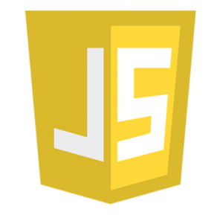



The Original Vala Use Case
The Sweet Spot...
Ease-Of-Use
Performance

Slide 18

However, Vala Has No Future (IMHO)
Few developers
Little development
No use outside of GTK+ Development

Slide 19
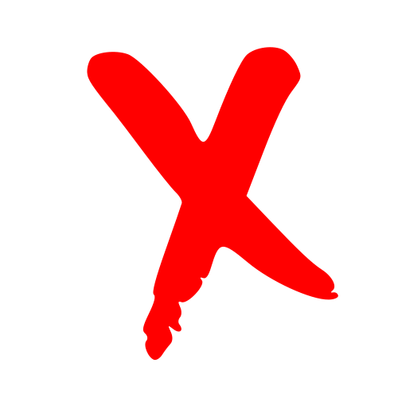
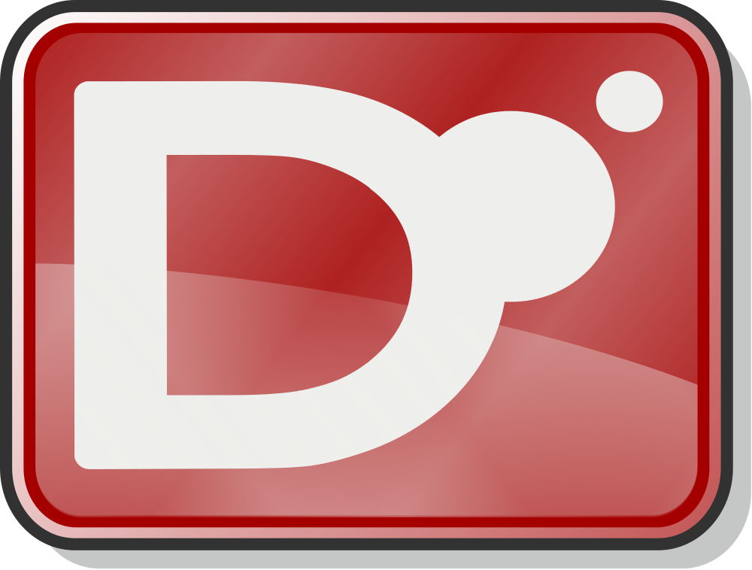
My Ideal Future...
The Sweet Spot...
Ease-Of-Use
Performance

Slide 20
Why D for GTK Applications?
GtkD advantages
Full coverage of GTK+ API plus more
Generated API based on GObject Introspection
High performance, fast compilation
Easy interfacing with C if you need to go low-level
CTFE potential as C Macros replacement
GC is productive for GUIs
Maintenance benefits of static typing
Easy transition for Vala developers
Notes:
(gstreamer, vte, peas, sourceview, rsvg…)

Slide 21
Why Not Rust?
High learning curve compared to D
Memory Safety is cool...
Is the benefit worth the cost?
Looks phenomenal when compared to C…
Less so compared to other modern languages
Dependencies on unsafe code
Great for Libraries and Low-Level Work

Slide 22
Success Story
Tilix Experience Report

Slide 23
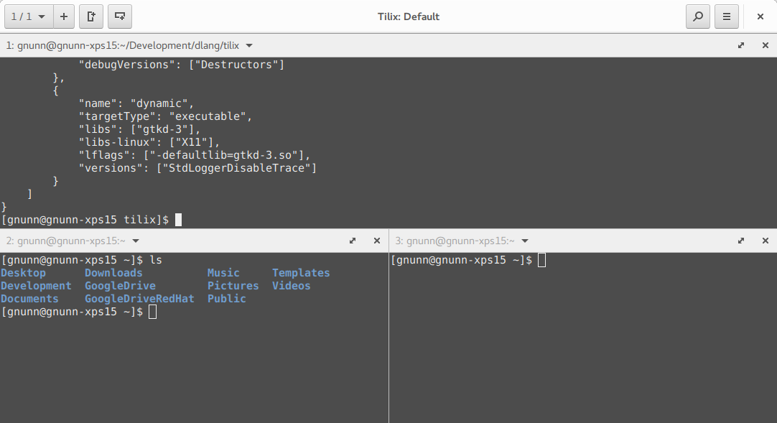
Tilix

Slide 24
Tilix - Fast Facts
Started in November 2015
Written in D using the GtkD bindings
Supports GTK+ 3.14 to 3.24
Complies with GNOME HIG
Is my second GTK+ program
Visual Grep was first, learning experience

Slide 25
Tilix Successes
Packages available for every major Linux Distro
Official packages for Debian
Official package for Fedora will be available in Fedora 26
Default Terminal for Ubuntu Budgie flavor
Localized in ~25 languages
Github:
74 Contributors
54 Releases
185 PRs
~ 700 issues, ~670 closed
~1300 stars, 72 forks
2nd most starred D Application on GitHub

Slide 26

Lessons Learned - The Good Stuff
GtkD bindings are mature
Linux packaging is hard, leave it to the experts
Distro specific bugs are unfortunately common…
… so be restrictive on what you support
GNU gettext works great using Vala as input language

Slide 27

Lessons Learned - Regrets
Should have made more effort up front to leverage unique D features
Check trademarks before choosing project name
Take the high road when interacting with users

Slide 28
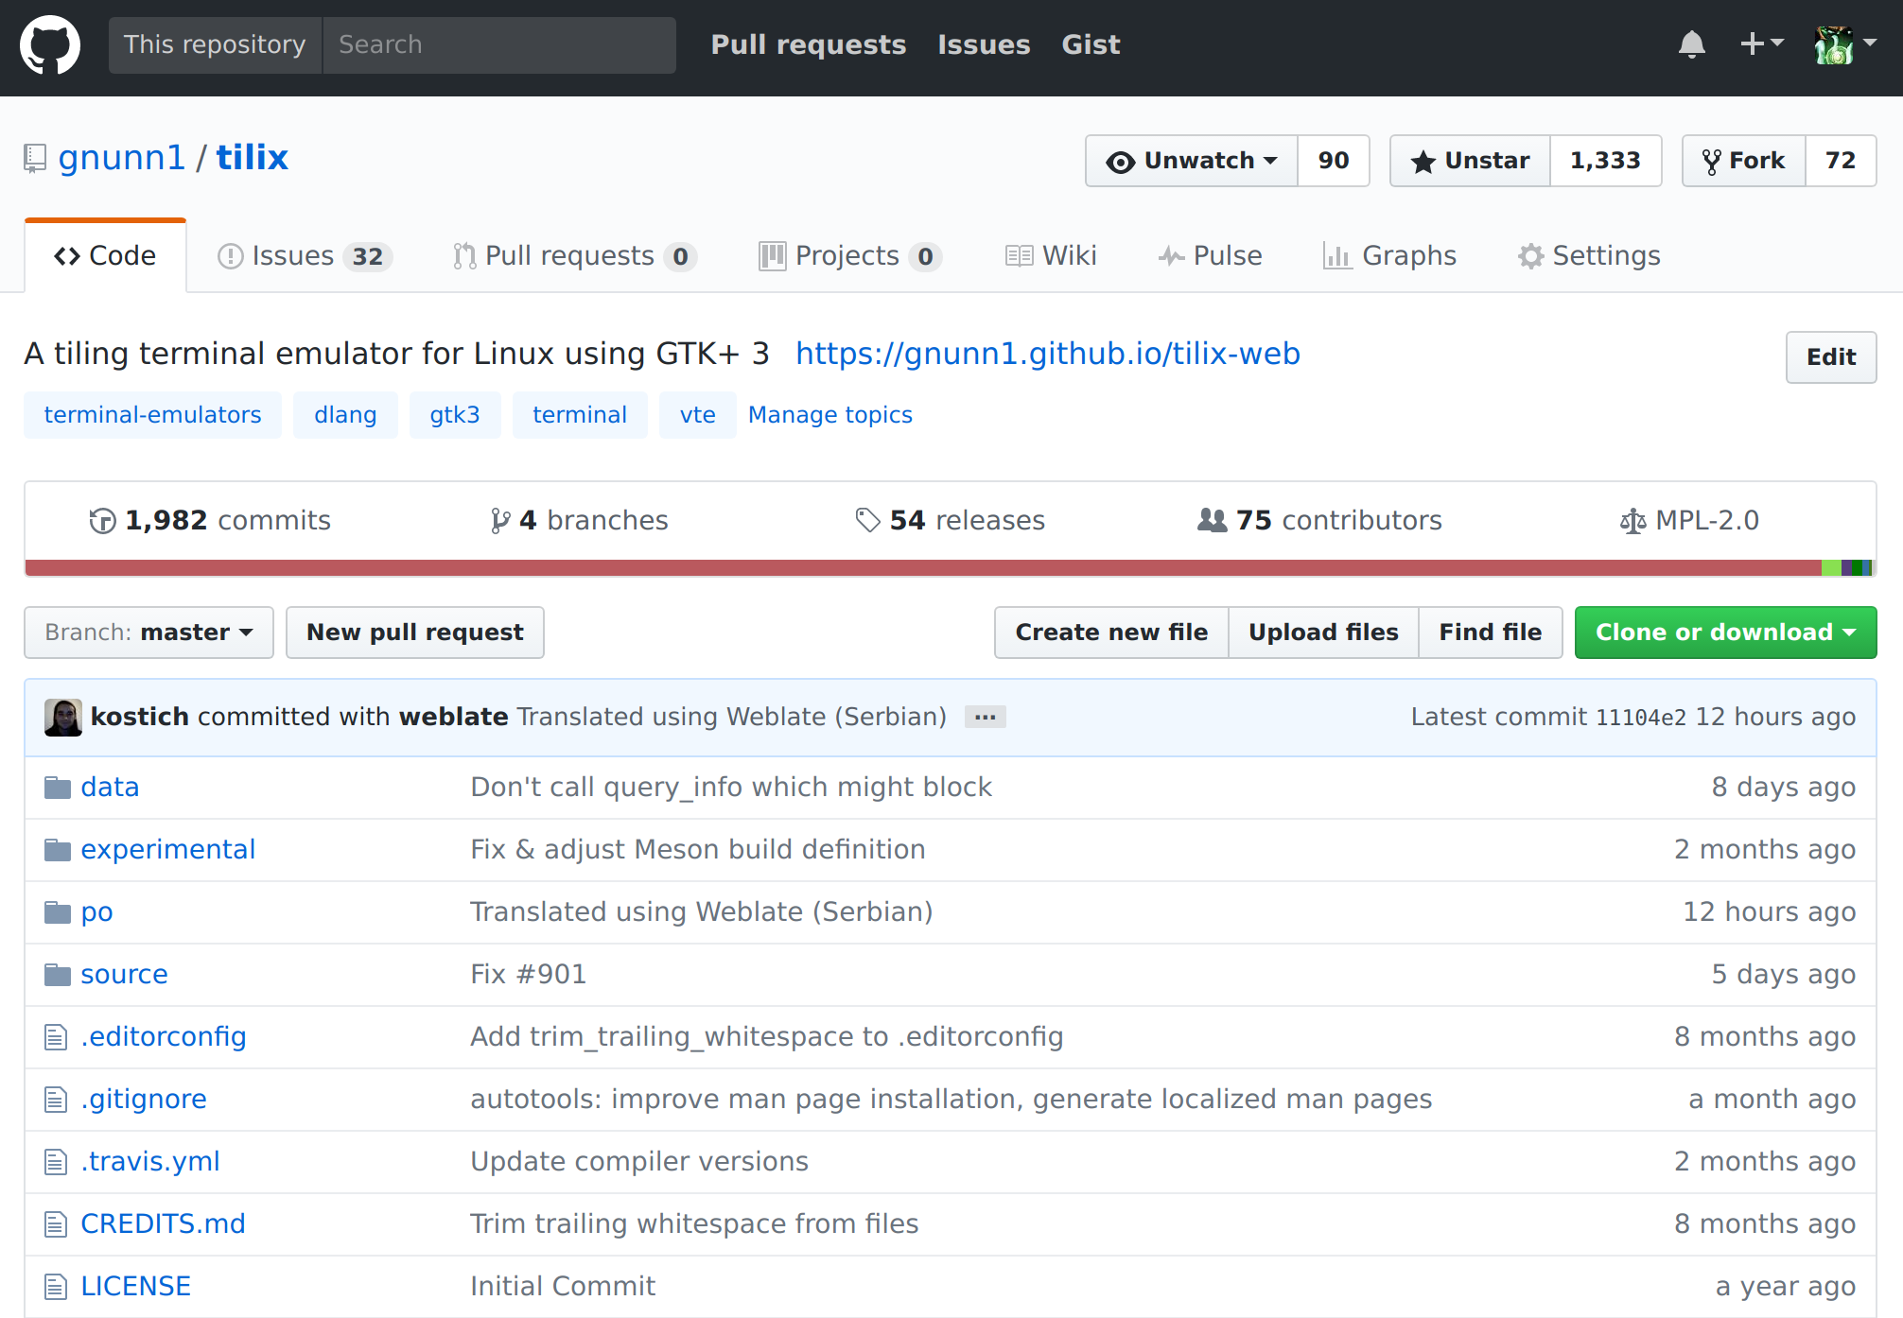
https://github.com/gnunn1/tilix

Slide 29
A Call To Action

Slide 30
What You Can Do
Write GTK+ Applications
More Apps = More Recognition
D & GTK Template App from GNOME Developer Carlos Soriano
https://gitlab.com/csoriano/GtkDApp
Contribute to GtkD Development
Create higher level API abstractions
Contribute To D Development
Improve Linux packaging for D Applications
https://gist.github.com/ximion/fe6264481319dd94c8308b1ea4e8207a

Slide 31
Questions?

Slide 32
Desktop Applications
Yes Matilda, Desktop Applications Are Still Relevant...

Slide 33
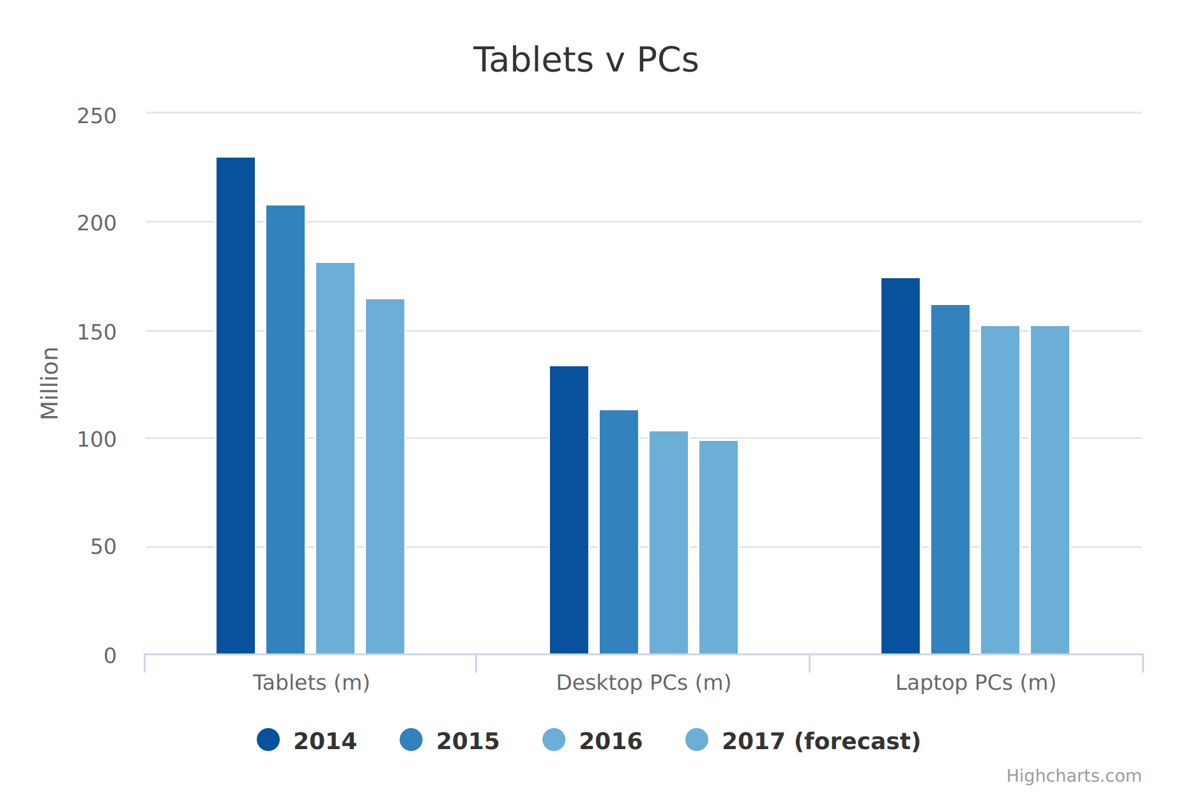
Desktop Applications - Still Relevant?
“There are three consumer devices that are leading tablets by a large margin: TVs, smartphones, and computers. It seems unlikely that the tablet will ever displace these devices.”
“What about tablets? People say they’re just as good a PC for making content. Sure they are, once you connect a keyboard and a mouse to them. Then guess what? That’s a PC too!”
“Well, it boils down to the reality that almost every piece of technology you use and much of the media content you consume, is designed and built on PCs.”
http://www.telegraph.co.uk/technology/2017/01/11/tablet-sales-fall-third-successive-year-pc-market-stabilises/amp/

Slide 34
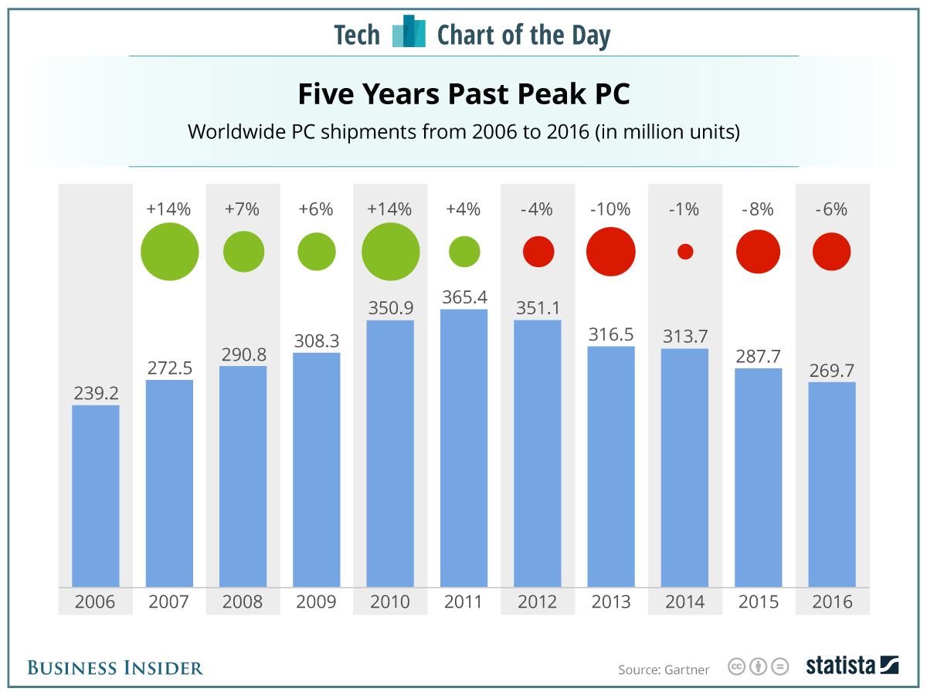
Desktop Applications
Down but not out....
Notes:
Yes market is shrinking but mitigating factors include:
People don’t replace PCs as often as they use to since performance improvements are much more incremental

Slide 35
Desktops Are Evolving
Convergence?
It's a desktop! It's a tablet!
The PC is evolving, not disappearing, analysts say
Content Creators Need More Power
Notes:
Desktops are changing but not disappearing
Move from tablets to “detachables”
Content Creators continue to need more power
Desktops extended to the cloud

Slide 36
Agenda
Bias Check
Desktop Applications, Not Dead Yet...
What is GTK?
Writing a GTK App
The Usual Suspects
The Up-and-Comers
D and GTK: The Perfect Match
Experience Report: Tilix

Slide 37
Tilix - Github Statistics
Commits | Almost 2000
Contributors | 74
Releases | 54
Issues | ~ 700 (~30 open)
Starred | 1316
Second most starred D language project on Github:
https://github.com/search?l=D&q=stars%3A%3E1&s=stars&type=Repositories
Notes:
Mention default terminal for Ubuntu Budgie distribution

Slide 38


Desktop Market Evolving
Software for Consumers
Software for Professionals
Notes:
TODO: Need to improve it, like graphics but doesn’t fully convey ideas
Talk about how consumer desktop market is fading, however applications for professionals and content creators will be kicking around for awhile.
Also talk about how desktop changes, whether it’s a laptop or a tablet that get’s plugged into a workstation, the desktop metaphor remains. Mentioning failed convergence attempts (Windows 8, Unity) may be worthwhile if time permits.

