Slide 1


A New Collections Framework for the Standard Library
Constantin Eduard Stăniloiu
University POLITEHNICA of Bucharest
eduard.c.staniloiu@gmail.com
DConf 2017
Berlin, May 4-7, 2017

Slide 2
Motivation
    Do you like
      Speed
      Safety
      Functional style
    Range API
    Integration with Phobos

Slide 3
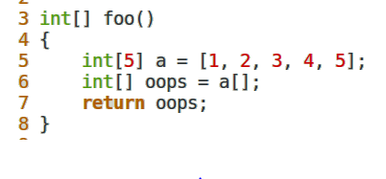
Not convinced?

Slide 4
Collection = Range + Optional Primitives
“There are no collections, only ranges”
    @nogc
    Own memory management
    Safe
    Qualified
“When in doubt, do what int[] does”

Slide 5
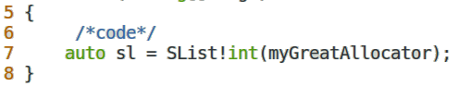
@nogc
  The allocator is not part of the type
    IAllocator
    ISharedAllocator
  Default to theAllocator or processAllocator

Slide 6

Own memory management
  Using reference counting
  AffixAllocator!(Mallocator, uint)
    fronts each allocation with an extra uint
    … that’s independently typed

Slide 7
Safety
Must be inferred from the contained type
Memory allocation is a safe operation
Deallocation is unsafe by definition, but RC makes it safe

Slide 8
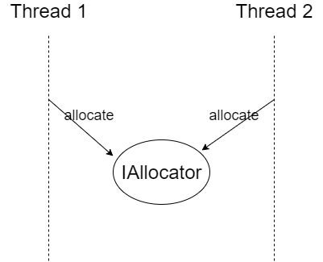
Qualifiers 1/3
Support const and immutable
ISharedAllocator

Slide 9

Qualifiers 2/3
Remember: do what int[] does
Need to store a mutating allocator in an immutable collection
  AffixAllocator anyone?

Slide 10
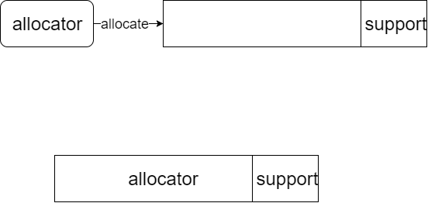
Qualifiers 3/3
Use an ouroboros allocator
prefix
Store in prefix
Must be reference counted

Slide 11
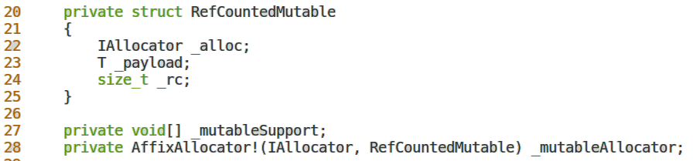
Mutable!T 1/2
Reference counted struct
Enables mutable T in immutable constructs

Slide 12
Mutable!T 2/2
Mutable!T | T
mutable | mutable
const | shared
immutable | shared
shared | shared

Slide 13
Primitives
  Range API
    empty, front, popFront
  tail
  insert, remove
  a ~ b, a ~= b, ++a[i], etc.
  isUnique
  get/setAllocator

Slide 14
Current status
  SList
  DList
  Array
  Hashtable

Slide 15
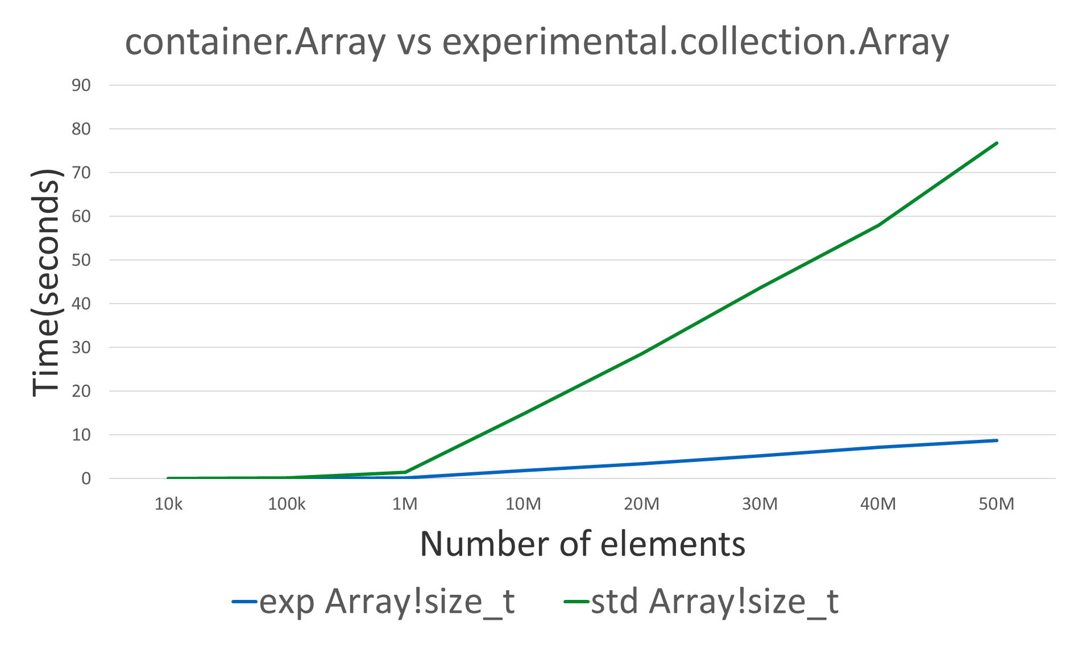
Benchmarking 1/2

Slide 16
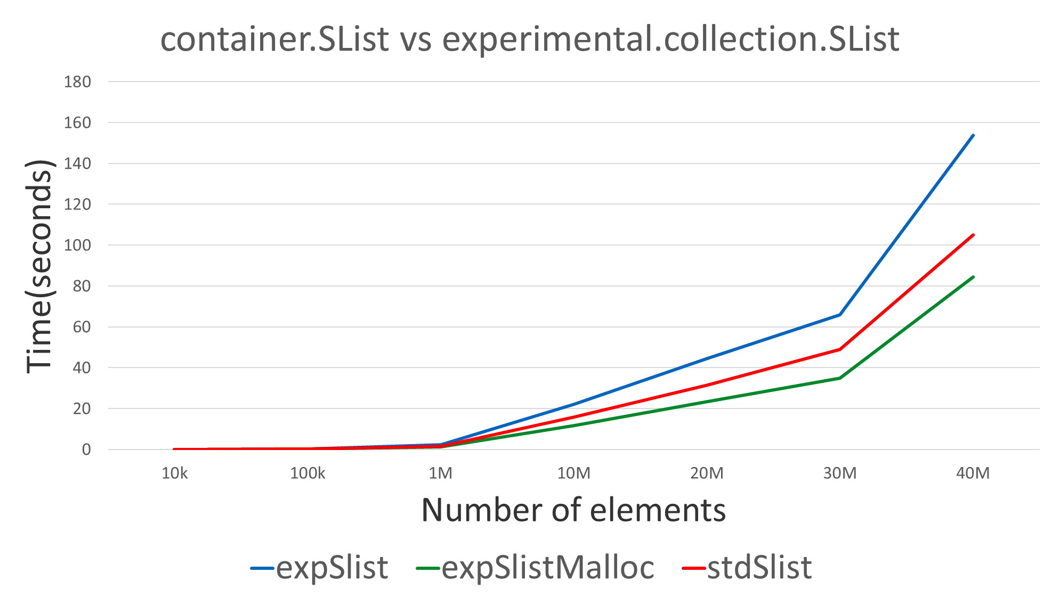
Benchmarking 2/2

Slide 17

Further work
Add more collections
Add shared collections
Composition scheme

Slide 18
Conclusions
A new collections framework that is
  Fast
  Safe
  @nogc
  Qualified

