Slide 1
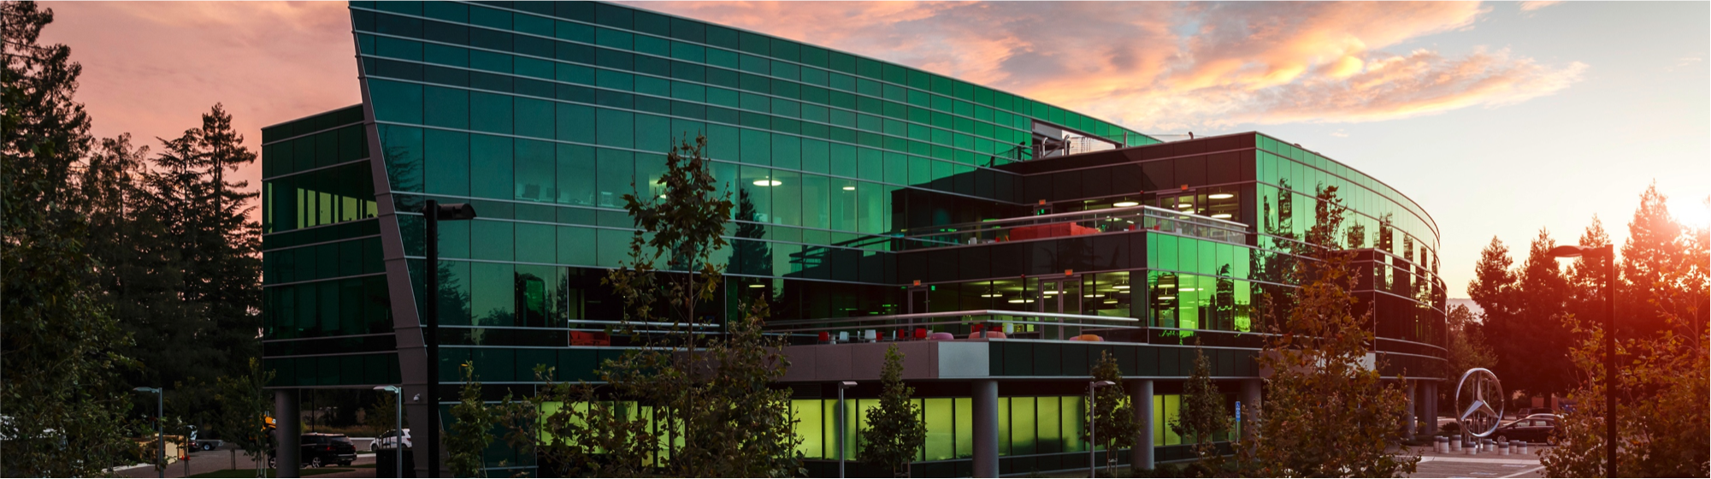
Using D for ROS Bag File Manipulation for Autonomous Driving
Ali Çehreli, DConf, May 10, 2019
For up to date imagery please refer to https://mapcms.e.corpintra.net/bmbds/en/dynamic/searchview.html?currentTab=asset&category=media

Slide 2
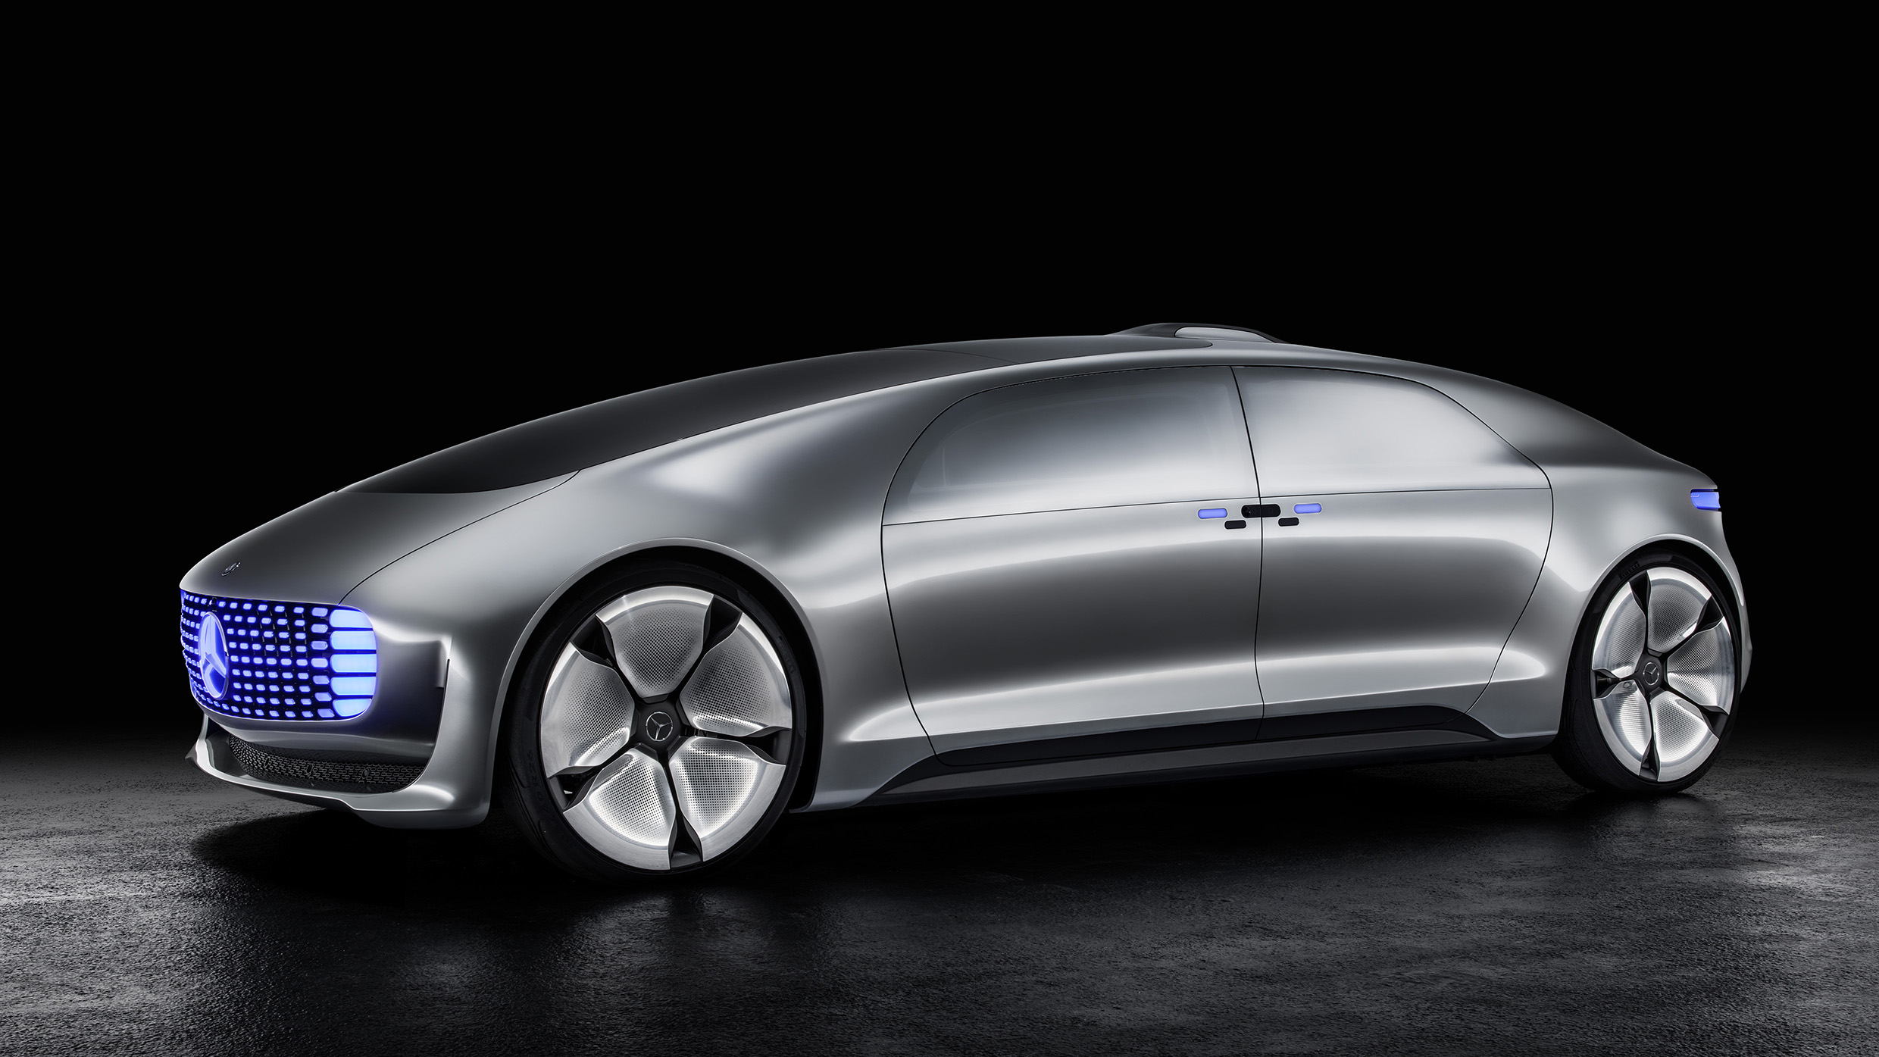
Autonomous Driving Project by Daimler and Bosch

Slide 3
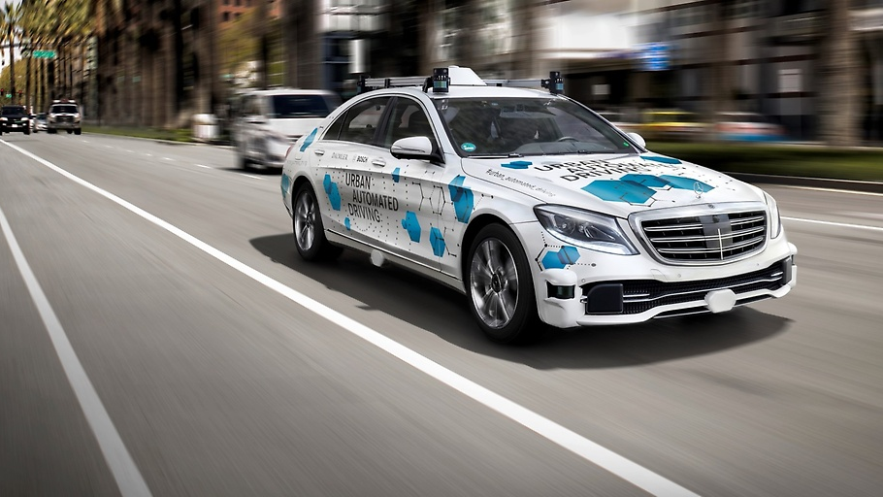
The Real Car is Headed to San Jose, California

Slide 4
We are Hiring
“We are not just about cars: we are also about
the latest and greatest software,
cutting-edge technology, and
groundbreaking innovation.”
https://mbrdna.com
Teams:
Advanced Exterior Design
Advanced User Experience Design
Autonomous Driving
Powertrain & eDrive
Artificial Intelligence & Digital Vehicle
Society & Customer Research Group
Testing & Regulatory Affairs

Slide 5
Content
Problem description
ROS
Bag files
Bag file migration
Solution
D code generation
Injected compilation errors
Purposeful Rambling

Slide 6
ROS: Robot Operating System
ros.org: “The Robot Operating System (ROS) is a set of software libraries and tools that help you build robot applications.”
Application level OS; more like a middleware
Features:
Manages building its applications
Starts and stops its applications
Handles message passing (publish+subscribe)
Records message streams as bag files for replay
…
Tools:
rviz
…

Slide 7
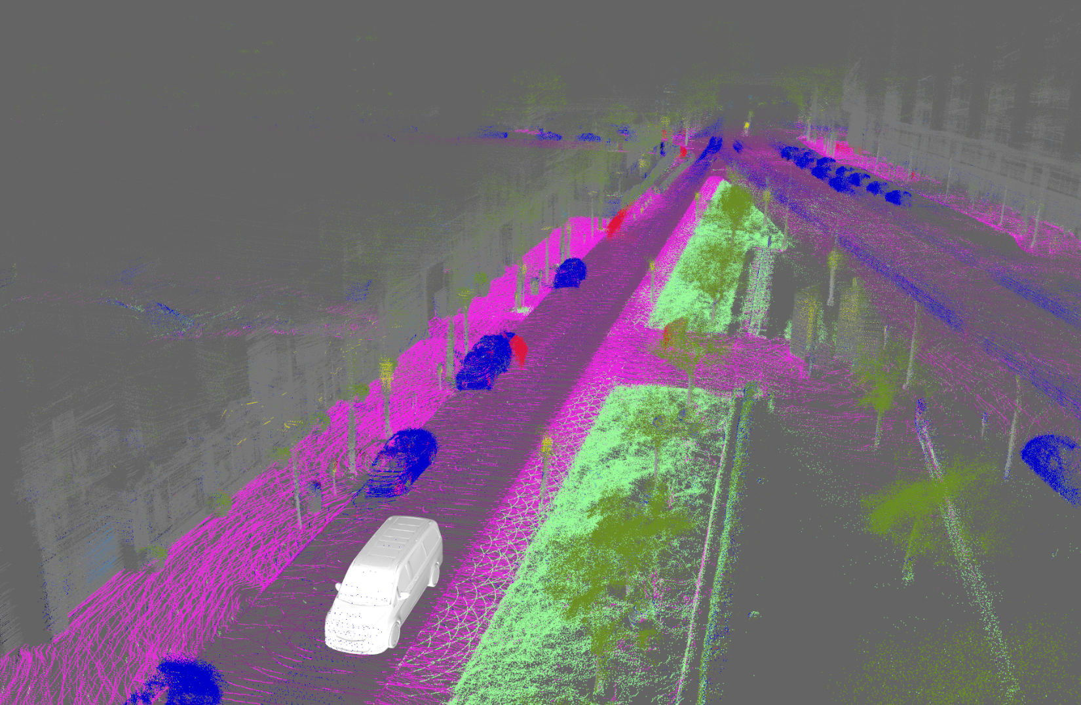
rviz: ROS Visualization Tool
3D point cloud; accumulated semantic lidar points

Slide 8
Functional Safety
Is top priority
Further reading:
ISO 26262: “Road vehicles – Functional safety”
Automotive Safety Integrity Levels: ASIL A, B, C, and D
Many aspects of an autonomous vehicle are ASIL D
ROS is not ASIL D certified
ROS is a research tool, not a part of the vehicle

Slide 9
ROS Bag File
ROS manages message passing
Saves communications in bag files
Connections (publishers)
Timestamped messages
... | Conn 1 | Msg 1 | ... | Msg 1 | ... | Conn 2 | Msg 2 | ... | Msg 1 | ... | Msg 2 | ...
 |  | 0101... |  | 0101... |  |  | 0101... |  | 0101... |  | 0101...

Slide 10
ROS Connection Records
id: 42
topic: /cool/topic
definition: Foo[] foos float32 f ======================= MSG: Foo Bar bar int32 i ======================= MSG: Bar int64 j

Slide 11
ROS Message Record
// Little-endian with 1-byte alignment
struct CoolTopic {
Foo[] foos;
float32 f;
}
struct Foo {
Bar bar;
int32 i;
}
struct Bar {
int64 j;
}
Connection id: 42
Timestamp: 12345.67
Data (binary): 010011000111…

Slide 12
Migration
Types often change during development:
struct Type1 {
int32 i;
}
struct Type1 {
int32 i;
int32 j;
}
So, existing bag files need “migration”:
... | Conn 1 | Msg 1 | ... | Msg 1 | ... | Conn 2 | Msg 2 | ... | Msg 1 | ... | Msg 2 | ...
 |  | 0101... |  | 0101... |  |  | 0101... |  | 0101... |  | 0101...
j
j
j

Slide 13
Migration rules
Version A, B, C of type Foo throughout development:
A
B
C
int32 a
int32 a
float32 x
int32[7] a
float32 x
rule A to B:
to.a = from.a
to.x = 1.5
rule B to C:
to.a = from.a.repeat(7)
to.x = from.x

Slide 14
Existing Migration Solutions
Open source Python solution
Generates migration rule files (.bmr)
Developer edits the file
Confirms with valid = True
Limitation with “latched” topics
In-house C++ solution
Both old and new types must be available
Separate program for each rule

Slide 15
D Solution
Statically typed solution inspired by the .bmr solution:
Statically typed rule generation in D
Developer edits the rule file
Confirms by removing compilation errors: i = ?;
migrator program knows all rules
Bag files are updated automatically by applying rules as necessary

Slide 16
Acceptance
The tool was written as a side project
“Invest your own time.”
News traveled by word of mouth
A team new to the project was assigned to solve the problem
Compared existing solutions
D solution worked better
Mostly, migration rules involve simple assignment; not different from most languages

Slide 17
No arguing
There was no “arguing” for D
D was pushed mostly by colleagues
“Write tools that work and they will come.”
“I love it!”
“It seems a good idea to make a cut and introduce a new language, instead of adding more and more to C++.”

Slide 18
Using Existing Tools vs Writing Your Own
Homegrown tool is definitely buggier
Can be solved by open sourcing (we will likely do that)
We are the experts of this homegrown tool
We are now experts on ROS bag files as well
Serendipity: The code base supported yet another tool to cover yet another problem
Several minute jobs → Split second jobs
The D solution is likely to remain as the basis for all bag file needs

Slide 19
Design and Workflow
1) Rule generation
Build time
3) Migrate
as needed
Known .msg files
Modified .msg file
Existing bag
2) migrator generation
Diff and
generate D code
by rulegen
New rule file with COMP. ERROR
Build migrator by compiling and linking with rule files
migrator
Known rule files
Migrated bag

Slide 20
Generated rule structs
struct MessageA_FROM {
int32 i;
// ...
}
struct MessageA_TO {
int32 i;
float64 d; ⬅ NEW FIELD
// ...
}

Slide 21
Generated update() function
struct MessageA_TO {
int32 i;
float64 d;
void update(ref const(MessageA_FROM) from, const(string) topic) {
i = from.i;
d = ?; ⬅ GENERATED COMPILATION ERROR
}
}
The task of the developer is to remove the compilation errors. Examples:
d = 0;
d = from.i * 0.5;
d = topic.length * 7.5;

Slide 22
Helpful code generation
Scalar:
i = ?;
New dynamic arrays:
new_arr.length = ?;
foreach (size_t i, ref elem; new_arr) {
elem = ?;
}
Existing arrays with different element types (static array in this example):
foreach (size_t i, ref elem; existing_arr) {
// elem = from.existing_arr[i];
elem = ?;
}

Slide 23

D Experience Report

Slide 24
The Code
D ROS bag file API (an addition to C++ and Python APIs)
rulegen
migrator
aligner (the serendipitous one)
The only external dependency: cmake-d
cloc’s output:
-------------------------------------------------------------------------------
Language files blank comment code
-------------------------------------------------------------------------------
D 25 1106 700 4596

Slide 25
Fun and Rewarding
This has been a fun project:
Programming is fun
D is fun
Solving others’ problems is rewarding
Being appreciated is rewarding
Soap box moment:
“Programming is about people”; everything is about people
Steve Jobs – “… you can build your own things that other people can use”

Slide 26
Plasticity
D is single language for
Prototyping
Production

Slide 27
The code is not optimized yet
The problem is I/O bound: Reads and writes1G - 10T files
No obvious pessimizations in the code
Garbage collector is used for advantage
Premature optimization caused some bugs

Slide 28
Casting bytes at the lowest level
T bytesAs(T)(const(ubyte)[] bytes)
if (!isSomeString!T)
in (bytes.length == T.sizeof)
{
return *cast(T*)bytes.ptr;
}

Slide 29
Ensure little-endianness
import std.system;
const endianMessage = "This program requires a little endian system";
static assert (endian == Endian.littleEndian, endianMessage);
static this() {
enforce(endian == Endian.littleEndian, endianMessage);
}

Slide 30
Nested functions
Very useful; DRY
Late Norm Hardy of the capability-based OS fame: “Does D have nested functions? Good!”

Slide 31
UDAs to identify ROS records
Used when parsing bag files.
@(BagRecord(OpCode.header))
struct Header {
// ...
}

Slide 32
Boilerplate
struct Foo {
// ...
int opCmp(typeof(this) that) const {
return tuple(this.tupleof).opCmp(tuple(that.tupleof));
}
}
Yes, needs mixin

Slide 33
Code inspection
static if (hasMember!(To, "update") &&
isFunction!(To.update)) {
to.update(from, *topic);
}

Slide 34
Code correctness
Number of times certain features appear.
unittest: 19 (could be way more)
Contracts
invariant: 1
in: 24
out: 11
static assert: 7
assert: 112
enforce: 56

Slide 35
Error handling
We take it for granted…
Exceptions are very useful
Passing error codes is
Tedious
Tried and wrong
Error prone
try and catch:
4 at top level in main functions
4 to translate errors (e.g. from ConvException)

Slide 36
Bounds checking
Safety for the win
Reduced many manual checks

Slide 37
Loops (bugs?)
static foreach: 4
foreach: 97
for: 1
.map: 37
.each: 11

Slide 38
The for loop
Was introduced when I thought I needed 2 loop variables. (Probably a little known feature.)
for ( { int i; double d; } i != 3; ++i) {
// ...
}
A colleague -- “I had a brain stack overflow.”
Linked data structure in an associative array:
for (Rule * rule = (head in rules); rule !is null; rule = (rule.next in rules)) {
// ...
}

Slide 39
The run-time-checked format string is a “bug”
format(“Hello %s. Today is %s.”, name, day) // BUG
Checked at run time
Often on the less-tested error path

Slide 40
The format string, “bug fix”
Checked at compile time. GREAT!
format!“Hello %s. Today is %s.”(name, day) // NOT GOOD ENOUGH

Slide 41
Should be: Interpolated strings
// D’OH, OBVIOUSLY, NATURALLY, EXPECTED, DESIRED
format!“Hello %{name}. Today is %{day}.”

Slide 42
Formatted string counts
format: 182
writefln: 54
writef: 5

Slide 43
Format string gotcha
Wrong:
format!“Hello %s.” ~
“ Today is %s.”(name, day)
Correct:
format!(“Hello %s.” ~
“ Today is %s.”)(name, day)

Slide 44
A memorable bug
foreach (elem; arr) {
elem.mutate();
}
ref was missing ☹

Slide 45
struct vs class
struct: 95
interface: 1
class: 2

Slide 46
Multiple dispatch
// Used as a part of a poor man's multiple dispatch table (and virtual functions)
struct AttentionStringGenerator {
alias Predicate = bool function(const(Foo) field);
alias Generator = string function(const(Foo) field);
Predicate doesMatch; // The prediate that is evaluated do pick this generator
Generator generator; // The code generator to use
}
// NOTE: Element order of this array is significant.
static AttentionStringGenerator[] attentionStringGenerators = [
// Any array to static array
// ...
// Any array to dynamic array
// ...
// Catch all
// ...
];
See Jean-Louis Leroy’s “open methods” instead.

Slide 47
dub
Just works; great!
Not usable because writes to source directory
Moved to cmake-d instead

Slide 48
opDispatch for fun
struct BiMap(A, string keyA, B, string keyB) {
A[B] as;
B[A] bs;
// ...
auto opDispatch(string op)(A a) inout
if (op == keyB ~ "For") {
return bs[a];
}
}
unittest {
auto bi = BiMap!(int, "number", string, "name")();
bi.add(42, “mary”);
assert(bi[42] == “mary”);
assert(bi[“mary”] == 42);
assert(bi.nameFor(42) == “mary”);
assert(bi.numberFor(“mary”) == 42);
}

Slide 49
Progress bar fun
Unicode art for more granular progress bar:
enum whole = "▉"; // 8-bit block
enum dstring partials = " ▏▎▍▍▋▊▉"; // 0-bit to 7-bit blocks
struct ProgressBar {
// ...
}
// Does not start printing a progress bar until patience is over
struct PatientProgressBar {
ProgressBar bar;
// ...
}

Slide 50
Command line fun
Usual:
$ mytool -i foo -i bar ...
Alternative:
$ mytool -i @my_file
my_file contents (with recursive @ expansion):
foo
bar
@your_file
...

Slide 51
Setting a field lazily
Missed mutable
Had to make a member function non-const
Had to pass containers of the type as non-const

Slide 52
std.json
Can be better

Slide 53
Stonewalling moment
private: 0

Slide 54
The End

