Slide 1

Metaprogramming in D
Making programming fun again
(Credit to Meiz for all the DMen)
Notes:
Metaprogramming in D

Slide 2

D has a plethora of metaprogramming features
  Static if
  Static foreach
  Templates
    Eponymous templates
  Mixins
    String mixins
    Template mixins
  __traits
  CTFE
  UDAs
  …
Notes:
D has a plethora of metaprogramming features, which allows it to perform quite amazing feats.
Some of the features include:
* static if for conditionally compiling code
* static foreach for generating or unrolling code
* templates to make types and functions generic
* eponymous functions to make templates even more powerful
* mixins to dynamically create code at compile time
* __traits to learn valuable information from the compiler itself
* CTFE, or Compile Time Function Execution, to run D code at compile time
* UDAs, or User Defined Attributes, to add the ability to customise behaviour in a fluent way
I only have 30 minutes, so I can’t go very in depth or cover much ground, so I’ll try my best.

Slide 3

Write code that can use other code
In this video I’ll try to cover most of D’s compile time features, while also providing example usages of them. Hopefully this will help you see why D’s metaprogramming is mostly unrivaled.
Though sometimes…
Notes:
The biggest part of D’s metaprogramming is that it let’s you write code that uses other code, and write code that writes its own code for you.
In these 30 minutes…
Though sometimes, it’s not all fun and games…

Slide 4
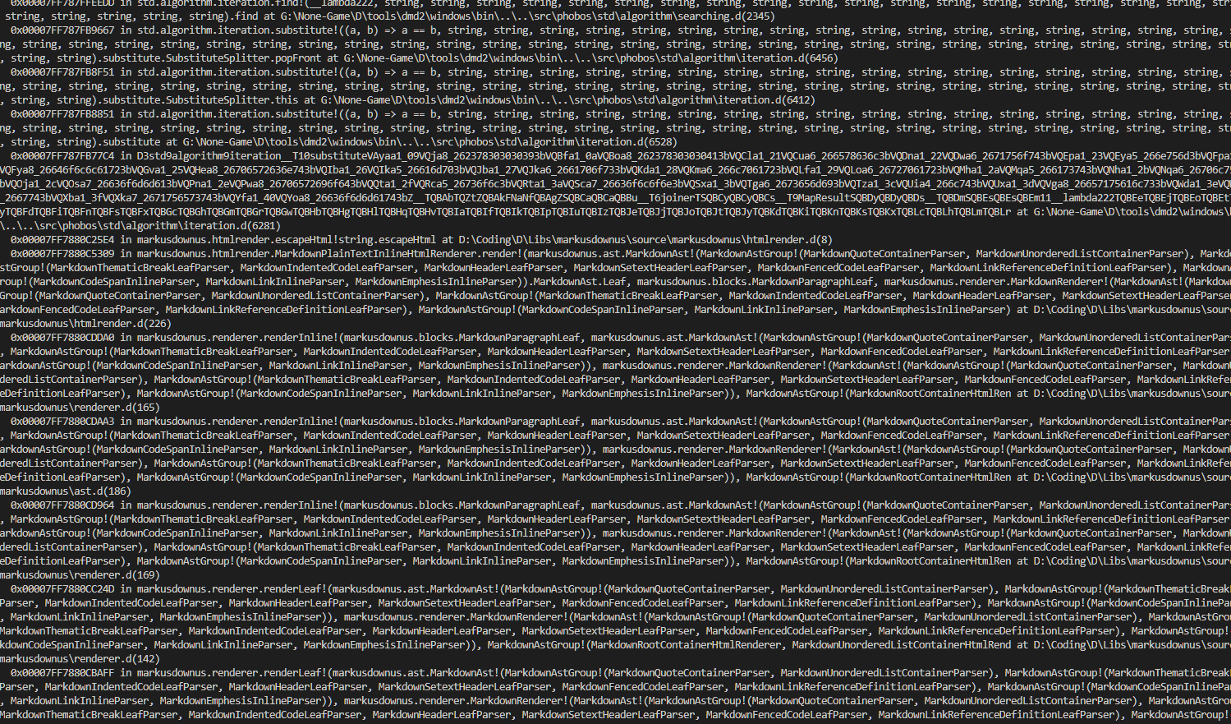

Notes:
Yikes, I’ve angered the template demon itself.

Slide 5
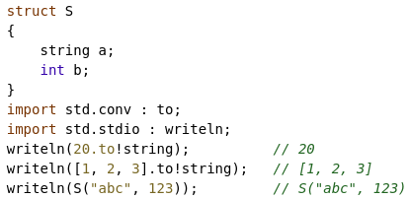
Starting off with std.conv.to
A very commonly used function is std.conv.to, a set of templated functions used to convert types into other types.
In some languages, the mere thought of automatically formatting things like structs and arrays into strings is nightmare fuel.
In D however, it's actually very straightforward.
So let's use std.conv.to to learn more about D's metaprogramming.

Slide 6
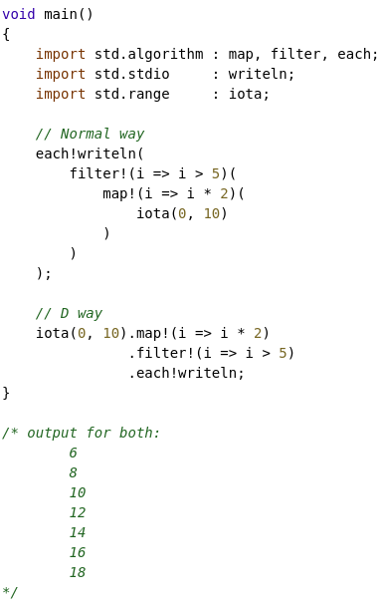
Component #0 - UFCS
Uniform Function Call Syntax allows us to call free-standing functions as if they were member functions.
As you can see on the left, we have the “normal” way where we nest successive function calls together in order to create our “pipeline”.
We then have the D way where we can chain functions calls together using UFCS which looks a lot more natural; easier to read, and most importantly: easier to make changes to.
Both pieces of code are equivalent in function, but not in maintainability.
Just to make sure it's clear, UFCS allows one to write:
func(a, b, c)
As:
a.func(b, c)

Slide 7
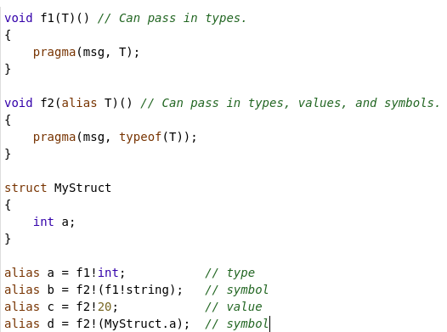
Component #1 – Templated functions
A templated function can take any number of template parameters.
Template parameters are defined using the second set of parenthesis.
Template parameters can either be a type parameter, or an alias parameter.
Alias parameters are more flexible as they support a wider variety of values.
You can see on the left that the f2 function can support a lot of interesting things being passed into it.
Honestly, you can pass pretty much anything into an alias parameter, including member symbols, modules, etc...
We still need to be able to filter which code is run based on the template parameter though, so...

Slide 8
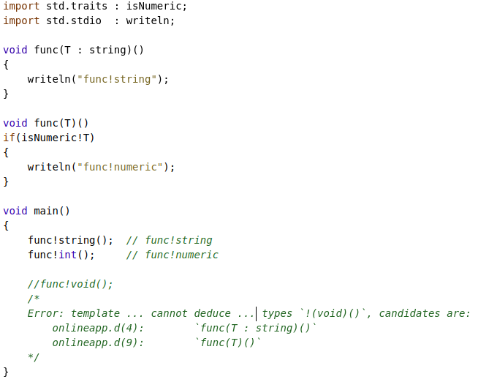
Component #2 – Template specialisations
We can attach constraints onto parameters, or onto the entire function, to control which specialisation the compiler will choose for any set of template params.
For the first specialisation we use the “is implicitly convertable” constraint directly on the `T` parameter, so it can only be used with strings.
For the second specialisation we use a function constraint to ensure that `T` is a numeric type.
As can be seen with `func!void`, if the compiler can't figure out which function to use it'll error out.
The compiler will also error out if there's more than one specialisation that could match.
This behaviour is very similar to normal function overloading.
We can now make a start on our own `to` function.

Slide 9
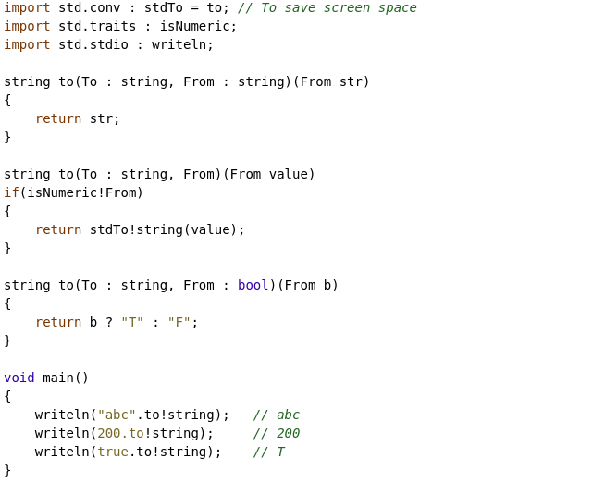
Basic start to our `to` function
Nothing really new here, except that it's easy to see the compiler's ability to infer template arguments.
When we instantiate one of the `to` template specialisations, we only need to specify what the `To` parameter is. We don't have to explicitly specify `From` because the compiler can figure it out (infer it) for us.
While converting primitive types like this is fine and dandy, we're going to want to also include arrays and structs.
Let's start off with arrays, since we've already covered everything we need to implement them.

Slide 10
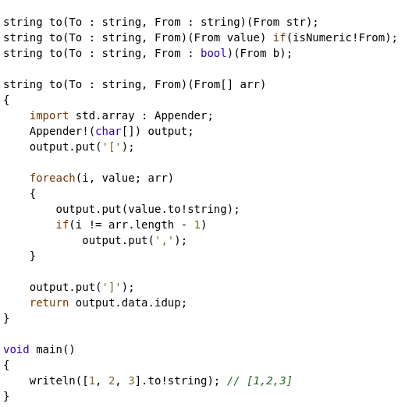

Component #3 – Expression Decomposition
The main thing to note here is: notice we specify a `From[]`, but we still don't have to specify what `From` is.
This is because the D compiler can still infer and decompose complex expressions like this, which is pretty awesome!
An alternative signature could look something like:
Which would still allow us to pass arrays, but the `From` parameter is now the array type instead of the value type.
e.g. It would be `string[]` instead of just `string`.
Moving on, let's learn about a few more features before implementing struct → string.

Slide 11
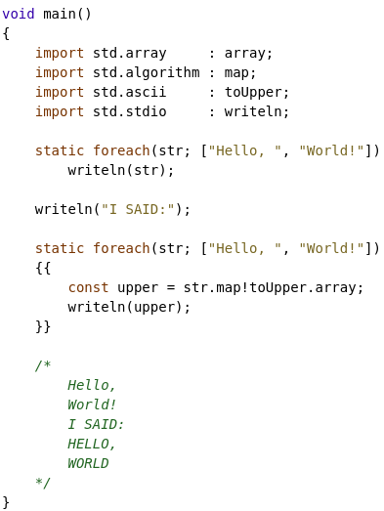
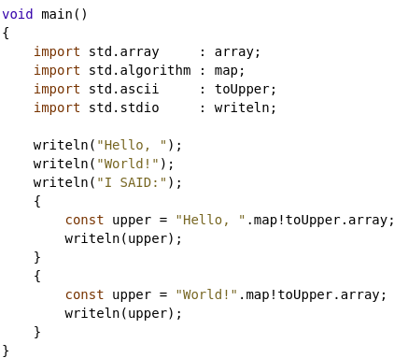
Component #4 – static foreach
Static foreach is a compile time foreach that duplicates its body for every iteration.
On the left, you see the original code.
On the right you see the unrolled version of the code.
Notice that for the second foreach we use double brackets to create a new scope, this allows us to create variables without conflict. Static foreach doesn't create a new scope by default.
The benefits may not be immediately obvious yet.

Slide 12
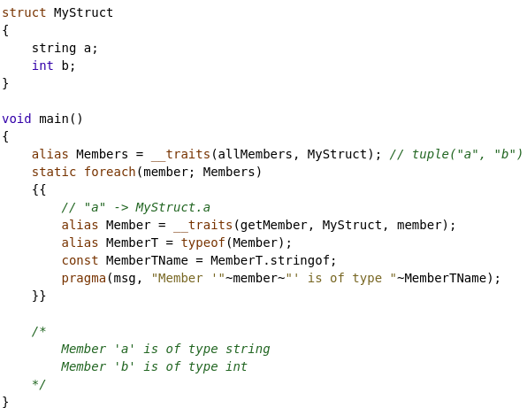
Component #5 - __traits
__traits is a special function that allows the compiler to inject special data into our code.
In this example we use the following traits:
allMembers – Provides a tuple of strings representing all the members of a symbol.
getMember – Given a string, returns an alias to the member of a symbol that has the same name as the given string.
D's metaprogramming is essentially lego – there are a bunch of building blocks that you can slot together to create something awesome.
Here, we combine `static foreach` with `__traits(allMembers)` which allows us to enumerate over the types of a symbol, at compile time, and gather as much information as we want about the symbol and its members.

Slide 13
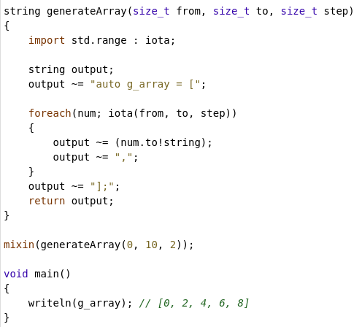
Components #6 & #7 -
Compile Time Function Execution & String Mixins
D is actually capable of running the majority of D code at compile time which allows for complex computations to take place before the program is even fully compiled.
We can use this feature for many purposes, such as pre-calculating data to use at runtime.
D also has another feature called string mixins where, given a string of a valid D statement or declaration, said string will be included into the final compiled output.
So if we combine CTFE and string mixins we can generate a string of say, an expensive array calculation and then mixin that string so we can access it at compile time.
You might even be using CTFE without knowing it, as there are many places where the compiler needs compile time known values, and thus will have to execute functions if you're using them.
You can generate functions; entire classes/structs, etc...

Slide 14
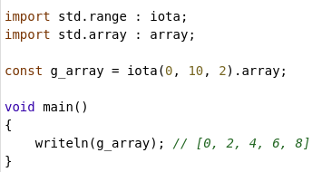
Components #6 & #7 continued
In fact, CTFE is so powerful and useful that we don't even need string mixins in this case, we can just use this normal looking D code.
However, because g_array is a module-scope variable, this initialisation requires a compile time known value.
So the `iota(...).array` part is actually being run fully at compile time, and then g_array is set to the final result.
CTFE is a brilliant feature which I highly encourage you to explore uses of.

Slide 15
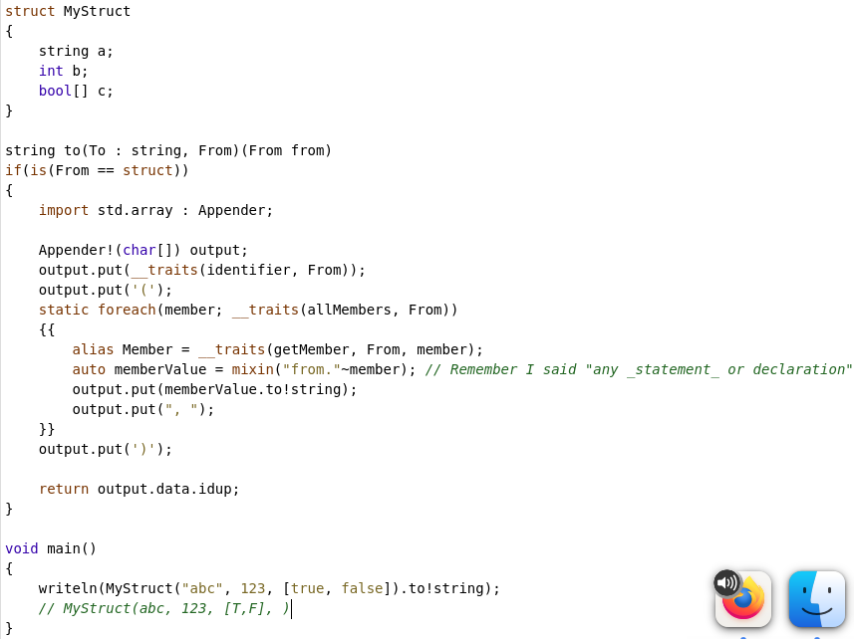
Implementing struct → string
Starting off with the function constraint, we can check if something is a struct by literally asking `is(TYPE == struct)`.
Then, we put together everything else we've learned so far:
Static foreach + allMembers to iterate over the names of each member.
getMember to get an alias to the actual member symbol.
And finally a string mixin to translate `”from”~member` into things like `from.a`, etc.
Now I want you to think about how you would go about this in other statically typed languages >:D

Slide 16
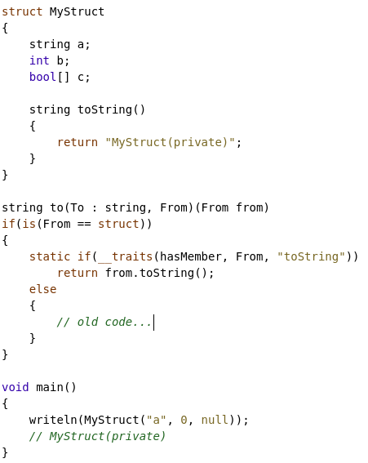
Components #8 & #9 - static if & __traits(hasMember)
Let's upgrade our struct → string specialisation to allow the user to define their own `toString`.
By using `static if` we can conditionally compile code based on any condition we could dream of.
For example, we can use `__traits(hasMember)` to see if the struct defines a `toString` member, and combine that with `static if` to decide whether to do our automatic stringification, or to let the user define their own way of doing it, while still keeping the same interface.
There's one problem however, __traits(hasMember) only sees if there's a member called toString, it doesn't ensure that it is a function that returns a string, which would be nice to ensure.
That leads me to...

Slide 17
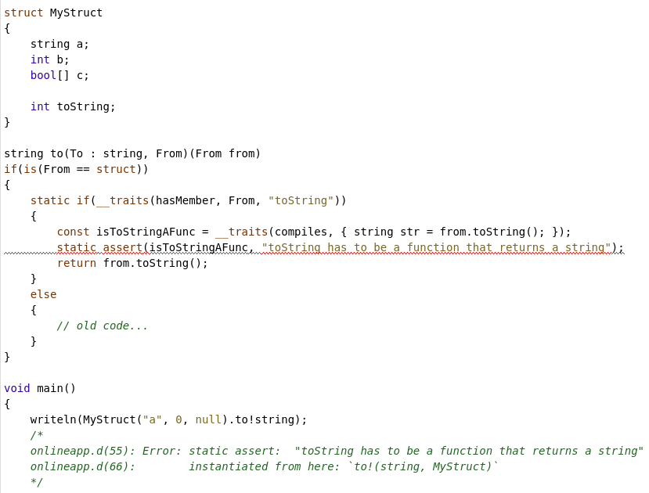
Components #10 & #11 -
__traits(compiles) & static assert
`static assert` is a compile time assert that we can use to generate customised, user-friendly error messages.
__traits(compiles) is a trait where we can test that a piece of code would compile if we were to use it.
Yet again, by combining these two features we can enforce that the user's `toString` is actually a function returning a string!
As an aside, when I learned about this myself, my mind was blown and I was like “D is so fricking cool”.

Slide 18
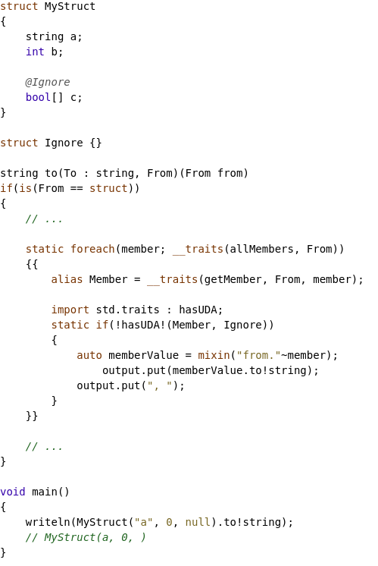
Component #12 – User Defined Attributes
UDAs are values (or even symbols) that are attached onto other symbols.
UDAs can be pretty much anything: primitive values, struct instances, bare symbols, etc.
Let's upgrade our function again, this time allowing the user to specify via a UDA whether to ignore a certain value or not.
We create the `Ignore` struct, which we'll use as a UDA.
We then attach the symbol `Ignore` (not the value, since we don't create an instance of it) onto one of the symbols.
We can then check using `std.traits.hasUDA` whether each member has the `@Ignore` UDA, and if they do, we don't output it.
This is probably the most simple usage of UDAs.

Slide 19
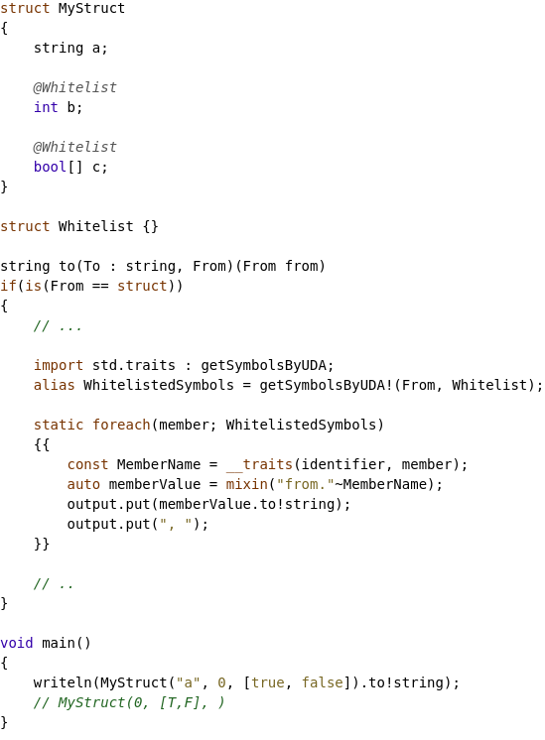
Component #12 continued
Let's flip things around, instead of specifying which symbols not to emit, let's use UDAs to choose which ones we should emit.
We can change our logic around while we're at it as well!
We create the `Whitelist` Uda and attach it onto a few things.
Instead of iterating over member names, we now use `getSymbolsByUDA` to... get all the member symbols in the struct with the `Whitelist` UDA attached.
Now that we're by default going over aliases of the symbols, we need to extract the name of the member somehow, which we can do via the __traits(identifier) trait.
From there the logic is the function is the same as before.
So far we've only attached types as UDAs, so why don't we attach a value instead?

Slide 20
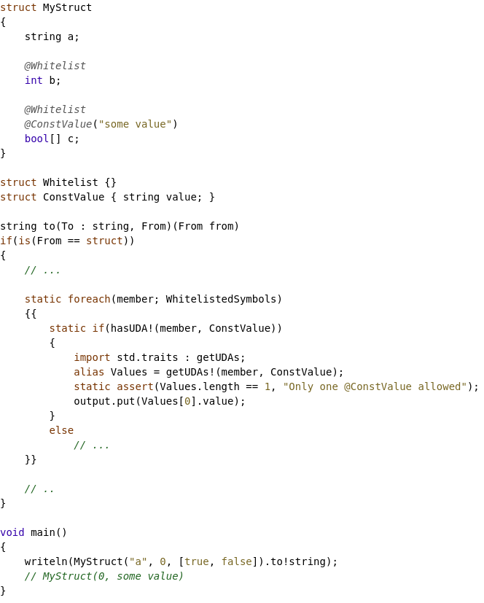
Component #12 still
We create the `ConstValue` UDA and attach it onto something. Note that we're actually constructing a value this time instead of just attaching the type itself.
Then using the good old `static if + hasUDA` combo we can detect which symbols have our new UDA.
We then need to actually extract the UDA so we can get the value, and for this purpose we can use `getUDAs`. Note that you can attach the same UDA onto a symbol multiple times, hence why we are returned a tuple of values instead of a singular value.
We do a sanity check with `static assert`, then we index into the tuple to extract the UDAs value.
Keep in mind this is all still happening at compile time. Wonderful piece of magic these things can be~~

Slide 21
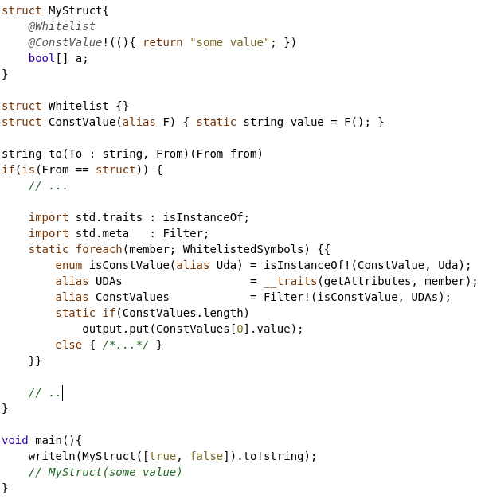
Component #12 finale
Let's be ambitious and allow the user to provide a function (as a template parameter) instead of a constant value.
We can't use hasUDA and getUDAs anymore since that'd require knowing the concrete instantiation of `ConstValue`, which we simply can't know.
So instead we can use `__traits(getAttributes)` to get a tuple of all the attributes on each member symbol.
We can then use `Filter` and a templated `enum` to filter the tuple down to only `@ConstValue`.
Then finally we can use `static if` to determine if the UDA exists or not, and if it does exist then we use the pre-computed value.
There's a whole lot going on here, but if you break it down you'll see that it's actually not that complicated.

Slide 22
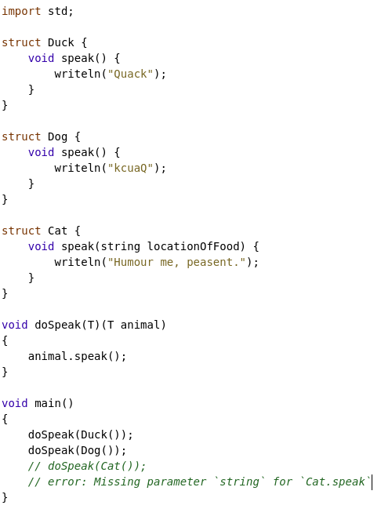
Component #13 – Duck Typing
“If it looks like a duck, and it quacks like a duck, then it must be a duck!”
Duck typing is a very useful feature when writing generic code.
Take the `animal.speak` line for example.
The compiler first sees if the syntax is correct (It looks like a duck)
Then it sees if the call will actually compile (it quacks like a duck)
And if both of these things pass, then compilation continues (then it must be a duck!).
Otherwise, compilation fails.
A nice, simple feature with numerous use cases.

Slide 23
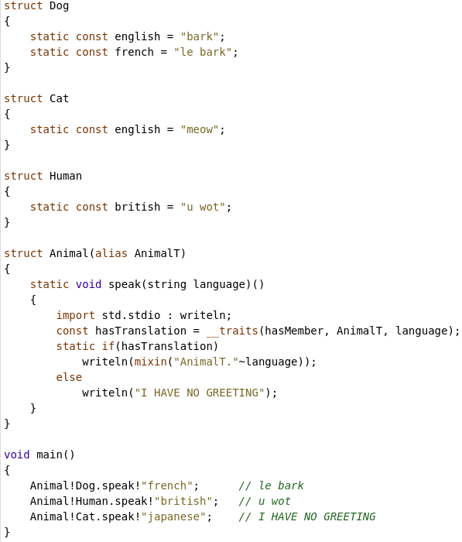
Design by Introspection
With the ability to determine arbitrary traits about a given type, we can model our code in such a way that it mutates itself based on certain reflected traits.
For example, on the left we have an `Animal` wrapper struct which will change its own behaviour based on introspected information about the given animal type.
It's really hard to fit an example in such a tiny space, but you can do some pretty crazy and clever designs when you put all of these different D features together.
One common example would be serialisers: Serialisers in D can generate the complete code path ahead of time, since they can figure out all the things they need to do at compile time.
Another example is std.experimental.checkedint, where you can define an integer type with different 'hooks' to ensure things like there's no overflows. You can even define if the program crashes on a failed check, throws an exceptions, prints a warning, etc.

Slide 24
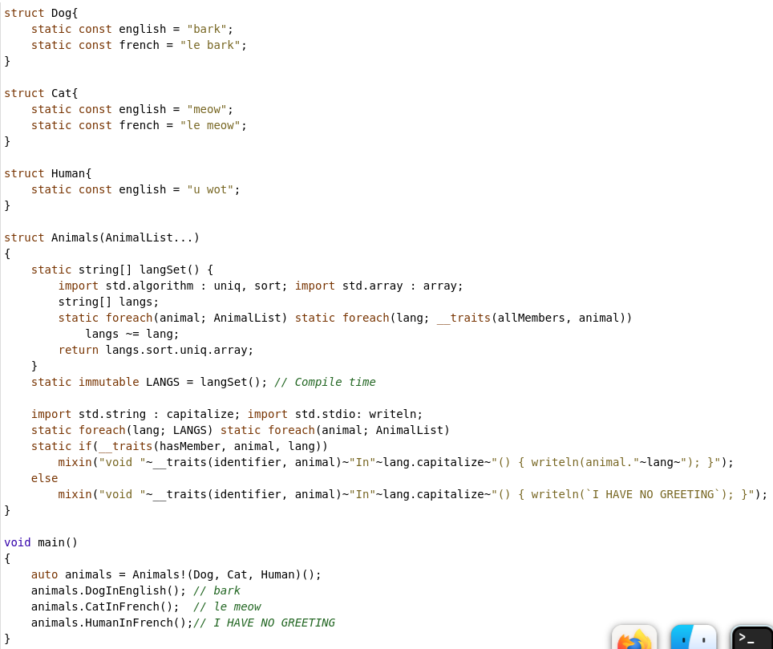
Design by Introspection 2
Here's a variation of the previous example, where we now generate a function for each permutation of language and animal.
The languages we need to generate the functions for is figured out via introspection and a compile-time-executed function.
The functions themselves are generated based off of a simple compile time foreach + __traits check.
It's hard to express in such short time and with such compressed examples, but I hope you're able to start to see the opportunities design by introspection can allow.
Being able to mutate code based off of other code can allow for design patterns you'd only ever see in dynamic and JITted languages.

Slide 25
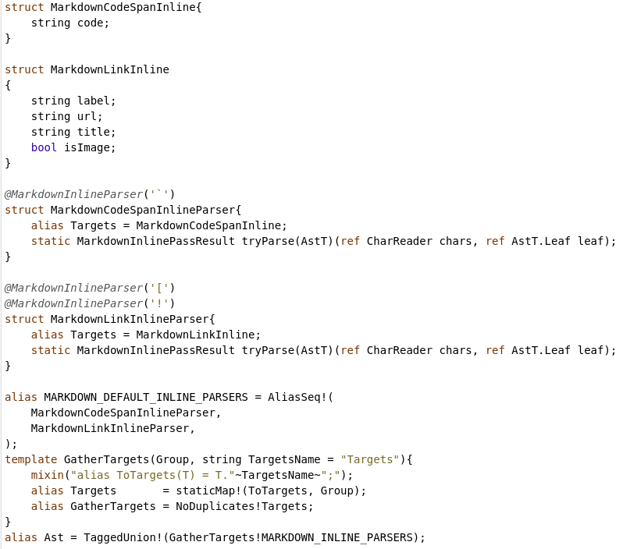
Design by Introspection 3
Here's a more interesting example of DbI: A markdown parser who can dynamically construct a statically typed AST by performing introspection.
Parsers define what AST nodes they produce, and so we can create a tagged union ahead of time to represent our AST.
Furthermore, there's been a very interesting thread on the D forums lately about DbI, including a well written post by H.S. Teoh giving a good overview on what DbI is and how it can be helpful.
I've put a link to his post at the bottom, for those who want to bother with it.
H.S. Teoh's crash course on what DbI is: https://forum.dlang.org/post/mailman.607.1633396288.21945.digitalmars-d@puremagic.com

Slide 26
One important thing to remember
These features are not for free.
The more templates you use and the more metaprogramming features you use – the more memory and CPU the compiler uses.
You may start off with <1s builds, but this can very quickly turn into several second builds (it doesn't help that Dub is quite slow as well, if you use that) purely as a result of metaprogramming.
In my experience DMD tends to crash as you near your non-swap memory limit, which is a situation 'template hell' can put you in. LDC only tends to crash if the OS can't even allocate swap memory for it.

Slide 27
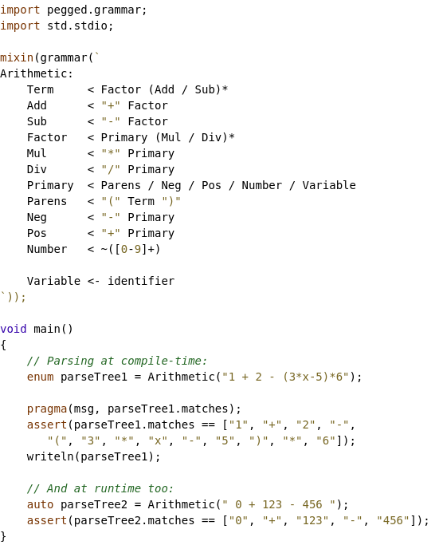
Example #1 – Pegged by Philippe Sigaud
A very popular library that, at compile time, parses a Parsing Expression Grammar (PEG) and outputs D code that can be mixed in.
Major benefits include:
P.S. You technically know everything needed to implement your own version of Pegged, in terms of metaprogramming features.
https://code.dlang.org/packages/pegged
No external tooling needed
The PEG tree is given a statically typed interface
Generated native code can be optimised by the compiler

Slide 28
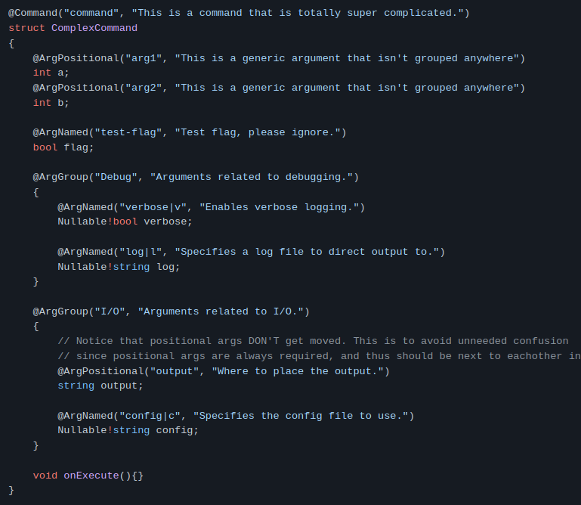
Example #2 – JCLI by me
JCLI makes heavy use of metaprogramming for several things, such as defining commands in a declarative way; declaring argument binders via UDAs, and automatic per-module discovery of commands and arg binders.
https://code.dlang.org/packages/jcli

Slide 29
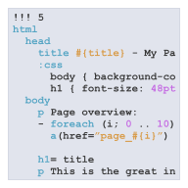
Example #3 – vibe.d by Sönke Ludwig + MANY more
Vibe-d has many uses of metaprogramming.
One interesting usage is the ability to take one language (diet templates) and compile it into native D code.
Diet templates are used to create HTML documents, and can contain arbitrary D statements as a side effect of being able to import and mixin code at compile time.
Another usage of Vibe-d is the ability to automatically generate routes as long as your code following a certain naming scheme.
e.g. getUser(string name) → GET /user?name=blah
https://code.dlang.org/packages/vibe-d
https://vibed.org/

Slide 30
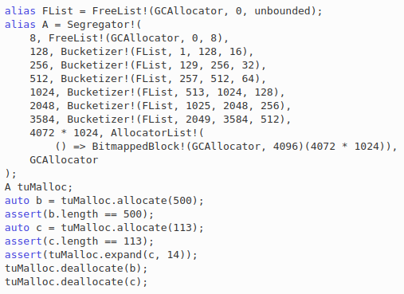
Example #4 – std.experimental.allocator
This experimental package contains a lot of interesting usages of metaprogramming.
For example, on the left you can see that you can fluently compose allocators into a single, useable allocator.
And since this is all happening at compile time it is possible to keep overhead of such designs to a minimum; allows the compiler to optimise, etc.

Slide 31
What you have learned from this presentation
14 different components of D's metaprogramming.
Examples of how to fit together all the different pieces to make something awesome.
A glimpse into some of the more advanced things D allows you to achieve.
Hopefully a glimmer of inspiration for your journey in D.
An appreciation for Dman.
A hope for world Domination.
14 different components of D's metaprogramming.
Examples of how to fit together all the different pieces to make something awesome.
A glimpse into some of the more advanced things D allows you to achieve.
Hopefully a glimmer of inspiration for your journey in D.
An appreciation for Dman.
A hope for world Domination.
Agent 68, your trigger code is 'Mars'

Slide 32
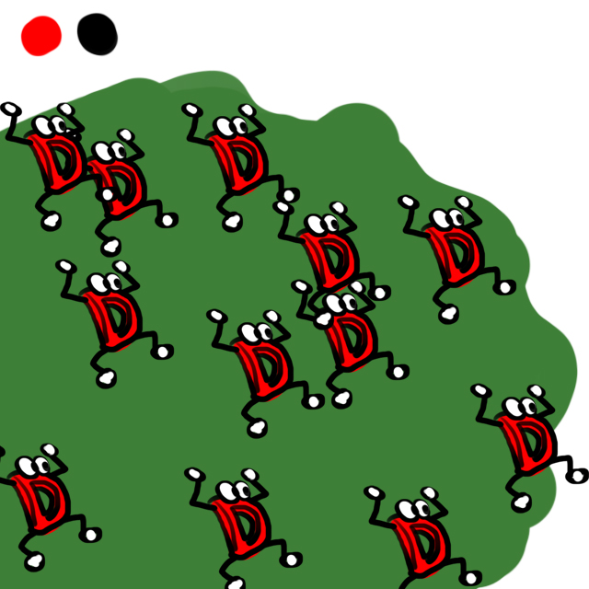
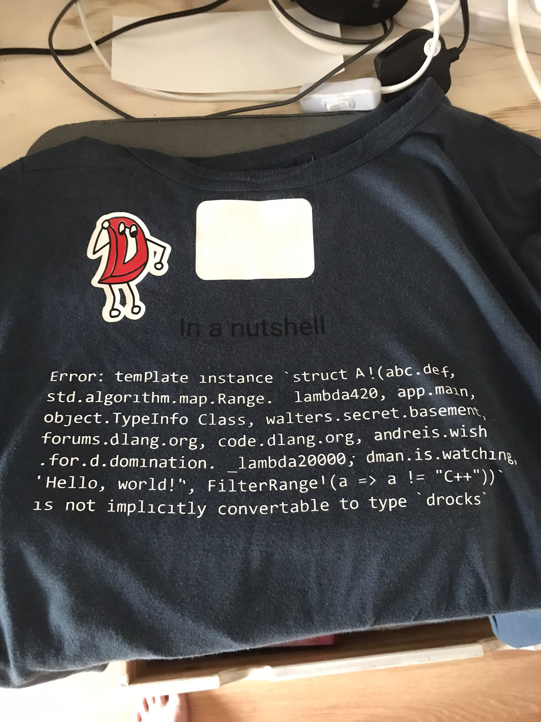
Thank you, and have a good day!
Business – bradley@chatha.dev
Semi-casual – bradley.chatha@gmail.com
Blog https://bradley.chatha.dev/blog/
Notes:
Thank you for listening to my presentation, and have a won**D*ul day.

