Slide 1
The Future of Phobos
Version 3 and Beyond

Slide 2
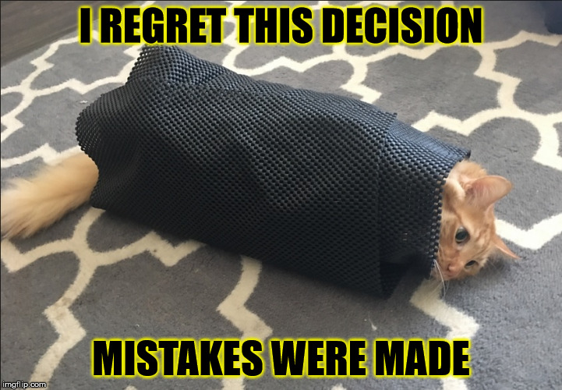
Why Phobos 3?
Language evolution
Changing best-practices
Experience has demonstrated that not every decision made was the right one.

Slide 3
Ok …

Slide 4

But

Slide 5
Why

Slide 6
Phobos 3

Slide 7
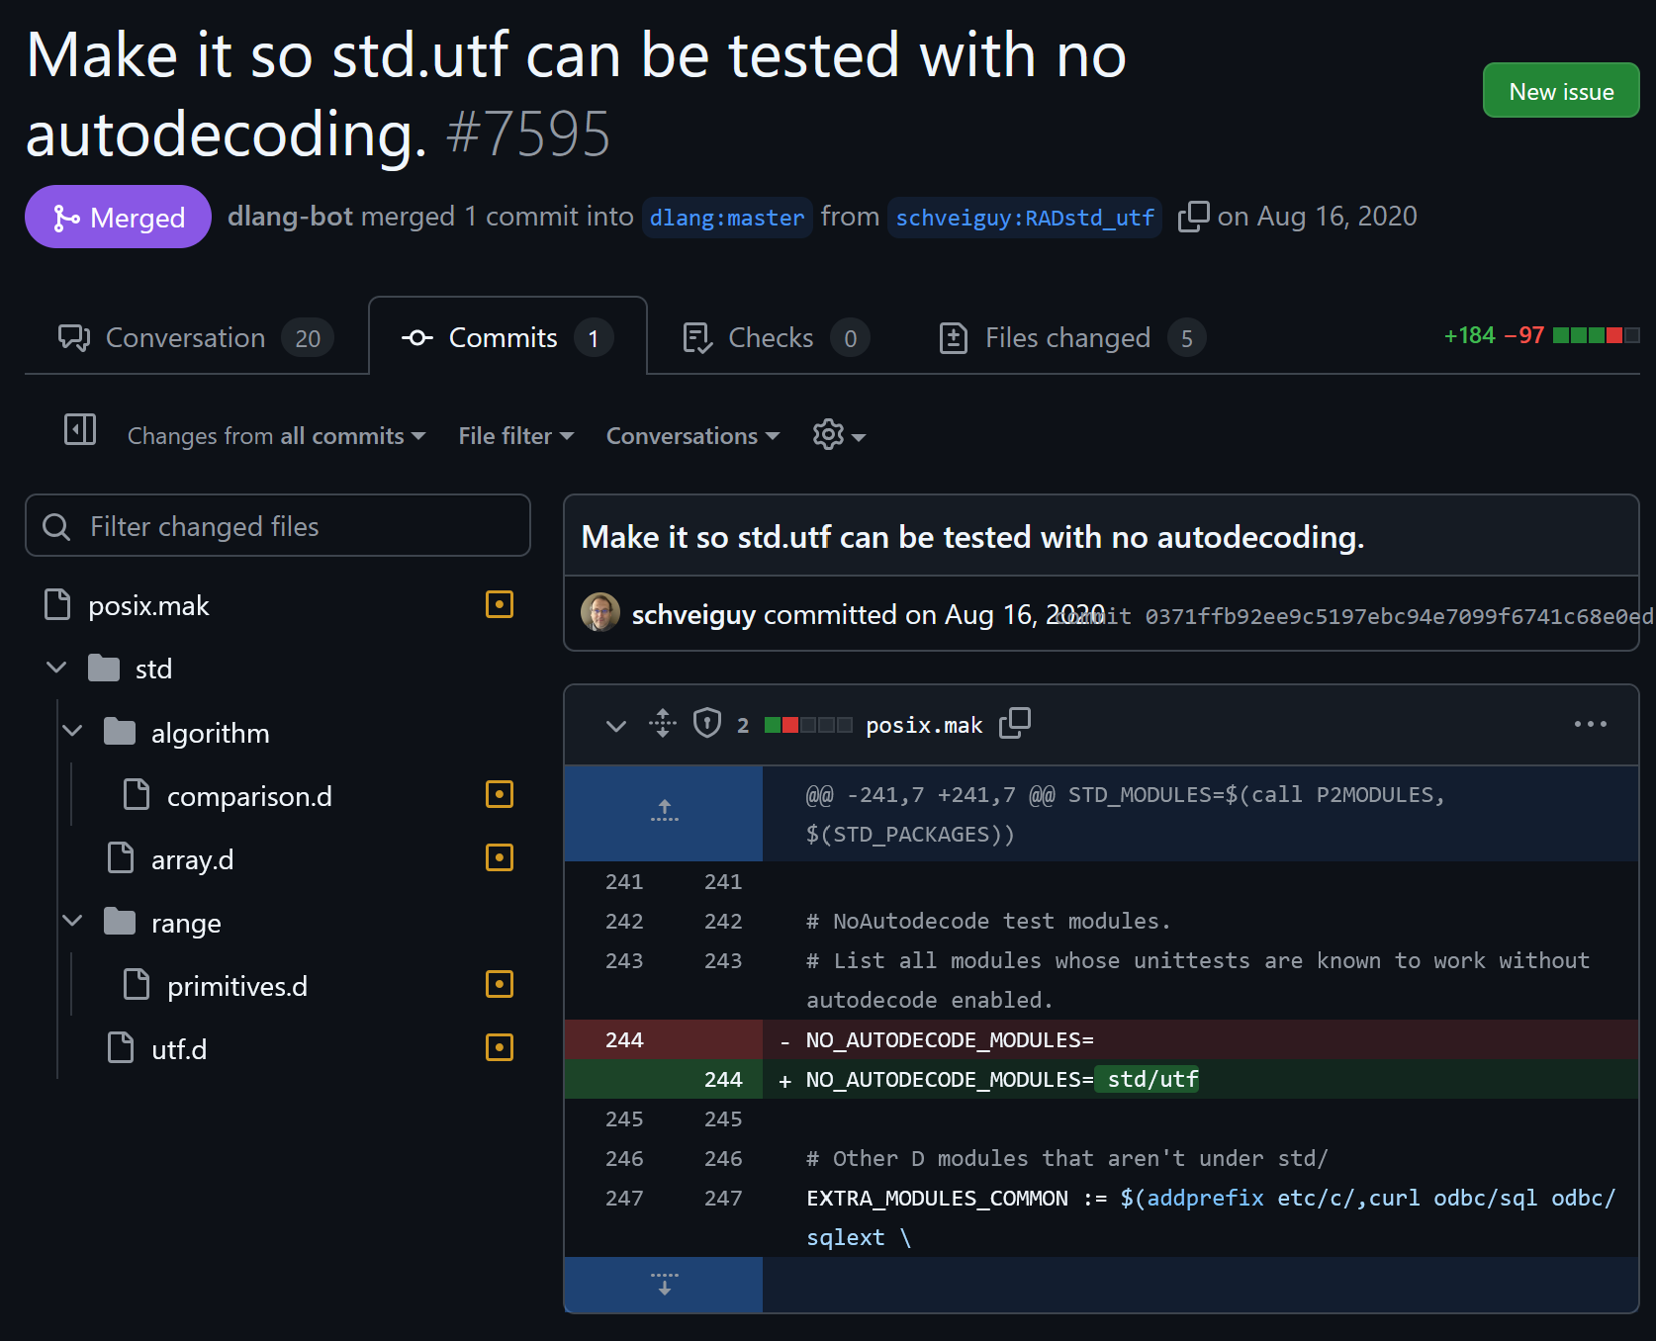
Why Phobos 3?
Remove Autodecoding
Requires a careful, file-by-file audit.
Is extremely complex to do in place.
Introduces potential bugs when done piecemeal.

Slide 8
Why Phobos 3?
But also…
@nogc / nothrow
Range redesign
Overhaul I/O package
Reduce inter-module dependencies
Reduce template usage
Phobos package structure redesign
Improve API consistency and accessibility
Align the Standard Library with Editions

Slide 9
Standard Library Ground Rules
Broad Applicability
Common and Standard
Consistency and Simplicity
Performance is a concern, but not the top concern.
If you need maximum performance, you will probably want to create your own implementation in any case.

Slide 10
Autodecoding
Removed across the Phobos 3 codebase.
Retained in Phobos 2.
Mixing Phobos 3 and Phobos 2 code can trigger auto-decoding.
Phobos will no longer support wchar and dchar.
Use byDChar() and byWChar() instead.
The world has effectively standardized on UTF-8.
Phobos will only use UTF-8 internally.
Phobos 2 throws on Invalid Unicode
Phobos 3 will offer both throwing and replacement-character methods.

Slide 11
@nogc
Phobos v2 makes liberal use of the GC, preventing the use of @nogc
Primary GC uses:
Buffers
Exceptions
Timon has suggested a “weak @nogc” that allows throwing.
Notes:
Buffers: Includes string manipulation
Not inclusive.

Slide 12
nothrow
The problem isn’t exceptions. It’s that exceptions use the GC.
Sumtypes offer a potential solution (once implemented).
Combined with “weak @nogc” provides stronger semantics.

Slide 13
@nogc / nothrow in Phobos 3
@nogc API’s are very different from GC-based API’s.
Low-Level @nogc API
Takes in a pre-allocated buffer.
Returns an error code or sumtype to indicate failure.
High-Level GC API
Wraps Low-Level API using a GC-allocated buffer.
Throws an exception when the low-level method fails.
Separate packages for High/Low level API’s is an open question.
Notes:
Personal preference is for separate packages.

Slide 14

Ranges

Slide 15
I/O
Add support for Terminal Colors
Replace C File API
GitHub - schveiguy/io: Core I/O functionality
File I/O only.
This implementation is consistently recommended as a starting point.
Likely needs rework to fit into Phobos according to the author.
Notes:
We would only use the File I/O portions.

Slide 16
Reduce Dependencies
Modules frequently import more than they need to.
Excess imports slow down the compiler.
Dependencies will be audited during the development process.
Most of these are from functions that have been moved in the past.

Slide 17
Reducing Template Usage
Excessive Templates slow down the compiler.
Excessive Templates obfuscate the code.
std.conv.to is a prime example.
Phobos 3 guideline: Start with an untemplated function.
Add templates only as necessary.
“Performance” is only a reason if it can be proven. Bring proofs first.
Notes:
Templates are a powerful tool. But with great power comes great responsibility.

Slide 18
Package Structure
Phobos 3 lives in the phobos.* root package.
Phobos 3 will use a multiple-package structure.
Pay-As-You-Go
Mitigates the 64k symbol limit on Windows.
Simplifies porting to new platforms.
Planned structure:
phobos.sys.*
phobos.text.*
phobos.data.*
phobos.net.*

Slide 19
Package Layering
phobos.text | phobos.data | phobos.net | phobos.???
phobos.sys
All packages may import phobos.sys.
phobos.sys may not import any other package.
phobos.sys provides @nogc/nothrow functions.
All other packages may use the @nogc/nothrow as deemed appropriate.
Other packages have no obligation to provide @nogc/nothrow functions.

Slide 20
Accessibility
We are frequently criticized for the difficulty of finding functions.
Non-standard abbreviations and acronyms are barriers to entry.
Example: “conv” is not a standard abbreviation; even native English speakers struggle to understand that it means “convert”.
Non-native speakers would find it even more difficult.
“Just read the manual” is not an option when the manual uses the same non-standard lingo.
Standardized language improve accessibility.
Consistent naming makes it easier to find what you need.

Slide 21
Naming
Follow the D Style Guide.
Survey of other languages for names of similar functions.
If there is broad agreement on the name of a function, use that.
If no clear choice is found, we will list the common options in the documentation so that search engines can find it from similar names.
Reduces friction for programmers coming from other languages.
Prefer whole words over abbreviations and acronyms.
Unless the abbreviations and acronyms are industry standard. (Ex: HTTP)
https://www.cs.kent.edu/~jmaletic/papers/ICSE2021.pdf (Sec 2, Part G)

Slide 22
Naming Examples
currTime() -> now()
C#
writeln() -> writeLine()
C#, Kent University Paper
std.conv.* -> phobos.sys.convert.*
Kent University Paper
Notes:
“sys” is a well-known abbreviation of “system”
Another example might be “crypto” for “cryptography”

Slide 23
Contributors
Module Maintainers will be noted in a MAINTAINERS file.
To add/remove yourself as a Module Maintainer, please submit a PR.
Required Reviewers will have seven days to respond.
Silence is approval.
This can be extended if they are temporarily unavailable.
Alternatively, another qualified reviewer can step in.
Disagreement must include an alternative.
Applies primarily to new features on the roadmap.
If no alternative is provided the presented implementation will be merged.
Does not apply to feedback on implementation quality and style.

Slide 24
Versioning
Phobos 3 intends to track DMD Editions.
Note that while Compiler Editions and Versioning has been discussed, no official decision has been made.
Phobos Major Versions will track with each Edition release.
May break API with prior Phobos versions.
Phobos Minor Versions will track the monthly compiler release.
Phobos Patch Versions will be out-of-band releases.
Patch versions will be limited to Security and Critical bugs.
This effectively yields a SemVer compatible version specifier.
Therefore, the first release of Phobos 3 will be: 3.0.0

Slide 25
What About Phobos 2?
Will:
Continue to be supported.
Receive bug fixes.
Support new Operating Systems and Editions.
Be usable in Phobos v3 projects.
Continue to use the std.* package.
Will Not:
Add new functionality.
Notes:
V2 Name conflicts will be inevitable. It is up to the user to address these.

Slide 26
What is Phobos 3?
Evolutionary, not revolutionary.
Serves as the foundation for future Phobos releases.
Built by auditing and improving the Phobos 2 codebase.
Separate and distinct from Phobos 2
Will co-exist alongside Phobos 2

Slide 27
When?
🤷‍♂️
Whenever it is completed.
We would like to time it with the first Edition, but this is an entirely volunteer project.
Everybody working on it has a full-time job, so time for large library projects is sparse.
The Library is not as popular as the Language.

Slide 28
Big or Small?
One of the enduring debates on the Forums.
Phobos 3 will begin the transition to a “Big Standard Library”
Notably, C++ is also making this transition.
Allows D to be a memory-safe alternative to C++.
Will allow us to attract more programmers from the C# and Java spaces.

Slide 29
Phobos 4
Add new packages:
phobos.crypto
phobos.database
phobos.http
Others?
Focused expanding the library.
Make use of new Language Edition features.
Will introduce a process, similar to DIP’s, for adding new features.

Slide 30
Phobos 4
Phobos 4 may introduce a third layer.
Lower layers will not import from higher layers.
Consider:
phobos.database |  | phobos.http
phobos.text | phobos.data | phobos.net | phobos.crypto
phobos.sys

Slide 31
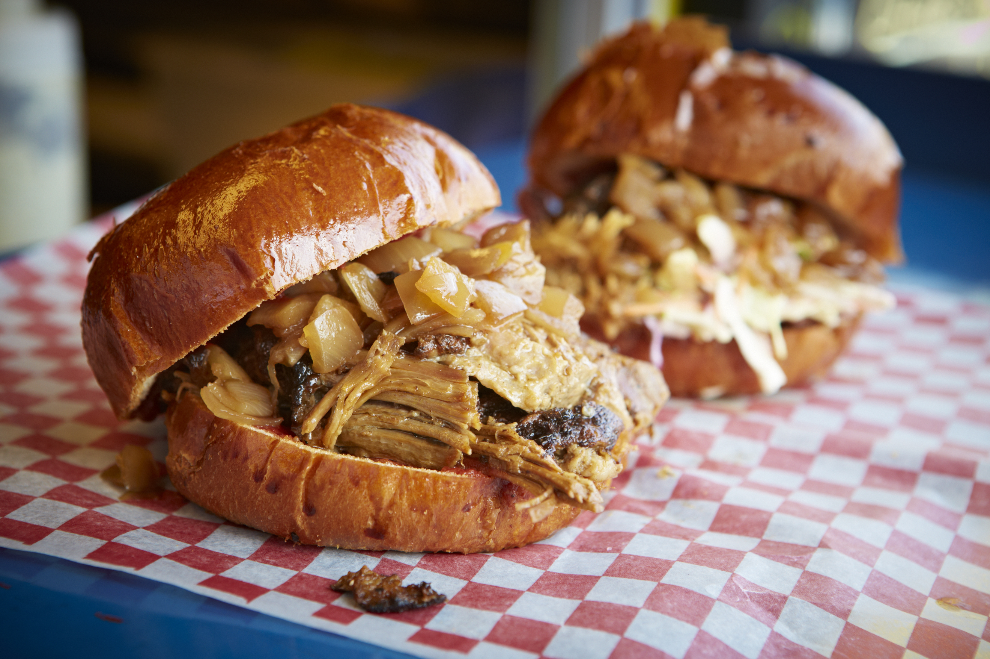
Thanks For Listening!

