Slide 1
Phobos 3: Year One

Slide 2


Slide 3
Where Are We Today?

Slide 4
Where Are We Today?
Usable Today
phobos.sys
compiler
system
meta
traits
Not Considered Stable
Symbols May Change!

Slide 5
Where Are We Today?
In Progress
phobos.sys.range
phobos.sys.optional
Drops range support.
Porting unittests has proven challenging.
Neither are merged into the main repo yet.
std.typecons will be flattened out into separate modules.

Slide 6
What’s Next?
std.algorithm
No new algorithms planned.
Significant renaming and reorganizing.
std.uni / std.utf / std.ascii / std.encoding
Focused on the removal of auto-decoding.
std.stdio
Will be split apart under the phobos.io package.
Console I/O will be left largely the same with a few renames.
File I/O to be replaced with IOPipe. (https://github.com/schveiguy/iopipe)

Slide 7
What’s the Hold Up?
Ranges are used virtually everywhere in Phobos.
Not much can be done without them.
One person is working on ranges in their spare time.

Slide 8
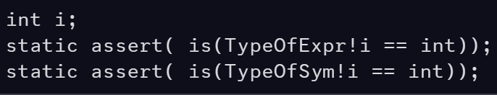
Naming Things Is Hard
Initial Proposal: TypeOfSym and TypeOfExpr
Similar names make it difficult to tell them apart from each other in code.
Repeated prefix is longer than the intended name.
Picture of the proposed templates:

Slide 9
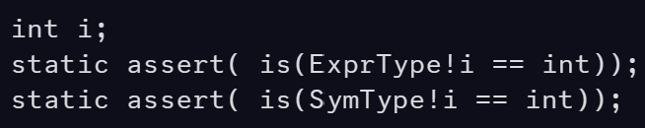
Naming Things Is Hard
Next Proposal: SymType and ExprType
Postfixes are generally easier to read.
Still easy to confuse at a glance.
Short, but uses abbreviations that some may not be familiar with.
Picture of the proposed templates:

Slide 10
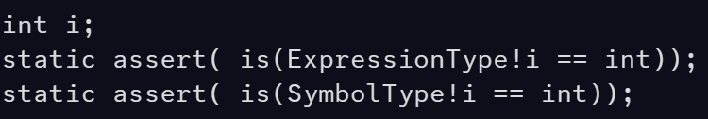
Naming Things Is Hard
Next Proposal: SymbolType and ExpressionType
Removes abbreviations.
Easy to differentiate at a glance.
Clear language, but now ExpressionType is quite long.
Picture of the proposed templates:

Slide 11
Naming Things Is Hard
Enter PropertyType
ex-ExpressionType
Sometimes we need to reset and re-evaluate.
The key question was “What is this actually used for?”
It’s used to get the return type of property getter methods.

Slide 12
What We Learned
Avoid Abbreviations
They are harder to read when combined with other code.
They are typically arbitrary to the parent language.
They make it easier to confuse symbols.
SymType was too close to SumType to be acceptable.
If you’re struggling with a name, ask a different question.
ExpressionType is what it does.
PropertyType is how it’s used.

Slide 13
Quick Primer on User Interfaces
Taxonomy of Human Visual Data Processing
Color
Shape
Text
Color is why syntax highlighting is so common.
Shape is why indentation is so frequently fought over.
Text is the most difficult to process.
Interpreted last as a result.

Slide 14
Quick Primer on User Interfaces
Humans do not process text as individual glyphs.
We interpret words by their shapes, as if they were pictures.
This is why logographic languages such as Japanese are just as legible to humans as alphabetic languages like English.
This means that variety of word-shapes reduces cognitive load.
Words with similar shape will be more easily mistaken.
Abbreviations violate word-shape.
This causes the brain to stop parsing word-shapes and attempt to infer the intended meaning of the abbreviation.

Slide 15
API’s as Programmer User Interface
The Language + API is the Programmer’s Interface to the Machine.
We can infer that the same rules of interfaces apply to code.
Prefer Color before Shape and Shape before Text.
Short Names reduce the number of characters in the “namespace”.
This in turn reduces the number of visual “shapes” possible in the API.
Short Names increase the likelihood of visual collisions.
SymType vs. SumType can be indistinguishable in some fonts.

Slide 16
Capabilities

Slide 17
New Capabilities
Data Formats
JSON, SDL, CSV, TOML.
Bringing JSON and SDL to Phobos will greatly simplify DUB development.
Possibly XML and YAML if we can get compliant implementations.
Cryptography
Absolutely no bespoke algorithm implementations!
Will use the intersection of what is provided by the major platforms.
HTTP Client
HTTP 1.1 at a minimum.
HTTP 2/3 if possible.

Slide 18
New Capabilities
The focus is on existing capabilities.
These new capabilities are required by modern software.
Data Formats support the tooling ecosystem.
Basic Cryptography is necessary for security.
The world is web-based, so we must have an HTTP client.

Slide 19
Removed Capabilities
std.json
To be replaced with JSONIOPipe using the std.json namespace.
std.getopt
std.digest.hmac/md/ripemd/sha
Mandatory removal for security concerns.
std.experimental
std.logger
All may be replaced or reimplemented.
List is subject to change.

Slide 20
Attributes

Slide 21
The Philosophy of Attributes
Discord says that @nogc/nothrow/etc. are a different language.
I argue that they represent different programming philosophies.
One philosophy is that of maximum performance and control.
The other is a philosophy of maximum simplicity and safety.
Neither philosophy is incorrect.
But they do not interact well.
Phobos 2 is a mixed philosophy library.

Slide 22
Attribute Usage in Phobos 3
Function Attributes
@nogc
nothrow
pure
Parameter Attributes
scope (DIP1000)
@live (DIP1021)

Slide 23
Attribute Usage in Phobos 3
Attributes represent limitations on the implementation.
But also represent promises to the caller.
Removing Attributes is always a Breaking Change
In most cases, adding an attribute is not a breaking change.
Aggressive attribution prevents future changes.
A method attributed as @nogc can never use the GC in the future. EVER!
Adding attributes prevents removing them in the future. EVER!

Slide 24
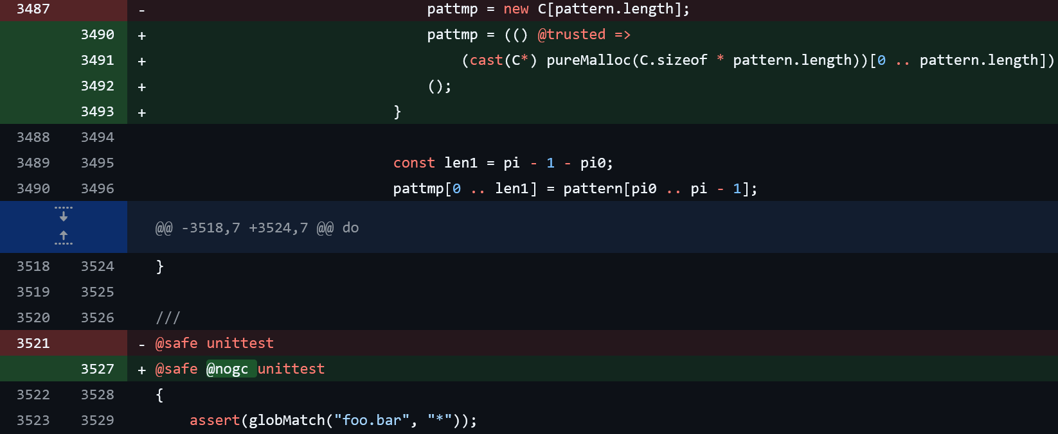
Example: Adding @nogc to globMatch
Pull Request replaces GC new with pureMalloc

Slide 25
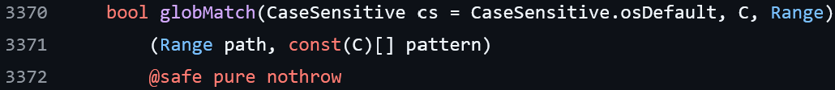
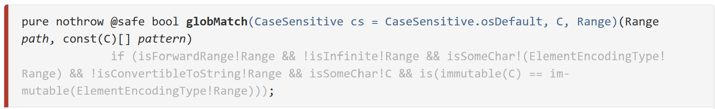
Example: Adding @nogc to globMatch
2.111 Source Declaration
2.111 Documentation
Pull Request: https://github.com/dlang/phobos/pull/9055

Slide 26
Did You Spot the Fib?
Method does not actually specify @nogc.
Method is technically @nogc but still allocates.
@nogc has two meanings depending on who you ask.
No GC allocations.
No allocations of any kind.
This type of PR will no longer be accepted into Phobos 2.
All attributes must be explicitly stated where possible.
Applies to all future Phobos 2 and Phobos 3 PRs.
Closures/lambdas represents a problem.

Slide 27
The Problem with Attributes
Template Attribute Inference
We never actually marked the globMatch function as @nogc.
There is no documentation for users to know the function is @nogc.
Heisenbugs. The function is both @nogc and NOT @nogc.
Whether the method is @nogc can change between releases.
No mandatory method level enforcement of promises.
API is naturally unstable.
Sole restraint is a unittest block.
This API can never use the GC ever again. Forever.

Slide 28
DIP1000
Extremely complicated.
Designed to make unsafe activities safe.
Attribute changes are breaking changes.
Every single programmer interested in working on Phobos 3 has stated that they have no interest in supporting DIP1000.
There are maybe three programmers in the D community who understand DIP1000 well enough to use it successfully.
All of them are compiler programmers.
Only one of them wants to work on Phobos 3 and they said “No” to DIP1000 in Phobos 3.

Slide 29
Banned Attributes in Phobos 3
Function Attributes
@nogc
nothrow
pure
Parameter Attributes
scope (DIP1000)
@live (DIP1021)

Slide 30
The Phobos 3 API
@safe-by-Default
@trusted limited to necessary usage only.
@system disallowed.
Garbage Collected
No malloc.
No Reference Counting.
No pointers/scope/@live.
Throwable Error Reporting
No error codes or other nothrow compatible error reporting.

Slide 31
BaseD

Slide 32
What is BaseD?
A compact high-performance “Base Library” for D.
Limited in scope.
Focused on performance, not safety.
Avoid duplication with Phobos.
Sometimes referred to as a “Kernel Library”.
Phobos 3 may publicly import symbols from BaseD.
Splits the performance sensitive code out into a low-level library.
Resolves the Philosophical tension in Phobos 2.

Slide 33
The BaseD API
@system-by-Default
No Garbage Collector
Malloc / Reference Counting Only.
Support pointers/scope/@live.
No Exceptions
Error handling by return code or other suitable mechanism.
No D Runtime
C Runtime allowed.
May not use third party libraries.

Slide 34
Supported Attributes in BaseD
Default Module Level Attributes
@nogc
nothrow
Function Attributes
pure
Parameter Attributes
scope (DIP1000)
@live (DIP1021)

Slide 35
BaseD Focus Areas
Algorithms
Metaprogramming
Numerics
Types
Date/Time
String Manipulation (No UTF exceptions, spec violation)
C-Style File + Console I/O

Slide 36
Platform Layer
platform.* is a new root namespace for System API definitions.
Contains only system API definitions.
Built using ImportC.
Example: platform.win.*, platform.stdc.*, etc.
Replaces parts of core.
Can be used by any layer of the ecosystem.

Slide 37
Phobos 3 Technology Stack
Phobos 3
D Runtime
BaseD
Platform

Slide 38

Thank You!

Slide 39
Questions?
Email: adamdjwilson@gmail.com
Discord: @Adam Wilson

