Slide 1

Industrial Computing Design Project 3 - DES371S
Title of Project: Network Data classisifaction for automatic resource allocation
Student Initials and Surname: L.B Dlangamandla

Slide 2

Outline
1. Introduction
2. Project Objectives
3. System Design
4. Methodology
5. Management (GA 11)
6. Conclusion

Slide 3
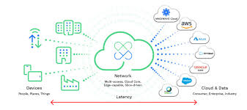



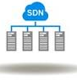
1. Introduction
Congestion, network performance Demands in network Realt –time Decision, misclassification resources for cloud computing 5G
The projects integrates SDNs, Improves real-time performance network, and Network management
Machine Learning ensures efficient use of resources

Slide 4
2. Project Objectives
Build a virtual network and integrate Ubuntu and 2 Linux Mint VMs
Use ML algorithms on the Ubuntu to forecast bandwidth
Build a classification system to classify network resources
Design a system that will process and classify traffic in real-time
Use ML algorithms to detects threats and address security vulnerability

Slide 5
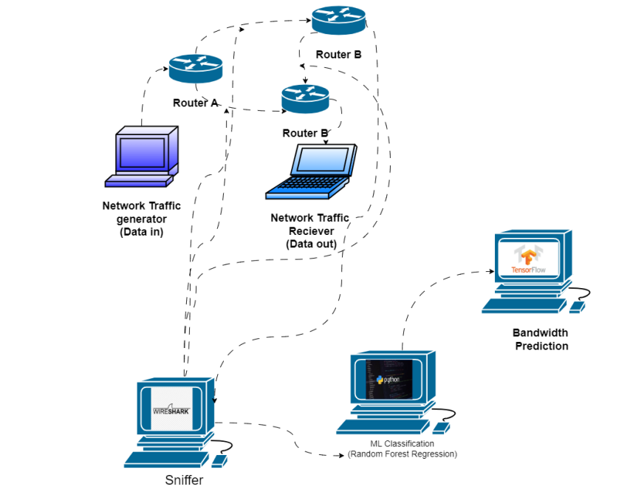
3. System Design

Slide 6
4. Methodology
Literature Review and Research
System Design and Planning
System Conceptual Design
ML model selection
Virtual Network Building
Real-Time Monitoring and ML model training
Testing and Validation

Slide 7
6. Management (GA 11)
6.1 Proposal:
Problem Understanding: Modern networks struggle with dynamic and unpredictable traffic, leading to congestion and inefficient bandwidth use.
Client Needs: Automatically classify and prioritize network traffic, Enable efficient, QoS-aware resource allocation, integrate with OpenDaylight (ODL) in a GNS3 + VyOS virtual network, and achieve accuracy, scalability, and automation.
Proposed Plan: 1. Build SDN topology (VyOS routers + ODL).
2. Capture and process traffic (Wireshark/tshark).
3. Extract key flow features.
4. Train a Random Forest Classifier for traffic types.
5. Test automated classification in ODL.

Slide 8

6. Management (GA 11)
6.2 Budget:
There was no fee spent in making the project

Slide 9
6. Management (GA 11)
6.3 Risk Analysis:
Unclean data
ML model Failure
Connectivity Issues

Slide 10
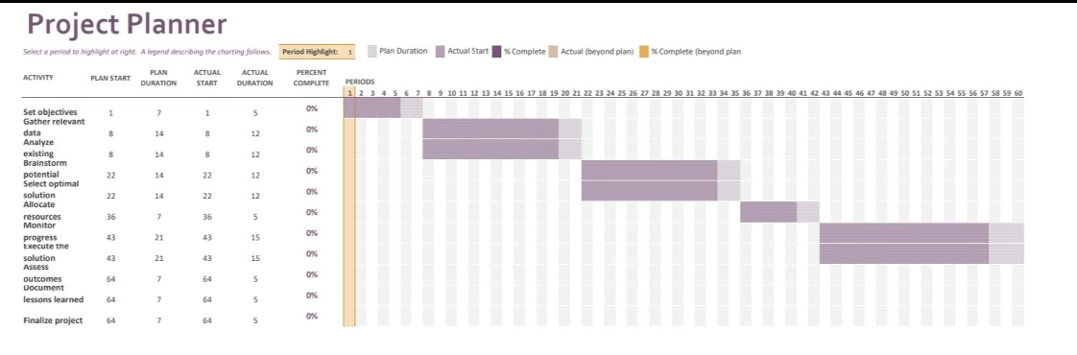
6. Management (GA 11)
6.4 Time and Change Management:

Slide 11
6. Management (GA 11)
6.5 Quality Assurance:
Continuous development for the ML model before integration.
Developing the classification system before integration.
Regular validation against expected outputs.
System evaluated for stability and reliability.

Slide 12
6. Management (GA 11)
6.6 Economics Principles:

Slide 13
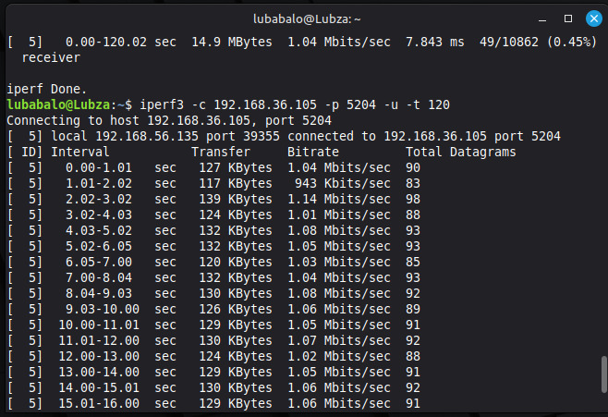
6. Management (GA 11)
6.7 Evaluation of Project Outcomes:

Slide 14
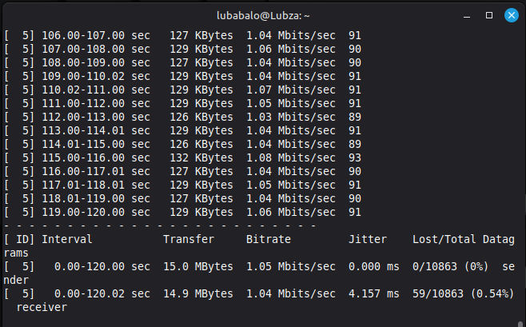
6. Management (GA 11)
6.7 Evaluation of Project Outcomes:

Slide 15
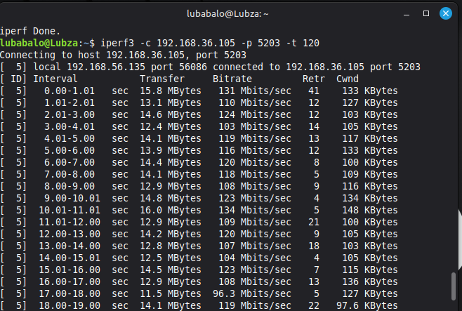
6. Management (GA 11)
6.7 Evaluation of Project Outcomes:

Slide 16
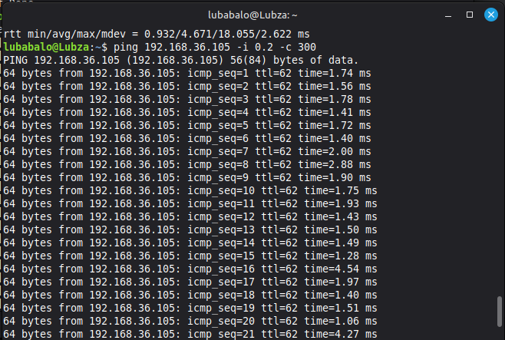
6. Management (GA 11)
6.7 Evaluation of Project Outcomes:

Slide 17
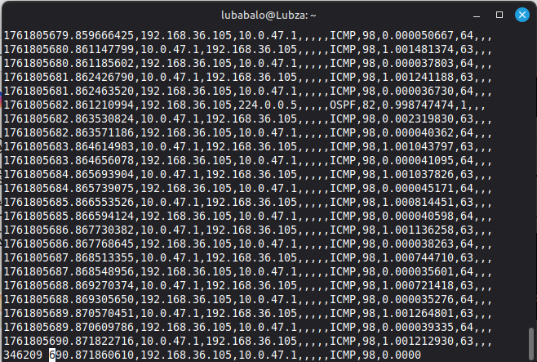
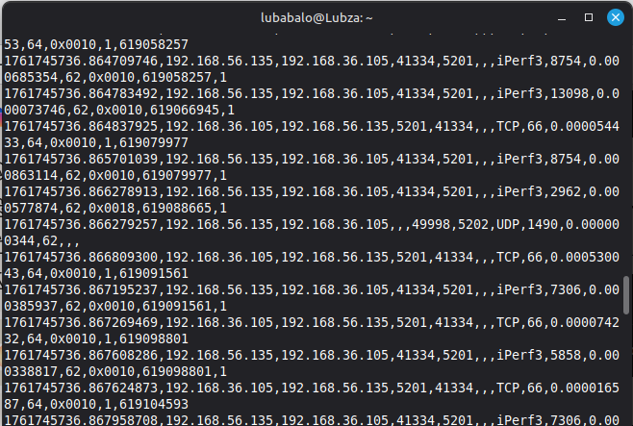
6. Management (GA 11)
6.7 Evaluation of Project Outcomes:

Slide 18
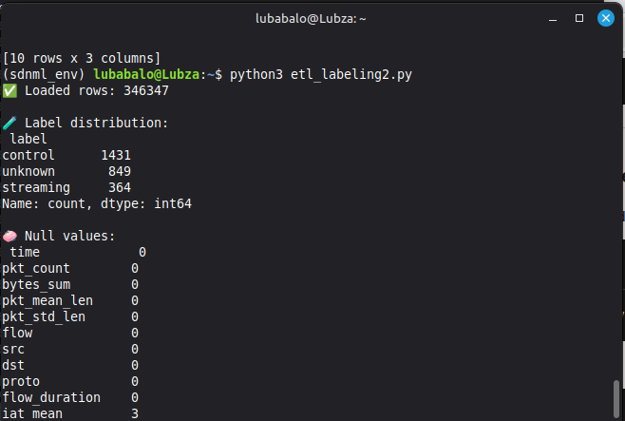
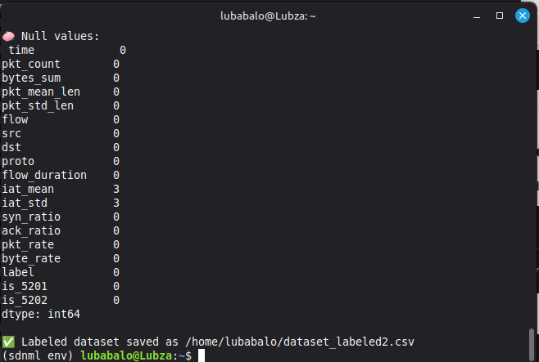
6. Management (GA 11)
6.7 Evaluation of Project Outcomes:

Slide 19
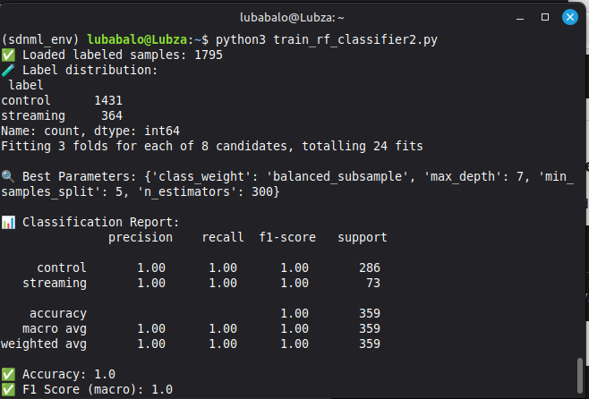
6. Management (GA 11)
6.7 Evaluation of Project Outcomes:

Slide 20
6. Management (GA 11)
6.7 Evaluation of Project Outcomes:

Slide 21
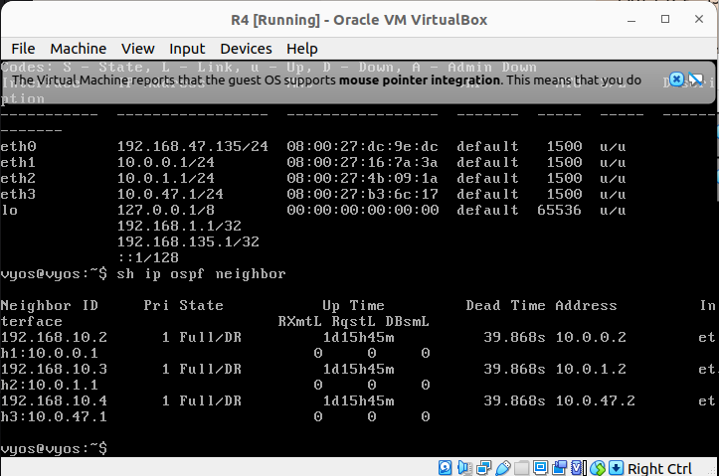
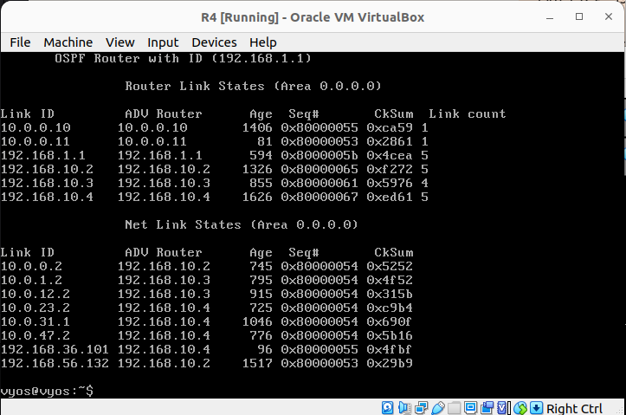
6. Management (GA 11)
6.7 Evaluation of Project Outcomes:

Slide 22
7. Conclusion
The system improves network performance, Less congestion & consistent performance
Optimizes resource distribution in a network
Reduces latency
Enhances Security & changes in the pattern

Slide 23
Thank you and Questions

