Slide 1
Breast Cancer Diagnosis Classification Analysis
Austin Lackey, Ethan Powers and Danny Laposata

Slide 2
Background
Breast Cancer Diagnosis Data
Predict Diagnosis of Tumor based on features
Reduce Type II Error (False-Negatives)
Feature Selection

Slide 3
Data
Data collected from Kaggle
Response: Diagnosis (Benign/Malignant)
Mean, SE, and “Worst” measurements of 10 variables
Training/Test Split (60/40)

Slide 4
Features

Slide 5
EDA
Different measurements of each variable are correlated
Relationship with Diagnosis visible for each measurement

Slide 6
Classification Analysis: Austin

Slide 7
Classification Analysis: Danny
Logistic Regression
K-Nearest Neighbors
QDA
Random Forest
xGBoost
Support Vector Classifier
Lower prediction cutoff to account for Type II Error

Slide 8
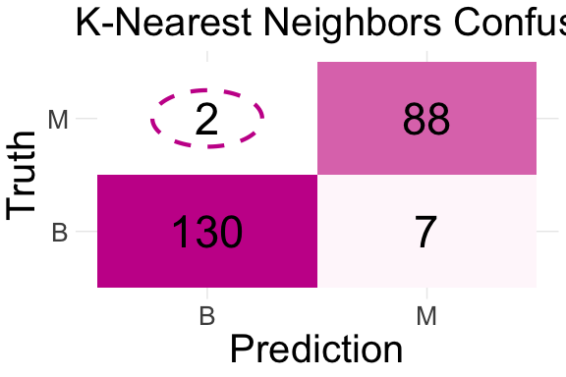
K-Nearest Neigbors Model

Slide 9
Tuned neighbors value to 7
2 False-Negatives
knn.err % prediction accuracy

Slide 10
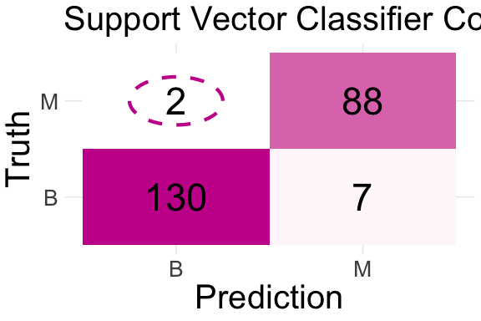
Support Vector Classifier Model

Slide 11
Tuned cost value to 1
2 False-Negatives
svm.err % prediction accuracy

Slide 12
Random Forest Model
1 False-Negative
95.15% prediction accuracy

Slide 13
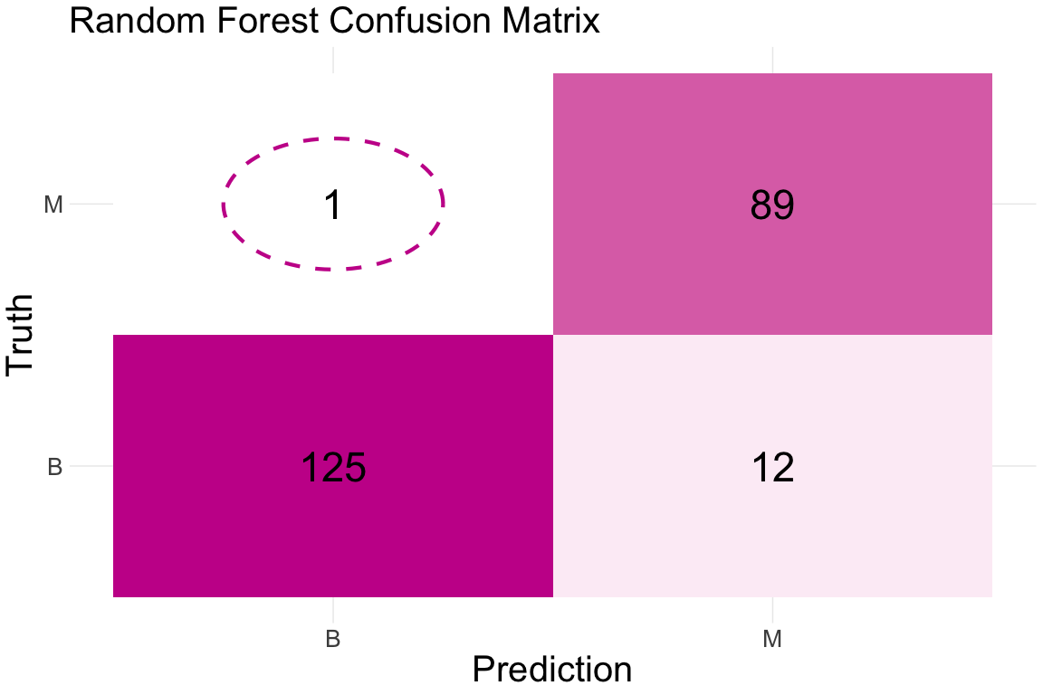

Slide 14
Regression Analysis: Ethan

Slide 15
Model Assesments

Slide 16
Works Cited
Insert link to kaggle dataset here

