Slide 1
Breast Cancer Diagnosis Classification Analysis
Austin Lackey, Ethan Powers and Danny Laposata

Slide 2
Background
Many people are diagnosed with breast cancer each year
Breast Cancer Diagnosis Data
Predict Diagnosis of Tumor based on features (Malignant or Benign)
Modivation: Reduce Type II Error (False-Negatives)
Feature and Model Selection

Slide 3
Models

Slide 4
KNN Model

Slide 5
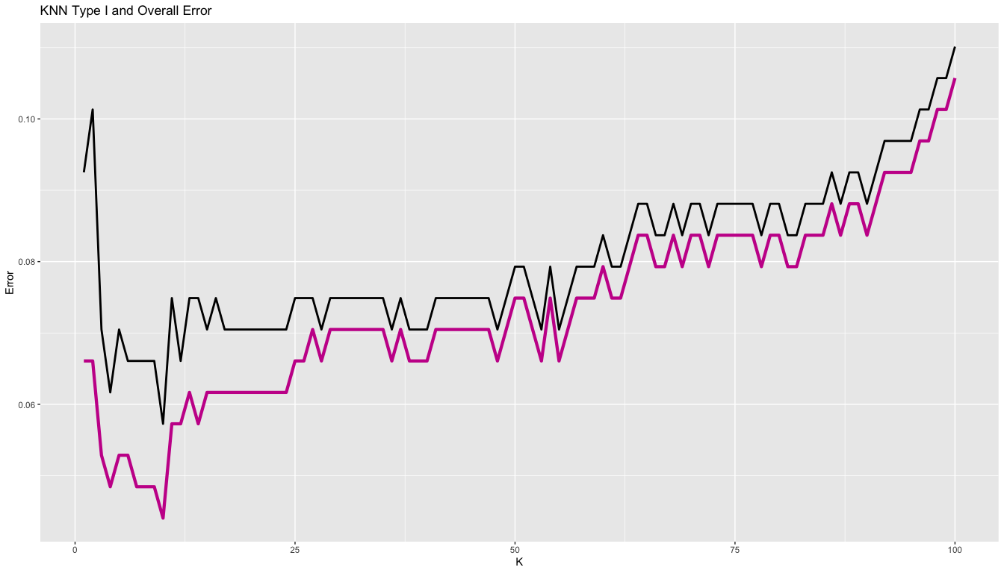
Tuning KNN

Slide 6
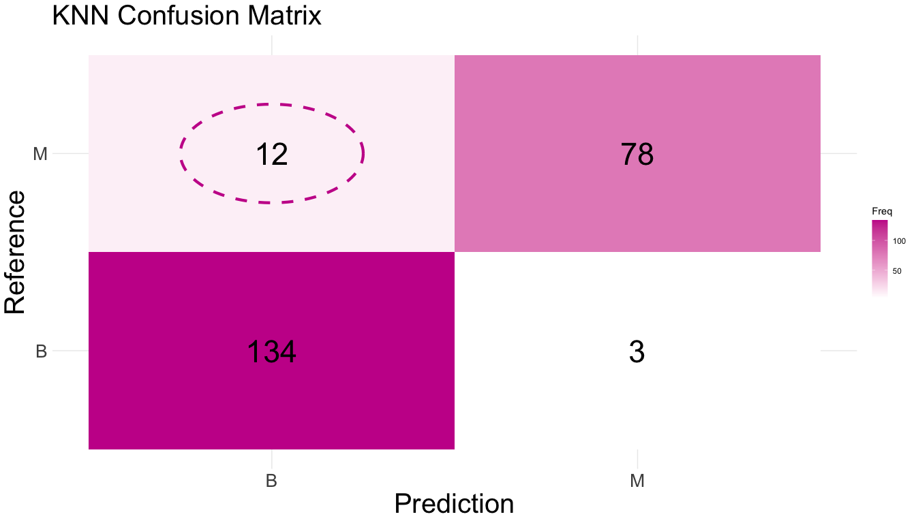
Tuned KNN

Slide 7
Tuned KNN Parameters
Using all features
10-fold cross validation repeated 10 times
$k=$ 10 neighbors
Type II Error: 0.0440529
Accuracy: 0.9339207

Slide 8
Random Forrest

Slide 9
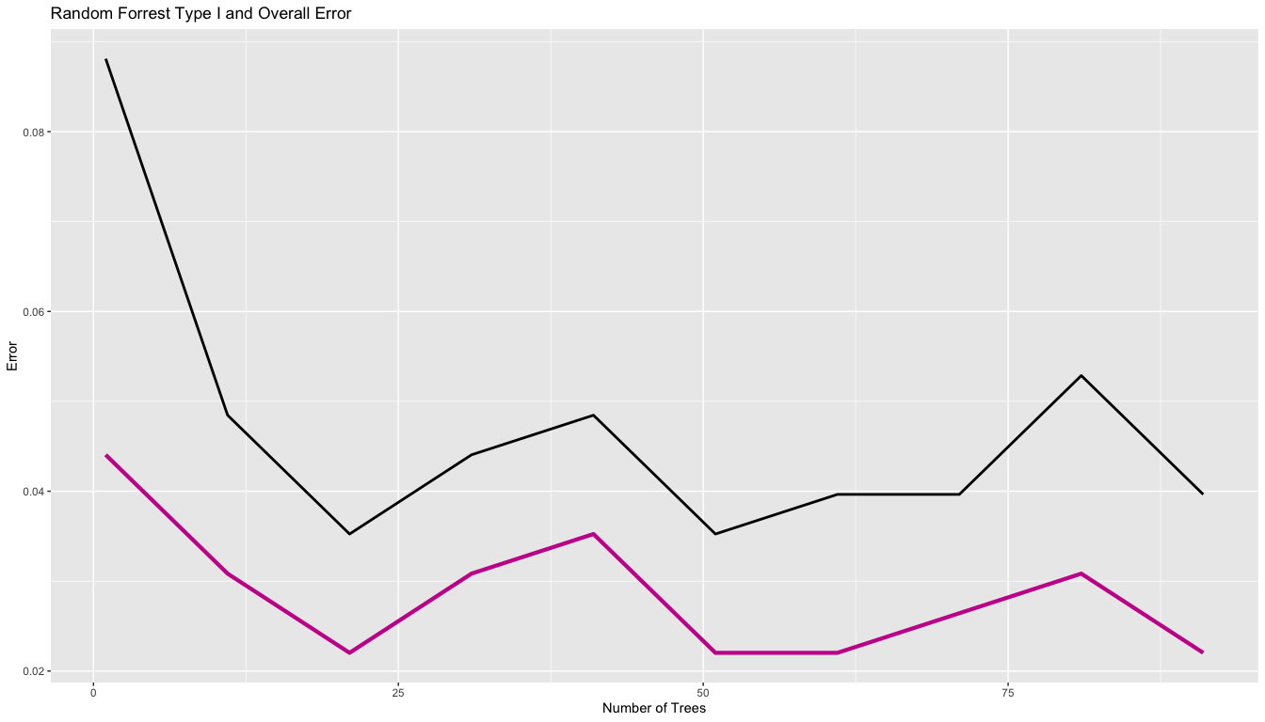
Tuning Random Forrest

Slide 10
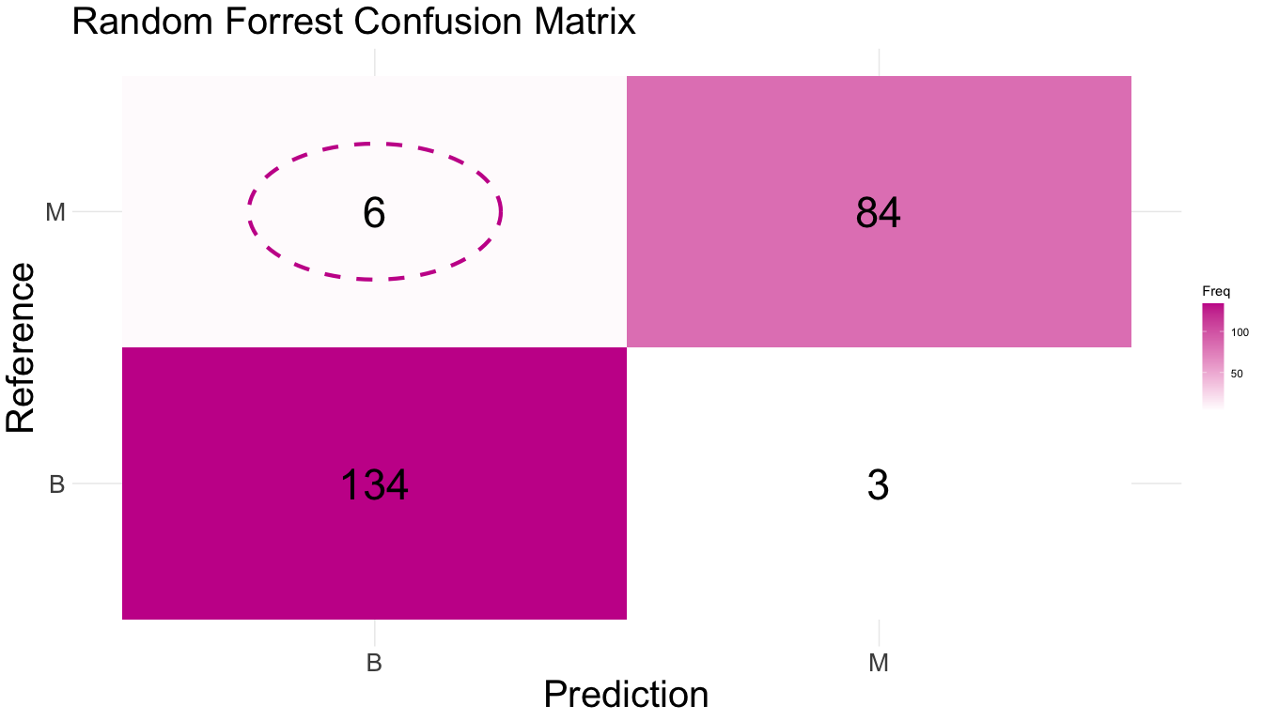
Tuned Random Forrest

Slide 11
Tuned Random Forrest Parameters
Using all features
10-fold cross validation repeated 10 times
$n=$ 21 trees
Type II Error: 0.0220264
Accuracy: 0.9603524

Slide 12
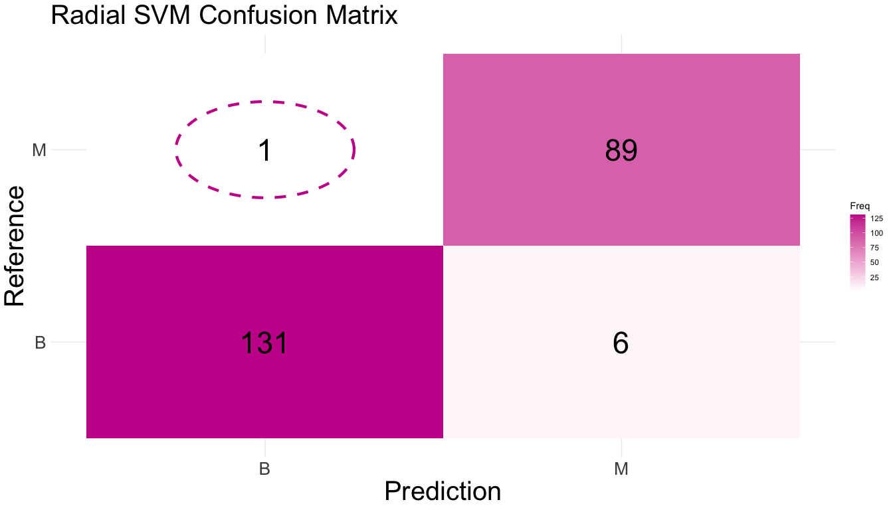
Radial Support Vector Machine

Slide 13
Radial Support Vector Machine Parameters
Using all features
10-fold cross validation repeated 10 times
Type II Error: 0.0044053
Accuracy: 0.969163

Slide 14

Tuned Radial Support Vector Machine

Slide 15
Tuned Radial Support Vector Machine Parameters
Using all features
10-fold cross validation repeated 10 times
Type II Error: 0.0088106
Accuracy: 0.9735683

