Slide 1
Characterizing breast cancer cells
Austin Lackey, Ethan Powers and Danny Laposata

Slide 2
The data
We have a dataset of 569 breast cancer cells, some of which are cancerous and some of which are benign.
We have 30 features for each cell, which are the measurements of the cell.
We have a binary variable, diagnosis, which is M for malignant and B for benign.
Add more stuff here…

Slide 3
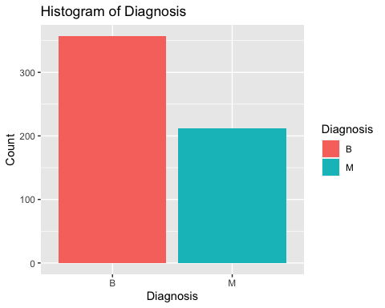
Sample Output

Slide 4
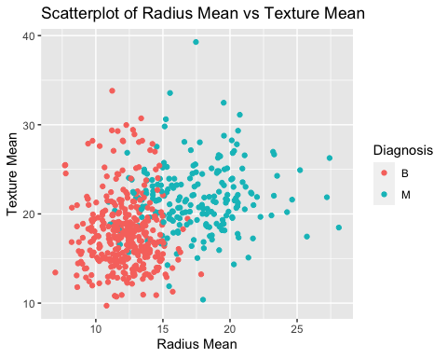
Plot

Slide 5
Works Cited
Insert link to kaggle dataset here

