Slide 1
Breast Cancer Diagnosis Classification Analysis
Austin Lackey, Ethan Powers and Danny Laposata

Slide 2
Background
Breast Cancer Diagnosis Data
Predict Diagnosis of Tumor based on features
Feature Importance/Selection
Reduce Type II Error (False-Negatives)

Slide 3
Data
Data collected from “Breast Cancer Wisconsin (Diagnostic) Data Set” from Kaggle
Response: Diagnosis
Benign: (Noncancerous Cells)
Malignant (Cancerous Cells)
Predictors: 10 variables each with 3 measurements:
Mean
Standard Error (SE)
Worst: Mean of 3 largest values of a variable
Training/Test Data Split 60/40

Slide 4
Variable Descriptions
Radius: Average Distance from cell center to cell perimeter
Texture: Standard deviation of gray-scale values; brightness of pixel of cell
Perimeter: Distance around nucleus boundary
Area: Area of the nucleus
Smoothness: Variation in cell’s radial lengths
Compactness: The Perimeter^2/Area
Concavity: Size of the indention in nucleus boundary
Concave Points: Number of points on indented section of nucleus boundary
Symmetry: Deviation of the nuclei shape from the ideal measurement
Fractal Dimension: Measurement of irregularity in nucleus boundary

Slide 5
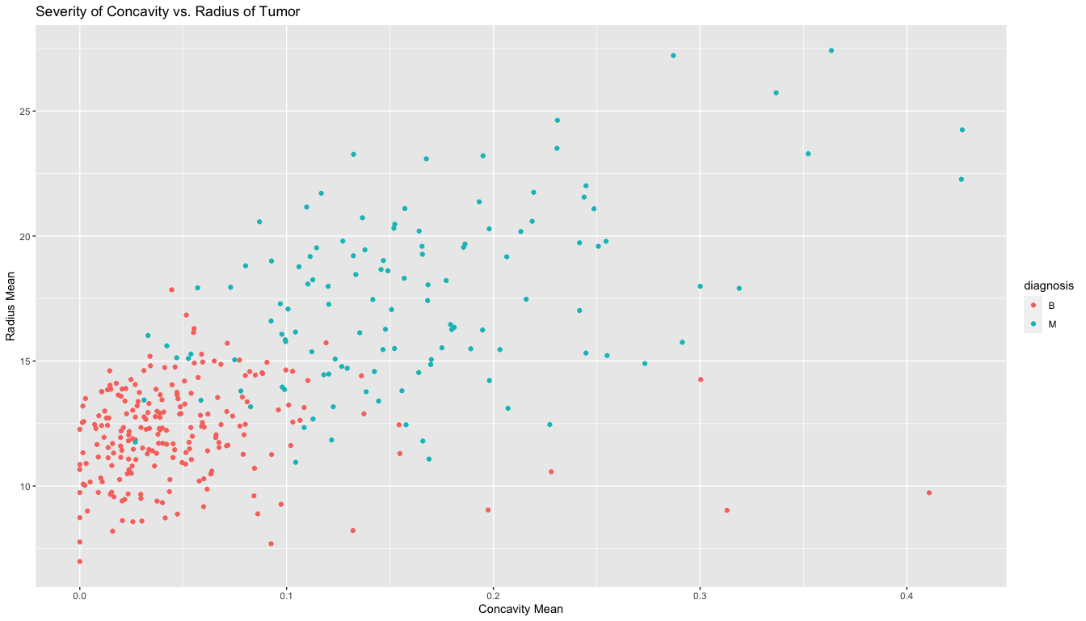
EDA

Slide 6
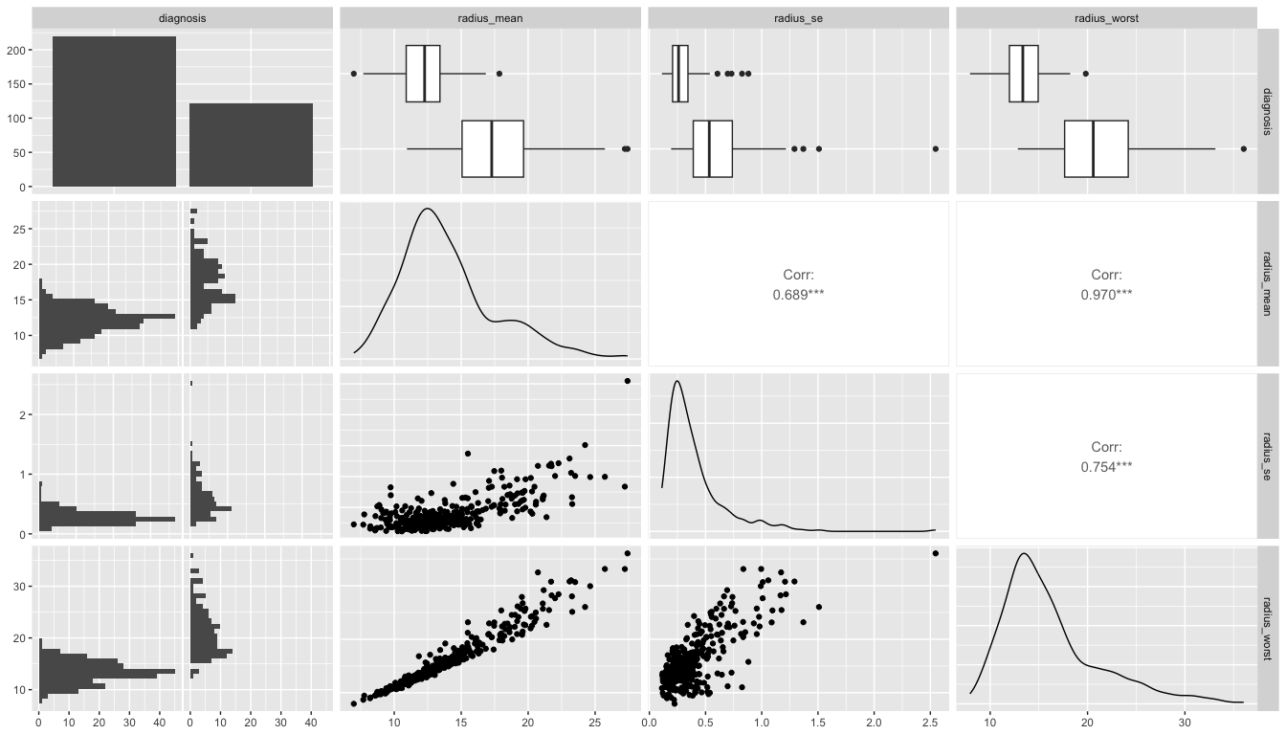
EDA

Slide 7
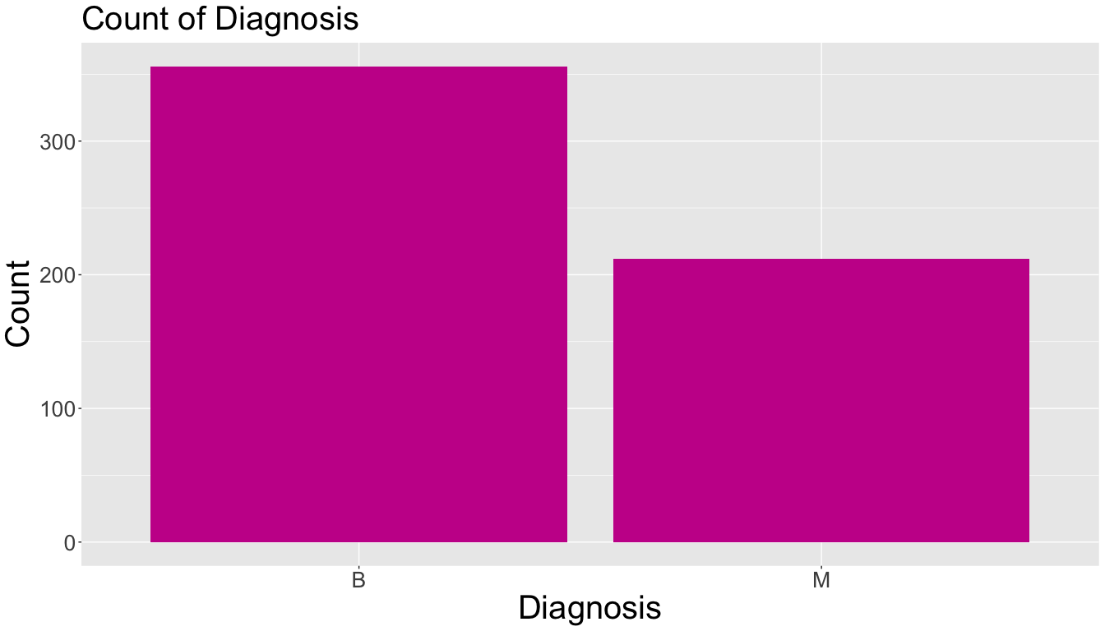
Diagnosis Distribution

Slide 8
Classification Analysis: Austin

Slide 9
Models

Slide 10
KNN Model

Slide 11
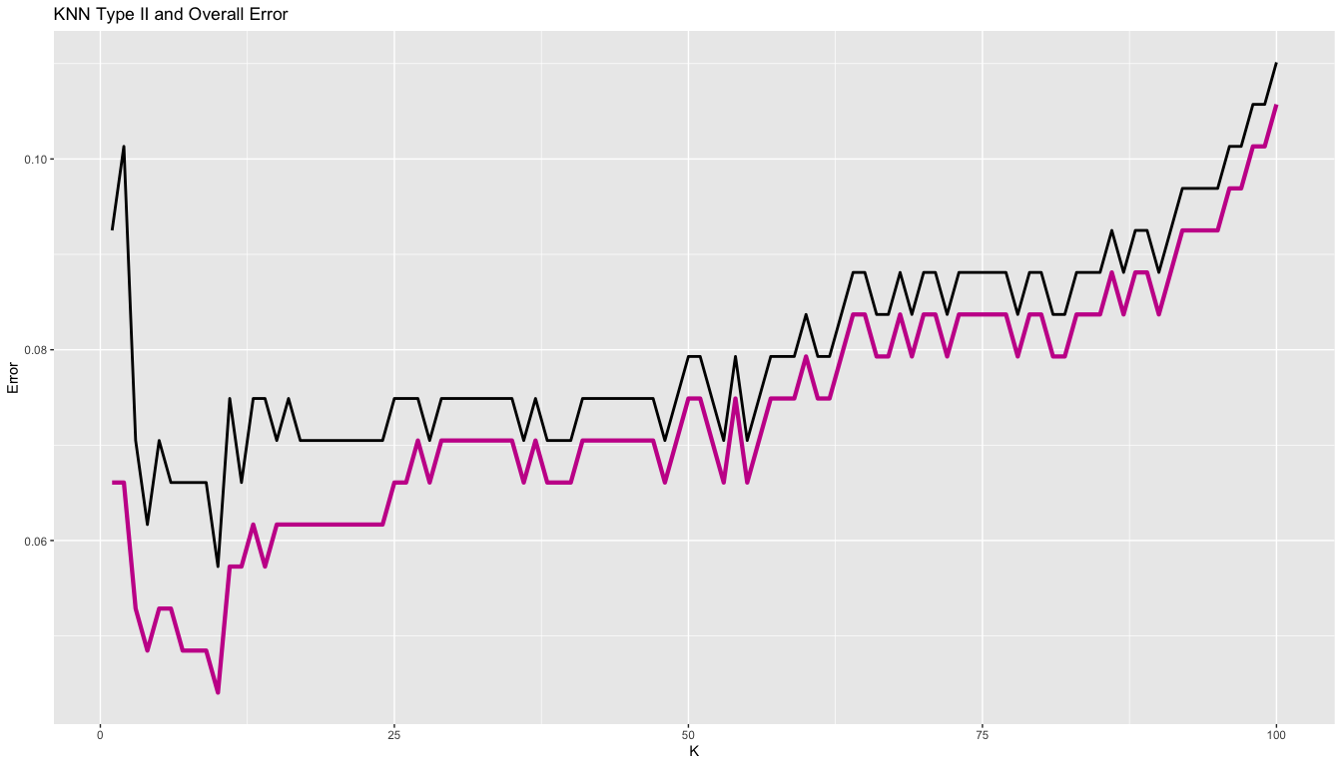
Tuning KNN

Slide 12
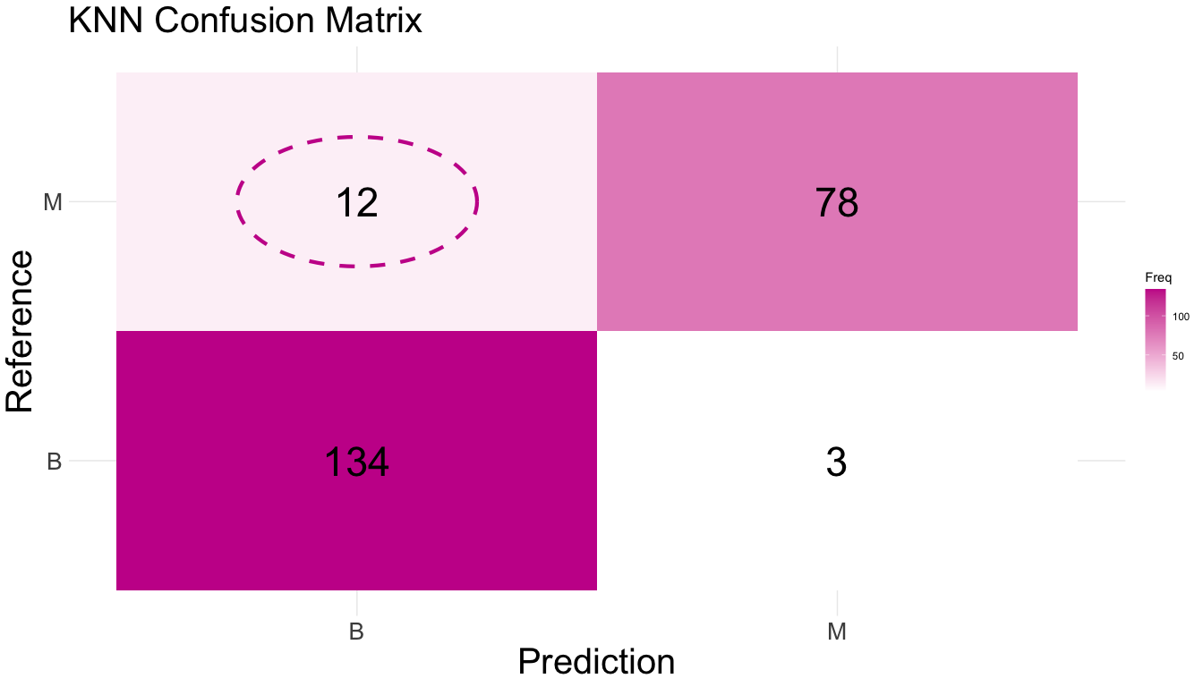
Tuned KNN

Slide 13
Tuned KNN Parameters
Using all features
10-fold cross validation repeated 10 times
$k=$ 10 neighbors
Type II Error: 0.0440529
Accuracy: 0.9339207

Slide 14
Random Forrest

Slide 15
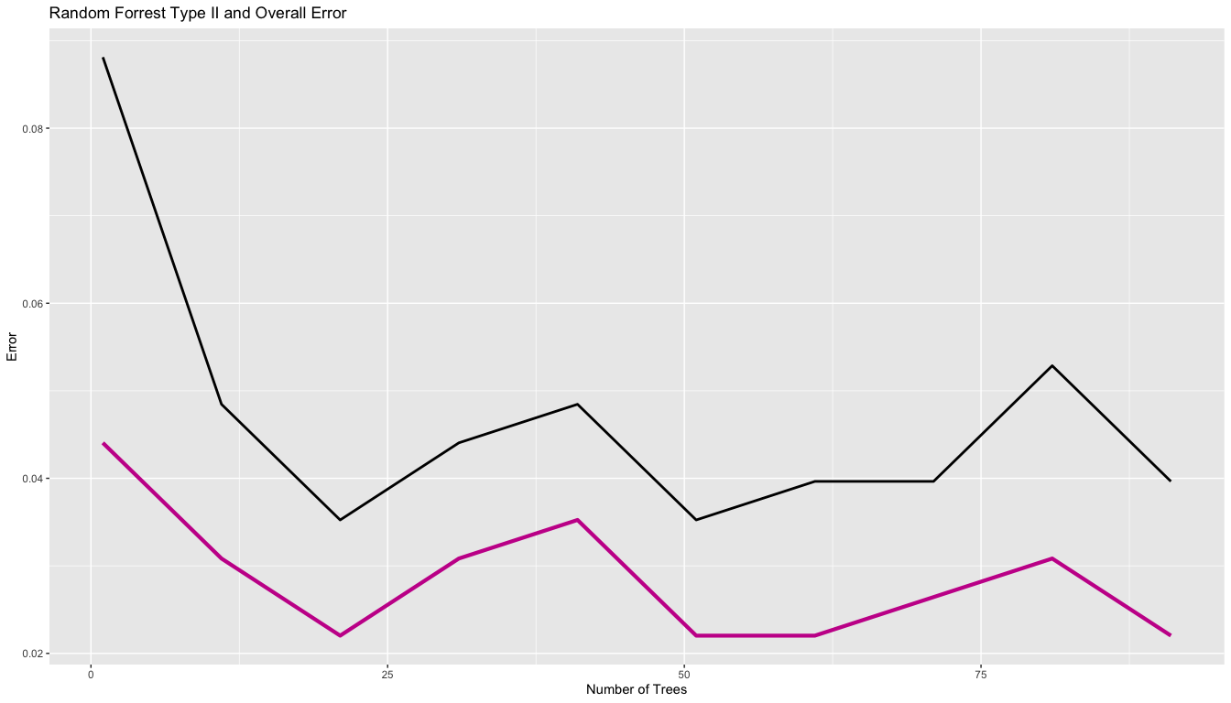
Tuning Random Forrest

Slide 16
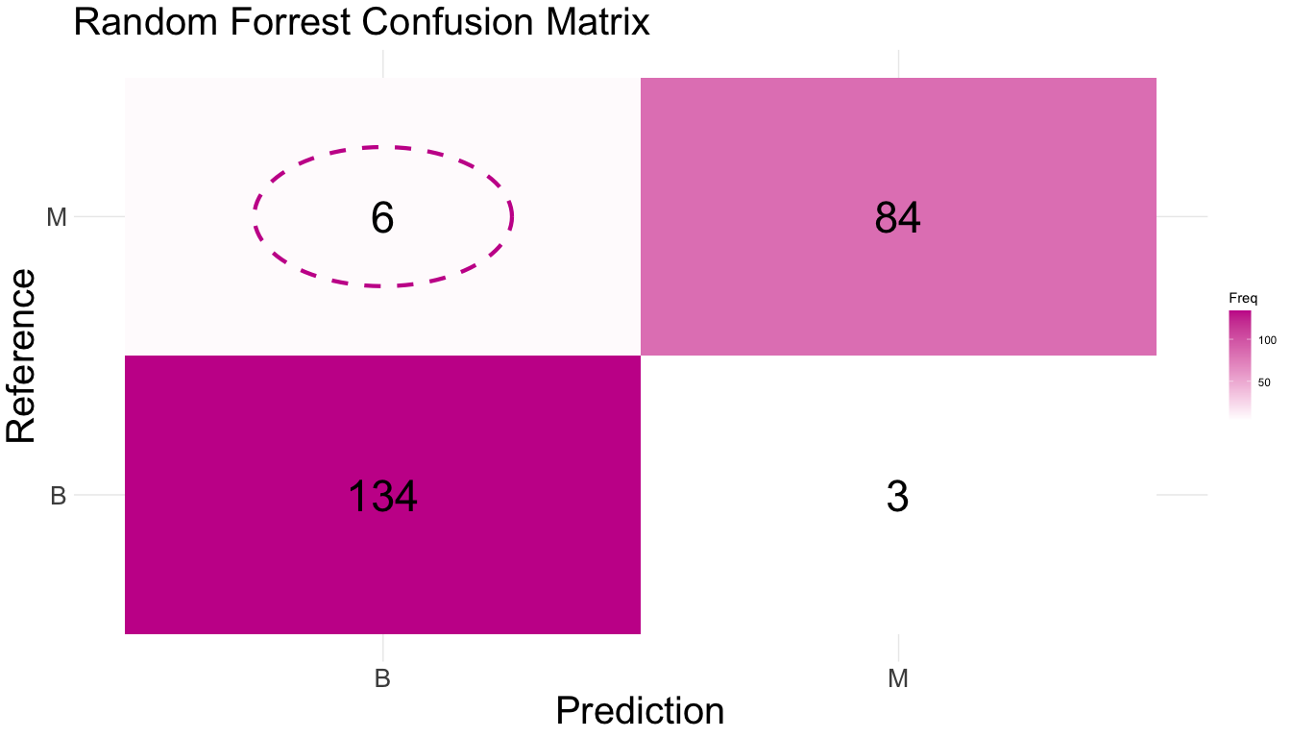
Tuned Random Forrest

Slide 17
Tuned Random Forrest Parameters
Using all features
10-fold cross validation repeated 10 times
$n=$ 21 trees
Type II Error: 0.0220264
Accuracy: 0.9603524

Slide 18
Support Vector Machines

Slide 19
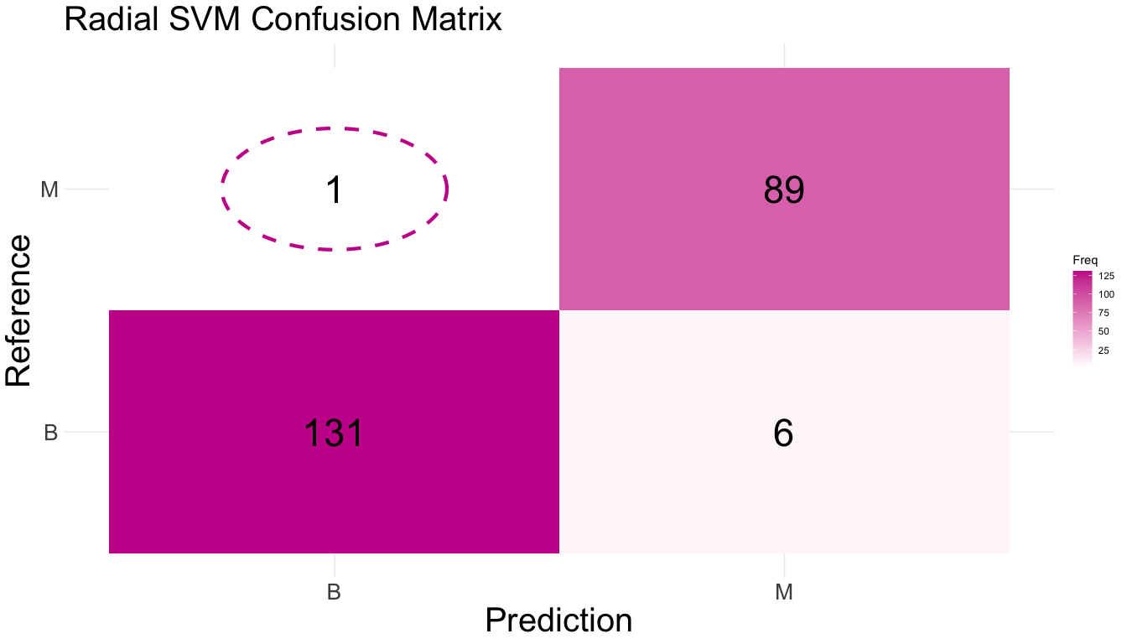
Radial Support Vector Machine

Slide 20
Radial Support Vector Machine Parameters
Using all features
10-fold cross validation repeated 10 times
Type II Error: 0.0044053
Accuracy: 0.969163

Slide 21

Tuned Radial Support Vector Machine

Slide 22
Tuned Radial Support Vector Machine Parameters
Using all features
10-fold cross validation repeated 10 times
Type II Error: 0.0088106
Accuracy: 0.9735683

Slide 23
Classification Analysis: Danny
Logistic Regression
K-Nearest Neighbors
QDA
Random Forest
xGBoost
Support Vector Classifier
Lower prediction cutoff to account for Type II Error

Slide 24
Preferred Models

Slide 25
K-Nearest Neigbors Model
Tuned neighbors value to 7
2 False-Negatives
96.04% prediction accuracy

Slide 26
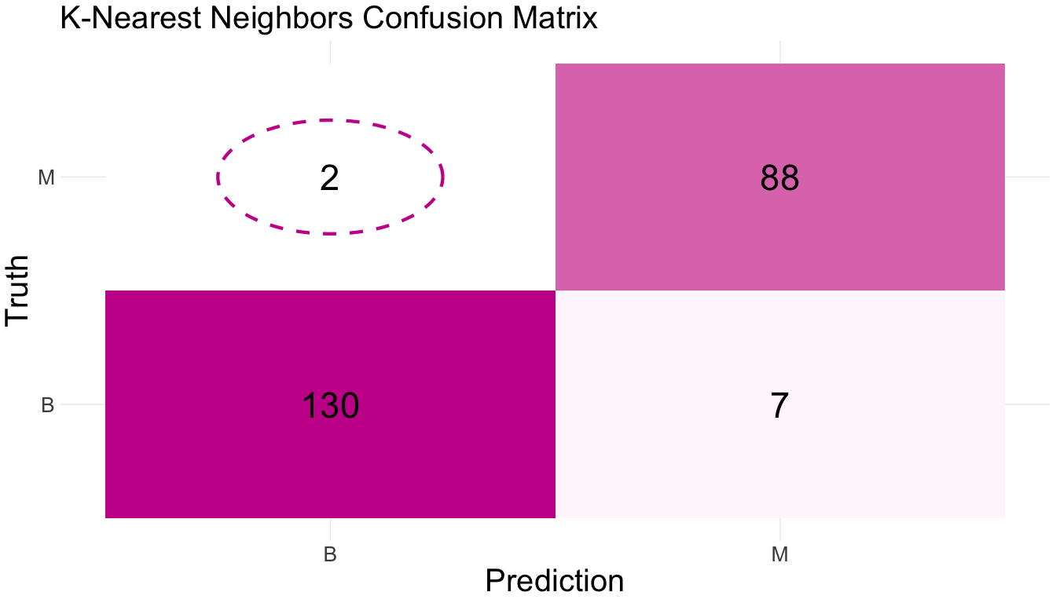
KNN Confusion Matrix

Slide 27
Support Vector Classifier Model
Tuned cost value to 1
2 False-Negatives
96.48% prediction accuracy

Slide 28
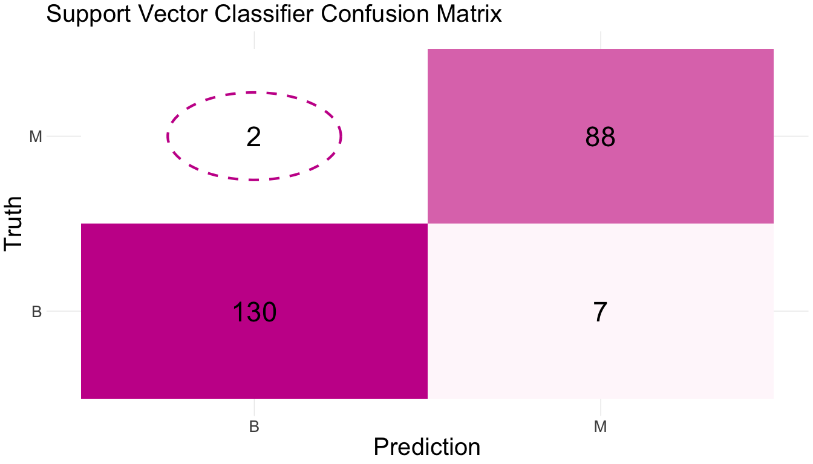
SVC Confusion Matrix

Slide 29
Random Forest Model
1 False-Negative
95.15% prediction accuracy

Slide 30
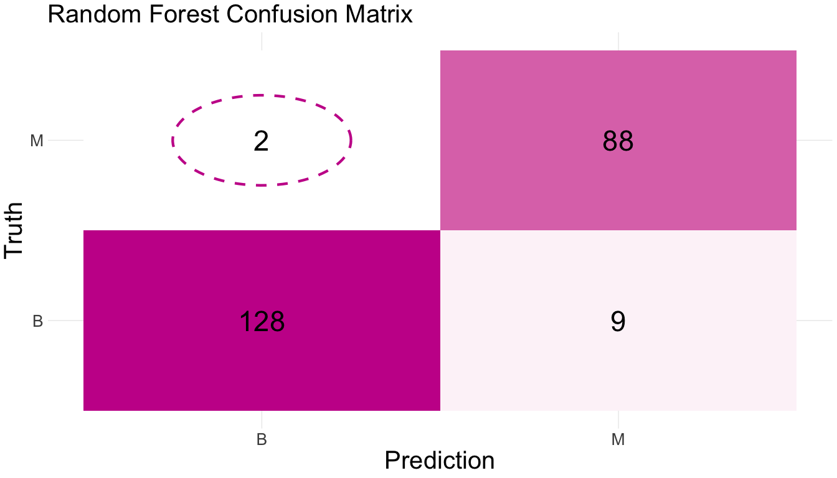
RF Confusion Matrix

Slide 31
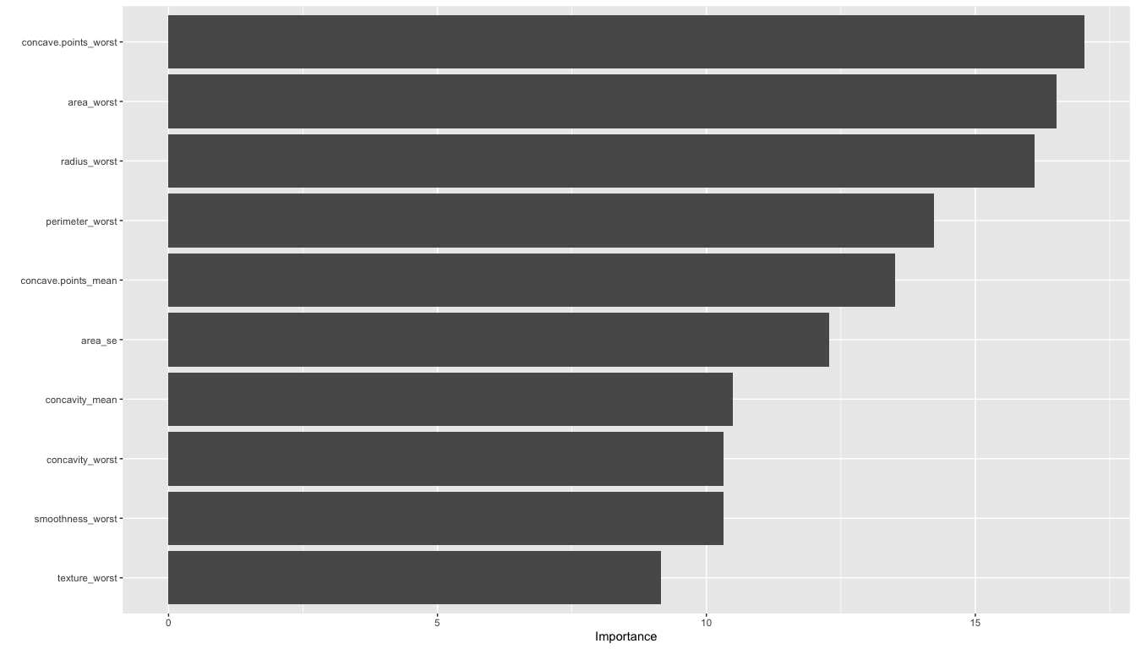
RF Confusion Matrix

Slide 32
Regression Analysis: Ethan
Austin Top 5 Importance Variables
*area_mean
*area_worst
*concave.points_mean
texture_mean
*radius_worst
Danny Top 5 Importance Variables
concave.points_worst
*concave.points_mean
*area_worst
*area_mean
*radius_worst

Slide 33
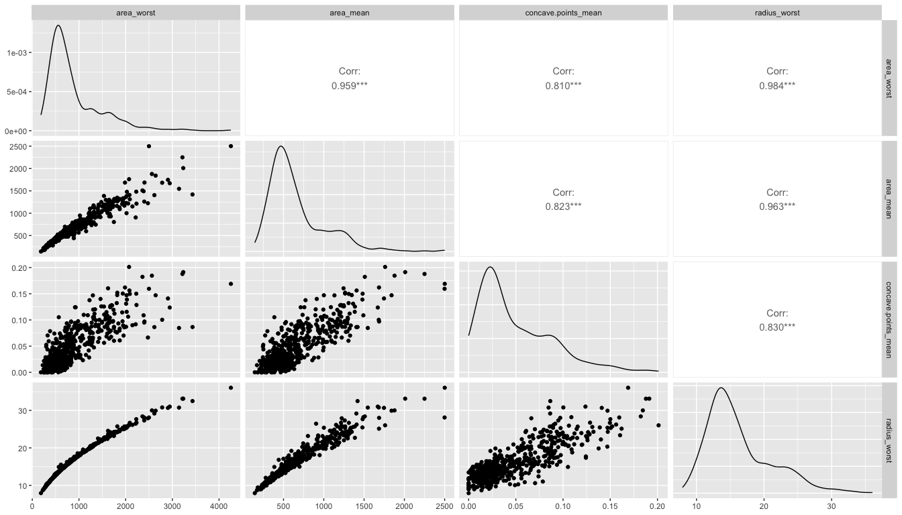
Correlation Plot

Slide 34
Models
Calculating Training and Test Set Error
Linear Regression
Ridge Regression
Lasso Regression

Slide 35
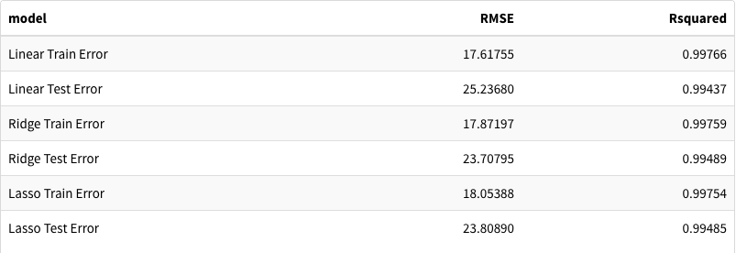
area_mean
Best Model was Ridge Regression

Slide 36
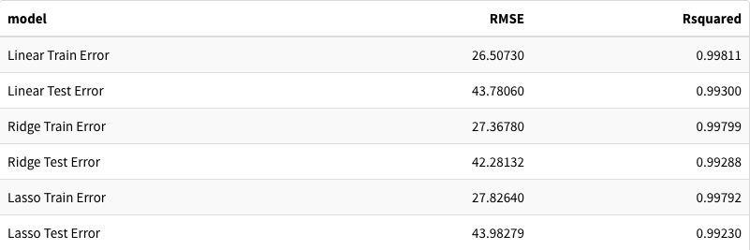
area_worst
Best Model was Linear Regression

Slide 37
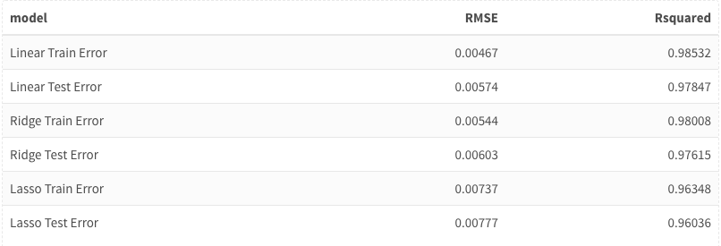
concave.points_mean
Best Model was Linear Regression

Slide 38

radius_worst
Best Model was Linear Regression

Slide 39
Analysis Summary
Interpretation difficulties
High prediction accuracy
Successful with multiple methods of reducing Type II Error

Slide 40
Potential Improvements
More data points (more observations)
More features (more variables)
More proccessing power

Slide 41
Works Cited
Breast Cancer Wisconsin (Diagnostic) Data Set:
https://www.kaggle.com/datasets/uciml/breast-cancer-wisconsin-data?datasetId=180&sortBy=voteCount
Definition of Features (Variables):
https://www.causeweb.org/usproc/sites/default/files/usclap/2017-2/Evaluating_Benign_and_Malignant_Breast_Cancer_Cells_from_Fine-Needle_Aspirates.pdf

