Slide 1
Breast Cancer Diagnosis Classification Analysis
Austin Lackey, Ethan Powers and Danny Laposata

Slide 2
Background
Breast Cancer Diagnosis Data
Predict Diagnosis of Tumor based on features (Malignant or Benign)
Reduce Type II Error (False-Negatives)
Feature and Model Selection

Slide 3
Models

Slide 4
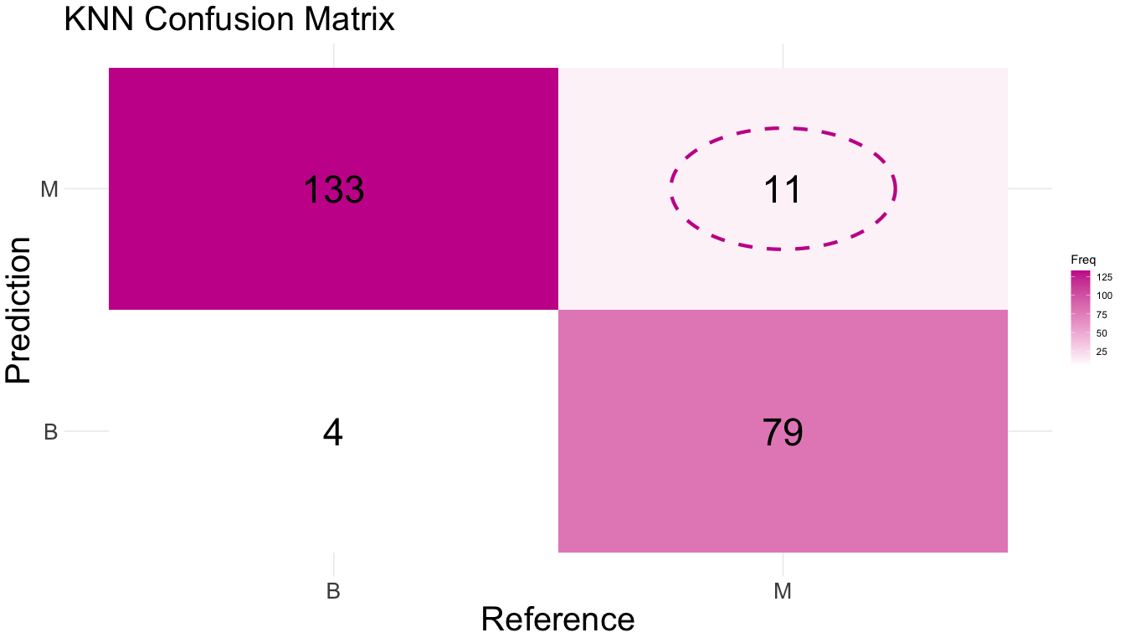
KNN

Slide 5
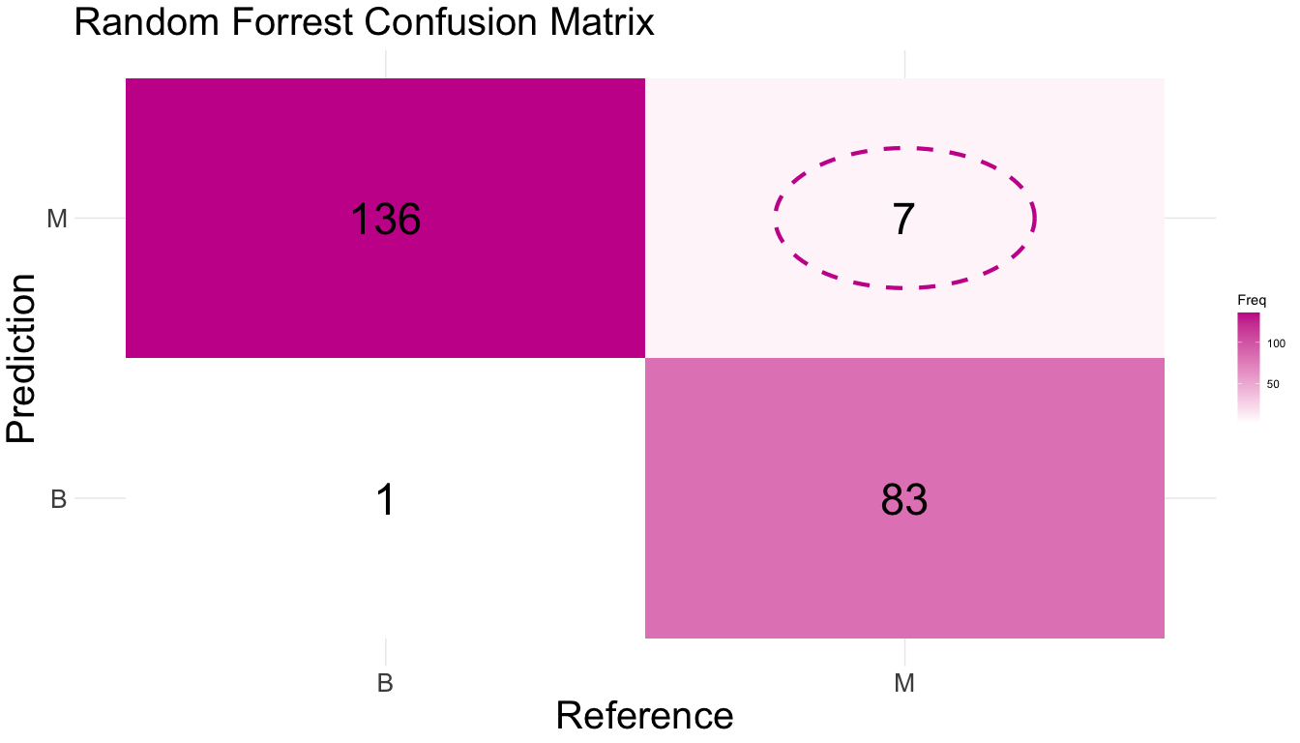
Random Forrest

Slide 6
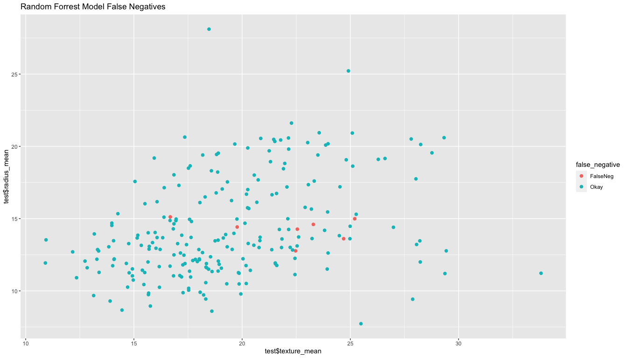

Slide 7
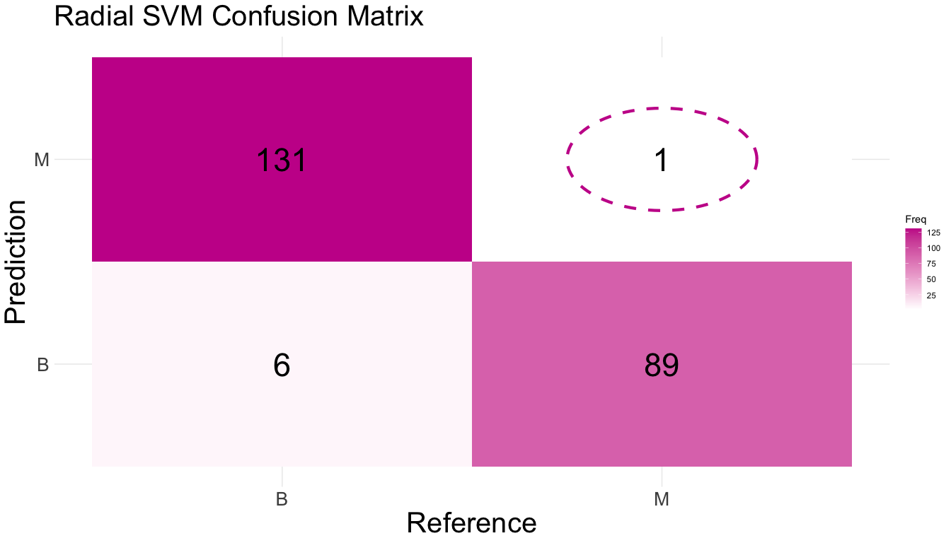
Radial Support Vector Machine

Slide 8


