Slide 1
Breast Cancer Diagnosis Classification Analysis
Austin Lackey, Ethan Powers and Danny Laposata

Slide 2
Background
Many people are diagnosed with breast cancer each year
Breast Cancer Diagnosis Data
Predict Diagnosis of Tumor based on features (Malignant or Benign)
Modivation: Reduce Type II Error (False-Negatives)
Feature and Model Selection

Slide 3
Data
Data collected from Kaggle
Response: Diagnosis (Benign/Malignant)
Mean, SE, and “Worst” measurements of 10 variables
Training/Test Split (60/40)

Slide 4
Features

Slide 5
EDA
Different measurements of each variable are correlated
Relationship with Diagnosis visible for each measurement

Slide 6
Classification Analysis: Austin

Slide 7
Models

Slide 8
KNN Model

Slide 9
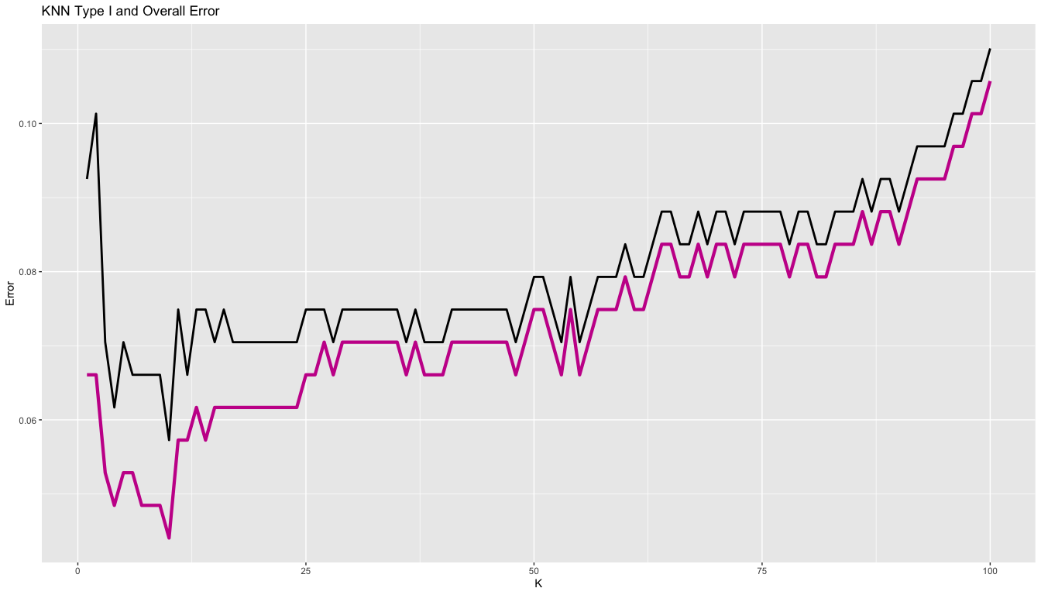
Tuning KNN

Slide 10
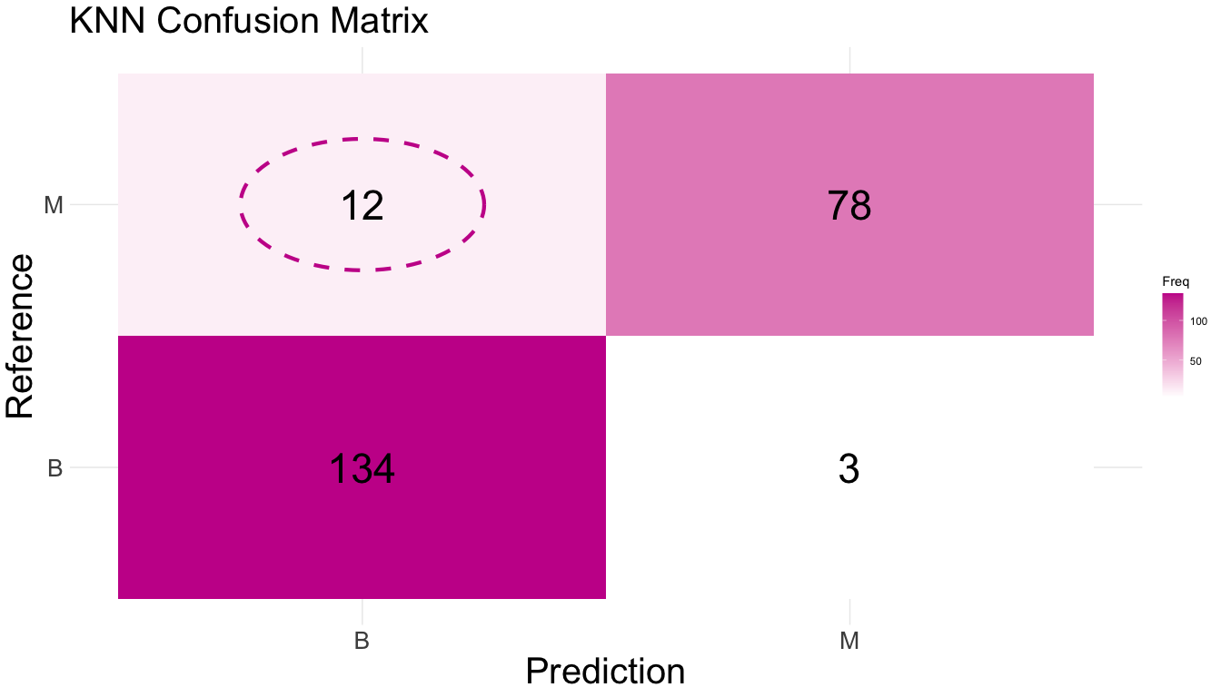
Tuned KNN

Slide 11
Tuned KNN Parameters
Using all features
10-fold cross validation repeated 10 times
$k=$ 10 neighbors
Type II Error: 0.0440529
Accuracy: 0.9339207

Slide 12
Random Forrest

Slide 13
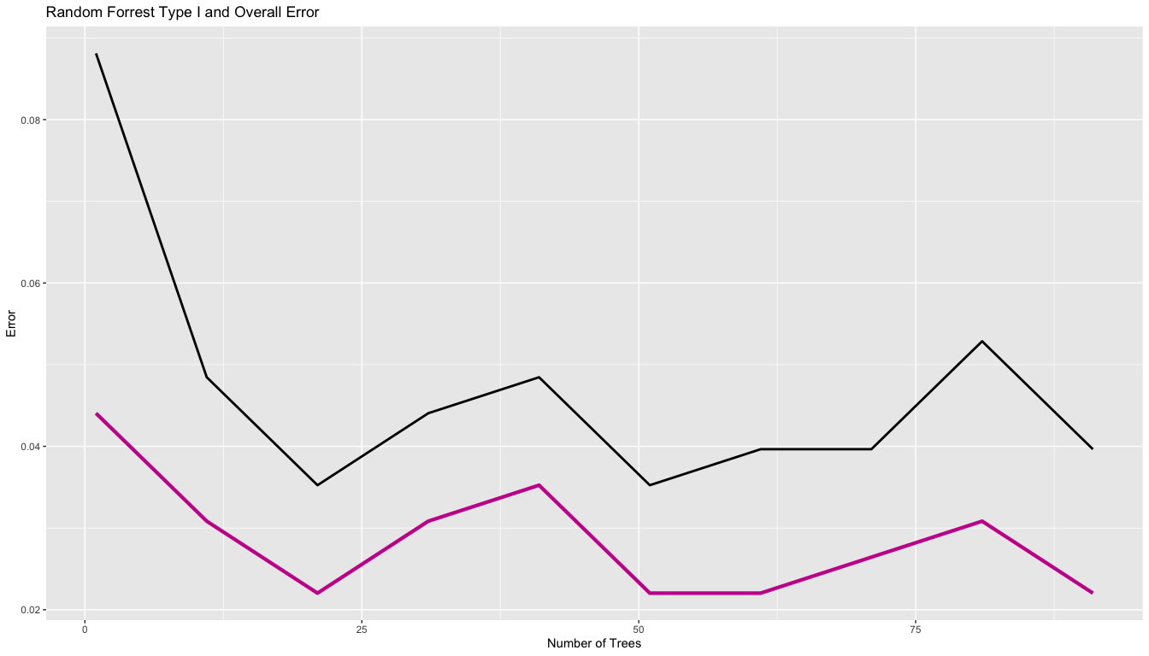
Tuning Random Forrest

Slide 14
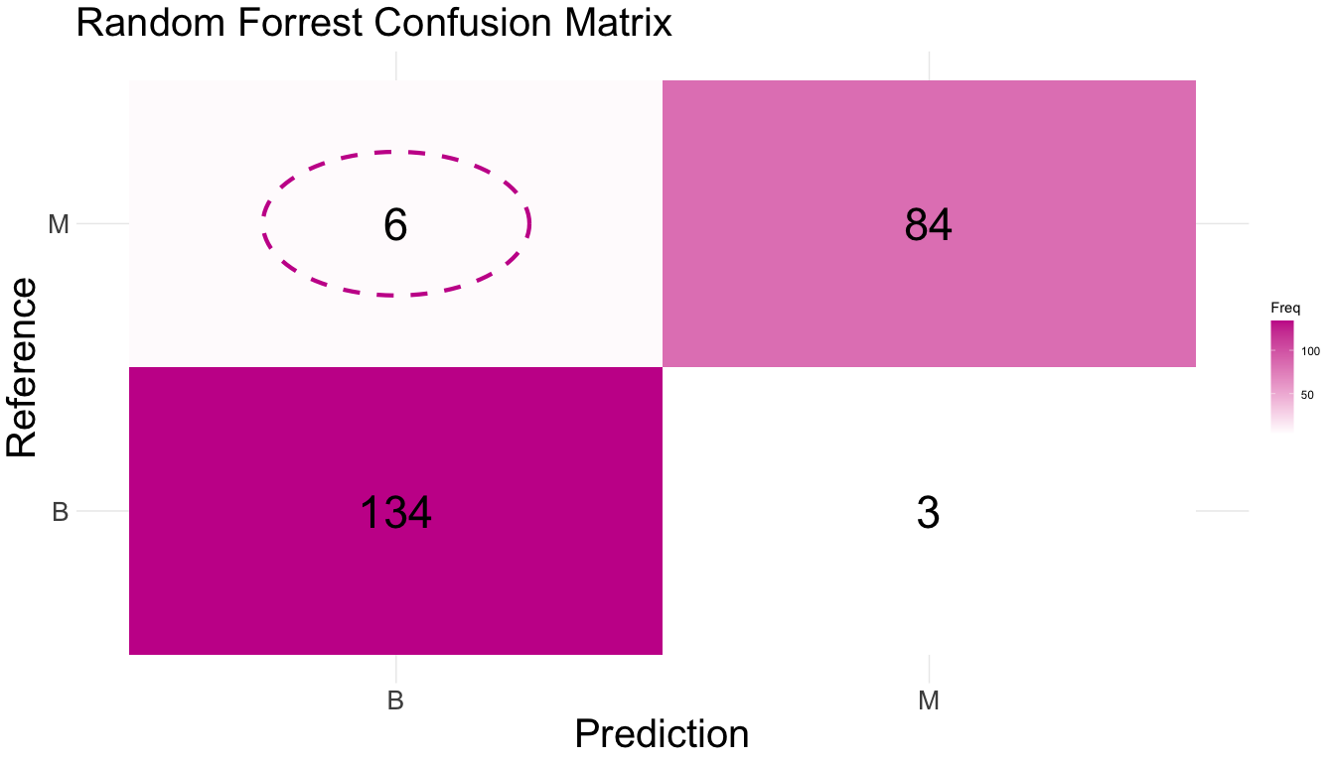
Tuned Random Forrest

Slide 15
Tuned Random Forrest Parameters
Using all features
10-fold cross validation repeated 10 times
$n=$ 21 trees
Type II Error: 0.0220264
Accuracy: 0.9603524

Slide 16
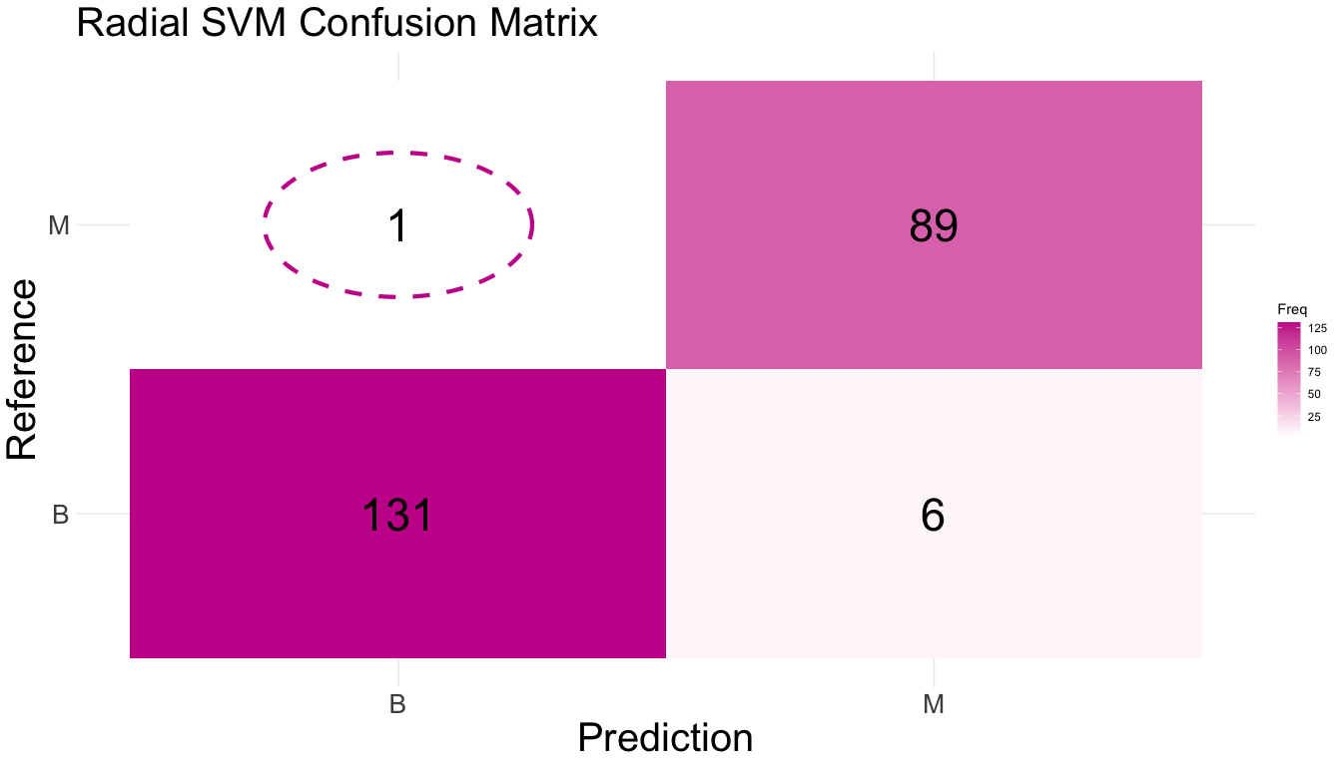
Radial Support Vector Machine

Slide 17
Radial Support Vector Machine Parameters
Using all features
10-fold cross validation repeated 10 times
Type II Error: 0.0044053
Accuracy: 0.969163

Slide 18

Tuned Radial Support Vector Machine

Slide 19
Tuned Radial Support Vector Machine Parameters
Using all features
10-fold cross validation repeated 10 times
Type II Error: 0.0088106
Accuracy: 0.9735683

Slide 20
Classification Analysis: Danny
Logistic Regression
K-Nearest Neighbors
QDA
Random Forest
xGBoost
Support Vector Classifier
Lower prediction cutoff to account for Type II Error

Slide 21
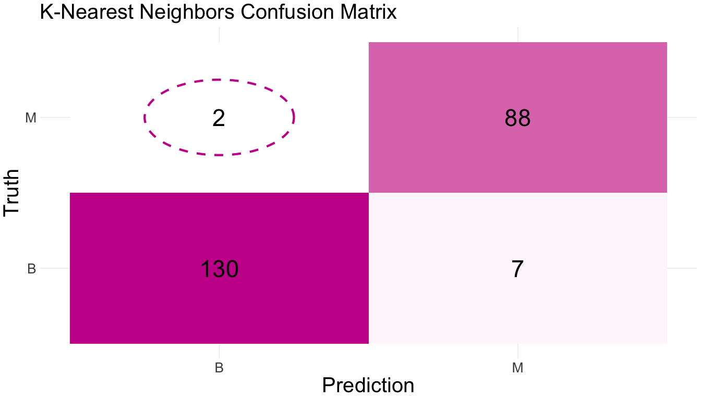
K-Nearest Neigbors Model
Tuned neighbors value to 7
2 False-Negatives
knn.err % prediction accuracy

Slide 22
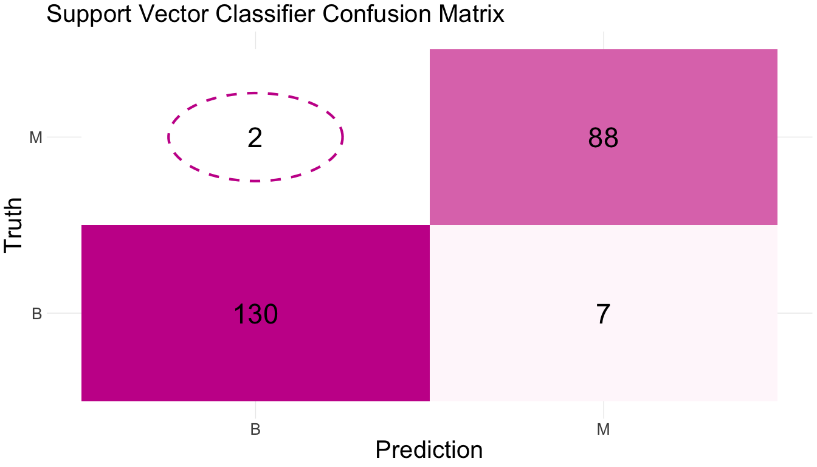
Support Vector Classifier Model
Tuned cost value to 1
2 False-Negatives
svm.err % prediction accuracy

Slide 23
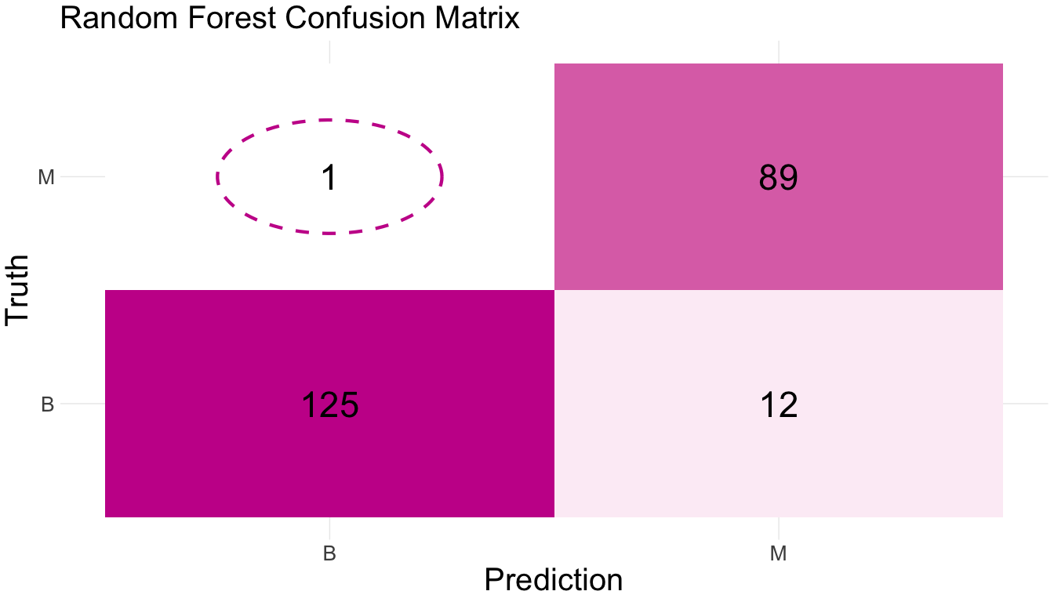
Random Forest Model
1 False-Negative
rf.err % prediction accuracy

Slide 24
Regression Analysis: Ethan

Slide 25
Model Assesments

Slide 26
Works Cited
Insert link to kaggle dataset here

