Slide 1
Breast Cancer Diagnosis Classification Analysis
Austin Lackey, Ethan Powers and Danny Laposata

Slide 2
Background
Breast Cancer Diagnosis Data
Predict Diagnosis of Tumor based on features
Reduce Type II Error (False-Negatives)
Feature Selection

Slide 3
Data
Data collected from Kaggle
Response: Diagnosis (Benign/Malignant)
Mean, SE, and “Worst” measurements of 10 variables
Training/Test Split (60/40)

Slide 4
Features

Slide 5
EDA
Different measurements of each variable are correlated
Relationship with Diagnosis visible for each measurement

Slide 6
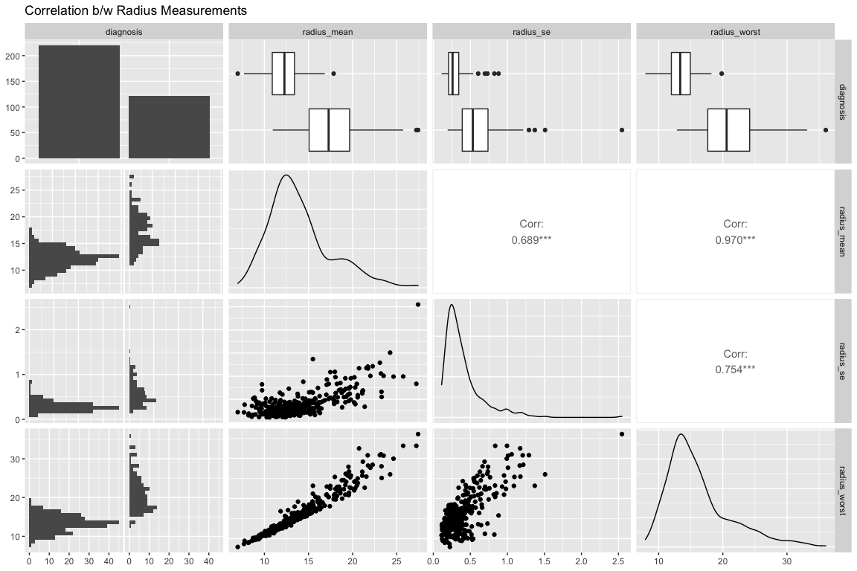

Slide 7
Classification Analysis: Austin

Slide 8
Classification Analysis: Danny

Slide 9
Regression Analysis: Ethan

Slide 10
Model Assesments

Slide 11
Works Cited
Insert link to kaggle dataset here

