Slide 1

AutoNN: An evolutionary algorithm for finding efficient Neural Network models
David Laredo
OCTOBER 2018

Slide 2


Introduction
Deep learning is changing the way artificial intelligence is being done
Efficiently choosing suitable neural network models (including hyperparameters) is time consuming.

Slide 3
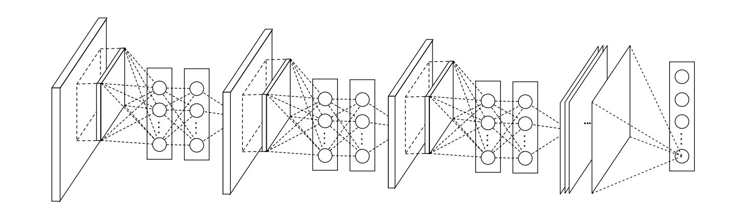
There are different types of neural networks (RNN, Dense, CNN, etc.)
Building a topology involves multiple choices
Type of layer
Number of layers
Number of neurons
Activation functions
Regularization/Dropout

Slide 4
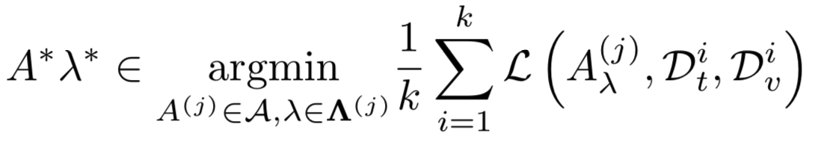
The CASH problem
Let A be any given algorithm (ANN, RNN, CNN), \lamda the combination of its different hyperparameters and L the loss achieved by A when trained on D_t and evaluated on D_v. Finally k is the number of folds used for evaluation.
CASH (Combined Algorithm Selection and Hyperparameter Optimization) is defined as:
Notes:
Every framework assumes it owns a set of nodes
Partitioning can be done in two ways: Physical machines or virtual machines (cut a slide for every framework and let it run in there)

Slide 5
Available frameworks for solving CASH
Auto Weka: Uses Bayesian optimization to search through the joint space of Weka learning algorithms and their hyperparameters:
Limited when it comes to neural networks
Not very flexible
Auto-sklearn: Part of sklearn framework
Comprises a smaller space of models and hyperparameters
Not very efficient when it comes to neural networks

Slide 6
Available frameworks for solving CASH
TuPAQ: Built on top of Spark and uses a planning algorithm to decide on and efficient parallel execution
Only provides support for classification problems
Suppor fot only thre types of learning algorithms (SVM, Logistic Regression and nonlinear SVM)
PyBrain

Slide 7
AutoNN
AutoNN is a technique based on evolutionary algorithms for selecting efficient neural network models.
It can optimize models based on MLP, RNN and CNN
Based on the micro-genetic algorithm for high efficiency
Fitness of the networks is assessed based on the size of the network and its performance L
Based on a set of rules to ensure the construction of valid architectures
Makes use of new crossover and mutation operators
Introduces a new technique for measuring the similarity between two neural networks.
Notes:
Run multiple instances of the same framework:
Workloads can be isolated which is good for production and experimental jobs
Run multiple versions of the framework concurrently (test out several versions or deploy ugrades)
Build specialized frameworks targeting particular problem domains: It is easier to build and deploy specialized frameworks for which general abstractions don’t work well: For instance Spark for iterative programming which outperforms Hadoop by a factor of 10

Slide 8
AutoNN Basic algorithm
Select a small population size (5-10 individuals)
Evaluate fitness of each individual (involves partial traini of the neural network)
Apply selection to form pairs of parents
From the parent pool apply crossover with probability of 1
For each offspring apply mutation with probability of C_m
Repeat until maximum of generations or model convergence
Notes:
Run multiple instances of the same framework:
Workloads can be isolated which is good for production and experimental jobs
Run multiple versions of the framework concurrently (test out several versions or deploy ugrades)
Build specialized frameworks targeting particular problem domains: It is easier to build and deploy specialized frameworks for which general abstractions don’t work well: For instance Spark for iterative programming which outperforms Hadoop by a factor of 10

Slide 9
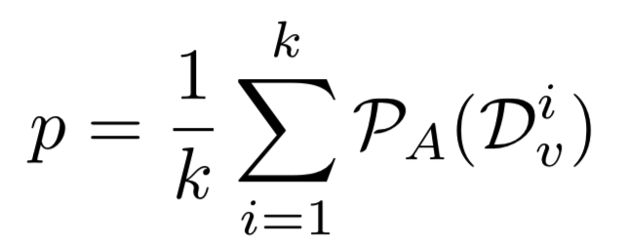
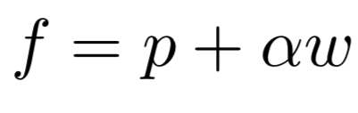
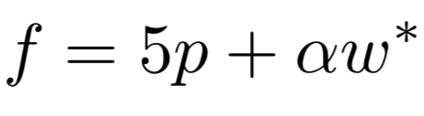
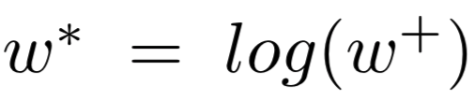
AutoNN: Fitness function
Let p be the performance of the neural network A tested on D_v and let w be the size of the network in terms of trainable weights. Finally let \alpha be a penalty factor (0,1) for the size of the network.

Slide 10
Genotype representation
Each layer is represented as a fixed size array
The neural network architecture is represented as a list of such arrays
Only compatible layers can be stacked together
Allows for variable length architectures to be represented.
Computationally efficient
Notes:
Each framework will have different scheduling needs
Small Micro-kernel like core pushes scheduling logic to frameworks

Slide 11
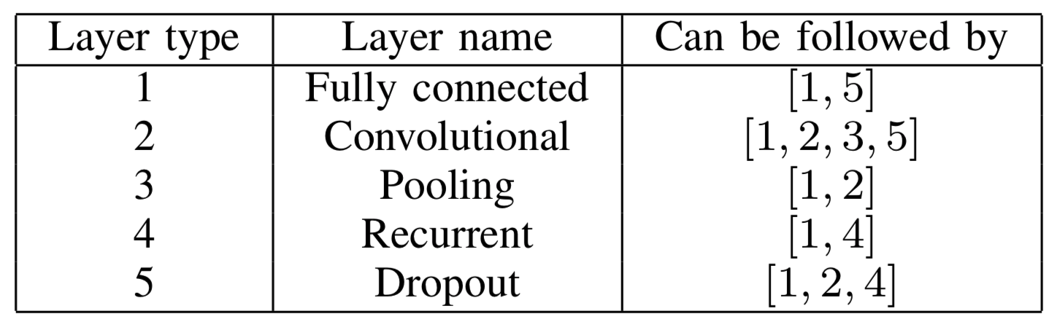
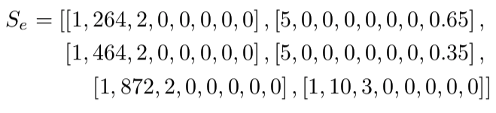
Architecture building rules
Notes:
If a user wishes to write an ad targeting algorithm in MPI instead of MapReduce, perhaps because MPI is more efficient for this job’s communication pattern,
then the user must set up a separate MPI cluster and import terabytes of data into it. This problem is not hypothetical;

Slide 12
Selection and crossover
Selection
Tournament based mechanism
Crossover
Takes two models and randomly selects two points at each model
Replaces selected part of first model with selected part of second model
Ensures valid models are generated
Notes:
Mesos decides how many resources to offer to each framework and the framework decides which resources to accept and which tasks to run on them
+Keeps mesos simple
-Decisions may not be optimal
Mesos is implemented in 10,000 lines of C++ code and scales up to 50,000 nodes
With centralized scheduling:
+Can make optimal decisions (you have all the information of the frameworks)
-Complex: Language must support all frameworks
-Difficult to scale and make robust
-Future frameworks may have needs not anticipated

Slide 13
Mutation
Select one layer at random
For that layer select one feature that affects that layer at random
Change the value of the feature for a randomly generated value
May also add dropout layers if it is compatible
Notes:
Mesos decides how many resources to offer to each framework and the framework decides which resources to accept and which tasks to run on them
+Keeps mesos simple
-Decisions may not be optimal
Mesos is implemented in 10,000 lines of C++ code and scales up to 50,000 nodes
With centralized scheduling:
+Can make optimal decisions (you have all the information of the frameworks)
-Complex: Language must support all frameworks
-Difficult to scale and make robust
-Future frameworks may have needs not anticipated

Slide 14
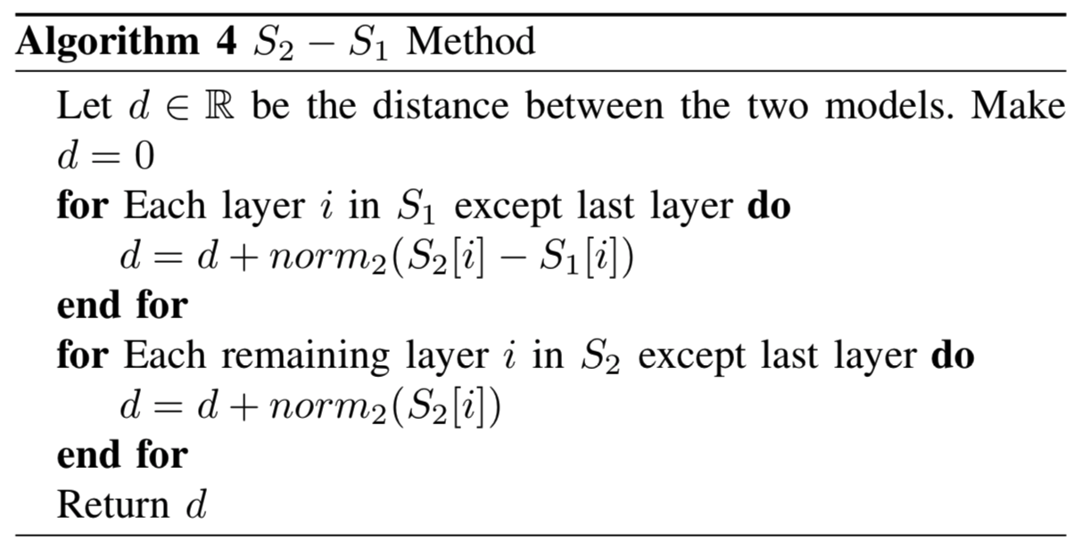
Determining convergence
Notes:
Mesos decides how many resources to offer to each framework and the framework decides which resources to accept and which tasks to run on them
+Keeps mesos simple
-Decisions may not be optimal
Mesos is implemented in 10,000 lines of C++ code and scales up to 50,000 nodes
With centralized scheduling:
+Can make optimal decisions (you have all the information of the frameworks)
-Complex: Language must support all frameworks
-Difficult to scale and make robust
-Future frameworks may have needs not anticipated

Slide 15
Implementation
AutoNN is implemented in Pyhton in about 700 lines of code
Code can be found in https://github.com/dlaredo/ automatic model selection
Models are fetched to keras an partially trained
Ray is used to distribute the training of the different models across the cluster. Genotypes are sent and scores are returned
Notes:
Characterize the environments that Mesos’ distributed scheduling model works well in

Slide 16
Evaluation
Evaluation on MNIST dataset
MNIST is used as a baseline to assess the performance of AutoNN
We evaluate the accuracy of the obtained models and their sizes
We analyze the tradeoff between neural network size and performance
We exemplify each of the components of AutoNN with MNIST
Notes:
Elastic framework such as Hadoop can scale its resources up and down, it can start using nodes as soon as it acquires them and releases them as soon its task finish
Rigid framework such as MPI can start running jobs only after it has acquired a fixed quantity of resources and can not scale up dynamically or scale down without a large impact on performance
Mandatory resources are those required by a framework in order to run
Preferred resources are not needed

Slide 17
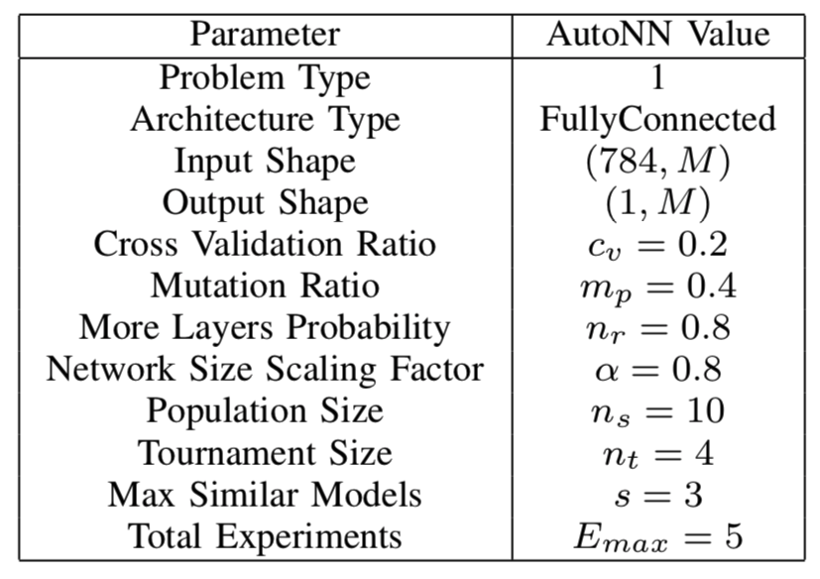
Evaluation on MNIST
Notes:
Elastic framework such as Hadoop can scale its resources up and down, it can start using nodes as soon as it acquires them and releases them as soon its task finish
Rigid framework such as MPI can start running jobs only after it has acquired a fixed quantity of resources and can not scale up dynamically or scale down without a large impact on performance
Mandatory resources are those required by a framework in order to run
Preferred resources are not needed

Slide 18
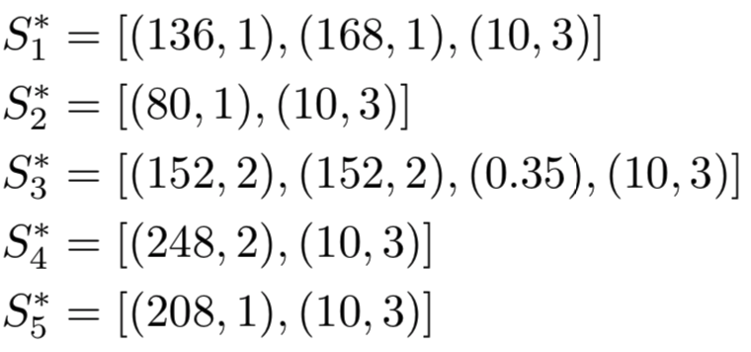
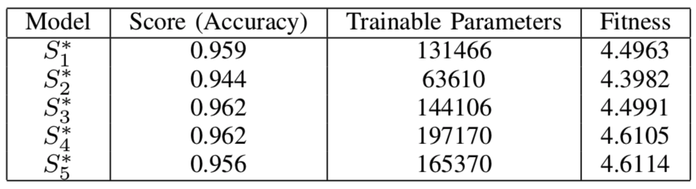
Evaluation on MNIST (\alpha=0.8)
Notes:
Elastic framework such as Hadoop can scale its resources up and down, it can start using nodes as soon as it acquires them and releases them as soon its task finish
Rigid framework such as MPI can start running jobs only after it has acquired a fixed quantity of resources and can not scale up dynamically or scale down without a large impact on performance
Mandatory resources are those required by a framework in order to run
Preferred resources are not needed

Slide 19
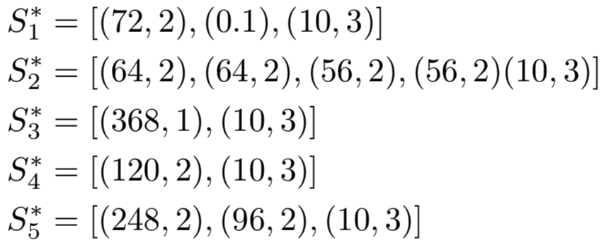
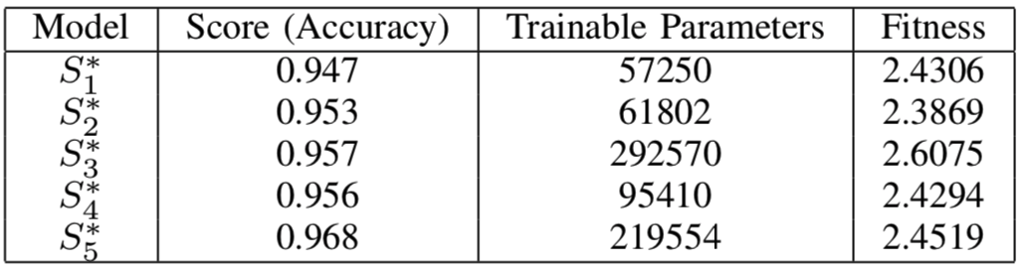
Evaluation on MNIST (\alpha=0.6)
Notes:
Elastic framework such as Hadoop can scale its resources up and down, it can start using nodes as soon as it acquires them and releases them as soon its task finish
Rigid framework such as MPI can start running jobs only after it has acquired a fixed quantity of resources and can not scale up dynamically or scale down without a large impact on performance
Mandatory resources are those required by a framework in order to run
Preferred resources are not needed

Slide 20
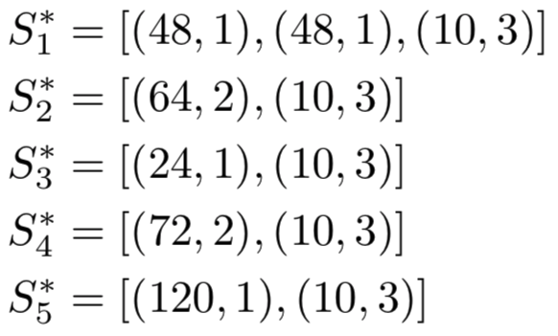
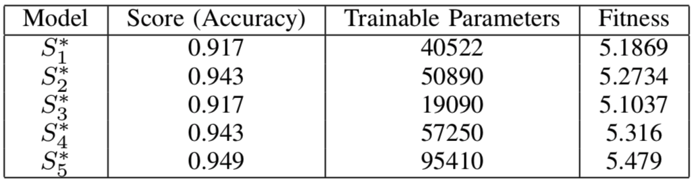
Evaluation on MNIST (\alpha=1)
Notes:
Elastic framework such as Hadoop can scale its resources up and down, it can start using nodes as soon as it acquires them and releases them as soon its task finish
Rigid framework such as MPI can start running jobs only after it has acquired a fixed quantity of resources and can not scale up dynamically or scale down without a large impact on performance
Mandatory resources are those required by a framework in order to run
Preferred resources are not needed

Slide 21
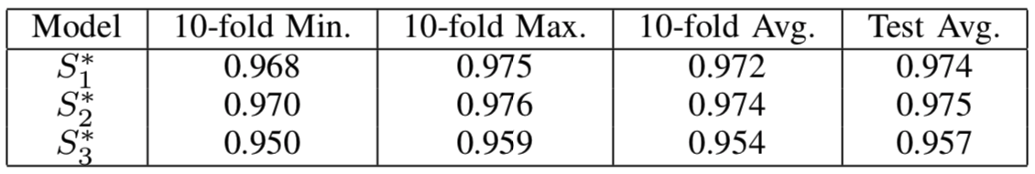
Evaluation on MNIST top three models
Trained top 3 models for 50 epochs each
Averaged using 10-fold cross validation
S_1 obtained the best tradeoff
S_2 obtains better performance but also exhibits larger network
S_3 is the most compact networks but looses performance
Notes:
Elastic framework such as Hadoop can scale its resources up and down, it can start using nodes as soon as it acquires them and releases them as soon its task finish
Rigid framework such as MPI can start running jobs only after it has acquired a fixed quantity of resources and can not scale up dynamically or scale down without a large impact on performance
Mandatory resources are those required by a framework in order to run
Preferred resources are not needed

Slide 22
Conclusion
AutoNN is a new evolutionary algorithm for finding suitable neural networks for classification and regression
AutoNN presents new mutation and crossover operators
AutoNN showed to be robust and being able to efficiently find suitable models for classification
The workload can be distributed using Ray
The efficiency obtained by the selected models is competitive
Future work will consider CNNs and RNNs, also the inclusion of more hyperparameters.

