Slide 1
GIT Training
The basics to neural nets
Brian Ray and Daniel Lasaga, March 27/28 2017

Slide 2
Index
Background on GIT
Getting Started with GIT
How to use GIT X

Slide 3
Background on GIT
What is GIT and when should I use it?

Slide 4
GIT is Source Control
What is source control?
Any software that

Slide 5
Source control software
GIT is part of a long line of source control software solutions
Was initially developed in 2005 as an open source Global Information Tracker
Was preceded by long line of earlier source control solutions

Slide 6
GIT is NOT Github.com
While we are going to use Github.com during this tutorial, github is not a requirement to use GIT
GIT | Github.com
A stand alone local app | A web site built on top of GIT
Free | Not free for enterprise version
Does not require an internet connection | Requires internet to access
Purpose is purely for source control | Purpose is for code sharing across different geographies

Slide 7
Getting Started with GIT
How to set it up

Slide 8
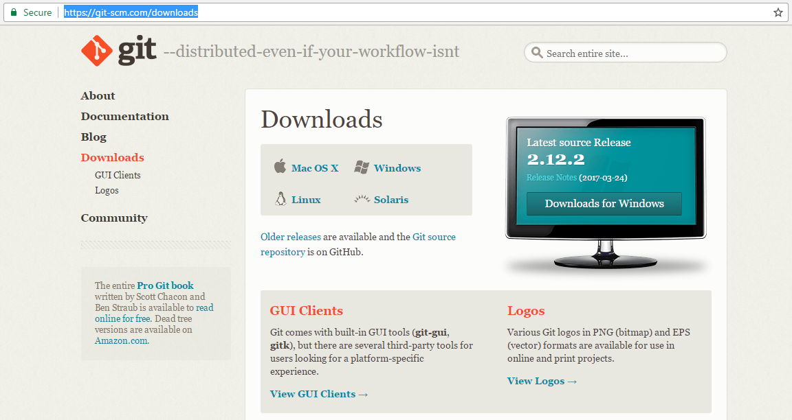
Download GIT
Where do I obtain GIT
Go to https://git-scm.com/downloads, download git for relevant OS and follow the default settings of install wizard

Slide 9
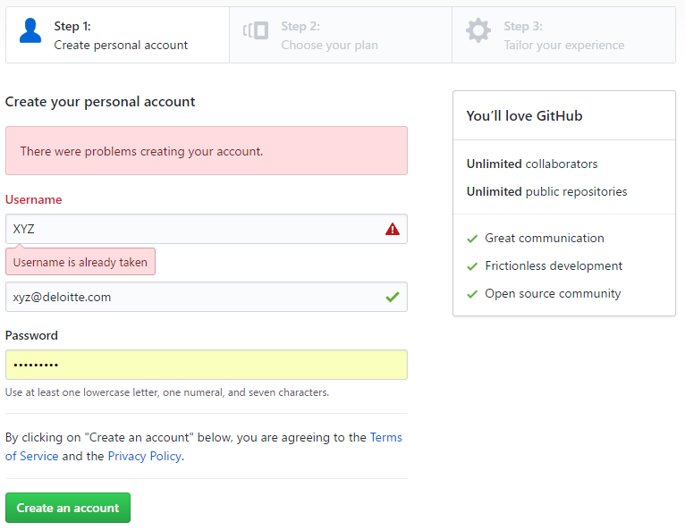

Start a Github.com account
This is needed just for participating in the training
STEP 1:
Go to https://github.com/join
STEP 2: Verify your email
You will receive an email from noreply@github.com on your xyz@Deloitte.com email account. Use the ‘Verify Email’ link to verify your email.
You are all set

Slide 10
How to use GIT
Tasks and commands

Slide 11
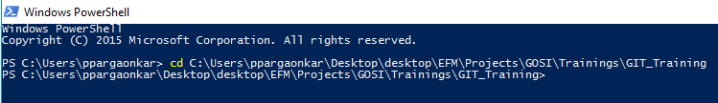
GIT works best on the command line
Where do I find my command line?
STEP 1: Open ‘Windows PowerShell’ on your computer.
The standard command-line terminal on Windows (cmd.exe) isn’t really capable of a customized Git experience, but if you’re using Powershell, it provides powerful tab-completion facilities, as well as an enhanced prompt to help you stay on top of your repository status. It looks like this:
STEP 2: Create a local git repository using the command
> cd <path to your directory>

Slide 12
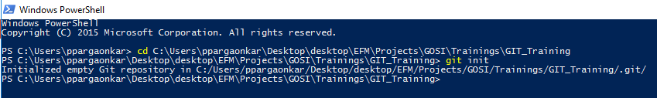
Initialize a repo
Starting your work area
Before starting anything in git you need to initialize a directory as a working git directory.
git init
You must run ‘git init’ to take a directory and turn it into a new Git repository so you can start version controlling it. We first introduce this in , where we show creating a brand new repository to start working with.

Slide 13
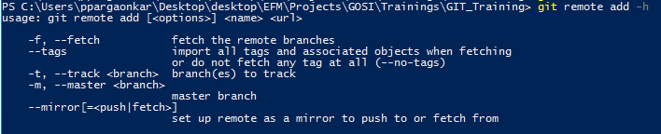
Remote connections
How do you connect to another repository?
For this session we will be using Dan’s github account to establish remote repository.
git remote
In order to understand the syntax and various functions associated with git remote command use the command,
git remote add -h
Syntax for establishing connection with a remote location is displayed as highlighted above is
git remote add [<options>] <name> <url>
Run: git remote add <repo name> https://github.com/dlasaga/test.git.
During your first run it will ask you to enter your github.com credentials. Do so.

Slide 14
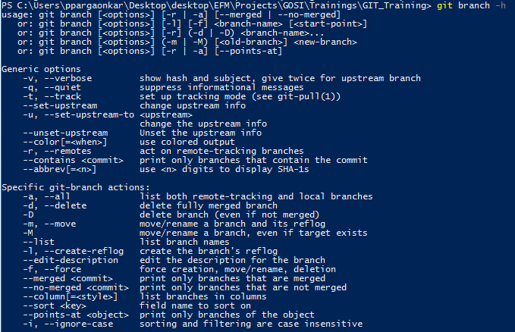
Viewing all the branches
How do I know what I can work with?

Slide 15
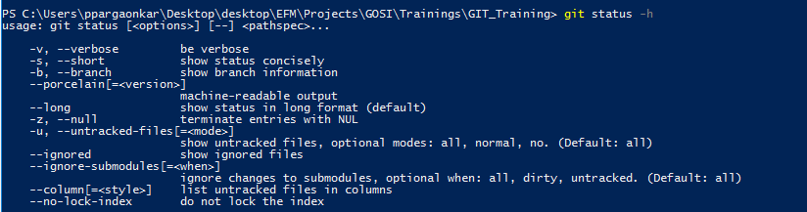
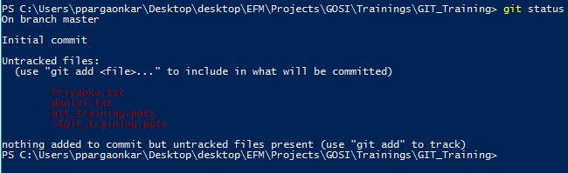
Status Command
See the current state of your local repository and the branch it is currently working on.
git status Shows the working tree status
Syntax for establishing connection with a remote location is displayed as highlighted above is
git status [<options>​] [--] [<pathspec>​

Slide 16
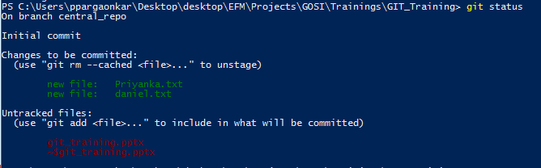
Add command
How do I stage data?
Once you have viewed and shortlisted all the files that you have want to stage for commit. To do so you will use the add command
*Tip: Type in the first letter for your file name and press ‘tab’ till you get your file name displayed in your command line.
Syntax for staging files for commit is
git add [<options>] <file name> (or - - all)
Once you have added the file run ‘git status’ it will display the files that are not being tracked for changes in green and the ones that are not in red

Slide 17
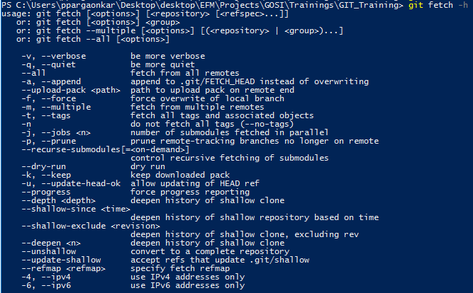
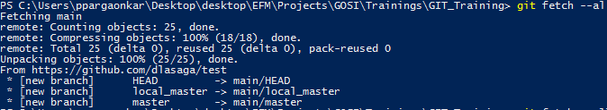
Fetching data
How do I download data from the remote repository?
git-fetch -- Downloads objects and refs from another repository
Syntax for creating a fetching from repositories is displayed as highlighted above is
git fetch[<options>] <branch> (or - - all)

Slide 18
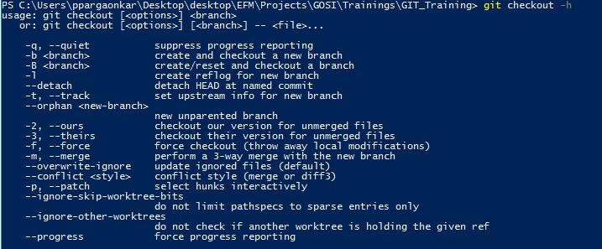
Checking out a branch
Now I want to work on a branch
git checkout
Syntax for creating a branch is displayed as highlighted above is
git checkout [<options>] <branch>

Slide 19
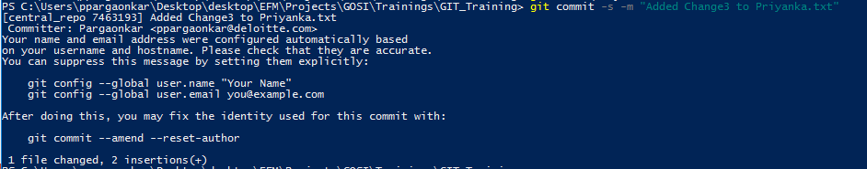
Two steps to committing work
You are done with your work and want to save it into the repository history
First you need to stage your commit. Think of this as adding a file to a roster of file that will be commited together. We stage commits using the add command
git add <list of files to add to your commit>
Once you have staged your file you need to commit the changes made to the file. You also need to add your signature (using option ‘-s’) so that each change can be tracked by the owner of the changes made to the file. You also need to add a brief description of the change using option ‘-m’.
git commit –s –m <“Change Description”>

Slide 20
Pushing code
Letting others see your changes
When a user wants to make changes to a code that resides on remote location called ‘Main Repo’ , the user fetches the file from ‘Main Repo’ onto user’s local machine and starts running series of changes
C5
C6
C7
C8
User 1
Push changes back to ‘Main Repo’
Main Repo
C1
C2
C3
C4
git push <repository> [<refspec>...]
Once the changes are complete you have to push the edited file to the ‘Main Repo’ using push command. So not the latest version of the file on ‘Main Repo’ will be ‘C8’.
C9
C10
User 1
Main Repo
C1
C2
C3
C4
C5
C6
C7
C8

Slide 21
Conflicts and Conflict resolution using ‘Rebase’
Synching your local repository with the latest changes
User 1 & User 2 fetch same file from ‘Main Repo’ and start working on it at the same time.
C5
C6
C7
C8
User 1
Main Repo
C1
C2
C3
C4
User 2
C9
C10
C11
C12
User 1 commits his changes and pushes the file to the ‘Main Repo’
C9
C10
User 1
Main Repo
C1
C2
C3
C4
C5
C6
C7
C8
User 2
C9
C10
C11
C12

Slide 22

Conflicts and Conflict resolution using ‘Rebase’
Continued ……
User 2 tries to commit his changes and pushes the file to the ‘Main Repo’
C9
C10
User 1
Main Repo
C1
C2
C3
C4
C5
C6
C7
C8
User 2 encounters ‘ERROR’
User 2
C9
C10
C11
C12
For User 2 to be able to push his edited file to ‘Main Repo’ he needs to first the version of file on his local machine to ‘C8’
C9
C10
User 1
Main Repo
C1
C2
C3
C4
C5
C6
C7
C8
User 2
C9
C10
C11
C12

Slide 23
Conflicts and Conflict resolution using ‘Rebase’
Continued……
Appropriate way to deal with this error is to first always ‘rebase’ your file to the most recent version of the file on the ‘Main Repo’ and then push the version of your file on the ‘Main Repo’
git rebase Main Repo
C13
C14
User 1
Main Repo
C1
C2
C3
C4
C5
C6
C7
C8
C9
C10
C11
C12
C15
C16

