Slide 1
American League Central
 | Wins | Losses | Games Behind | Games Remaining
Tigers | 85 | 73 | - | 4
White Sox | 83 | 75 | 2
There’s Still A Chance!!!

Slide 2
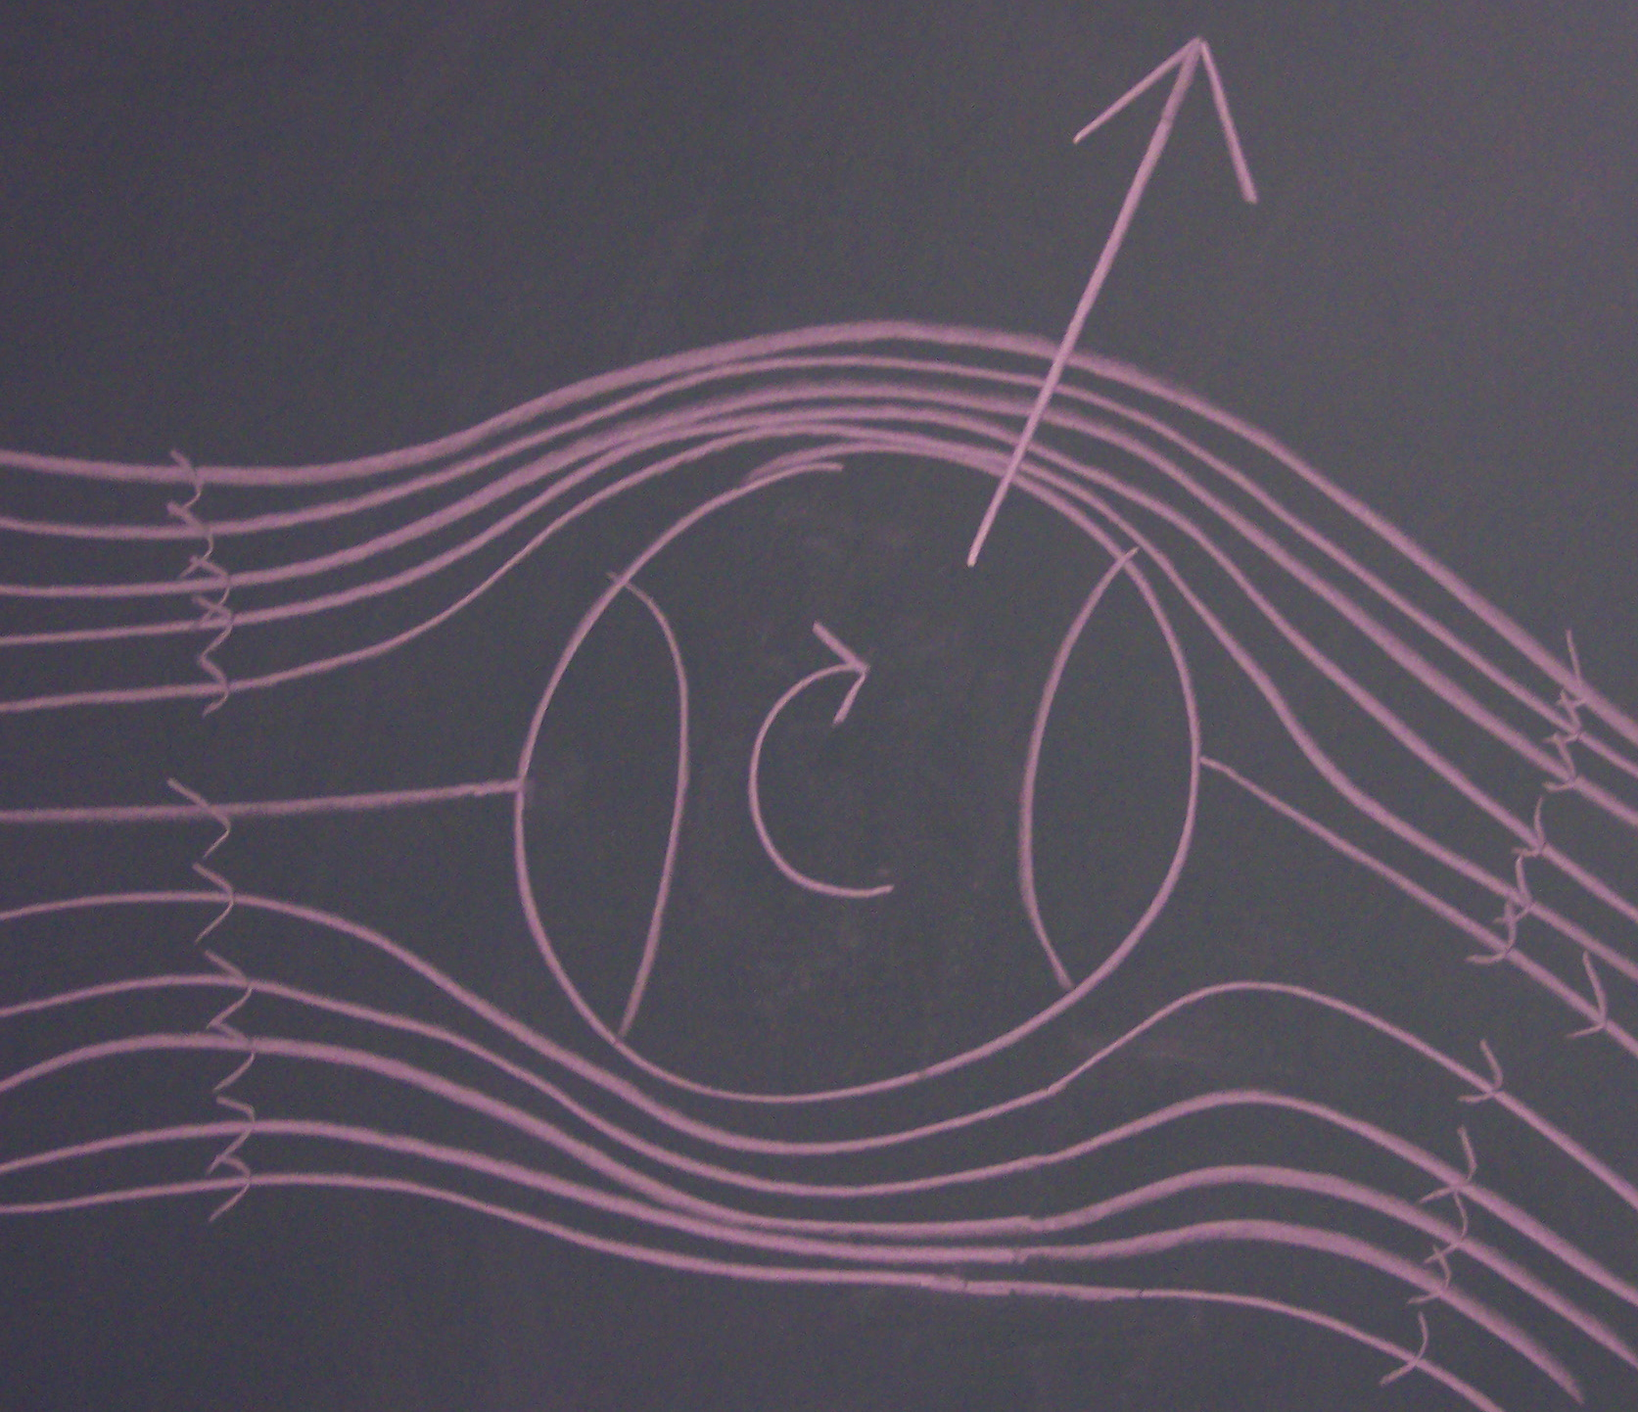
The Physics of Baseball
September 30, 2012
(Rays v. White Sox)
Daniel Lascar AB ’03
&
Benjamin Recchie AB ’03

Slide 3

Talk Outline
Pitching
Current Measuring Technology – PITCHf/x
Forces on the Ball
Different Pitches
Batting
Coefficient of Restitution (COR)
Timing
Batting Kinematics

Slide 4
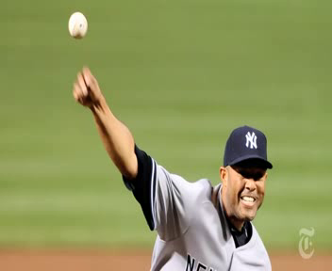

Slide 5
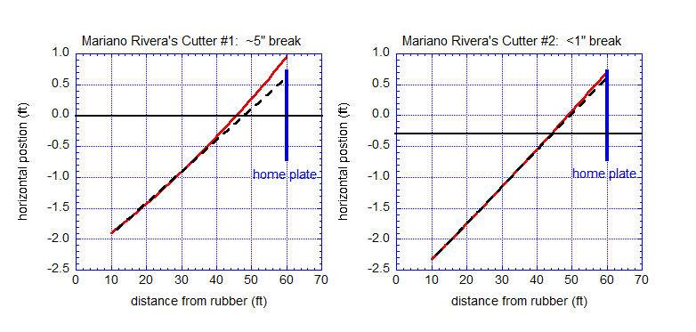
“Late Break”: Truth or Myth? Mariano Rivera’s Cut Fastball
View from above:
actual trajectory --------
linear extrapolation - - - -
Notes:
What do we mean when we say “break?”
Both pitches heading for ~same location. One seems to break at the last minute, the other doesn’t.

Slide 6
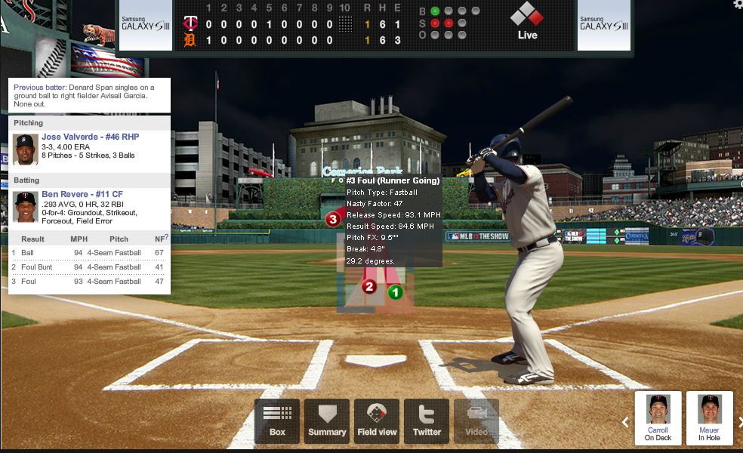
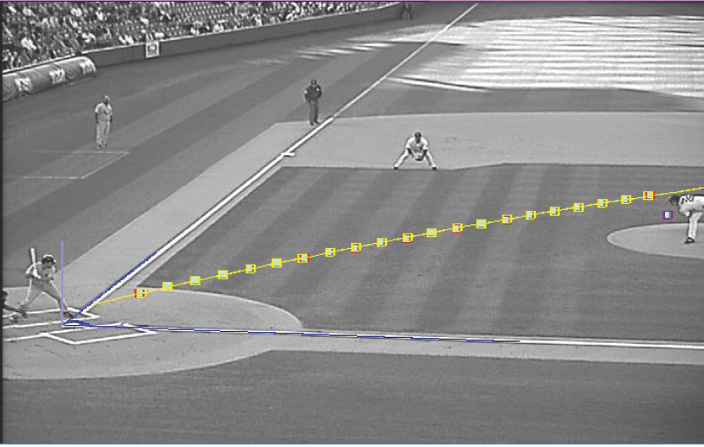
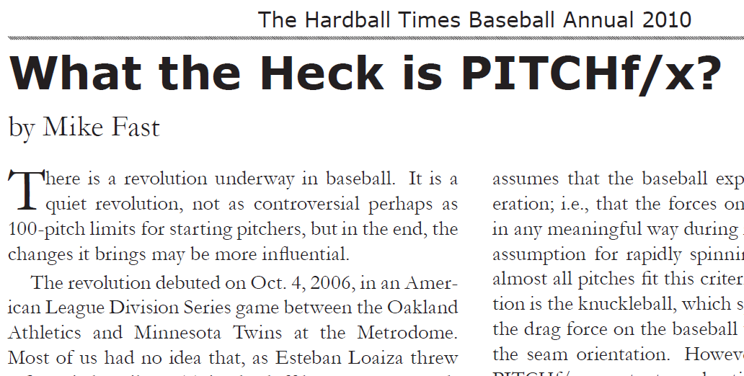
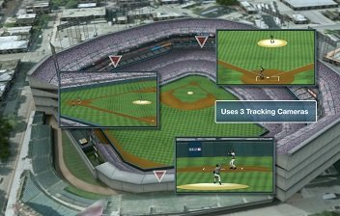

Today we can follow the ball better than a well-trained scout
PITCHf/x takes data from two cameras:
“High Home”
“High First”
Outfield (Strike Zone)
Data taken @ 60 fps (20-30 images).
Sportvision claims a precision of 0.5”
Image, courtesy of Sportvision
N Saint (2010)
Notes:
Developed by Sportvision
For Gameday image, talk about the data points.

Slide 7

What makes an effective slider
Josh Kalk, THT, 5/22/08
This slider is very effective since it looks like a fastball for over half the trajectory, then seems to drop at the last minute (“late break”).
side view

Slide 8
Forces on a Spinning Baseball in Flight
F_{M}
Drag slows ball down
Magnus + mg deflects ball from straight line
F_{D}
Gravity
Courtesy of Alan Nathan
Notes:
Ball is moving in the plane of the screen
Velocity moving up and to the right
List forces
Show the spin axis coming out of the screen
Mention that the cross product only means that the Magnus force will operate in a direction that is perpendicular to both the velocity and the spin axis

Slide 9
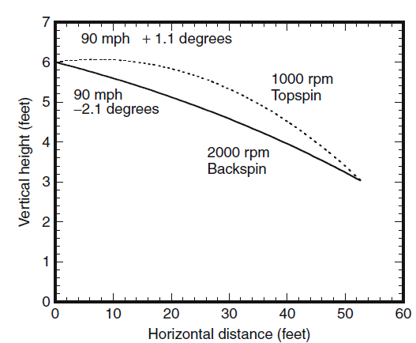
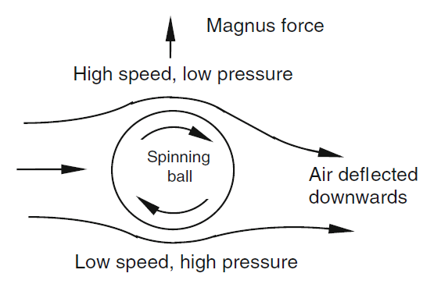
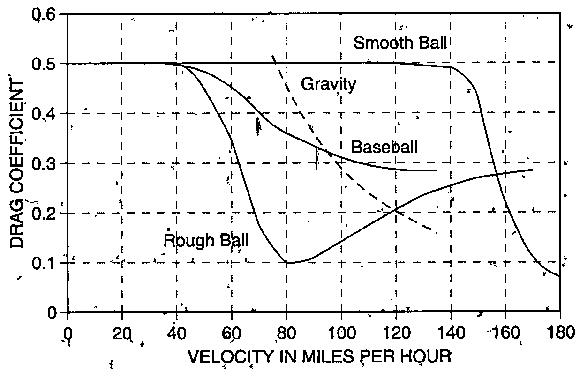
Magnus Force: How A Pitch Breaks Across the Plate
Without the magnus force, all we have is gravity and drag.
Stitches make it all possible.
Regions of turbulence exist at velocities where humans can throw.
Rotational Speeds: 2 Pitches, Same Target, Different Rotations
Fastball
90 mph & 2,000 rpm backspin
Thrown 2.1º downward
Curveball
90 mph & 1,000 rpm topspin
Thrown 1.1º upward

Slide 10
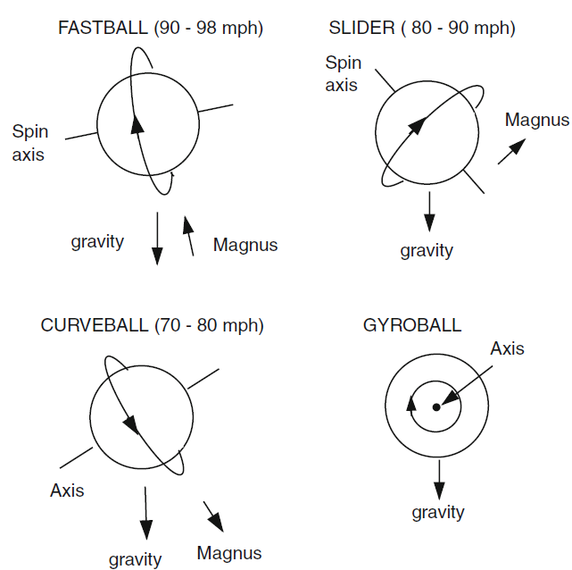
Types of Pitches

Slide 11
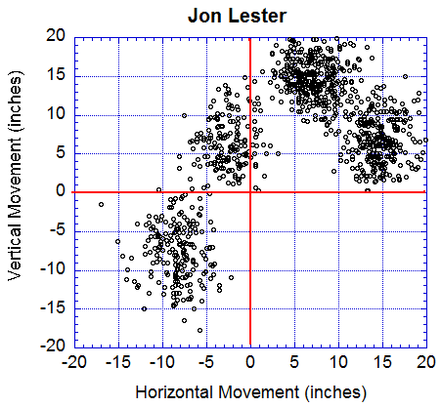
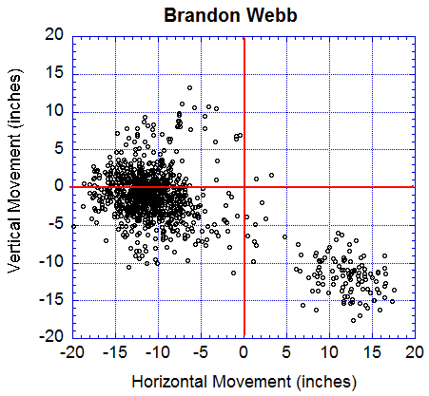
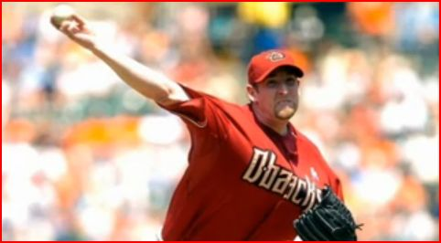
Jon Lester vs. Brandon Webb
15 inches
Brandon Webb is a “sinkerball” pitcher:
Almost no rise on his fastball
Notes:
Remove spin axis arrows. Try to find ball with spin axis showing.

Slide 12
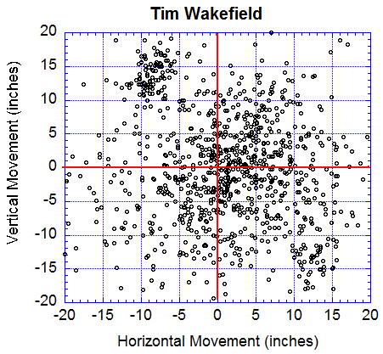
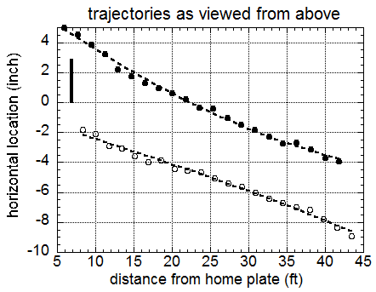
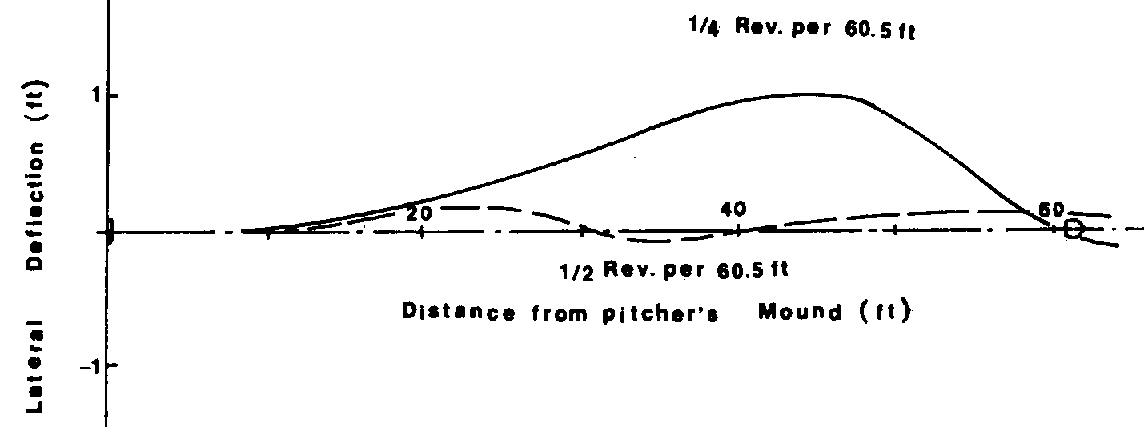
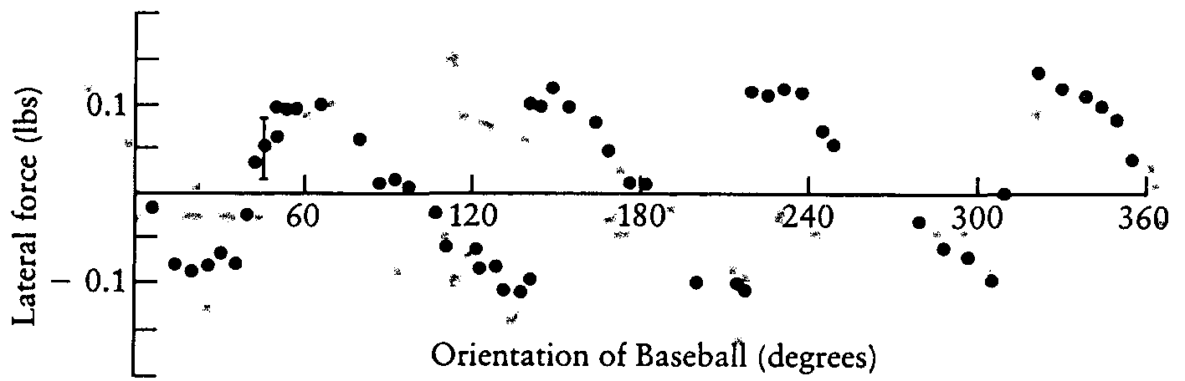
Knuckleball Research
Myth or Fact: The knuckleball “jumps around” or zigzags.
1975 paper tried to find the forces on the ball.
Recent paper by Alan Nathan analyzed pitch trajectories.
Curveball
Knuckleball
“Within the precision of the tracking data, knuckleball trajectories are just as smooth as ordinary pitches.”
R. A. Dickey Knuckleball
A. Nathan, Baseball Prospectus, Jan. 31, 2012
R. G. Watts, E Sawyer, Am. J. Phys 43 (11) 1975
R. G. Watts, E Sawyer, Am. J. Phys 43 (11) 1975
Notes:
Ask Audience who has heard about it.
Watts & Sawyer showed that there are forces on a non-spinning ball that depend critically on the orientation of the seams.
Mass of a baseball is 145g = 0.32 lbs.
This is NOT the same as the magnus force
If a ball is pitched with no spin at all, it will just feel a constant lateral force.
The key is the fractional turn over the flight of the ball
Other Pitcher is Anibal Sanchez of the Marlins

Slide 13
The Knuckleball
Tim Wakefield is a knuckleball pitcher:
Chaotic Movement
Notes:
Remove spin axis arrows. Try to find ball with spin axis showing.

Slide 14
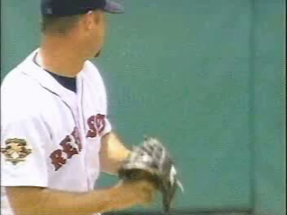

Slide 15
Where you hit a baseball depends on...
Coefficient of restitution (COR) for bat/ball
Angle of bat at impact
Trajectory of ball at impact
Kinetic energy of bat
Kinetic energy of ball
Timing
Where on the bat ball hits
Spin motion of the ball
Humidity
Temperature
Wind
Notes:
15

Slide 16
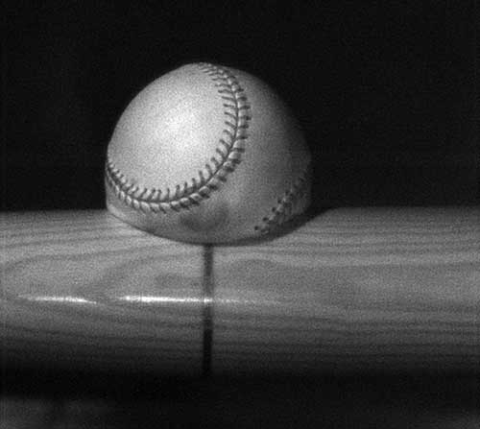
Coefficient of restitution
Defined as:
MLB standard is e=0.55
Varies with temperature; cold balls “dead,” warm balls “live”
http://memagazine.asme.org/Articles/2010/april/Our_Favorite_Pastime.cfm
Notes:
16

Slide 17
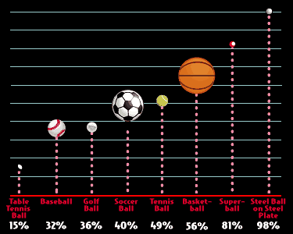
Coefficient of restitution

Slide 18
A few words about timing
0.000 s: ball released
0.100 s: batter's eye registers ball
0.175 s: batter's brain registers ball
0.175-0.200 s: batter decides to swing
0.200-0.225 s: batter decides which swing
0.215-0.240 s: batter moves body
0.240-0.400 s: batter swings
Notes:
18

Slide 19
Bat materials
Material | Density (g/cm^3)
Mahogany (Spanish) | 0.85
Hickory | 0.82
Ash | 0.638
Maple (black) | 0.620
Cork | 0.24
Balsa | 0.11
Aluminum | 2.70
Notes:
19

Slide 20
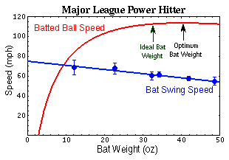
Heavy versus light
Average bat weight in pro baseball is 32 oz, but “optimum” bat weight is 40.5 oz
Your mileage may vary!
http://www.acs.psu.edu/drussell/bats/batw8.html
Notes:
20

Slide 21
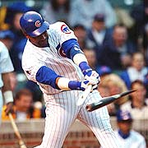
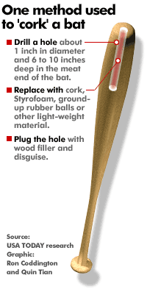
Corking
Increases chances of hitting ball (maybe)
Does not increase power
Save your time and don't bother
Notes:
21

Slide 22
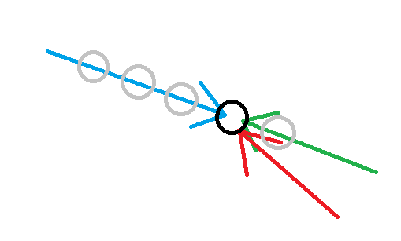
Optimum angles
For average
“Level” swing (10 degrees up)
Maximizes chances of good contact
For power
Uppercut swing (≤ 20 degrees)
Maximizes flight time, distance
Notes:
22

Slide 23
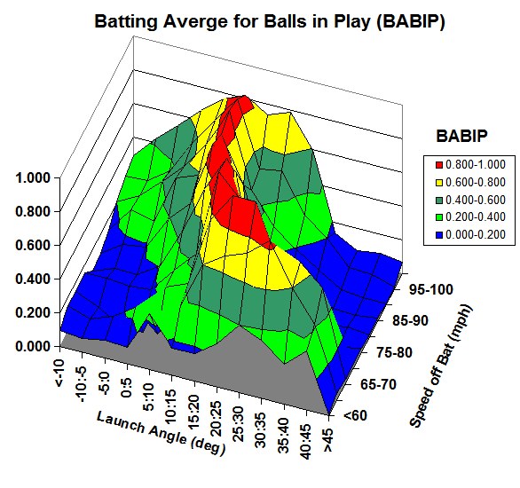
Where a ball goes once put into play
http://webusers.npl.illinois.edu/~a-nathan/pob/ppt/APS-March10-v6.ppt
Notes:
23

Slide 24
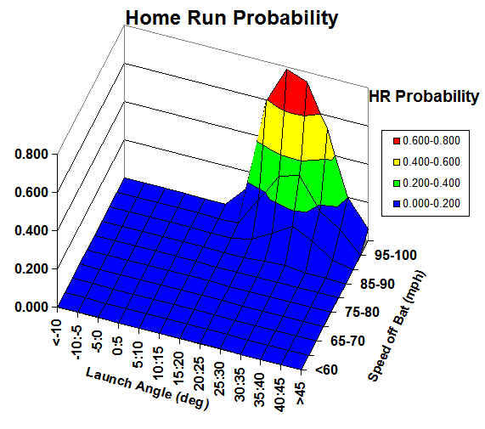
Where a ball goes once put into play
http://webusers.npl.illinois.edu/~a-nathan/pob/ppt/APS-March10-v6.ppt
Notes:
24

Slide 25
Where a ball goes once put into play
http://webusers.npl.illinois.edu/~a-nathan/pob/ppt/APS-March10-v6.ppt
Notes:
25

Slide 26
Works Cited
G. Roberts, S. Carter, J. Ward, “How Mariano Rivera Dominates Hitters,” NYT, June 29, 2010.
M. Fast, “What the Heck is PITCHf/x?” Hardball Time Baseball Annual, 2010.
N. Saint, “How High-Tech Cameras Are Changing Baseball Forever,” Bus. Insider, April, 12, 2010.
R. Cross, Physics of Baseball, New York: Springer, 2011.
A. Nathan, “The Knuckleball Mystique: Using PITCHf/x to Distinguish Perception from Reality,” Baseball Prospectus, Jan 31, 2012.
A. Nathan, http://webusers.npl.illinois.edu/~a-nathan/pob/index.html
R.G. Watts and E. Sawyer, “Aerodynamics of a knuckleball,” American Journal of Physics, 43 (11) 1975
http://www.exploratorium.edu/baseball/howfar7.html
Adair, Robert K. The Physics of Baseball. (Harper: New York) 1990.
Watts, Robert G., and Bahill, A. Terry. Keep Your Eye on the Ball: Curve Balls, Knuckleballs, and Fallacies of Baseball. (W. H. Freeman and Co.: New York) 2000.

Slide 27
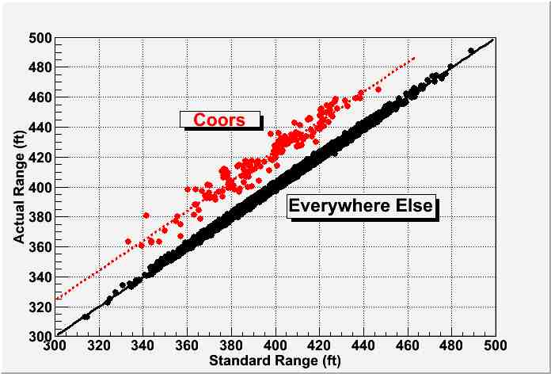
The Coors Effect
~26 ft
Warning Track: 10-15 ft

Slide 28
Home Runs and Humidors
Coors Field in Denver:
Pre-humidor (1995-2001):
Rockies home: 3.20 HR/game away: 1.93 HR/game
Post-humidor (2002-2010):
Rockies home: 2.39 HR/game away: 1.86 HR/game
25% Reduction!

Slide 29
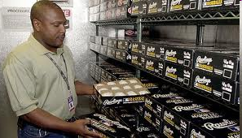
The Humidor
Coors Field uses a humidor to prepare baseballs.
Higher humidity:
Decreases the COR (less “bouncy”)
Makes the ball heavier (ball isn’t hit as hard)
Makes the ball larger (ball doesn’t fly as well)
Notes:
Coors has many more home runs than any other park. 2 reasons: Altitude and dry air because of altitude

Slide 30
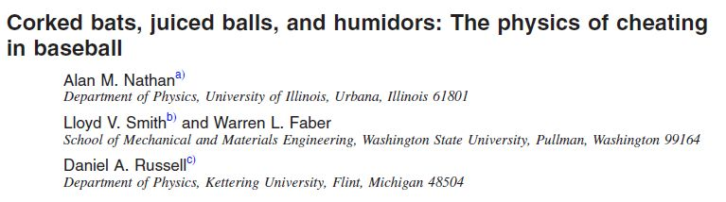
Summary of Findings with RH increased from 30% to 50%
Weight increases by 1.6%
COR decreases by 3.7%
Diameter change negligible
For typical long fly ball (100 mph, 30 deg)
- Batted ball speed decreases by about 3 mph
- Fly ball distance decreases from 415 ft to 402 ft

Slide 31
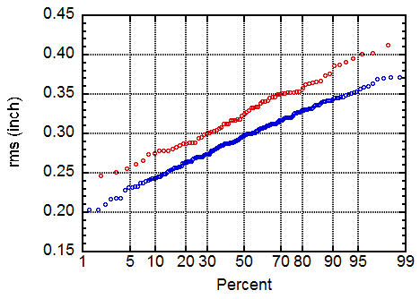
A Bit More On The Knuckleball
These are the RMS deviations of all the pitches in Mets-Marlins game on Aug. 29, 2011
Knuckleballs in red
All other in blue
Using just the blue pitches, the precision of PITCHf/x = ± 0.3 in
Sportvision claims ± 0.5 in
0.03 in
Notes:
Baseball is 2 7/8” in diameter
Deviation is 1/100th the diameter of the baseball

