Slide 1
Verification and Validation -> Verification

Slide 2
 | Verification | Validation
Definition | Evaluating work-products -> do they meet requirements | Evacuating software -> so it satisfies specified business requirements.
Looks at | Artifacts NOT its operation | Operation (not artifacts)
Question | Are we building the product right? | Are we building the right product?
Evaluation Items | Plans, Requirement Specs, Design Specs, Code, Test Cases | The actual product/software.
Activities | Reviews Walkthroughs Inspections | Testing

Slide 3
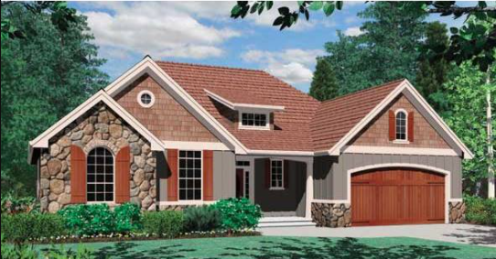
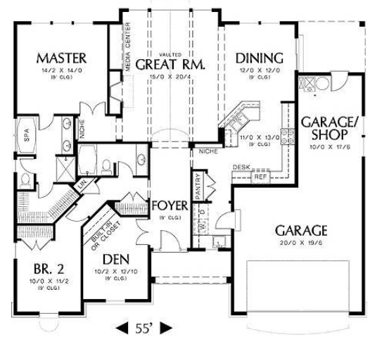
Validation – it’s a 2 room house that meets this spec
Verification – 16’’ on center?
Electric up to code? Plumbing?

Slide 4
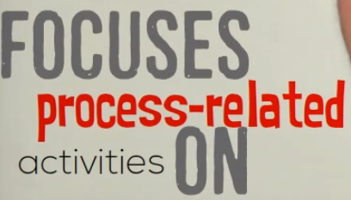
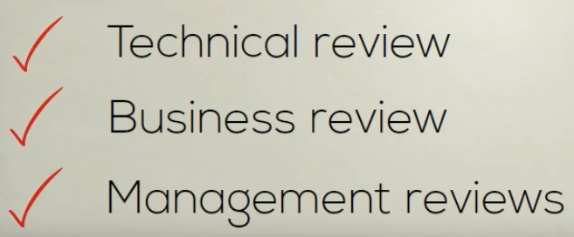
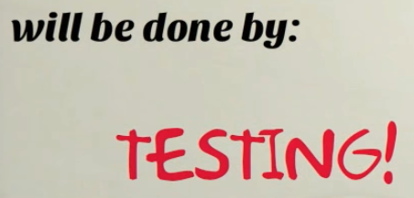
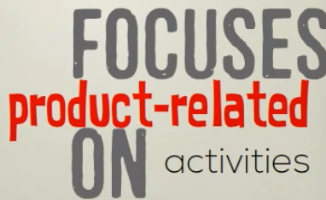
Software Quality control - Verification vs validation - https://en.wikipedia.org/wiki/Software_verification_and_validation
https://www.youtube.com/watch?v=PVmxp7BG5I4
To ensure product meet the specified requirements before final test
Verification -> "Are we building the product right”.
Validation -> "Are we building the right product”.
The System meet customer expectations .
Does Software conform to specification
As a house conforms to its blueprints.)
Does the software do what the user realy requires ..(As a house conforms to what the owner needs and wants.)

Slide 5
Inspections and testing
Can have inspections (reviews) of code or any of these artifacts

Slide 6
Code inspections
The main purpose of code inspection is to find defects and it can also spot any process improvement if any.
Group examination of code => to find defects.
Usually not execute system.
May be applied to any representation of the system (requirements, design ,configuration data, test data, etc.).
They have been shown to be an effective technique for discovering program errors.
Inspection Advantages –
Fault dependence - errors can mask other errors. Inspections can find these issues
Partial implementations - can be inspected without additional costs. )
VS partial program need to develop specialized test harness.
Broader quality - compliance with standards, portability and maintainability.
Fagan 1976 - > 60% defects can be found from inspections
Prowell, 1999 -> 90%
Inspections -> no substitute for testing. Both are needed.
- Inspections are not as good for usability or performance issues.

Slide 7
Code review goals:
Better code quality – Clean code for maintainability and readability
Defect Finding – Improve correctness, performance, security vulnerabilities, etc
Knowledge transfer – spread knowledge about the codebase, solution approaches, expectations regarding quality, etc; both to the reviewers as well as to the author
Increase Shared Responsibility – Everyone owns this
Finding better solutions – generate ideas for new and better solutions and ideas that transcend the specific code at hand.
Complying to QA guidelines – Code reviews are mandatory in some contexts, e.g., air traffic software

Slide 8
The Case for – believe that
Defect finding rate is as much as 2x most other forms of testing
evidence that up to 75% of code review defects affect software evolvability/maintainability rather than functionality,

Slide 9
https://simpleprogrammer.com/why-code-reviews-make-better-code-teams/ Top 10 Reasons Code Reviews Matter
Go to this article and write
1 paragraph summarizing the argument
Double Check Requirements fulfilled
Fewer Bus in Code (E.g., senior developer makes sure edge cases covered or look at code from different angle)
Improved Code Readability
Knowledge Sharing
Style of Code becomes similar
Removes single point of failure
Better Estimates and planning
Improves Code quality through peer pressure
Earlier Detection of defects
Mentoring of Junior Developers
BUT …. It costs time and effort and may delay schedules

