Slide 1
Chapter 8 – Software Testing
Development testing
Test-driven development
Release testing
User testing

Slide 2
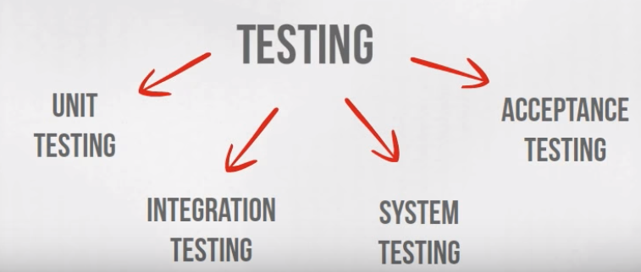
The Four Levels of Software Testing
Integration testing is conducted to evaluate the compliance of a system or component with specified functional requirements. It occurs after unit testing and before validation testing.

Slide 3
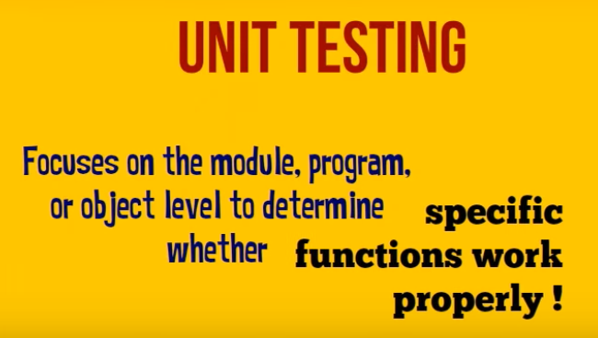
Unit testing -> individual program units or object classes are tested. (focus on testing the functionality of objects or methods).
The main aim of this endeavor is to determine whether the application functions as designed.
In this phase, a unit can refer to a function, individual program or even a procedure

Slide 4
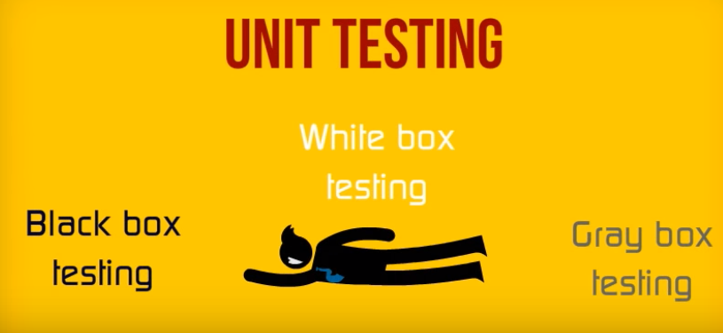
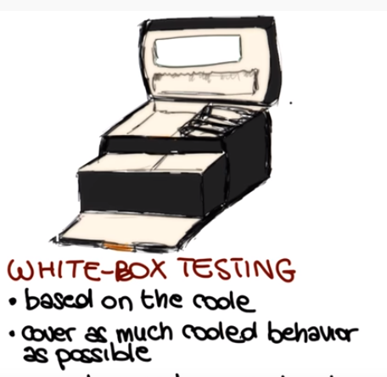
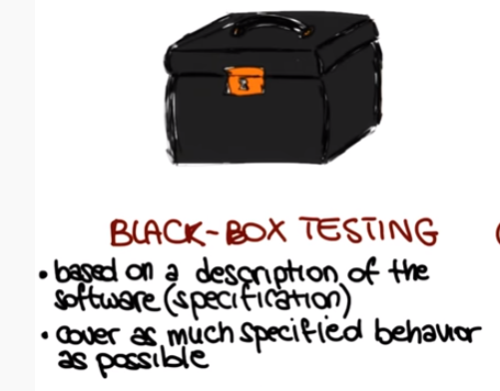
Lets look at Black box testing
https://www.youtube.com/watch?v=jRwwb7iaRsU 1:30

Slide 5
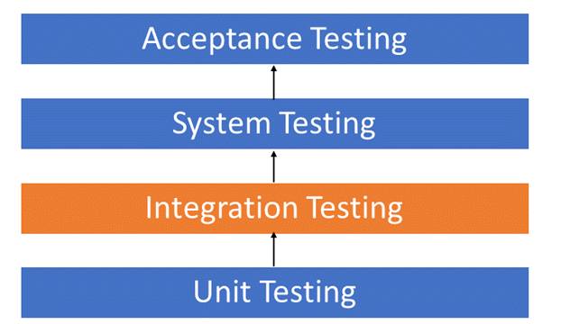
The Four Levels of Software Testing
Left Off Here
Integration
testing
Modules integrated logically and tested as a group.
A typical software project consists of multiple software modules, coded by different programmers.
Integration Testing focuses on checking data communication amongst these modules.

Slide 6
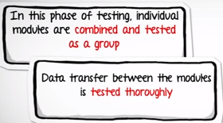
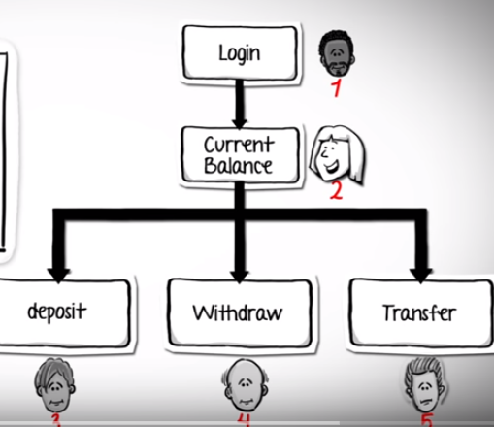
Integration testing
https://www.youtube.com/watch?v=QYCaaNz8emY 3:04
Done by developers

Slide 7
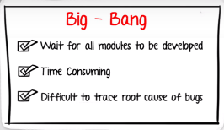
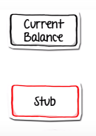

Integration testing
https://www.youtube.com/watch?v=QYCaaNz8emY 3:04
Disadv: Cannot start until all modules are complete

Slide 8
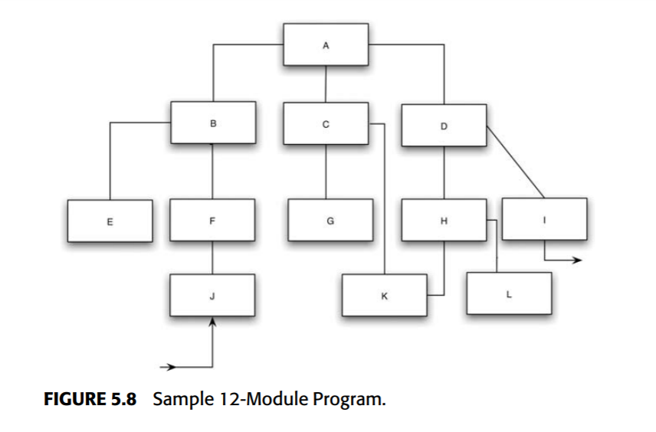
Top-Down
Start at top
Select next module (no 1 way to do) => incrementally test

Slide 9
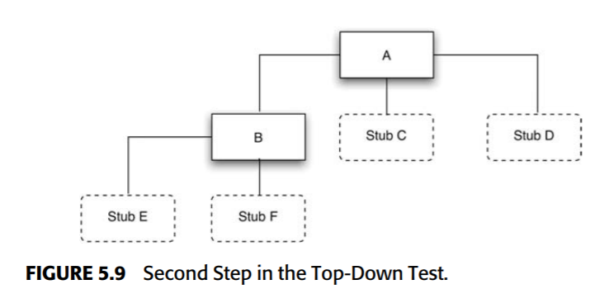
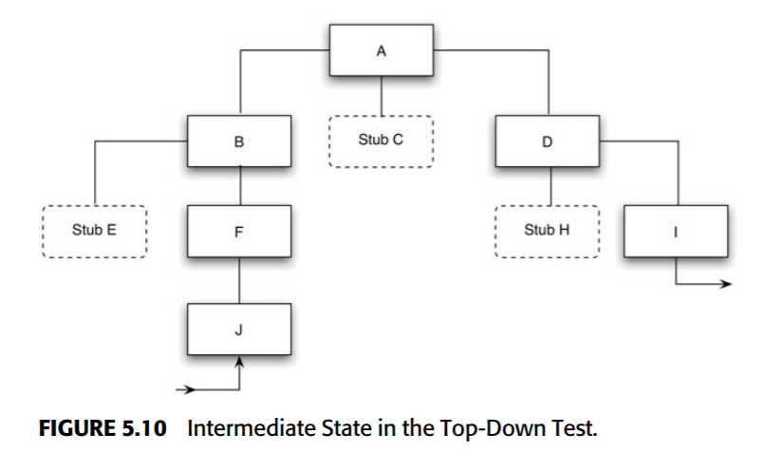
No single best sequence -> 2 guidelines
“Critical Sections” (complex or new algo) => Add sooner
I/O modules => Add sooner

Slide 10
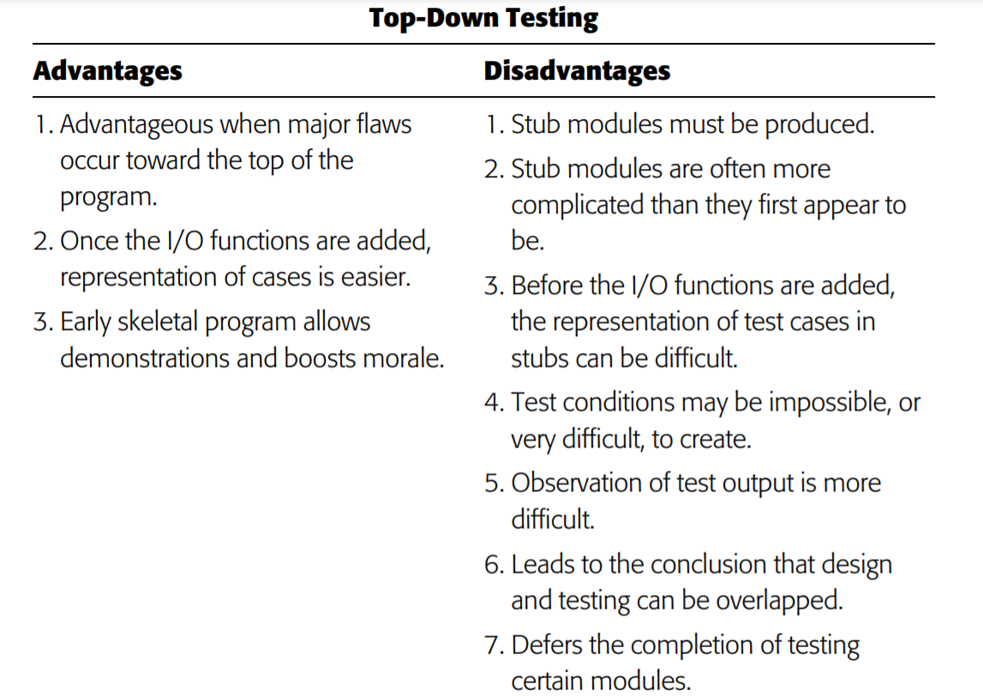
Top Down

Slide 11
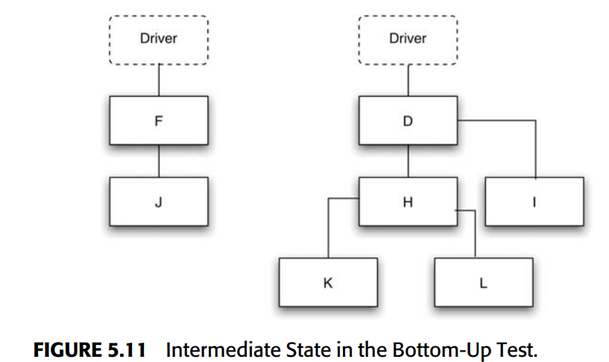
Bottom-up
Begin at a low level module (terminal module that does not call other modules)
Select next module (no 1 way to do) => incrementally test

Slide 13
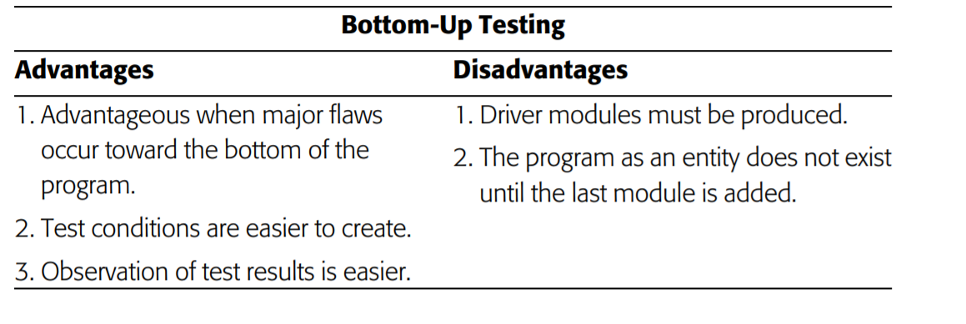

Slide 14

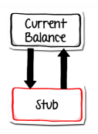
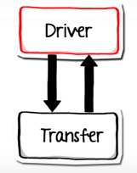
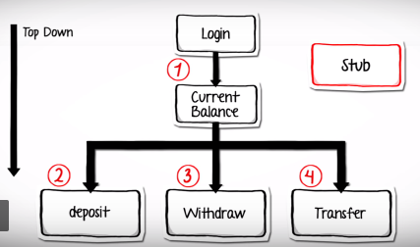
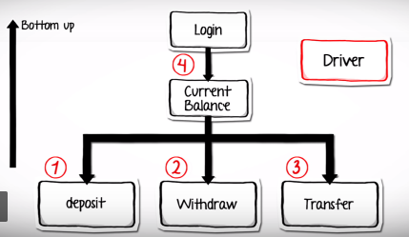
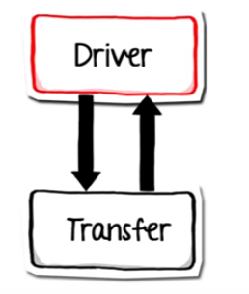
Integration Testing – Incremental Testing
Modules are tested as they become available
Can be top-down
Or bottom up
May have to create a stub to ‘simulate’ the transfer module
Or ‘Driver’ to simulate the current balance and drive the lower level module
(depending upon which on is available)

Slide 15
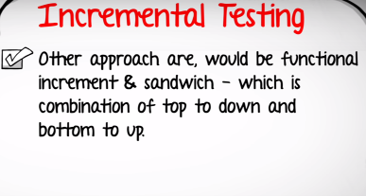
https://www.guru99.com/integration-testing.html 3:00
Choice depends on module availability,
Location of high risk modules,
Ease of stubbing and driver development

Slide 16
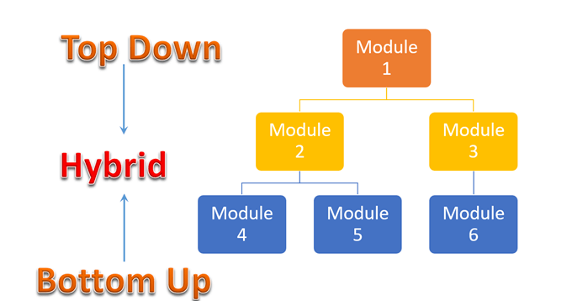
Hybrid/ Sandwich Integration
sandwich/hybrid strategy is a combination of Top Down and Bottom up approaches
Top modules are tested with lower modules that are available. Stubs are used for others
strategy makes use of stubs as well as drivers.

Slide 17
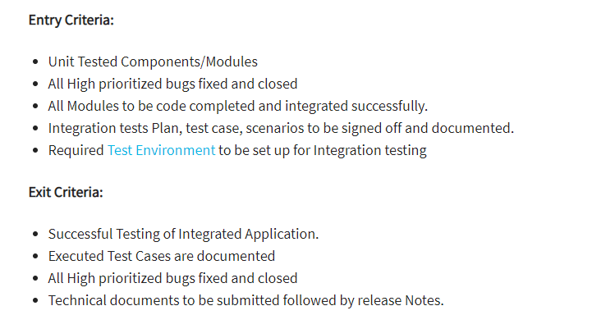

Slide 18
The Four Levels of Software Testing
System Testing
Testing of a complete and fully integrated software product. (Could include other software/hardware systems)
A series of different tests whose sole purpose is to exercise the full computer-based system.

Slide 19
System Testing
System test falls under the black box testing category of software testing.
Tests The fully integrated applications
including external peripherals
to check how components interact with one another and with the system as a whole
Verify thorough testing of every input in the application to check for desired outputs.
Testing of the user's experience with the application

Slide 20
Different Types of System Testing – There are > 50 types
1. Usability Testing - focuses on the user's ease to use the application, flexibility in handling controls and ability of the system to meet its objectives
2. Load Testing - how the software solution will perform under real-life loads.
3. Regression Testing- - testing done to make sure none of the changes made over the course of the development process have caused new bugs. It also makes sure no old bugs appear from the addition of new software modules over time.
4. Recovery Testing - demonstrate a software solution is reliable, trustworthy and can successfully recoup from possible crashes.
5. Migration Testing - how the software can be moved from older system infrastructures to current system infrastructures without any issues.
6. Functional Testing - trying to think of any possible missing functions. Testers might make a list of additional functionalities that a product could have to improve it during functional testing.
7. Hardware/Software Testing - focused attention on the interactions between the hardware and software during system testing.

Slide 21
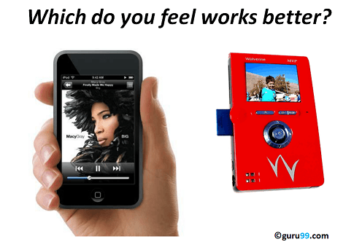
Usability Testing AKA User Experience Testing
small set of target end-users, of a software system, "use" it to expose usability defects.
Focus:
- Users ease to use the application
- Flxibility to handle controls
- ability of system to meet objects
https://www.guru99.com/usability-testing-tutorial.html

Slide 22
Usability Testing: 2 Techniques
Laboratory Usability Testing:. separate lab room in presence of the observers.
The testers are assigned tasks to execute.
Observer(s) monitor tester behavior report the testing outcome .
Observers(s) are silent testing.
Remote Usability Testing: observers and testers are remotely located.
Testers access the System Under Test, remotely and perform assigned tasks.
Tester's voice , screen activity , testers facial expressions are recorded by an automated software.
Observers analyze this data and report findings of the test. ( http://silverbackapp.com/ )

Slide 23

How many usability testers ?
Research (Virzi, 1992 and Neilsen Landauer, 1993) indicates that 5 users are enough to uncover 80% of usability problems. Some researchers suggest other numbers.
Depends a lot on time and budget availability

Slide 24
Usability Testing Adv/DisAdv
Usability Advantages … it help …
uncover usability issues before the product is marketed.
improve end-user satisfaction
to makes your system highly effective and efficient
gather true feedback from your target audience who actually use your system (You do not need to rely on "opinions" from random people.)
Usability Testing Disadvantages
Cost => . It takes lots of resources to set up a Usability Test Lab. Recruiting and management of usability testers can also be expensive

Slide 25
A/B Testing (AKA Split Testing)
A/B Testing compares 2 different web site versions to determine which is better to drive leads, sales or hits.
Usability Testing -> evaluates a sites usability to determine usability such as easy-of-use and common activities
A/B: Compares two versions webpages or app against each other to determine which one performs better.
An experiment where two or more variants of a page are shown to users at random, and statistical analysis is used to determine which variation performs better for a given conversion goal.
Both aim to improve end-users experience and increase conversion rates

Slide 26
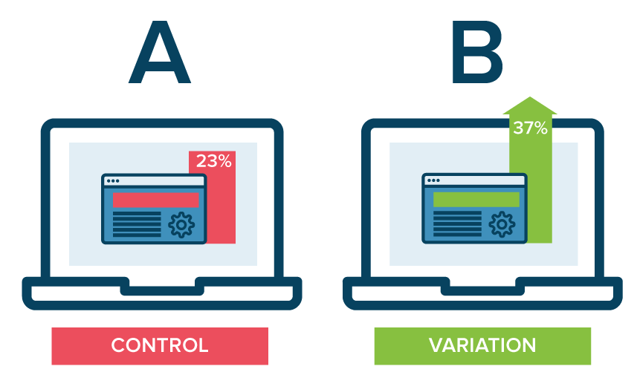
A/B Testing … is more difficult
Experimentally ask questions about 2 different UI versions => collect data and analyze for “Better”

Slide 27
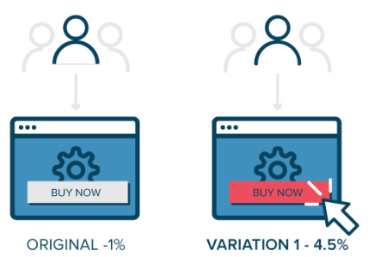
How A/B Testing works
Show 50% of traffic 1 UI version
Show 50% the other UI version
(can be a single control difference)

Slide 28
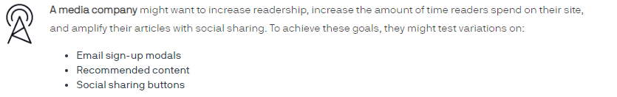
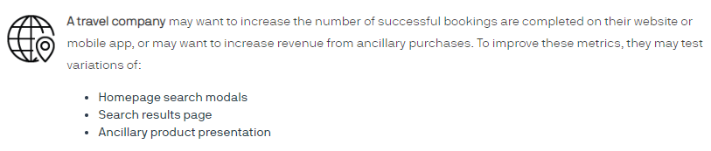
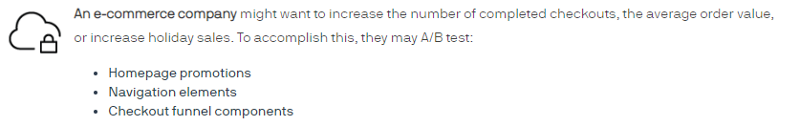
https://www.optimizely.com/optimization-glossary/ab-testing/

Slide 29
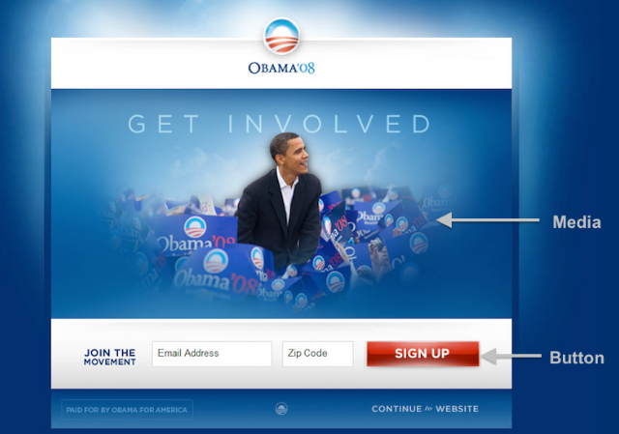
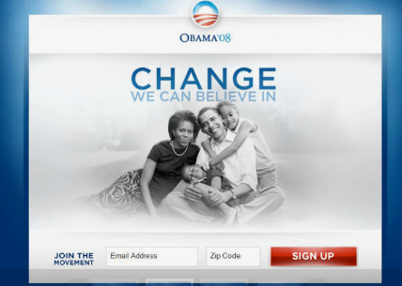
https://blog.optimizely.com/2010/11/29/how-obama-raised-60-million-by-running-a-simple-experiment/

Slide 30
Before we ran the experiment, the campaign staff heavily favored “Sam’s Video” (the last one in the slideshow shown above). Had we not run this experiment, we would have very likely used that video on the splash page. That would have been a huge mistake since it turns out that all of the videos did worse than all of the images.

Slide 31
How A/B Testing works
Collect overall traffic data -> high level traffic and conversion rates
Identify goals -> E.g., not getting donations on page XXX
Generate hypothesis => What you think can improve
Create UI variations -> some A/B testing tools help specific editors to make this easier.
Run Experiment – randomly assign different users 2 different versions. Data must be collected.
Analyze data -> Is there a statistically significant difference in UI versions?

Slide 32
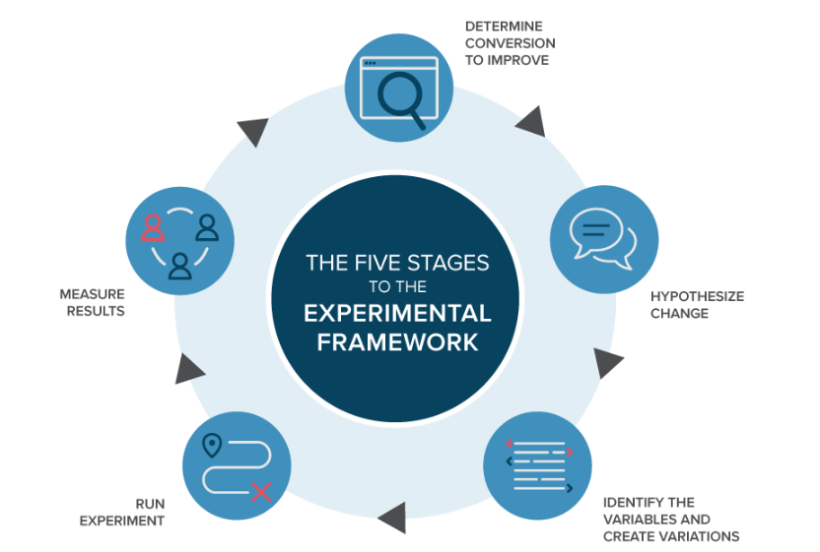

Slide 33
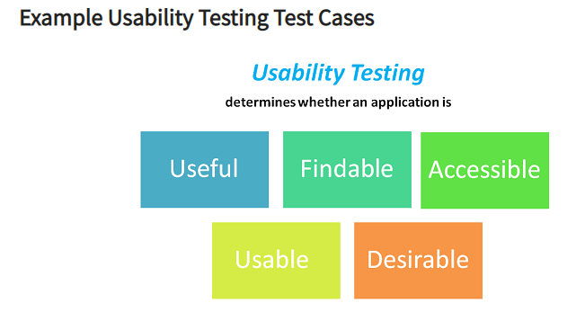

Slide 34
Load Testing
s a kind of Performance Testing which determines a system's performance under real-life load conditions.
Use to determine
application’s max operating capacity
if current infrastructure is sufficient to run the application
How app responds during to peak user load
Max Number of concurrent users that an application can support, and scalability to allow more users to access it.
Consider the following examples
Popular toy store Toysrus.com, could not handle the increased traffic generated by their advertising campaign resulting in loss of both marketing dollars, and potential toy sales.
An Airline website was not able to handle 10000+ users during a festival offer.
Encyclopedia Britannica declared free access to their online database as a promotional offer. They were not able to keep up with the onslaught of traffic for weeks.

Slide 35
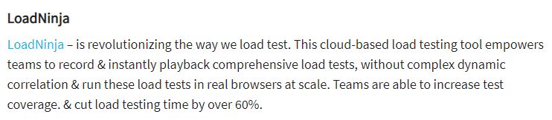
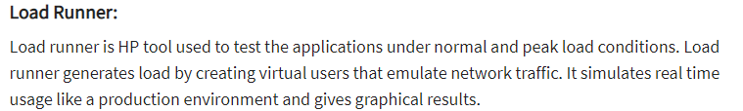
2 load testing tools

Slide 36
How to do load testing …
Manual Load Testing: Try to manual load the system.
Hard to repeat
Hard to set up
Hard to measure.
In house developed load testing tools: build your own tools to execute load tests.
Open source load testing tools: There are several load testing tools available as open source that are free of charge. They may not be as sophisticated as their paid counterparts, but if you are on a budget, they are the best choice.
Enterprise-class load testing tools: They usually come with capture/playback facility. They support a large number of protocols. They can simulate an exceptionally large number of users.

Slide 37
Load Testing Adv/Disadv
Advantages of Load testing:
ID Performance bottlenecks before production
Improves the scalability of the system
Minimize risk related to system downtime
Reduced costs of failure
Increase customer satisfaction
Disadvantages of Load testing:
Need programming knowledge to use load testing tools.
Tools can be expensive as pricing depends on the number of virtual users supported.

Slide 38
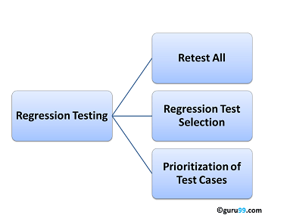
Regression Testing
a type of software testing to confirm that a recent program or code change has not adversely affected existing features.
a full or partial selection of already executed test cases which are re-executed to ensure existing functionalities work fine.
all existing tests re-executed.
expensive => requires huge time and resources.
Select specific test cases based on
Those which found defects in past
Verify core functionality
Are integration tests
Perform boundary value tests
Execute features more visible to customer
Are more complex test cases

Slide 39
The Four Levels of Software Testing
Acceptance Testing
testing performed by the Client to certify the system with respect to the requirements that was agreed upon.
This testing happens in the final phase of testing before moving the software application to the Market or Production environment.

Slide 40
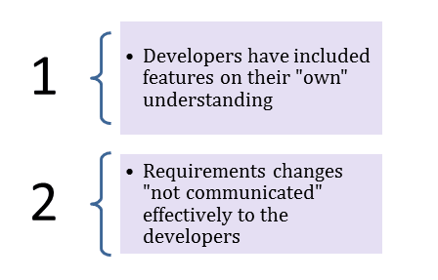
Acceptance testing …
The last phase of testing before deployment performed by a client or subject matter expert
May seem redundant … undergone Unit, Integration, and System
But Acceptance Testing is required because
Developers understanding of the requirements and may not actually be what the client needs from the software.
Requirements changed

Slide 41
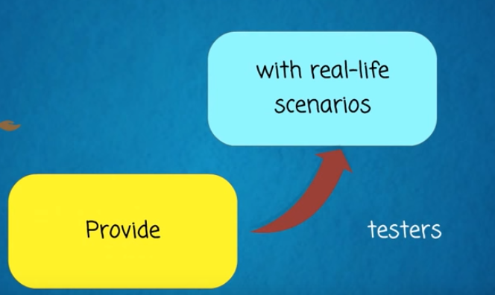
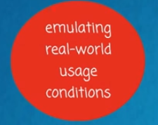
2 major goals of acceptance testing
Application conforms – According to what the client expected
Decision – if client accepts or rejects the new system
Output is usually a summary of the findings to decide if to go forward or no
https://www.youtube.com/watch?v=ws7KS39jMBU 4:02
Ideally want UAT to contain a set of
Real-life scenarios
e.g.,
3 most common tasks
3 most difficult tasks

Slide 42
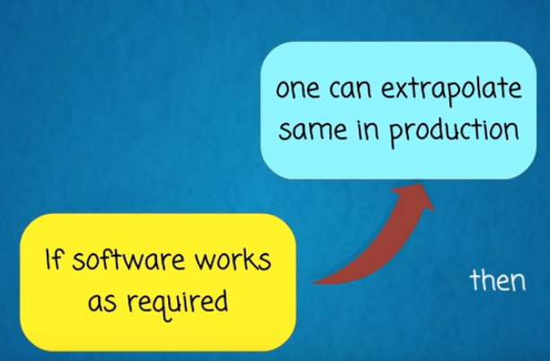
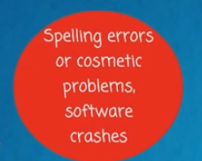
The UAT idea
By this time … simple things should be fixed … In other phases of testing

Slide 43
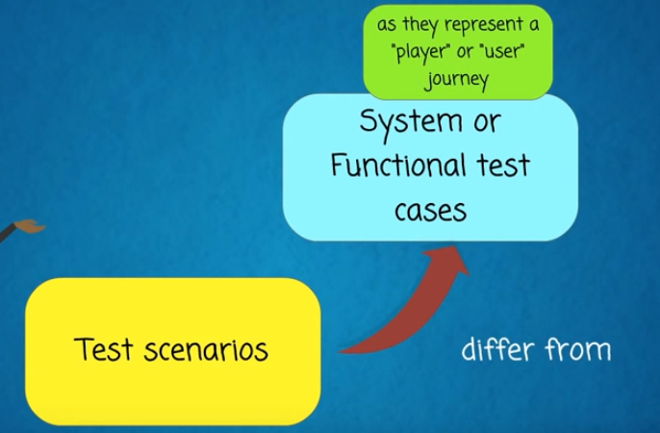
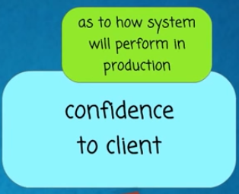
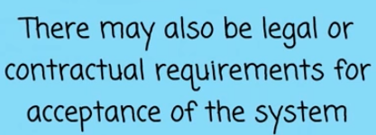
UAT focuses on test scenarios
No click-by-click test steps
Results should provide confidence (or lack of)

Slide 44
Acceptance Testing Entry Criteria
These Items done:
Business Requirements
Application Code
Unit Testing, Integration Testing & System Testing
System Integration Test Phase W/o issue
Regression Testing
All the reported defects should be fixed and tested before UAT
Sign off mail or communication from System Testing Team that the system is ready for UAT execution
With UAT, the client can be sure "What to expect" from the product rather than assuming.
The benefit of UAT is that there will be no surprises when the product is released to the market.

Slide 45
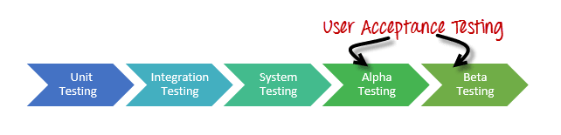
Types of user testing
system testing carried out by the test team within the development organization.
Provides earlier feedback
Alpha testing
Users of the software work with the development team to test the software at the developer’s site.
Beta testing
A release of the software is made available to users to allow them to experiment and to raise problems that they discover with the system developers.
Acceptance testing
Customers test a system to decide whether or not it is ready to be accepted from the system developers and deployed in the customer environment. Primarily for custom systems.
testing performed by a selected group of friendly customers.
performed by the customer to determine whether to accept or reject the delivery of the system

Slide 46
Beta testing Types
Traditional Beta testing: Distributed to the target market, and related data is gathered in all aspects. This data can be used for Product improvement.
Public Beta Testing: Product is publicly released to the outside world via online channels and data can be gathered from anyone. Based on feedback, product improvements can be done. For example, Microsoft conducted the largest of all Beta Tests for its OS -- Windows 8 before officially releasing it.
Technical Beta Testing: Product is released to the internal group of an organization and gathers feedback/data from the employees of the organization.
Focused Beta: Product is released to the market for gathering feedback on specific features of the program. For example, important functionality of the software

Slide 47
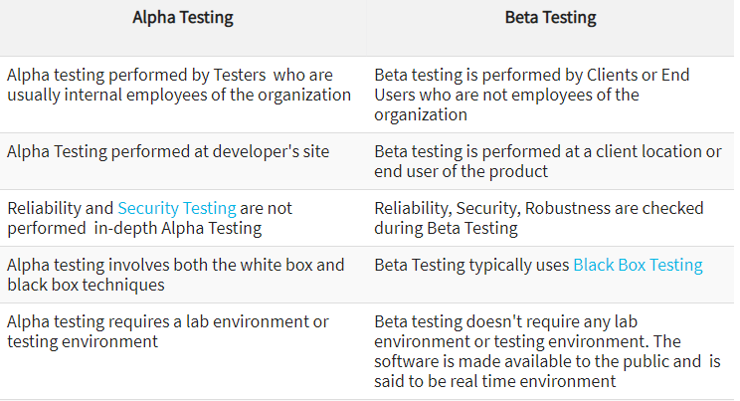
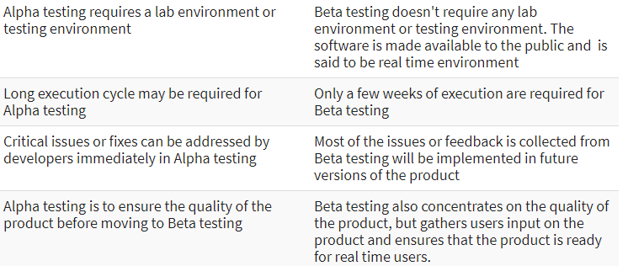

Slide 48
The acceptance testing process

Slide 49
Stages in the acceptance testing process
Define acceptance criteria
Plan acceptance testing
Derive acceptance tests
Run acceptance tests
Negotiate test results
Reject/accept system

