Slide 1
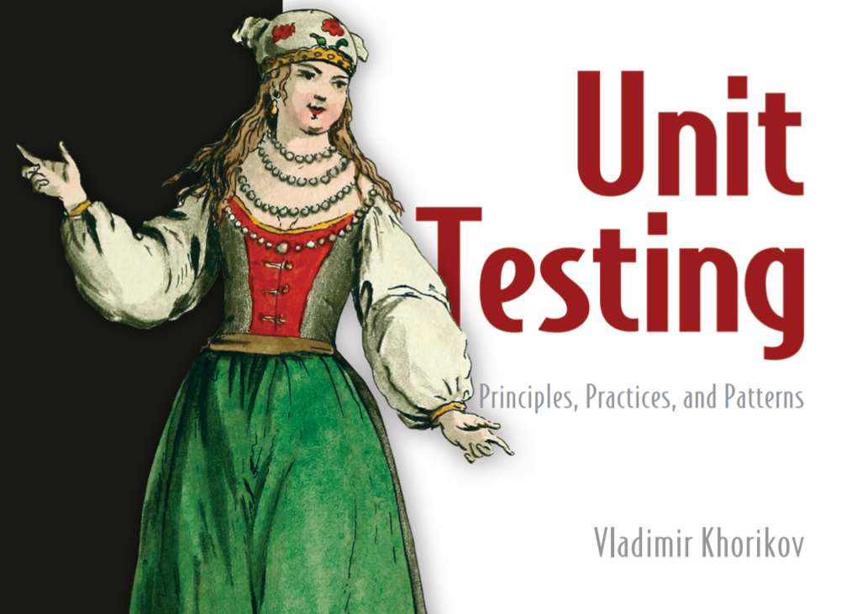
Unit Testing

Slide 2
State of unit testing
last ~10 years -> push for most unittesting
Almost all projects use unit testing
How many tests: anywhere between 1:1 and 1:3 (1 production LOC => one to three lines of test code).
Sometimes -> 1:10
Software goes through continuous change --> may last for decades.
Must have test suites ... How does SE know if break some function while impl change?
Question is NOT should you have a suite of unit tests
But - what are the best tests to create?
Question is NOT should you have a suite of unit tests
But - what are the best tests to create?
Goal of unit test -> to enable sustainable group of a project ... sustainable over time

Slide 3
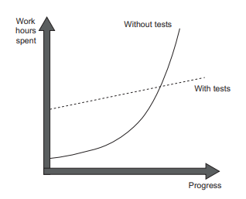
Goal of unit test -> to enable sustainable group of a project ... sustainable over time
Software Entropy -> Projects -> without tests
has a head start but quickly slows down => hard to change
Initially faster w/o tests …
But as software get complex -> progress slows

Slide 4
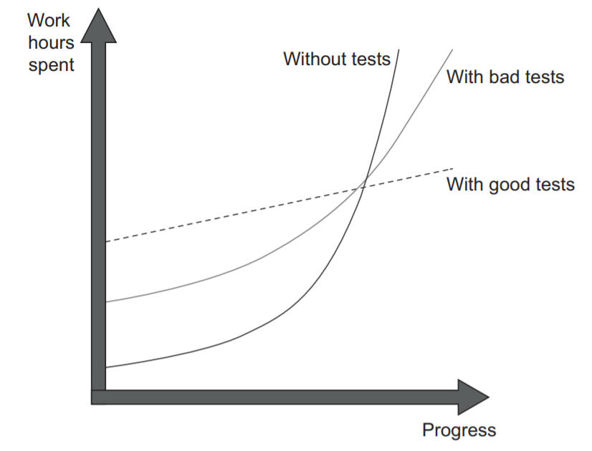
Inability to unit test code -> points out poor-quality code with relatively high accuracy.
BUT just because CAN test code -> Not necessarily mean it is high quality
Indicator of high coupling in code
Bad tests -> “looks initially better”
but it eventually falls into the stagnation phase

Slide 5
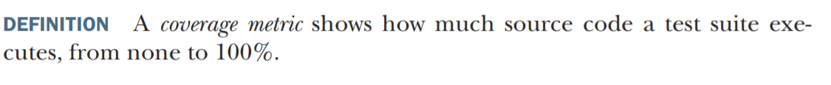
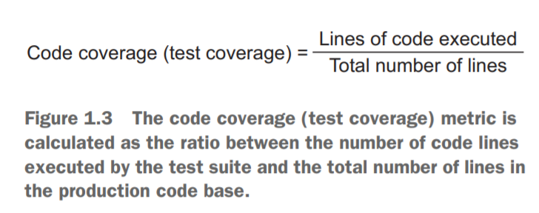
Coverage Metrics

Slide 6
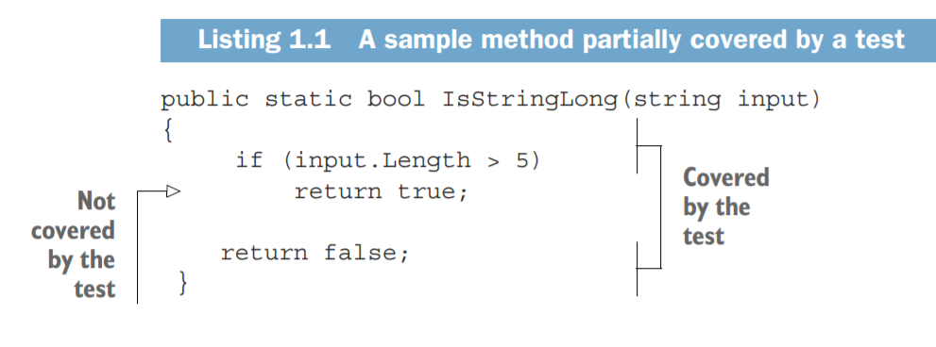
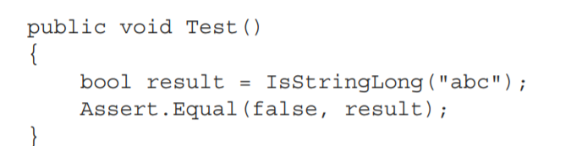
Partial Coverage
The total number of lines in the method is five (curly braces count, too).
LOC in test-> 4
LOC Not in test -> 5
This gives us 4/5 = 0.8 = 80% code coverage.

Slide 7
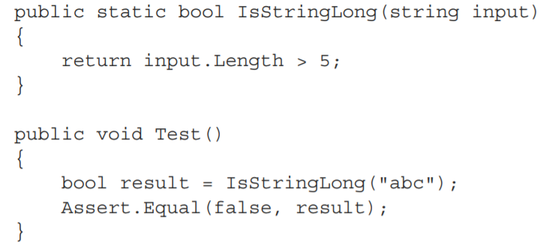
How coverage metrics can deceive
Refactor previous code to the following ….
Now -> Coverage is 100%
test now exercises all three lines of code (the return statement plus two curly braces),
the code coverage increases to 100%

Slide 8
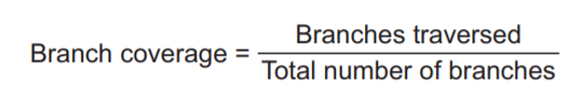
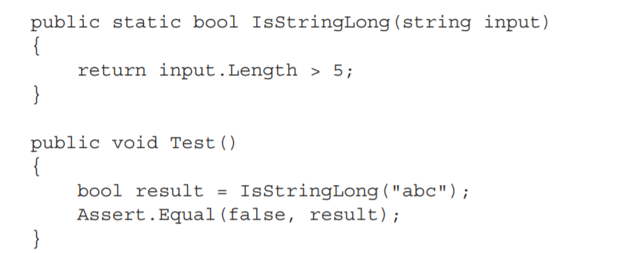
Branch Coverage -> Improvement
Branch Coverage
Focus on control structures, such as if and switch statements
Shows -> how many of such control structures are traversed by at least one test in the suite
Branch Coverage
LOC Exercised / Total number of branches
recognize:
-> two branches in the IsStringLong method:
1. when the length of the string argument > 5
2. when it’s not.
he test covers only one of these branches, so the branch coverage metric is 1/2 = 0.5 = 50%

Slide 9
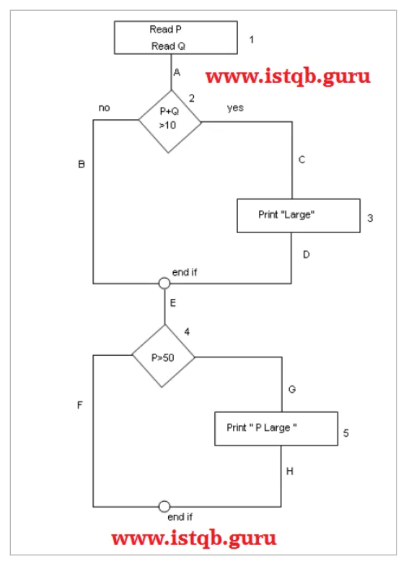
https://www.istqb.guru/how-to-calculate-statement-branchdecision-and-path-coverage-for-istqb-exam-purpose/
Suppose you have the following
1. What is the coverage by this test?
Read P Read Q if P+Q > 100 THEN Print “Large”
Endif If P > 50 THEN Print “P Large”
Endif
Statement Coverage (SC): All nodes covered: 1A-2C-3D-E-4G-5H
So by traveling through only one path all the nodes 12345 are covered, so the Statement coverage in this case is 1.

Slide 10
https://www.istqb.guru/how-to-calculate-statement-branchdecision-and-path-coverage-for-istqb-exam-purpose/
Suppose you have the following
1. What is the coverage by this test?
Read P Read Q if P+Q > 100 THEN Print “Large”
Endif If P > 50 THEN Print “P Large”
Endif
Statement Coverage (SC): All nodes covered: 1A-2C-3D-E-4G-5H
So by traveling through only one path all the nodes 12345 are covered, so the Statement coverage in this case is 1.

Slide 11
Statement coverage example
https://www.softwaretestinghelp.com/code-coverage-tutorial/
Add( int a, int b ) {
if ( b > a ) {
b = b –a;
system.out.print( b);
}
if ( a > b ) }
b = a – b
system.out.print(b)
} else {
system.out.print(a)
}
}
What input cases would have 100% statement coverage?
execute the tests with all three [(2, 3), (3, 2), (0, 0)] set of values to ensure 100% Statement Coverage.

Slide 12
Branch coverage example
Add( int a, int b ) {
if ( b > a ) {
b = b –a;
system.out.print( b);
}
if ( a > b ) }
b = a – b
system.out.print(b)
} else {
system.out.print(a)
}
}
every branch appearing in each conditional structure gets executed in source code.
What input cases would have 100% Branch coverage
For example, set (2, 3), (4, 2), (1, 1)

Slide 13
Condition Coverage
Add( int a, int b ) {
if ( b > a ) {
b = b –a;
system.out.print( b);
}
if ( a > b ) }
b = a – b
system.out.print(b)
} else {
system.out.print(a)
}
}
A condition -> has true and false resultls
CC -> tests for both the ‘true’ and ‘false’ results
Condition Coverage
.
For example, (2, 3) and (4, 2) are used then Condition Coverage would be 100%.
When data set (2, 3) is used then (b > a) evaluates to true and (a > b) evaluates to false. Similarly, when data set (4, 2) is used then (b > a) evaluates to false and (a > b) evaluates to true.
Thus both the conditions have both the values i.e true and false covered. Hence the Condition Coverage would be 100%.

Slide 14
Difference between Branch and Condition Coverage
If (a >0) & (b >0) Then
Print “Hello”
Else Print “Bye”
‘a’ and ‘b’ both are true,
so the If condition gets executed.
Branch Coverage Input:
(1, 1)
(1, 0)
‘a’ is true and ‘b’ would be false,
so the Else part of the code is executed.
purpose of Condition Coverage is to get each of true and false for every condition executed
Condition Coverage input
(1, 0) (0, 1)
‘a’ is true and ‘b’ would be false
‘a’ is false and ‘b’ would be true
notice that the else part does not get executed in Condition coverage

Slide 15
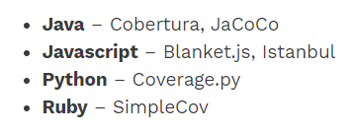
A few code coverage tools
a coverage of 75% – 80% should be an ideal number.

Slide 16
So what makes a good test suite?
execute them on every code change, even the smallest one
Good test suite is
integrated into the development cycle.
targets only the most important parts of your code base.
maximum value with minimum maintenance costs.
Main parts of business logic
Not necessarily
Infrastructure code
External services and dependencies, such as the database and
third-party systems ○ Code that glues everything together
Use tests whose value exceeds their upkeep costs by a good margin.
1. Writing only valiable tests
2. Recognizing low quality tests.

Slide 17
Main Ideas so far
Code tends to deteriorate -> Tests help overturn this tendency.
The goal of unit testing is to enable sustainable growth of the software project
All tests are not created equal. Each test has a cost and a benefit component
The ability to unit test code is a good litmus test, but it only works in one direction. It’s a good negative indicator (if you can’t unit test the code, it’s of poor quality) but a bad positive one (the ability to unit test the code doesn’t guarantee its quality).
Coverage metrics are a good negative indicator but a bad positive one. Low coverage numbers are a certain sign of trouble, but a high coverage number doesn’t automatically mean your test suite is of high quality.
Branch coverage provides better insight into the completeness of the test suite but still can’t indicate whether the suite is good enough.
A successful test suite exhibits the following attributes:
– It is integrated into the development cycle.
– It targets only the most important parts of your code base.
– It provides maximum value with minimum maintenance costs.
8. The only way to achieve the goal of unit testing (that is, enabling sustainable project growth) is to – Learn how to differentiate between a good and a bad test. – Be able to refactor a test to make it more valuable.

Slide 18
Chapter 2 – Unit Tests
A unit itest is an automated test that:
Verifies a small piece of code (also known as a unit),
Does it quickly,
And does it in an isolated manner.
root of the differences between the classical and London schools of unit testing
1. Classical -> Kent Beck: Test-Driven Development: By Example (Addison-Wesley Professional, 2002).
2. London style is sometimes. Steve Freeman and Nat Pryce, Growing Object Oriented Software, Guided by Tests (Addison-Wesley Professional, 2009), as a good source on this subject

Slide 19
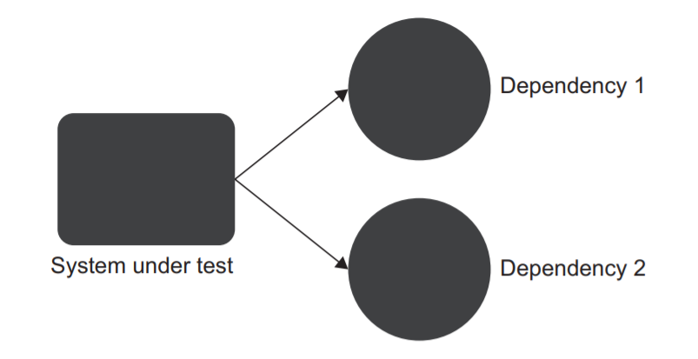
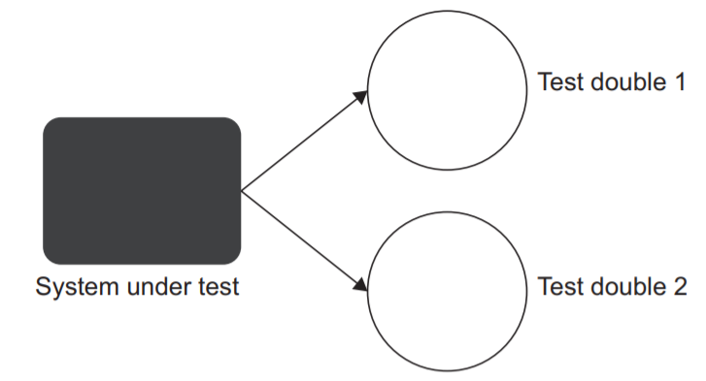
What is isolated?
London school = isolating the system under test from its collaborators
Ie if a class has a dependency on another class, or several classes, => replace all such dependencies with test doubles.
Focus on the class under test exclusively by separating its behavior from any external influence
test double is an object that looks and behaves like its release intended counterpart but is actually a simplified version that reduces the complexity and facilitates testing
if the test fails, you know for sure which part of the code base is broken: it’s the system under test

Slide 20
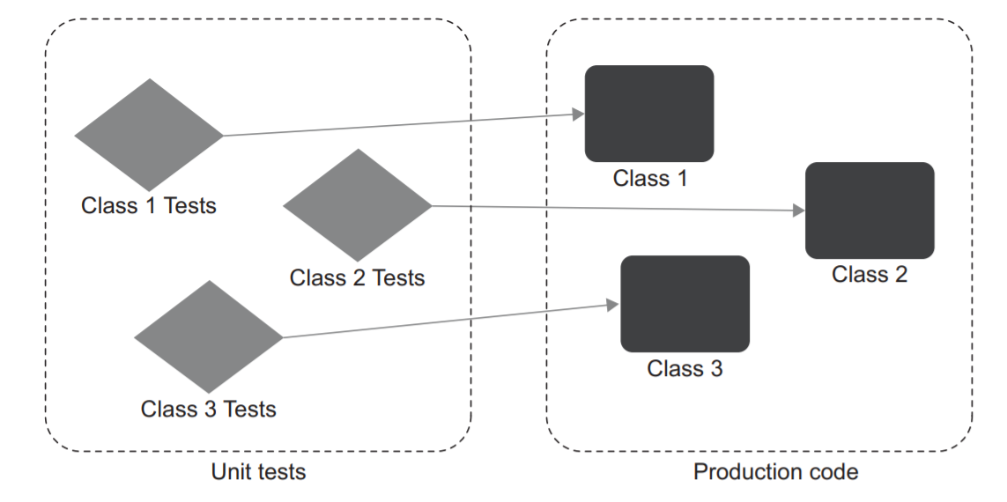
Advantages of London Approach
if the test fails, you know for sure which part of the code base is broken: it’s the system under test
allows you to introduce a project-wide guideline of testing only one class at a time, which establishes a simple structure in the whole unit test suite
1.
one class with tests for each class in the production code.

Slide 21
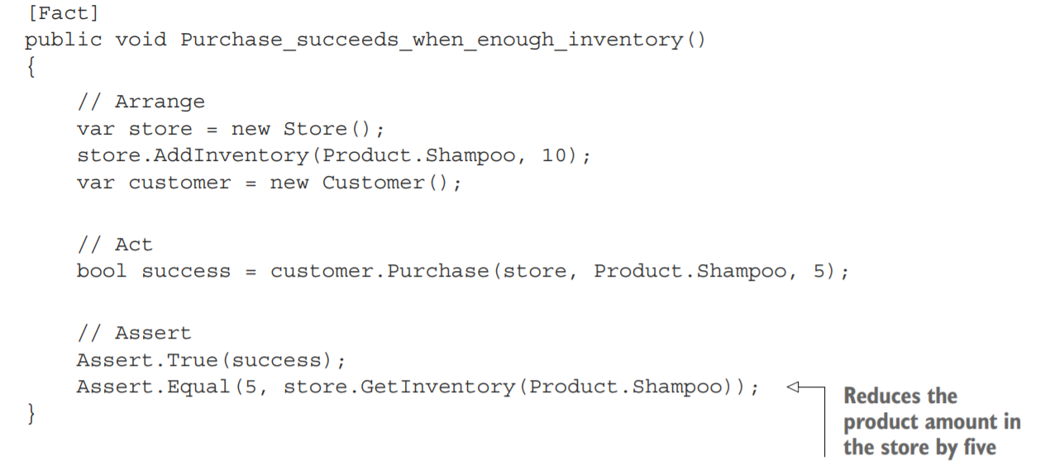
The ‘classical’ approach
typical three-phase sequence: arrange, act, and assert (AAA)

Slide 22
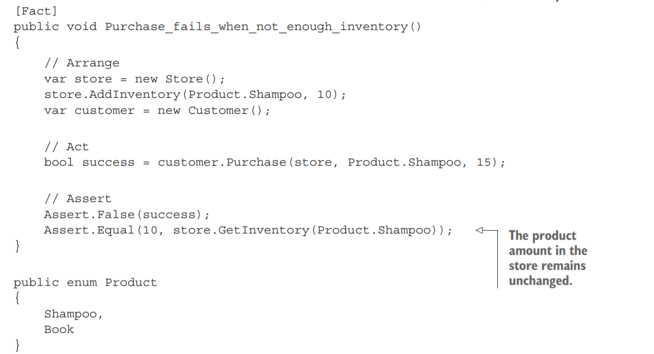

Slide 23
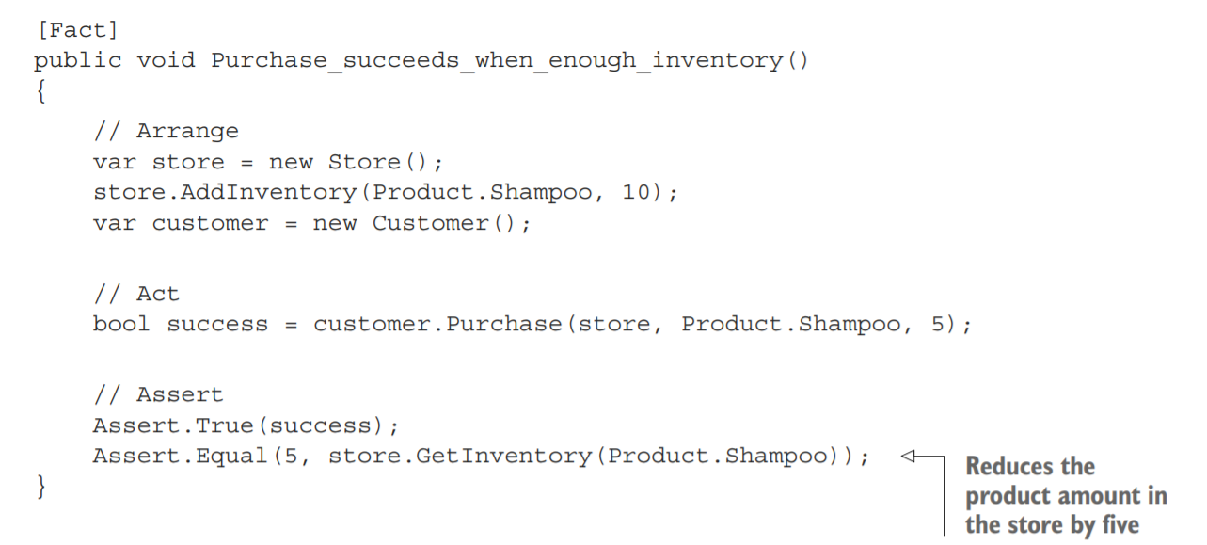
operate an online store. . . use case … a customer can purchase a product.
if enough inventory -> sell item and reduce inventory
If there’s not enough product -> deny sale keep inventory levels
act phase => exercise the behavior you want to verify
the verification stage

Slide 24
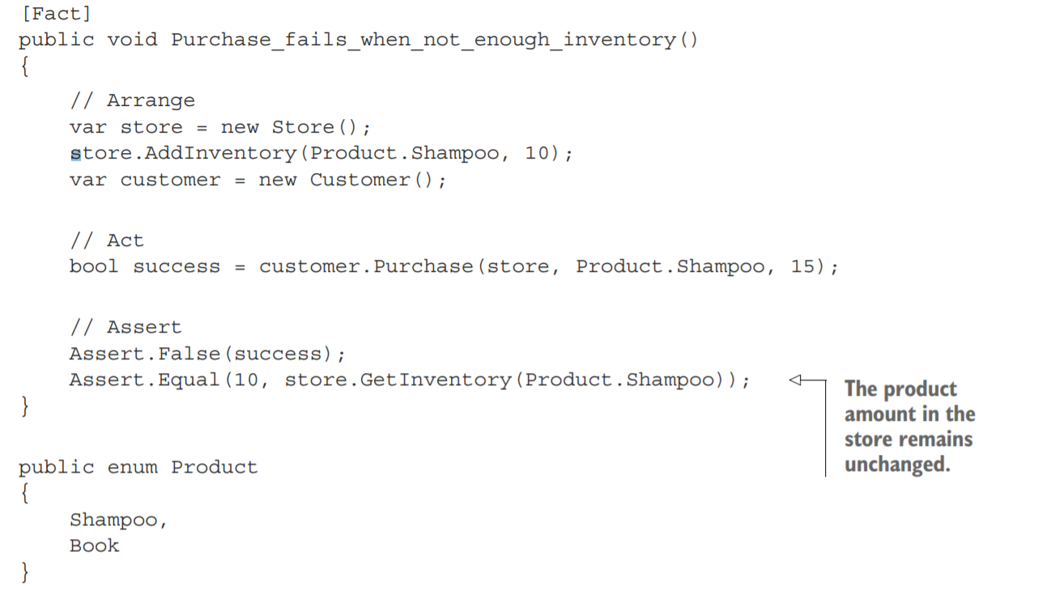

Slide 25
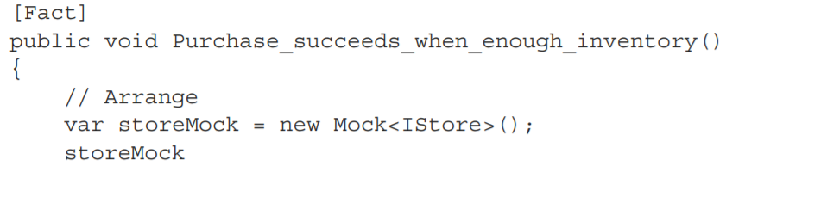
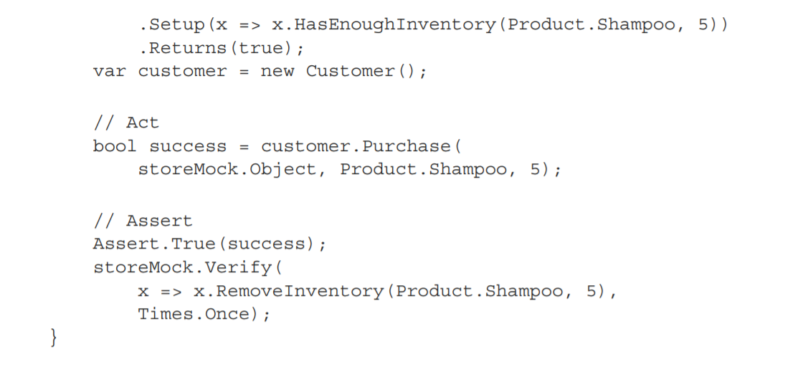
London Style -> Uses a mock
A special test double
no longer instantiate a production-ready instance of Store but instead create a substitution for it, using Moq’s built-in class Mock
instead of modifying the state of Store by adding a shampoo inventory to it, we directly tell the mock how to respond to calls to HasEnoughInventory().
examine the interactions between Customer and Store: the tests check to see if the customer made the correct call on the store.

Slide 26
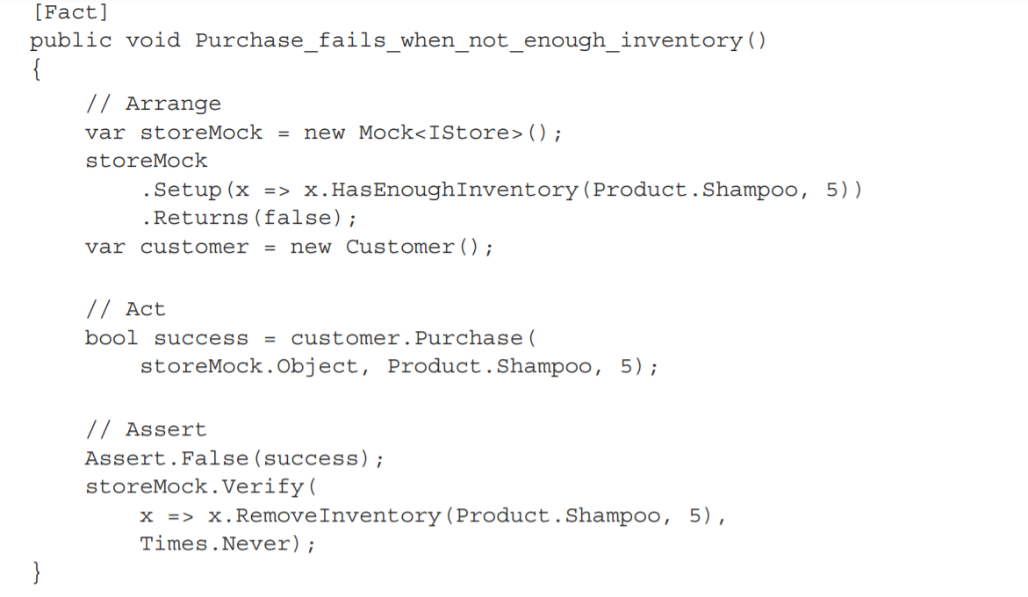

Slide 27
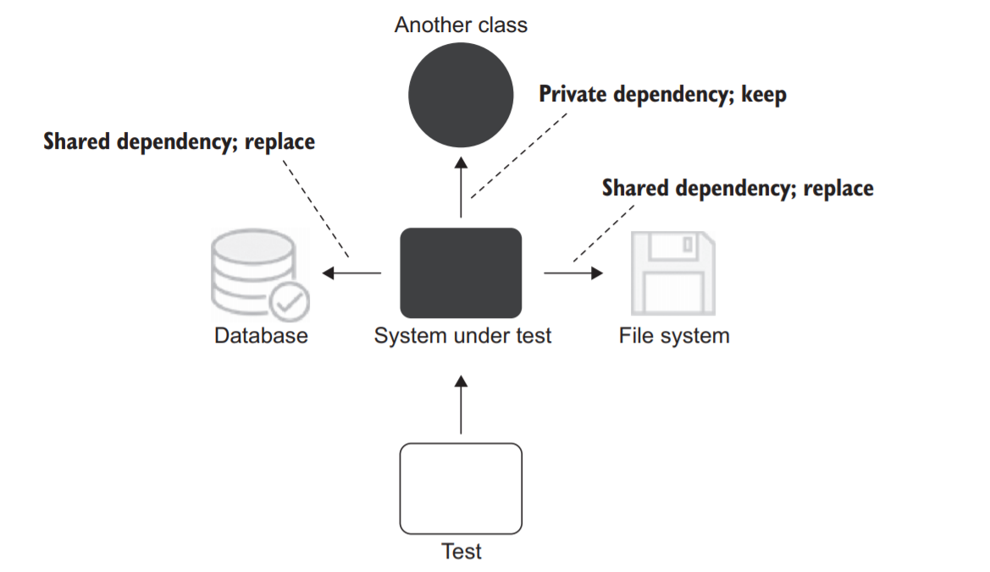
A more hybrid classical style might …
Isolate … shared dependencies -> so tests can run in parrelelt or any order

Slide 28
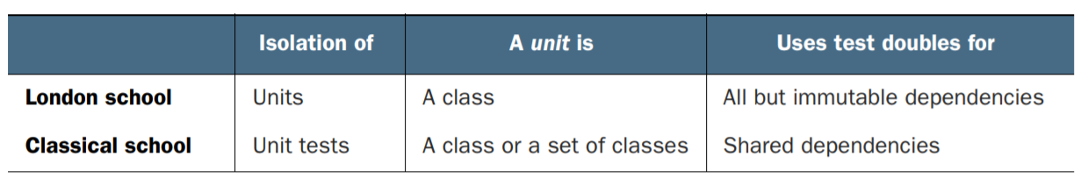

Slide 29
Advantages of London School
Better granularity. The tests are fine-grained and check only one class at a time.
It’s easier to unit test a larger graph of interconnected classes. Since all collaborators are replaced by test doubles, you don’t need to worry about them at the time of writing the test.
If a test fails, you know for sure which functionality has failed. Without the class’s collaborators, there could be no suspects other than the class under test itself..

Slide 30
an integration test is a test that verifies that your code works in integration with shared dependencies, out-of-process dependencies, or code developed by other teams in the organization.
London school considers any test that uses a real collaborator object an integration test.

Slide 31
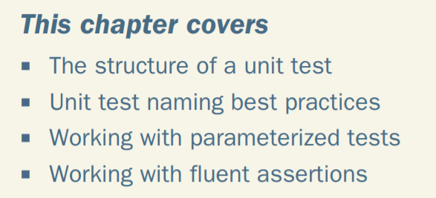
Chapter 3 – Anatomy of a unit test

Slide 32
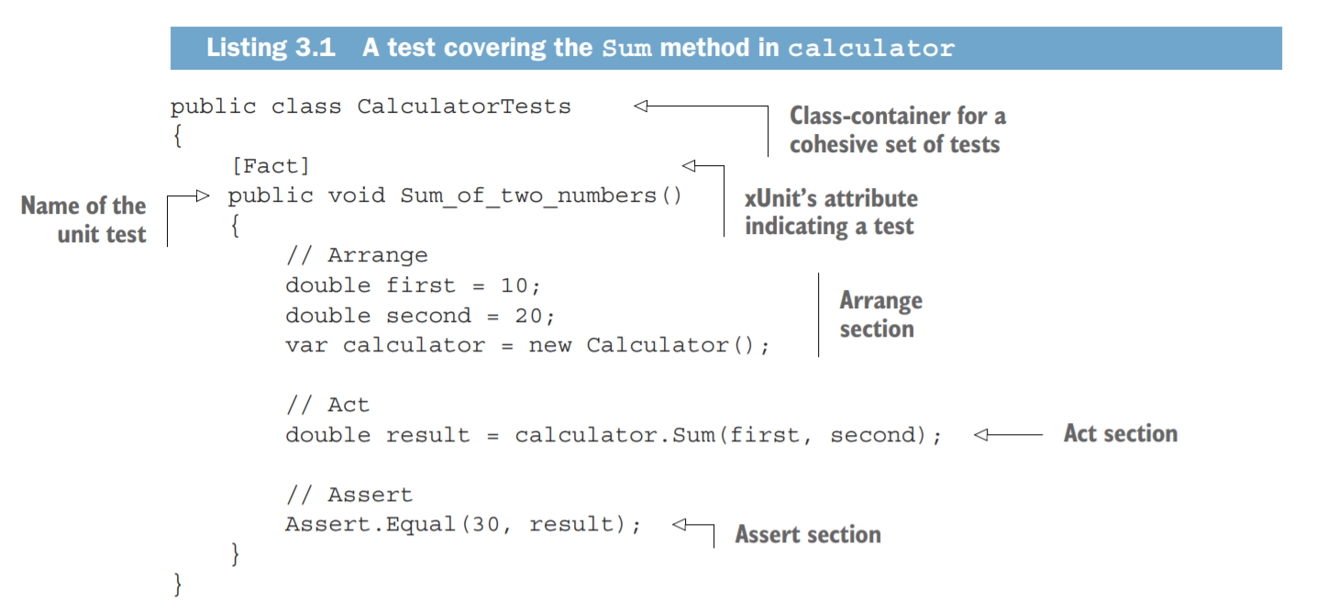
you bring the system under test (SUT) and its dependencies to a desired state.
you call methods on the SUT, pass the prepared dependencies, and capture the output value
verify the outcome

Slide 33
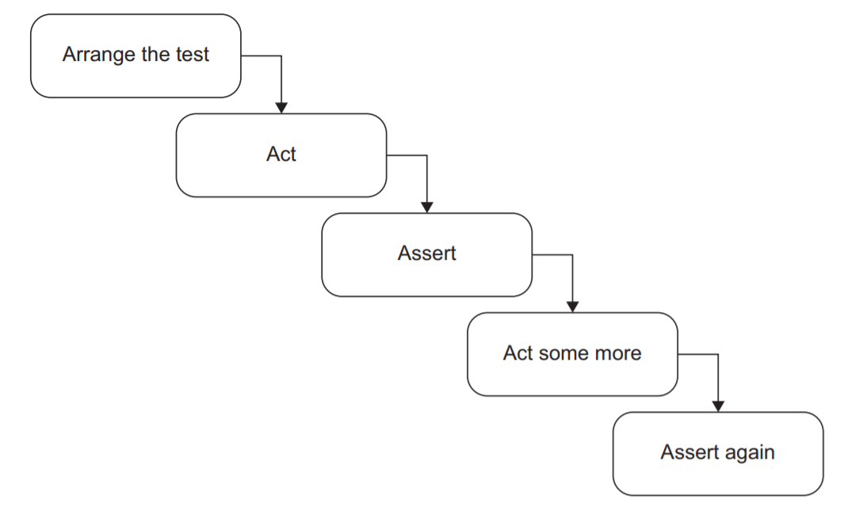
Avodi Multiple ‘Acts’ per test
multiple act sections separated by assert => test verifies multiple units of behavior
A single action -> ensures that your tests remain within the realm of unit testing, which means they are simple, fast, and easy to understand

Slide 34
Avoid if statements in tests
—should be a simple sequence of steps with no branching
are no benefits in branching within a test.
You only gain additional maintenance costs:
if statements make the tests harder to read and understand.

Slide 35
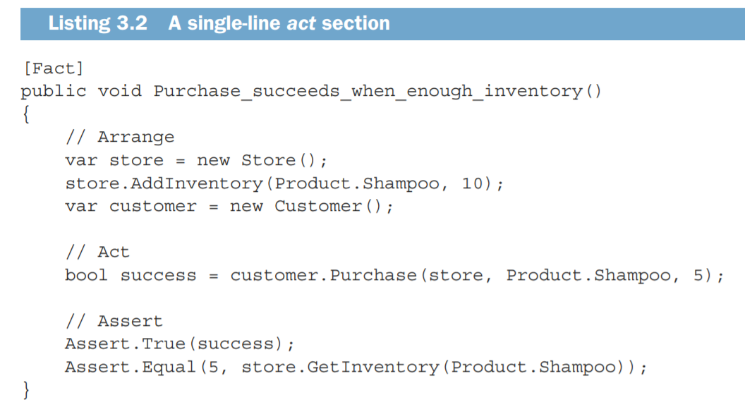
If the act consists of two or more lines, it could indicate a problem with the SUT’s public API
the act section in this test is a single method call, which is a sign of a well designed class’s API

Slide 36
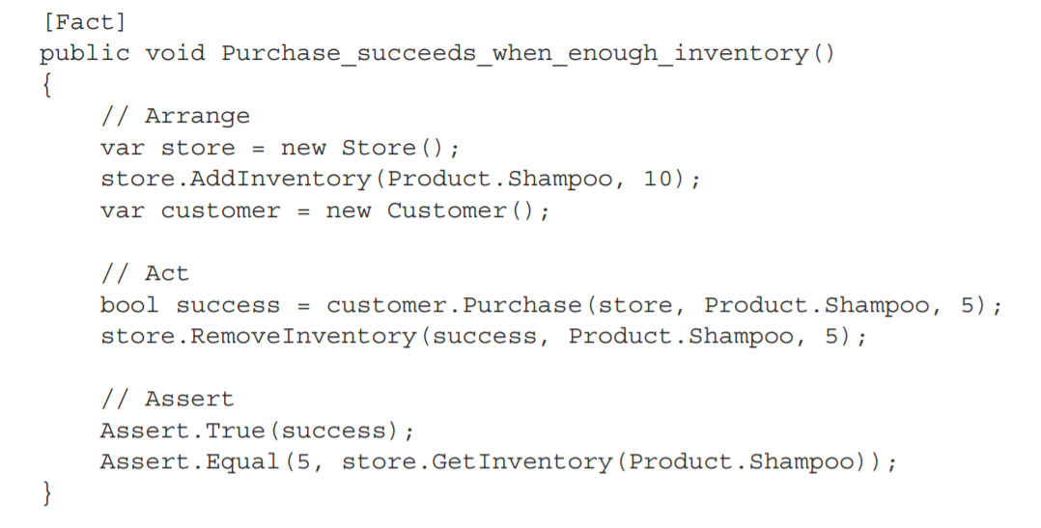
tries to acquire five units of shampoo from the store.
Two lines => a sign of a problem with the SUT: it requires the client to remember to make the second method call to finish the purchase and thus lacks encapsulation
inventory is removed from the store.
The removal takes place only if the preceding call to Purchase() returns a success

Slide 37
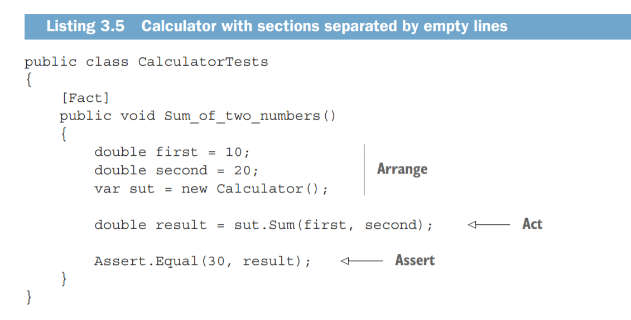
Be Clear about each of the A A A sections

