Slide 1
CSC Program Data and Changes

Slide 2
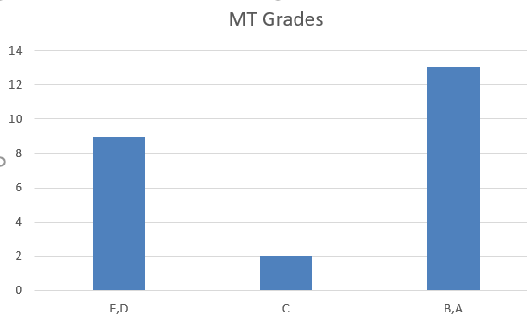
U-Curve of Grades

Slide 3
CSC4900 Readiness to Graduate
CSC4990 Graduation Readiness
Resume Reviewed by 2 Others | 20%
4 pillars | 10%
Practice technical Interview | 10%
Linked in Profile ready | 15%
DB Join Question | 40%
Git Tool Knowledge | 20%
Portfolio | 20%
Design patterns | 15%
Data Structure quiz | 45%

Slide 4
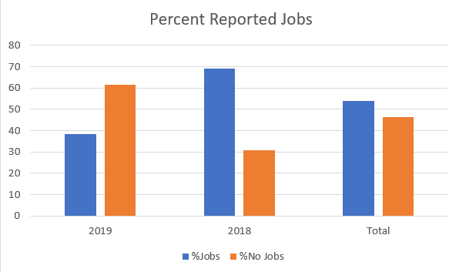
Reported Jobs
I had an interview that went great, but they didn't offer me the job. I had a couple of interviews where I flubbed a question on the technical interview and I think that is what disqualified me, and then I've had a couple of interviews where they were looking for specific skills that I did not have (usually deployment or cloud technologies like AWS). ..
No luck yet. Still putting in applications though… I’ve had three interviews
Yeah I had a couple of interviews. They never reached out to me again to see what I missed. … [Asked an optimization question I gave a bad answer]
Thanks, I haven't really applied for many other places to be honest, I just started looking in the last couple weeks. I've been having a hard time finding the motivation in light of everything going on but I think I'm there now.
Source: Linked-in student reported via msg

Slide 5
What tech skills need in job?

Slide 6
Group by Web Dev and DB
Even though web frameworks are not

Slide 7
Required Curriculum Outcomes
CSC1700 | Intro to programming | Python | No | Needs specific outcome expectations. Suffers from genEd population mixed with CSC Majors
CSC2200 | Web Application | CSS,HTML, JavaScript | Yes (2020) | Suffers from only CSC1700 prerequisite.
CSC2300 | Architecture | Some Python | Hardware project | Contributes to hardware knowledge but perhaps should code in this course. (e.g., learn C)
CSC2650 | Object Oriented Programming | Java | No | Needs specific outcome expectations
CSC3610 | Data Structures | Java | Optional | Could tackle projects better if did not require JavaFX.
CSC4350 | Software Engineering | Node.js, JS (2020) | Yes | Needs to introduce a web technology and use it for project.
CSC4350 | Database | SQL, Java, Ruby on Rails | Yes | Should complete a specific, web-based project using a DB.
CSC4990 | Capstone project |  | yes | Prior to 2020, project completion was only outcome. Should consider job readiness and interviewing skills
* Experimenting with CSC2200 with project … more programming requirement

Slide 8
Elective Course Outcomes
Not being worked - Too many electives (11) – Too few projects – Too few skills
- Approximately
- 27% would help grad school
- 55% help with job readiness skill
- 36% build a project
 |  | Grad | Skill | Project
1 | AI | 1
2 | Cyber
3 | Test |  | 1 | 1
4 | Design |  | 1
5 | Network |  | 1
6 | Linux |  | 1
7 | O/S | 1
8 | Robotics
9 | Web App |  | 1 | 1
10 | Mobile |  |  | 1
11 | PL | 1 | 1 | 1
 |  | 3 | 6 | 4
 |  | 27.27273 | 54.54545 | 36.36364

Slide 9
Other General Recommendations
Recommendations
Require portfolios early and provide more project opportunities
More emphasis on programming fundamentals
More emphasis on key technologies
Clean up electives
Definition and better measurement outcomes
CSC4990 test(s) and work beyond project
Unknown:
How to handle the ‘camel-hump’ curve

