Slide 1
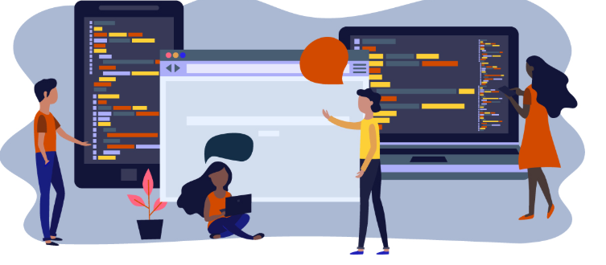






Software Engineering Careers Friday June 26th 1-130 David Lash dlash@aurora.edu

Slide 2
Your Questions
How and when did you become interested in Software Engineering?
What are the requirements to graduate with a Software Engineering degree? What is a university that provides this degree?
Describe a daily day as a Software Engineer.
Some students are interested in Software Engineering and/or Computer Science. What advice would you give them?

Slide 3

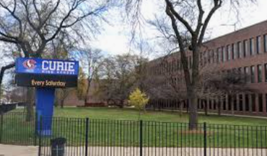
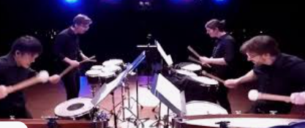
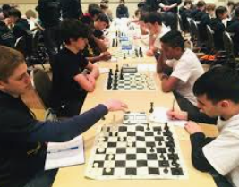
How and when did you become interested in Software Engineering?
Went to Curie High School in Chicago
Graduation rate %50 – Most schools out here >80% go to college
Liked Science in High School,
Math was OK. Sports OK (I was too slow and small)
LOVED music
Found Chess Team
Didn’t read my English books
Never had to study
Never took notes
Did not even write down when tests were

Slide 4
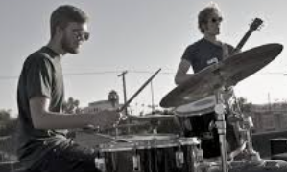

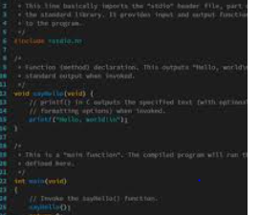

How and when did you become interested in Software Engineering?
Sophomore year at University –
Was a music Majors
2. Considered Science – recently changed … and was lost
- Poor Grads Freshman at U of I CCC
3. Switched schools -> Took Introduction to Computer Science
By end of class I switched my major … barely knew what it was,
My Dad did not know what it was (never really did).
I knew it was “up and coming” and a job growth area

Slide 5
How and when did you become interested in Software Engineering?
What are the requirements to graduate with a Software Engineering degree? What is a university that provides this degree?
Describe a daily day as a Software Engineer.
Some students are interested in Software Engineering and/or Computer Science. What advice would you give them?
Computer Science programs are ‘accredited’ (think certified) by a board.
Almost all programs require:
- Math:
- 2 semesters of Calculus (some require 3 and deferential equations)
- Discrete Mathematics
Science
1 or 2 semesters of science like: bio, chem, physics
General electives
Like history, writing, English, Sociology
Several Computer Science Courses (10-15)
Like Introduction to Programming, Data Structures, Advanced Programming, Design, Software Engineering, Databases,

Slide 6




How and when did you become interested in Software Engineering?
What are the requirements to graduate with a Software Engineering degree? What is a university that provides this degree?
Describe a daily day as a Software Engineer.
Some students are interested in Software Engineering and/or Computer Science. What advice would you give them?
SEs focus on dev of software products
PMs help organize many projects
IT Specialists focus on installing maintaining equipment
Tech managers focus on managing technical employees

Slide 7
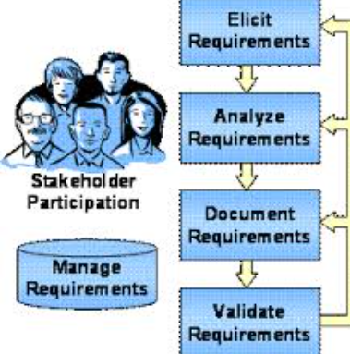



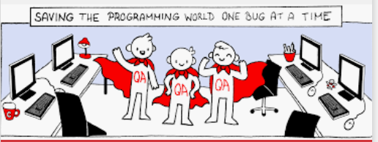
Software Engineers build software Systems
May ‘specialize’ -> Requirements
SEs develop
But collaborate ALOT
May ‘specialize’ -> Architecture
May ‘specialize’ -> QA

Slide 8




A little like building a custom house
What do the ‘buyers’ really want?
What will they consume?
What do they need?

Slide 9
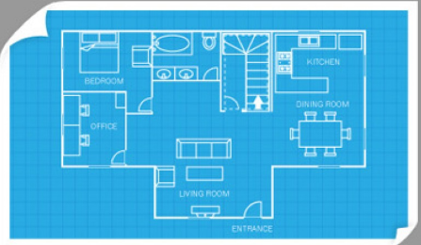
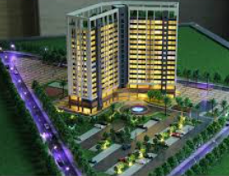
Often show them ‘plans’ or models or mock ups

Slide 10
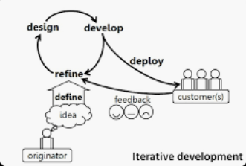
Most development done iteratively
Devs … develop systems and deliver incremental versions to customer.

Slide 11


Additional roles for planners and testers
How will make sure every feature of house works and nothing is missed?
How will make sure house is done
on time and on budget?

Slide 12


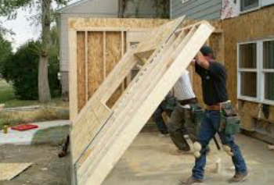
Software Maintenance
Software stays in production a long time
(E.g., Microsoft word)
Engineers fix bugs, build new features, clean up issues

Slide 13

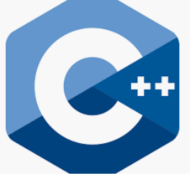




How and when did you become interested in Software Engineering?
What are the requirements to graduate with a Software Engineering degree? What is a university that provides this degree?
Describe a daily day as a Software Engineer.
Some students are interested in Software Engineering and/or Computer Science. What advice would you give them?
Take control of your learning
Start building TODAY!
TONS of online classes
https://www.codecademy.com/
http://freeCodeCamp.org
https://www.freecodecamp.org/news/the-50-best-free-online-university-courses-according-to-data-deb6fe34ef30/
https://www.w3schools.com/

Slide 14


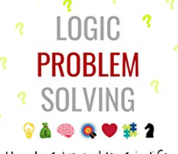
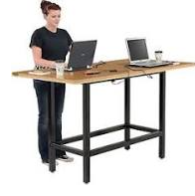

5 signs you are NOT a programmer - https://www.makeuseof.com/tag/6-signs-meant-programmer/
Sign #1: You Lack Experimental Creativity
Sign #2: You Are Not Self-Driven
Sign #3: You Hate Logic Problems
Sign #4: You Can’t Sit for Long Periods
Sign #5: You Want Normal Work Hours
Inquisitive about:
How things work?
Logic puzzles
Fix that’s what broken

