Slide 1
5.3 Data Quality Features
Talend, Global Leader in Open Source Integration Solutions
Sebastiao Correia
scorreia@talend.com
Notes:
Good afternoon and thanks for the opportunity to speak to you today about how Talend can help your organization meet the challenges it faces dealing with any of your integration needs. We’re going talk about “Integration at Any Scale” and why it is that Talend is the only company positioned to help businesses like yours manage data, applications and process that must be integrated for your company to move forward to maintain its competitiveness in a market that’s ever-changing and ever-challenging.
Beyond the speaking points, some additional elements, clarification or background information are provided for certain slides. They are underlined to make them easier to recognize.

Slide 2
Agenda
What's new in …
- Profiling
- Matching
- Cleansing
- Monitoring
- Big Data

Slide 3
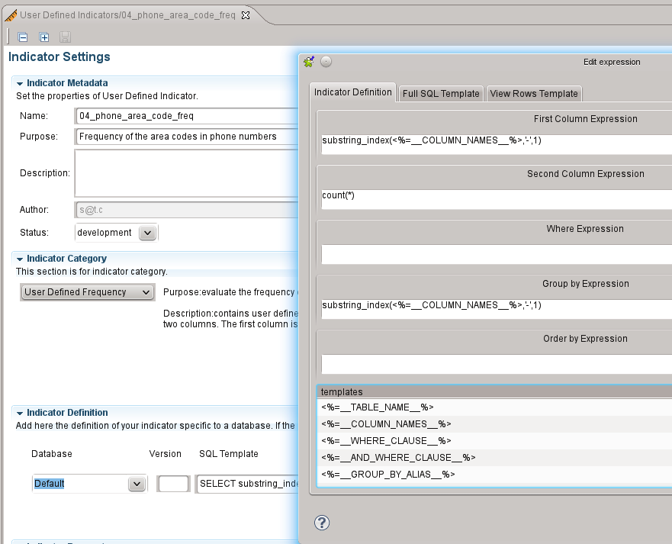
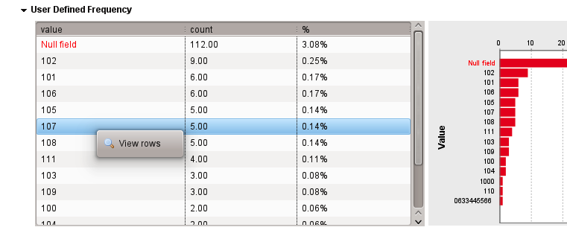
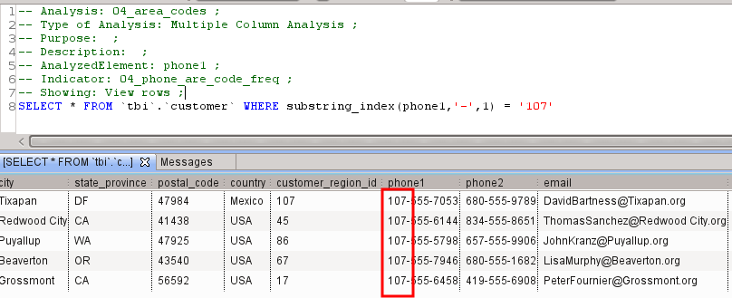
Profiling
- User Defined Indicators (UDI)
- Drill down
- Import/export/Exchange
- JRXML management

Slide 4
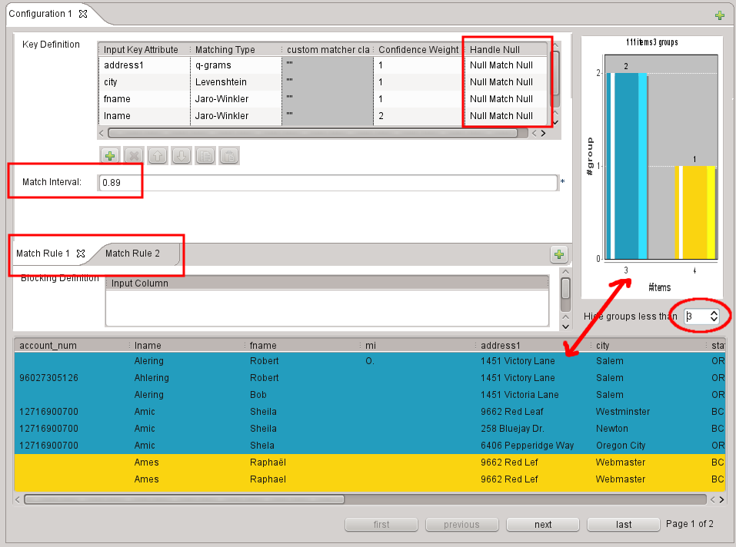
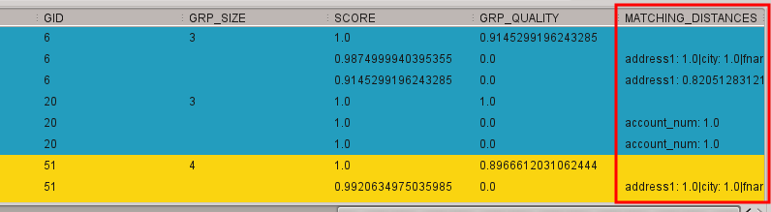
Matching
- Double-click
- Multiple matching
rule management
- handle null values
in comparisons
- Memory management
improvements
- UI improvements

Slide 5
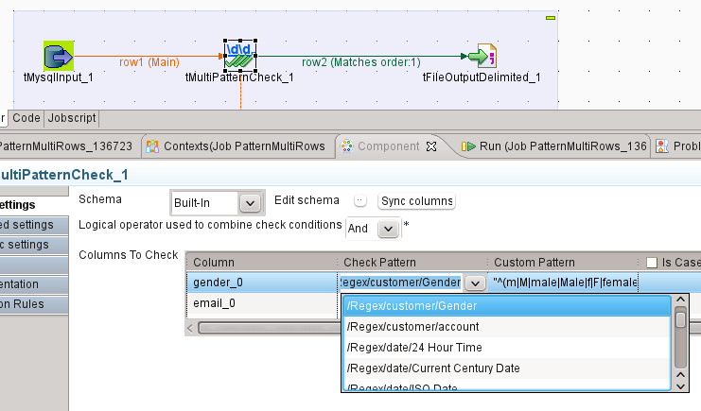
Cleansing
- tMultiPatternCheck component improvement

Slide 6
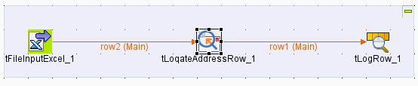
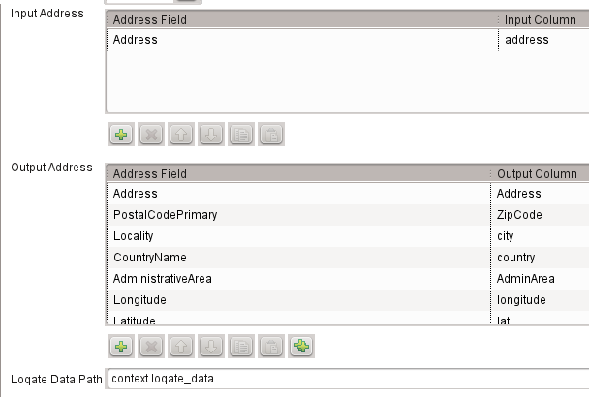
Cleansing
- Address cleansing with
the tLoqateAddressRow component

Slide 7
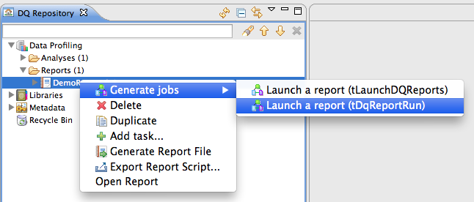
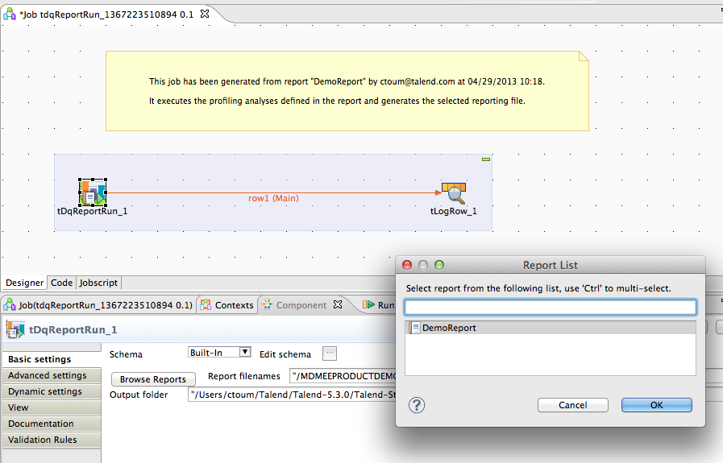
Monitoring
- New component tDqReportRun
- will replace tLaunchDqReport
- can be scheduled via TAC

Slide 8
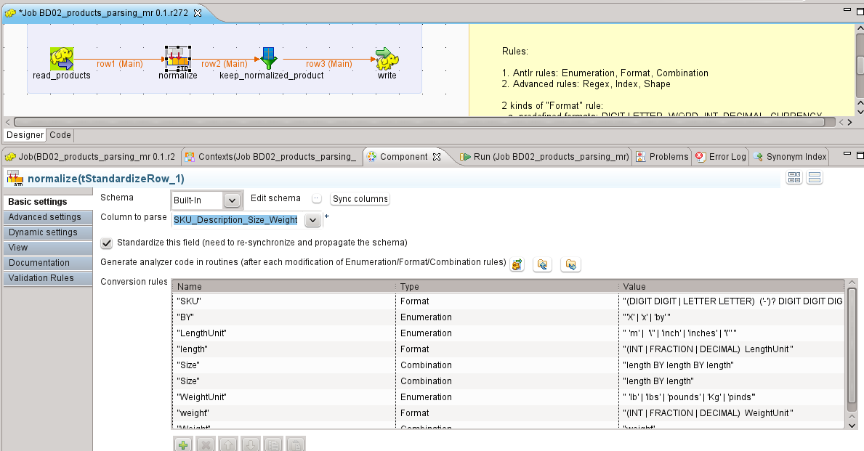
Big Data Parsing and Cleansing
- standardization component for the M/R framework

Slide 9
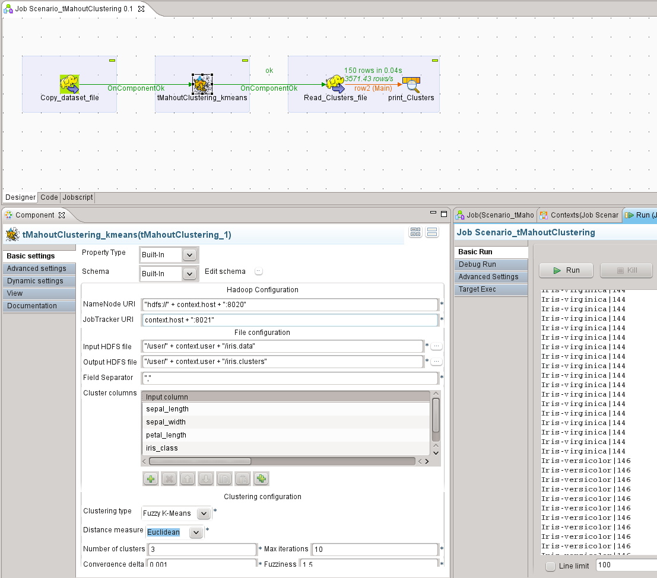
Big Data Mining
- Clustering
component
with Apache
Mahout

Slide 10
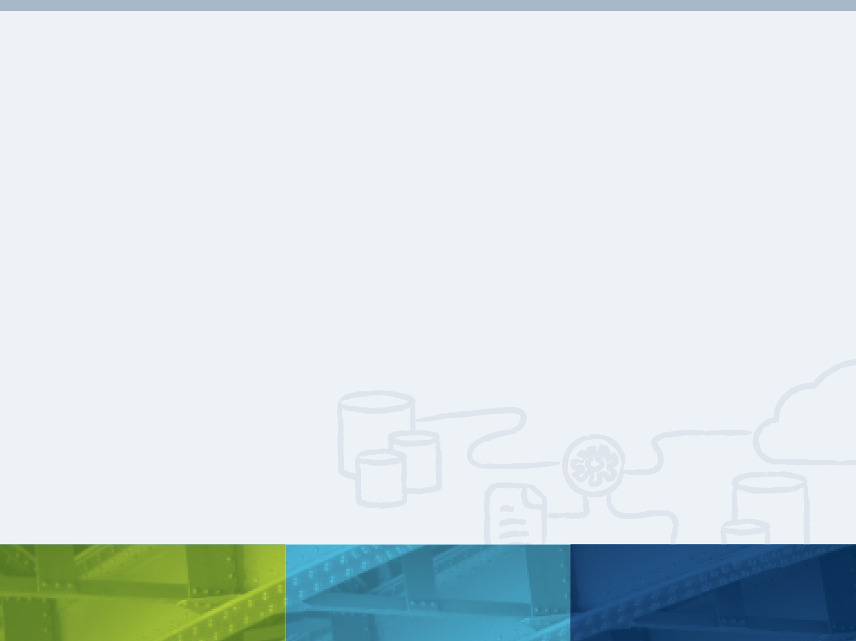
Thank You!
Notes:
Thank you again for the opportunity to speak with you about Talend and how we believe that we can help your organization manage all of your integration needs.
I’ll take questions at this time.

