Slide 1
house saleprice prediction in ames, ia
Laura luo
(06/2019)

Slide 2
Content
Goal: Predict saleprice based on historical dataset
Data Description
Data Processing
Modeling
Evaluation & Conclusion
(Appendix)
- Data cleaning
- Feature Engineering (X, y)
- Model Adjust: Lassocv

Slide 3
Data Description
Information for individual residential properties sold in Ames, IA from 2006 to 2010.
78 features
- General: type, shape, house condition, square feet, house age
- Basement
- Garage
- Porch
- Pool
- Sale info: sale type, sale condition
- …
2501 houses with saleprice
879 houses to predict

Slide 4
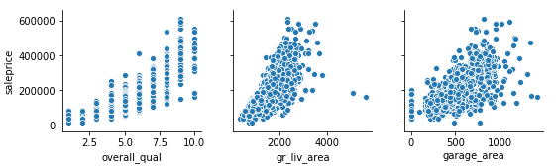
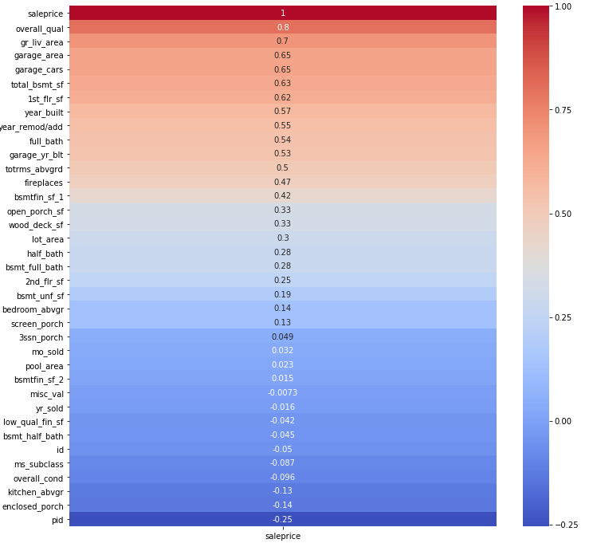
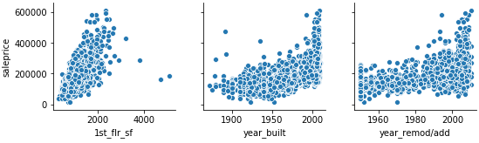
Correlation
(Which features are key factors here?)
House condition ?
Square feet ?
Property age ?
Garage ?
Bathroom ?
…
→ Linear Regression model

Slide 5
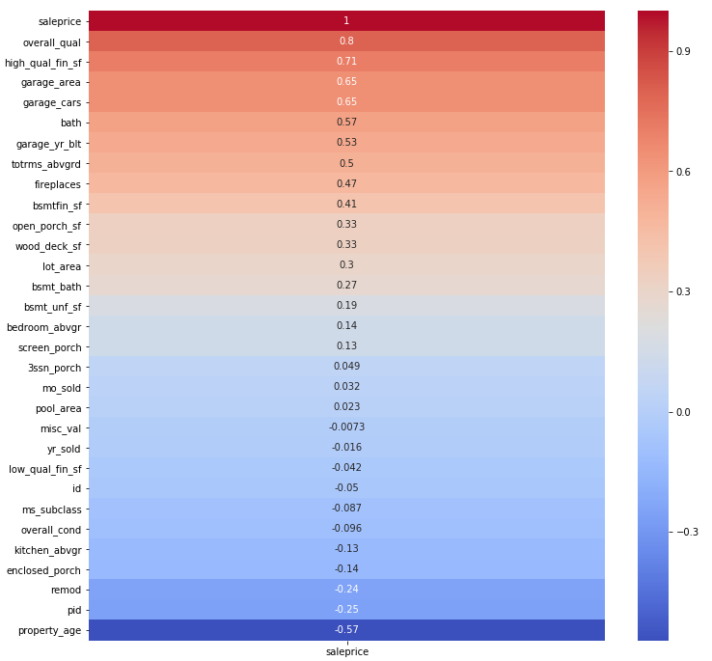
Data processing
Get rid of too many features:
- House condition ✓
- Square feet ✓
- Property age: year sold – year built
- Garage ✓
- Bathroom: Full bath + 0.5 * Half bath
…
Others
- Categorical data ? --numeric
- Ordinal data ? --numeric

Slide 6
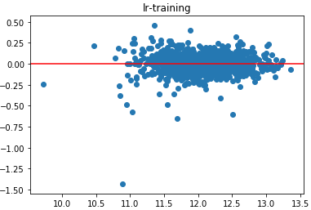
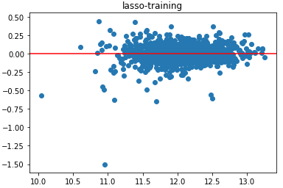
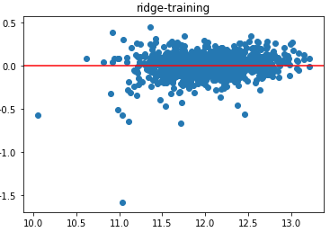
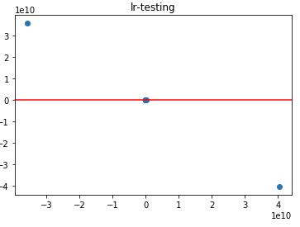
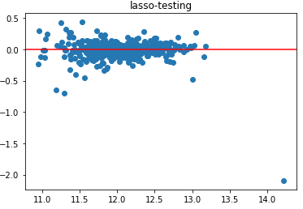
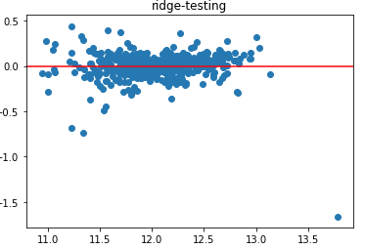
modeling
Difference between real saleprice and predicted saleprice (MSE) → the smaller, the better
Other scores (R2, cross validation etc.)
M1: Linear Regression
M2: Lasso
M3: Ridge
 | M1 | M2 | M3
Training | 0.010 | 0.011 | 0.012
Testing | 5.67 | 0.021 | 0.020

Slide 7
Conclusion
Saleprice = 0.033 * lot_area + 0.082 * overall_qual + 0.041 * overall_con + … + 0 * lot shape + 12.02
The house price started at 12.02 dollars
With lot_area increase one unit, if other variables stay, the final saleprice will increase 0.033 dollars
House quality(overall_qual) has higher weight than lot_area
Lot shape won’t affect house saleprice
…

Slide 8
Appendix

Slide 9
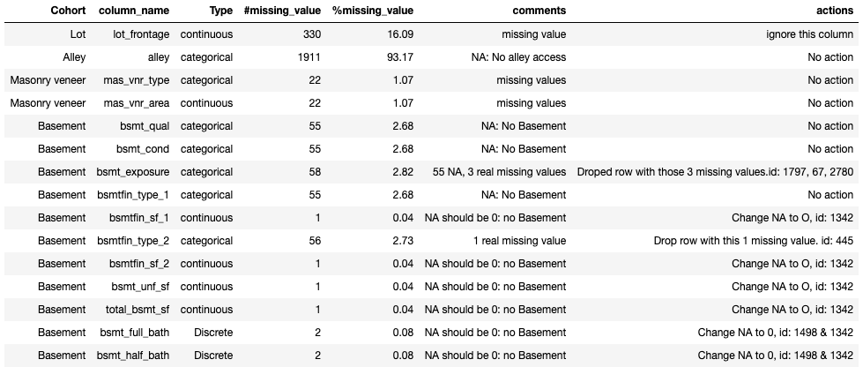
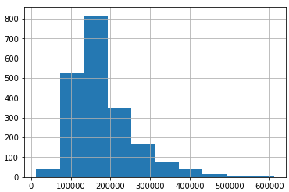
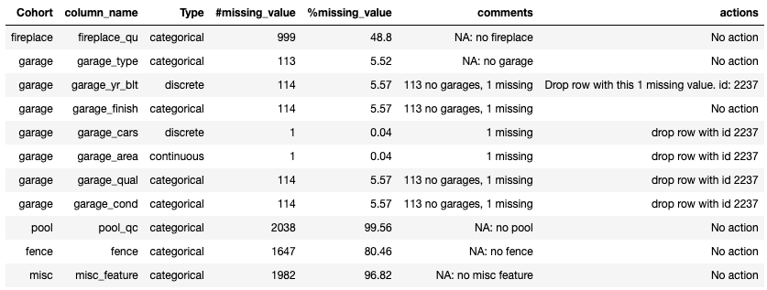
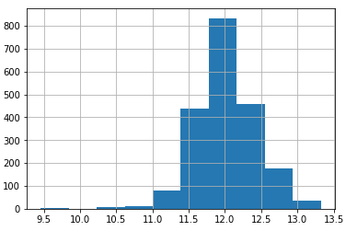
Data cleaning feature ENGINEER mODEL ADJUST
Remove real missing values
Transfer saleprice into log_saleprice

Slide 10
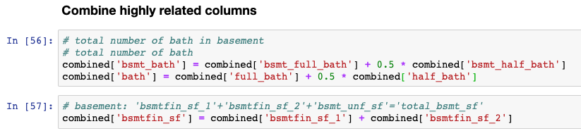
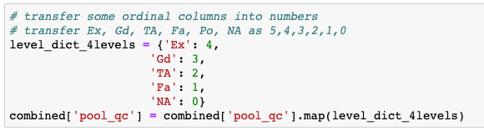
Data cleaning feature ENGINEER mODEL ADJUST
For both training & testing data:
Combine highly related columns
Remember to create N-1 dummy variables
- Drop rows with the least records
Create ranking for ordinal columns
Scale your data

Slide 11
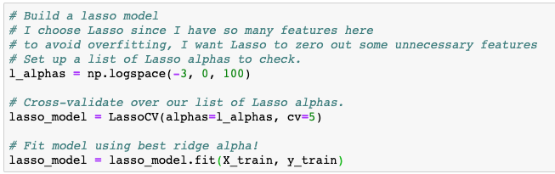
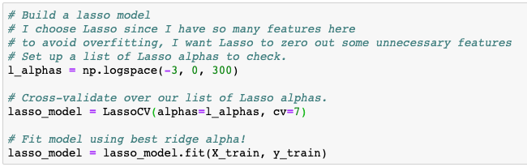
Data cleaning feature ENGINEER mODEL ADJUST
Adjust parameters to compare

