Slide 1
Space X vs Blue Origin
(Reddit Web API & Classification)
Laura Luo
07/2019
http://www.free-powerpoint-templates-design.com

Slide 2
Content
01
Data Collection
02
Goal 1: NLP & EDA
03
Goal 2: Classification Modeling
04
Model Insights
05
Conclusion

Slide 3
Data Collection
Key words: spacex and blueorigin
Goal:
- extract words from posts of two subreddits
- use NLP to train a binary classifier on which subreddit a given post came from
Data Source: pull Reddit posts from Reddit API
Data:
- 989 unique posts of space x
- 977 unique posts of blue origin

Slide 4
Goal1: Web Scrapping & NLP
Remove Punctuations
“Bag-of-words”: words with frequency in a dictionary
Remove Stop words
DataFrame: words with frequency
Lemmatize words
* CountVectorizer can be applied to do the same steps

Slide 5
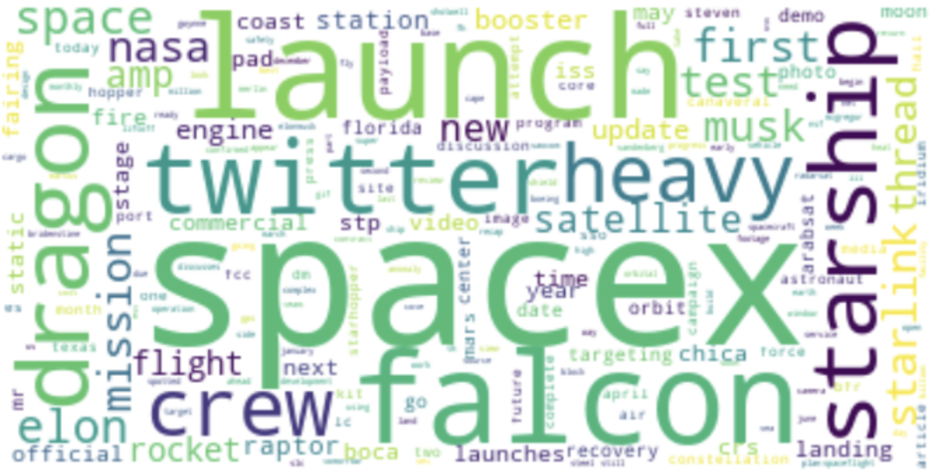
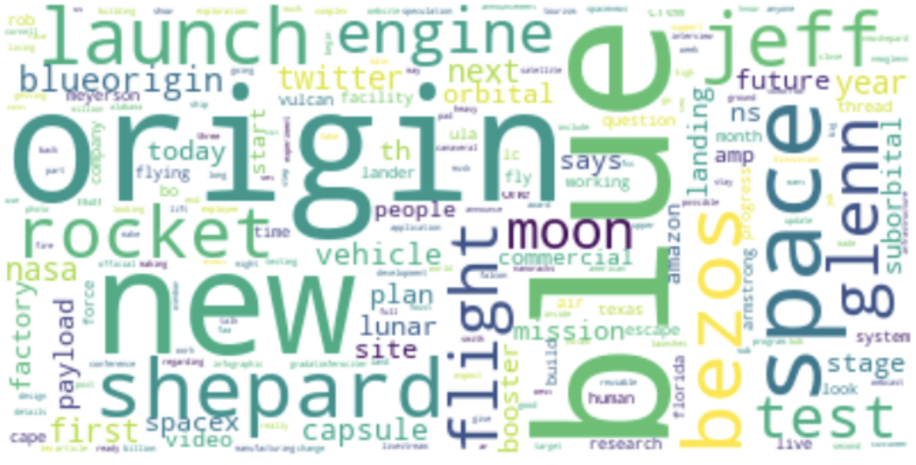
EDA: Overview
Subreddit 1: Space X
Subreddit 2: Blue Origin
These two word cloud chart are created based on word frequency.
“spacex” and “blue/ origin” are words that appear the most.
Some other interesting words: falcon, dragon, shepard, twitter…

Slide 6



 | Space X | Blue Origin
Founded | 2002 | 2000
Industry | Private aerospace manufacturer
Key people | Elon Musk | Jeff Bezos
Heavy Rockets | Heavy Falcon | New Glenn
Reusable Rockets | Falcon | New Shepard
Others | Dragon, starship | Blue Moon
Goal | space transportation; with the hope to Mars (leave Earth’s atmosphere) | Sub-orbital space flights that allow passengers to experience space (within Earth’s atmosphere)

Slide 7
Why twitter is a key word in
Spacex posts?

Slide 8
Goal 2: Classification Modeling
(Data preprocessing)
Train test split &
Assign 1/0 to differentiate posts
Accuracy Score check &
Comparison
Lemmatize &
Tokenize rule set
Vectorize
(params: ngram_range,
stop_words etc.)
Spacex: 1, blueorigin: 0
Built 4 classification models
Tried CountVectorizer (CV) and Tf-Idf Vectorizer on each model --> 8 models in total
Used Pipeline and GridSearch to find best parameters for each model

Slide 9
Goal 2: Classification Modeling
(Model Comparison)
Log Reg
(Lasso)
Naïve Bayes
(Multinomial)
KNN
Random
Forest
Training
0.96
0.96
0.93
0.99
CV
Cross validation
0.92
0.94
0.88
0.93
Testing
0.92
0.94
0.87
0.91
Training
0.94
0.96
0.90
0.99
Tf-Idf
Cross validation
0.91
0.93
0.84
0.93
Testing
0.90
0.93
0.81
0.90

Slide 10
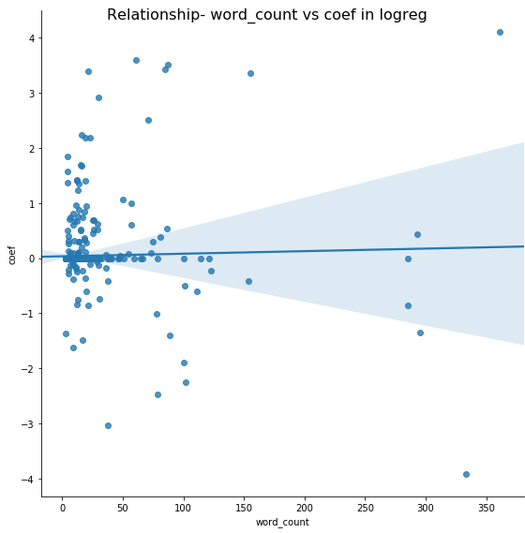
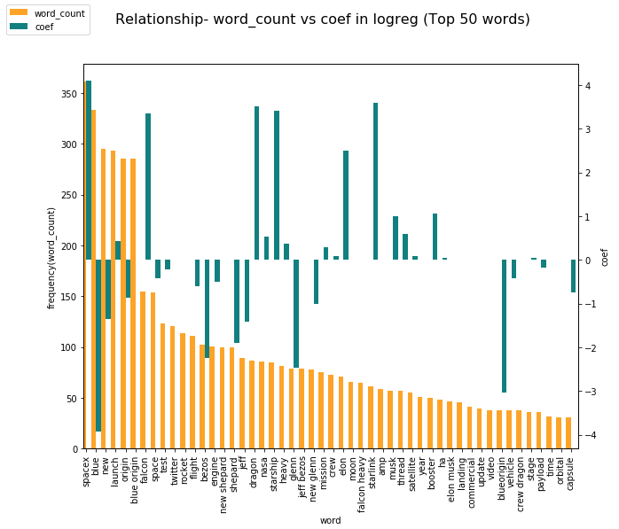
Logistic Regression
Conclusion
Frequency and Coef (in the logreg model) of each word don’t have
linear relationship between each other
spacex
dragon
spacex
starship
falcon
launch
blue origin
space
origin
new
blueorigin
blue

Slide 11
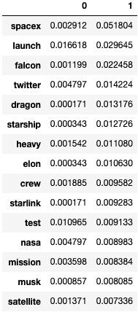
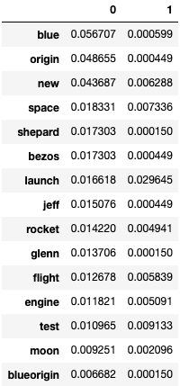
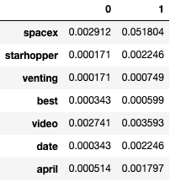
Naïve Bayes
Words with high prob
(space x)
Words with high prob
(blue origin)
Conclusion
Multiply probs to determine which group the post belongs to
Example
Use 7th post as an example:
spacex s starhopper venting best video to the date april
P(7th post| 0) = 1.41e-23* 736 /(736+738)
P(7th post| 1) = 7.56e-19* 738 /(736+738)
P(7th post 0) = P(7th post 0) / (P(7th post 0) + P(7th post 1)) = 0.00…..1
P(7th post 1) = P(7th post 0) / (P(7th post 0) + P(7th post 1)) = 0.999…
P(7th post 1) > P(7th post 0)

Slide 12
Key words
01
Company name& founder name are most frequent words and weighted words
NLP
02
Elaborate NLP steps are the foundation of building a good model
Classification model
03
Native Bayes performs the best in this pro-ject. Word frequency and coef in logreg are not linearly related.
Conclusions

Slide 13
Thank you

