Slide 1
Screenshots
2016 August 24

Slide 2
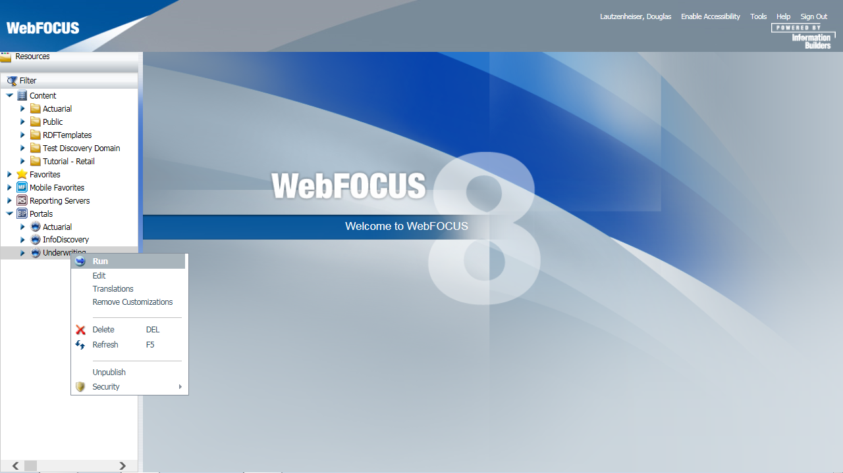
BI Portal

Slide 3
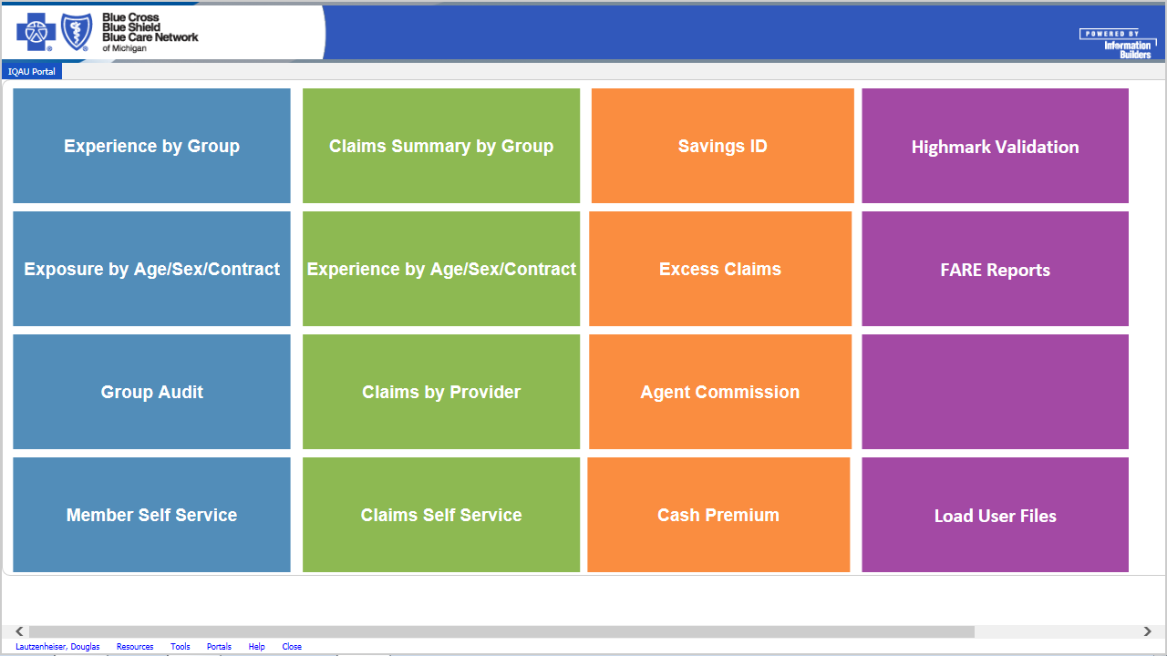
Main Launch Page

Slide 4
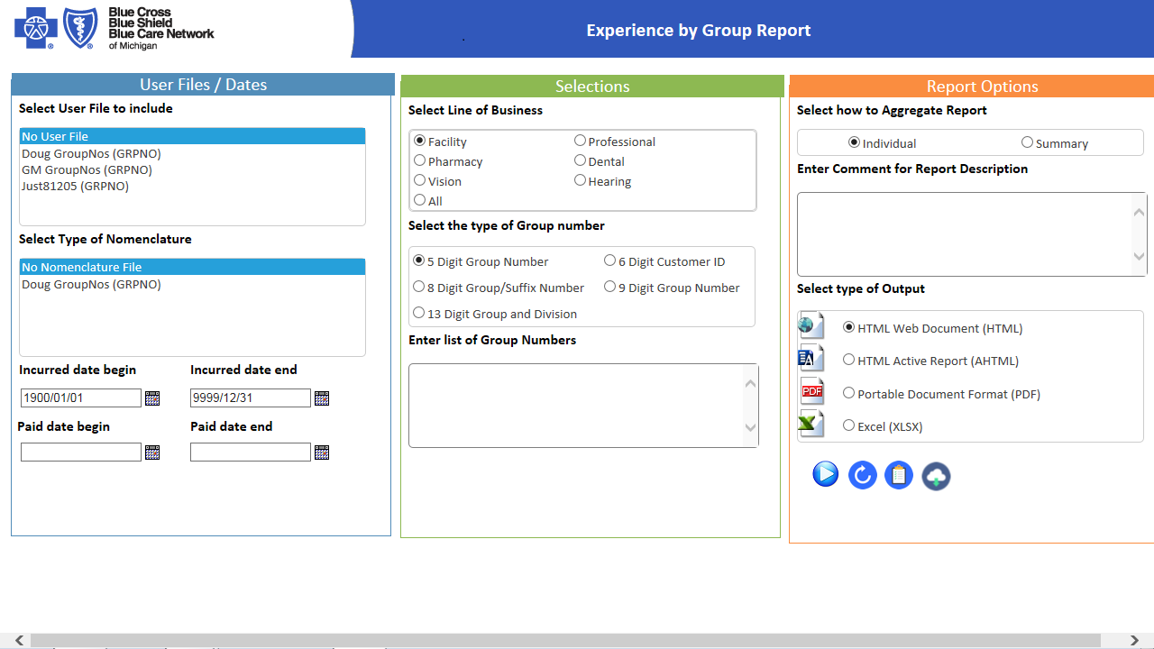
Experience by Group (Claims)

Slide 5
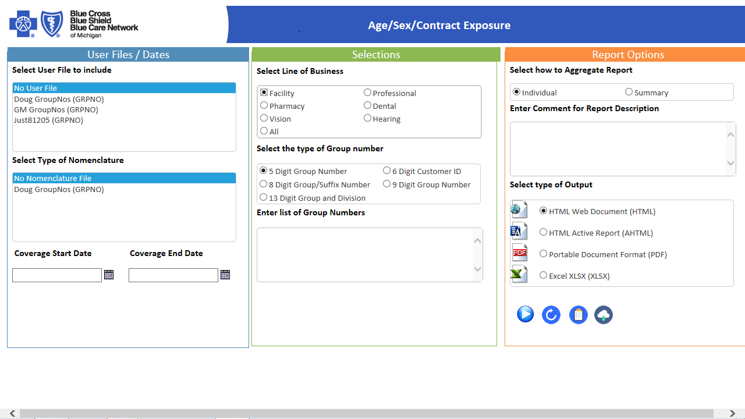
Age/Sex/Contract Exposure (Members)

Slide 6
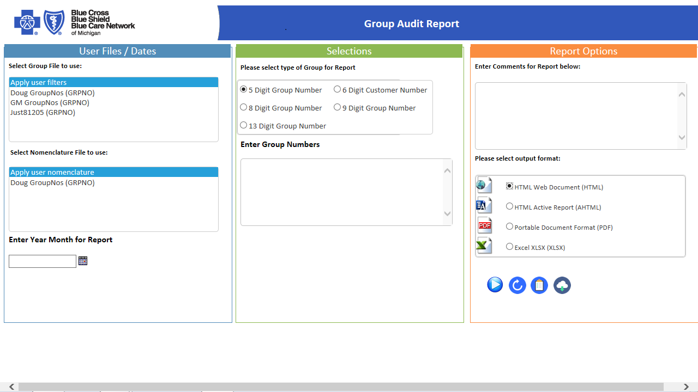
Group Audit

Slide 7
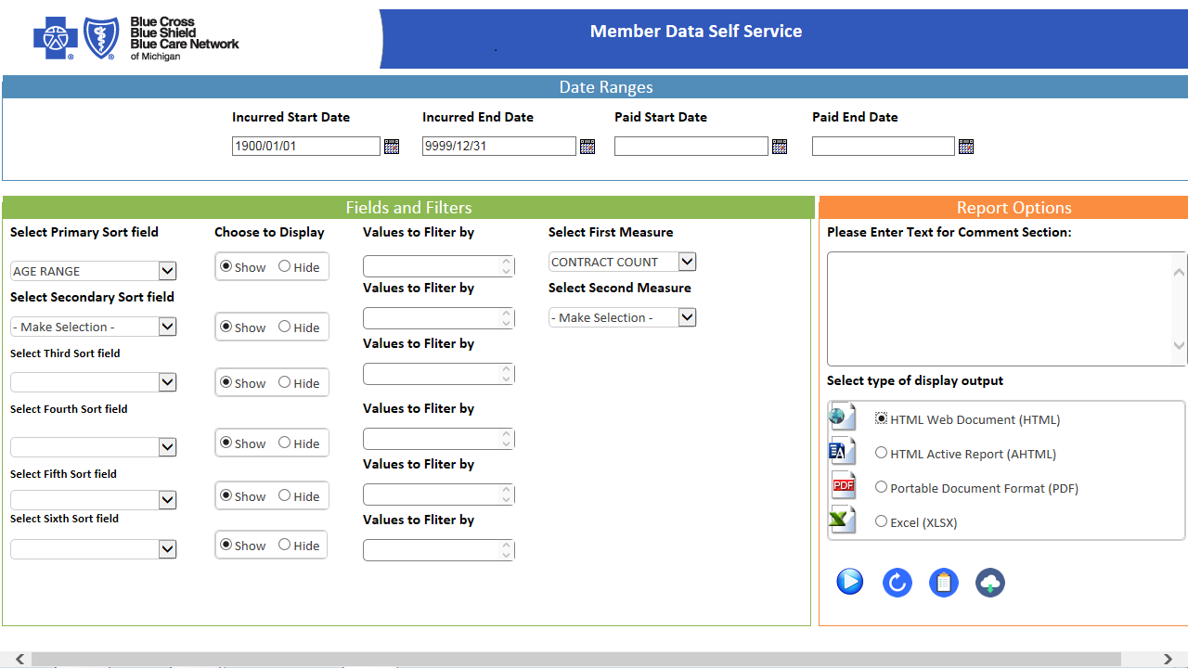
Member Guided Ad-Hoc

Slide 8
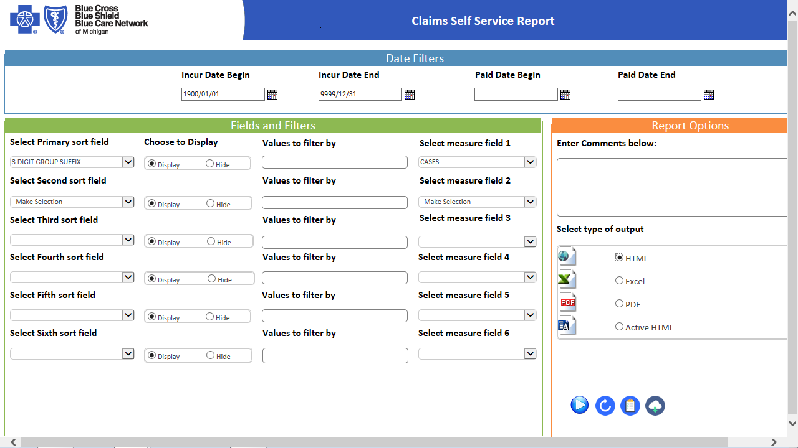
Claims Guided Ad-Hoc

Slide 9
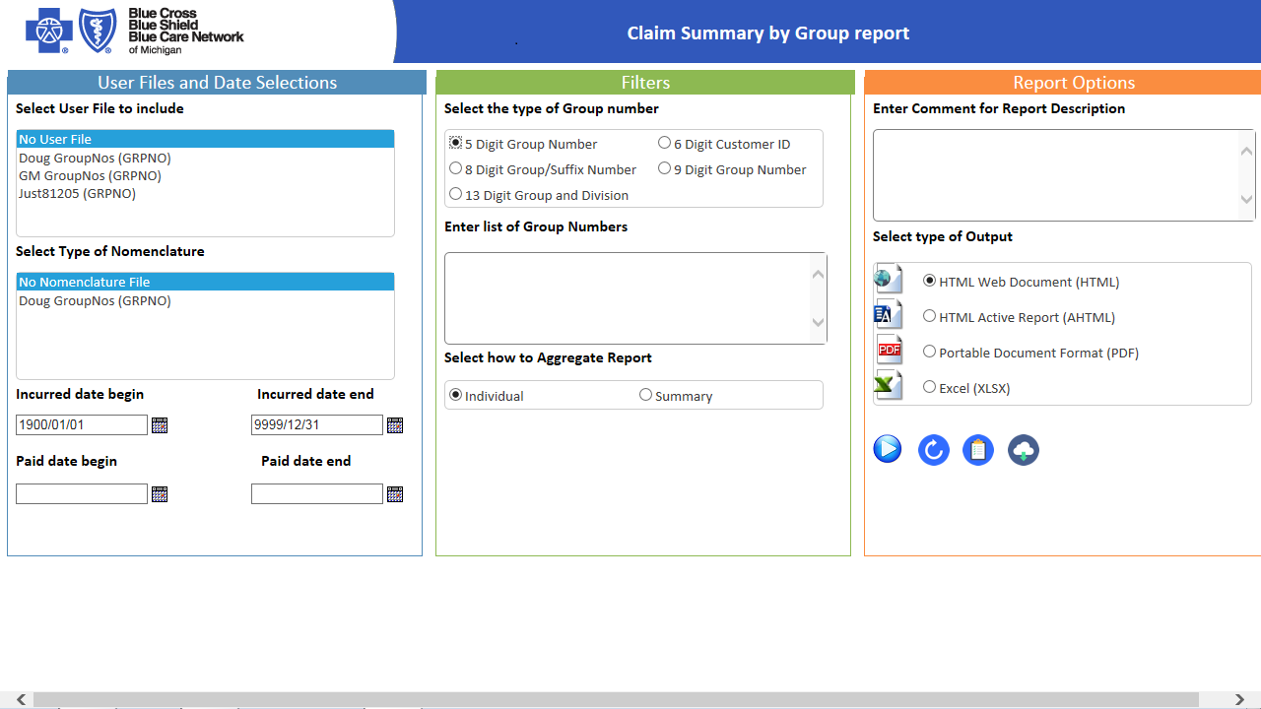
Claims Summary by Group

Slide 10
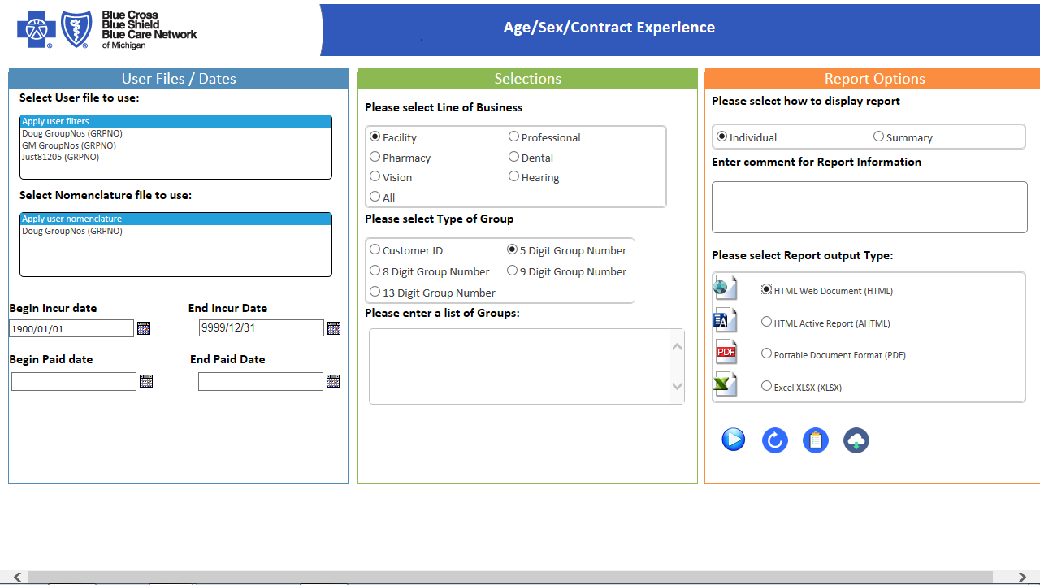
Age/Sex/Contract Experience (Claims)

Slide 11
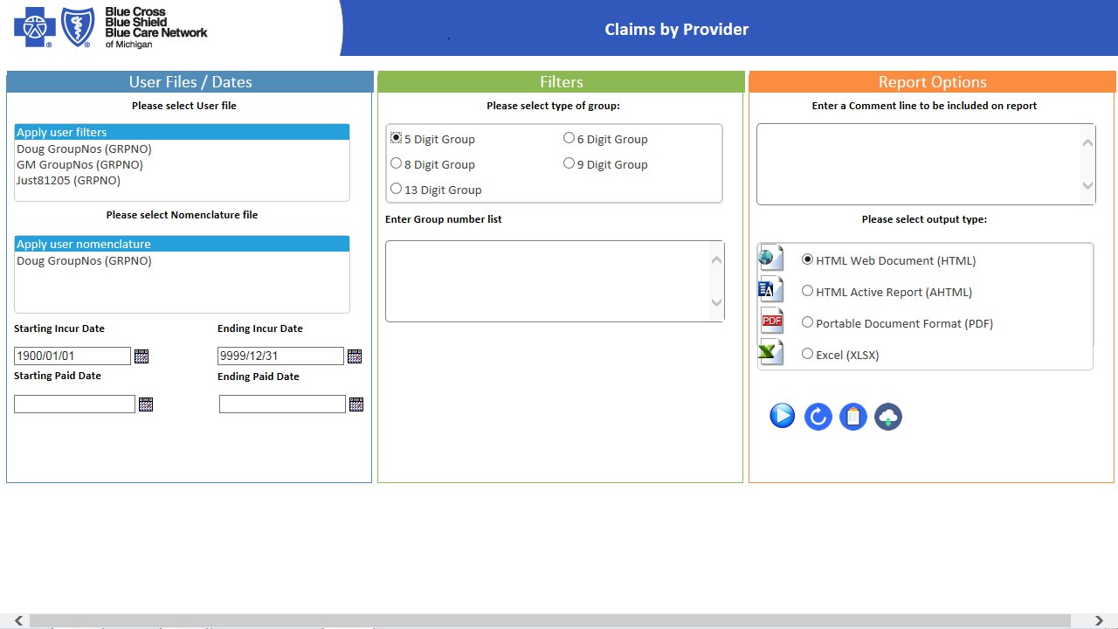
Claims by Provider

Slide 12
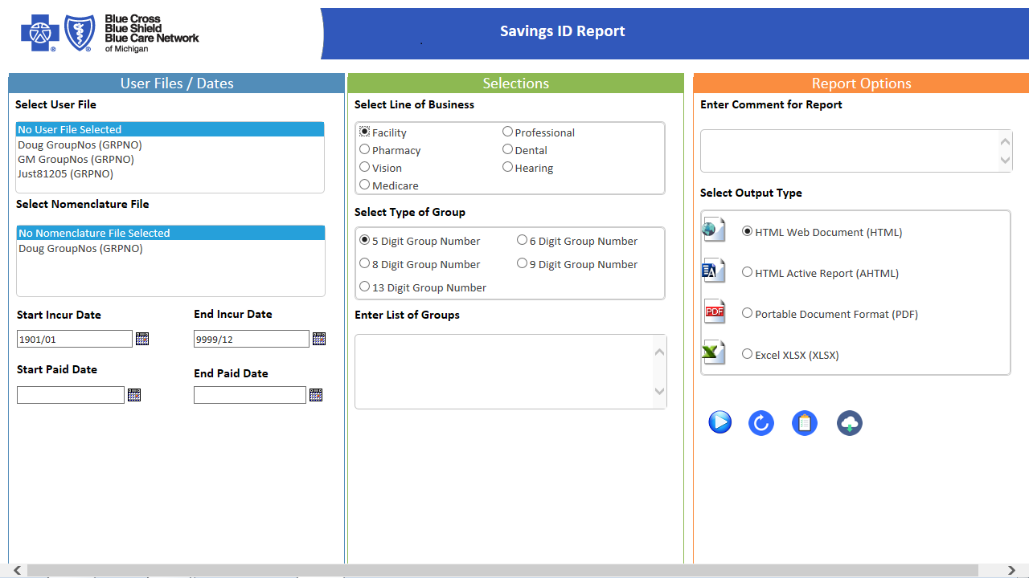
Savings ID

Slide 13
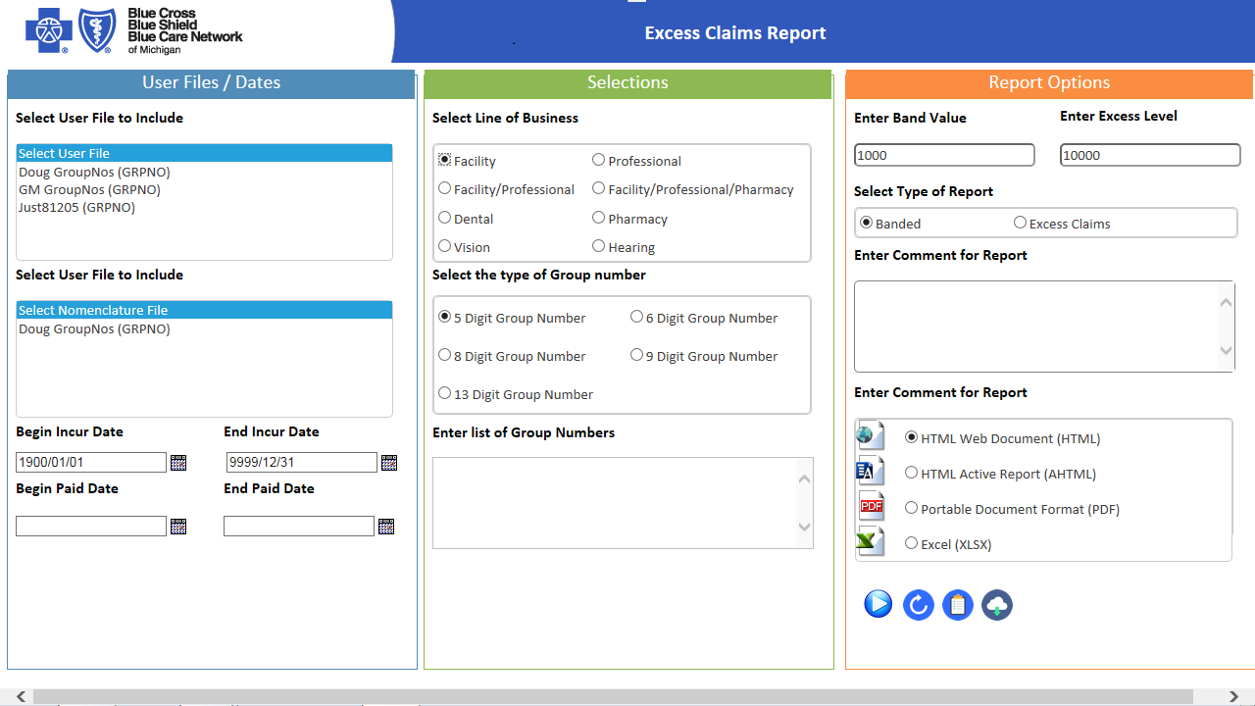
Excess Claims

Slide 14
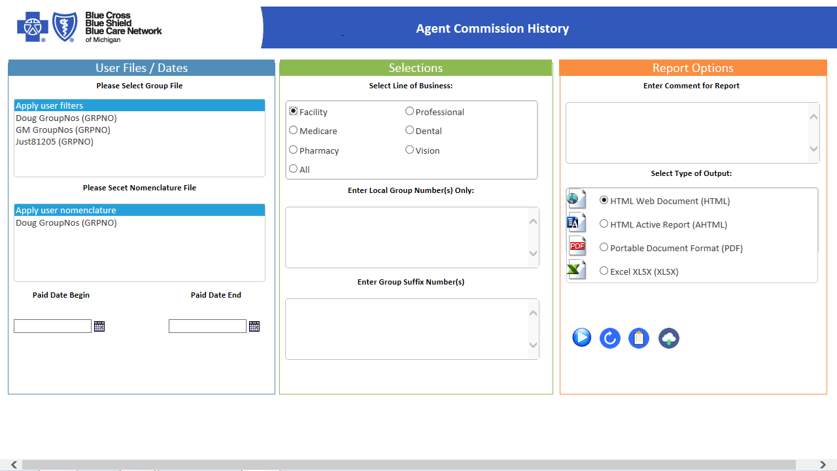
Agent Commission

Slide 15
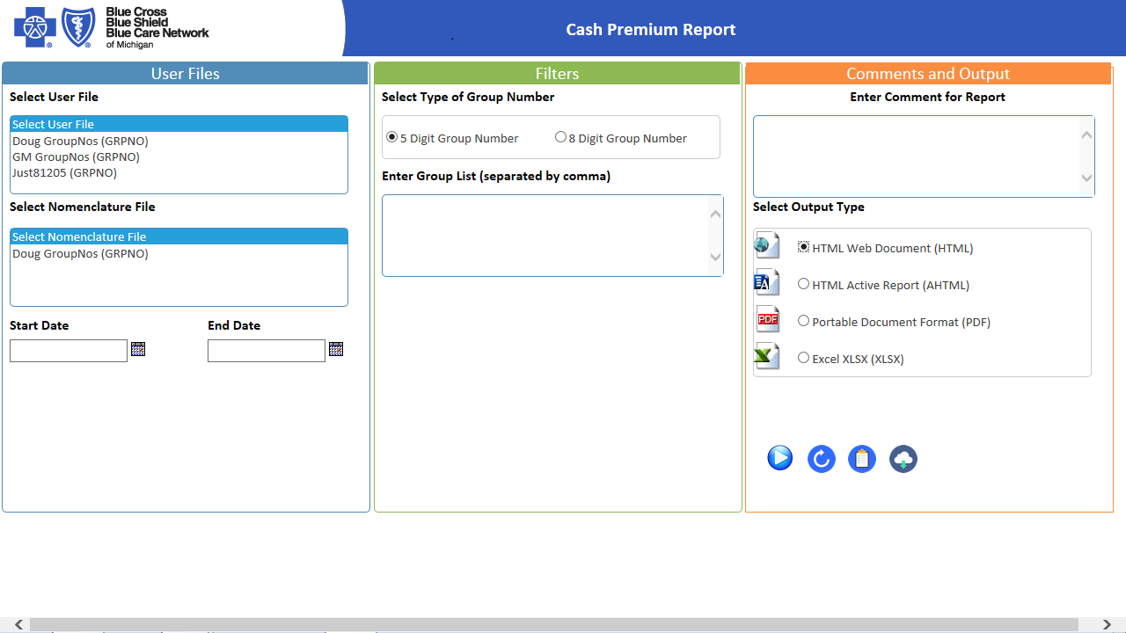
Cash Premium

Slide 16
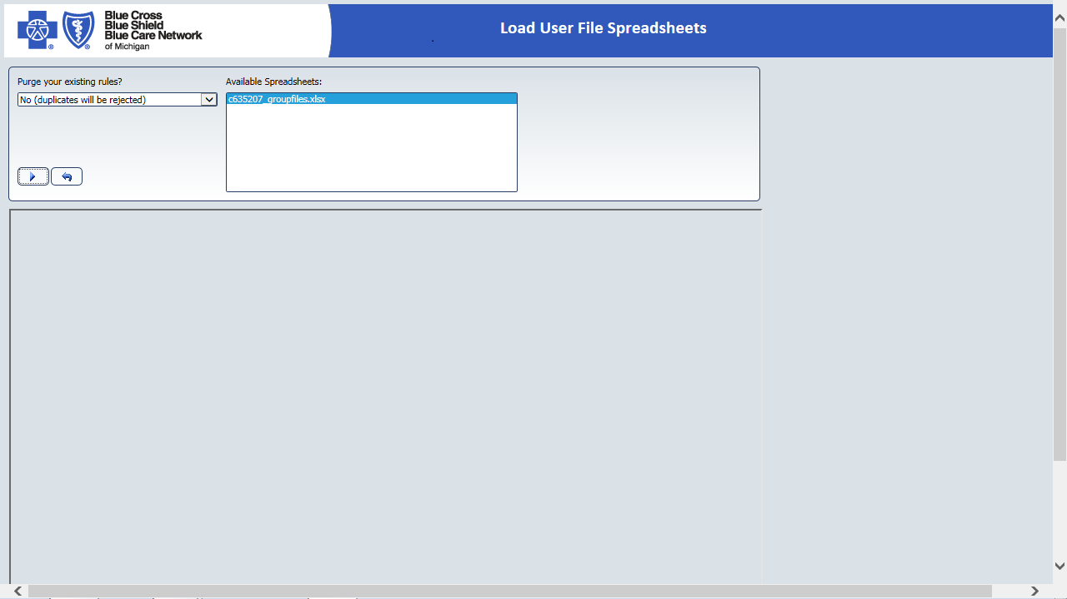
Load User Files

