Slide 1
Discrete-time noise filtering for Pulse-Processing in particle physics experiments
Diego Ávila
This work was supported by the National Commission for Scientific and Technological Research (CONICYT) of Chile under grant FONDECYT 11110165 and scholarship CONICYT-PCHA/Magíster Nacional/2013 - folio 221320673.

Slide 2
Outline
Motivations
Basic concepts: noise analysis for pulse-processing in particle physics experiments
Noise analysis in pulse-processing discrete-time filters
A SC filter for arbitrary weighting function synthesis (if we have time)
Conclusion

Slide 3
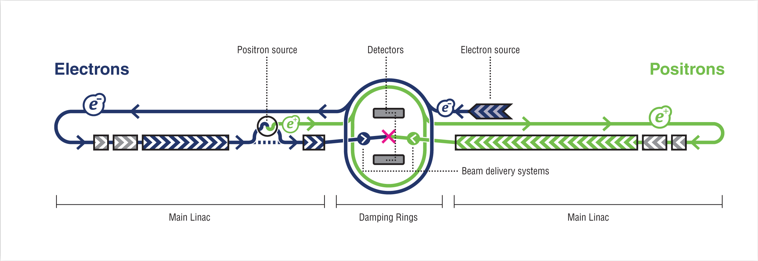
Motivations
The ILC

Slide 4
The Bean

Slide 5
Basic concepts: noise analysis for pulse-processing in particle physics experiments
As electrical engineers we are used to model the noise in the frequency domain.
Most of the times we deal with continuous processes: we assume that the noise process started at - ∞ (stationary noise process).

Slide 6
… but in pulse-processing for particle physics
Start after restarting C_{F}
End after taking the sample
Finite-time process
A continuous-time noise analysis is more intuitive

Slide 7
Weighting function
White noise can be modeled as a Poisson sequence of Dirac impulses.
Colored noise can be modeled as a Poisson sequence of shaped pulses.

Slide 8
animation

Slide 9
Our approach
[Avila, Alvarez, Abusleme, IEEE TNS 2013]

Slide 14
Result
Low entropy expression: input noise can be easily identified and separate from filter influence

Slide 15
Comparison (thermal noise)
Weighting function
Our approach

Slide 16
SNR maximization
In the following configuration
Where

Slide 17
we want to minimize
Independent variables

Slide 18
Results:

Slide 21
A SC filter for arbitrary weighting function synthesis
UMC180nm (through Europractice)
Mentor graphics tools (ICUC new analog toolchain)

Slide 24
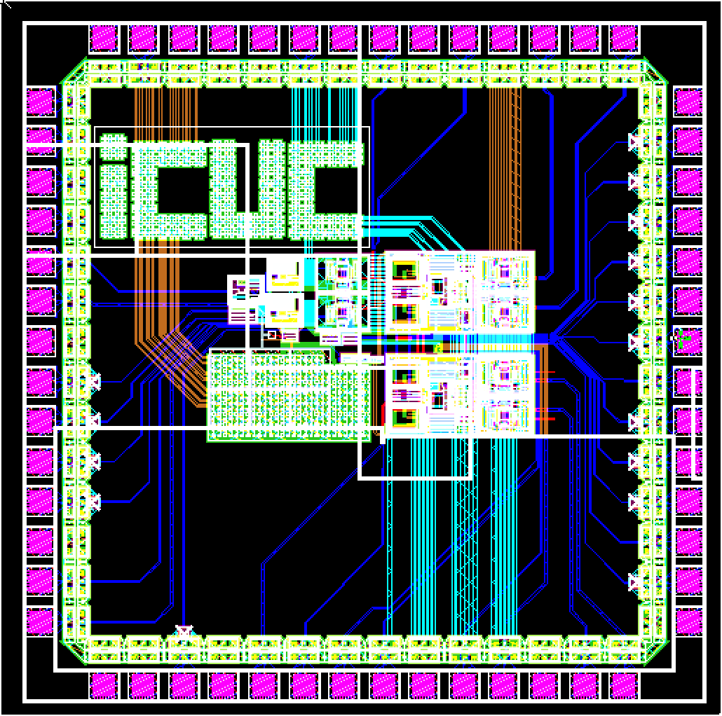
~1.5 mm x 1.5mm

Slide 25
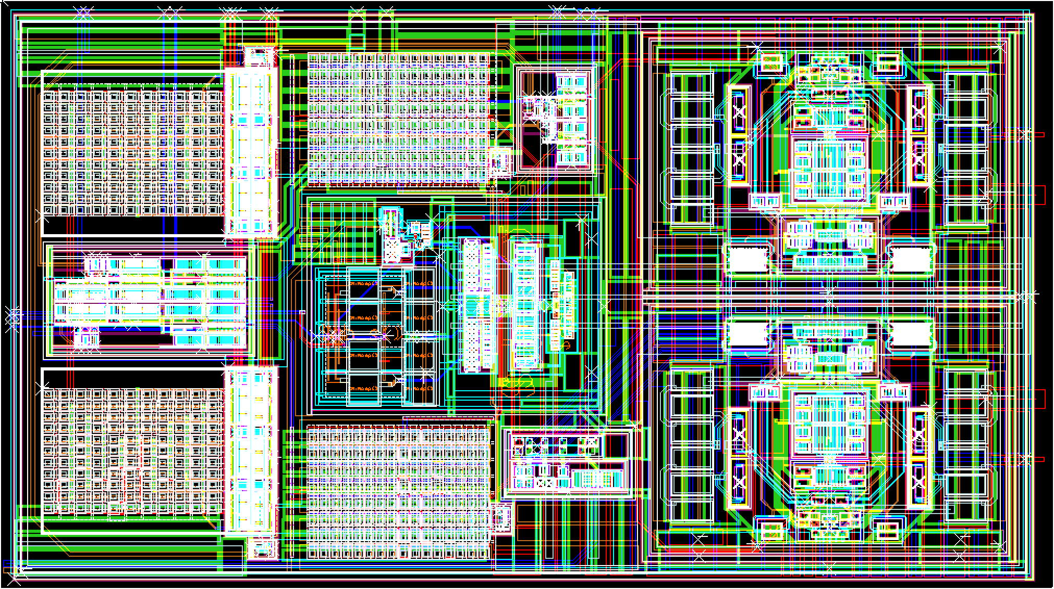
~ 185um x 332um
Cs Cf OTA Buffers Logic

Slide 26
Post-layout simulations
Due to the binary cap arrangement
Filter step response (64 available gains)

Slide 28
Conclusion

Slide 29
Thank you

