Slide 1
Projection neuron optical physiology analysis
12-18-2018
MAC

Slide 2
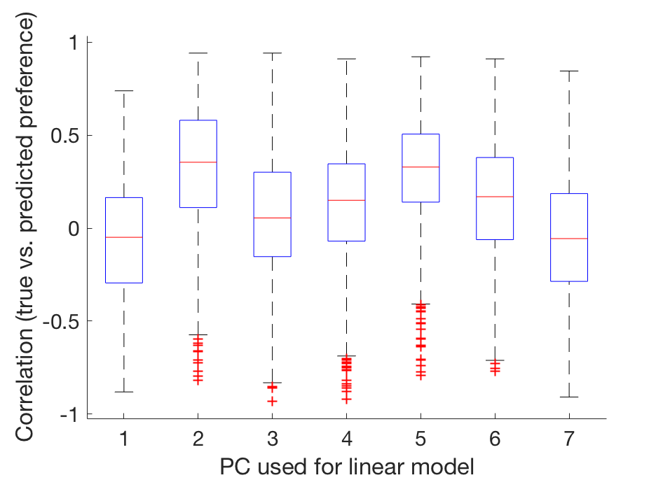
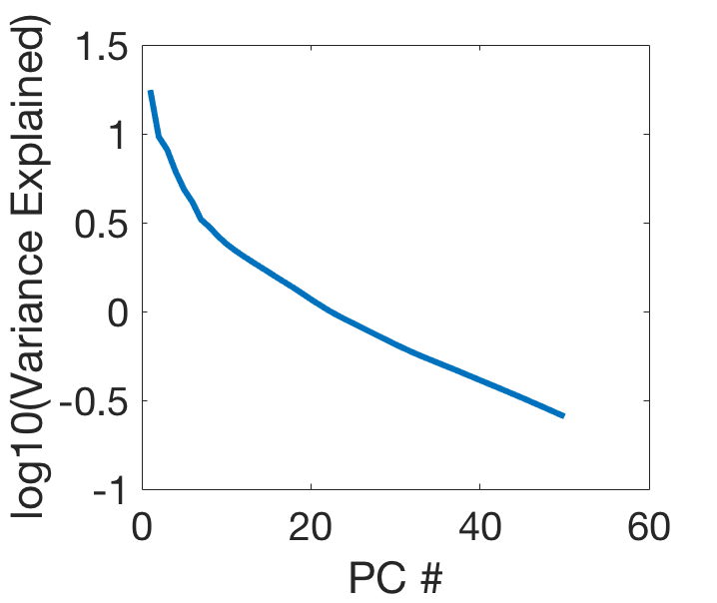
Predicting MCH vs. OCT behavior preference from GH146—gcamp6m activity
Cross-validation with 1000 iterations of random 80/20 train/test split
N=47 flies
PC2 and PC5 are consistent predictors of behavior
Kink at PC7. Didn’t use PCs higher than 7

Slide 3
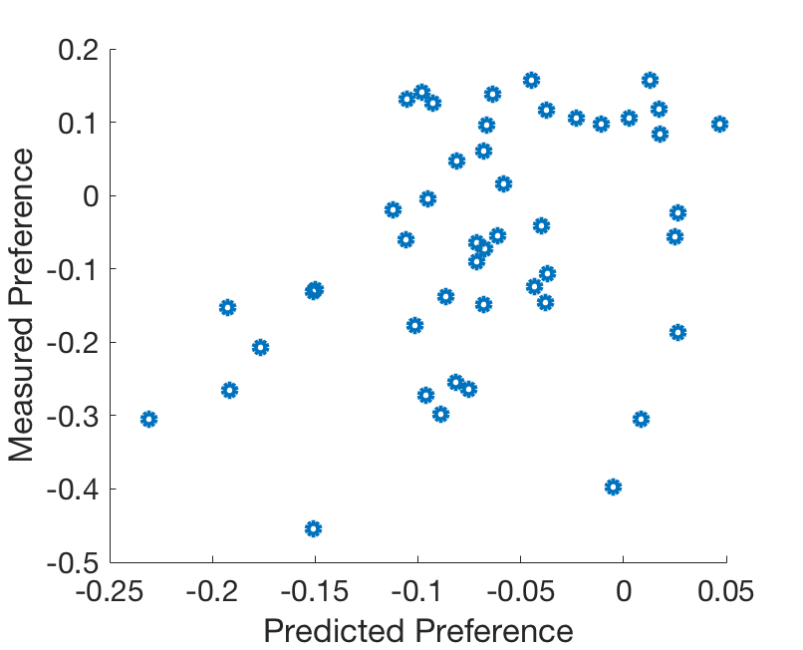
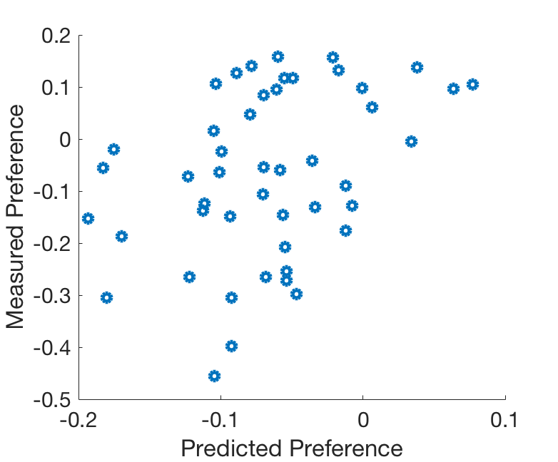
Training data
PC 2 prediction
PC 5 prediction
PC 2 and 5 prediction

Slide 4
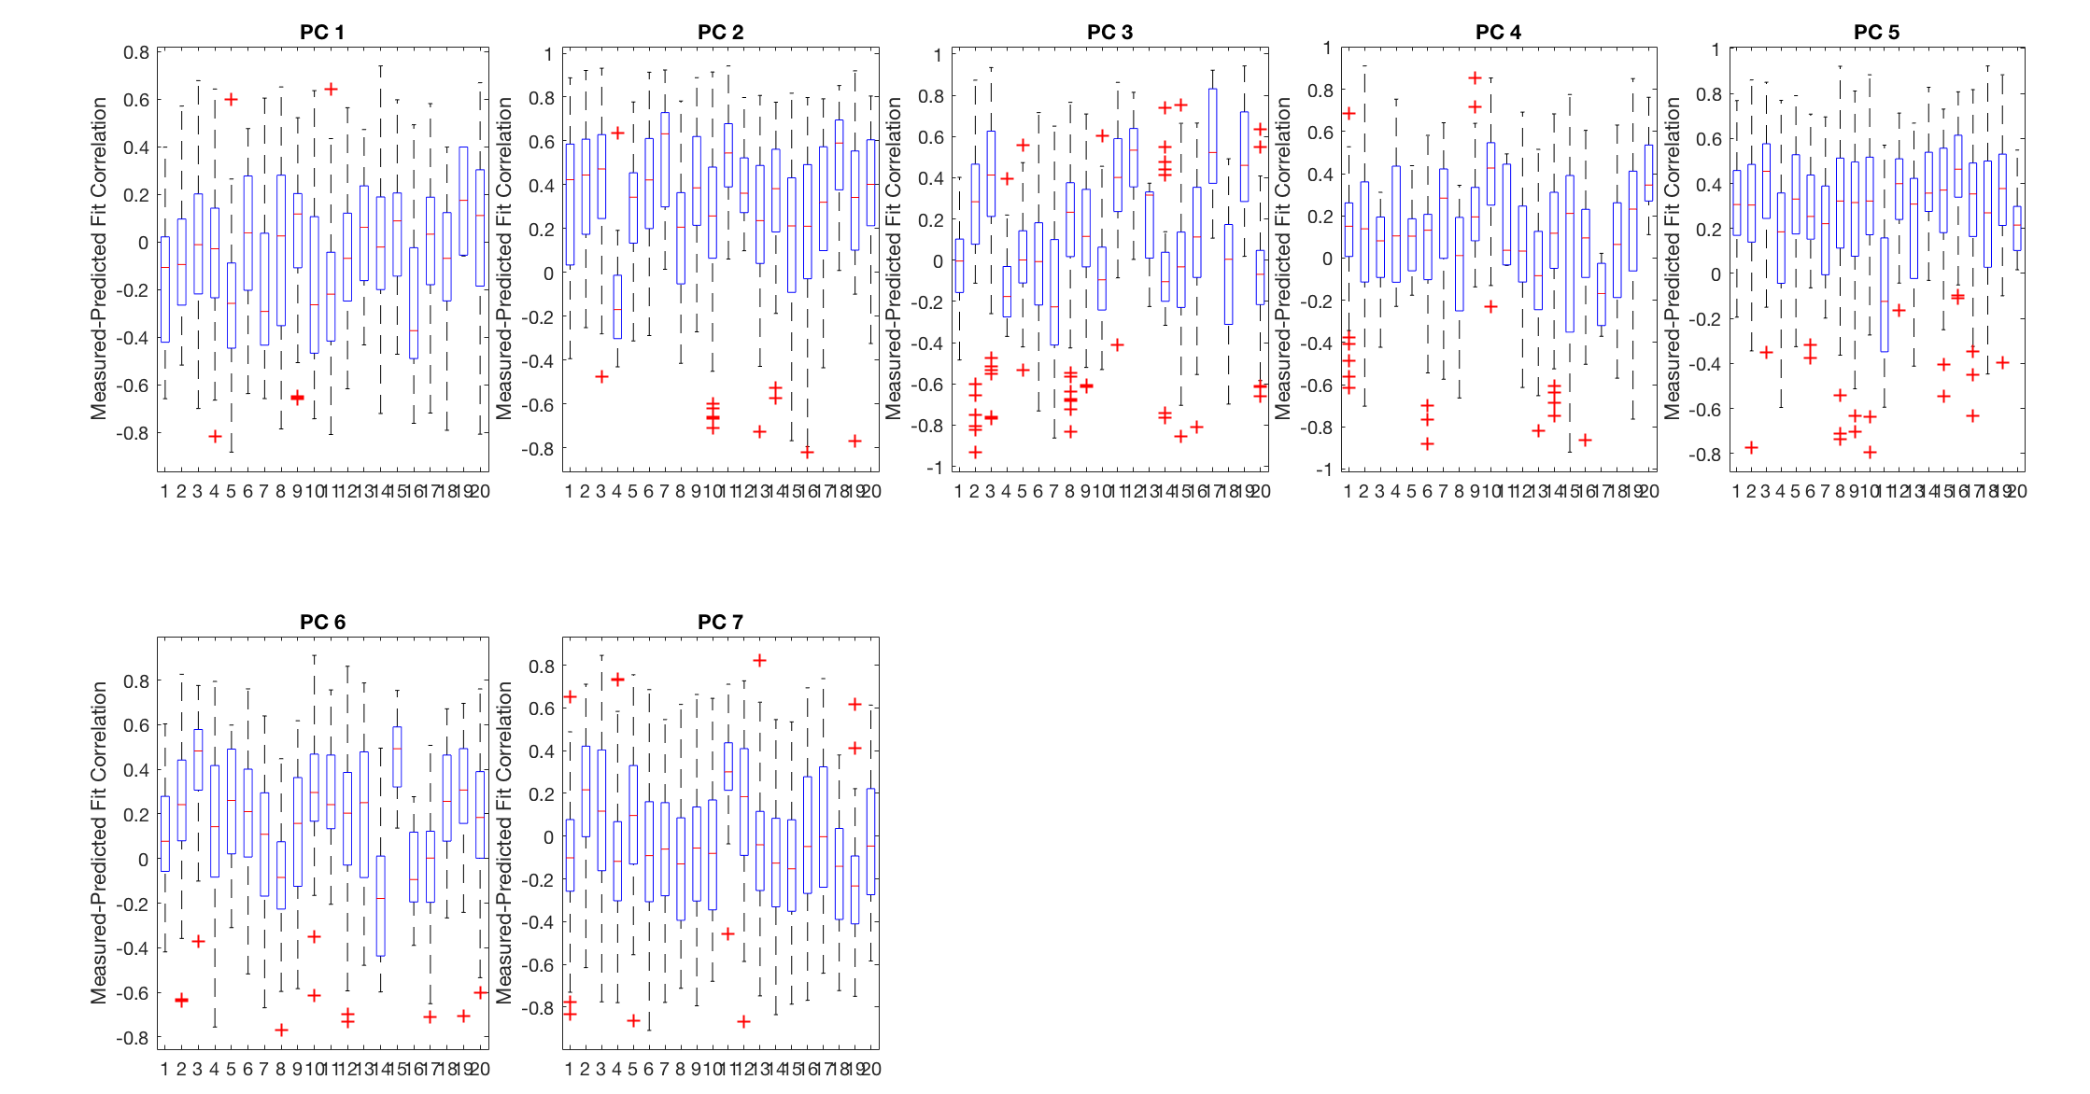
Addressing PC shuffling during cross-validation
1) Save each PC during each cross-validation iteration (1000 iterations)
2) Perform k-means (k=20) on each saved PC matrix to identify the common motifs within each PC
Plotted here: Measured-Predicted behavior correlation for each PC and each k-means-identified clusters within each PC

Slide 5
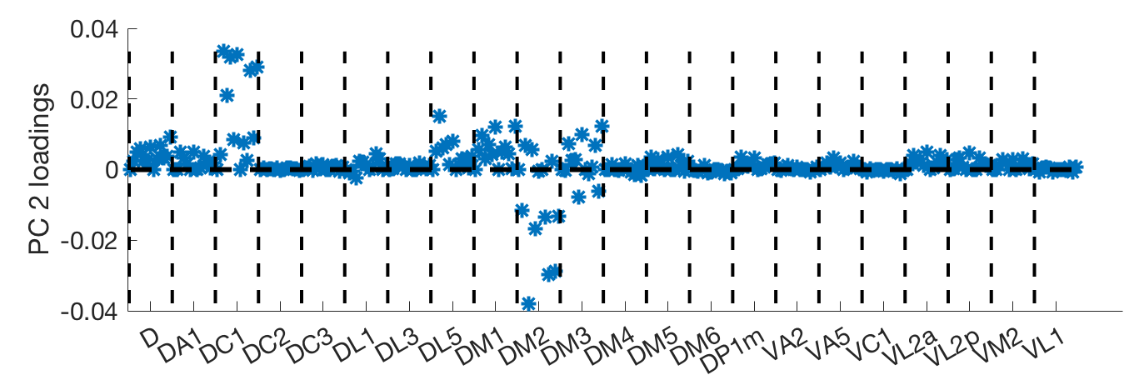
What does PC 2 represent?
Basically represents average DC1 – DM2 response

Slide 6
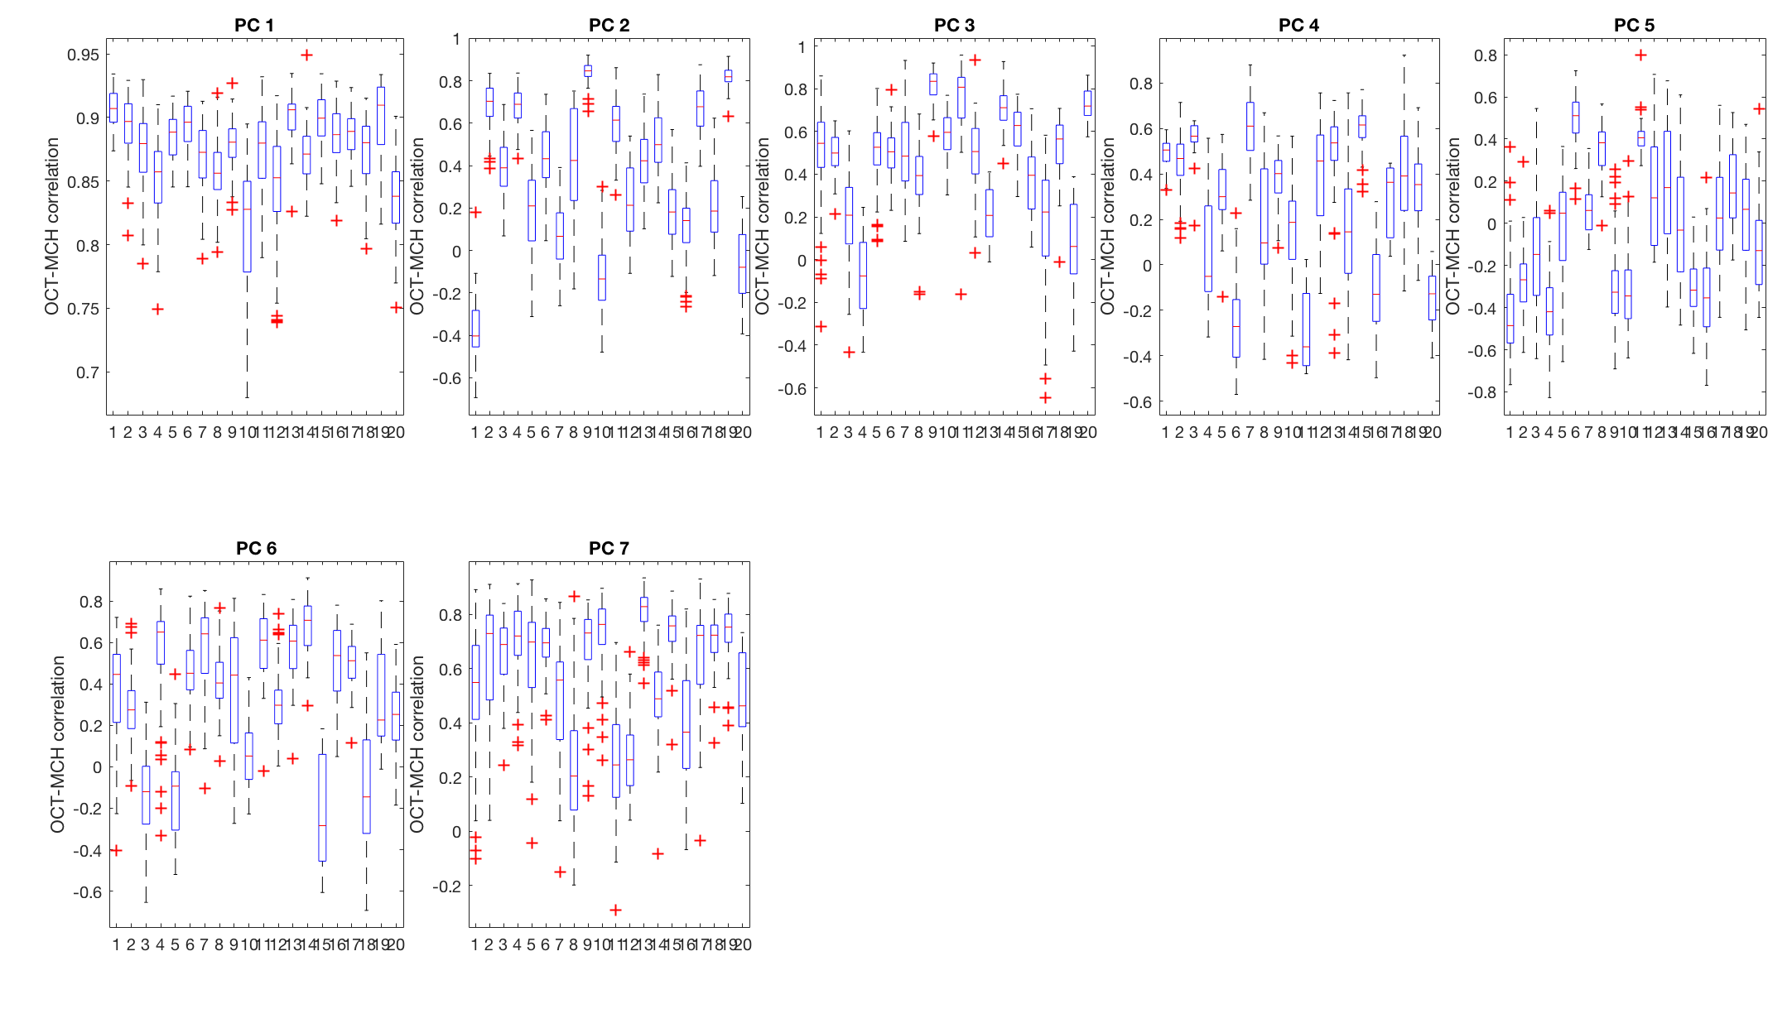
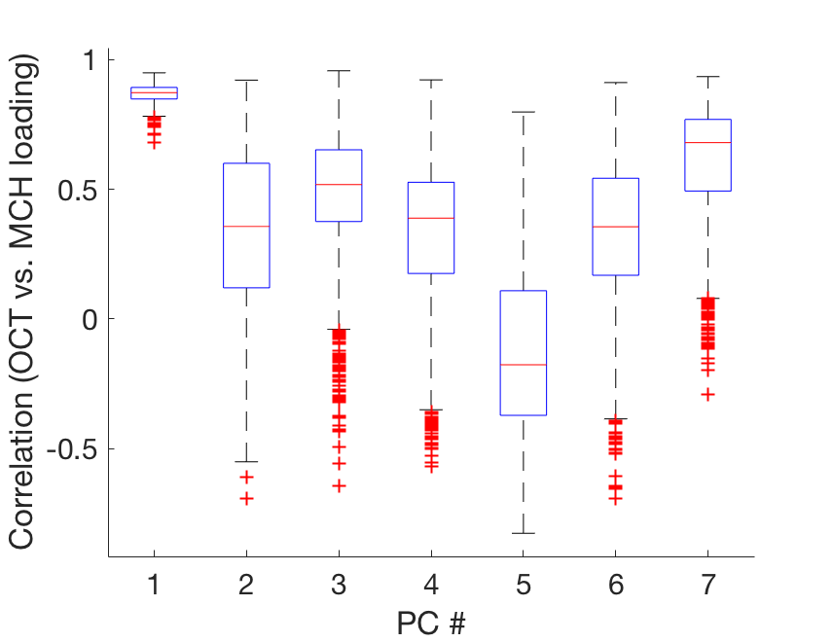
What does PC 5 represent?
PC 5 represents average (OCT minus MCH) activation across all glomeruli

Slide 7
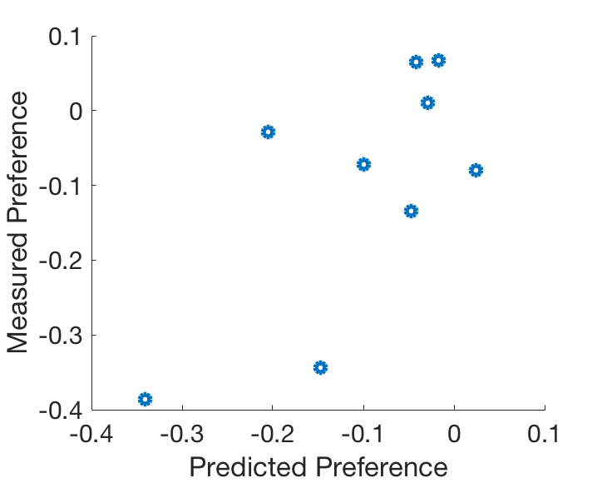
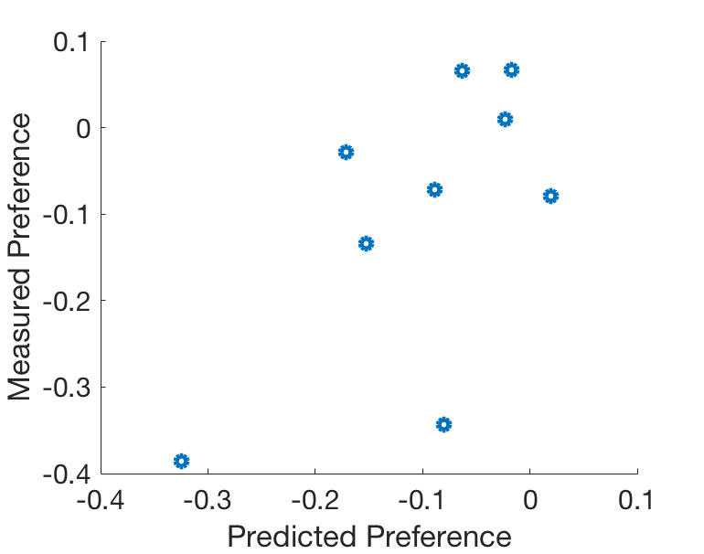
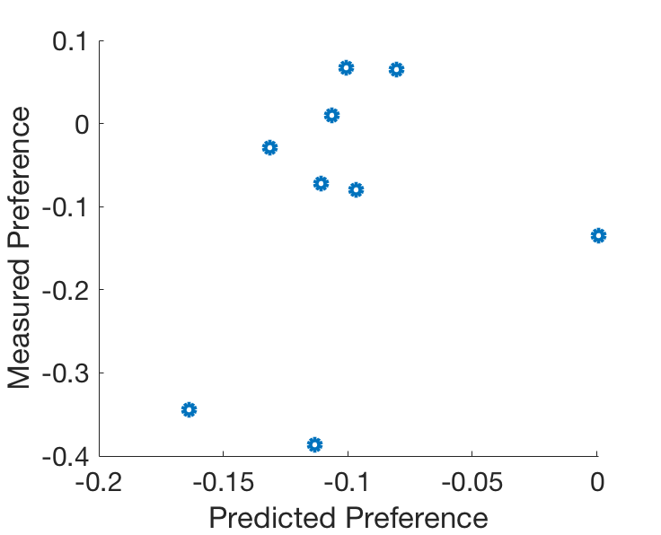
Predictions on held out data
PC 2 prediction
PC 5 prediction
PC 2 and 5 prediction
N = 9 flies

Slide 8
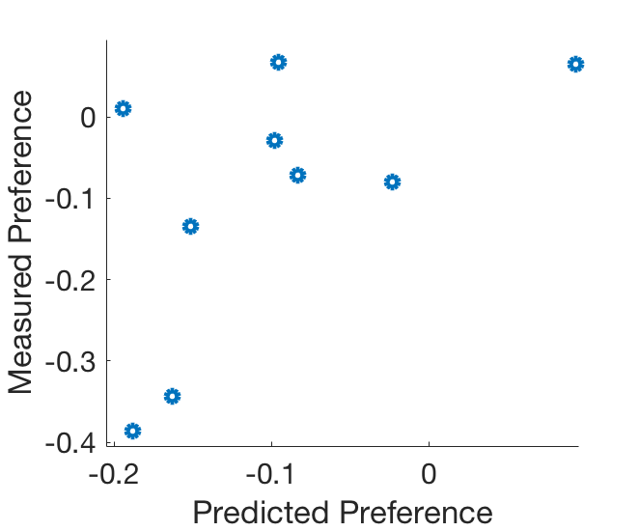
Prediction on held out data using 1) relative DC1/DM2 activation and 2) relative OCT/MCH activation
2 hypotheses generated from PC cross-validation analysis.
Directly compute
Average DC1 - DM2 activation (hypothesis came from PC2)
Average OCT - MCH activation (hypothesis came from PC5)
Use these quantities for behavior prediction (right)
N = 9 flies

Slide 9
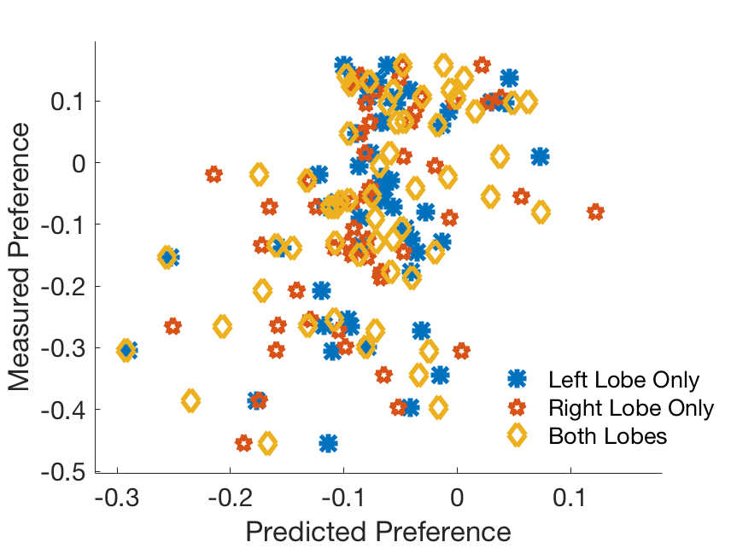
Behavior preference is better predicted from the average of both lobe responses than either lobe response alone
Lobe response used for behavior prediction
Left lobe only R²: 0.109
Right lobe only R²: 0.141
Both lobes R²: 0.189

