Slide 1
PN and ORN dynamics
MAC update 190212

Slide 2
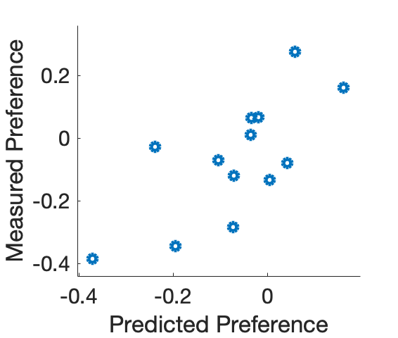
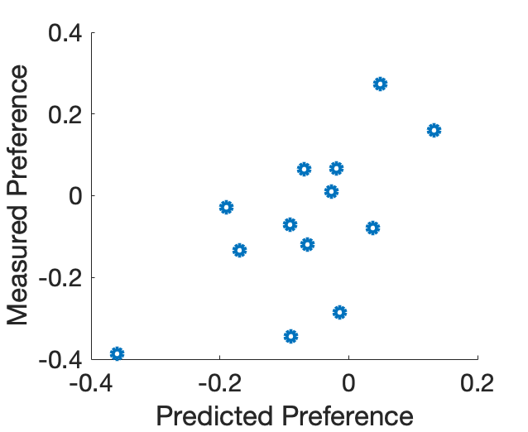
Behavior prediction from PN dynamics in completely held-out flies
Using previously trained PC 2 only
Using previously trained PC 2 and 5
R²=0.357
P=0.0182
R²=0.419
P=0.0266
N=13
N=13

Slide 3
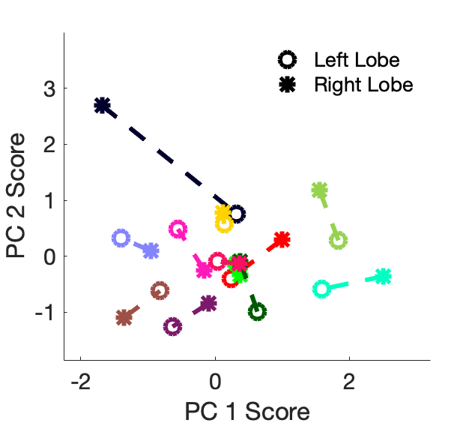
ORN (orco>gcamp) dynamics
ORNs
PNs

Slide 4
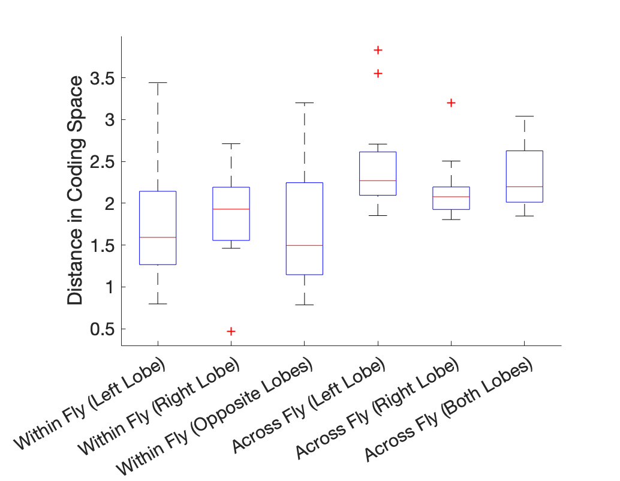
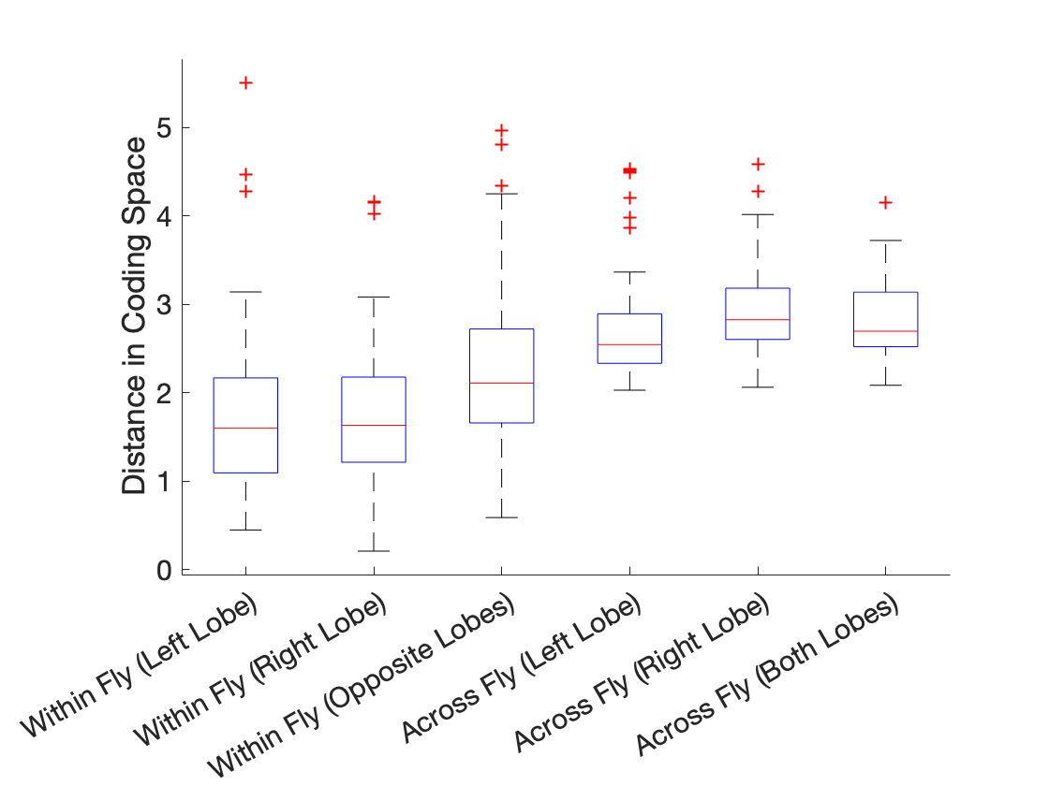
Individuals are less idiosyncratic in ORNs than PNs?
ORNs
PNs

