Slide 1

IBM EXPERT LABS
IBM Bob + Maximo MCP
Hands-on Lab Experience
External-agent access to governed Maximo tools
10 HANDS-ON LABS
MAS 9.2
IBM Expert Labs
Notes:
[Sources]
- Source: IBM Bob-MCP-Lab Guide V3-slide deck.docx, workshop title and lab sequence.
- Visual on this slide was generated with Microsoft Copilot.
[/Sources]

Slide 2
WORKSHOP CONTEXT
02
External agent calling governed Maximo tools
The workshop follows one operating pattern
IBM Bob interprets the request, discovers an available MCP tool, and calls Maximo. Maximo remains the system of control for security, validation, and execution.
IBM Bob
MCP
Maximo
External agent
Connection + discovery
Governed execution
WORKSHOP FOCUS
External agent → MCP → Maximo tools
Natural language remains flexible.
Execution remains controlled.
IBM Expert Labs | Maximo Application Suite 9.2 MCP Enablement
Notes:
[Sources]
- Source: IBM Bob-MCP-Lab Guide V3-slide deck.docx, labs 2, 5, 8, and 9.
[/Sources]

Slide 3
MAXIMO MCP
03
Tool patterns available to an external agent
The workshop uses the standard MCP tool framework
Object Structure
Automation Script
Workflow
API Route
Structured Maximo operations
Deterministic custom logic
Governed process actions
Purpose-built API capability
Registered for external MCP invocation through the Maximo tool framework
Selected Maximo capabilities become tools. Not every REST API is exposed as an MCP tool.
IBM Expert Labs | Maximo Application Suite 9.2 MCP Enablement
Notes:
[Sources]
- Source: User-provided MCP tool model image and workshop scope direction.
[/Sources]

Slide 4
WORKSHOP SCOPE
04
Focused on external-agent tool invocation
IN SCOPE
OUTSIDE THIS WORKSHOP
Connect IBM Bob to Maximo through MCP
Discover and invoke published Maximo tools
Use Object Structure tools
Create an Automation Script tool
Use read-only tools for asset and PM analysis
Keep execution governed by Maximo controls
AI Configuration tools
Separate activation and registry model
Internal AI Configuration processing
AI Configuration inference setup
MAXAICFGTOOL administration
The distinction keeps the hands-on experience centered on an external agent calling Maximo tools.
IBM Expert Labs | Maximo Application Suite 9.2 MCP Enablement
Notes:
[Sources]
- Source: User-provided AI Configuration image and explicit workshop scope direction.
[/Sources]

Slide 5

THE LEARNING JOURNEY
Build confidence, then build capability
01–04
05–07
08–09
10
Foundation
Operate
Extend
Analyze
Install, connect, configure, navigate
Discover tools and work in plain language
Enable native tools and create custom logic
Combine asset and PM data into insights
Notes:
[Sources]
- Source: IBM Bob-MCP-Lab Guide V3-slide deck.docx, lab sequence.
- Visual on this slide was generated with Microsoft Copilot.
[/Sources]

Slide 6
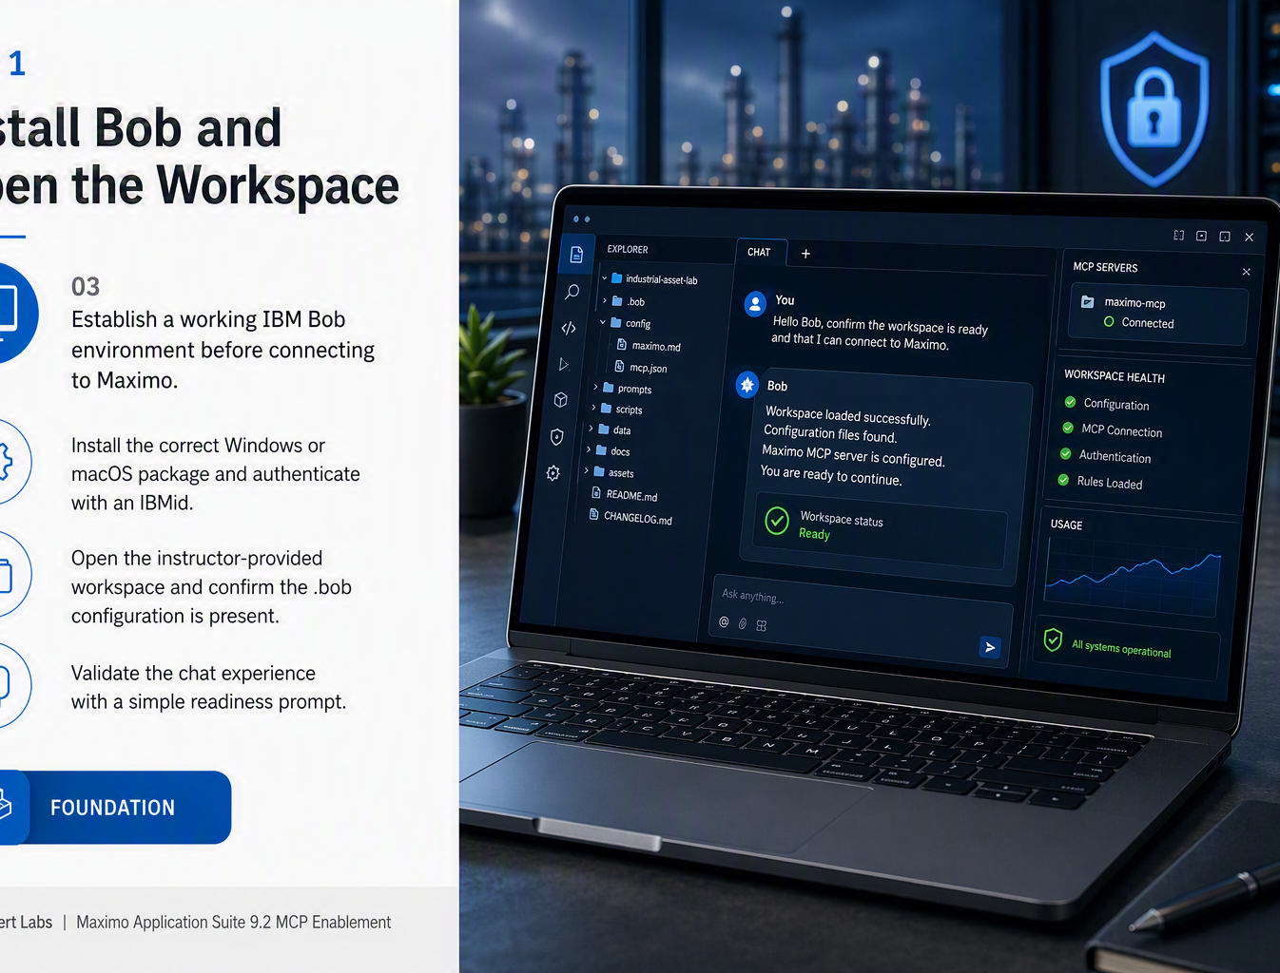
LAB 1
06
Install Bob and Open the Workspace
Establish a working IBM Bob environment before connecting to Maximo.
Install the correct Windows or macOS package and authenticate with an IBMid.
Open the instructor-provided workspace and confirm the .bob configuration is present.
Validate the chat experience with a simple readiness prompt.
https://bob.ibm.com/download
https://bob.ibm.com/trial
https://github.com/dlboggs/MAC-WS-2026
FOUNDATION
IBM Expert Labs | Maximo Application Suite 9.2 MCP Enablement
Notes:
[Sources]
- Source: IBM Bob-MCP-Lab Guide V3-slide deck.docx, relevant lab section.
- Visual on this slide was generated with Microsoft Copilot.
[/Sources]

Slide 7
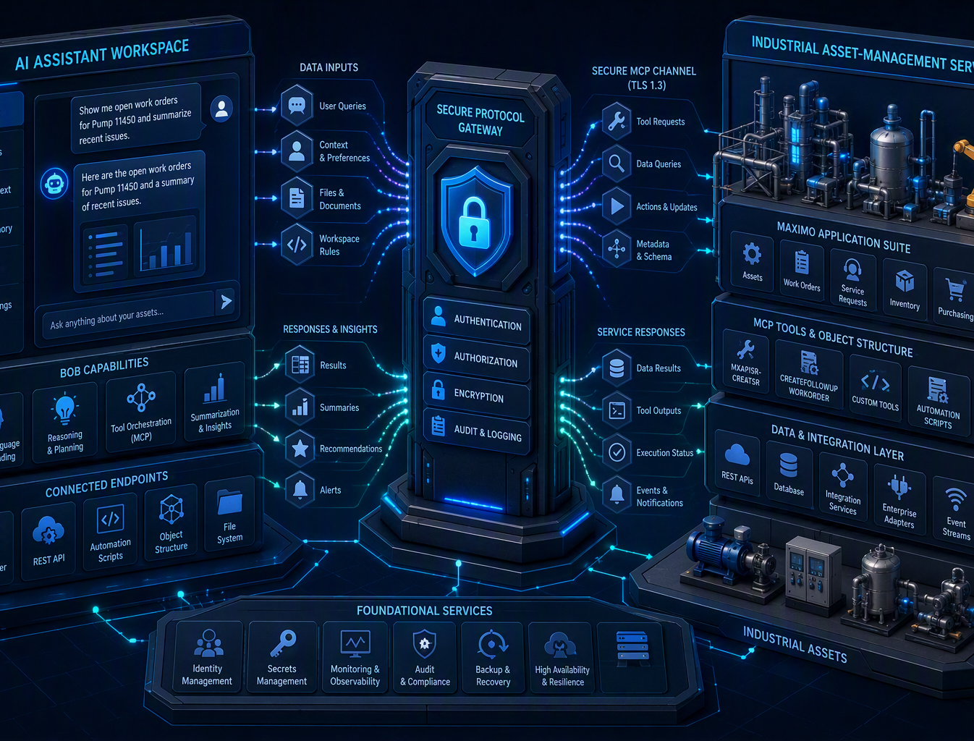
LAB 2
07
Connect Maximo to Bob via MCP
Create the secured workspace-scoped connection that enables Bob to invoke Maximo capabilities.
Locate the Maximo MCP route and prepare access to the lab instance.
Use a Maximo API key in the workspace mcp.json configuration.
Verify the server reports Connected and protect workspace credentials.
CONNECT
IBM Expert Labs | Maximo Application Suite 9.2 MCP Enablement
Notes:
[Sources]
- Source: IBM Bob-MCP-Lab Guide V3-slide deck.docx, relevant lab section.
- Visual on this slide was generated with Microsoft Copilot.
[/Sources]

Slide 8
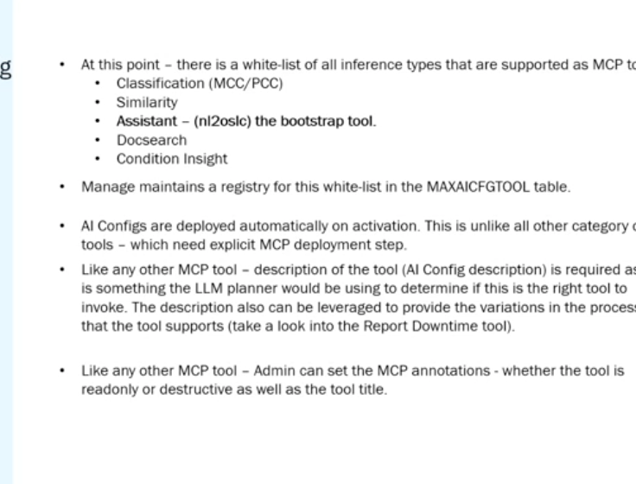
LAB 3
08
Configure Bob Rules
Give Bob the endpoint, credentials, and guidance needed to interact efficiently with Maximo.
Update the maximo.md rule file with REST API and MCP service values.
Use MCP tools and query templates to reduce trial-and-error and token consumption.
Start a new chat when needed so updated workspace rules are loaded.
CONFIGURE
IBM Expert Labs | Maximo Application Suite 9.2 MCP Enablement
Notes:
[Sources]
- Source: IBM Bob-MCP-Lab Guide V3-slide deck.docx, relevant lab section.
[/Sources]

Slide 9
LAB 4
09
Navigate the Bob Workspace
Orient participants to the workspace, chat, settings, modes, skills, and MCP tool inventory.
Use Explorer, editor, and chat as one integrated environment.
Review usage, approval controls, and MCP connection status.
Understand modes as specialized behaviors and skills as reusable instruction sets.
ORIENT
IBM Expert Labs | Maximo Application Suite 9.2 MCP Enablement
Notes:
[Sources]
- Source: IBM Bob-MCP-Lab Guide V3-slide deck.docx, relevant lab section.
- Visual on this slide was generated with Microsoft Copilot.
[/Sources]

Slide 10
LAB 5
10
Discover Maximo MCP Tools
See how Bob discovers available capabilities and uses schema knowledge from the live Maximo environment.
Ask Bob which Maximo MCP tools are currently available.
Invoke apischema to retrieve fields and data types for Maximo records.
Recognize that the published tool set expands as capabilities are enabled.
DISCOVER
IBM Expert Labs | Maximo Application Suite 9.2 MCP Enablement
Notes:
[Sources]
- Source: IBM Bob-MCP-Lab Guide V3-slide deck.docx, relevant lab section.
- Visual on this slide was generated with Microsoft Copilot.
[/Sources]

Slide 11

LAB 6
11
Create a Service Request
Turn a plain-language maintenance report into a trackable Maximo service request.
Describe the asset issue conversationally, using asset 11450 as the lab context.
Confirm intent and provide missing details when prompted.
Capture the returned service request number for downstream exercises.
ACT
IBM Expert Labs | Maximo Application Suite 9.2 MCP Enablement
Notes:
[Sources]
- Source: IBM Bob-MCP-Lab Guide V3-slide deck.docx, relevant lab section.
- Visual on this slide was generated with Microsoft Copilot.
[/Sources]

Slide 12
LAB 7
12
Operate Maximo in Plain Language
Use conversation to query, filter, update, and create connected maintenance records.
Retrieve assets, locations, work orders, and job plans without constructing API calls.
Carry context forward to narrow results and update multiple asset statuses.
Create a work order from a job plan and associate it to the service request.
OPERATE
IBM Expert Labs | Maximo Application Suite 9.2 MCP Enablement
Notes:
[Sources]
- Source: IBM Bob-MCP-Lab Guide V3-slide deck.docx, relevant lab section.
- Visual on this slide was generated with Microsoft Copilot.
[/Sources]

Slide 13
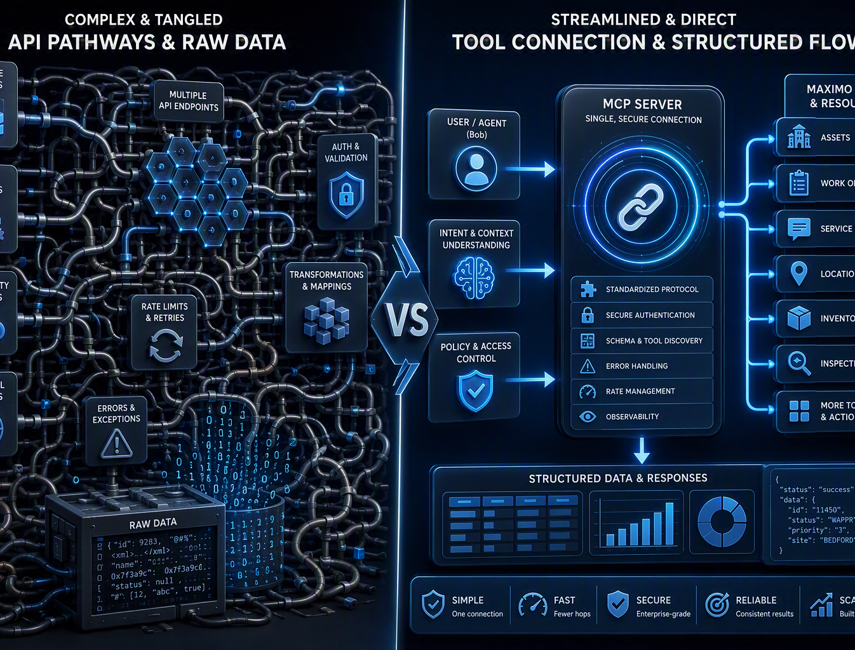
LAB 8
13
Enable Object Structure Tools
Replace repeated API reasoning with native Maximo tools designed for agent invocation.
Activate CREATESR on MXAPISR and CREATEFOLLOWUPWORKORDER on MXAPIWODETAIL.
Refresh Bob and verify the os_ tools are published through MCP.
Compare direct tool execution with REST construction for reliability, consistency, speed, and token use.
EXTEND
IBM Expert Labs | Maximo Application Suite 9.2 MCP Enablement
Notes:
[Sources]
- Source: IBM Bob-MCP-Lab Guide V3-slide deck.docx, relevant lab section.
- Visual on this slide was generated with Microsoft Copilot.
[/Sources]

Slide 14
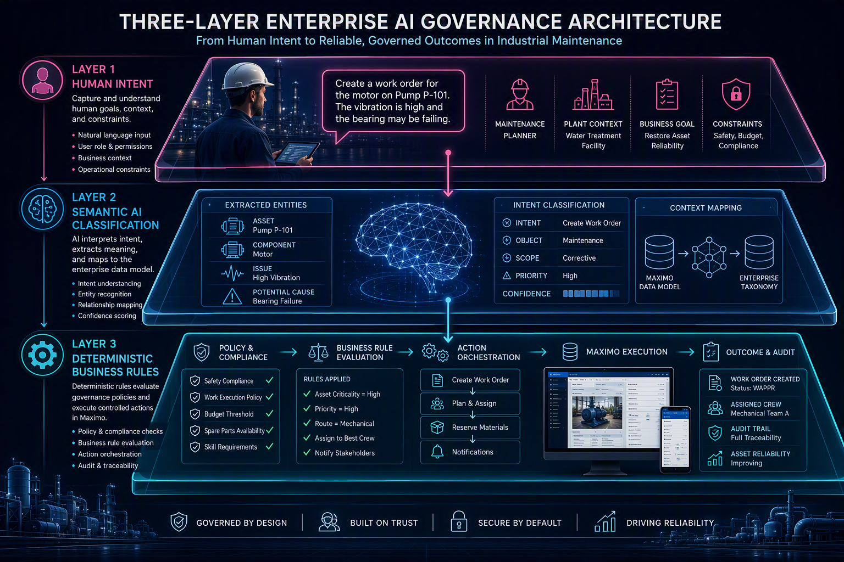
LAB 9
14
Create an Automation Script MCP Tool
Build a governed Inspection Failure Advisor with structured inputs, outputs, and deterministic logic.
Create the automation script, literal input variable, and response schema.
Publish the script as an MCP tool and validate natural-language invocation.
Separate semantic classification in the agent from auditable business rules in Maximo.
GOVERN
IBM Expert Labs | Maximo Application Suite 9.2 MCP Enablement
Notes:
[Sources]
- Source: IBM Bob-MCP-Lab Guide V3-slide deck.docx, relevant lab section.
- Visual on this slide was generated with Microsoft Copilot.
[/Sources]

Slide 15
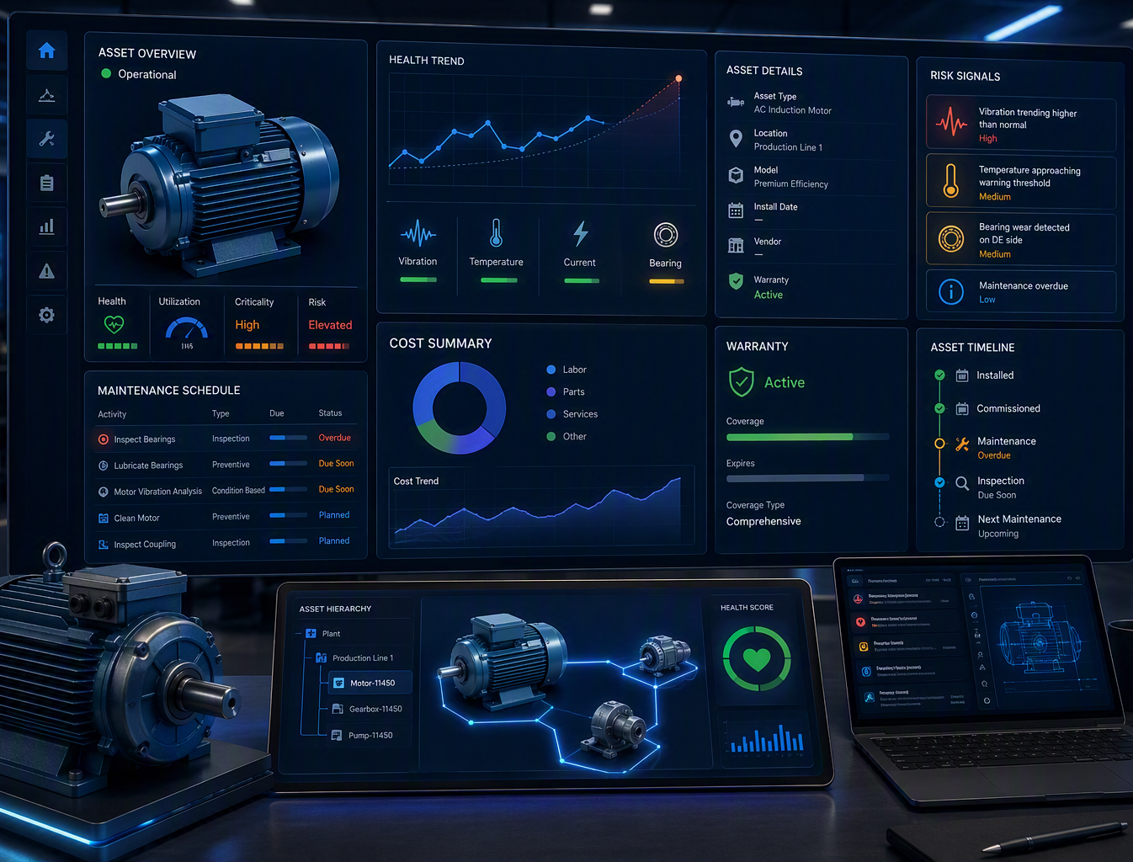
LAB 10
15
Perform Asset and PM Analysis
Orchestrate read-only tools to turn operational data into a client-ready analytical artifact.
Build Asset and PM query tools with structured response schemas.
Retrieve warranty, cost, operating status, maintenance history, and next-due information.
Ask Bob to synthesize risk findings and render a shareable HTML report.
ANALYZE
IBM Expert Labs | Maximo Application Suite 9.2 MCP Enablement
Notes:
[Sources]
- Source: IBM Bob-MCP-Lab Guide V3-slide deck.docx, relevant lab section.
- Visual on this slide was generated with Microsoft Copilot.
[/Sources]

Slide 16
WORKSHOP TAKEAWAY
16
From conversation to controlled execution
1
User intent
2
Bob reasoning
3
Maximo control
Describe the maintenance outcome in natural language.
Interpret context, classify meaning, and select the right tool.
Apply deterministic rules and execute within enterprise security.
Language remains flexible. Execution remains governed.
IBM Expert Labs | Maximo Application Suite 9.2 MCP Enablement
Notes:
[Sources]
- Source: IBM Bob-MCP-Lab Guide V3-slide deck.docx, workshop takeaway.
- Visual on this slide was generated with Microsoft Copilot.
[/Sources]

Slide 17
LEAVE WITH A WORKING PATTERN
Connect. Discover. Extend. Analyze.
Participants finish with practical experience using IBM Bob as a governed conversational interface to Maximo, from first connection through custom MCP tools and operational analysis.
✓
A connected Bob workspace
✓
Native and custom MCP tools
✓
A repeatable maintenance workflow
✓
A client-ready analysis artifact
Notes:
[Sources]
- Source: IBM Bob-MCP-Lab Guide V3-slide deck.docx, workshop outcomes.
- Visual on this slide was generated with Microsoft Copilot.
[/Sources]

