Slide 1
Exploring Potential Energy Surfaces
Presenter: Deborah Crittenden
School of Physical and Chemical Sciences
University of Canterbury
Christchurch, New Zealand

Slide 2
Interactive Exercise
Find someone who shares at least one initial with you
Find out the following information from them
Name
Educational Institution + Location
Educational Stage – Hons, MSc, PhD, postdoc, ancient
One other piece of information of any type

Slide 3
Interactive Exercise – Part 2
Now find another pair/group with a member who shares one of these things in common with one of you (e.g. another PhD student, or a student who attends the same institution as you, or someone with a different initial in common)
Introduce the person you have just met to the new larger group you have just formed, repeating all the information you have just learned about them.

Slide 4
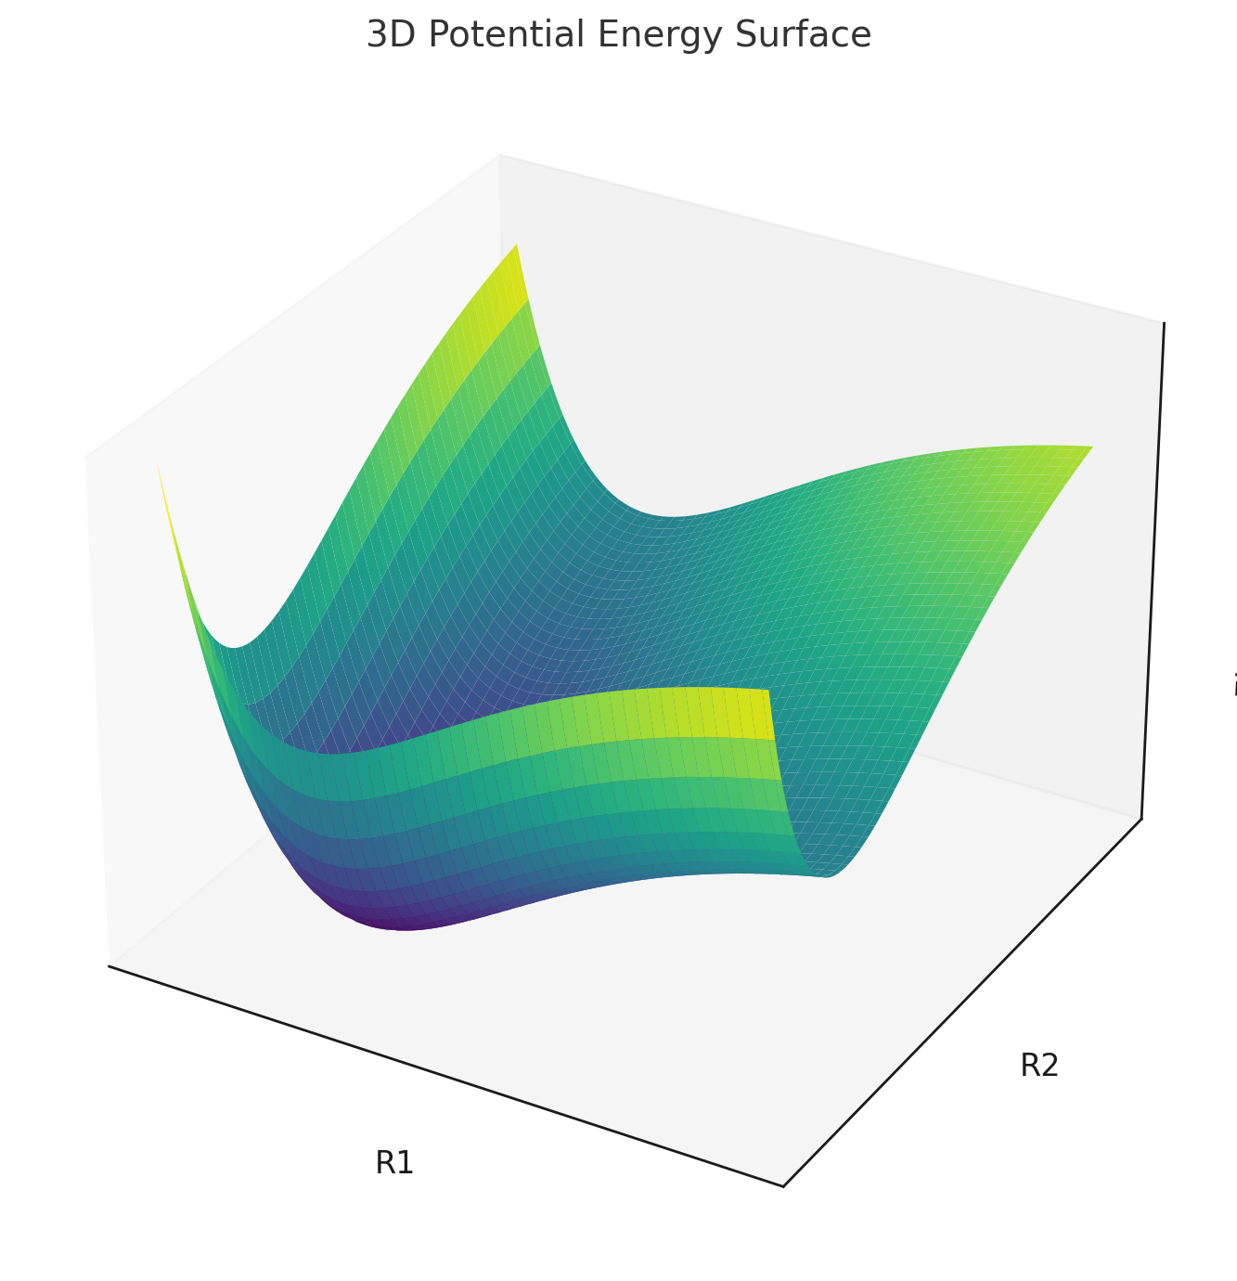
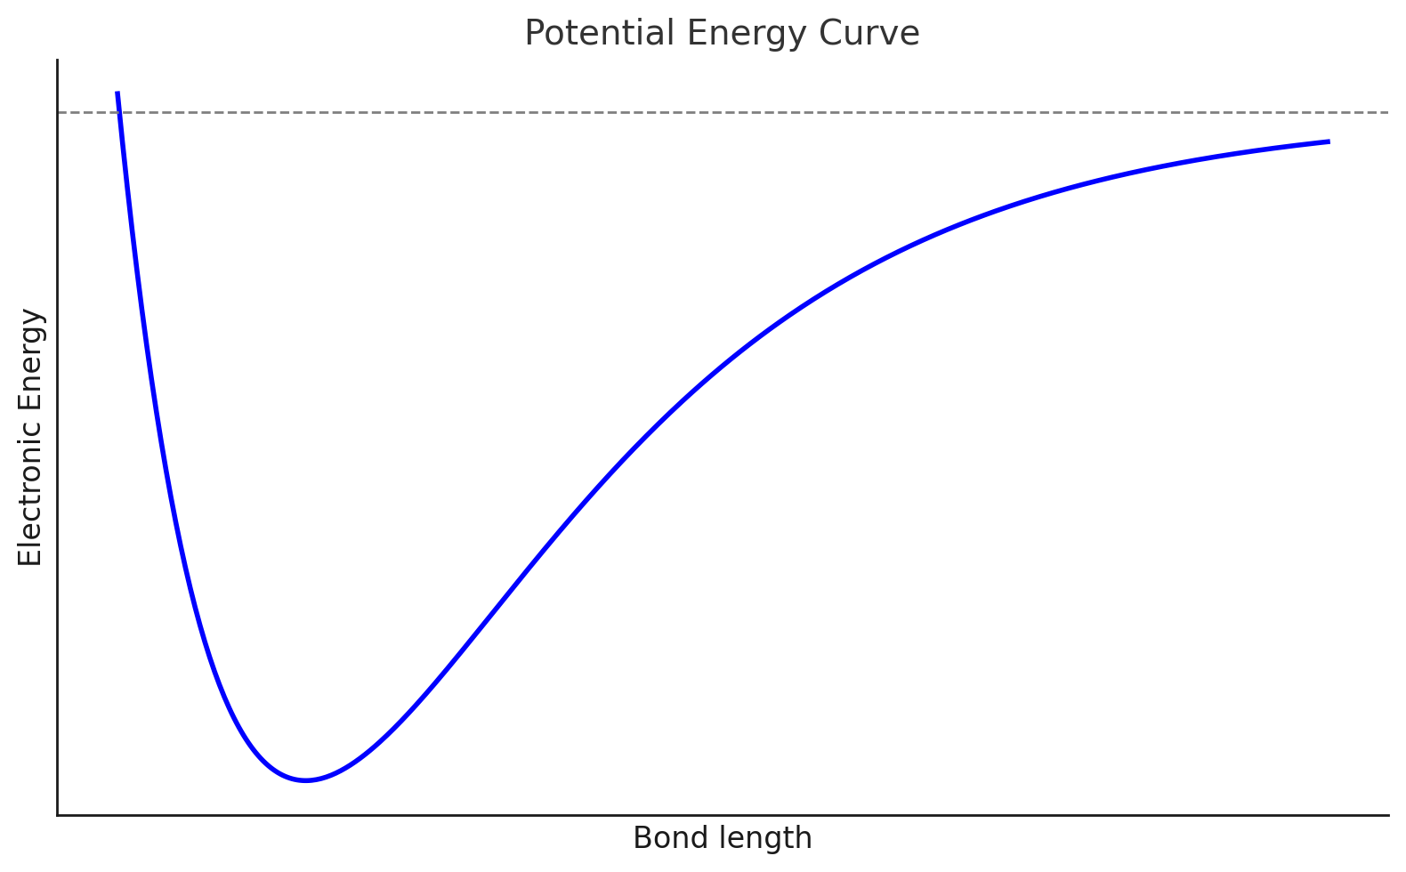
What is a Potential Energy Surface?
A function that describes how the electronic energy of a system changes as you move the atoms
Easy to visualize in 1D, and 2D

Slide 5
What can we do with PES data?
Can be (approximately) fitted in 1D/2D slices ➙ “Force Fields”
Can be fitted using interpolation between data points in multidimensional space – includes neural network models
Can be analysed to find properties such as bond lengths (equilibrium + vibrationally-averaged), bond dissociation energies, bond force constants, etc.
Can be explored to find minimum energy paths, activation energies, free energies of reaction

Slide 6
Reduced-dimensional models
That all sounds like a lot of hard work – how can I cheat?
Most of the time, we only care about one or two “active” degrees of freedom, e.g.
SN2 substitution reaction:
Cl⁻ + CH₃F ➝ ClCH₃ + F⁻

Slide 7
Reduced-dimensional models
Perform “relaxed scan” – constrain C-Cl distance, minimize energy with respect to positions of all other atoms
Perform frequency calculation at point of highest energy to confirm you have identified a “transition state”
1 (collective) direction of negative curvature = 1 “imaginary” frequency

Slide 8
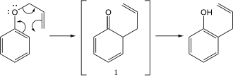
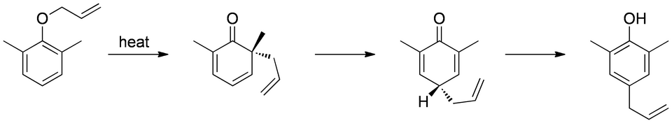
Collective coordinates
But what if I want to model concerted reactions involving the rearrangement of multiple bonds?

Slide 9
Collective coordinates
Automatically construct (multidimensional) pathway linking reactants and products, e.g.
Nudged elastic band method
Freezing/growing string method
Quadratic synchronous transit

Slide 10
Exercise
Explore the potential energy surface for the isomerization reaction:
HCN ⟷ HNC
Compute frequencies for reactants, product and transition state.
Save these files to use in tomorrow’s transition state theory workshop.

Slide 11
Even even more cheating
Download the pre-computed PES scan input and output files from:
https://github.com/dlc62/TST (QM_Data_Complete folder)
Plot potential energy as a function of “reaction coordinate” (from hcn_hnc.out or your own calculations)
Visualise normal modes of vibration (from frequency output files)
Look at SN2 reaction as well

Slide 12
Sebel Staff
23S3belSt@ff#@!

