Slide 1
Reaction rate modelling
Presenter: Deborah Crittenden
School of Physical and Chemical Sciences
University of Canterbury
Christchurch, New Zealand

Slide 2
The “modelling/reality” gap
“Microscopic” quantities
Bond dissociation energies
Activation energy barriers
Vibrational frequencies
Rotational constants
Molecular velocities
Easy to calculate
“Macroscopic” observables
Reaction rates
Enthalpies, entropies and free energies
Pressure and temperature
Volume, viscosity, density
Heat capacity, melting point
Easy to measure
Statistical
models
?

Slide 3
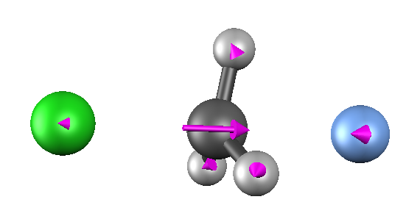
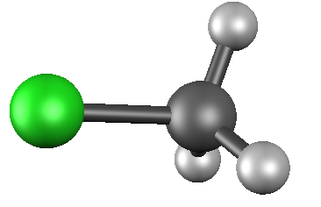
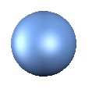
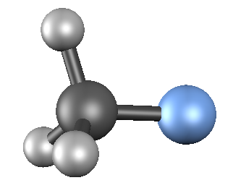
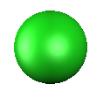
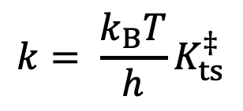
Transition state theory
Assumes:
Reaction proceeds along a single well-defined coordinate defined by a first-order saddle point on the potential energy surface and associated vibrational mode
Any time the system reaches this transition state, the reaction will proceed to completion
TS
reactants
products
Pseudo-equilibrium constant for formation of “activated complex”
$$k= \frac{k_{B}T}{h}K_{ts}^{‡}$$

Slide 4


How to predict $K_{ts}^{‡}$?
Need relative populations of “activated complex” and reactants, e.g. for a bimolecular reaction, A + B ➝ AB‡ ➝ products
$$K_{ts}^{‡}∝\frac{[{AB}^{‡}]}{\left[A\right][B]}$$

Slide 5
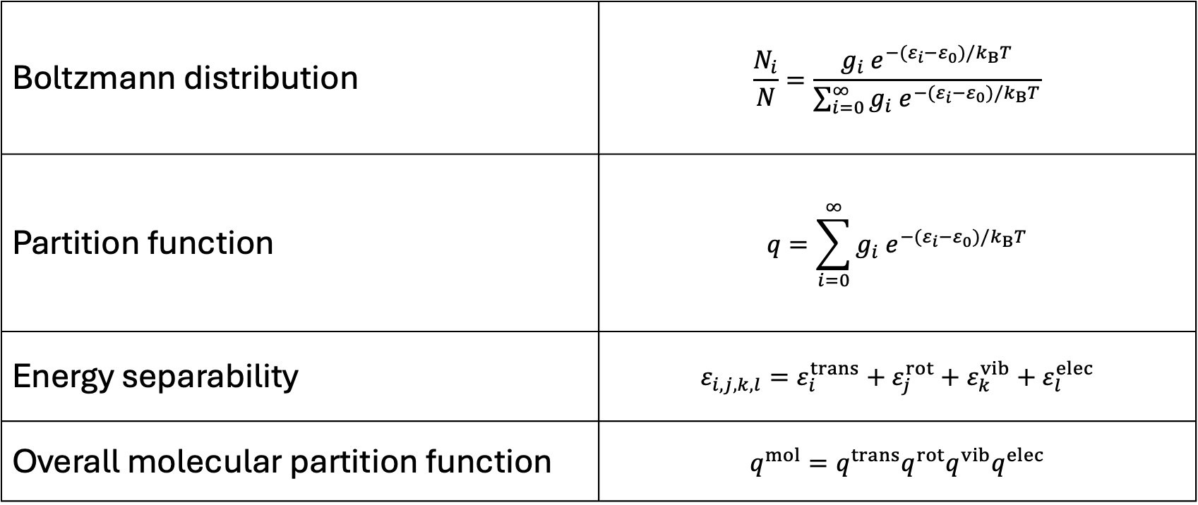
Statistical thermodynamics – key concepts
Boltzmann distribution | $$\frac{N_{i}}{N}=\frac{g_{i}{ e}^{−(ε_{i}−ε_{0})/k_{B}T}}{\sum_{i=0}^{∞}{g_{i}{ e}^{−(ε_{i}−ε_{0})/k_{B}T}}}$$
Partition function | $$q=\sum_{i=0}^{∞}{g_{i}{ e}^{−(ε_{i}−ε_{0})/k_{B}T}}$$
Energy separability | $$ε_{i,j,k,l}=ε_{i}^{trans}+ε_{j}^{rot}+ε_{k}^{vib}+ε_{l}^{elec}$$
Overall molecular partition function | $$q^{mol}=q^{trans}q^{rot}q^{vib}q^{elec}$$

Slide 6
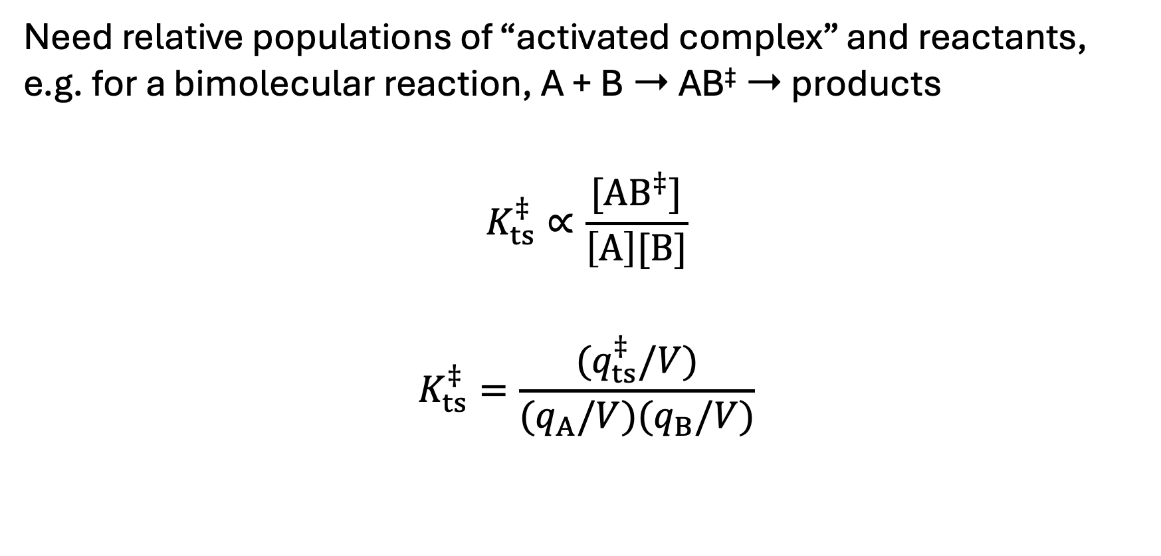
How to predict $K_{ts}^{‡}$?
Need relative populations of “activated complex” and reactants, e.g. for a bimolecular reaction, A + B ➝ AB‡ ➝ products
$$K_{ts}^{‡}∝\frac{[{AB}^{‡}]}{\left[A\right][B]}$$
$$K_{ts}^{‡}=\frac{{(q}_{ts}^{‡}/V)}{{(q}_{A}/V){(q}_{B}/V)}$$

Slide 7
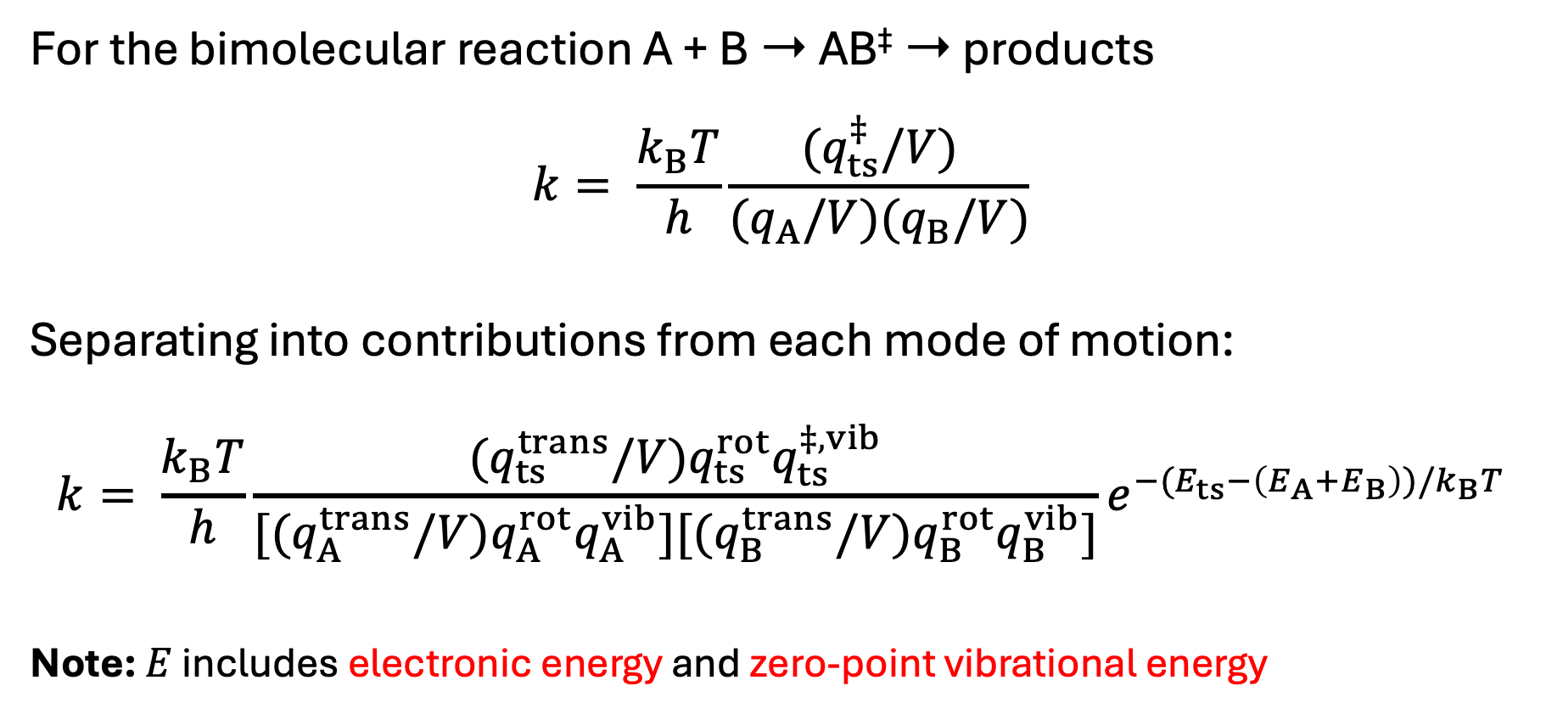
Final TST expression for k
For the bimolecular reaction A + B ➝ AB‡ ➝ products
$$k= \frac{k_{B}T}{h}\frac{{(q}_{ts}^{‡}/V)}{{(q}_{A}/V){(q}_{B}/V)}$$
Separating into contributions from each mode of motion:
$$k= \frac{k_{B}T}{h}\frac{{(q}_{ts}^{trans}/V)q_{ts}^{rot}q_{ts}^{‡,vib}}{{[(q}_{A}^{trans}/V)q_{A}^{rot}q_{A}^{vib}]{[(q}_{B}^{trans}/V)q_{B}^{rot}q_{B}^{vib}]}e^{−(E_{ts}−\left(E_{A}+E_{B}\right))/k_{B}T}$$
Note: $E$ includes electronic energy and zero-point vibrational energy

Slide 8
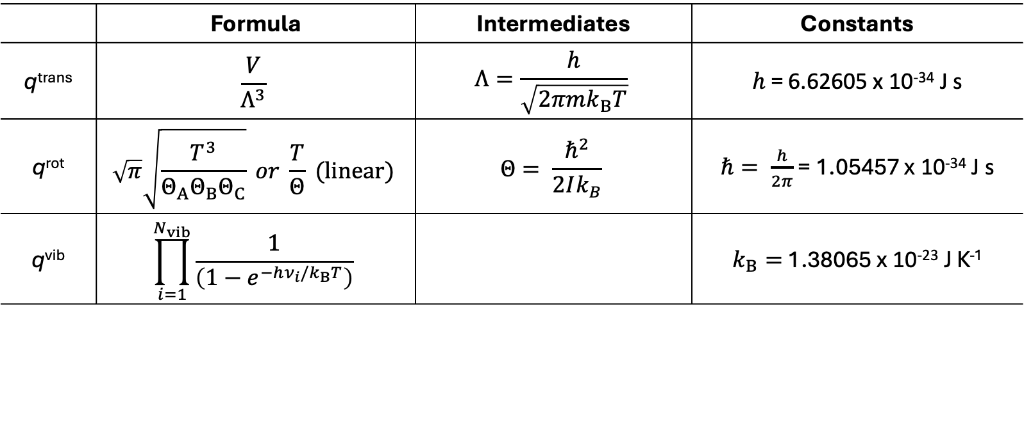

How to compute molecular partition functions?
 | Formula | Intermediates | Constants
q^{trans} | $$\frac{V}{Λ^{3}}$$ | $$Λ=\frac{h}{\sqrt{2πmk_{B}T}}$$ | $h$ = 6.62605 x 10⁻³⁴ J s
q^{rot} | $$\sqrt{π}\sqrt{\frac{T^{3}}{Θ_{A}Θ_{B}Θ_{C}}} or \frac{T}{Θ} (linear)$$ | $$Θ= \frac{ℏ^{2}}{2Ik_{B}}$$ | $ℏ= \frac{h}{2π}$ = 1.05457 x 10⁻³⁴ J s
q^{vib} | $$\prod_{i=1}^{N_{vib}}{\frac{1}{\left(1−e^{−hν_{i}/k_{B}T}\right)}}$$ |  | $k_{B}=$ 1.38065 x 10⁻²³ J K⁻¹
Need:
Mass of molecule
Moments of inertia
Vibrational frequencies
Note: $T$ = temperature in Kelvin
Notes:
+ Make handout of key equations

Slide 9
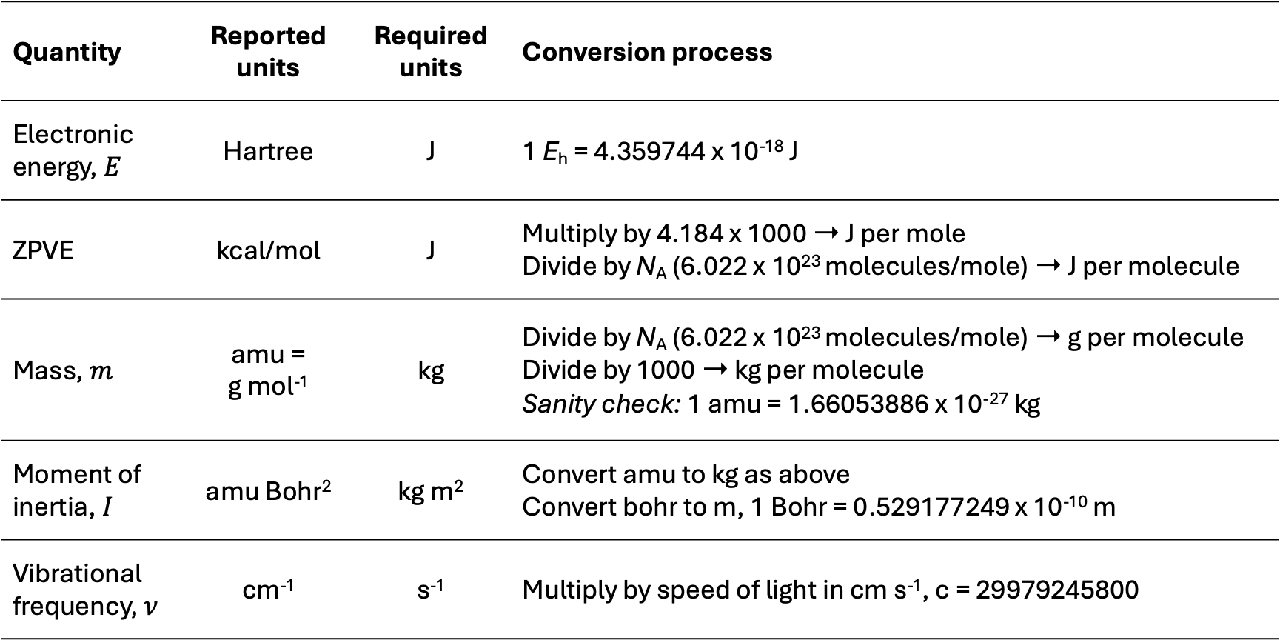
Quantities and units conversions
Quantity | Reported units | Required units | Conversion process
Electronic energy, $E$ | Hartree | J | 1 E_{h} = 4.359744 x 10⁻¹⁸ J
ZPVE | kcal/mol | J | Multiply by 4.184 x 1000 ➝ J per mole Divide by N_{A} (6.022 x 10²³ molecules/mole) ➝ J per molecule
Mass, $m$ | amu = g mol⁻¹ | kg | Divide by N_{A} (6.022 x 10²³ molecules/mole) ➝ g per molecule Divide by 1000 ➝ kg per molecule Sanity check: 1 amu = 1.66053886 x 10⁻²⁷ kg
Moment of inertia, $I$ | amu Bohr² | kg m² | Convert amu to kg as above Convert bohr to m, 1 Bohr = 0.529177249 x 10⁻¹⁰ m
Vibrational frequency, $ν$ | cm⁻¹ | s⁻¹ | Multiply by speed of light in cm s⁻¹, c = 29979245800

Slide 10
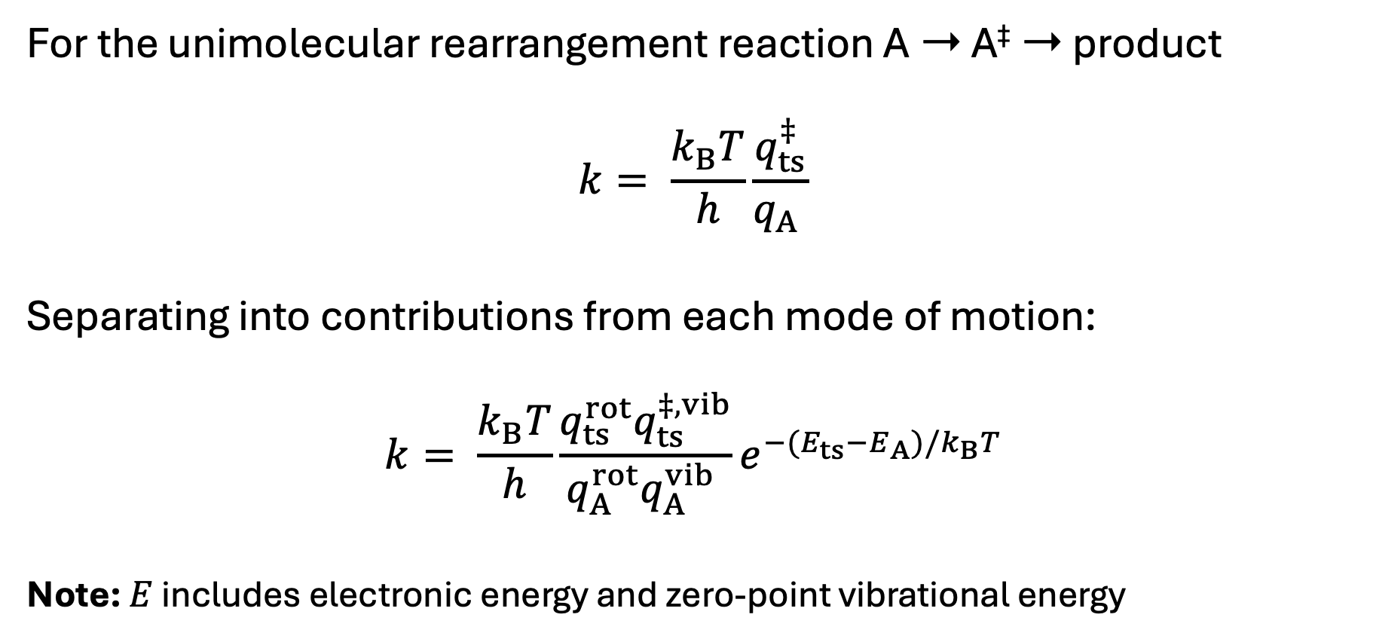
A simpler example to start
For the unimolecular rearrangement reaction A ➝ A‡ ➝ product
$$k= \frac{k_{B}T}{h}\frac{q_{ts}^{‡}}{q_{A} }$$
Separating into contributions from each mode of motion:
$$k= \frac{k_{B}T}{h}\frac{q_{ts}^{rot}q_{ts}^{‡,vib}}{q_{A}^{rot}q_{A}^{vib} }e^{−(E_{ts}−E_{A})/k_{B}T}$$
Note: $E$ includes electronic energy and zero-point vibrational energy

Slide 11
To do
Download TST_Working_Spreadsheet.xlsx and handout from:
https://github.com/dlc62/TST
Download QM_Data folder (if you don’t have QM_Data_Complete)
Copy frequencies, rotational constants and electronic energy into spreadsheet from “frequency” output files into spreadsheet
Convert these from reported units into SI units (conversion factors in spreadsheet)
Compute partition functions using formulae from handout
Compute rate constants

Slide 13
Statistical rate constant modelling
This workshop
Analytical
Brute Force
Rate constants | Molecular rearrangement | + Quantum nuclear tunnelling | + Electron transfer
k(T) | TST, V-TST | Q-TST | Marcus-Hush theory
k(E) | μTST, RRKM | WKB | --
Rice–Ramsperger–Kassel–Marcus
Wentzel-Kramers-Brillouin
Rate constants | Molecular rearrangement | + Quantum nuclear tunnelling | + Electron transfer
k(T) or k(E) | “reactive” MD | PIMD, RPMD | Surface-hopping MD

Slide 14
Statistical reaction process modelling
Takes rates for a series of processes, models changes in concentration of reaction components over time by solving a set of coupled differential equations
Analytic version:
Master Equation Modelling, requires k_{i}(E)
Brute-force version:
Kinetic Monte Carlo, requires k_{i}(T)

