Slide 1
Semantic Fluency Analysis

Slide 2
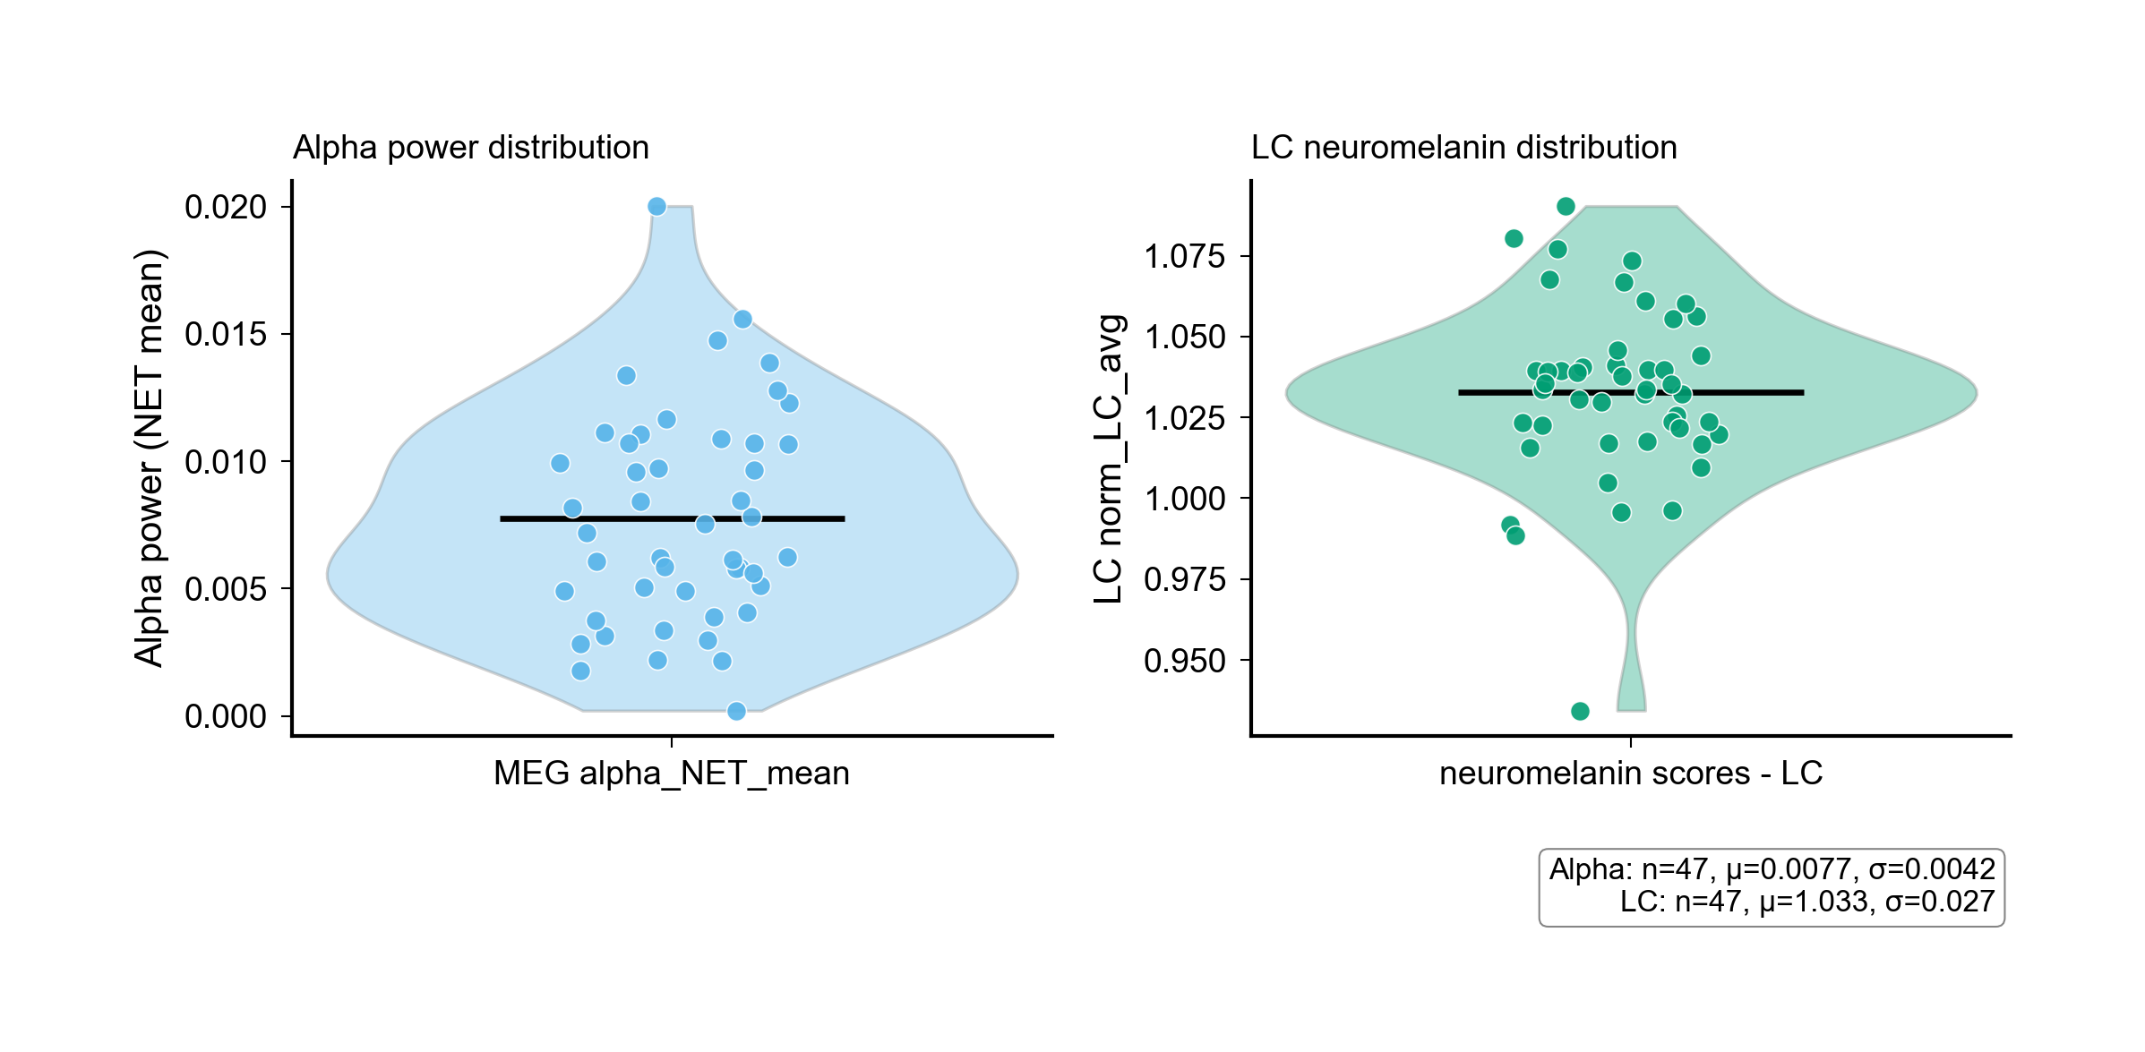
Figure0 Alpha Violin Swarm (.PNG)
File: output/NATURE_REAL_figure0_alpha_violin_swarm.png
Full path: /Users/diettachihade/snafu-py/research/semantic_fluency_analysis/output/NATURE_REAL_figure0_alpha_violin_swarm.png

Slide 3
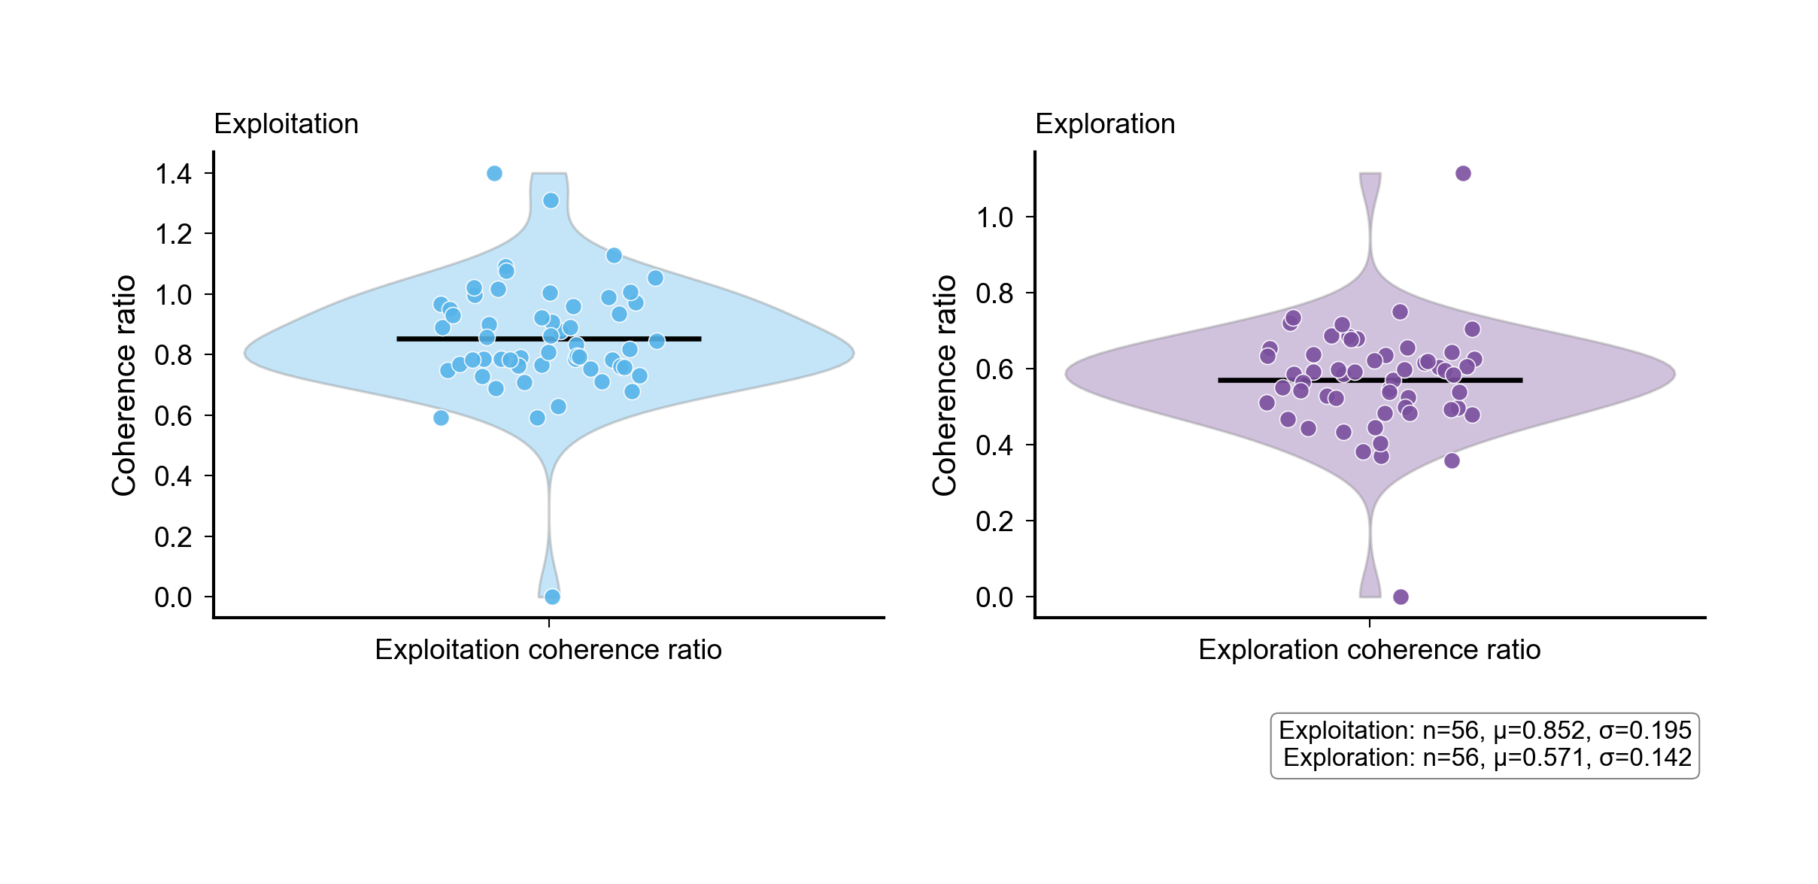
Figure0B Coherence Violin Swarm (.PNG)
File: output/NATURE_REAL_figure0b_coherence_violin_swarm.png
Full path: /Users/diettachihade/snafu-py/research/semantic_fluency_analysis/output/NATURE_REAL_figure0b_coherence_violin_swarm.png

Slide 4
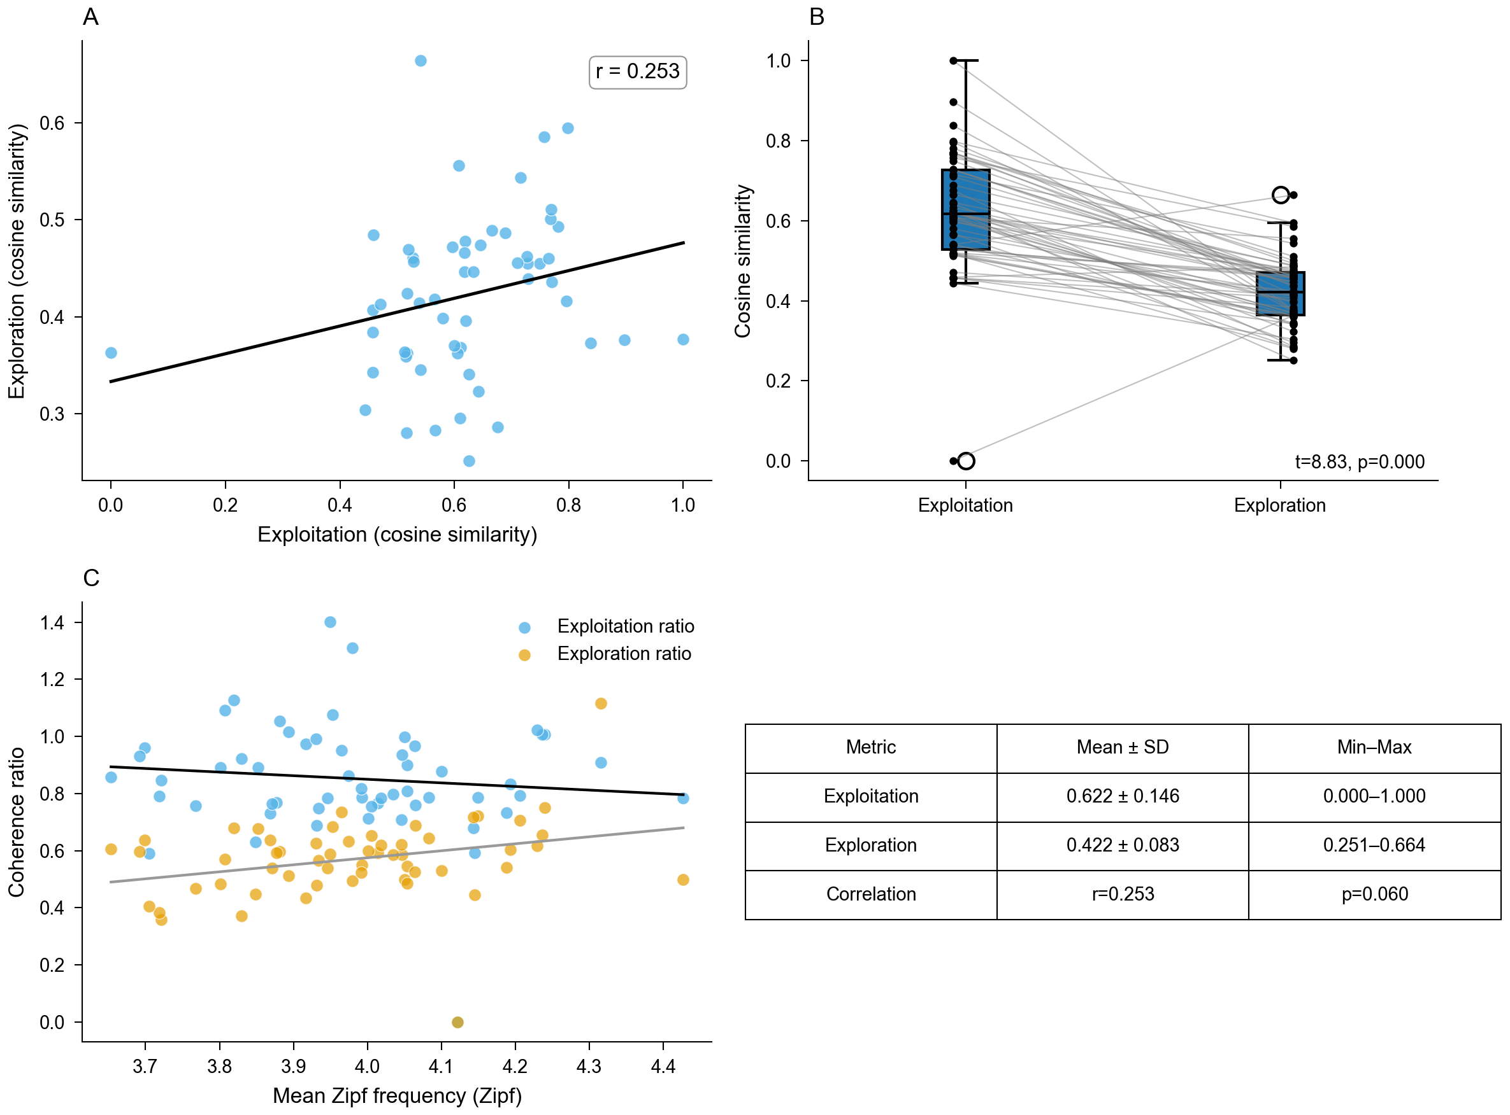
Figure1 Exploration Exploitation (.PNG)
File: output/NATURE_REAL_figure1_exploration_exploitation.png
Full path: /Users/diettachihade/snafu-py/research/semantic_fluency_analysis/output/NATURE_REAL_figure1_exploration_exploitation.png

Slide 5
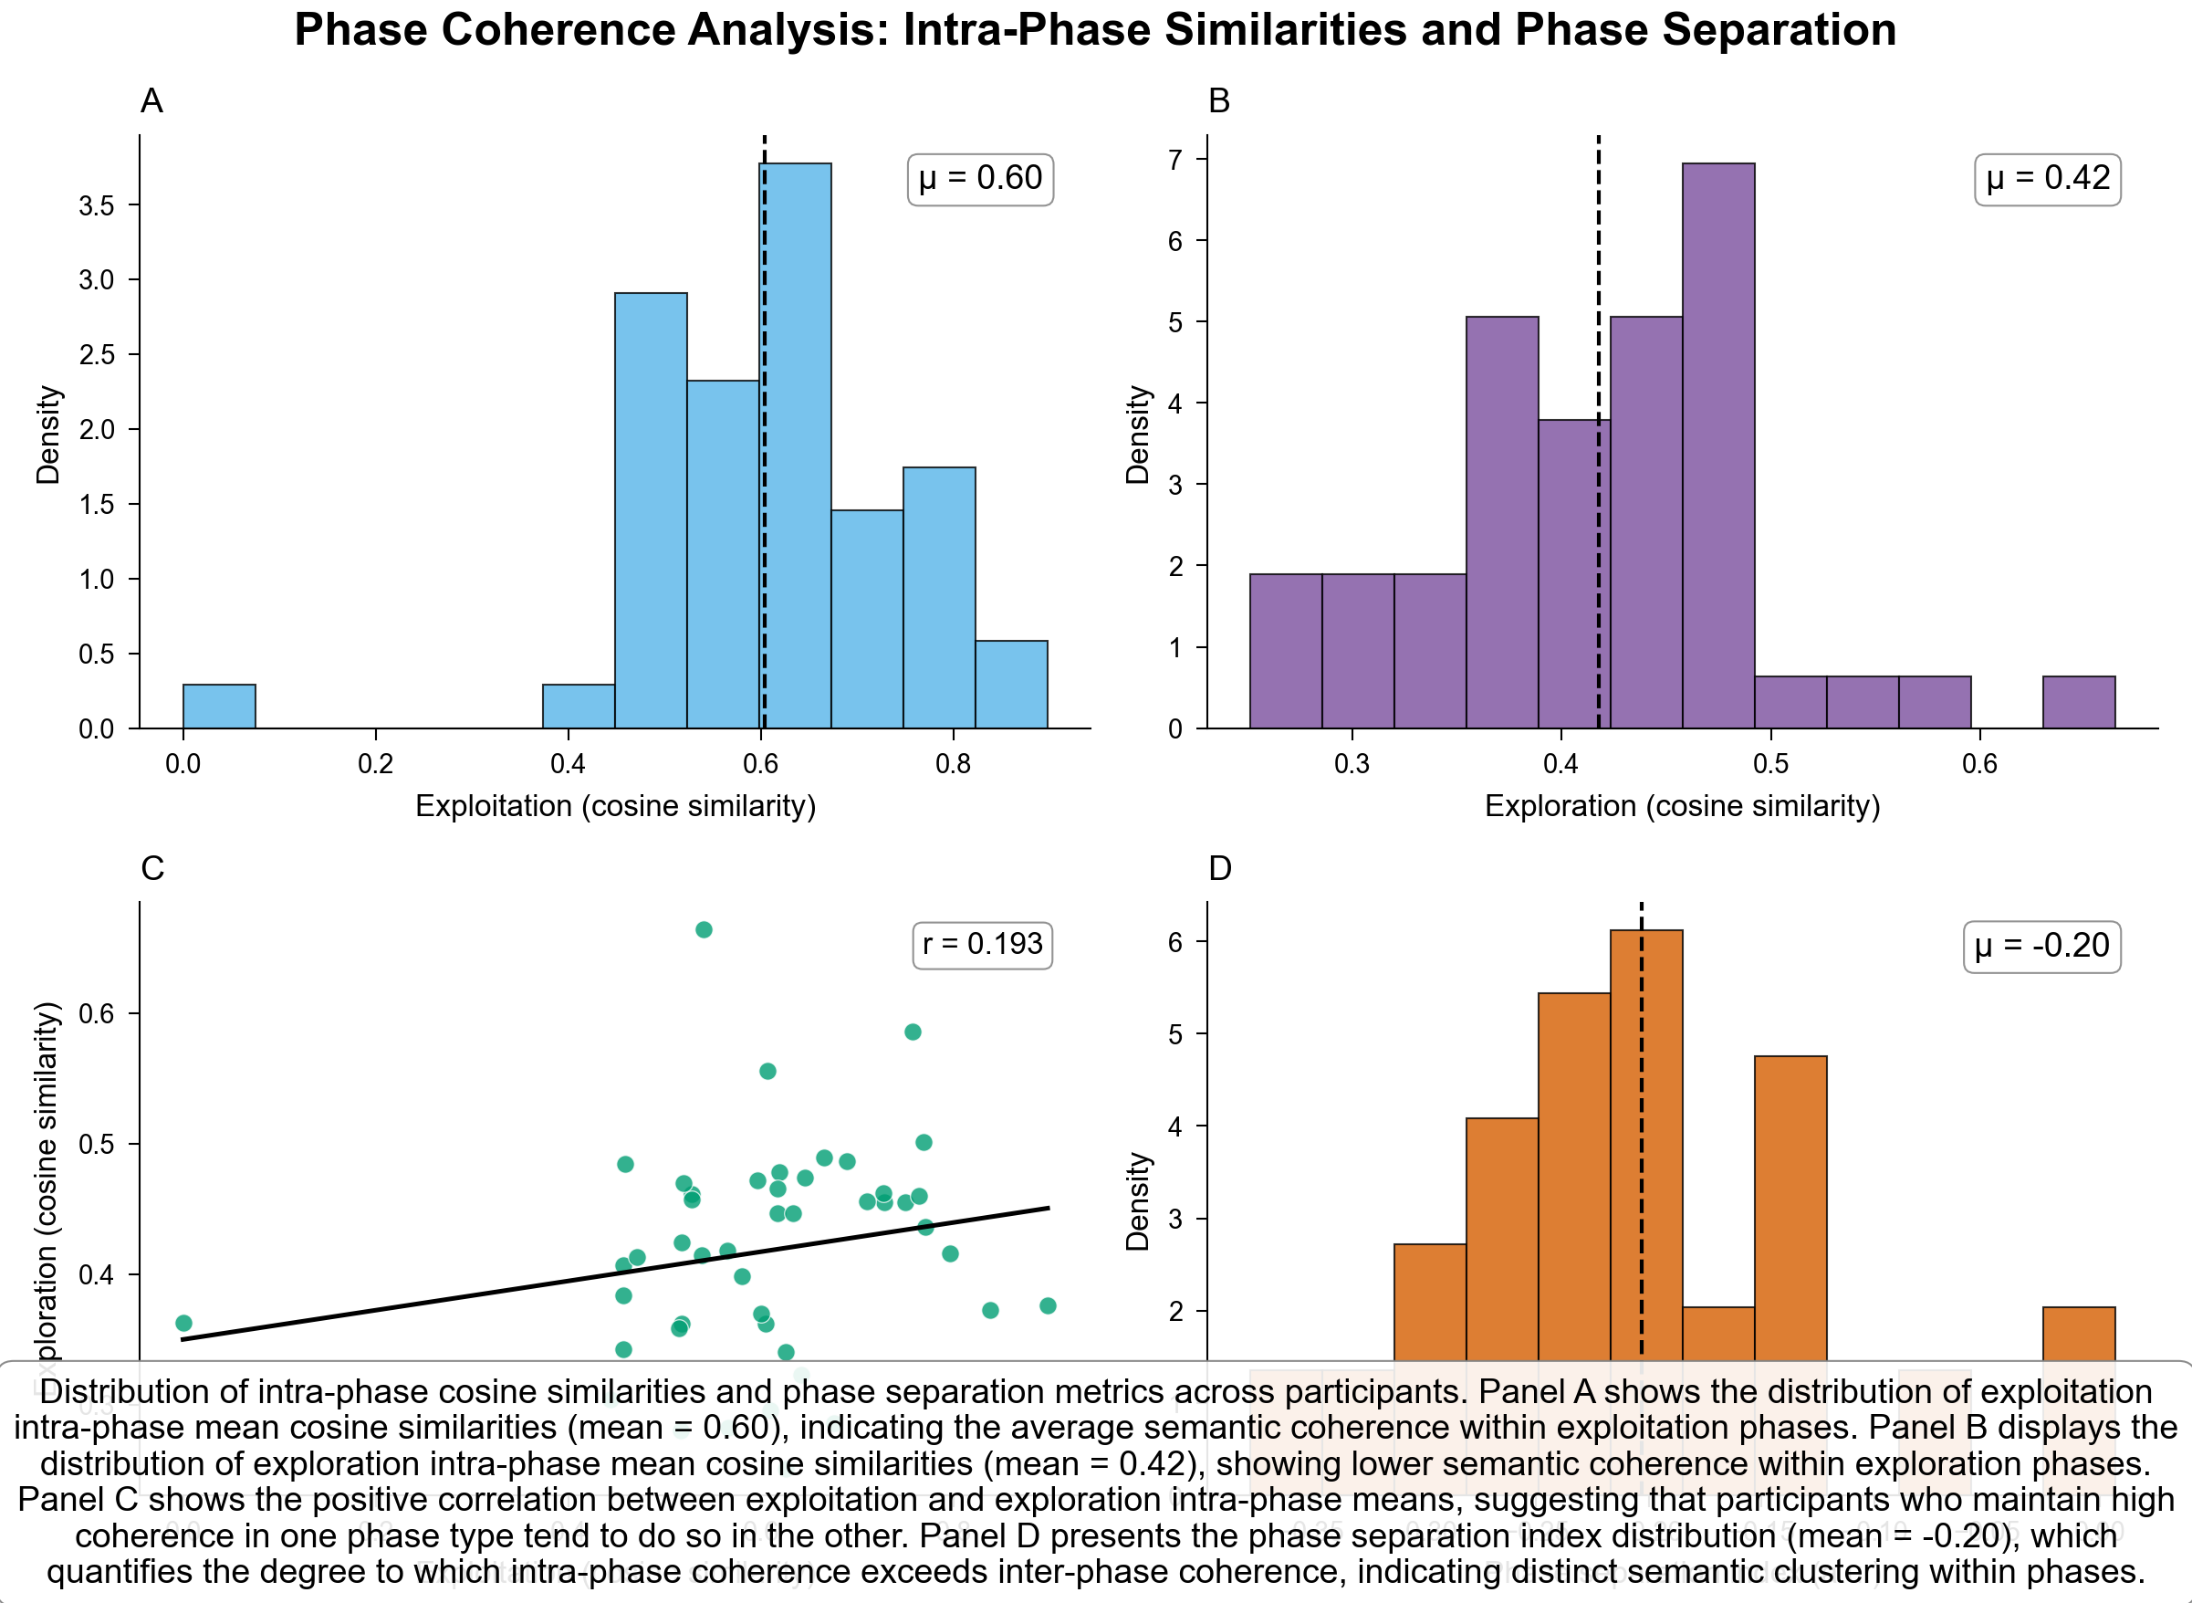
Figure2 Phase Coherence (.PNG)
File: output/NATURE_REAL_figure2_phase_coherence.png
Full path: /Users/diettachihade/snafu-py/research/semantic_fluency_analysis/output/NATURE_REAL_figure2_phase_coherence.png

Slide 6
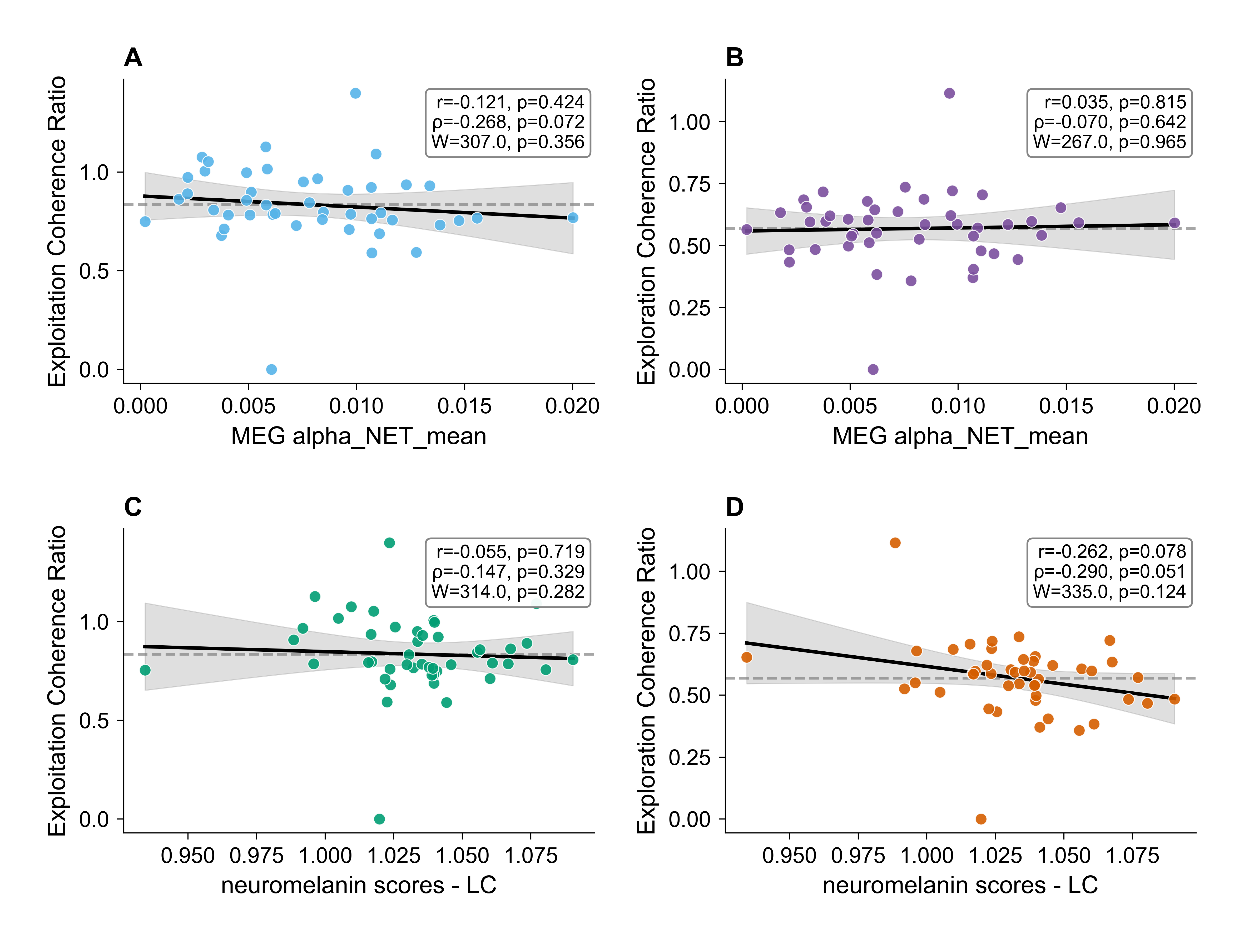
Figure3 Meg Correlations (.PNG)
File: output/NATURE_REAL_figure3_meg_correlations.png
Full path: /Users/diettachihade/snafu-py/research/semantic_fluency_analysis/output/NATURE_REAL_figure3_meg_correlations.png

Slide 7
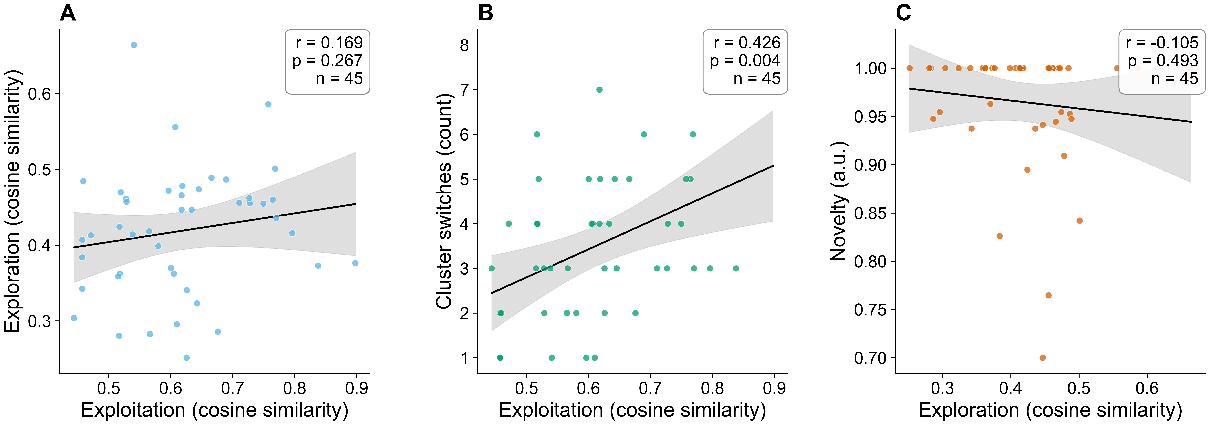
Figure4 Comprehensive (.PNG)
File: output/NATURE_REAL_figure4_comprehensive.png
Full path: /Users/diettachihade/snafu-py/research/semantic_fluency_analysis/output/NATURE_REAL_figure4_comprehensive.png

Slide 8
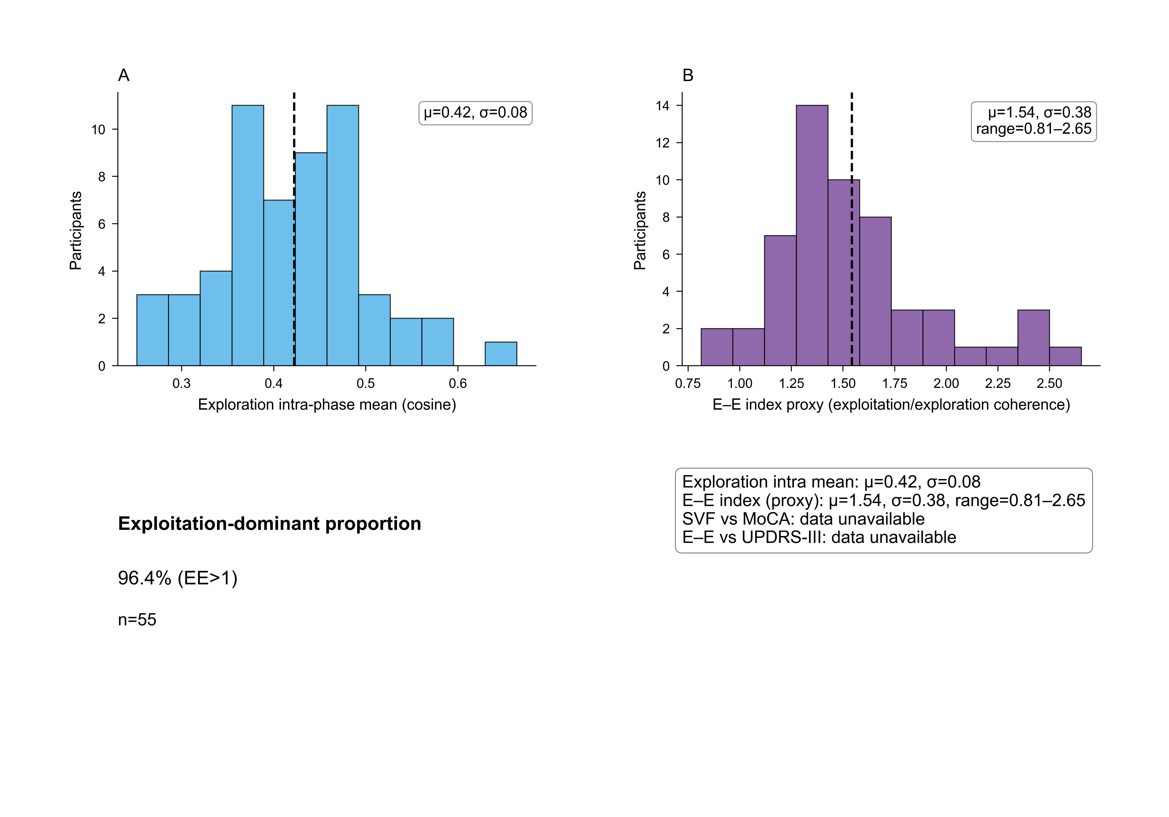
Behavior Performance (.PNG)
File: output/NATURE_REAL_behavior_performance.png
Full path: /Users/diettachihade/snafu-py/research/semantic_fluency_analysis/output/NATURE_REAL_behavior_performance.png

Slide 9
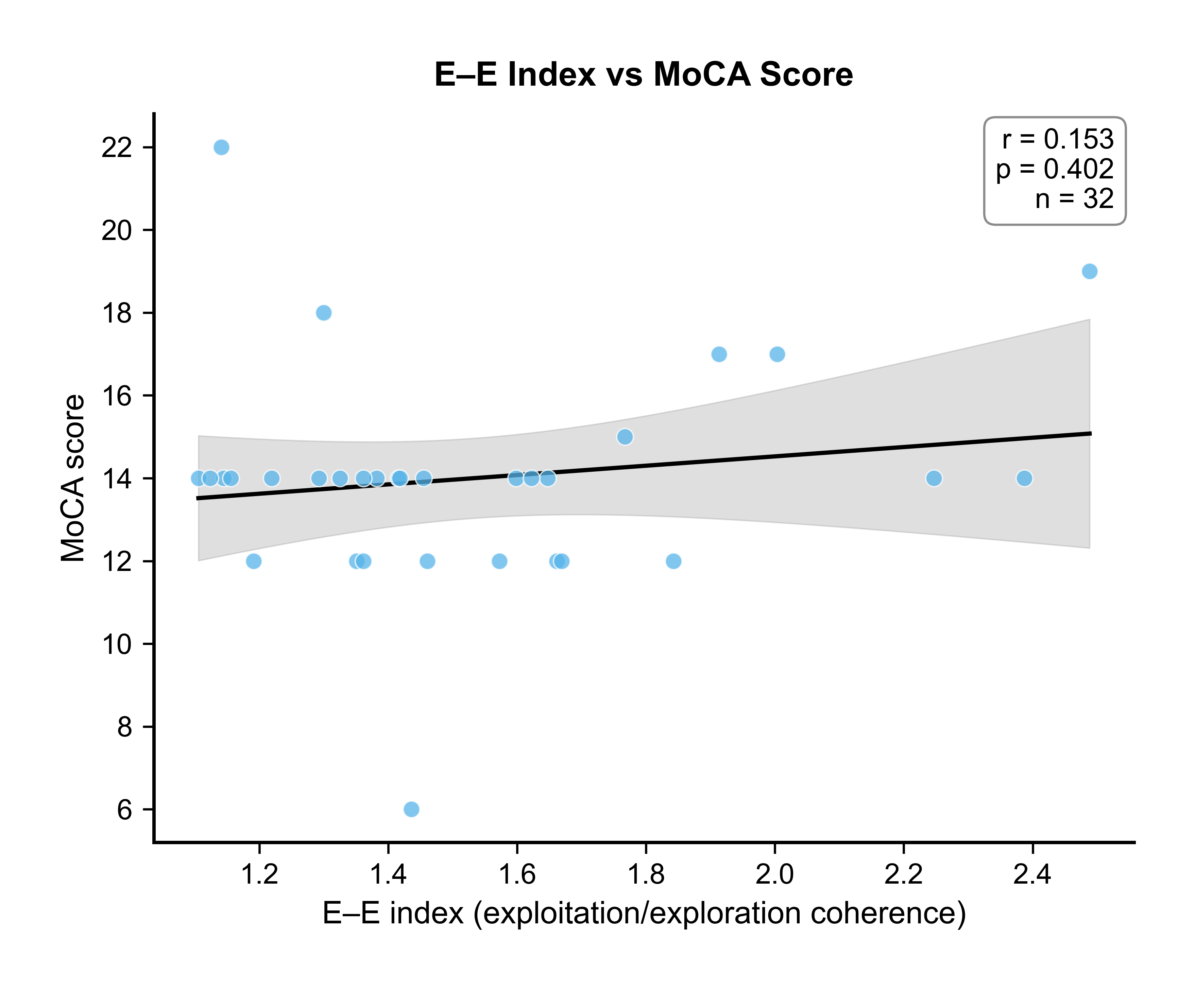
Ee Vs Moca (.PNG)
File: output/NATURE_REAL_ee_vs_moca.png
Full path: /Users/diettachihade/snafu-py/research/semantic_fluency_analysis/output/NATURE_REAL_ee_vs_moca.png

Slide 10
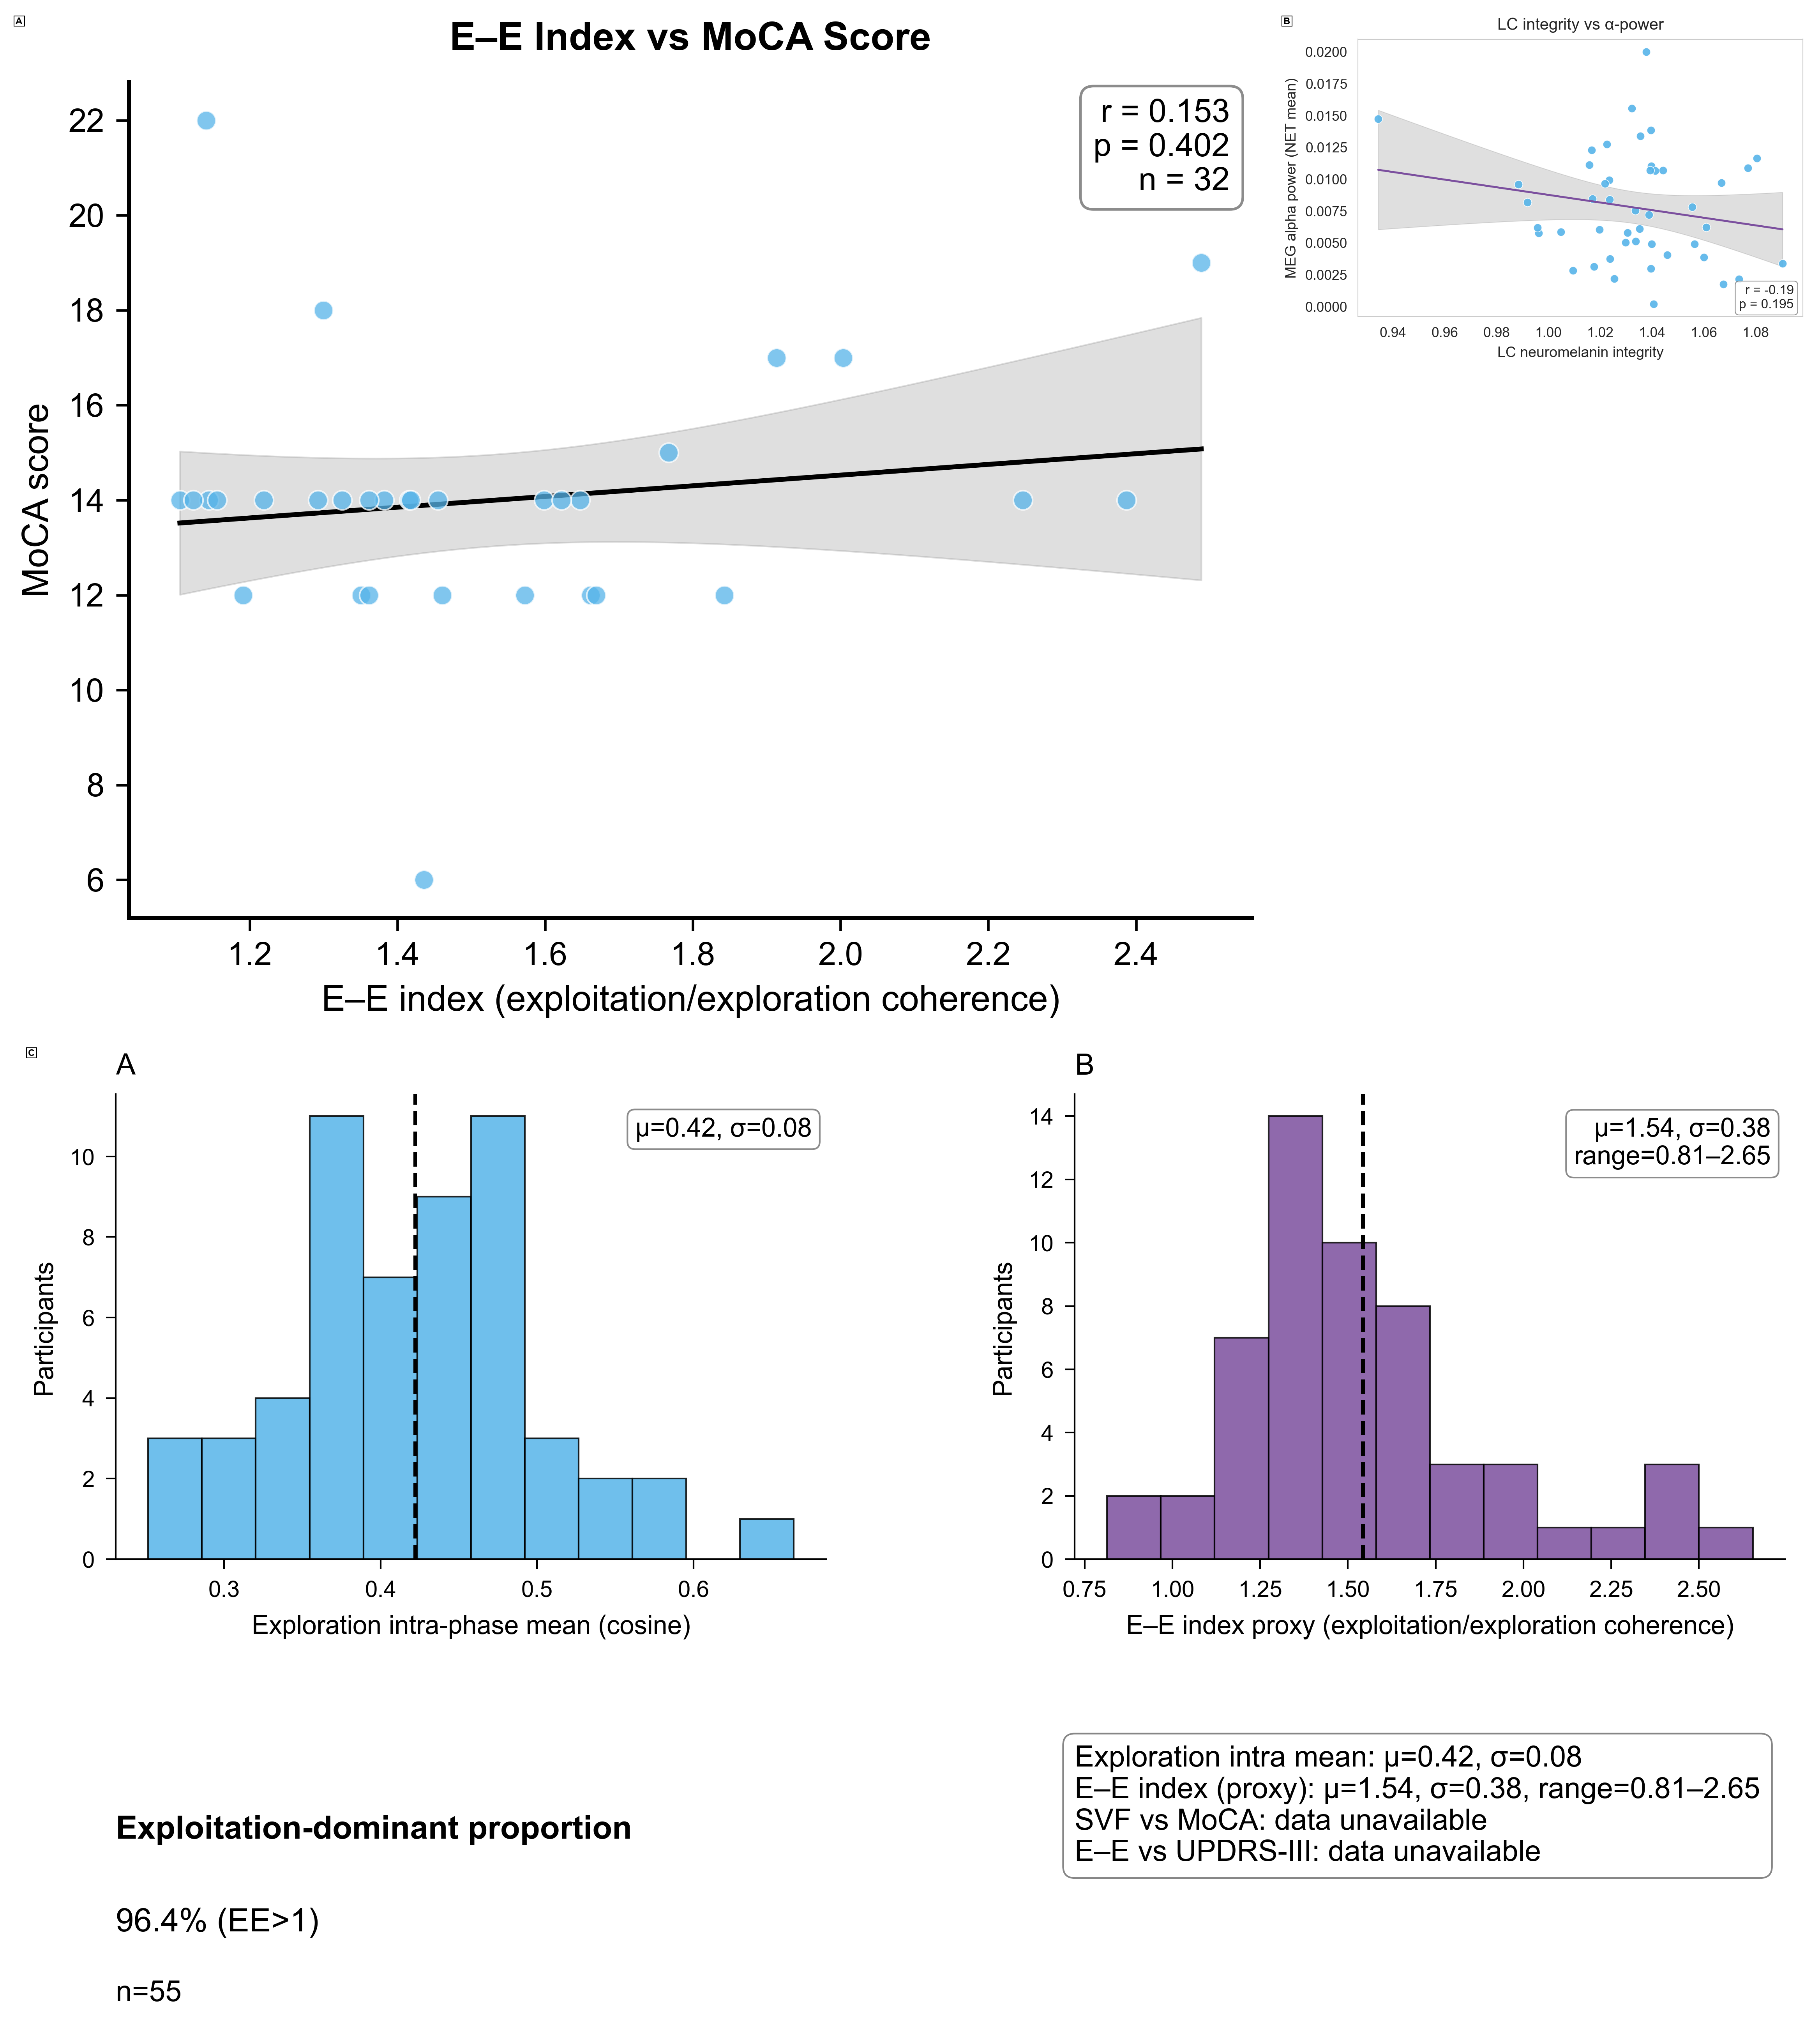
Compiled Results (.PNG)
File: output/NATURE_REAL_compiled_results.png
Full path: /Users/diettachihade/snafu-py/research/semantic_fluency_analysis/output/NATURE_REAL_compiled_results.png

Slide 11
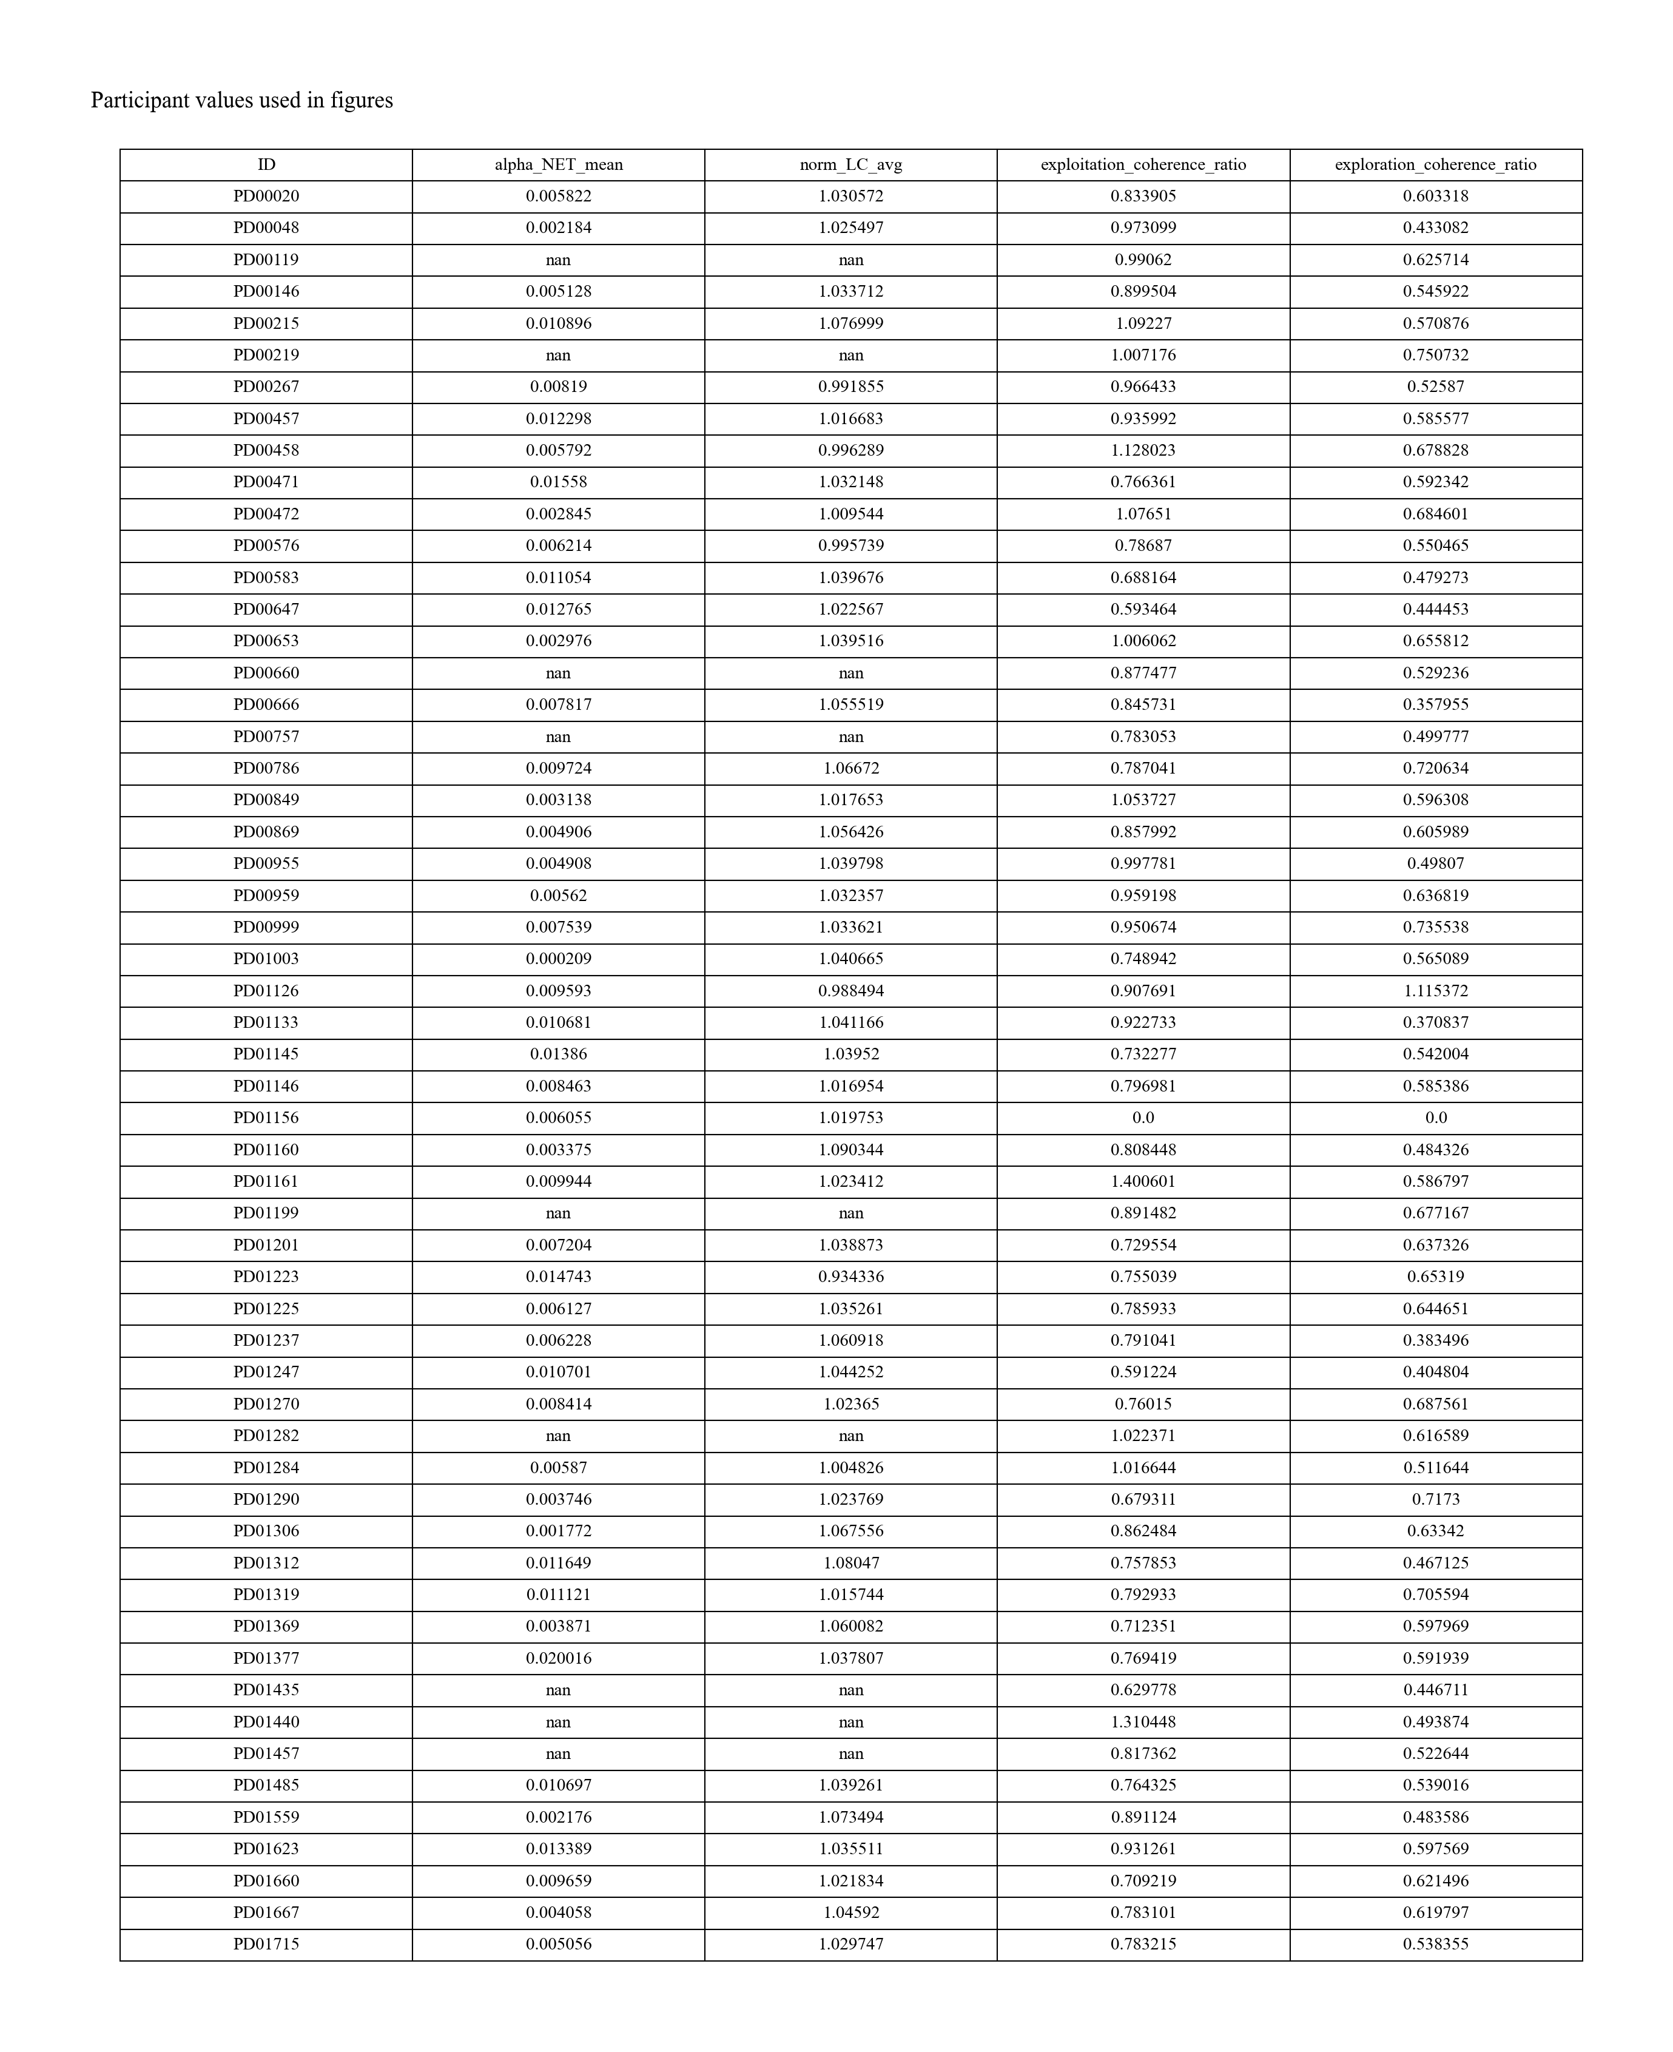
Participant Values Table (.PNG)
File: output/NATURE_REAL_participant_values_table.png
Full path: /Users/diettachihade/snafu-py/research/semantic_fluency_analysis/output/NATURE_REAL_participant_values_table.png

Slide 12
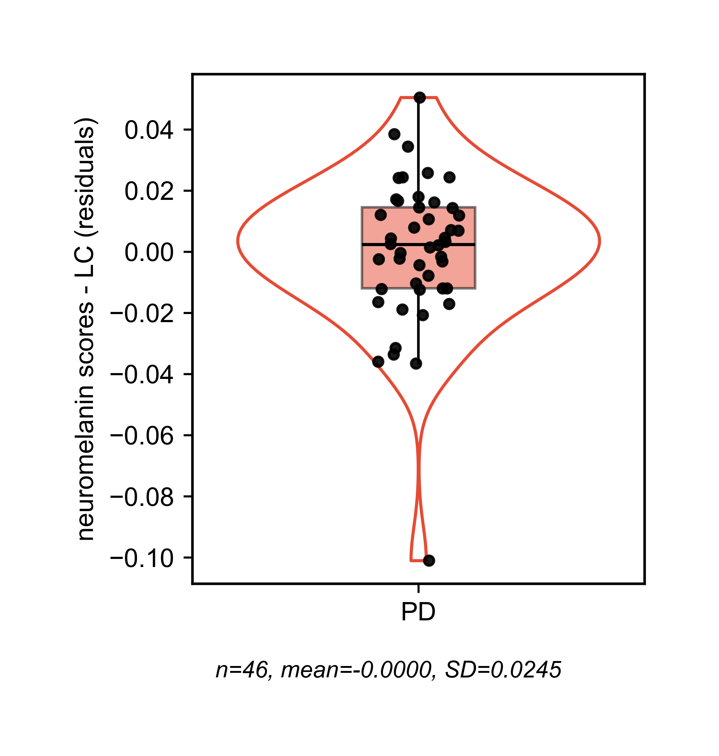
Violin Lc Residuals (.PNG)
File: output/NATURE_REAL_violin_lc_residuals.png
Full path: /Users/diettachihade/snafu-py/research/semantic_fluency_analysis/output/NATURE_REAL_violin_lc_residuals.png

Slide 13
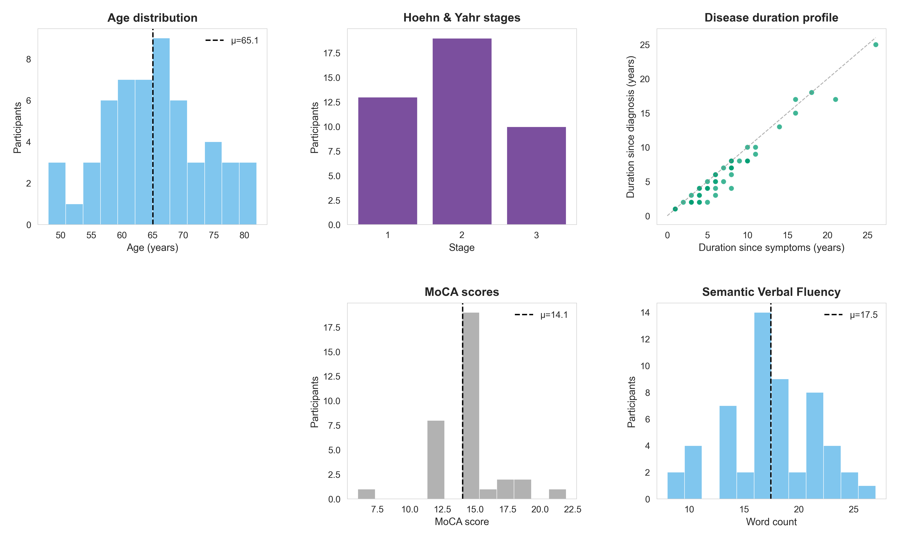
Intermediate: Participant Demographics (.PNG)
File: output/figures/intermediate/participant_demographics.png
Full path: /Users/diettachihade/snafu-py/research/semantic_fluency_analysis/output/figures/intermediate/participant_demographics.png

Slide 14
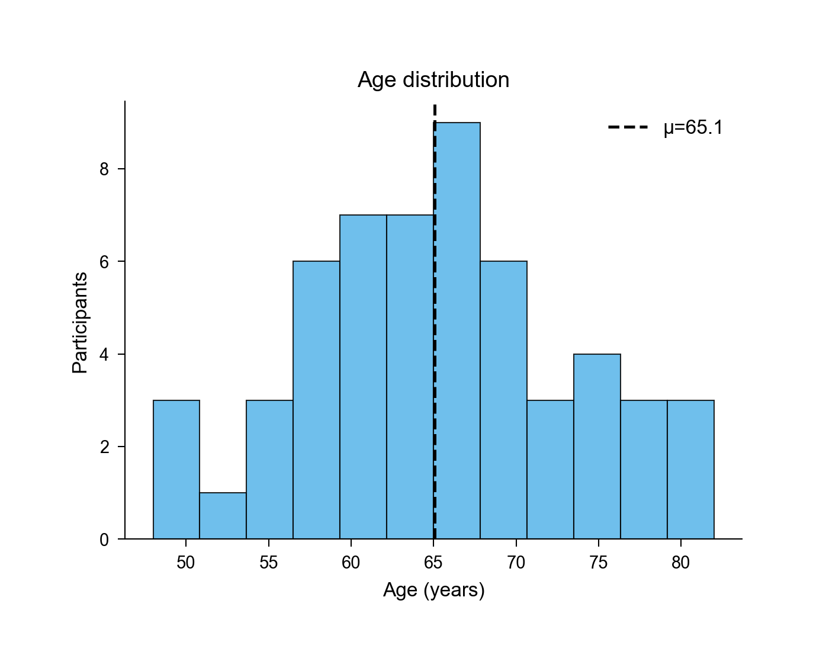
Intermediate: Age Distribution (.PNG)
File: output/figures/intermediate/age_distribution.png
Full path: /Users/diettachihade/snafu-py/research/semantic_fluency_analysis/output/figures/intermediate/age_distribution.png

Slide 15
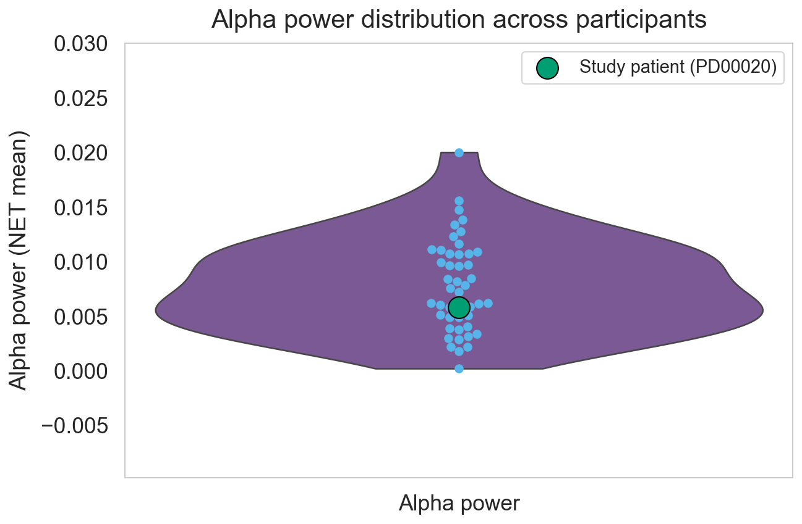
Intermediate: Alpha Power Violin (.PNG)
File: output/figures/intermediate/alpha_power_violin.png
Full path: /Users/diettachihade/snafu-py/research/semantic_fluency_analysis/output/figures/intermediate/alpha_power_violin.png

Slide 16
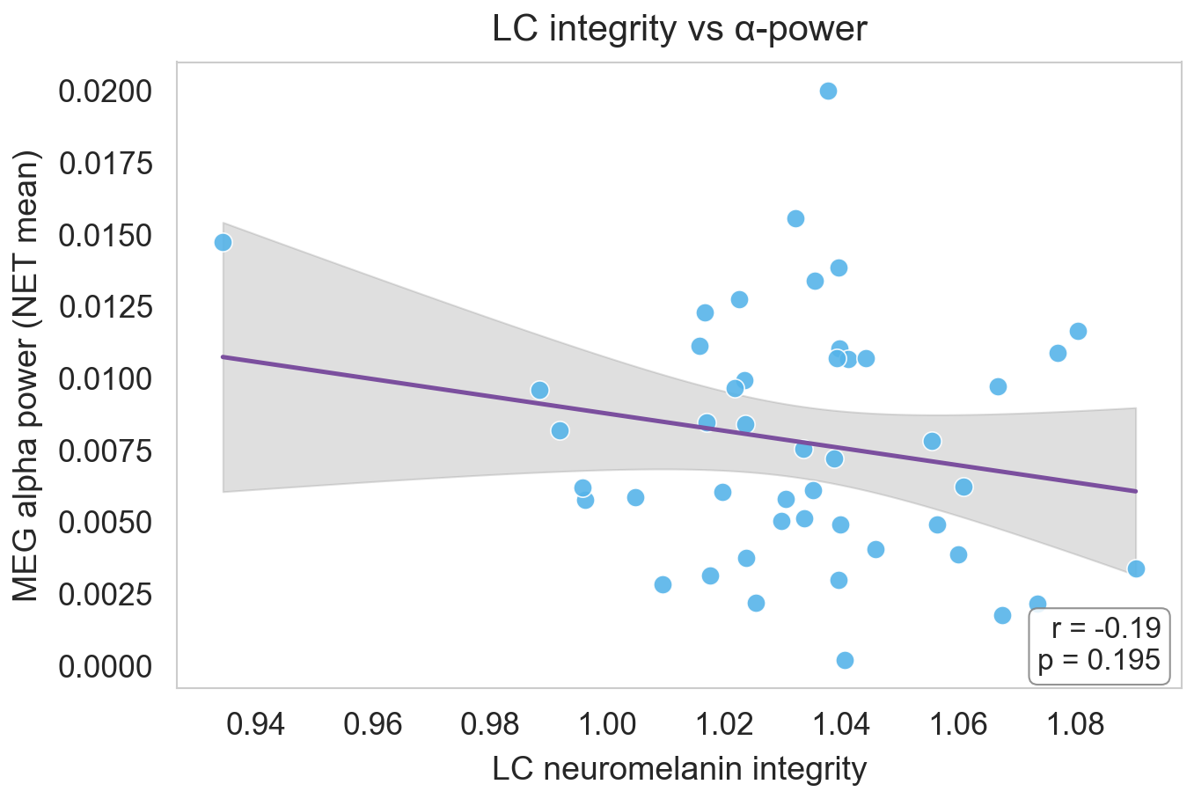
Intermediate: Lc Vs Alpha (.PNG)
File: output/figures/intermediate/lc_vs_alpha.png
Full path: /Users/diettachihade/snafu-py/research/semantic_fluency_analysis/output/figures/intermediate/lc_vs_alpha.png

Slide 17
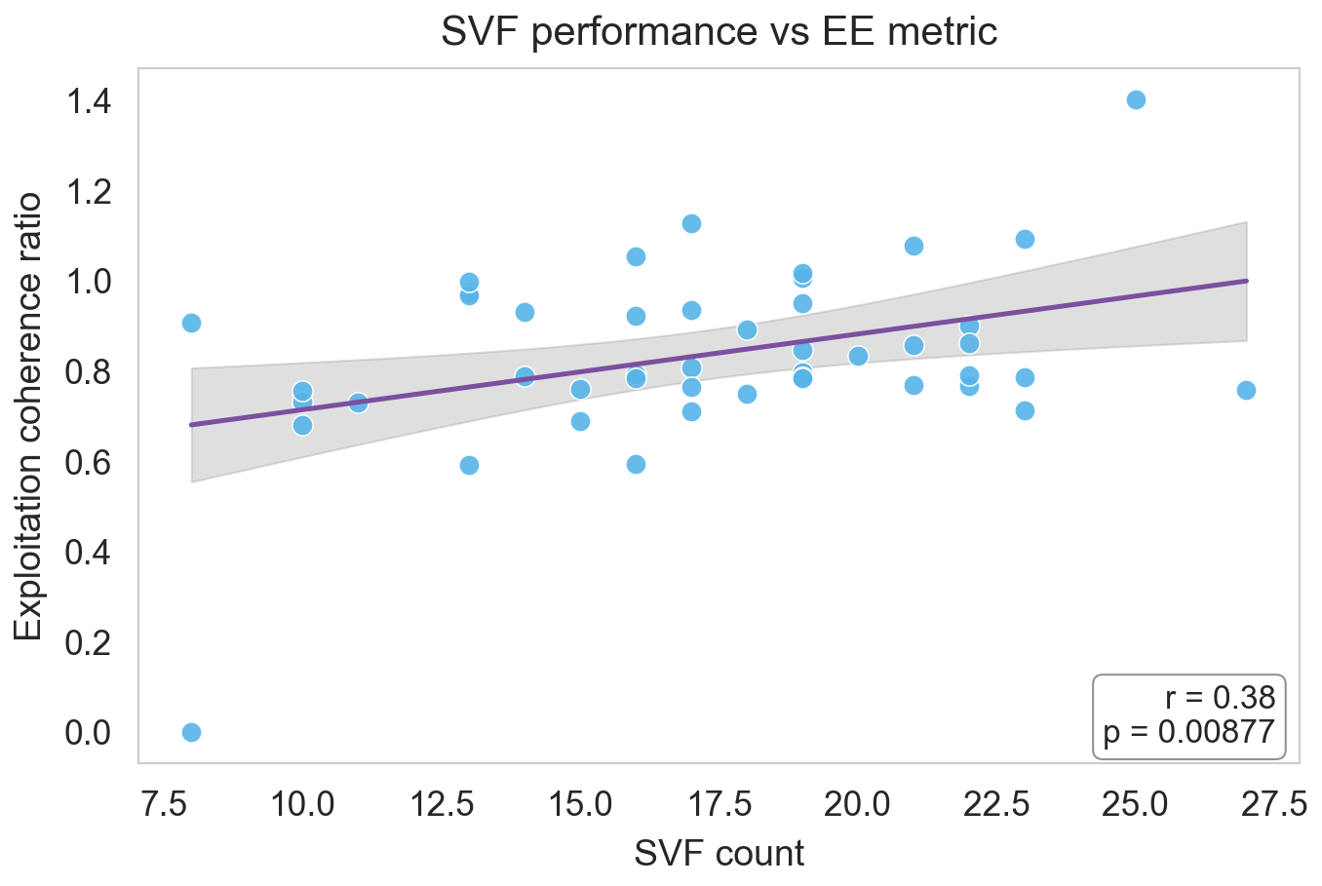
Intermediate: Svf Vs Ee (.PNG)
File: output/figures/intermediate/svf_vs_ee.png
Full path: /Users/diettachihade/snafu-py/research/semantic_fluency_analysis/output/figures/intermediate/svf_vs_ee.png

Slide 18
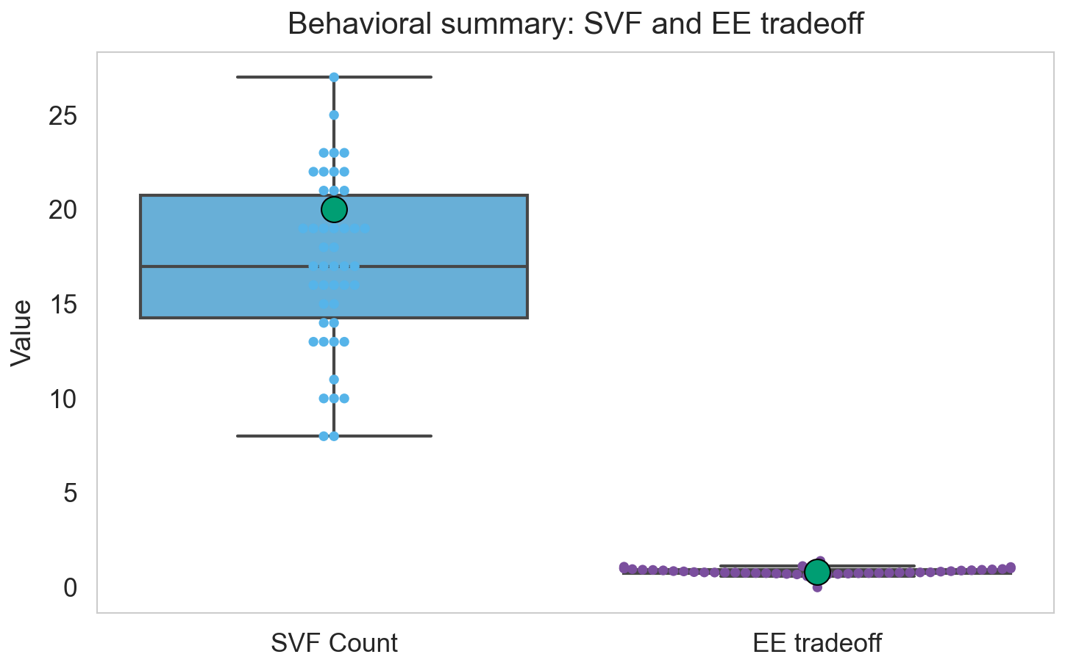
Intermediate: Svf Ee Boxswarm (.PNG)
File: output/figures/intermediate/svf_ee_boxswarm.png
Full path: /Users/diettachihade/snafu-py/research/semantic_fluency_analysis/output/figures/intermediate/svf_ee_boxswarm.png

Slide 19
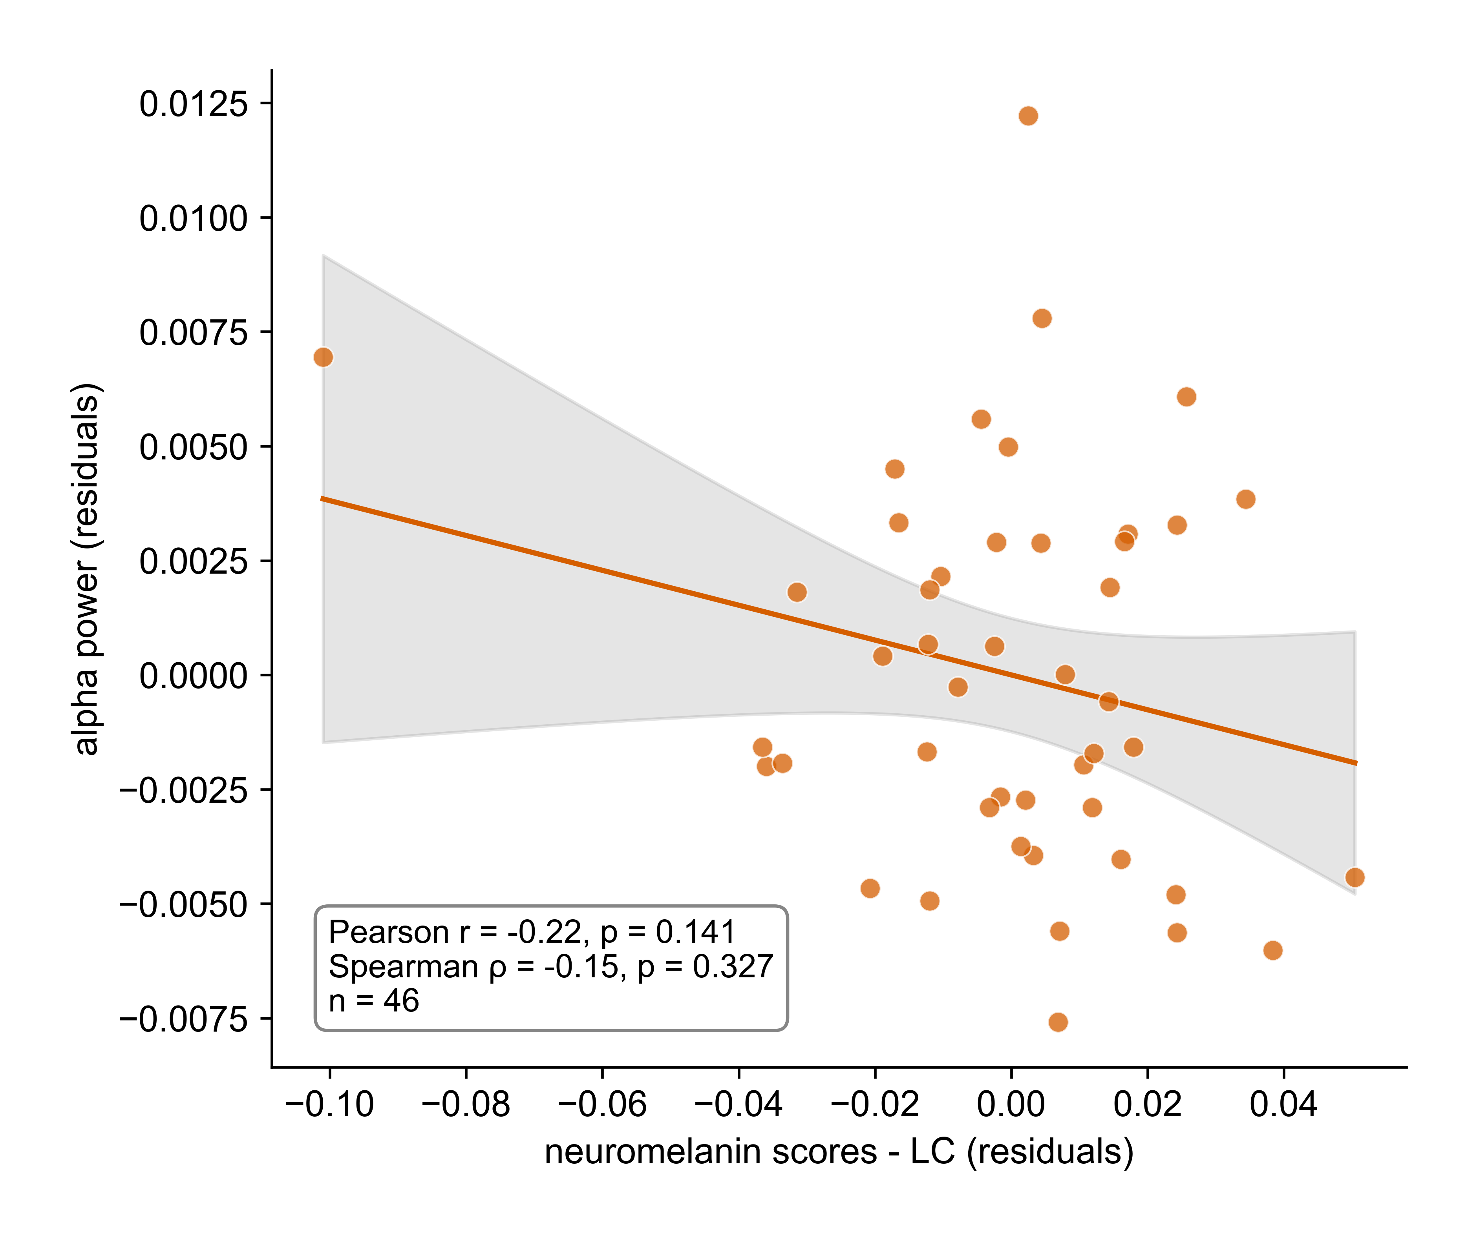
Alpha Vs Lc Residuals (.PNG)
File: output/alpha_vs_LC_residuals.png
Full path: /Users/diettachihade/snafu-py/research/semantic_fluency_analysis/output/alpha_vs_LC_residuals.png

Slide 20
Semantic Fluency Analysis (.PNG)
File: output/semantic_fluency_analysis.png
Full path: /Users/diettachihade/snafu-py/research/semantic_fluency_analysis/output/semantic_fluency_analysis.png

Slide 21
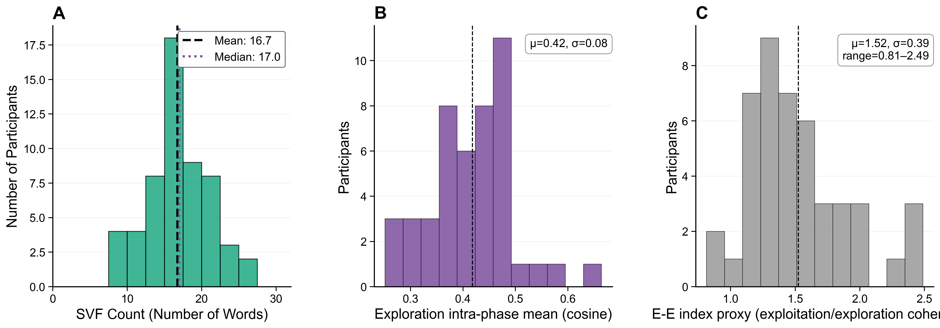
Compiled Distribution Figures (.PNG)
File: output/compiled_distribution_figures.png
Full path: /Users/diettachihade/snafu-py/research/semantic_fluency_analysis/output/compiled_distribution_figures.png

Slide 22
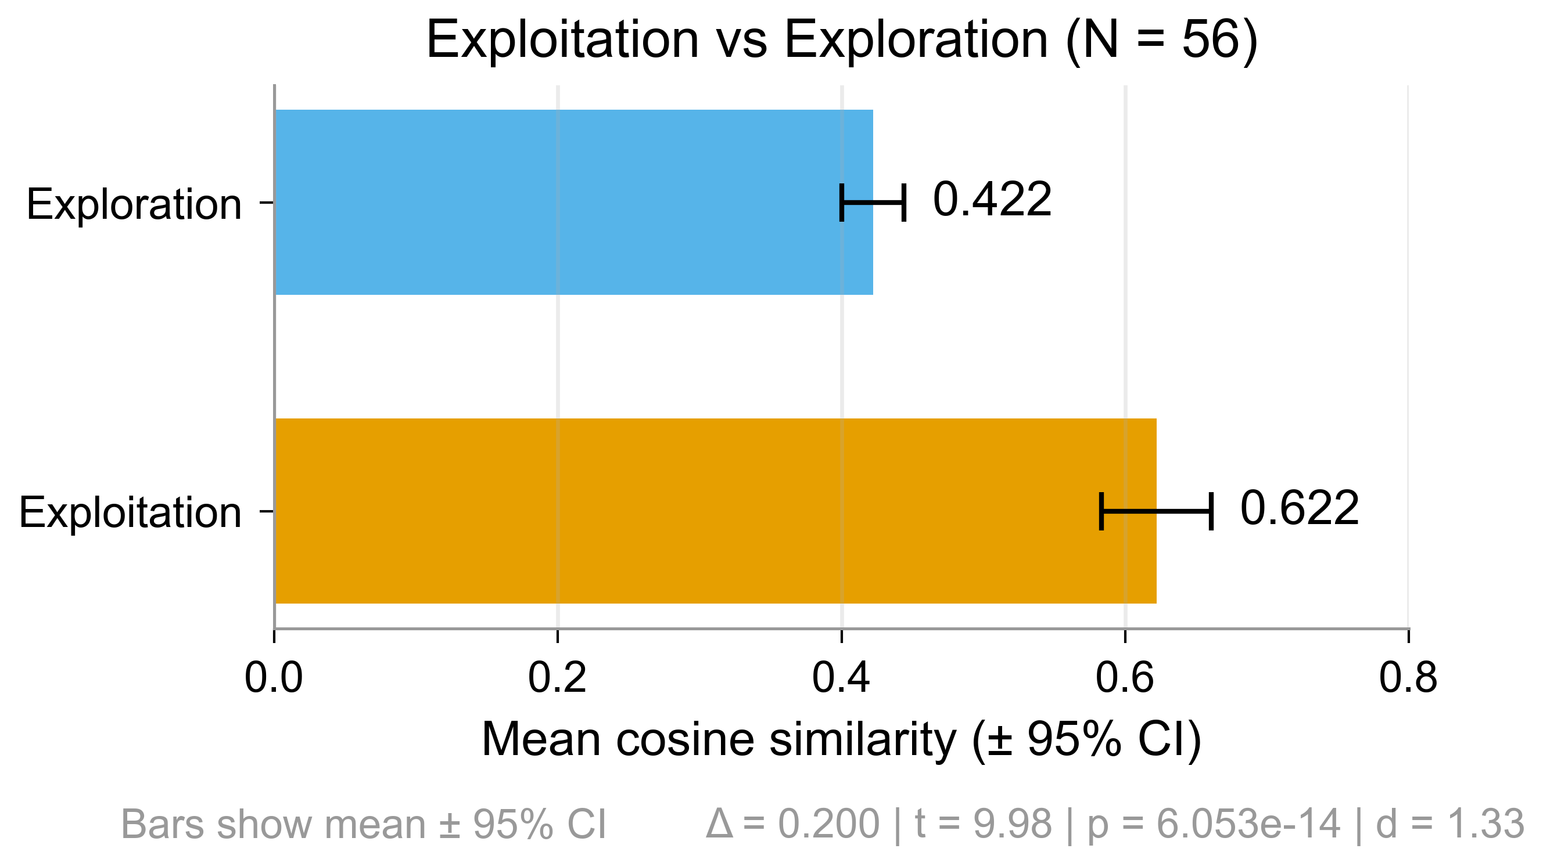
Exploit Explore Bar (.PNG)
File: output/exploit_explore_bar.png
Full path: /Users/diettachihade/snafu-py/research/semantic_fluency_analysis/output/exploit_explore_bar.png

Slide 23
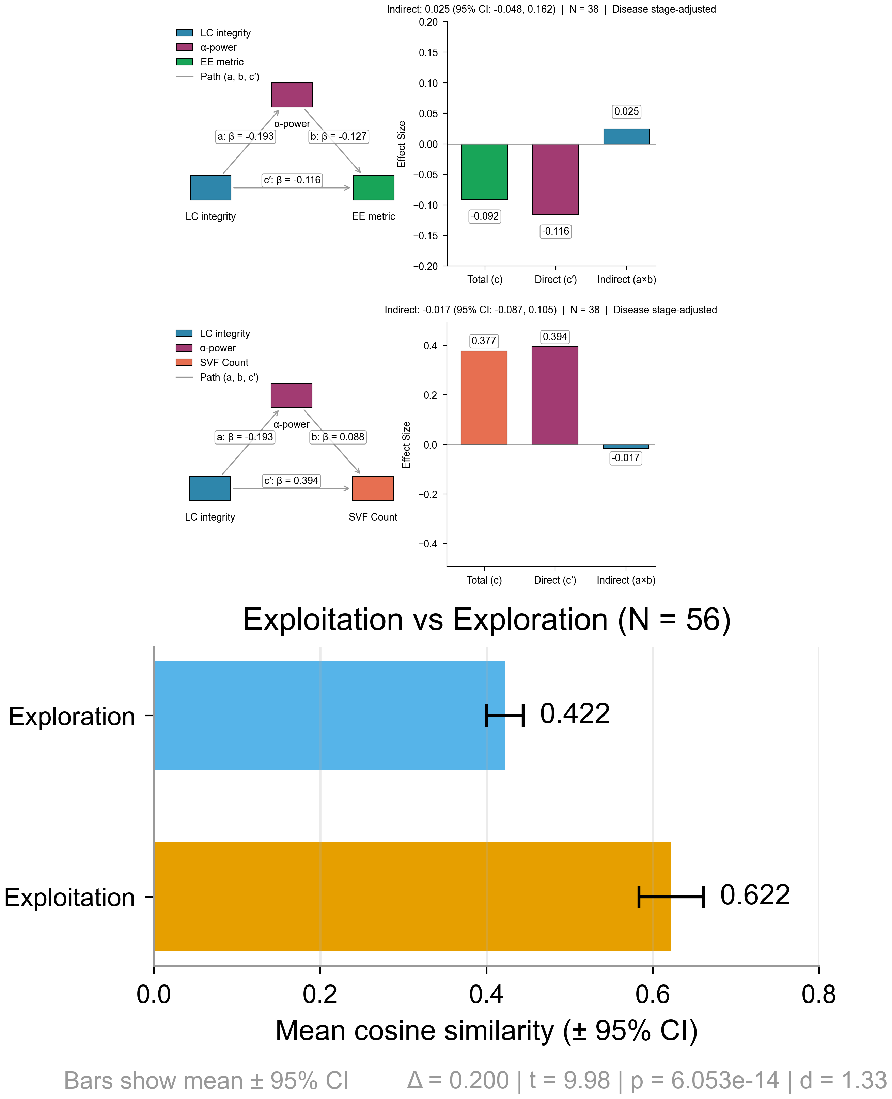
Combined Mediation Exploit Panels (.PNG)
File: output/combined_mediation_exploit_panels.png
Full path: /Users/diettachihade/snafu-py/research/semantic_fluency_analysis/output/combined_mediation_exploit_panels.png

Slide 24
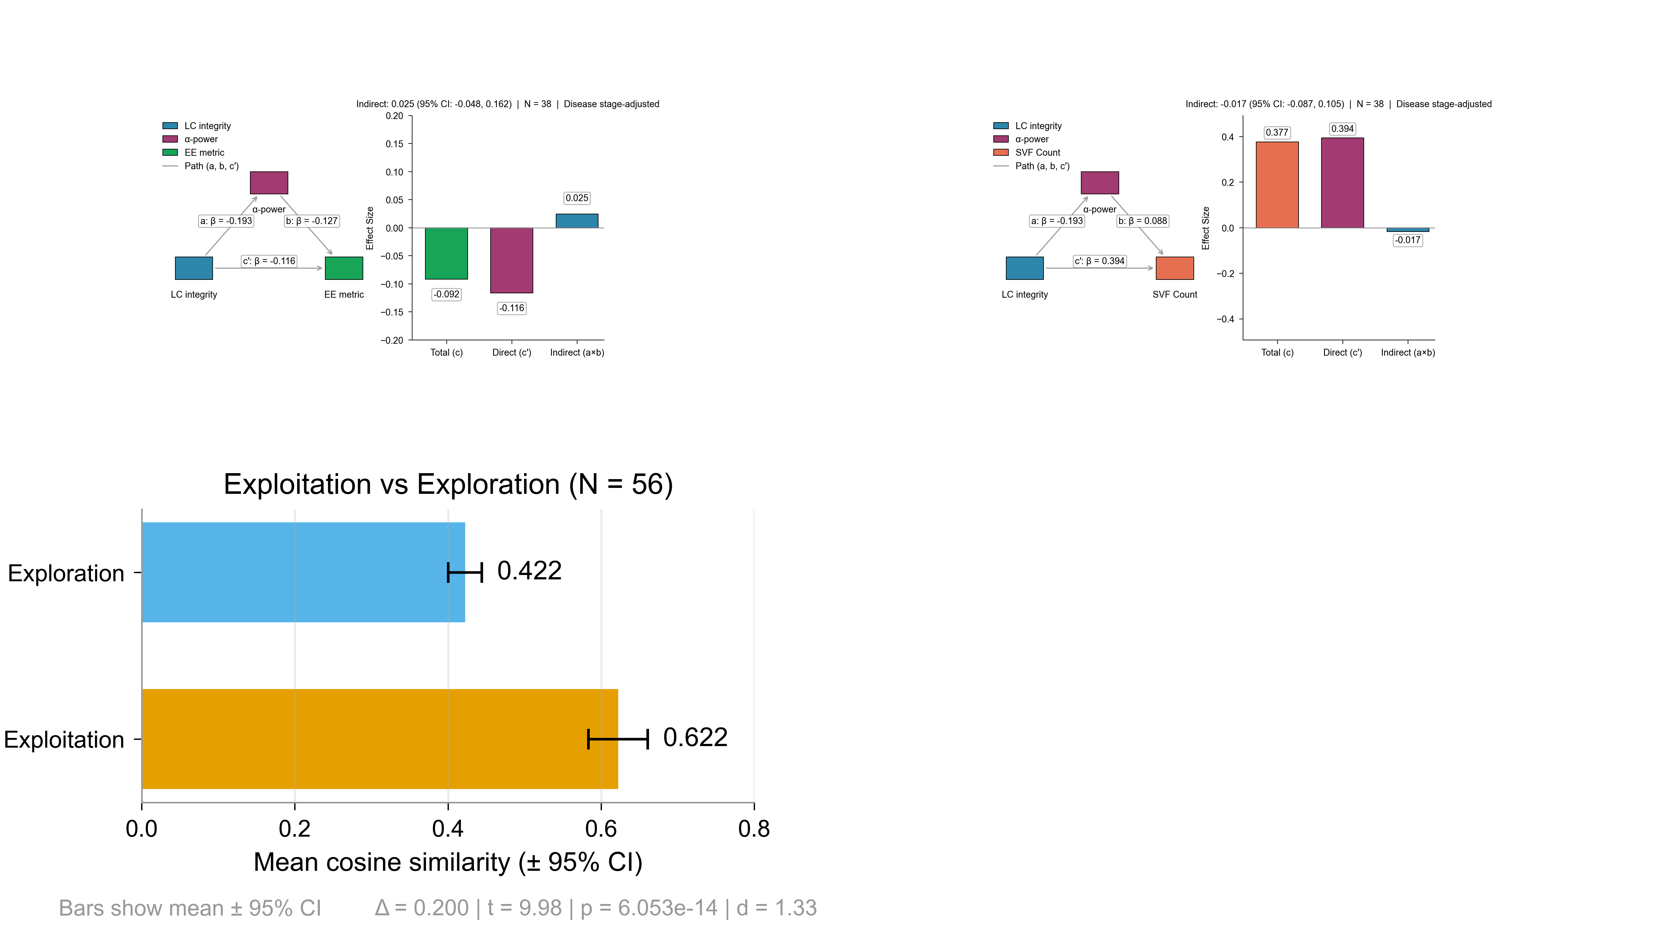
Test Grid Panels (.PNG)
File: output/test_grid_panels.png
Full path: /Users/diettachihade/snafu-py/research/semantic_fluency_analysis/output/test_grid_panels.png

Slide 25
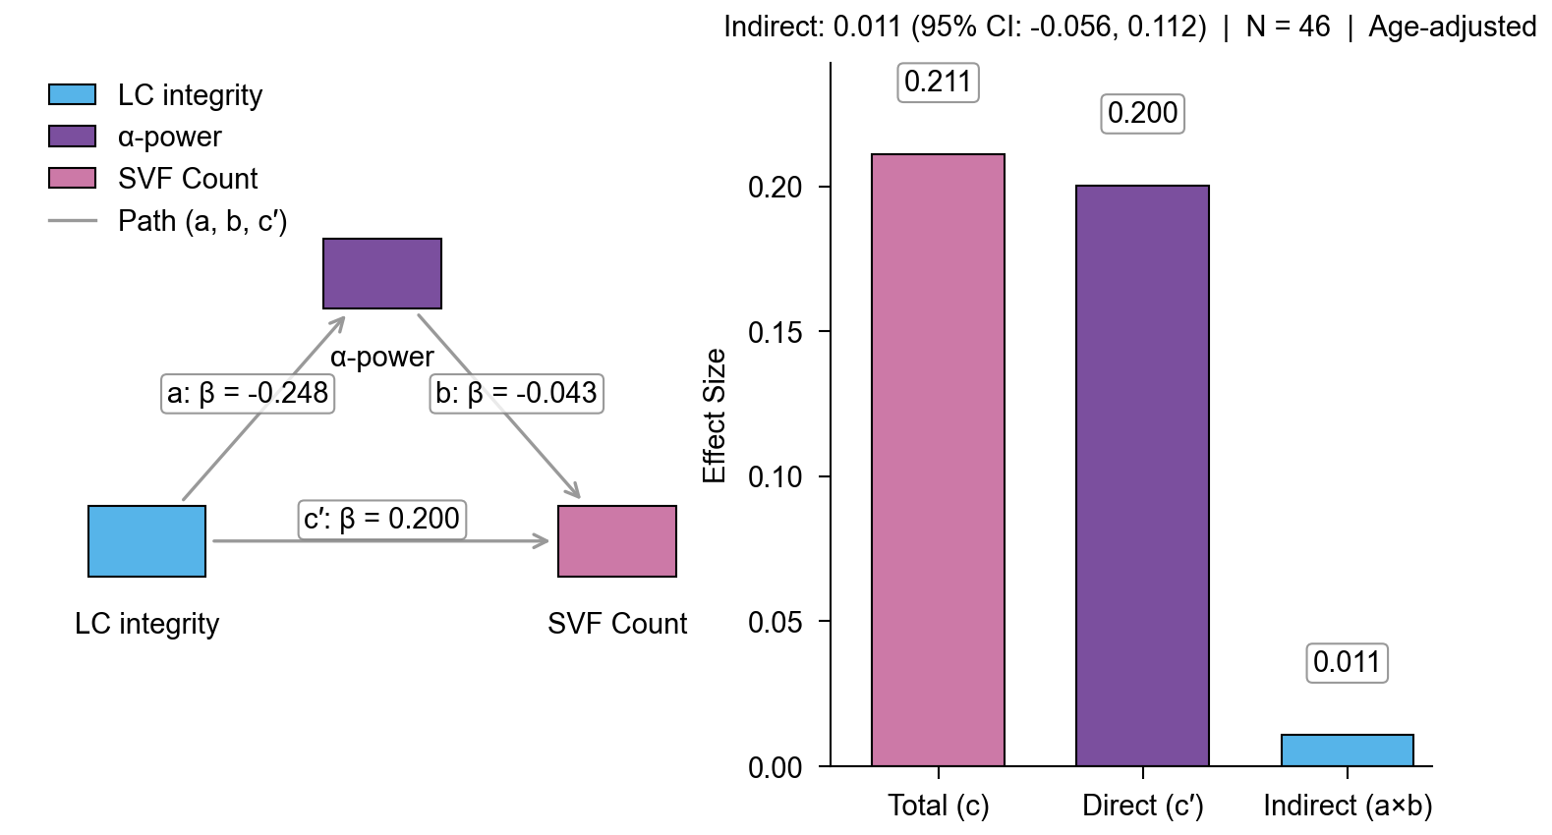
Mediation Svf Age Nature (.PNG)
File: output/mediation_svf_age_nature.png
Full path: /Users/diettachihade/snafu-py/research/semantic_fluency_analysis/output/mediation_svf_age_nature.png

Slide 26
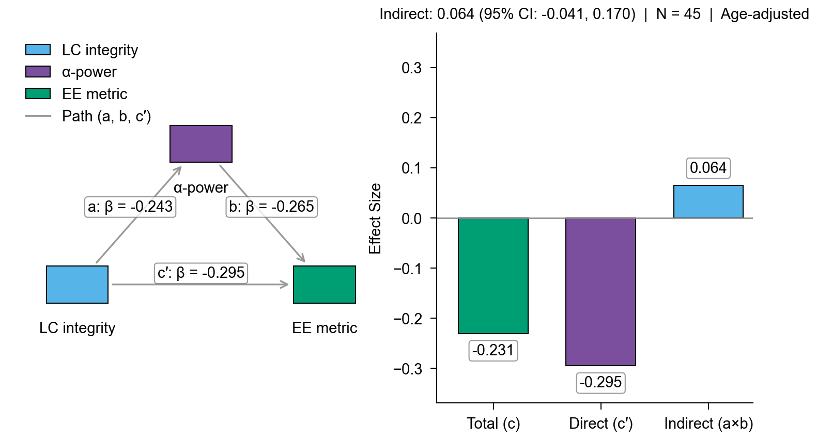
Mediation Exploit Age Nature (.PNG)
File: output/mediation_exploit_age_nature.png
Full path: /Users/diettachihade/snafu-py/research/semantic_fluency_analysis/output/mediation_exploit_age_nature.png

Slide 27
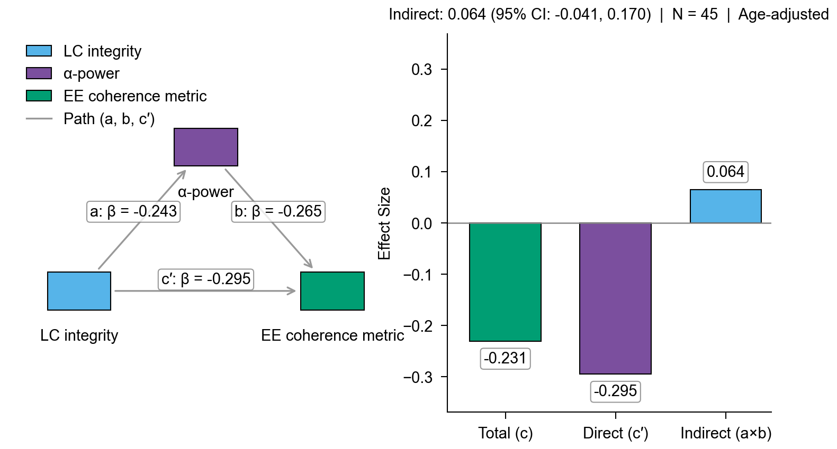
Mediation Exploit Coherence Metric Nature (.PNG)
File: output/mediation_exploit_coherence_metric_nature.png
Full path: /Users/diettachihade/snafu-py/research/semantic_fluency_analysis/output/mediation_exploit_coherence_metric_nature.png

Slide 28
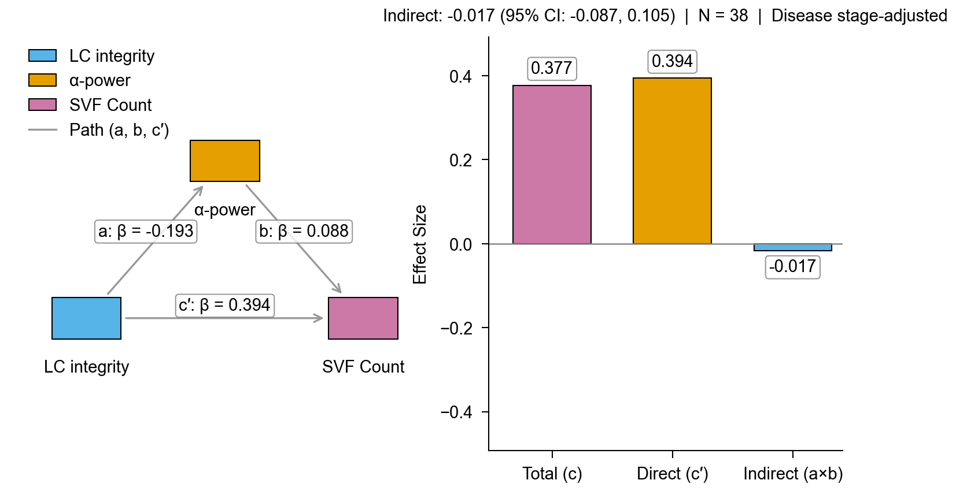
Mediation Svf Disease Stage Working (.PNG)
File: output/mediation_svf_disease_stage_working.png
Full path: /Users/diettachihade/snafu-py/research/semantic_fluency_analysis/output/mediation_svf_disease_stage_working.png

Slide 29
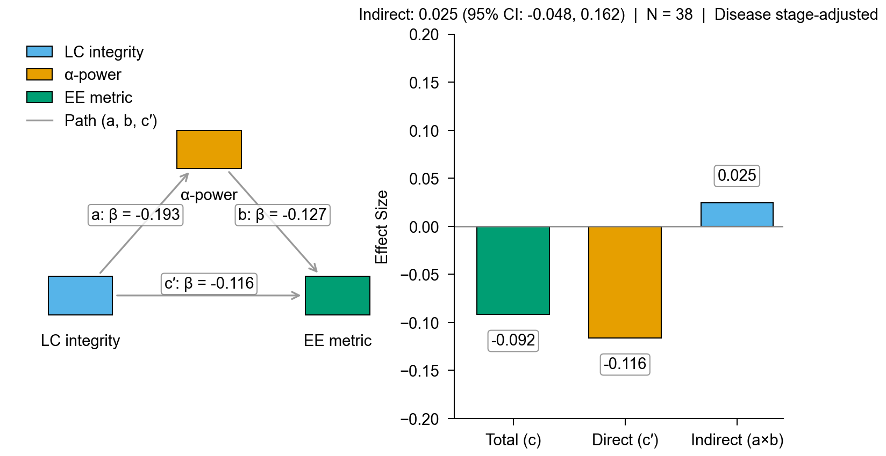
Mediation Ee Disease Stage Working (.PNG)
File: output/mediation_ee_disease_stage_working.png
Full path: /Users/diettachihade/snafu-py/research/semantic_fluency_analysis/output/mediation_ee_disease_stage_working.png

Slide 30
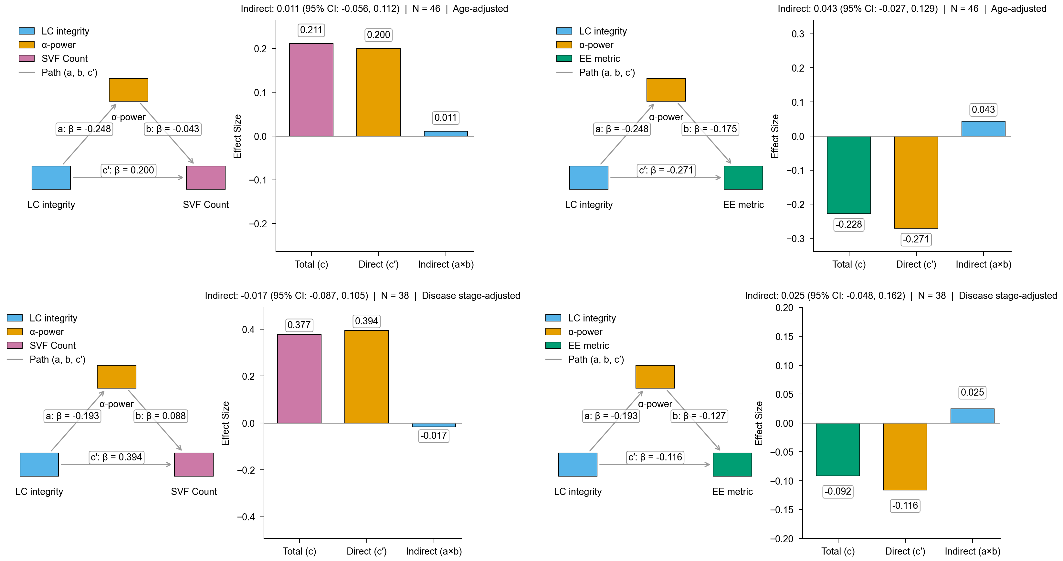
Mediation Age Vs Disease (.PNG)
File: output/mediation_age_vs_disease.png
Full path: /Users/diettachihade/snafu-py/research/semantic_fluency_analysis/output/mediation_age_vs_disease.png

Slide 31
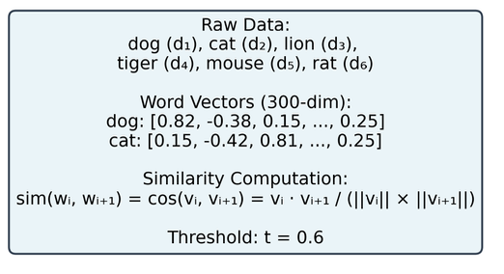
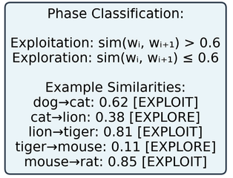
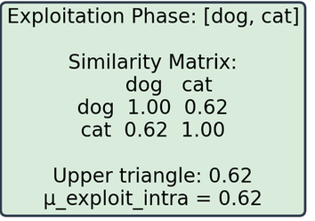
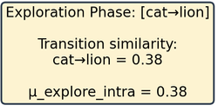
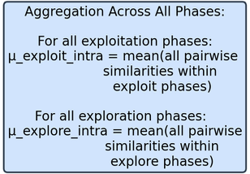
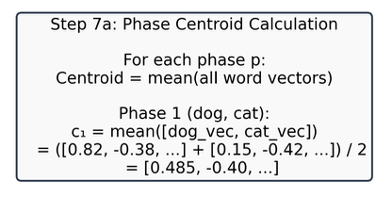
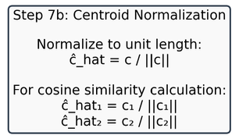
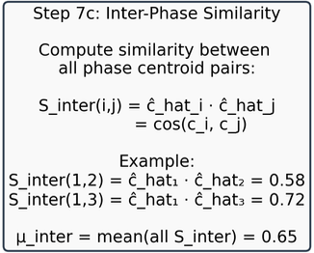
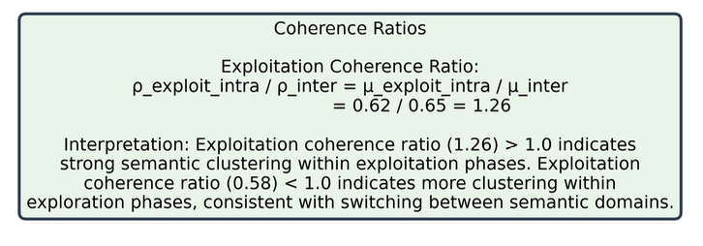
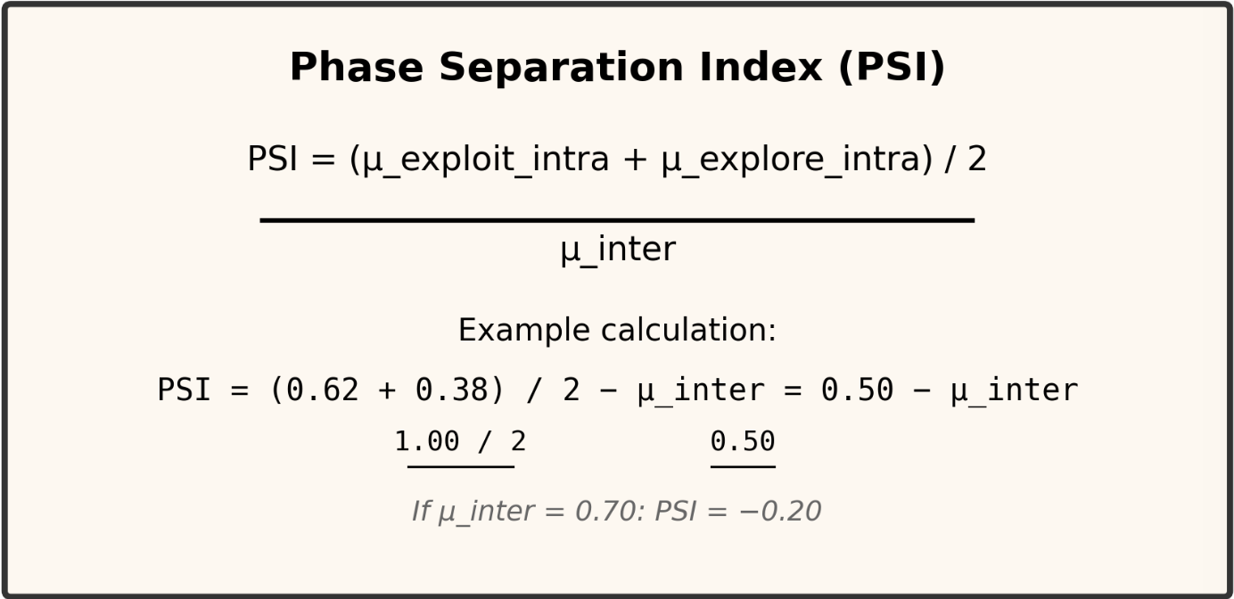
Step 1-5 Data Processing and Phase Detection
Step 6: Intra Phase Similarity Computation
Step 7: Inter-phase Similarity Computation
Step 8: Coherence ratio and Final metrics

