Slide 1
Semantic Fluency Analysis
All Figures - All Formats
(SVG, PNG, PDF)
Excluding Zero Values (N=45)

Slide 2
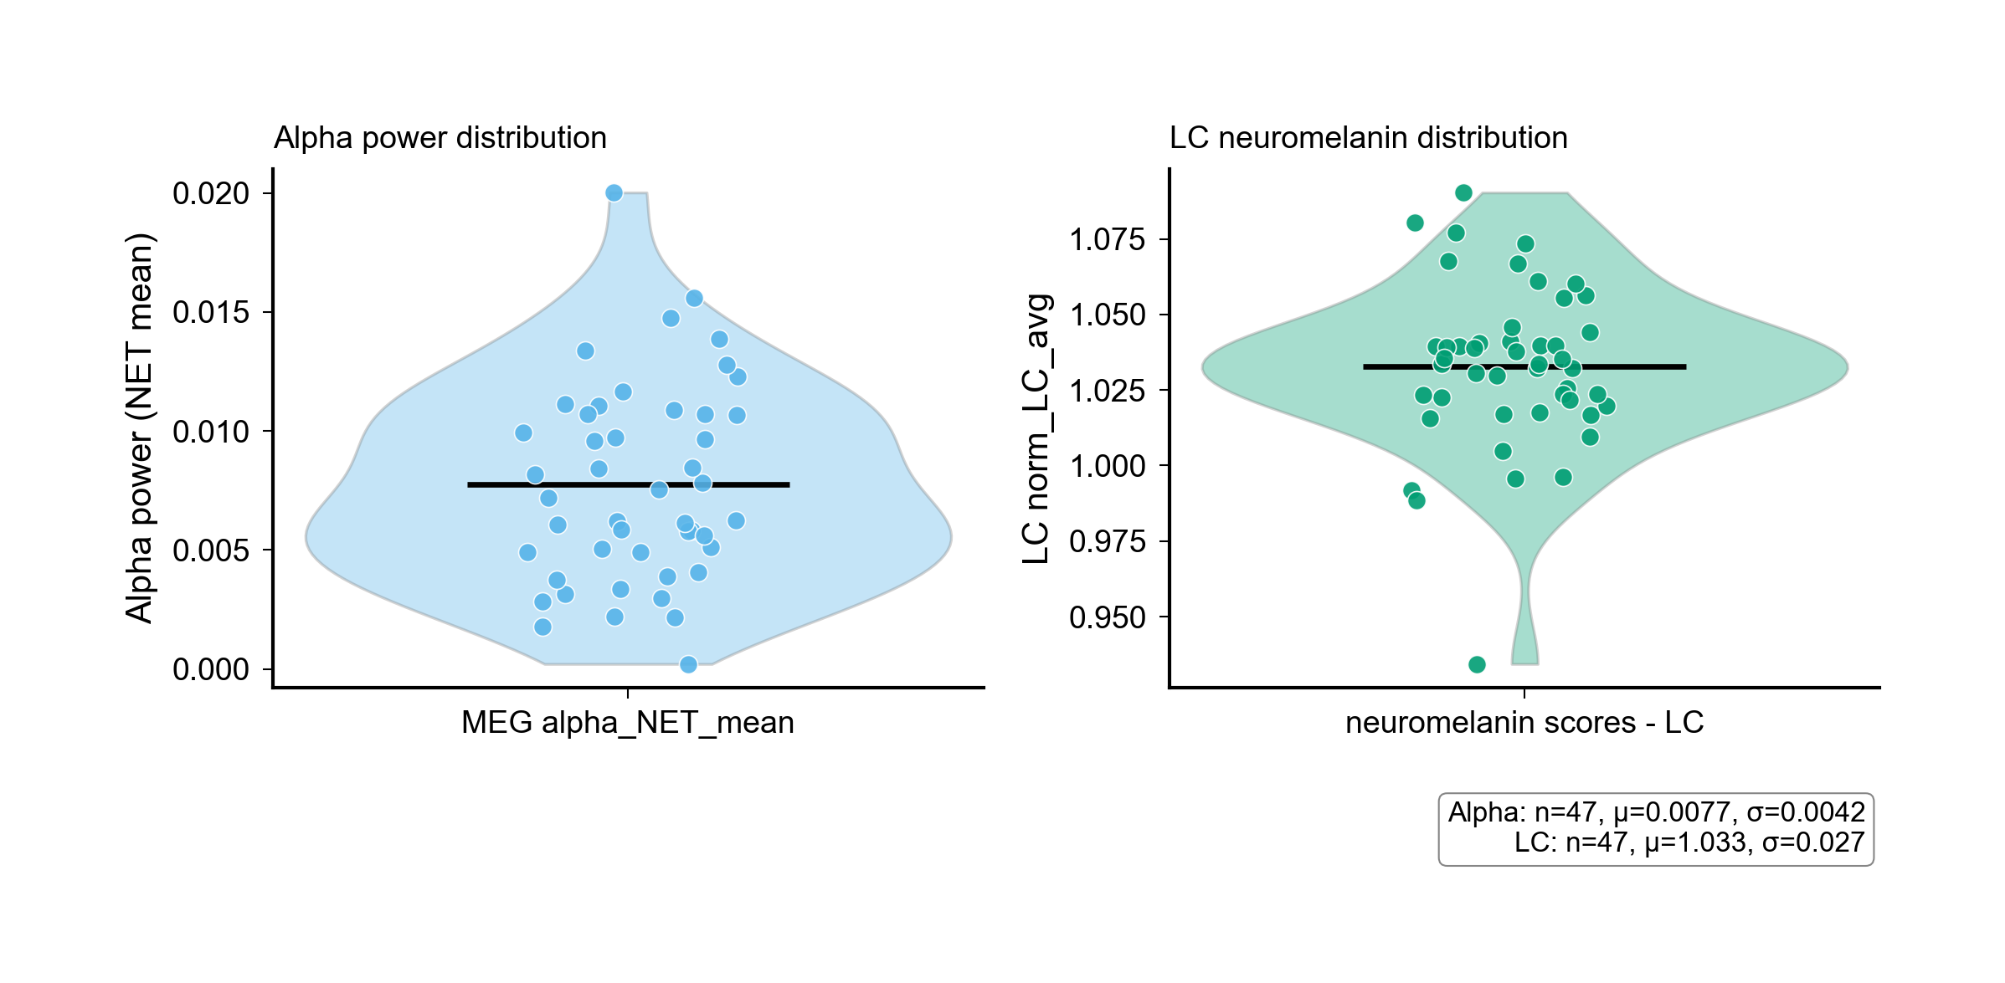
Figure0 Alpha Violin Swarm (.PNG)
output/NATURE_REAL_figure0_alpha_violin_swarm.png

Slide 4
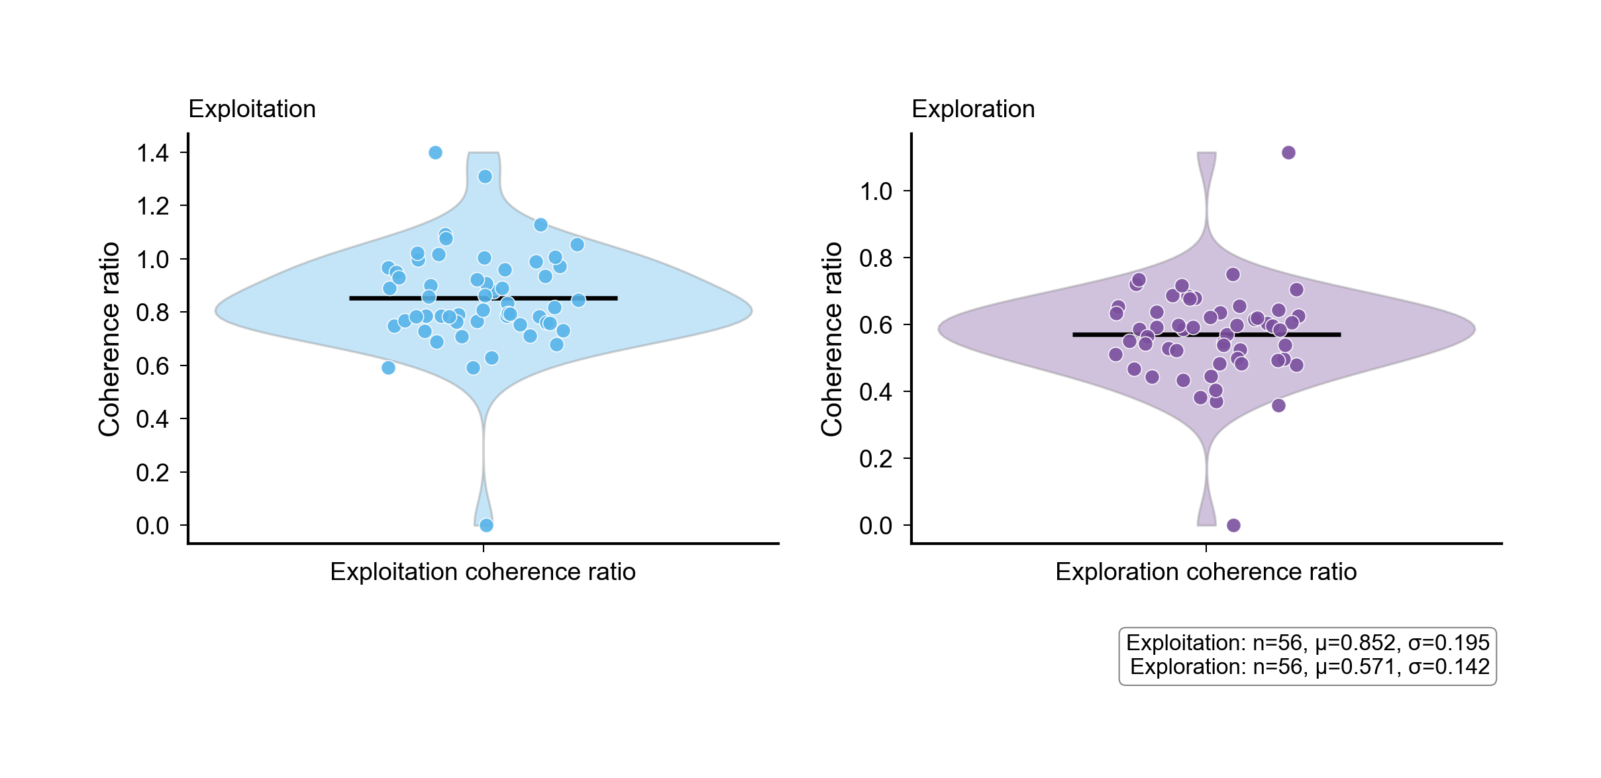
Figure0B Coherence Violin Swarm (.PNG)
output/NATURE_REAL_figure0b_coherence_violin_swarm.png

Slide 6
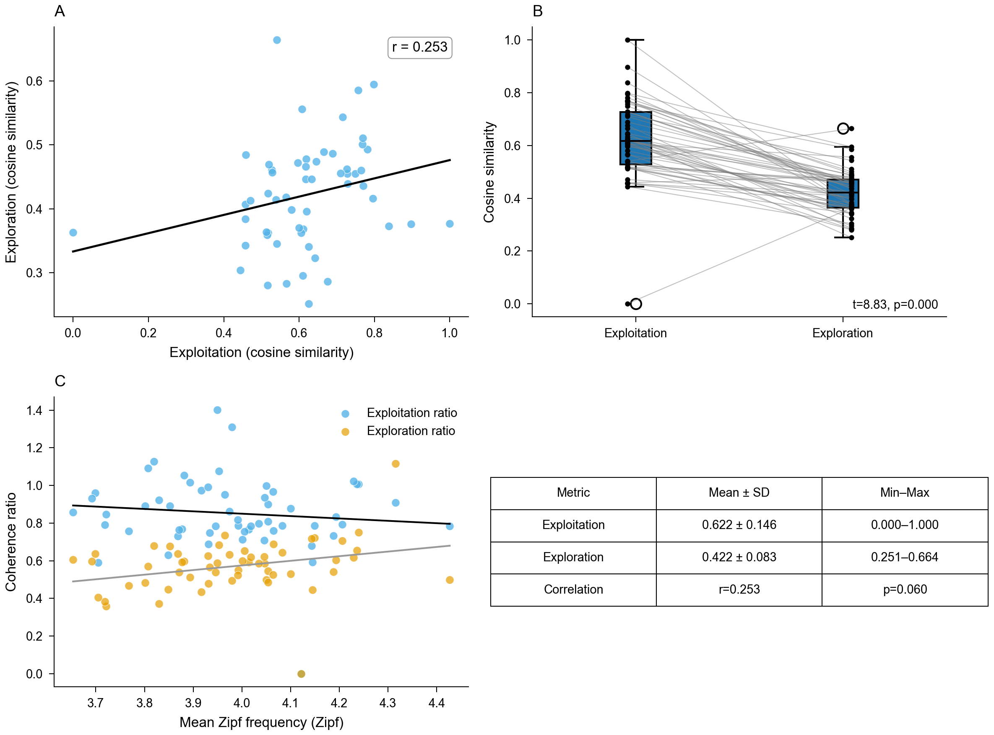
Figure1 Exploration Exploitation (.PNG)
output/NATURE_REAL_figure1_exploration_exploitation.png

Slide 8
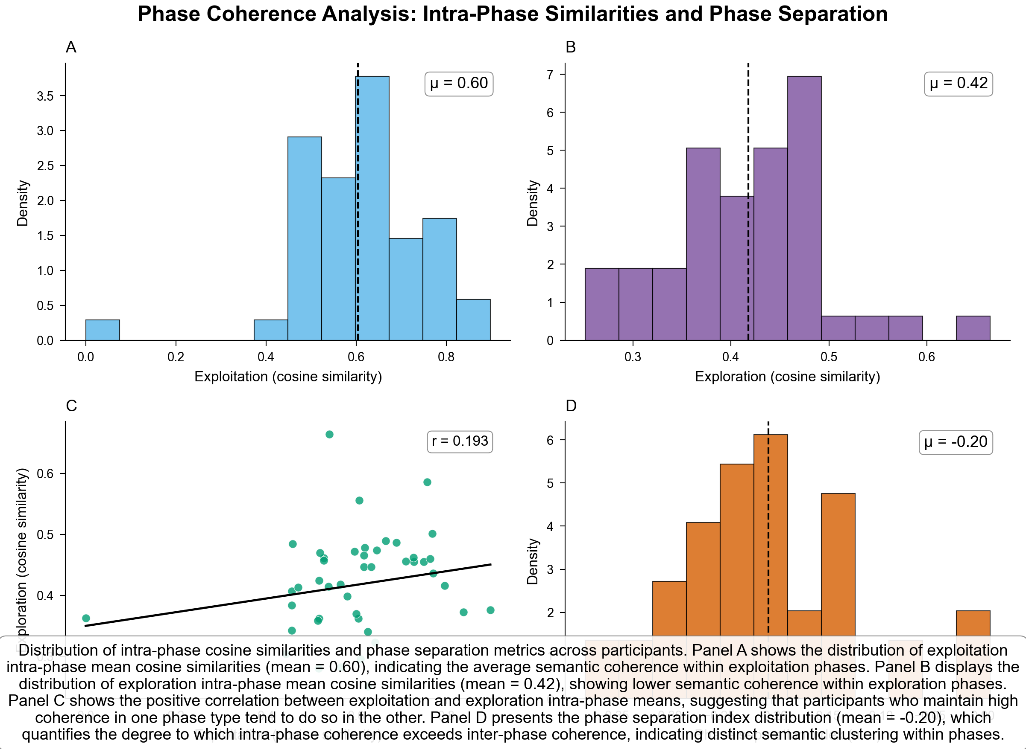
Figure2 Phase Coherence (.PNG)
output/NATURE_REAL_figure2_phase_coherence.png

Slide 10
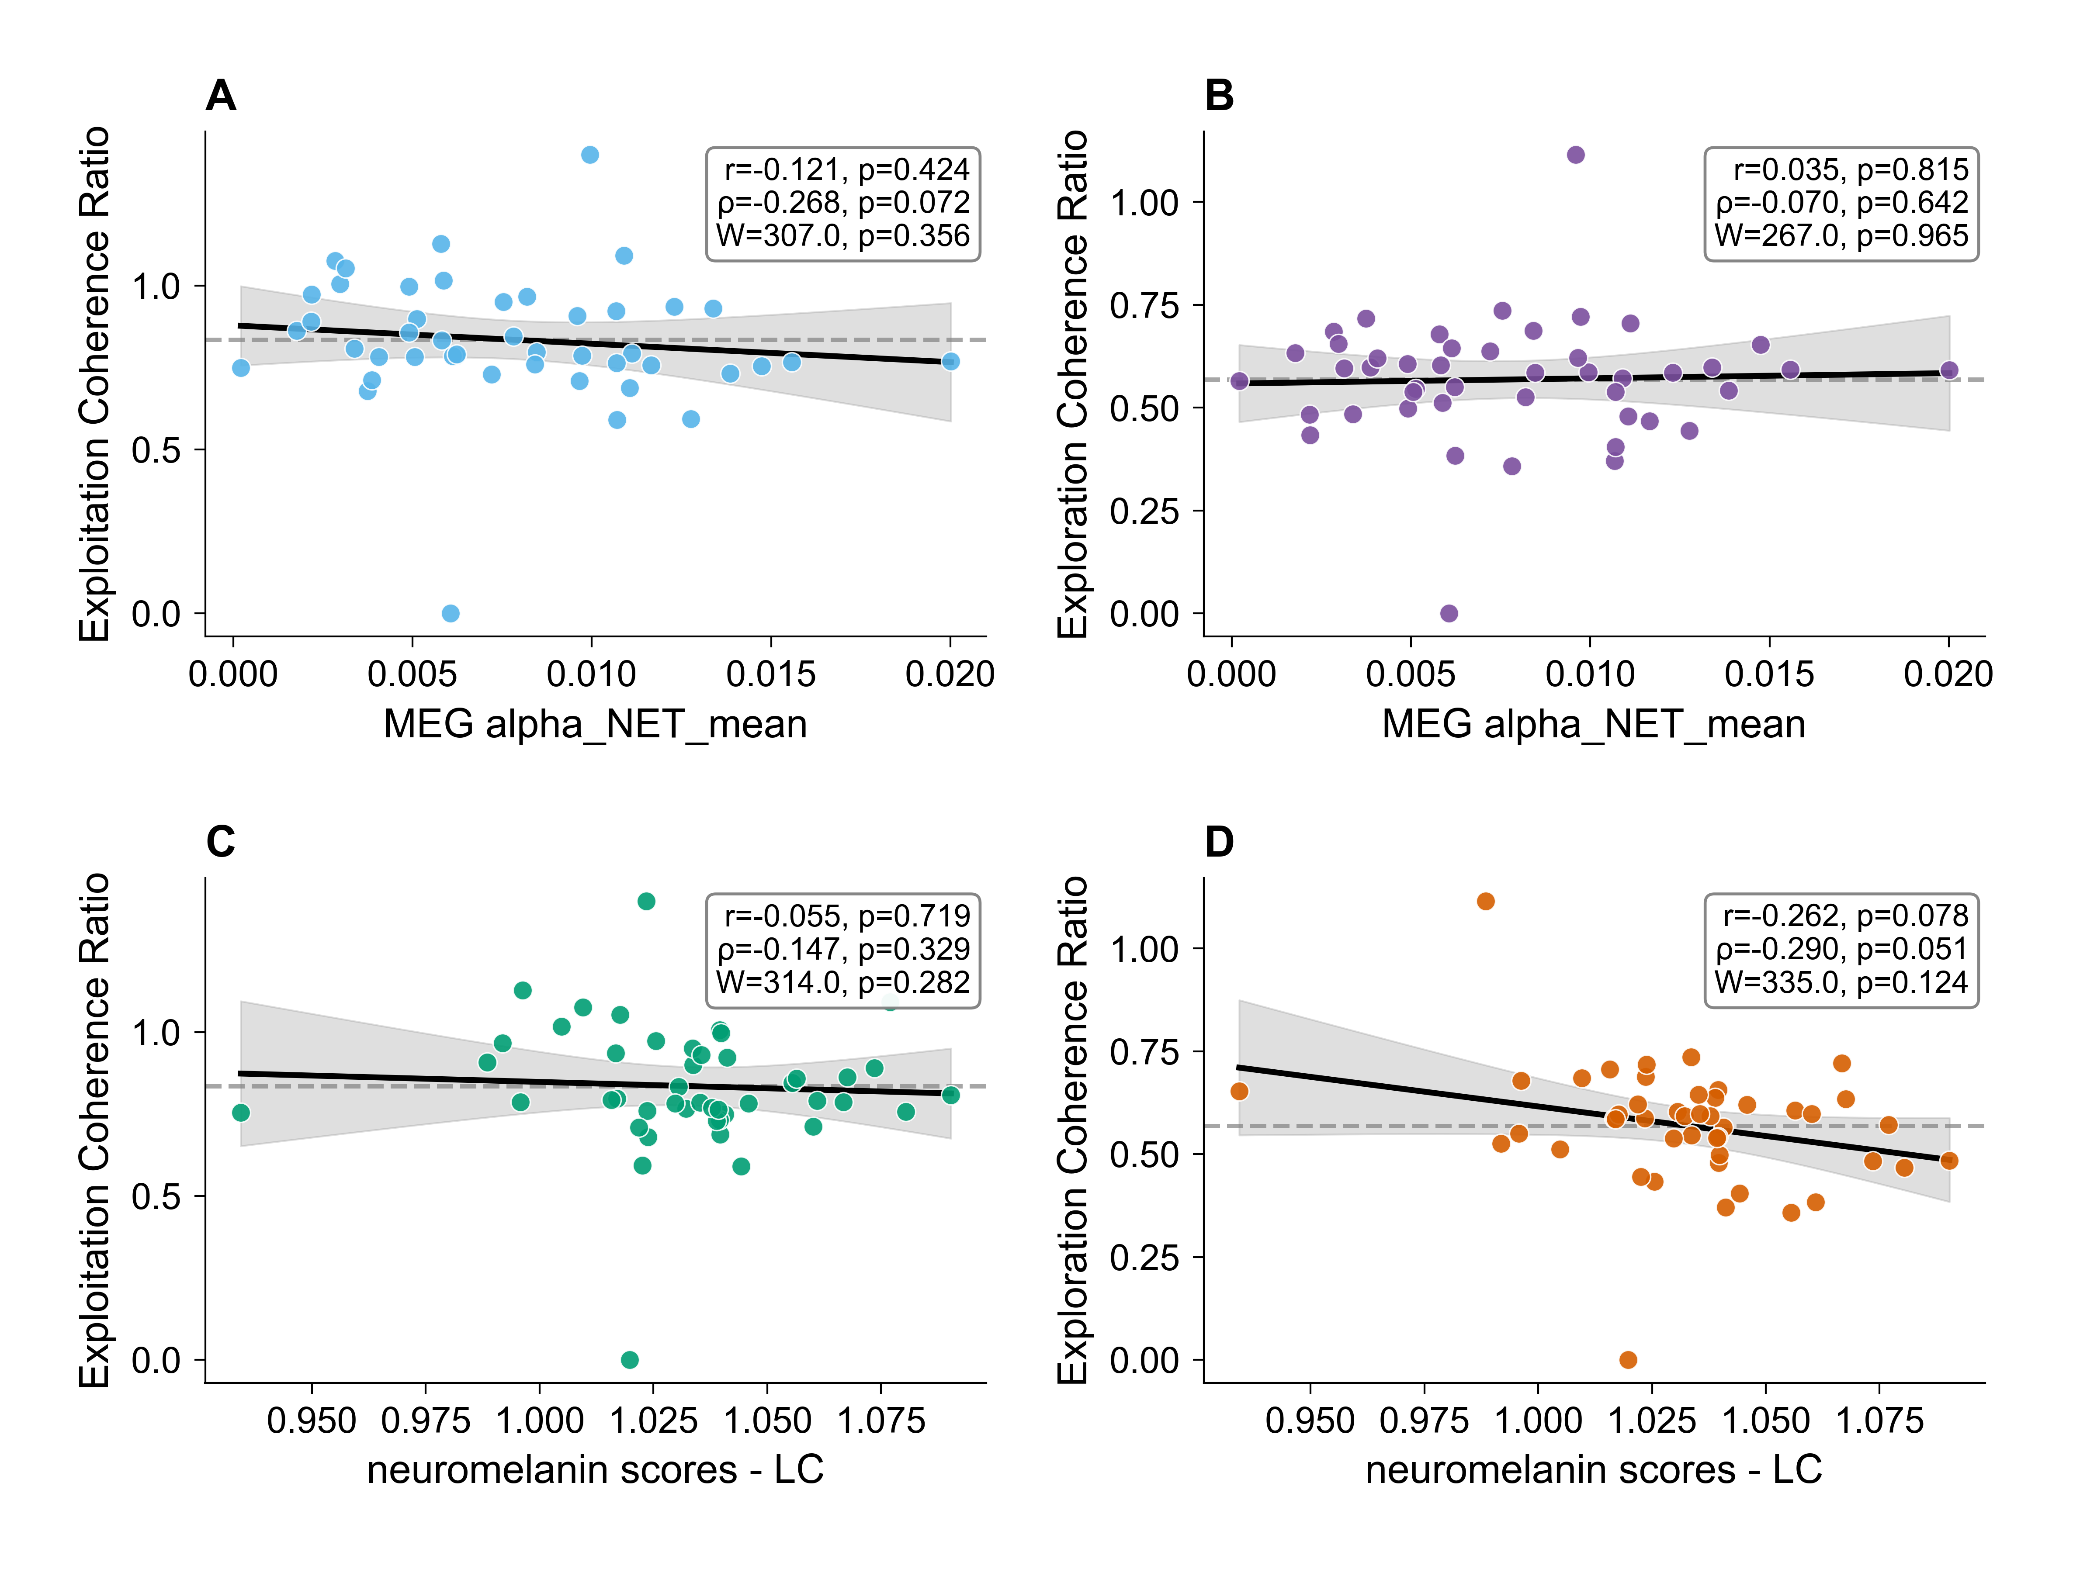
Figure3 Meg Correlations (.PNG)
output/NATURE_REAL_figure3_meg_correlations.png

Slide 12
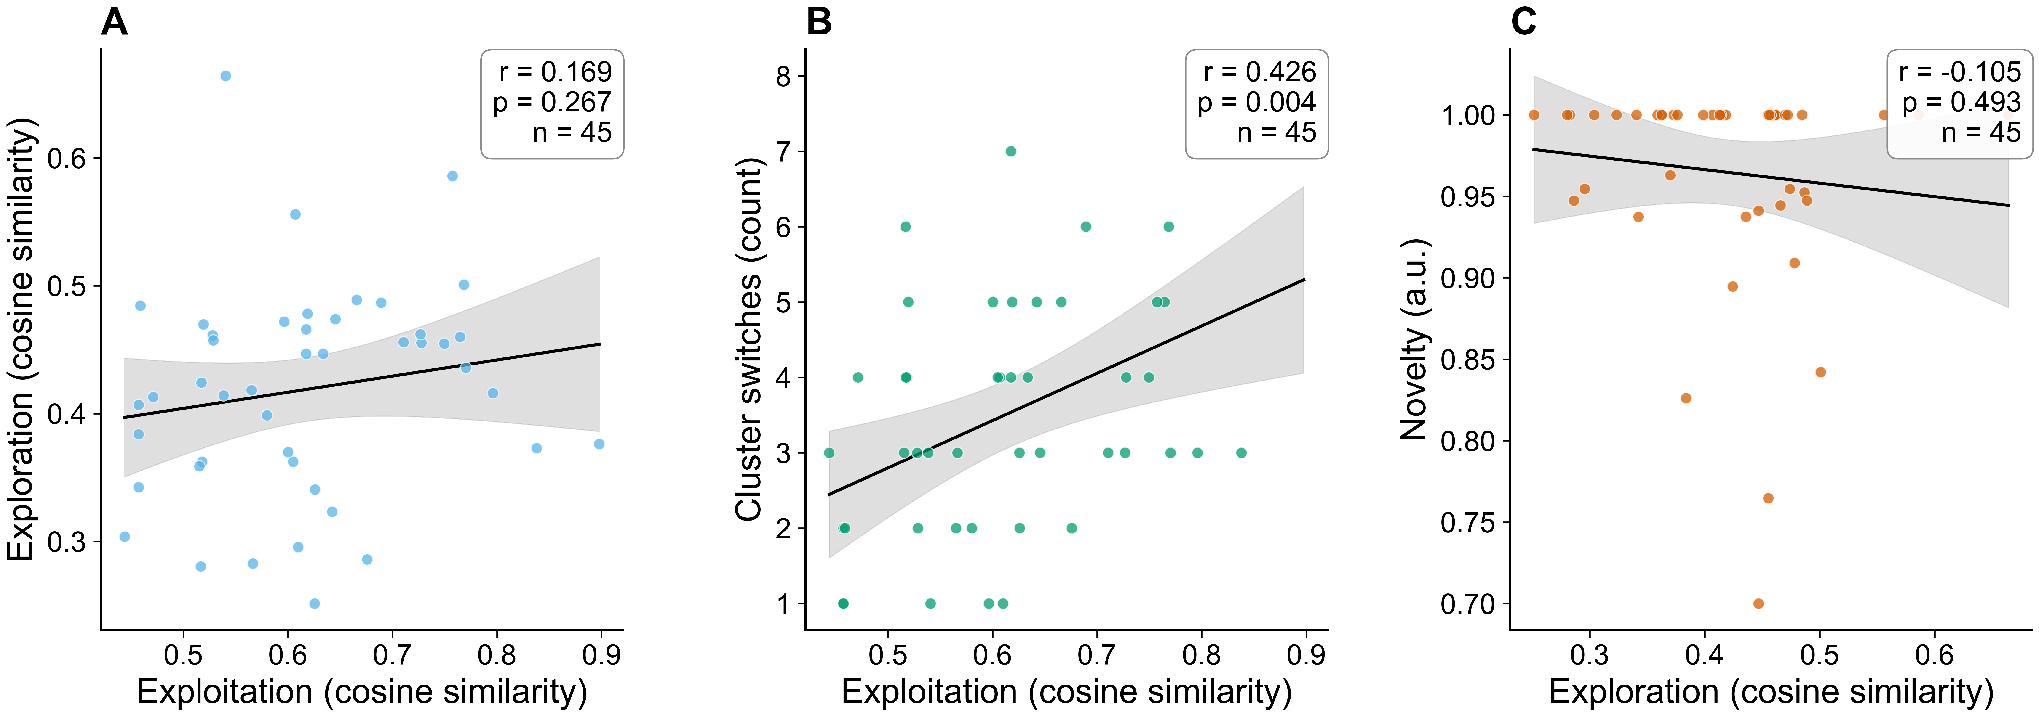
Figure4 Comprehensive (.PNG)
output/NATURE_REAL_figure4_comprehensive.png

Slide 15
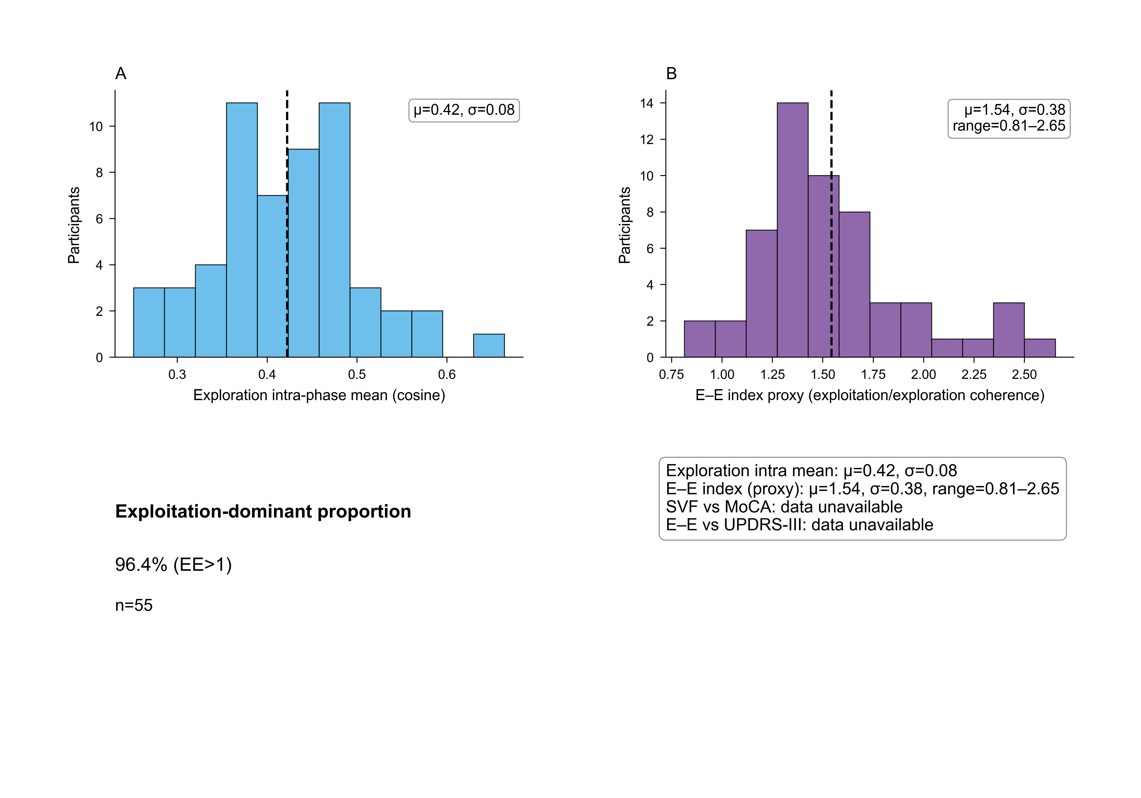
Behavior Performance (.PNG)
output/NATURE_REAL_behavior_performance.png

Slide 17
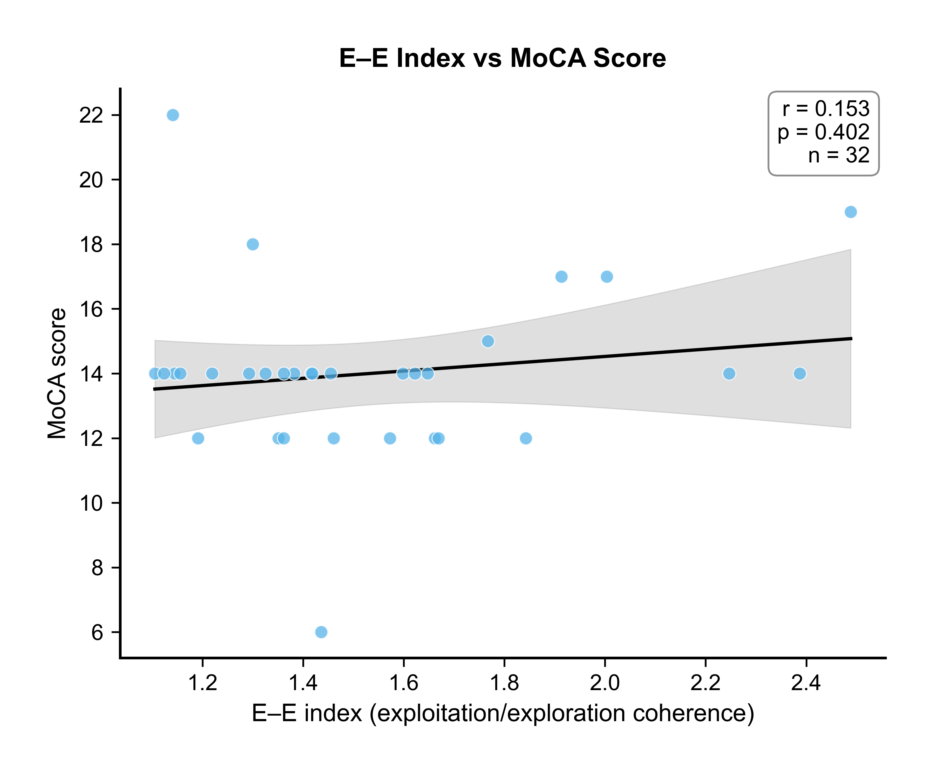
Ee Vs Moca (.PNG)
output/NATURE_REAL_ee_vs_moca.png

Slide 19
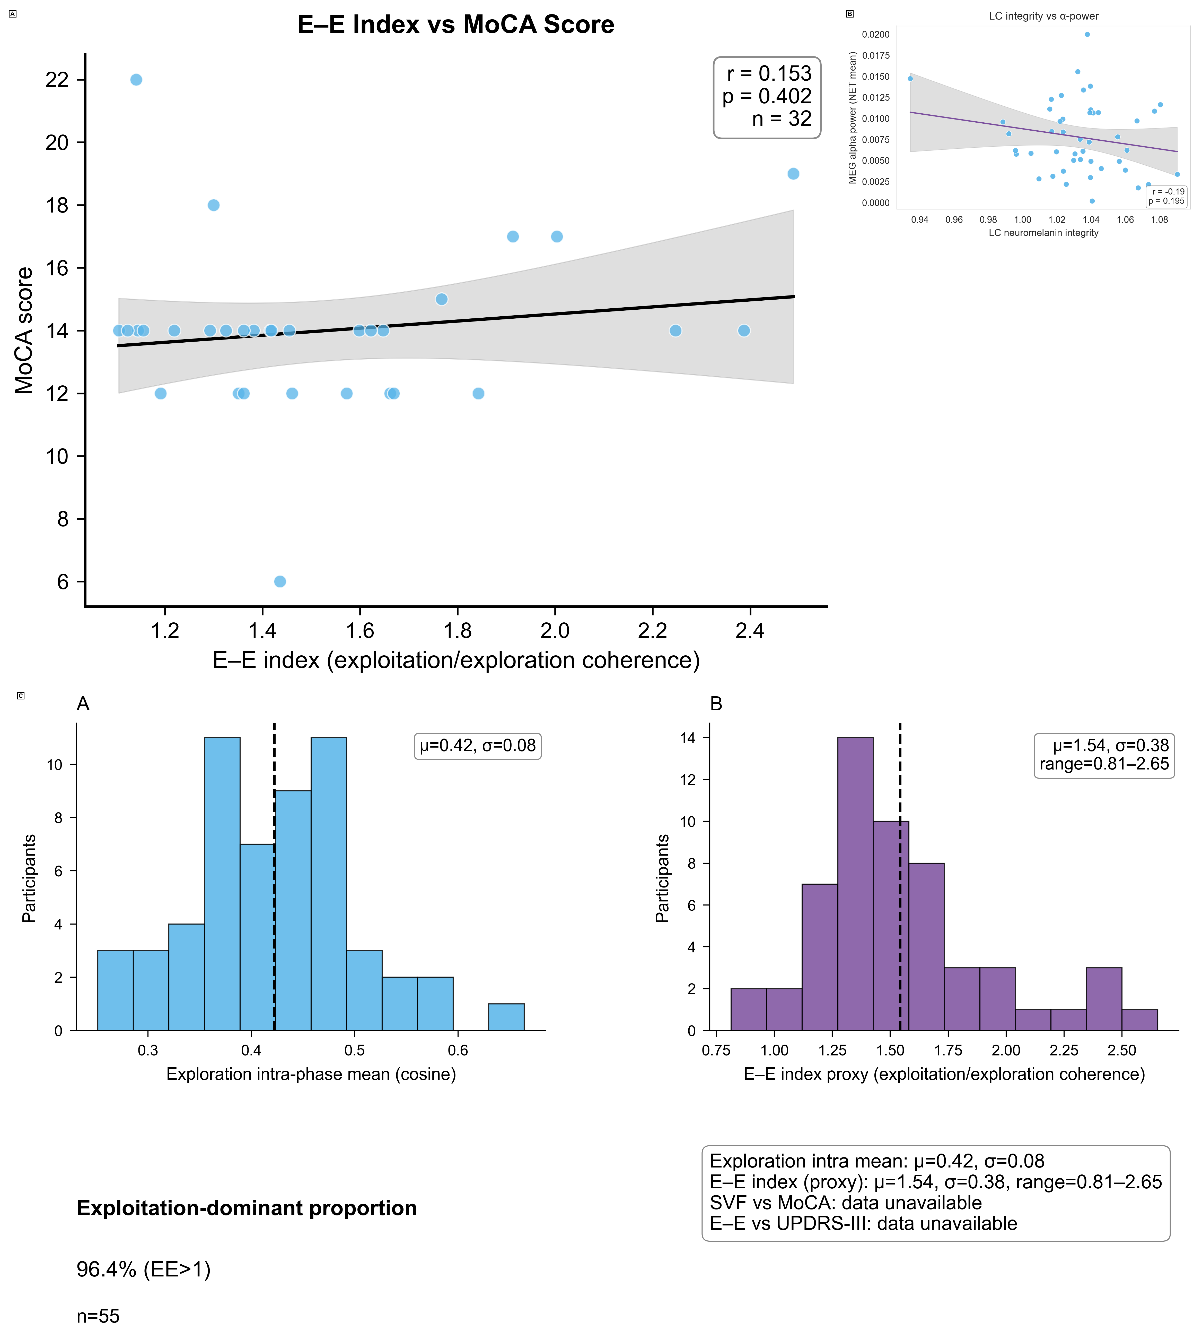
Compiled Results (.PNG)
output/NATURE_REAL_compiled_results.png

Slide 21
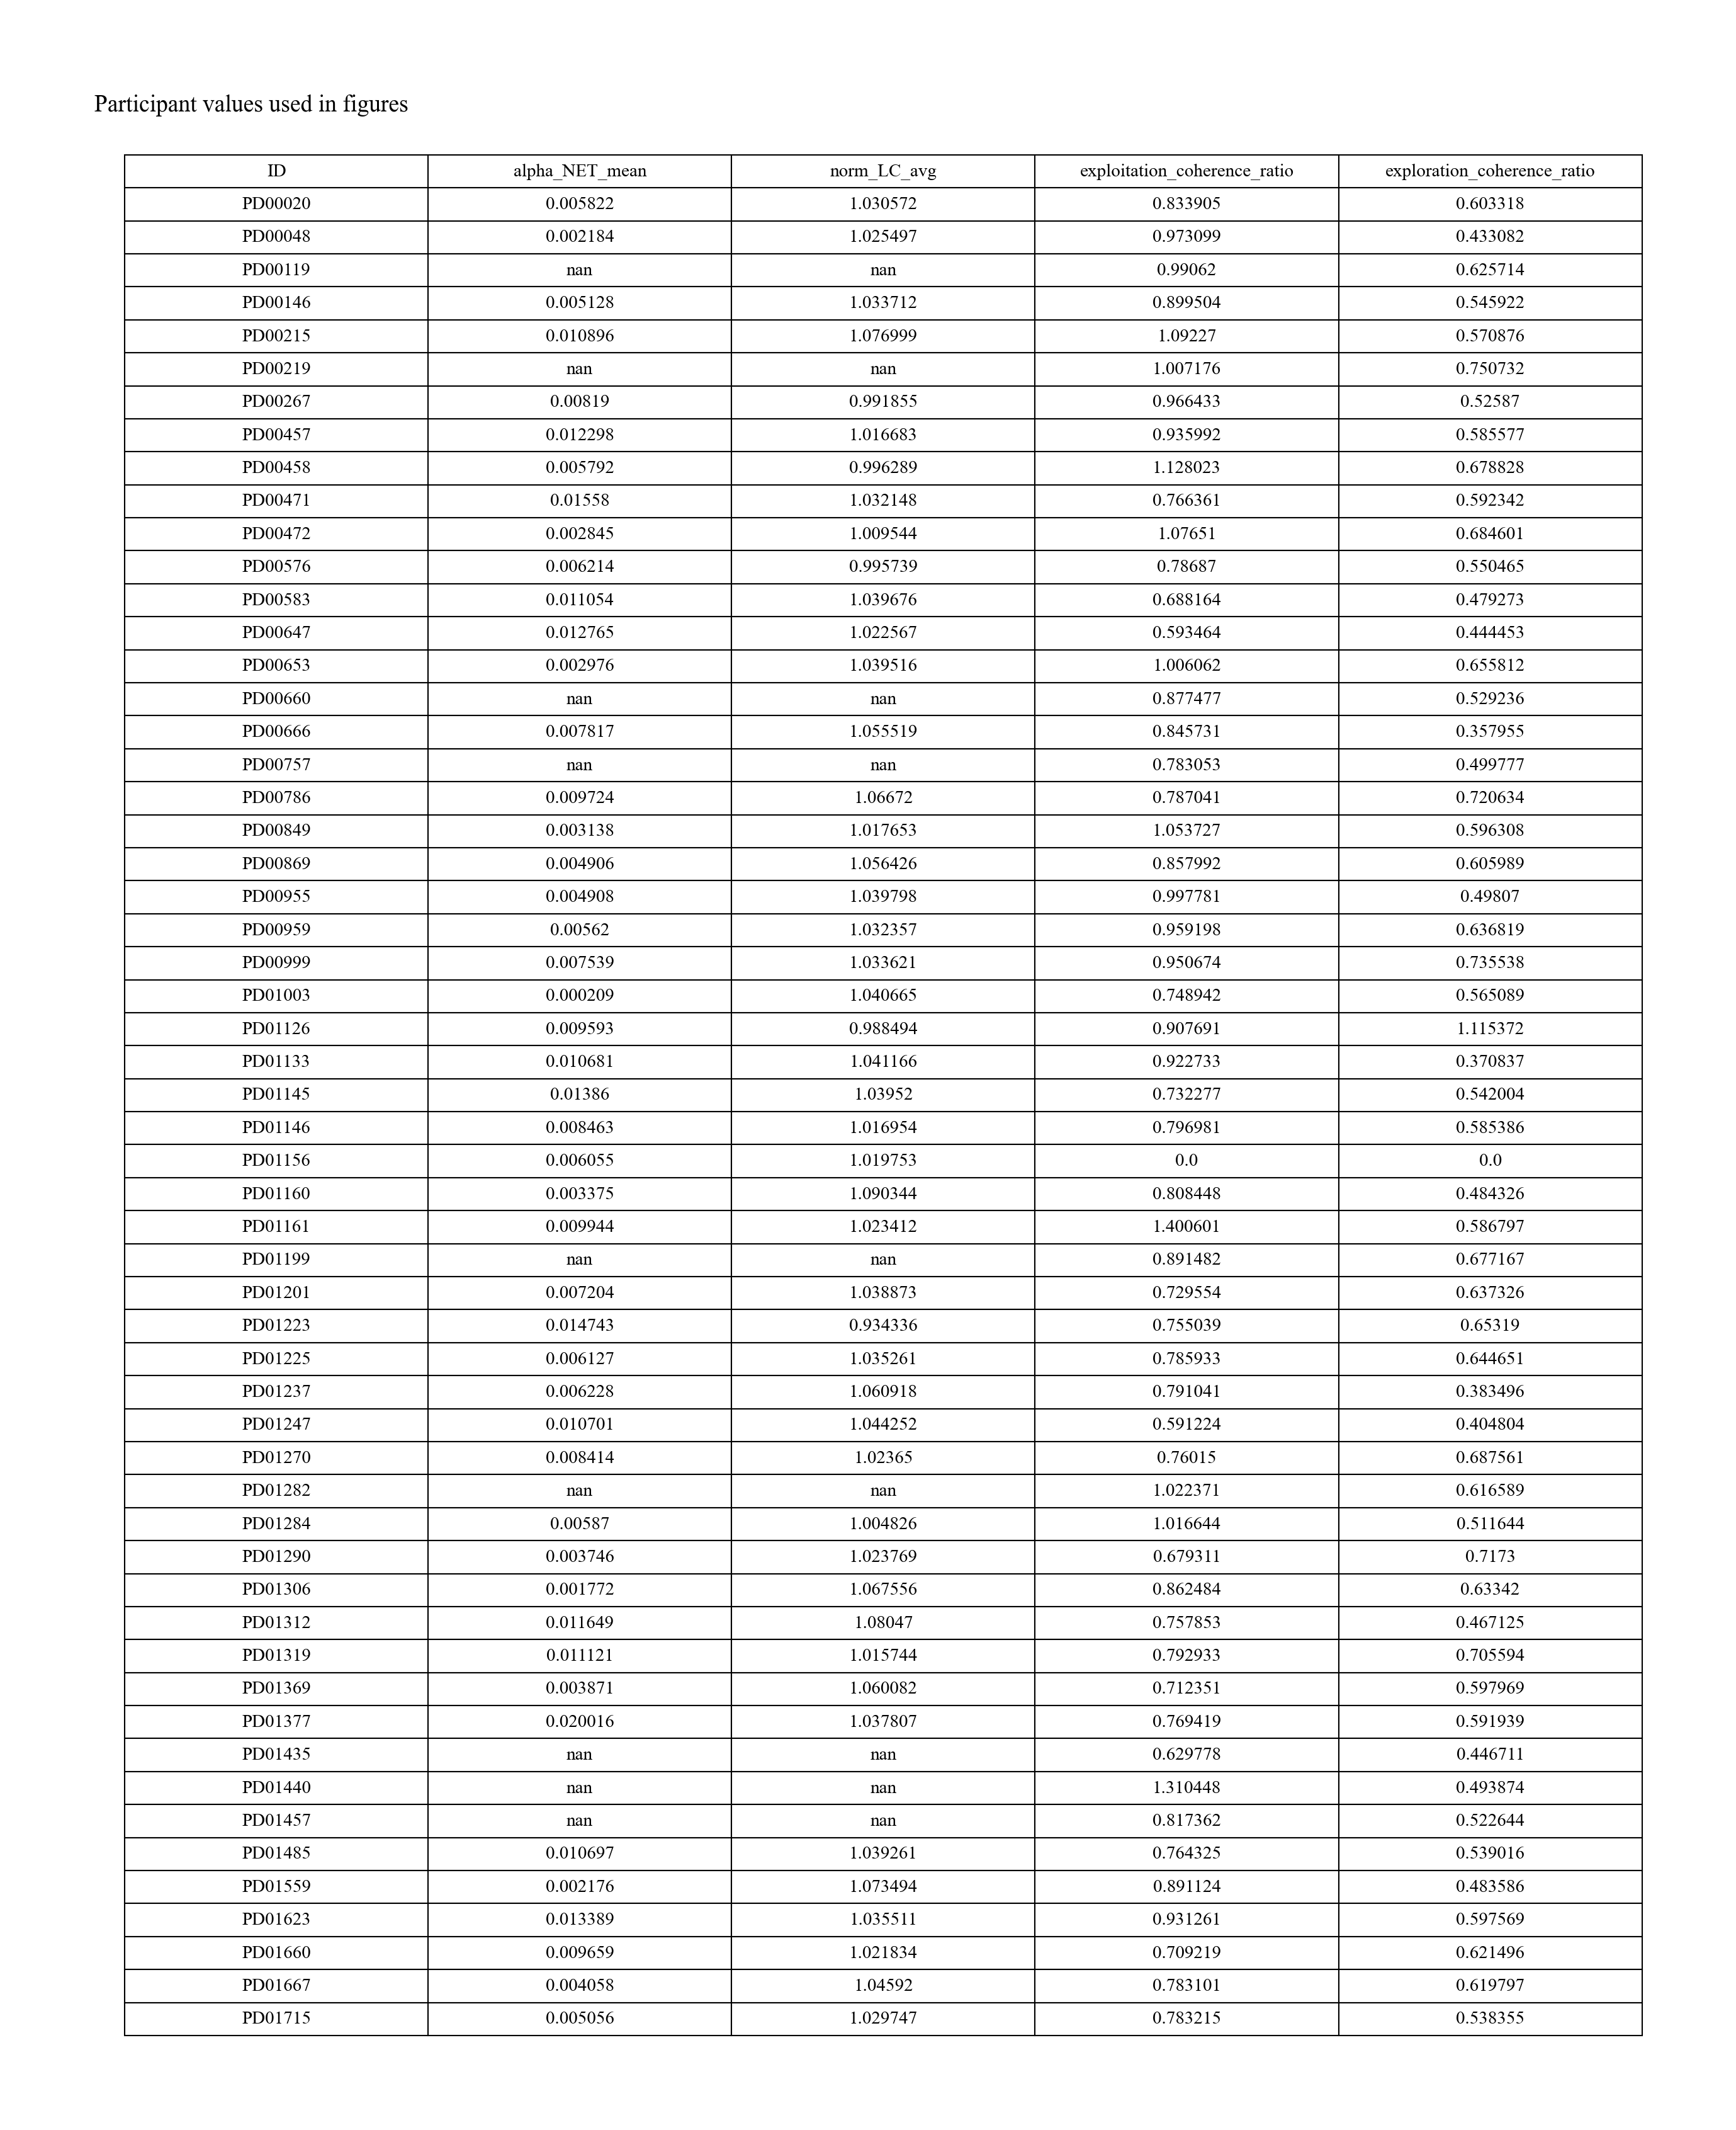
Participant Values Table (.PNG)
output/NATURE_REAL_participant_values_table.png

Slide 23
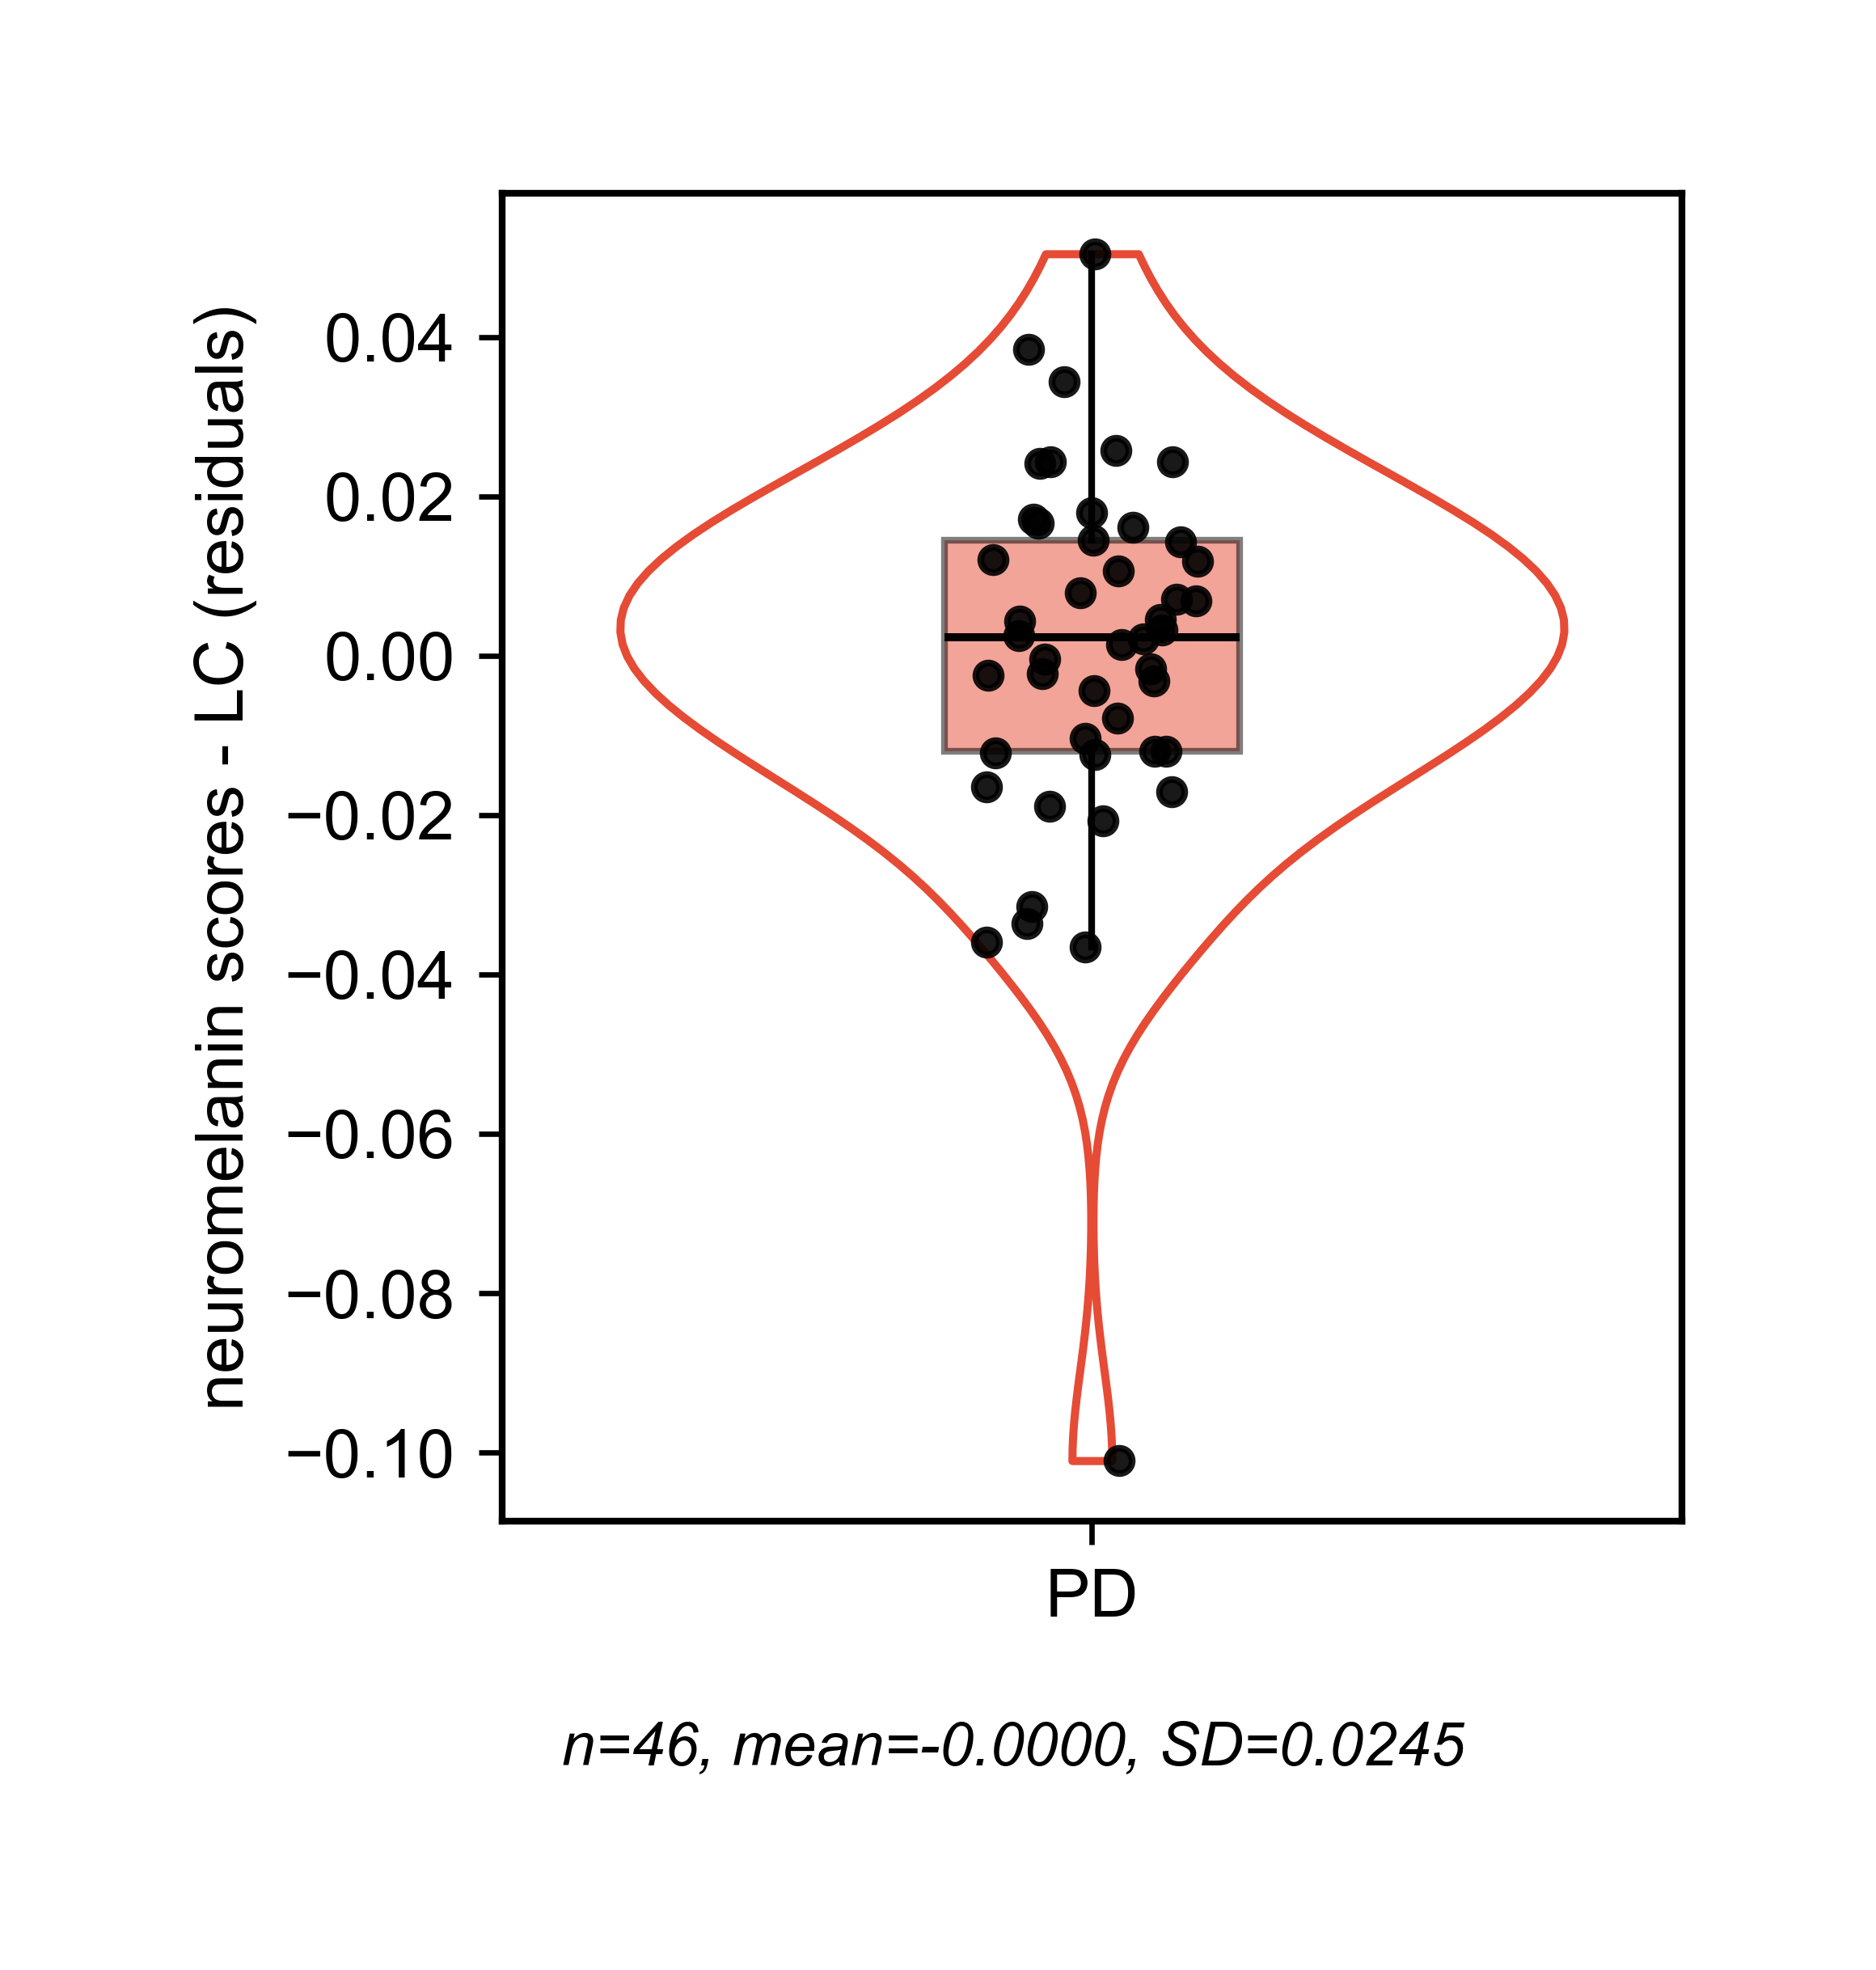
Violin Lc Residuals (.PNG)
output/NATURE_REAL_violin_lc_residuals.png

Slide 25
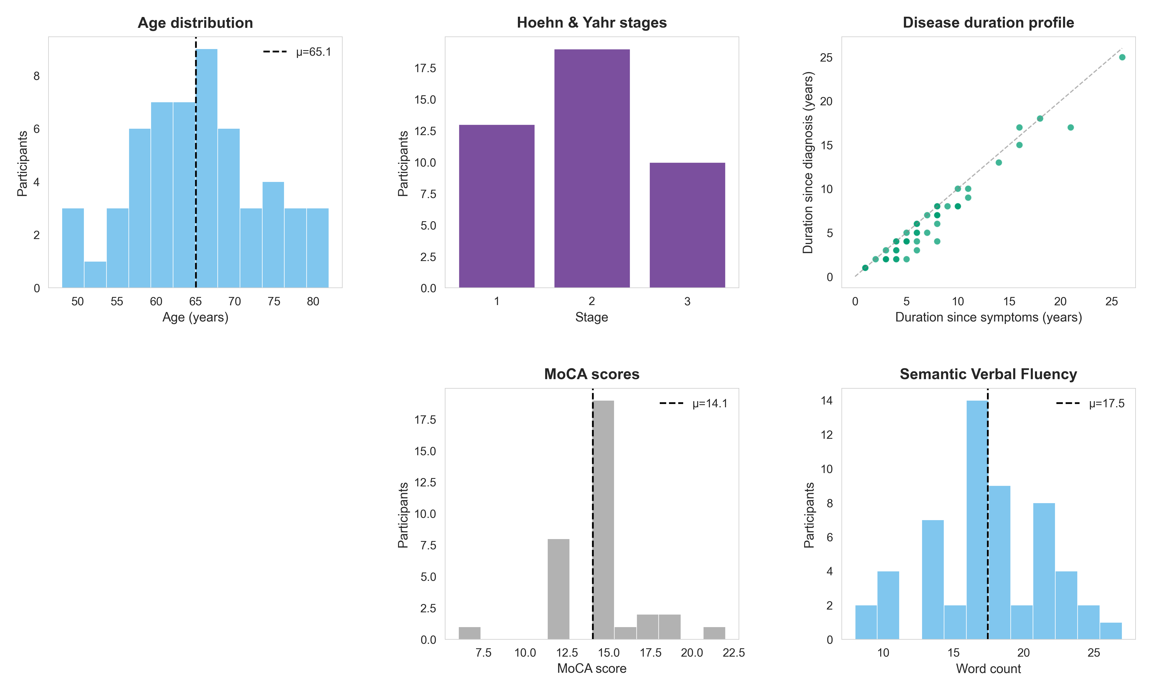
Intermediate: Participant Demographics (.PNG)
output/figures/intermediate/participant_demographics.png

Slide 27
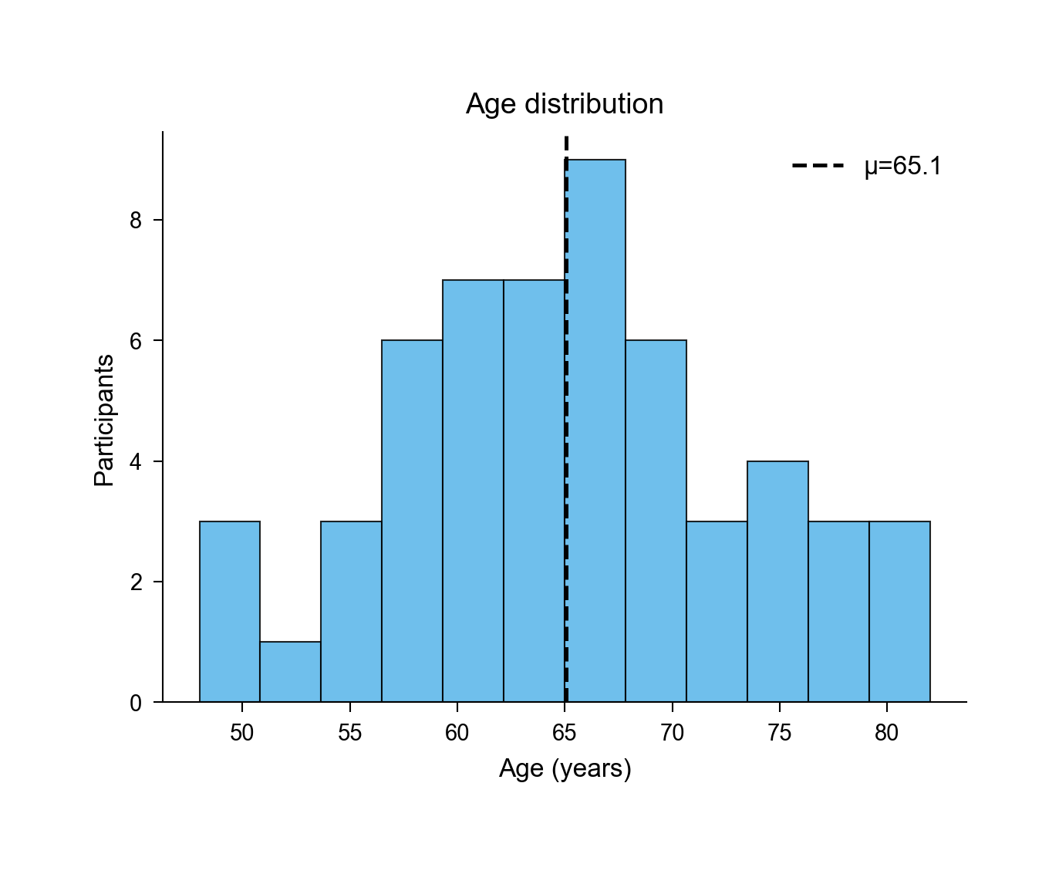
Intermediate: Age Distribution (.PNG)
output/figures/intermediate/age_distribution.png

Slide 29
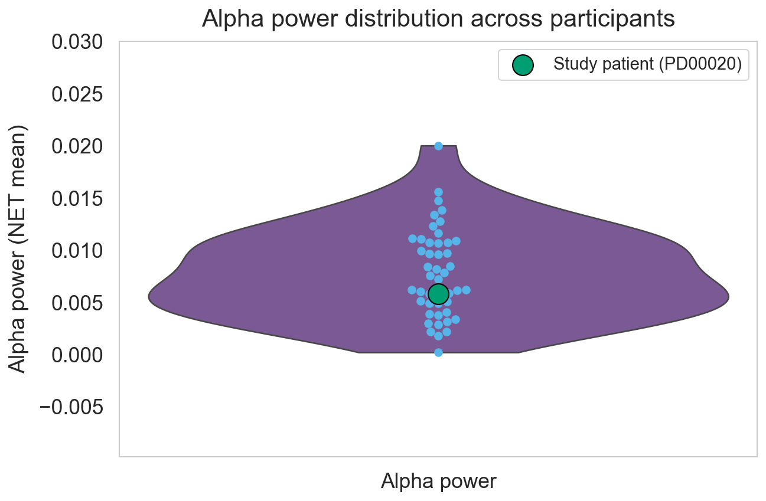
Intermediate: Alpha Power Violin (.PNG)
output/figures/intermediate/alpha_power_violin.png

Slide 31
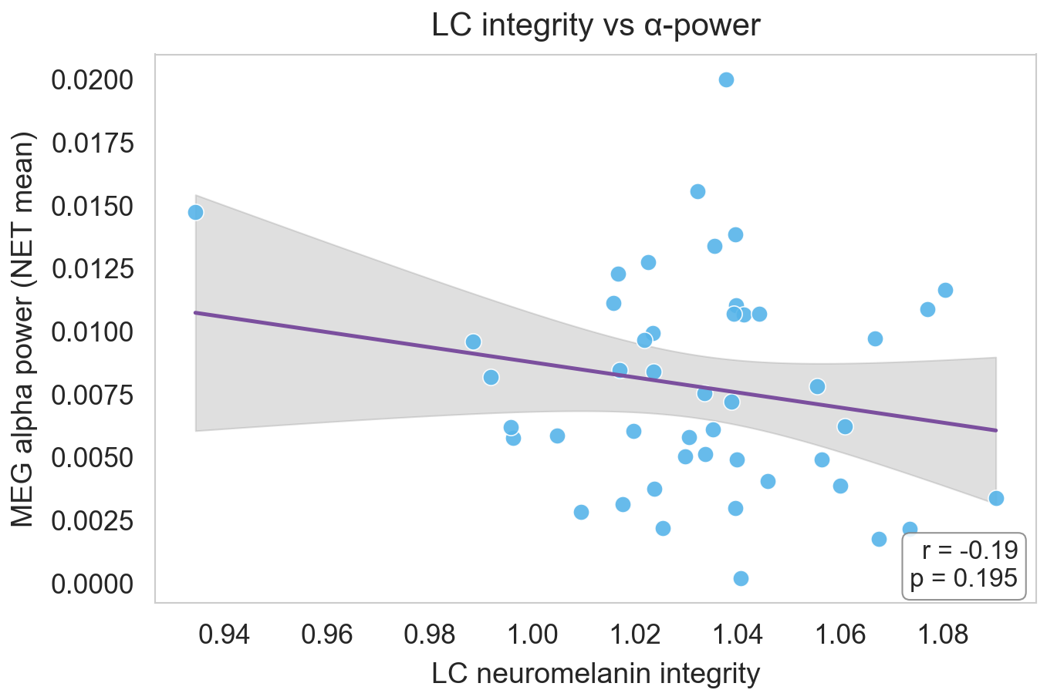
Intermediate: Lc Vs Alpha (.PNG)
output/figures/intermediate/lc_vs_alpha.png

Slide 33
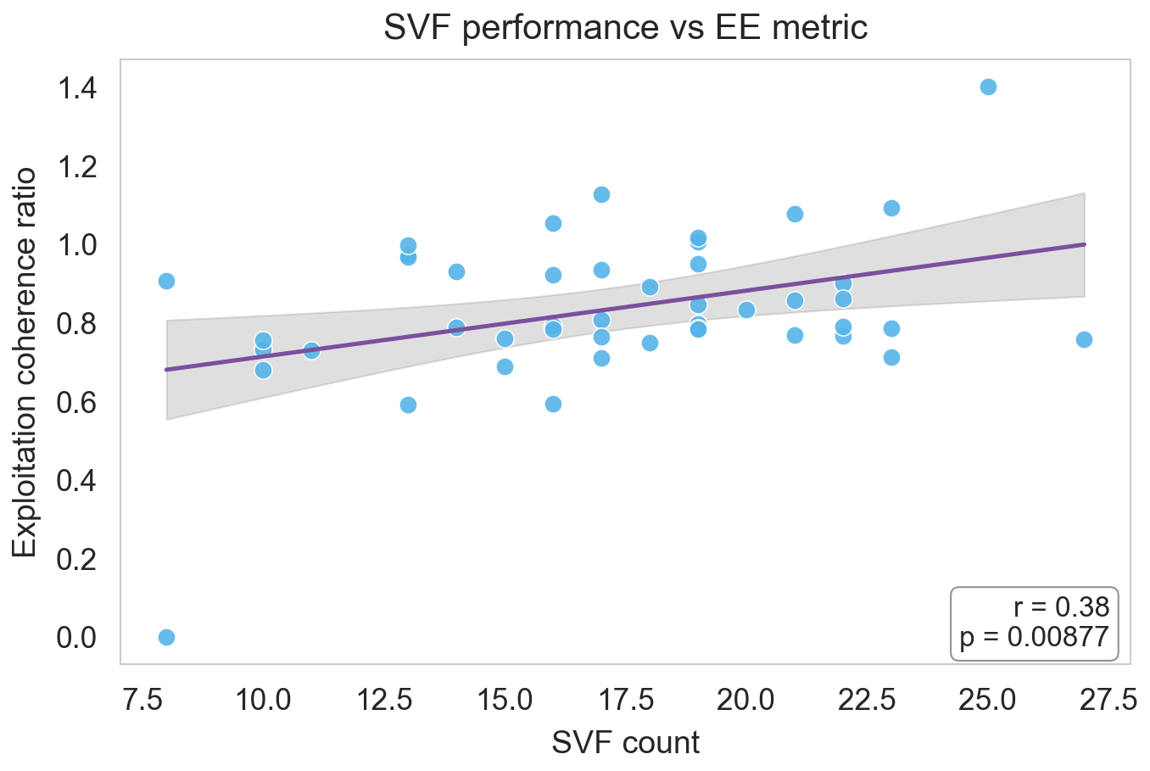
Intermediate: Svf Vs Ee (.PNG)
output/figures/intermediate/svf_vs_ee.png

Slide 35
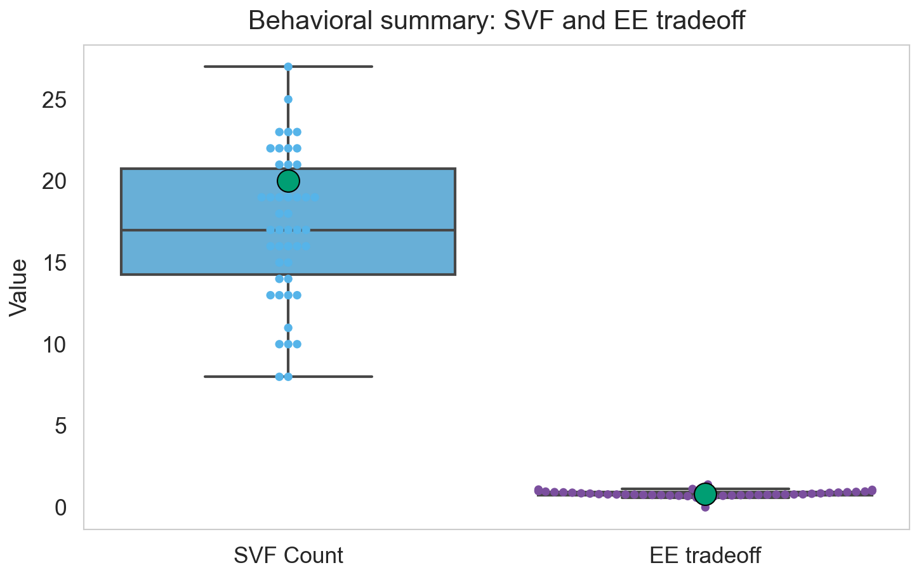
Intermediate: Svf Ee Boxswarm (.PNG)
output/figures/intermediate/svf_ee_boxswarm.png

Slide 37
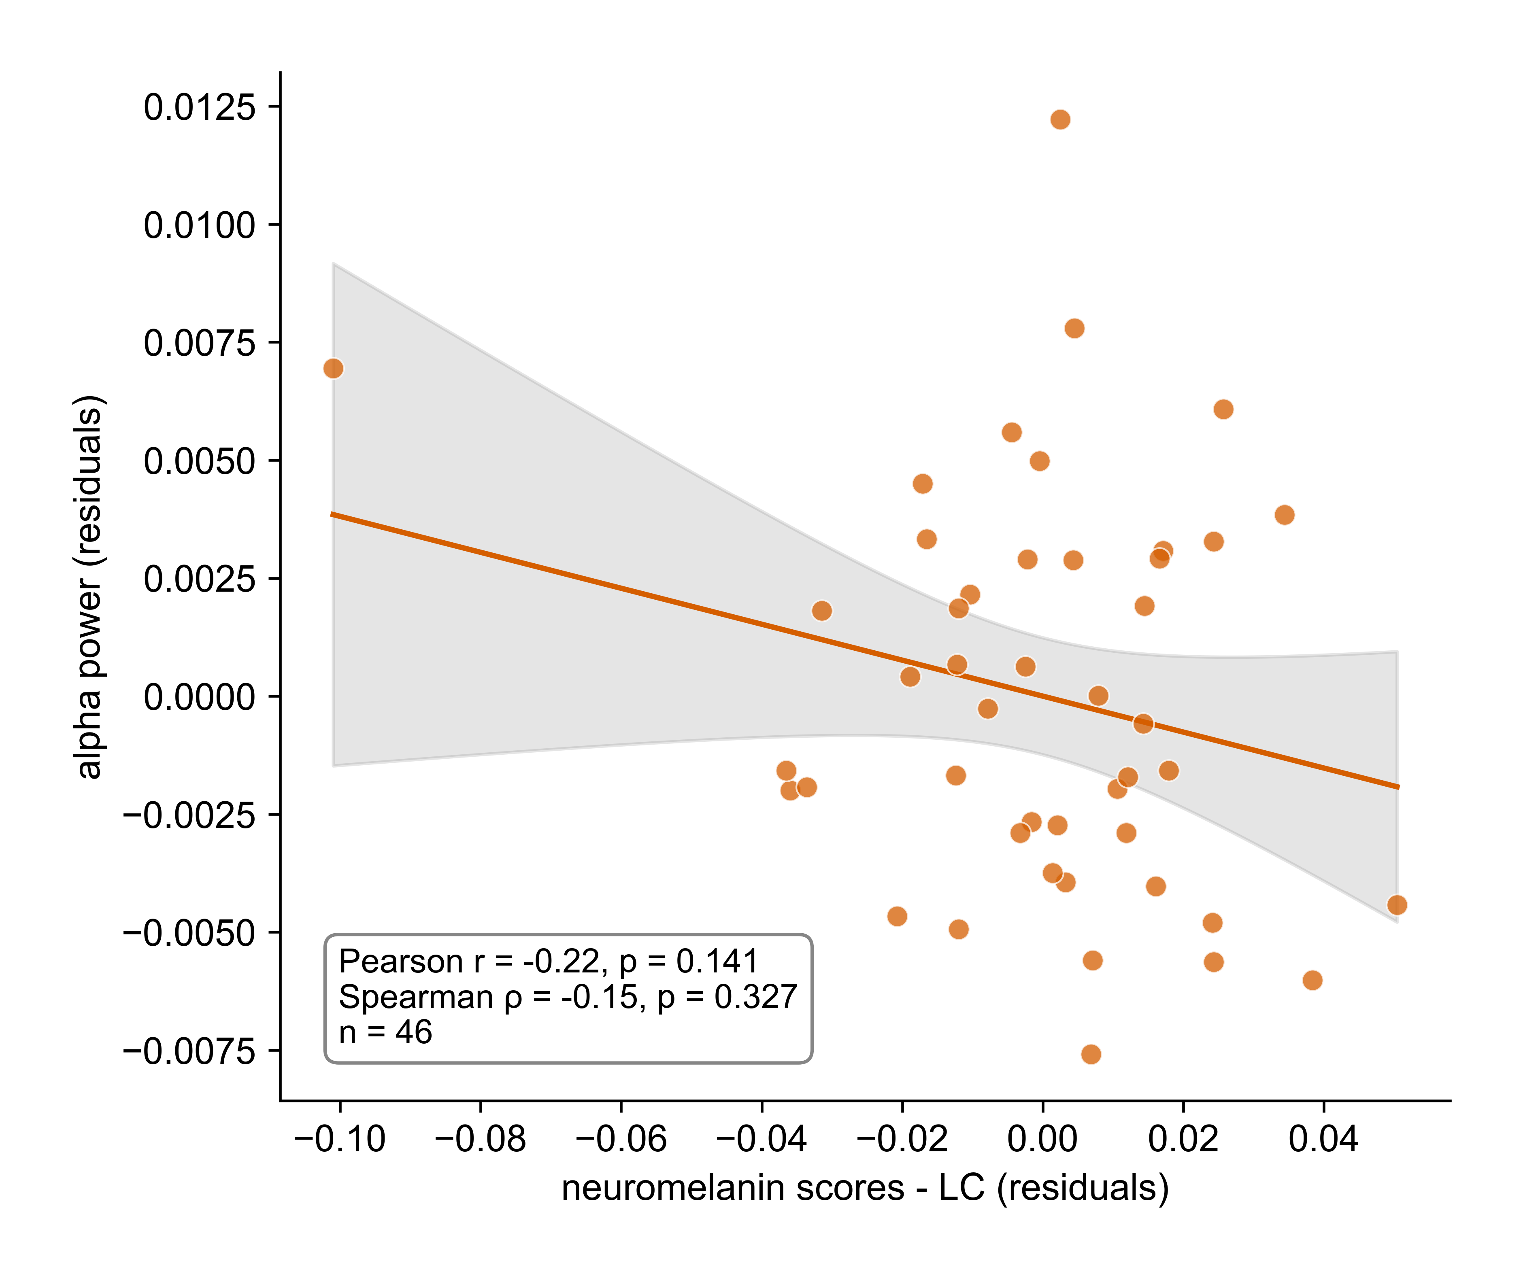
Alpha Vs Lc Residuals (.PNG)
output/alpha_vs_LC_residuals.png

Slide 39
Semantic Fluency Analysis (.PNG)
output/semantic_fluency_analysis.png

Slide 42
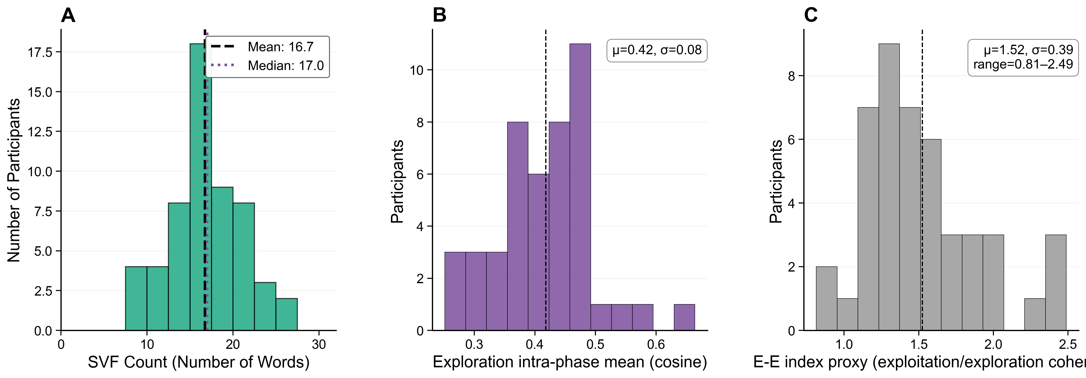
Compiled Distribution Figures (.PNG)
output/compiled_distribution_figures.png

Slide 45
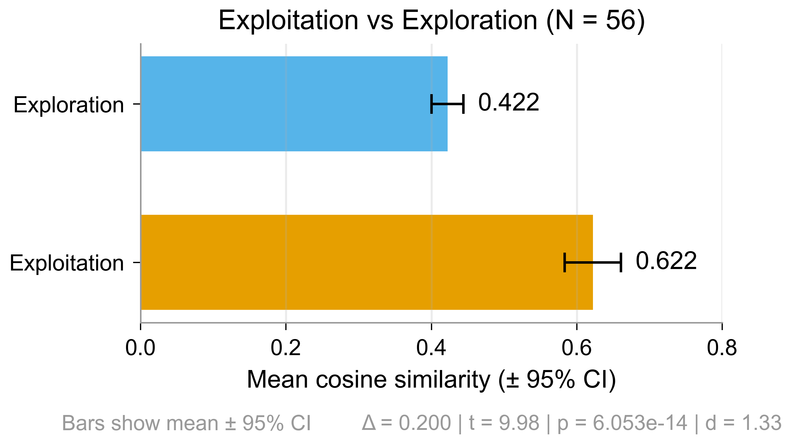
Exploit Explore Bar (.PNG)
output/exploit_explore_bar.png

Slide 47
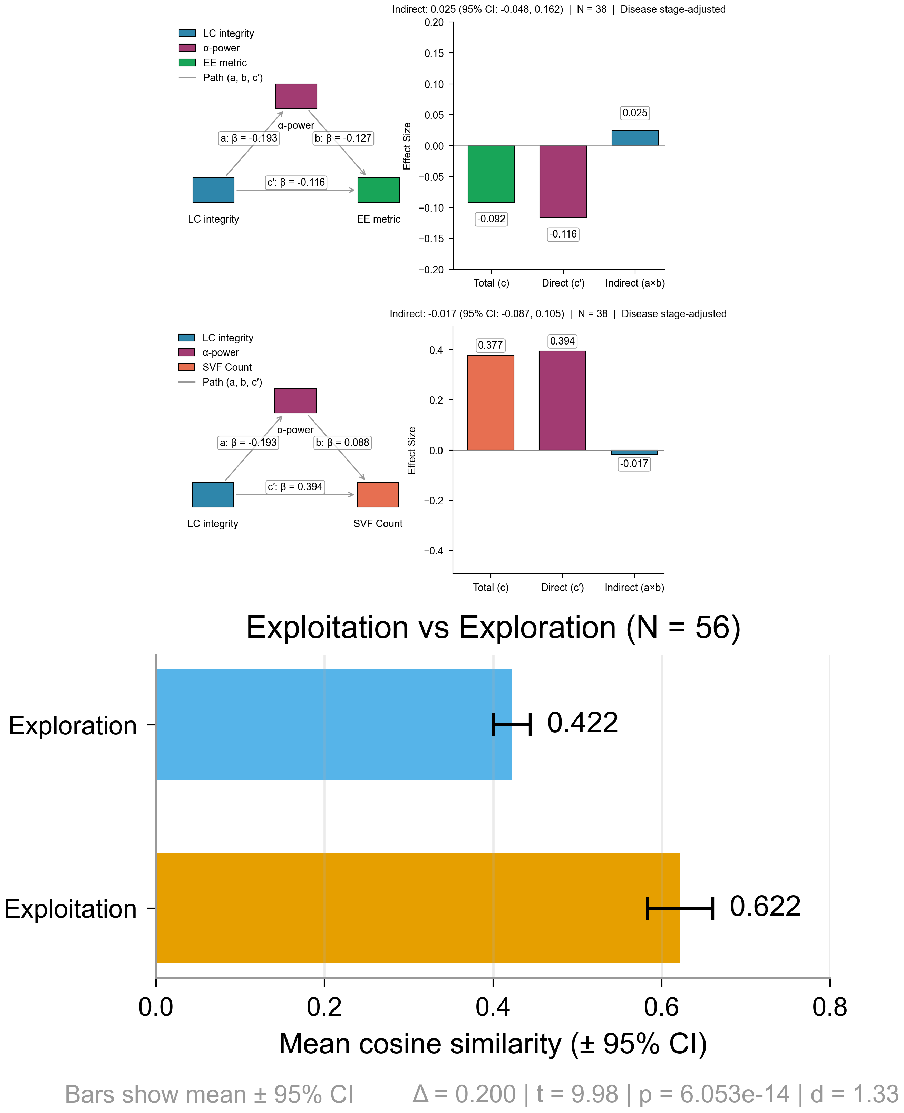
Combined Mediation Exploit Panels (.PNG)
output/combined_mediation_exploit_panels.png

Slide 49
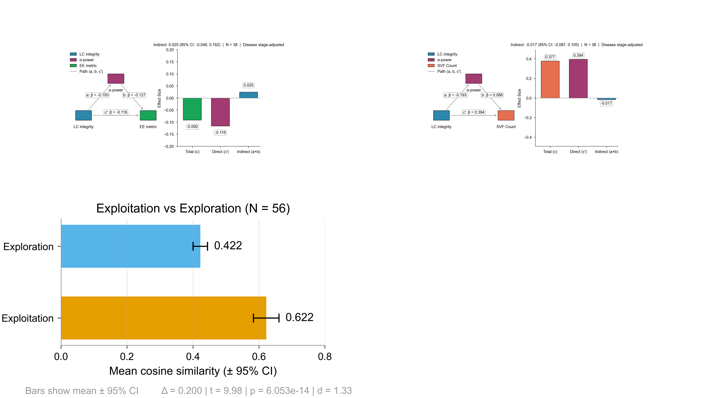
Test Grid Panels (.PNG)
output/test_grid_panels.png

Slide 51
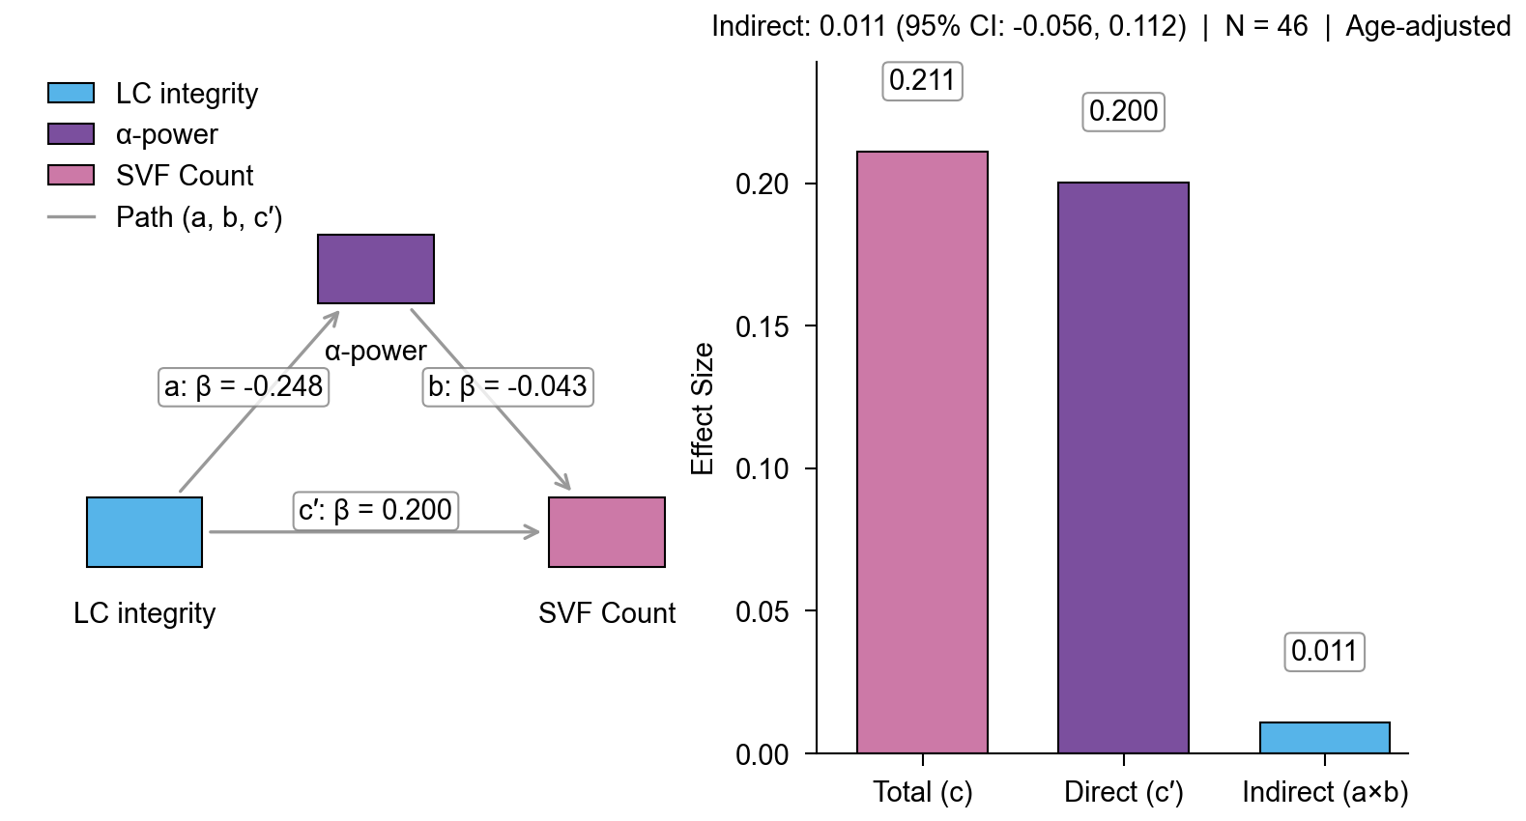
Mediation Svf Age Nature (.PNG)
output/mediation_svf_age_nature.png

Slide 53
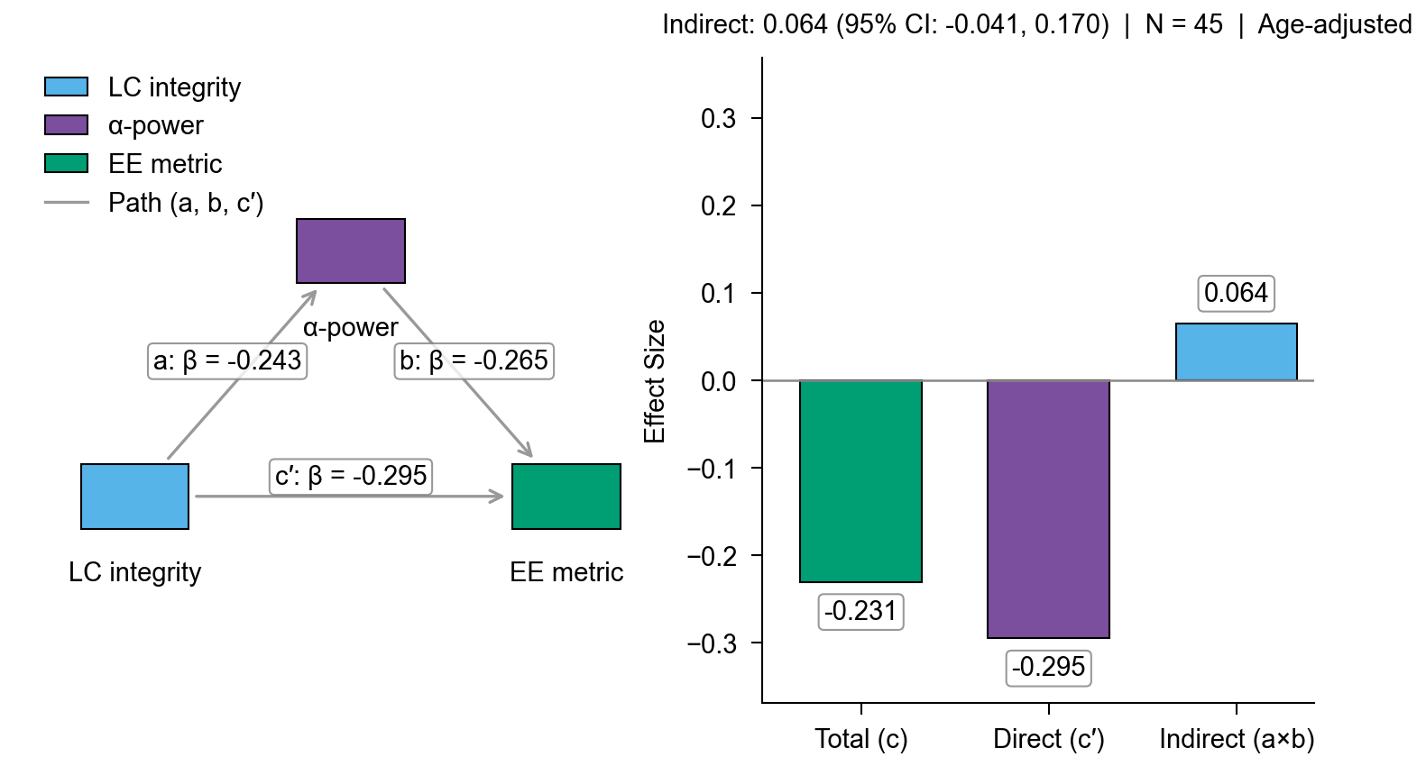
Mediation Exploit Age Nature (.PNG)
output/mediation_exploit_age_nature.png

Slide 55
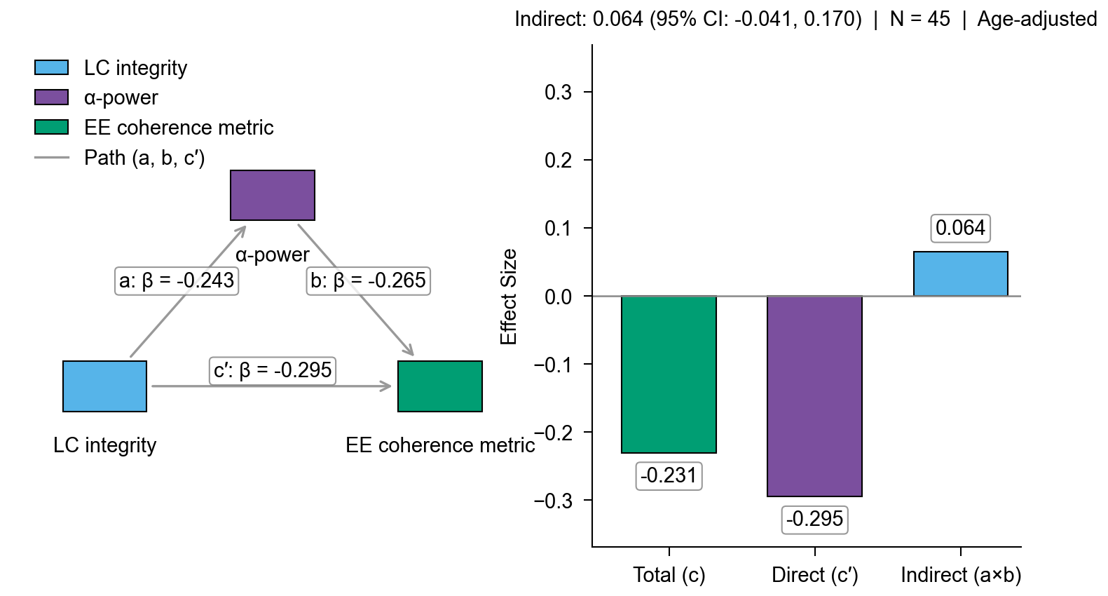
Mediation Exploit Coherence Metric Nature (.PNG)
output/mediation_exploit_coherence_metric_nature.png

Slide 57
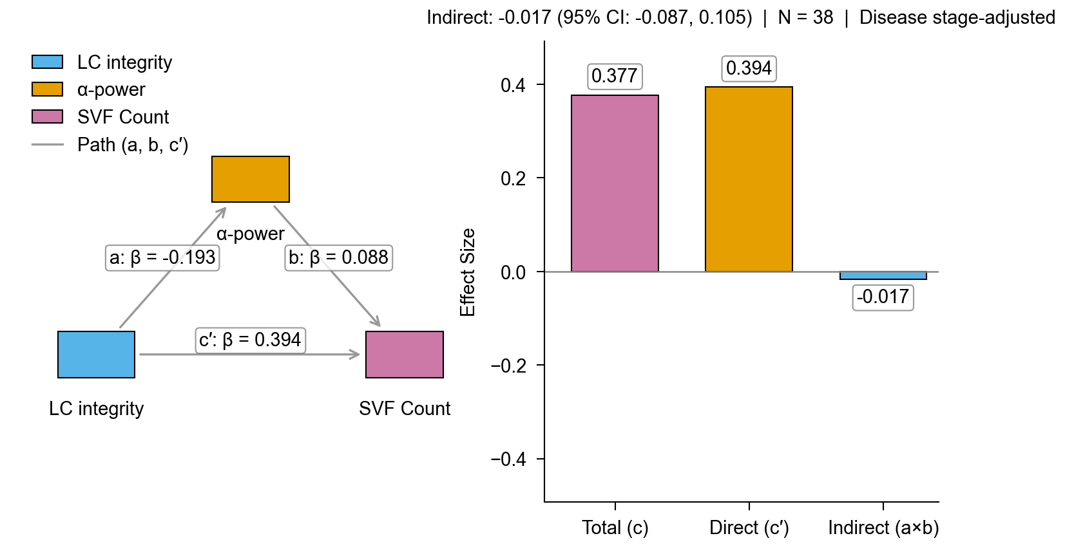
Mediation Svf Disease Stage Working (.PNG)
output/mediation_svf_disease_stage_working.png

Slide 59
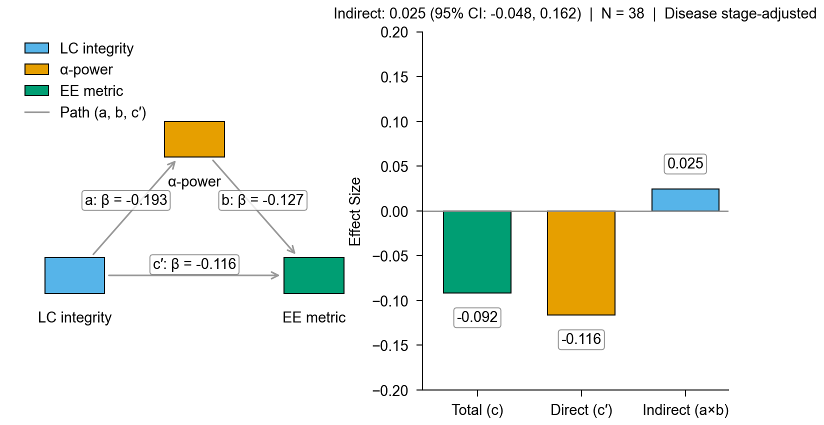
Mediation Ee Disease Stage Working (.PNG)
output/mediation_ee_disease_stage_working.png

Slide 61
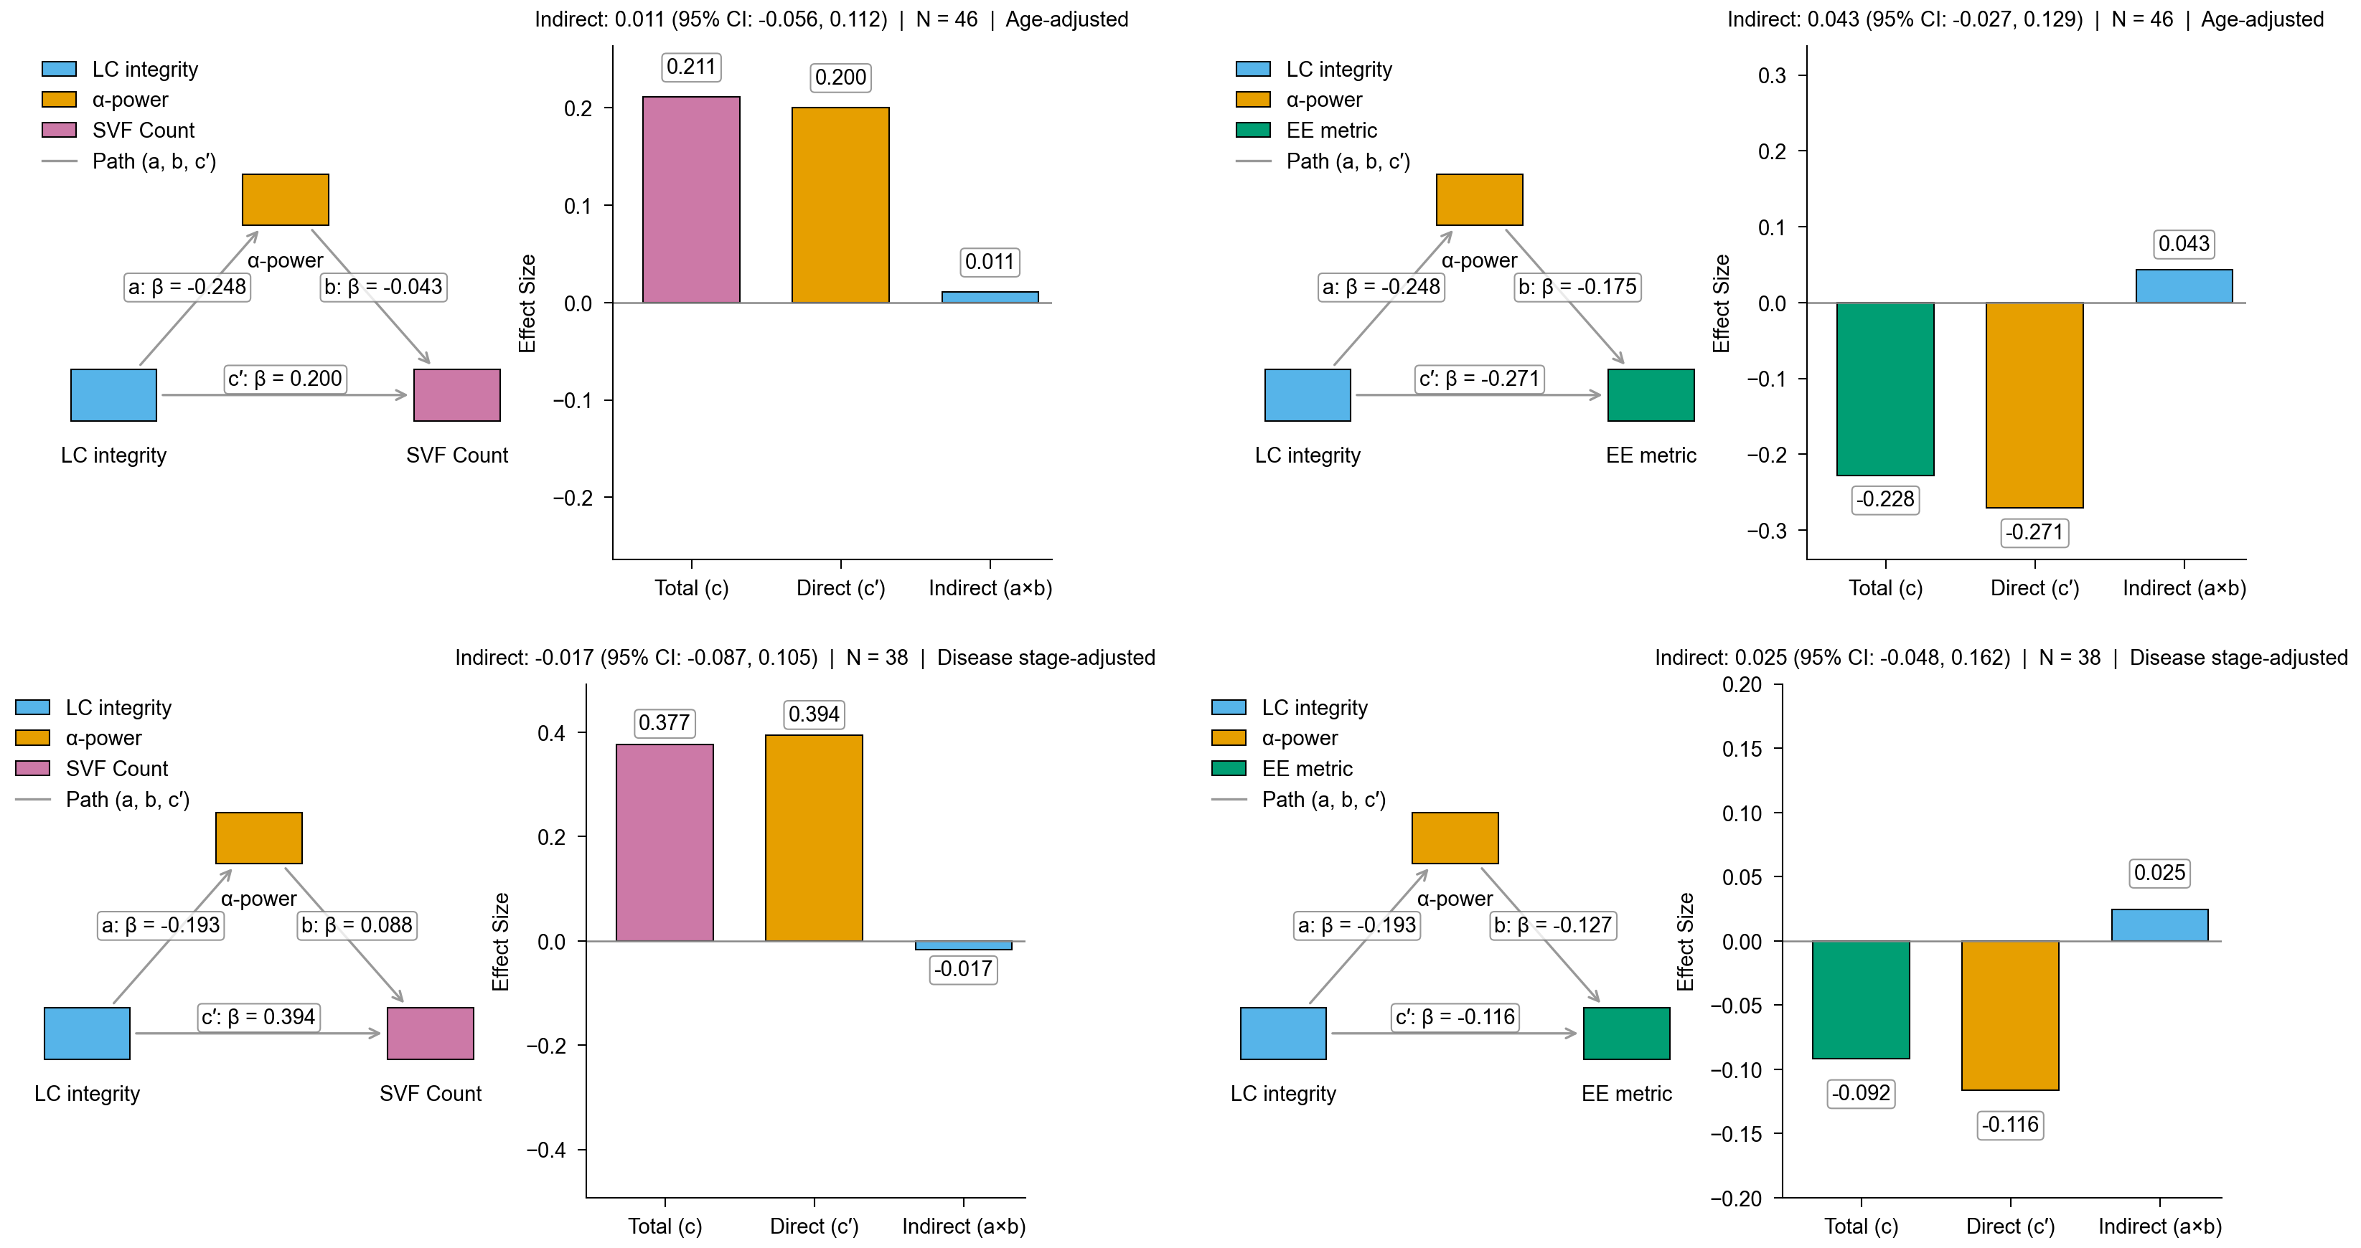
Mediation Age Vs Disease (.PNG)
output/mediation_age_vs_disease.png

