Slide 1
Semantic Fluency Analysis

Slide 2
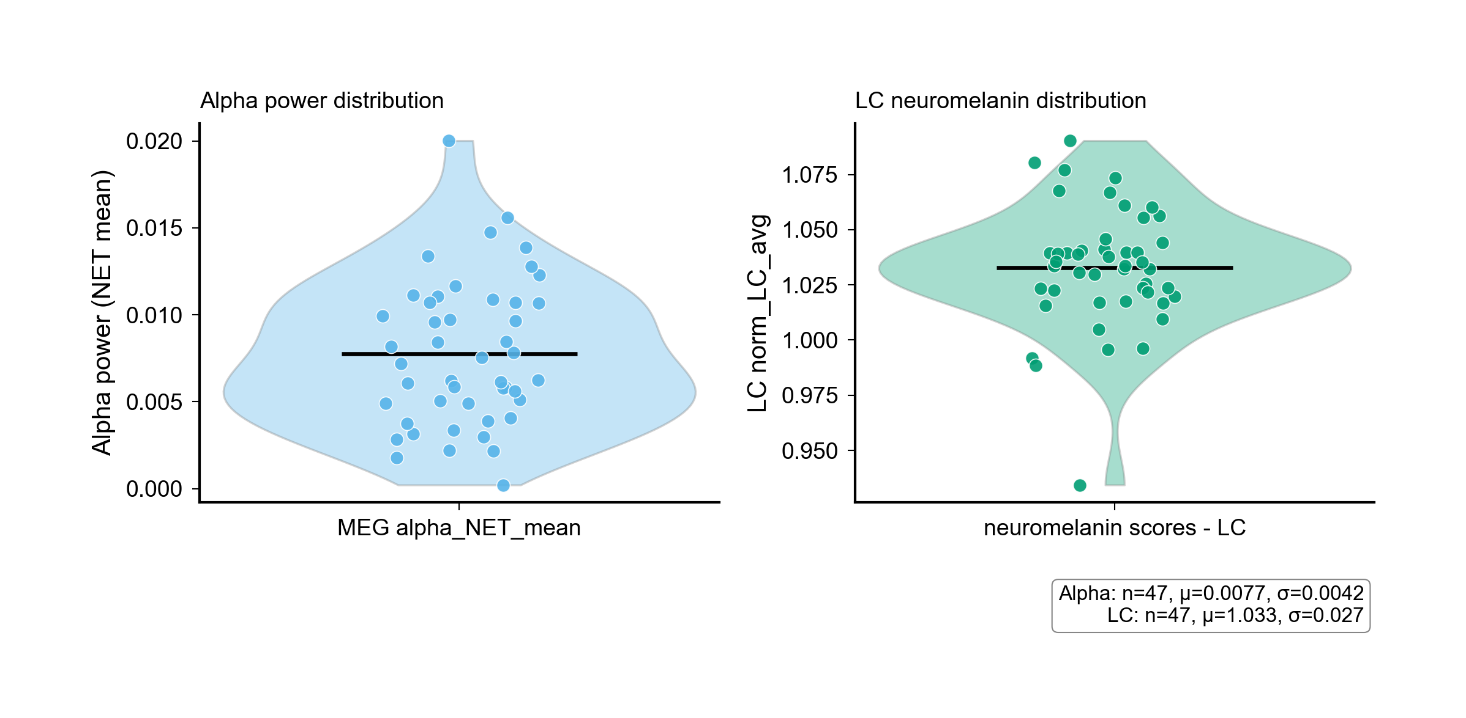
Figure 0a: Alpha Power Distribution

Slide 3
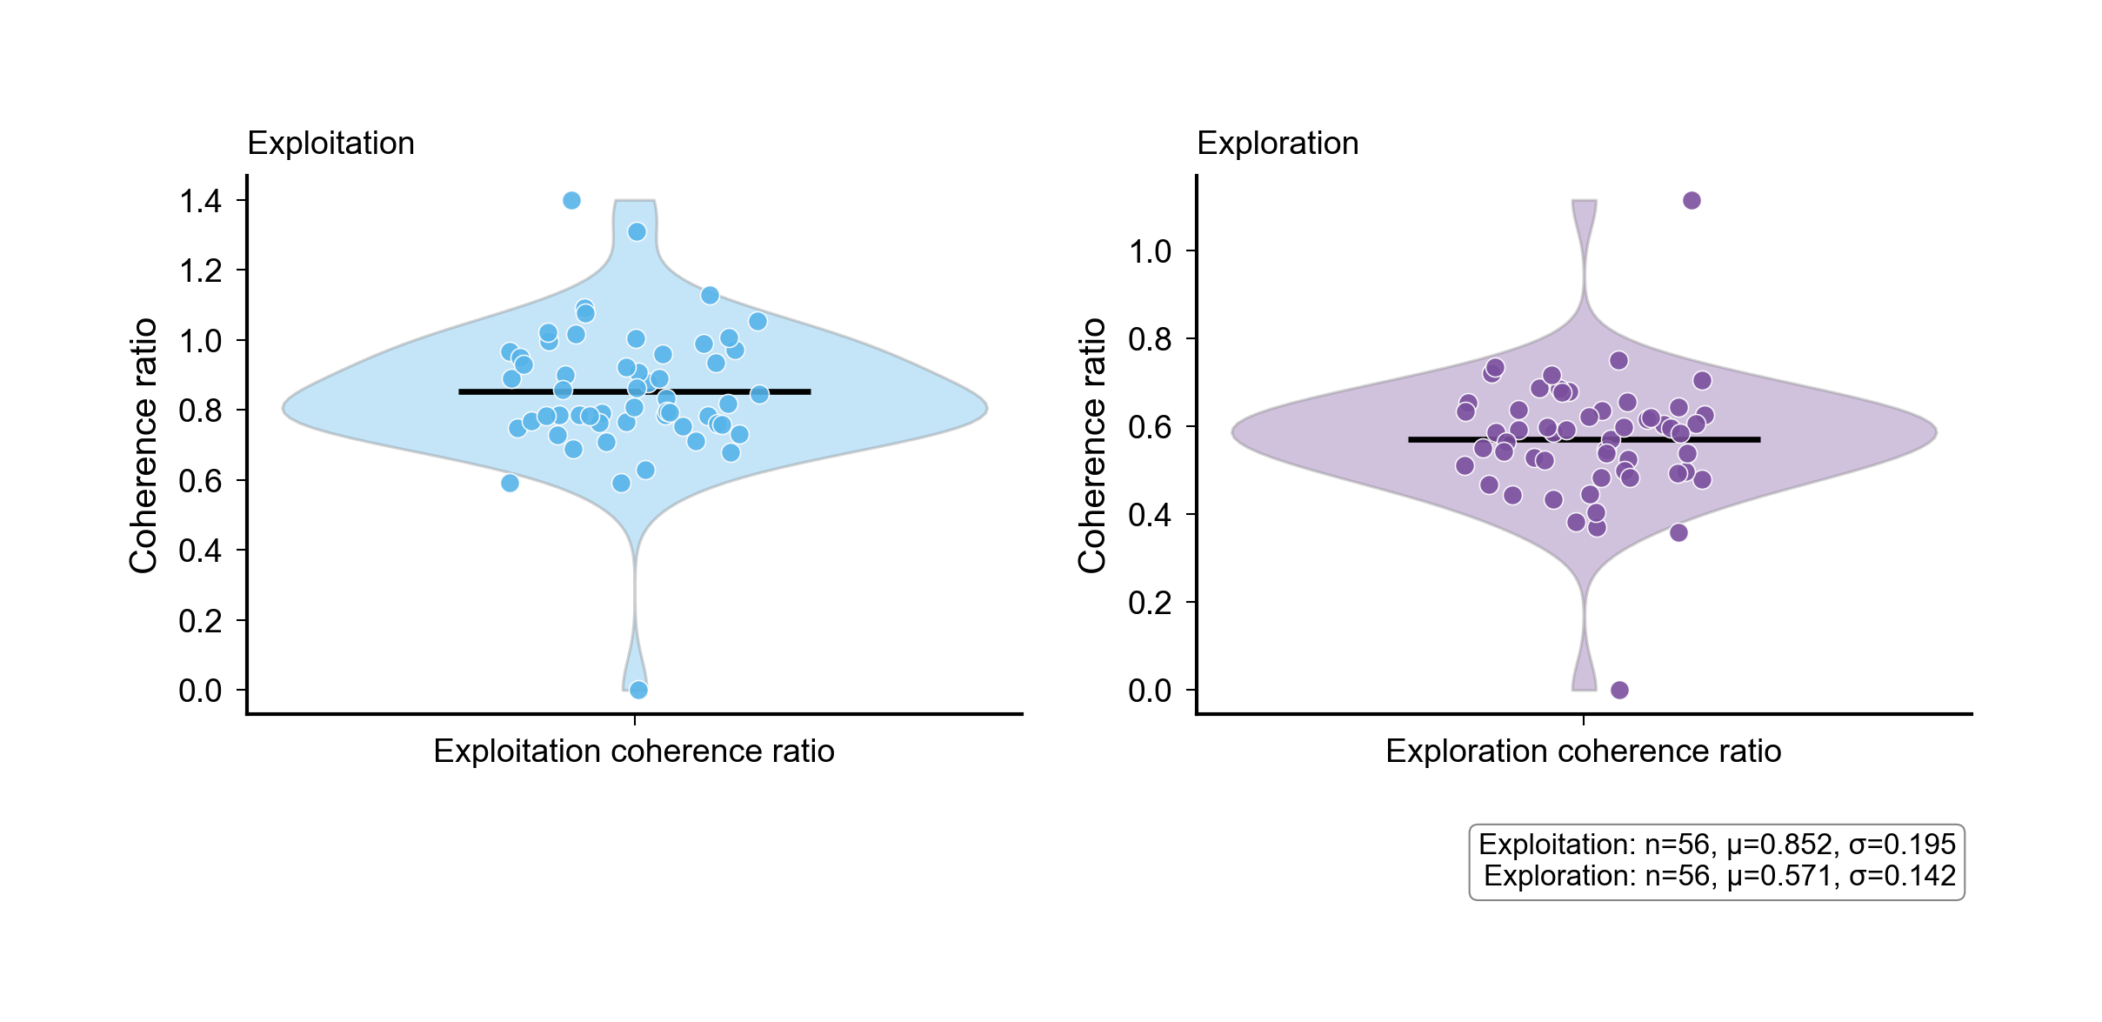
Figure 0b: Coherence Distribution

Slide 4
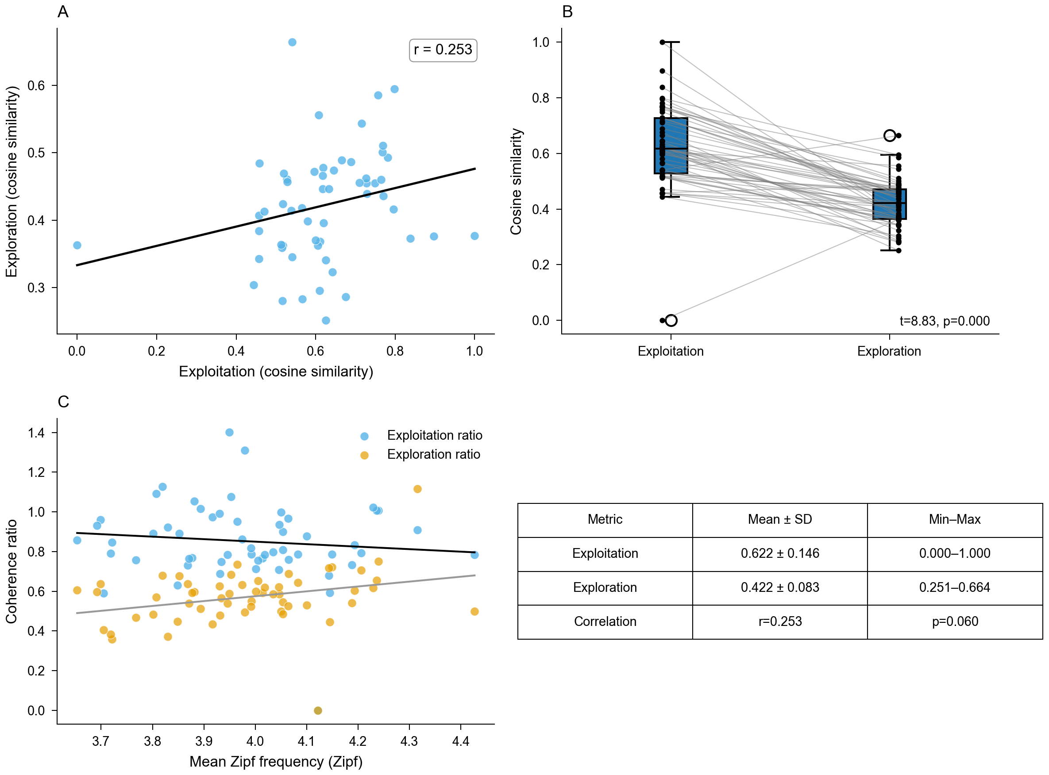
Figure 1: Exploration vs Exploitation

Slide 5
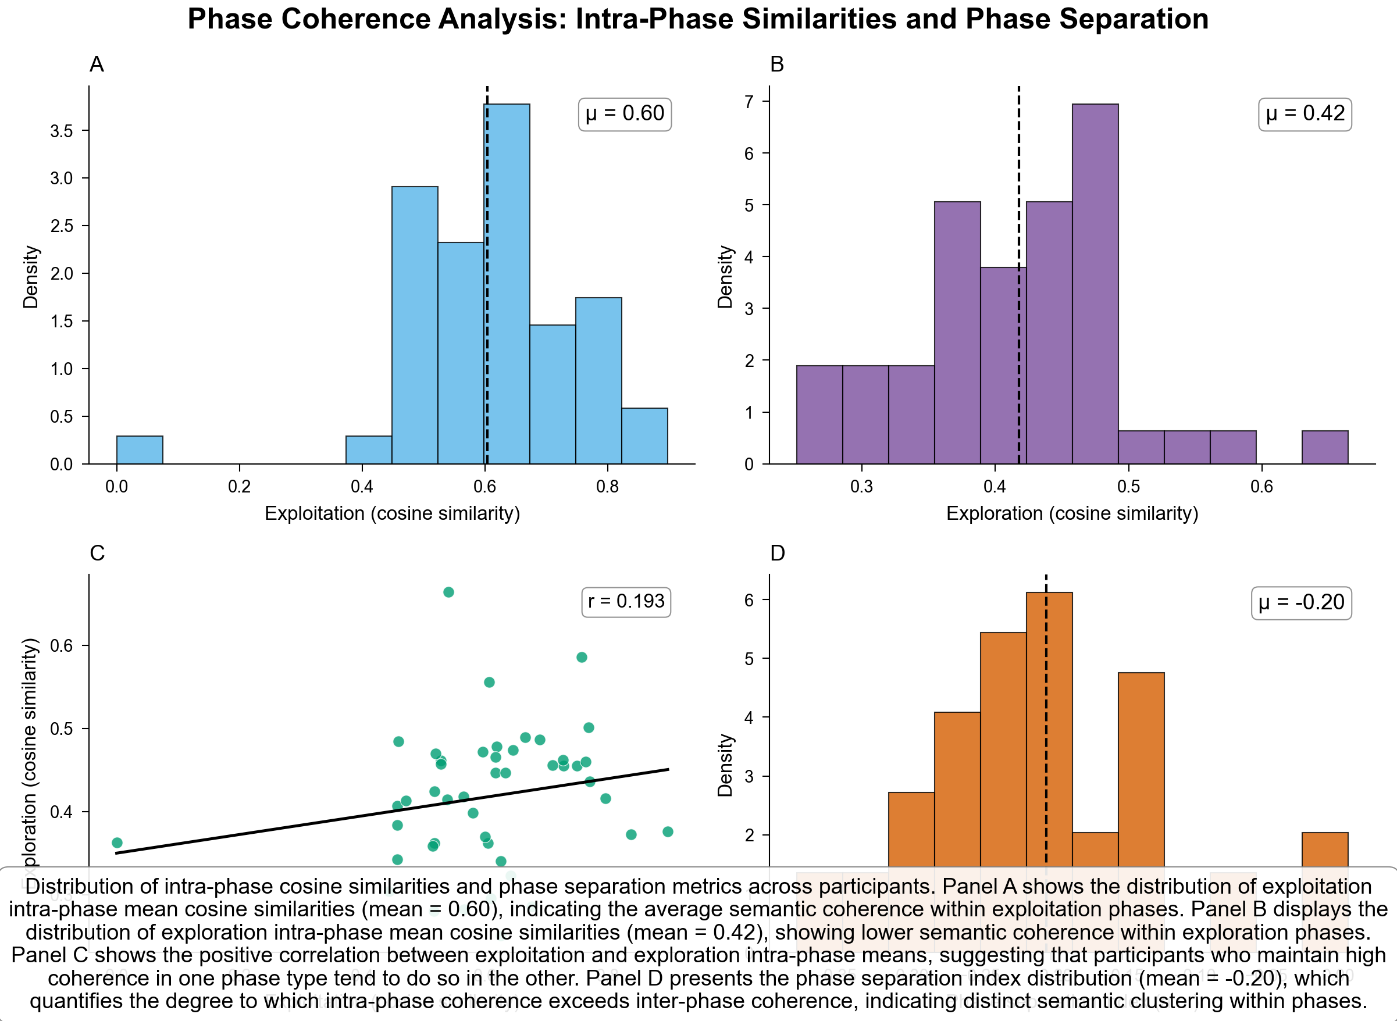
Figure 2: Phase Coherence

Slide 6
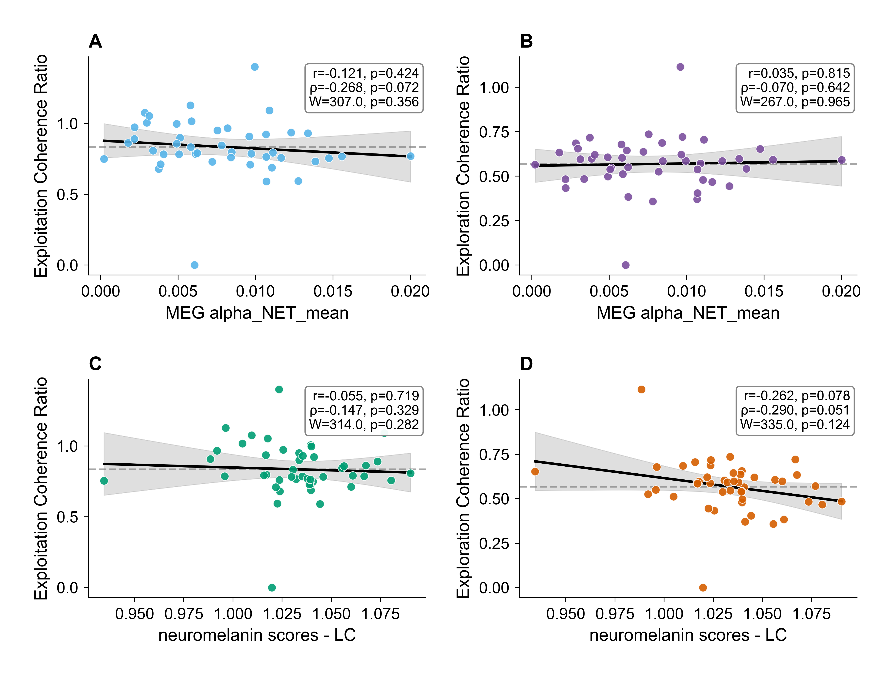
Figure 3: MEG Correlations

Slide 7
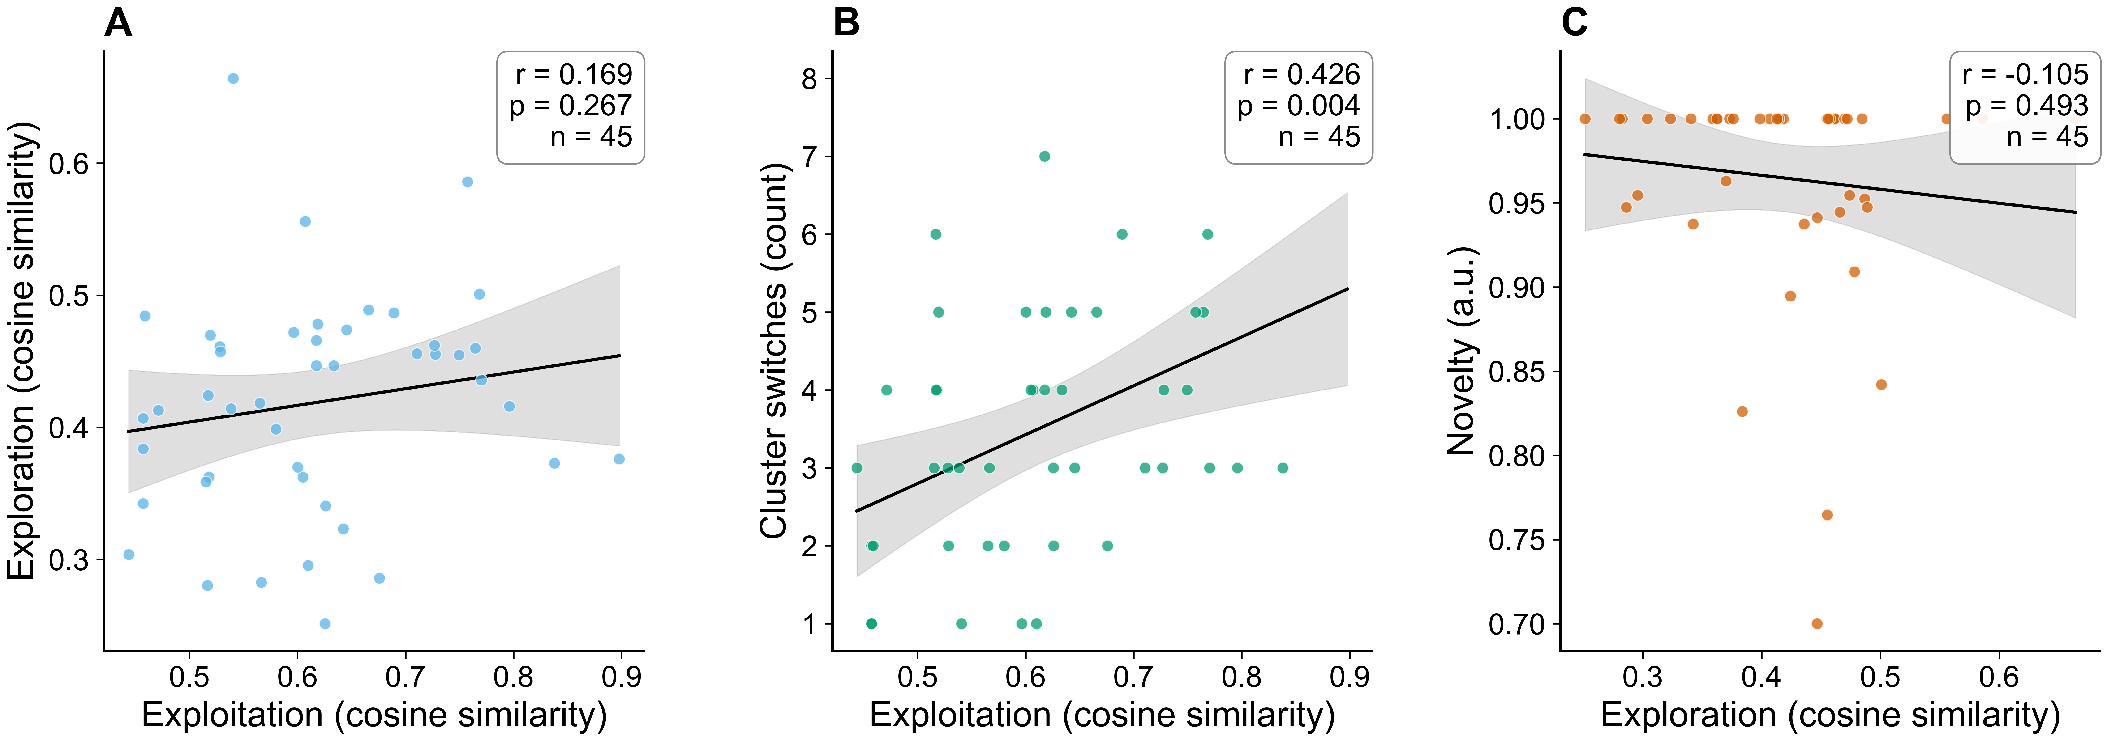
Figure 4: Comprehensive Scatter Plots

Slide 8
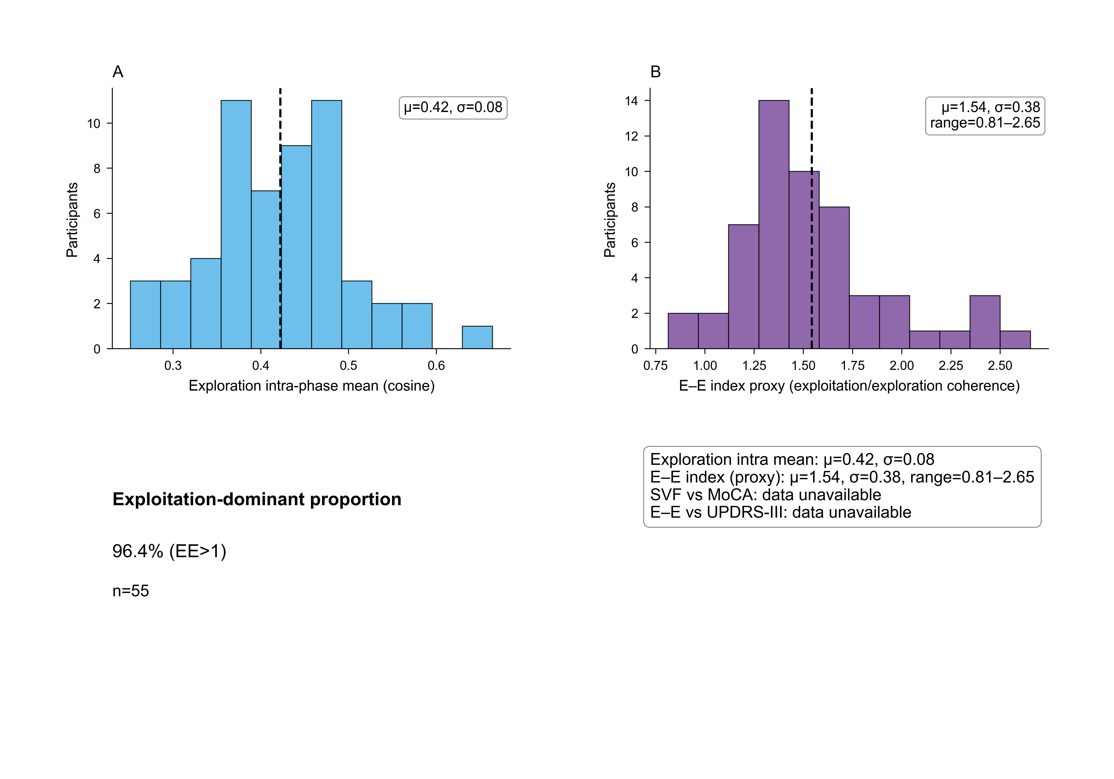
Behavior Performance Metrics

Slide 9
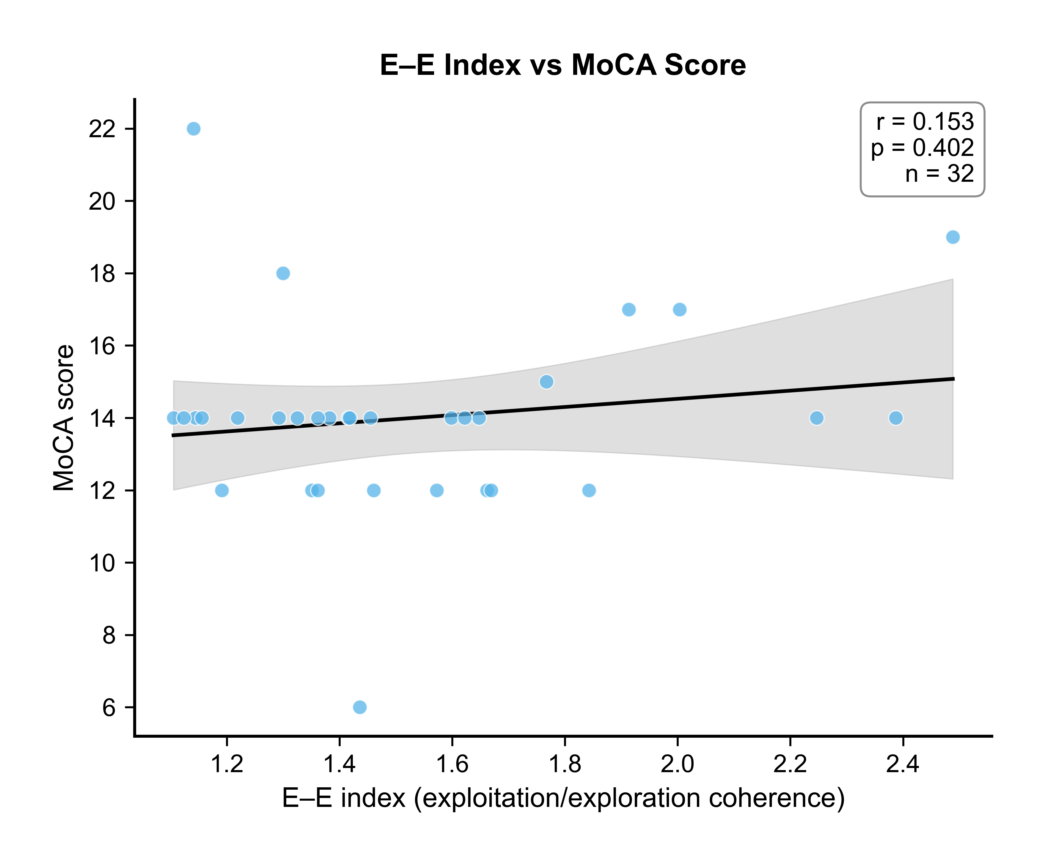
E-E Index vs MoCA

Slide 10
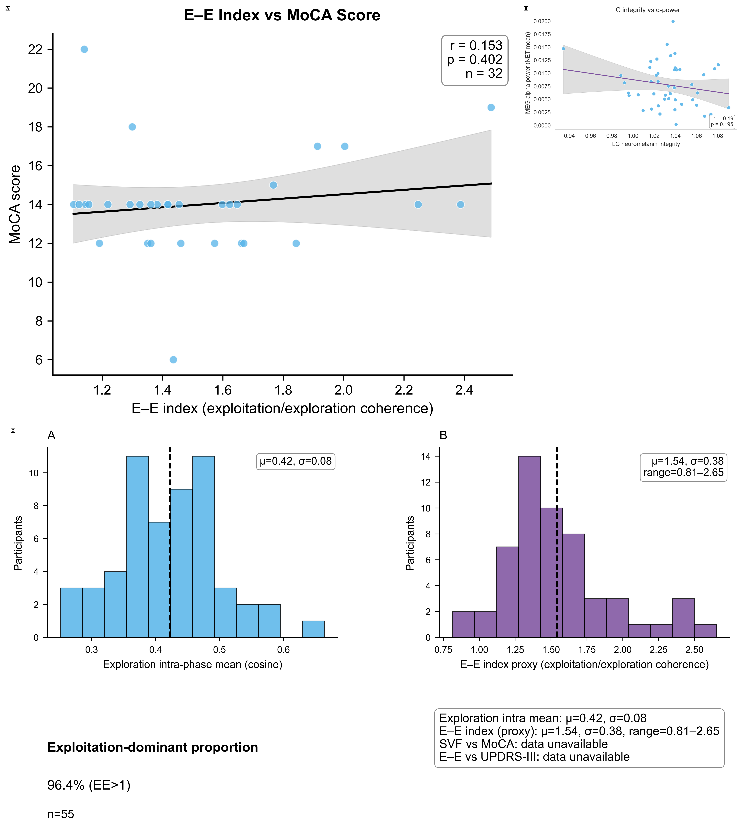
Compiled Results

Slide 11
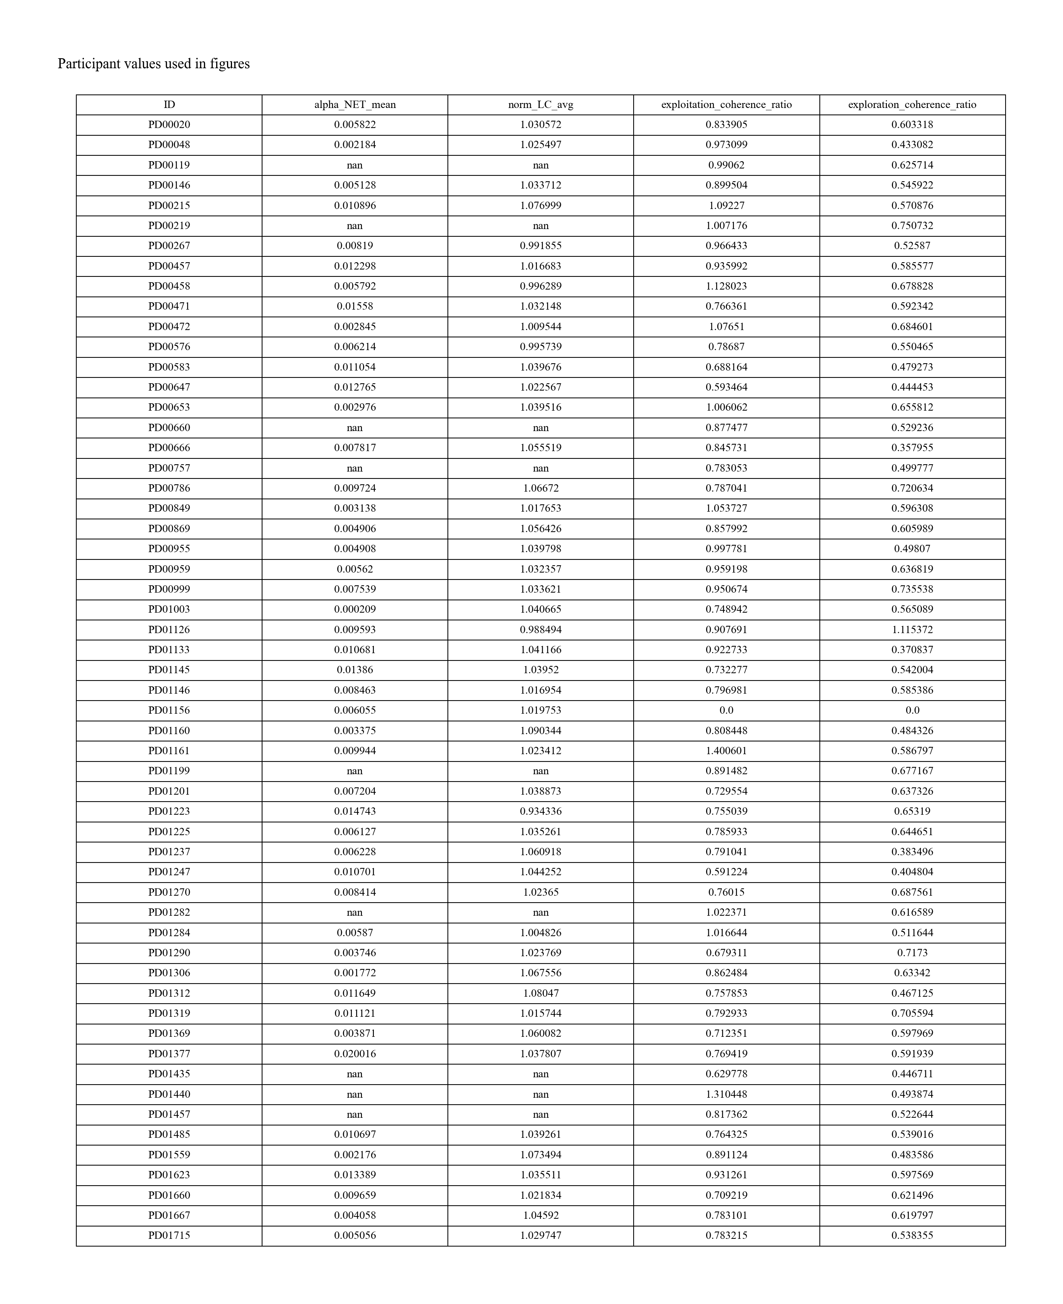
Participant Demographics Table

Slide 12
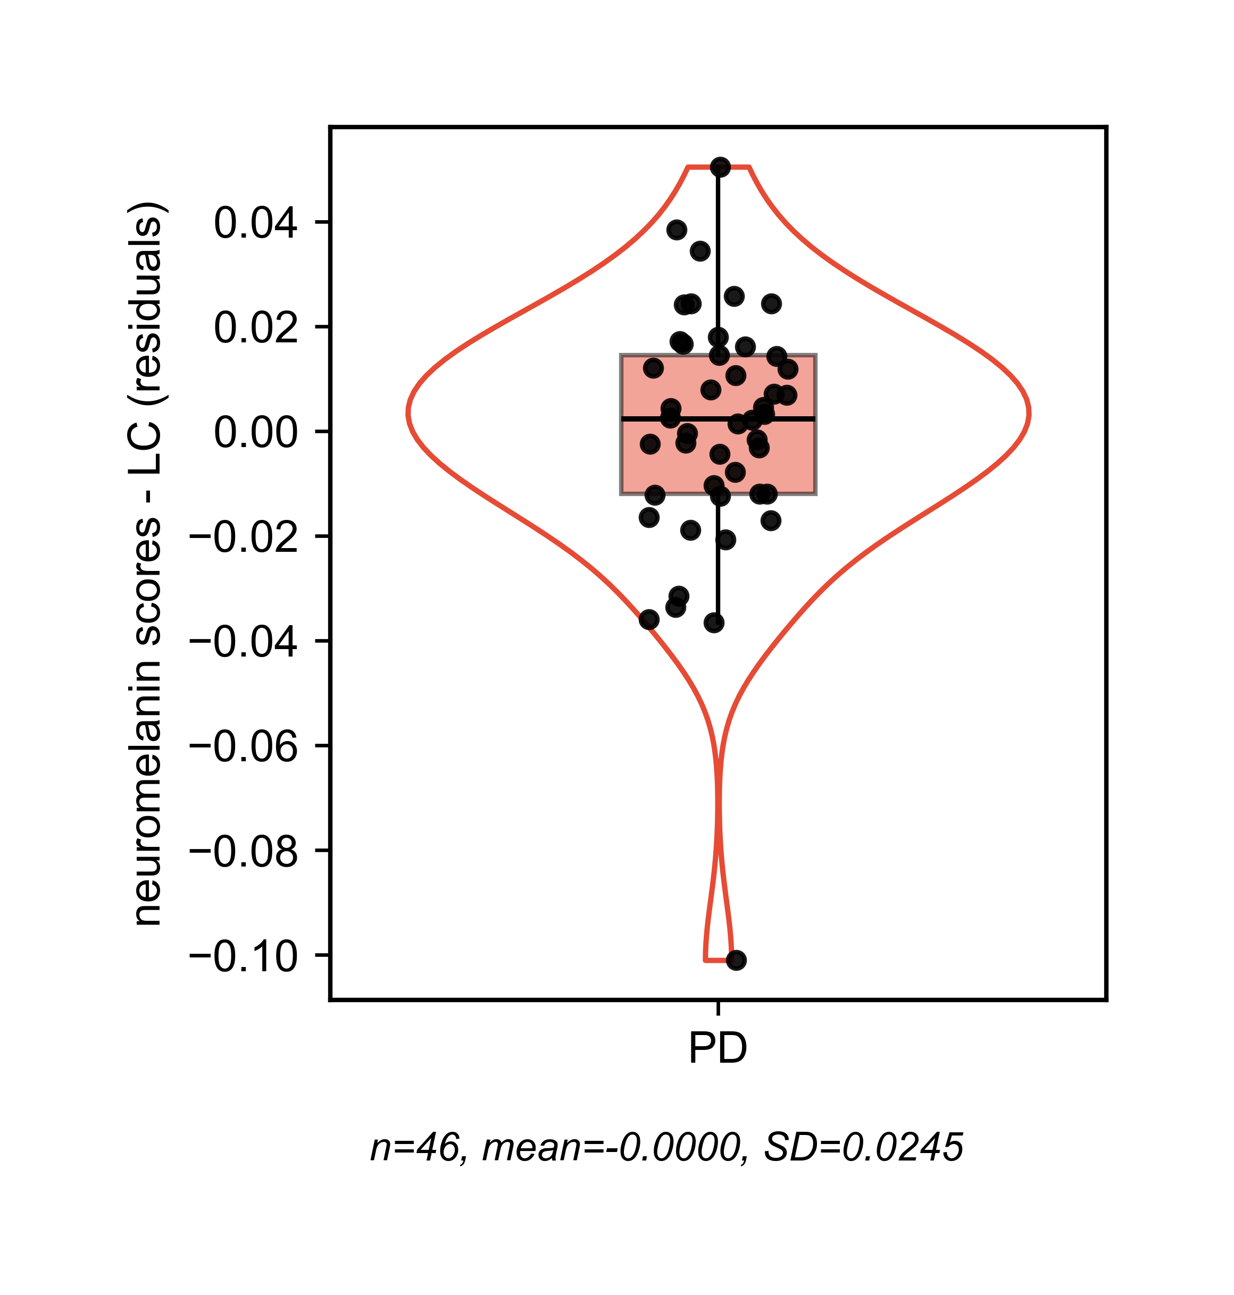
LC Residuals Violin Plot

Slide 13
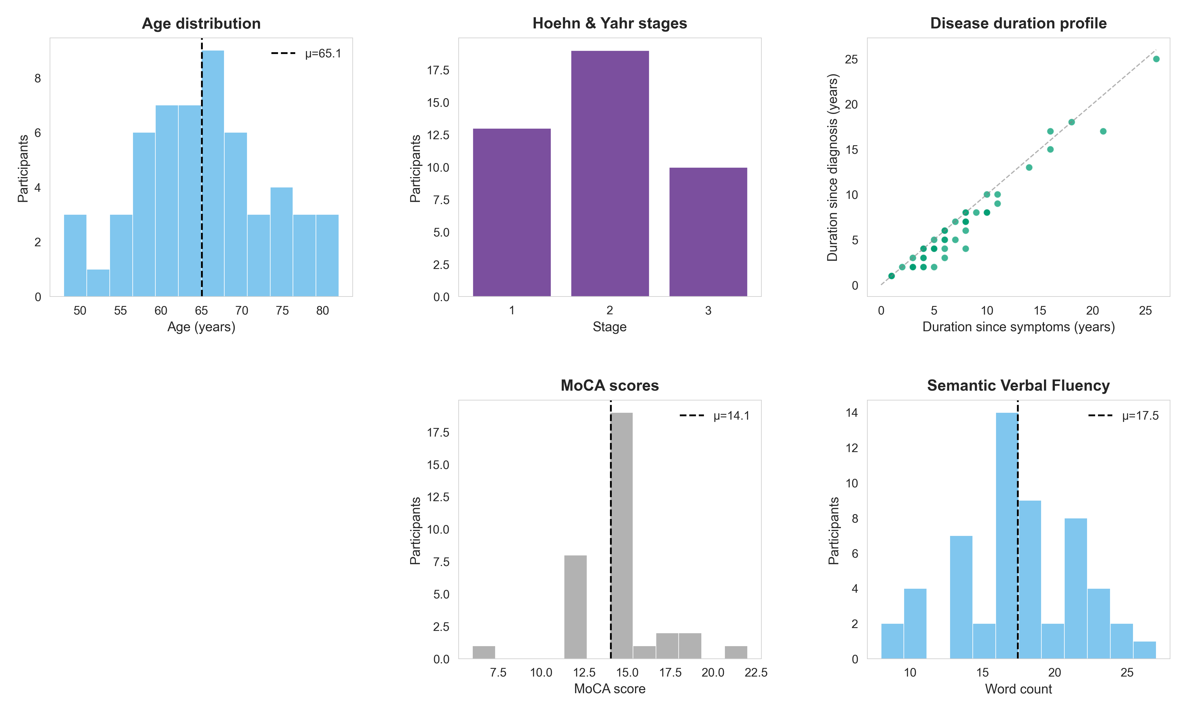
Intermediate: Participant Demographics

Slide 14
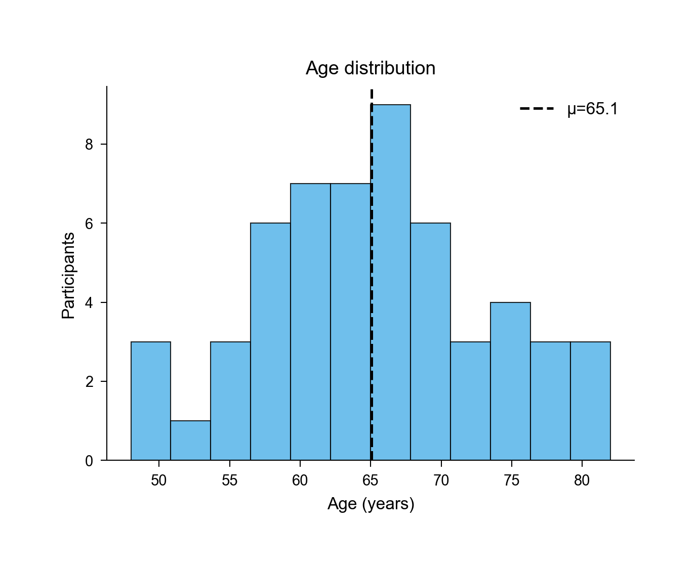
Intermediate: Age Distribution

Slide 15
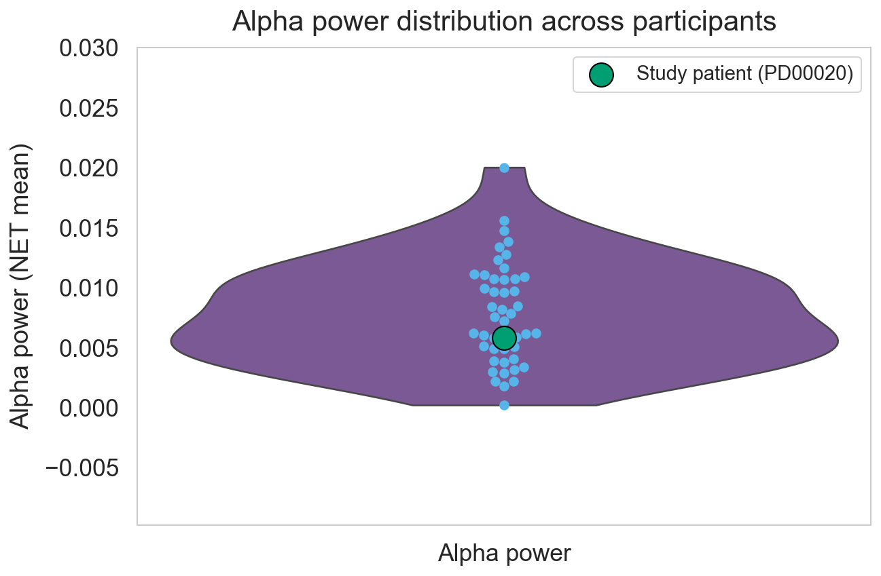
Intermediate: Alpha Power Violin

Slide 16
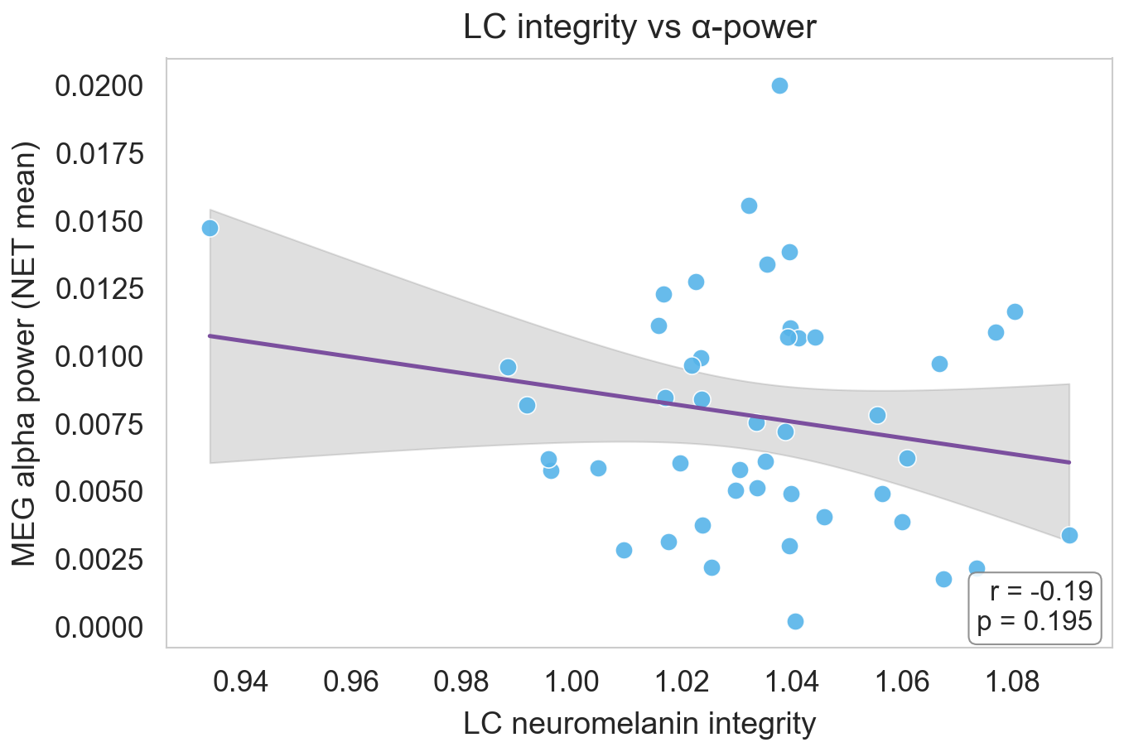
Intermediate: LC vs Alpha

Slide 17
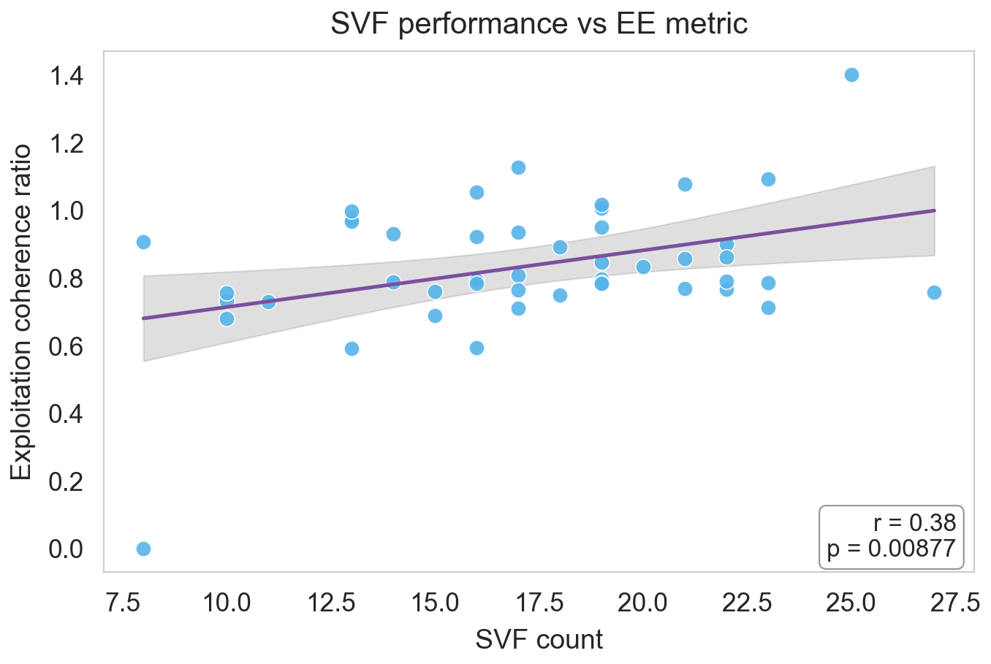
Intermediate: SVF vs EE

Slide 18
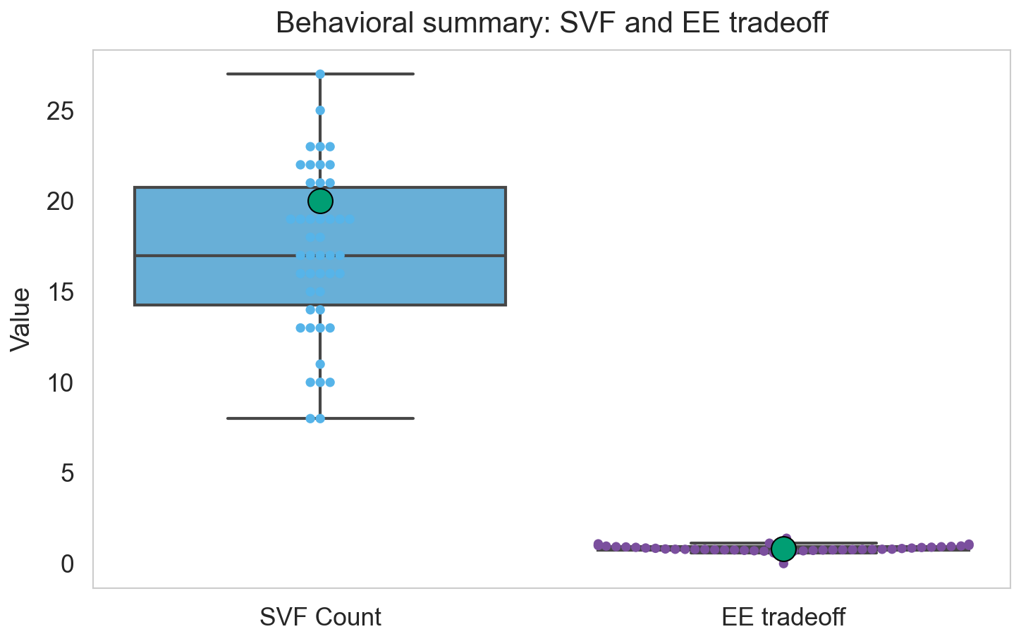
Intermediate: SVF EE Box-Swarm

Slide 19
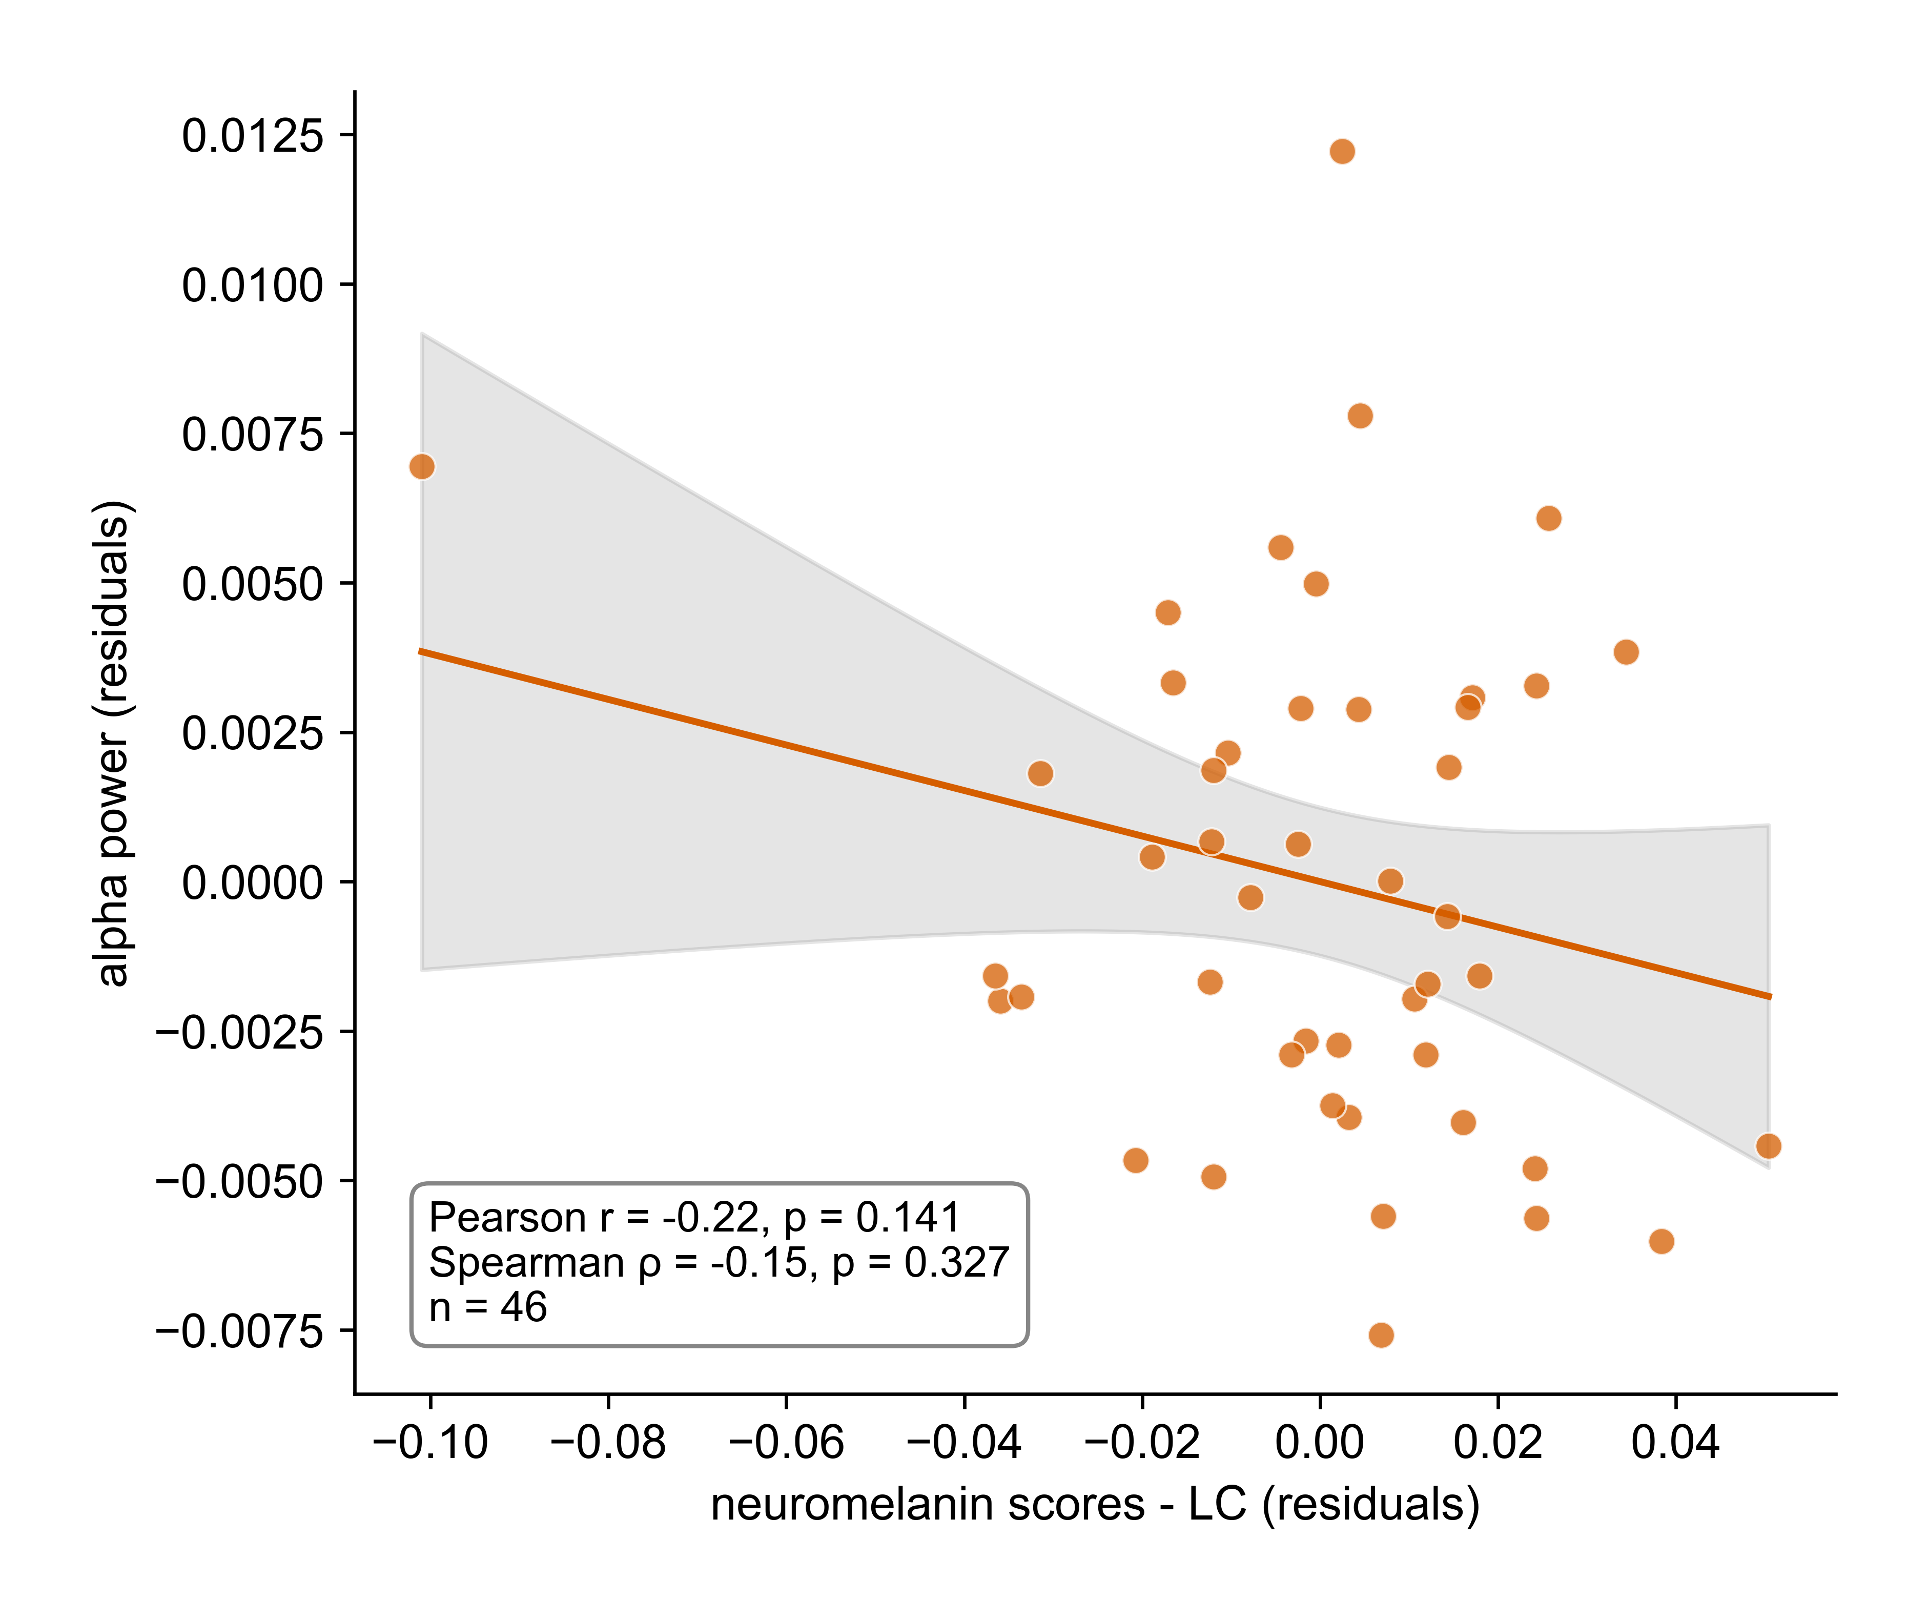
Alpha vs LC Residuals

Slide 20
Semantic Fluency Analysis

Slide 21
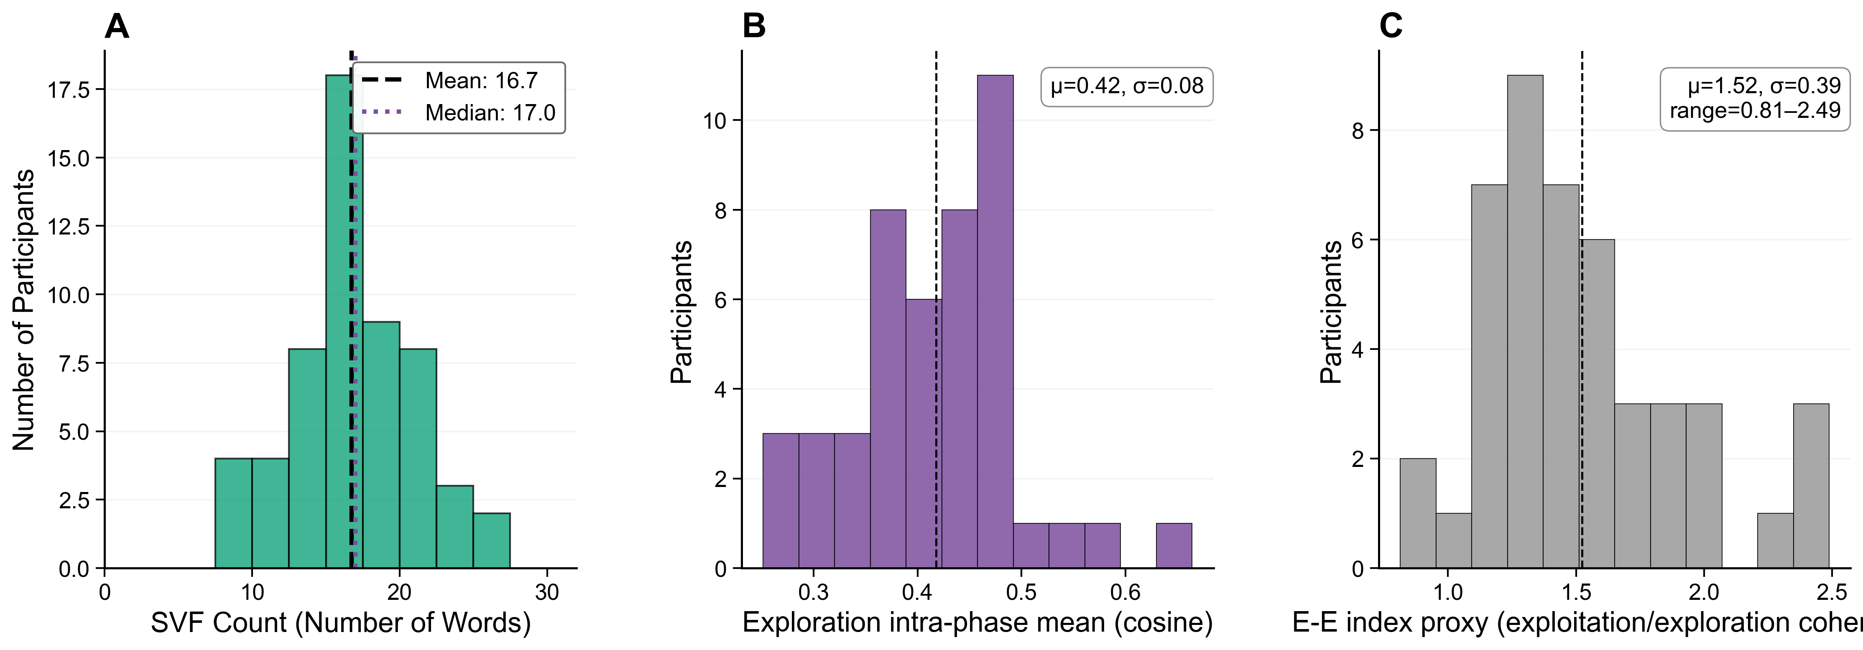
Compiled Distribution Figures

Slide 22
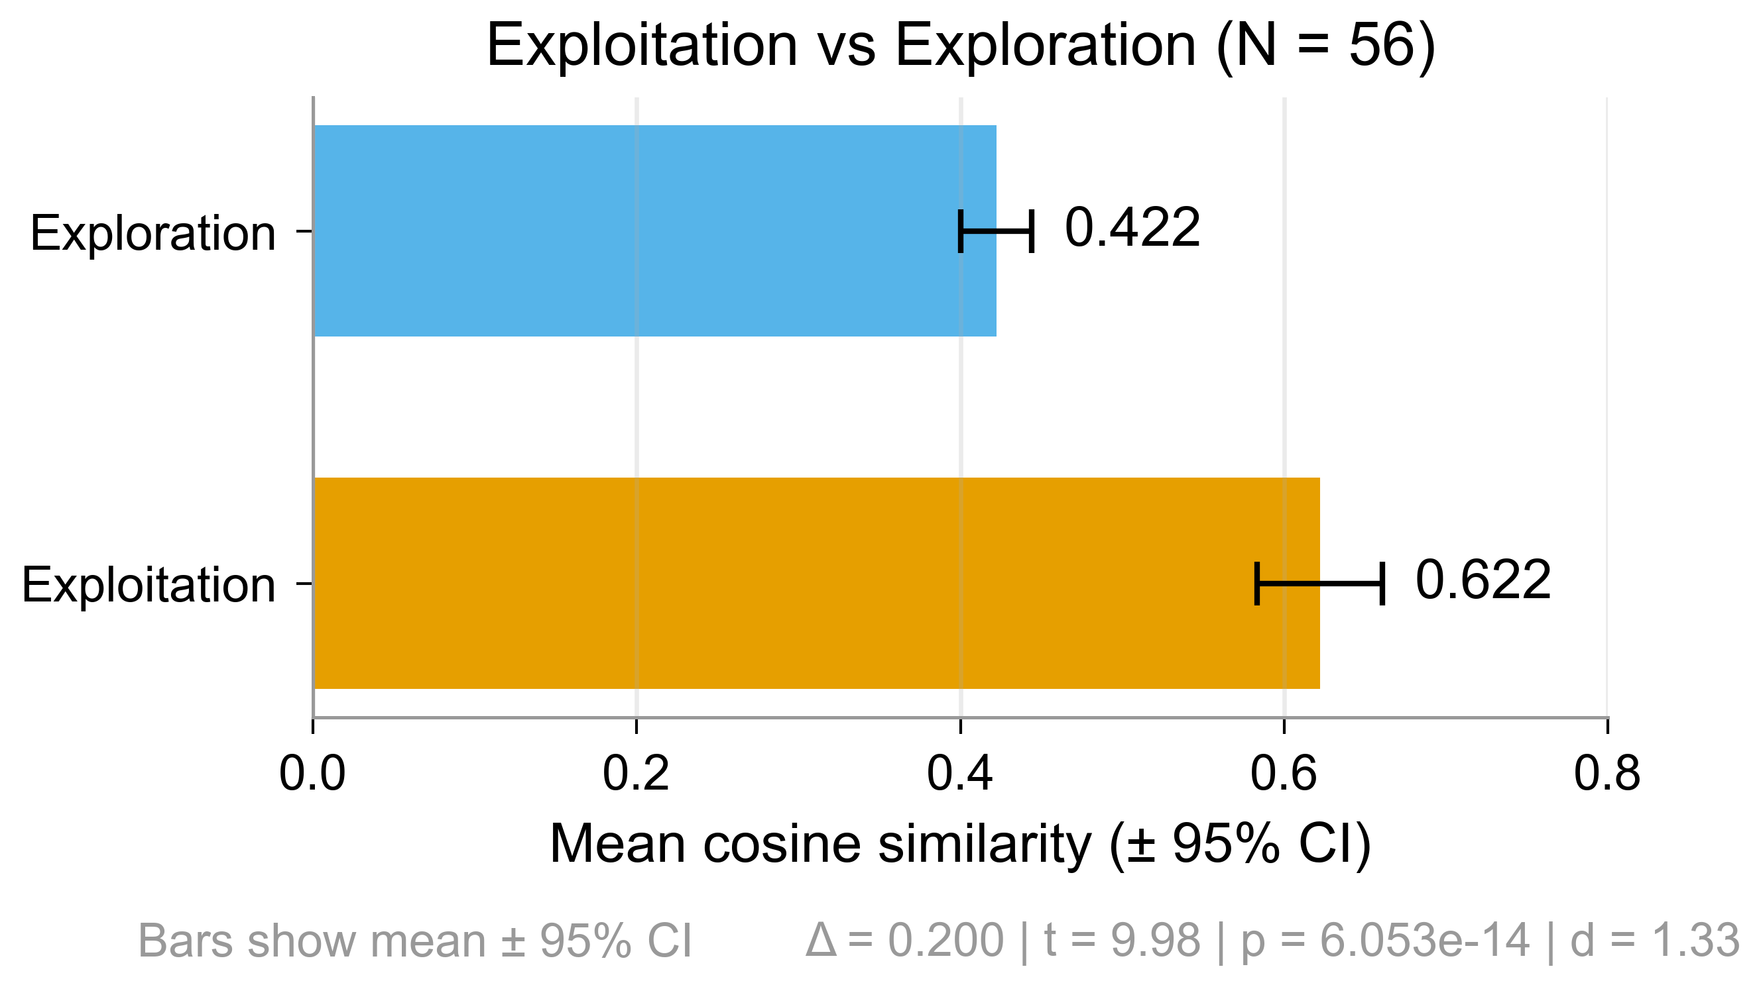
Exploit Explore Bar Chart

Slide 23
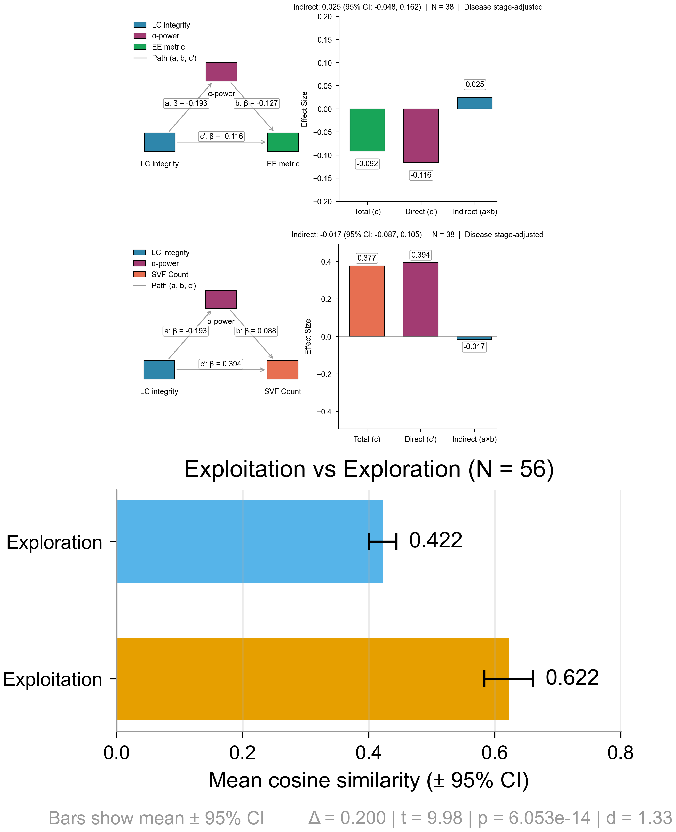
Combined Mediation Exploit Panels

Slide 24
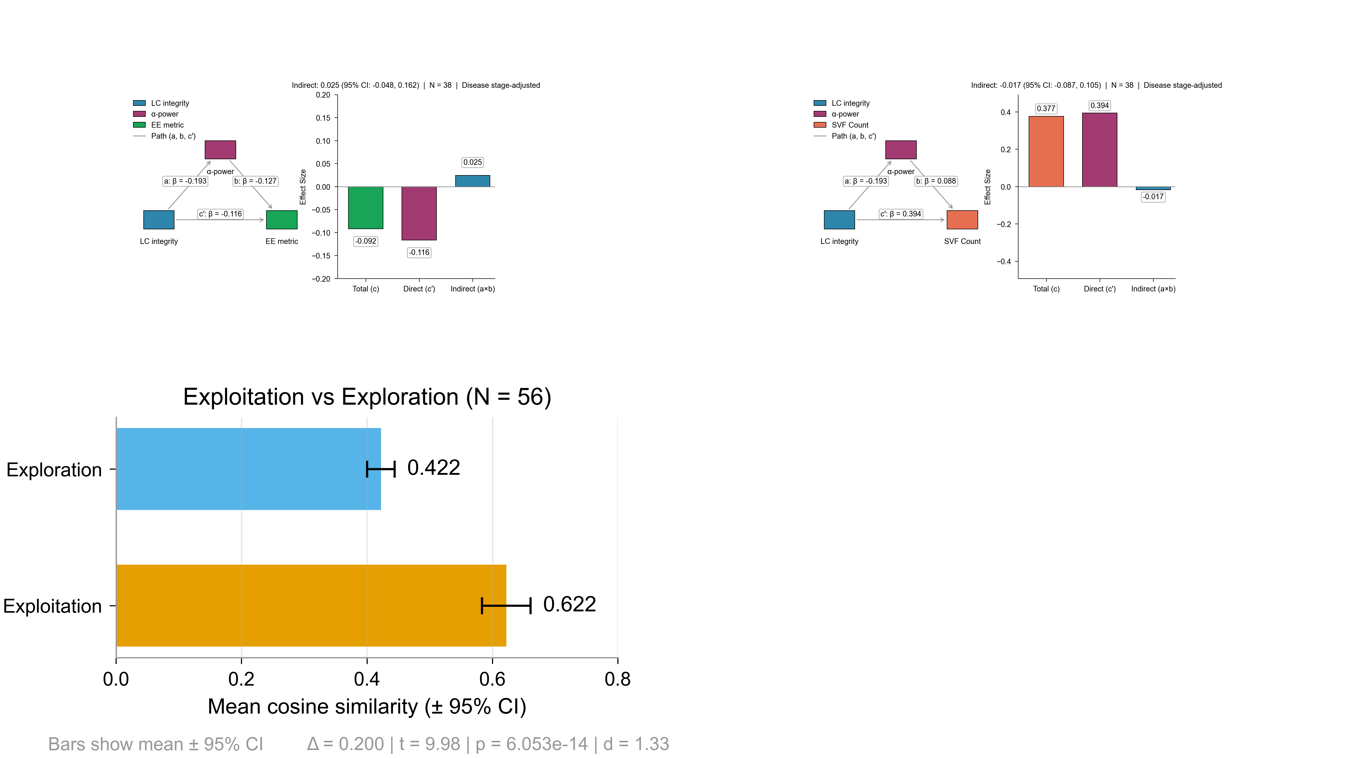
Test Grid Panels

Slide 25
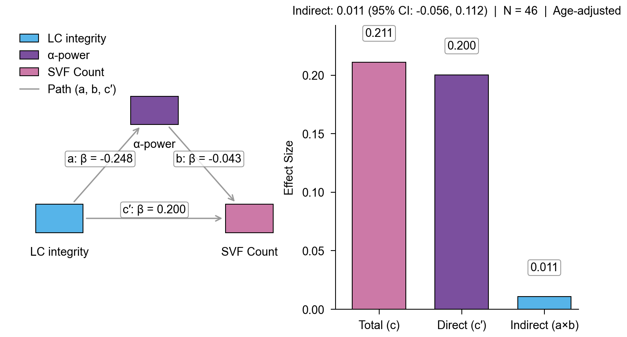
Mediation: SVF (Age-adjusted)

Slide 26
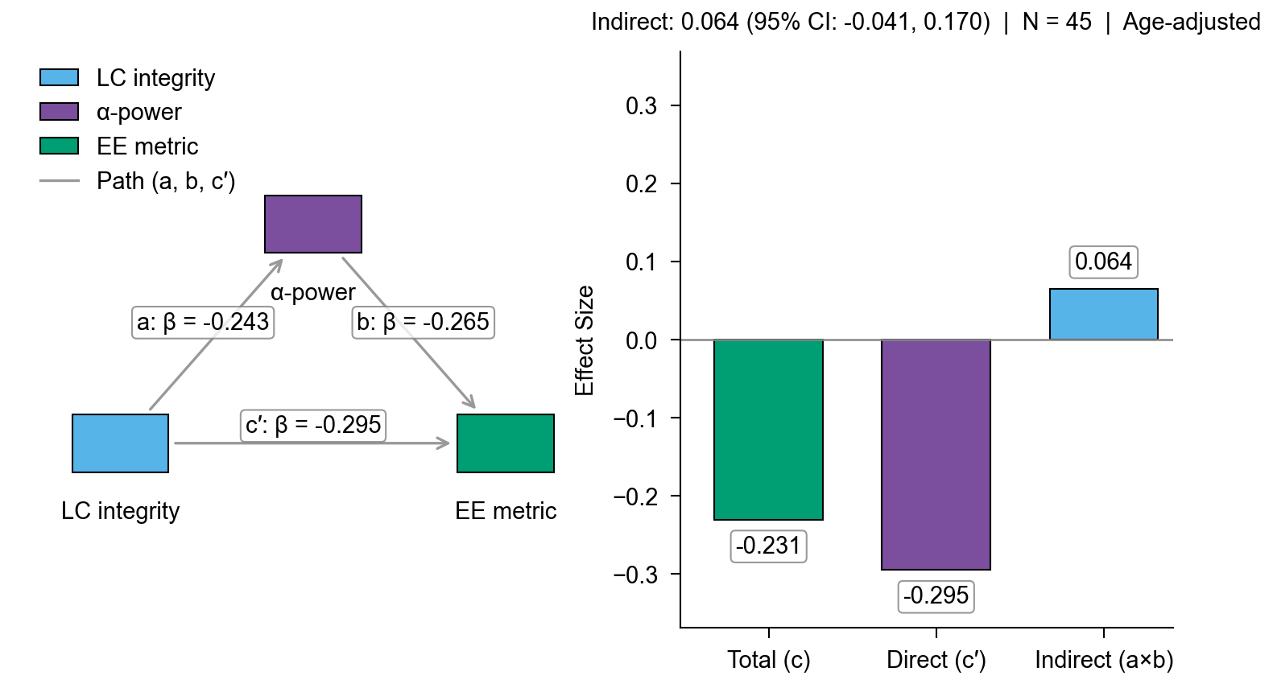
Mediation: EE Metric (Age-adjusted)

Slide 27
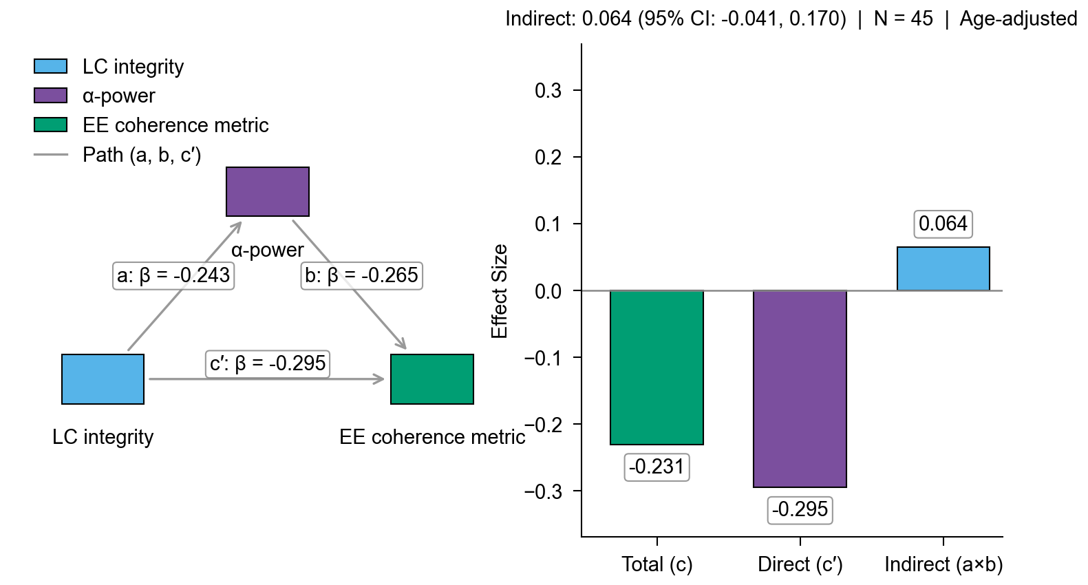
Mediation: EE Coherence Metric (Age-adjusted)

Slide 28
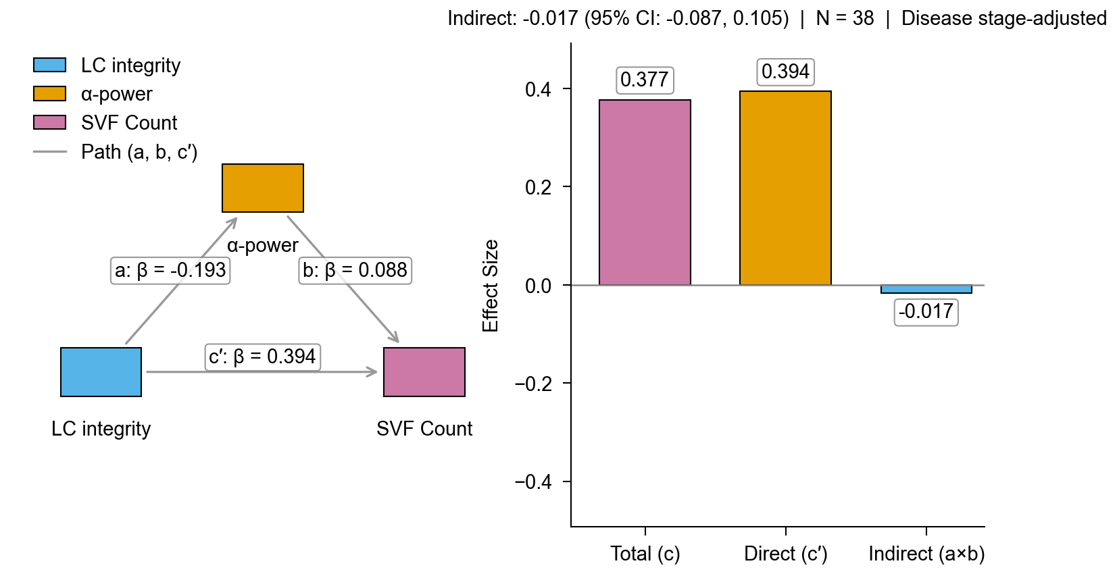
Mediation: SVF (Disease Stage)

Slide 29
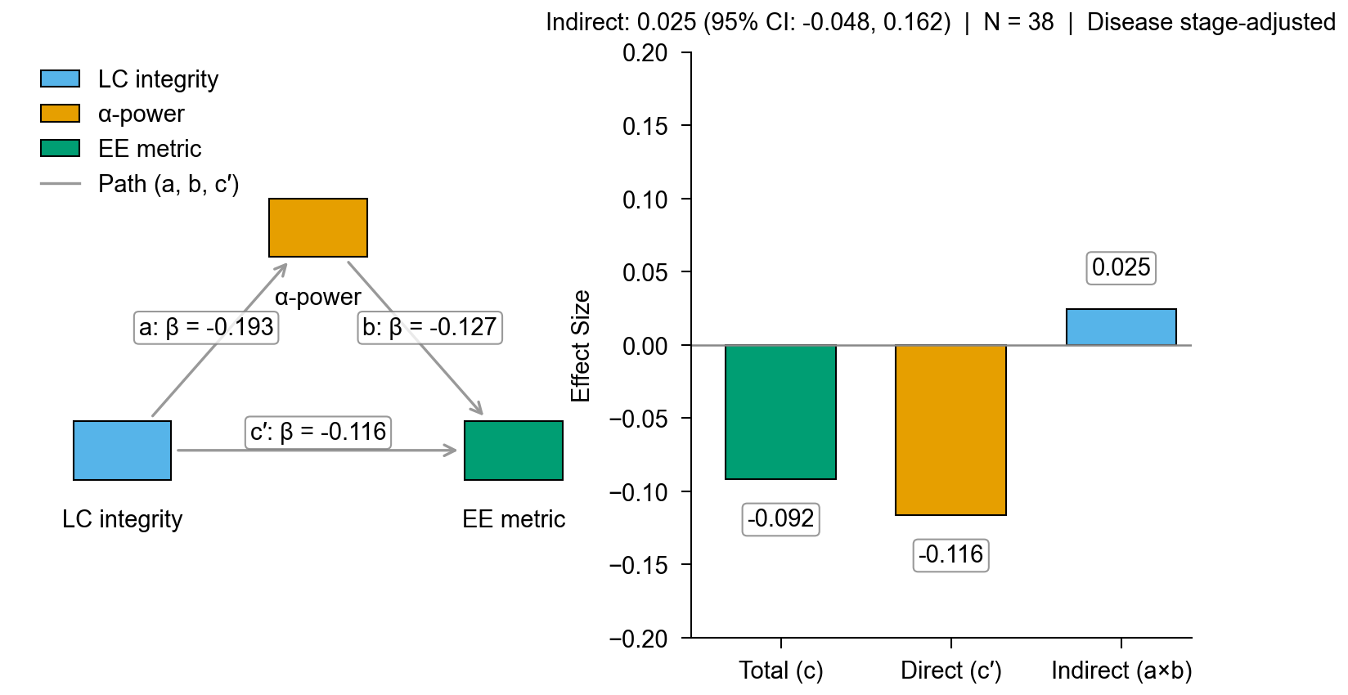
Mediation: EE (Disease Stage)

Slide 30
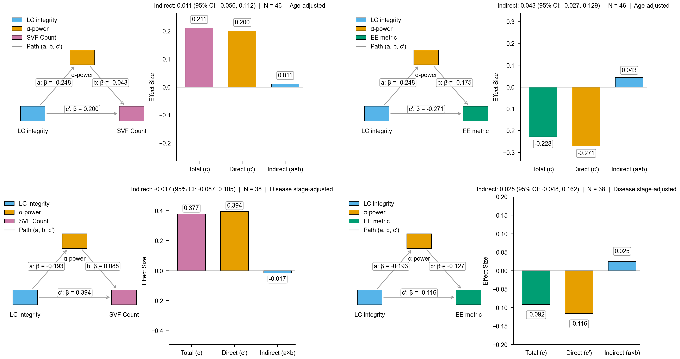
Mediation: Age vs Disease

