Slide 1
PPT模板下载：www.1ppt.com/moban/ 行业PPT模板：www.1ppt.com/hangye/
节日PPT模板：www.1ppt.com/jieri/ PPT素材下载：www.1ppt.com/sucai/
PPT背景图片：www.1ppt.com/beijing/ PPT图表下载：www.1ppt.com/tubiao/
优秀PPT下载：www.1ppt.com/xiazai/ PPT教程： www.1ppt.com/powerpoint/
Word教程： www.1ppt.com/word/ Excel教程：www.1ppt.com/excel/
资料下载：www.1ppt.com/ziliao/ PPT课件下载：www.1ppt.com/kejian/
范文下载：www.1ppt.com/fanwen/ 试卷下载：www.1ppt.com/shiti/
教案下载：www.1ppt.com/jiaoan/
《 Locating Visual Explanations for Video Question Answering》
汇报人：宋小萌

Slide 2
Outline
1. New Task: VQA-VE
2. New Dataset: Activity-QA
3. New Model
4. Experiments

Slide 3
Outline
New Task: VQA-VE
  Motivation
  Task
  Advantages
  Challenges

Slide 4
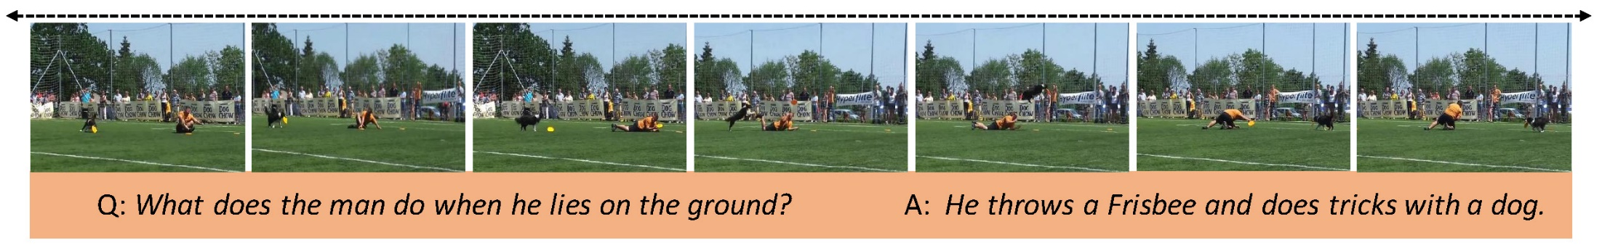
Motivation
Traditional Video Question Answering (VideoQA)
Task: answering a natural language question based on a given video
Goal: joint reasoning of visual contents and natural languages
Limitation: There is still a huge gap for human to truly understand the
model decisions.

Slide 5
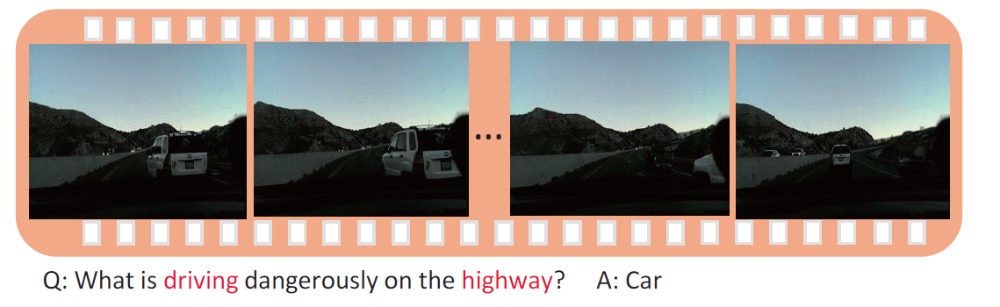
Motivation
1.some models show good performance can only by exploiting strong language prior without truly understanding the visual contents.
2. answers in some datasets present imbalanced distribution, in which case models can achieve high accuracy by simply remembering the most frequent answer and discarding the visual contents.
It is desirable to let models provide explanations with predicted answers for human to truly understanding their desicions.

Slide 6
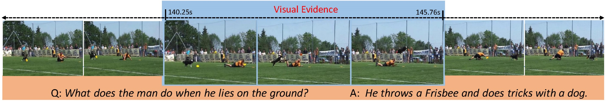
Task
Video Question Answering with Visual Explanations (VQA-VE)
Task: models are not only required to generate answers given questions and videos, but also expected to provide visual explanations (i.e., locating relevant moments within the whole video) simultaneously

Slide 7
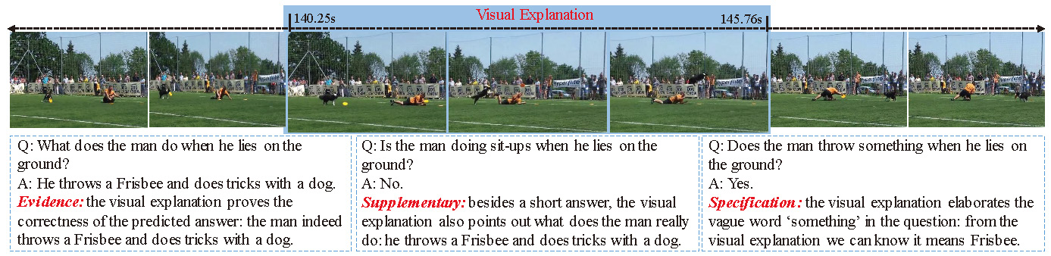
Advantages
Increasing the model interpretation
An evidence to justify if predicted answers are convincible and traceable
A supplementary to provide relevant information on the context of QA pairs
A specification to indicate vague expressions or abstract concepts in QA pairs vividly

Slide 8
Challenges
Bridging two separate and typical visual tasks: video question answering and temporal localization
Dealing with short as well as long sequences of video frames
Generating complete and fluent sentences as answers
Capturing the correlations between natural languages and visual contents

Slide 9
Outline
2. New Dataset: Activity-QA
  Motivation
  Dataset Collection
  Dataset Analysis
  Dataset Comparison

Slide 10
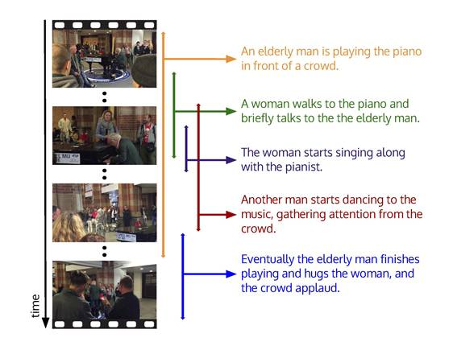
Motivation
VQA-VE consists of two coupled sub-tasks: generate answers and provide visual explanations. Its nature and function needs corresponding datasets have temporally annotated QA pairs (each QA pair is coupled with a start time and end time to mark the relevant moment within the whole video). Unfortunately, most existing datasets fail to meet such requirement. Therefore, we build a new dataset called Activity-QA on top of ActivityNet Captions.

Slide 11
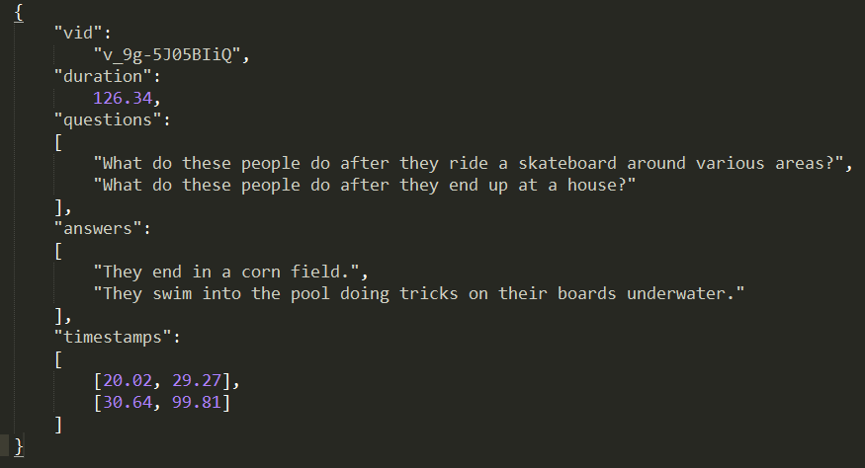
By leveraging the videos and temporally annotated descriptions in original dataset, we collect 12059 QA pairs for 7034 untrimmed long
videos.
Dataset Collection

Slide 12
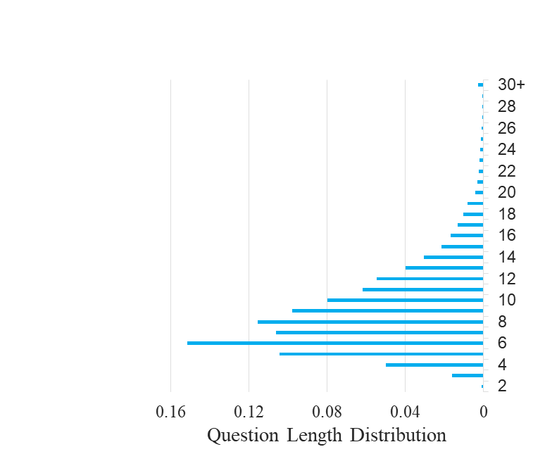
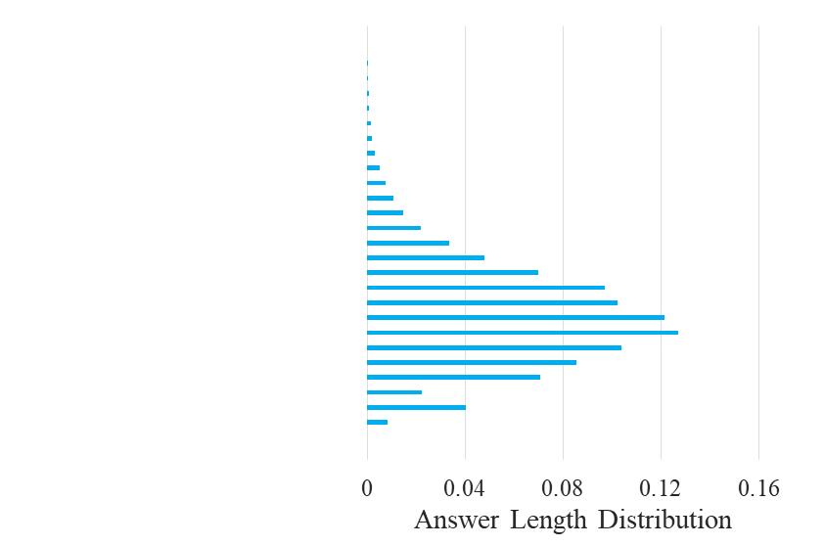
Dataset Analysis
Open-ended: Activity-QA is an open-ended dataset that natural language sentences are expected to be produced word by word as answers. Compared with other open-ended VideoQA datasets our QA pairs are longer. In addition, since our videos are about real-world scenes and collected from Youtube, QA
pairs share rich vocabulary diversity. The total number of words appearing in our QA pairs is 4992.

Slide 13
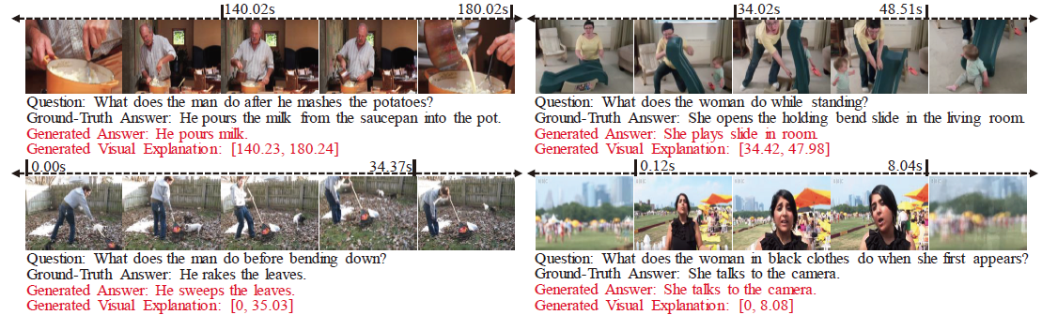
Dataset Analysis
Action-centric and Time-centric：Corresponding to the dynamic and temporal characteristics of videos, our QA pairs feature action-centric and time-centric. Specifically, questions in Activity-QA are all about the evolving of events or actions. Besides, most of our questions contain temporal adverbial such as ‘after’, ‘at first’, ‘the second time’ etc, which serves as the key to answer questions and locate relevant moments accurately.

Slide 14
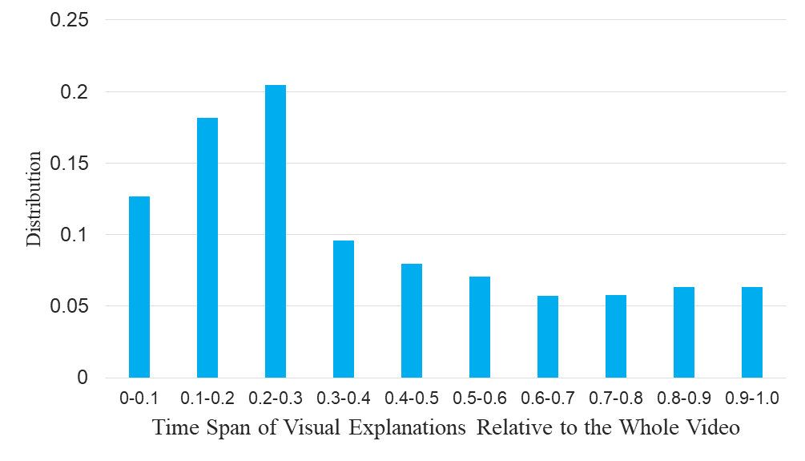
Dataset Analysis
Temporally Annotation: The time spans of visual explanations are various relative to the overall video length. Therefore, in order to locate all visual explanations, models need to encode short as well as long sequences of video frames.

Slide 15
Dataset Analysis
Double-check: After constructing temporally annotated QA pairs, we double check each one manually for ensuring their reasonability and validity. During the double-check process, we ensure each QA pair only matches one exact part in the whole video for eliminating the ambiguity when models provide visual explanations. We also adjust the start time and end time, making them more precisely. Besides, we filter out QA pairs which are not action-centric and time-centric. However, we keep some grammar errors because we believe that models should be robust under such errors. Under those strict standards, we collect 12059 temporally annotated QA pairs for 7034 videos in total.

Slide 16
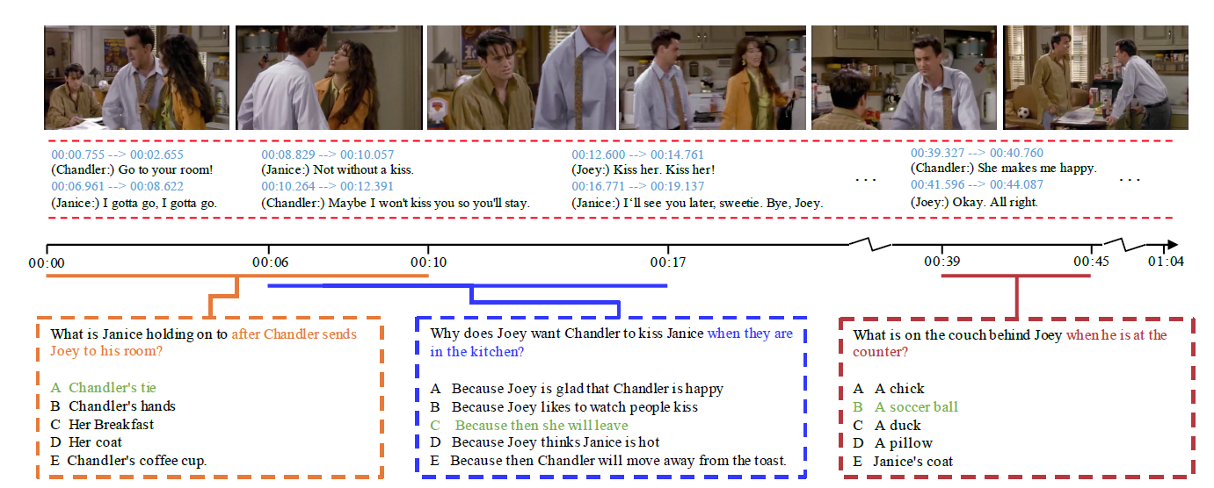
Dataset Comparison
TVQA : TVQA consists of 152,545 QA pairs from 21,793 clips, spanning over 460 hours of video.

Slide 17
Dataset Comparison
Compared with TVQA, Activity-QA has two advantages:
Our QA form is open-ended which is a more general and challenging task than the multiple choice form in TVQA. Besides enabling much wider applications, open-ended puts forward higher requirements for models to deal with natural languages. Also, without candidates, models can hardly utilize prior information related to answers in the test process.
Our QA pairs feature action-centric and time-centric while some QA pairs in TVQA are only about static objects. It allows to find answers by observing single frame with no consideration of temporal dependency of videos, which reduces the native challenges of videos.

Slide 18
Outline
3. New Model
  Problem Formulation
  Overview
  Multi-task Loss

Slide 19
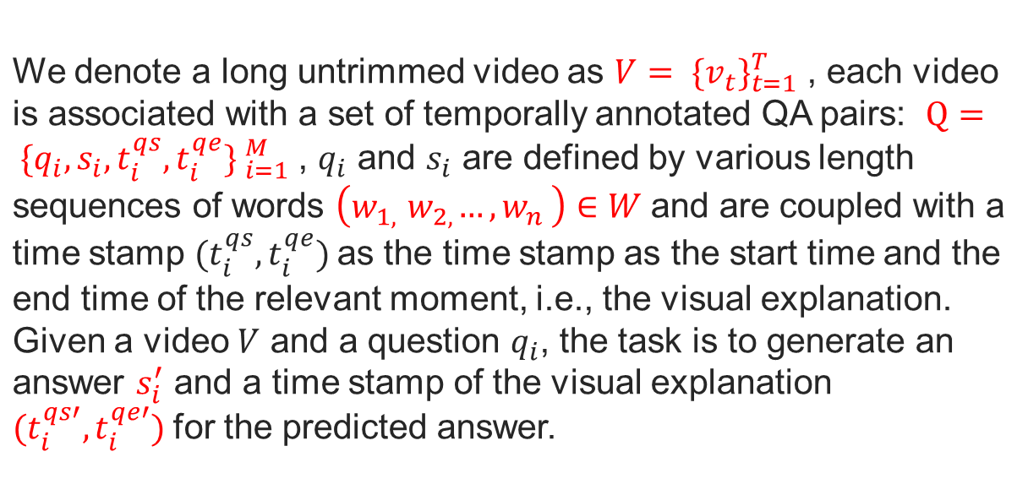
Problem Formulation

Slide 20
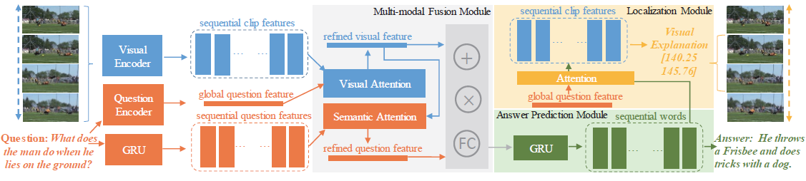
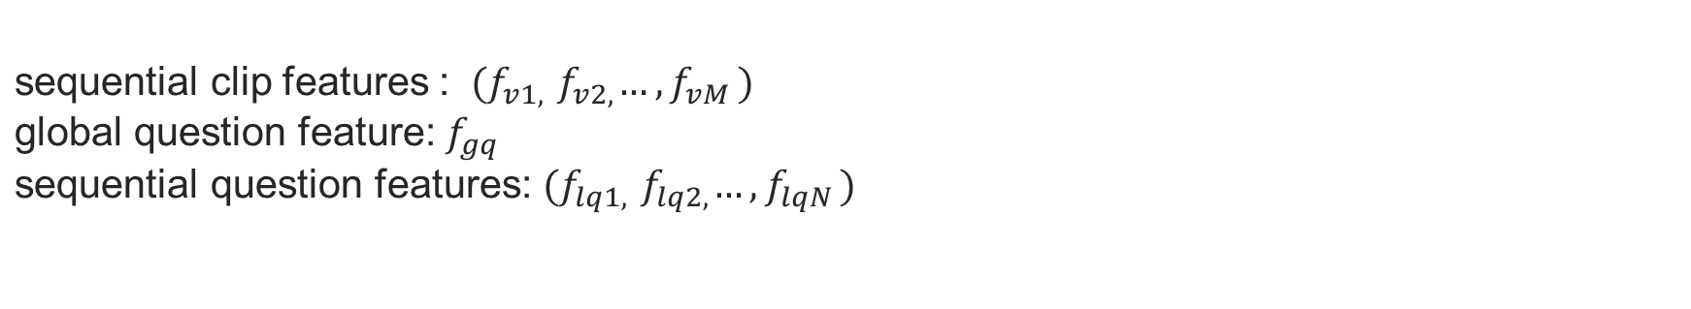
Overview

Slide 21


Overview
Visual Attention
Semantic Attention

Slide 22
Overview
Multi-modal Fusion Module: First, we refine cross-modal features by visual attention and semantic attention. Then we use element-wise addition, element-wise multiplication and concatenation followed by a Fully Connected (FC) layer to integrate two generated features. Outputs from three operations are concatenated to construct a multi-modal representation.

Slide 23
Overview
Answer Prediction Module: We employ a single-layer GRU to generate each word of answers step by step. The multi-modal representation from
multi-modal fusion module serves as an initial state to GRU
for guiding the answer generation.
Localization Module: We concatenate the final hidden state of GRU in answer prediction module with global question feature to calculate attention weights for sequential clip features and feed weighted clip features into two FC layers to generate localization predicted results.

Slide 24

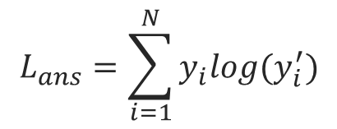

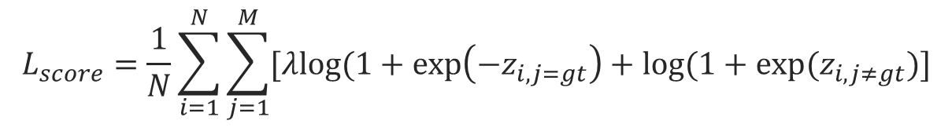
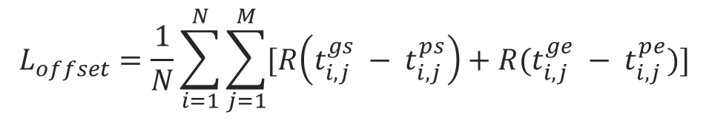
Multi-task Loss
Total loss
Answer loss - Cross Entropy
Localization loss

Slide 25
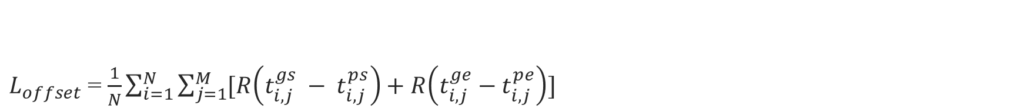
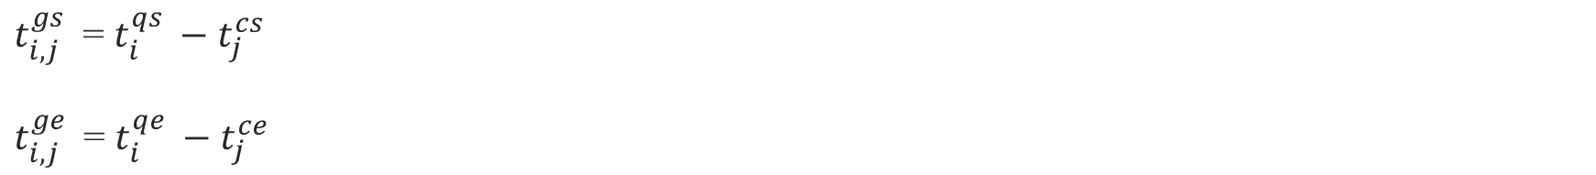
Multi-task Loss

Slide 26
Outline
4. Experiments
  Training Sample
  Evaluation Metric
  Comparison of Visual Encoder
  Comparison of Question Encoder
  Baseline Methods
  Experiments on ActivityQA / TVQA
  Experiments on Traditional VideoQA Task

Slide 27
Training Sample
To deal with visual explanations with various time span, we use multi-scale temporal sliding windows to collect clips according to the frame number of videos in two datasets.
Training Time:
        [32,64,128,256,512] 80% overlap for Activity-QA
        [9,15,21,33,45] 80% overlap for TVQA
Test Time (coarse sampling for speeding up):
        [128,256] 80% overlap for Activity-QA
        [9,15] 80% overlap for TVQA

Slide 28
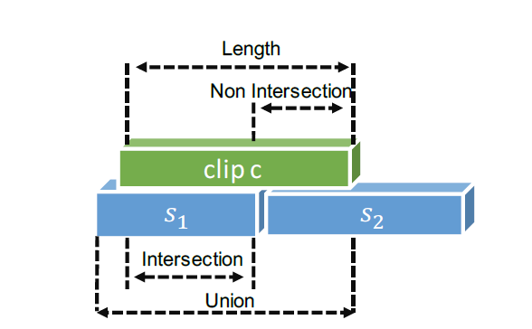
Training Sample
For each temporally annotated QA pair, we assign a sliding window clip as a matched one if it has the largest IoU with the ground-truth time stamp. We also stipulate that non Intersection over Length between matched clip and ground-truth is smaller than 0.15. Under these constraints, each QA pair is aligned with only one matched clip.

Slide 29
Training Sample
To avoid redundant mismatched samples, we also filter out clips whose IoU smaller than 0.1 with the ground-truth when training (at test time we feed all clips into model).

Slide 30
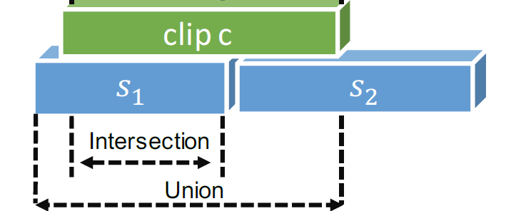
Evaluation Metric
For localization quality, we use the Intersection over Union (IoU) to calculate the localization predicted result and ground-truth.

Slide 31
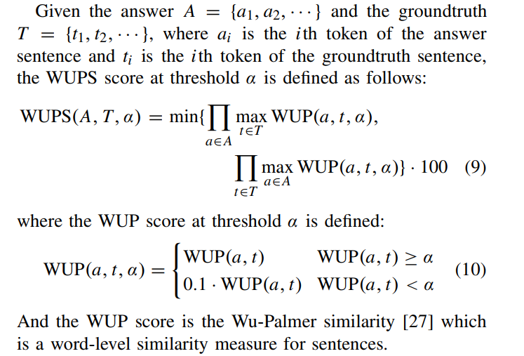
Evaluation Metric
For answer quality, we use the WUPS following the previous works. WUPS is a reasonable metric that not simply compares the prediction and ground truth word by word, but calculates the semantic similarity of two sentences.

Slide 32
Evaluation Metric
We combine them to measure the whole task quality by two different ways.
‘hard metric’: when calculated IoU higher than the given threshold, we set it to 1.0, otherwise 0.0, and multiply with the WUPS score as the whole task quality. Specifically, we compute ‘WUPS=n, IoU=m’ which means we set threshold n for WUPS and m for IoU, and ‘R@t’ means the top-t results we pick to calculate the IoU.
‘soft metric’: in that case we don’t set any threshold for IoU. Instead, we pick the calculated IoU as the confidence score for predicted answers and multiply with the WUPS score as the whole task quality.

Slide 33
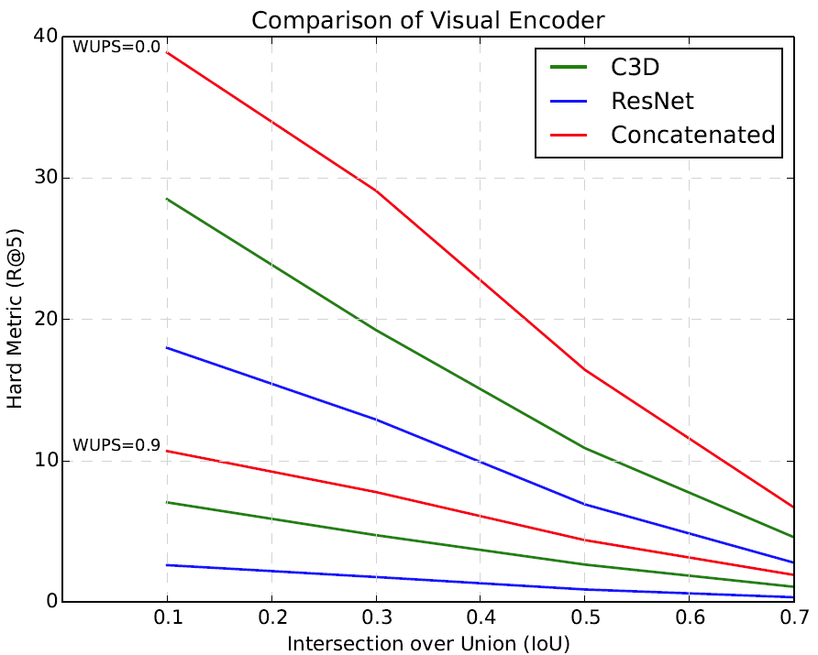
Comparison of Visual Encoder
The reason might be that C3D features capture the temporal information of clips while ResNet-200 features capture the static frame contents, combining them can complement each other and make visual information more complete.

Slide 34
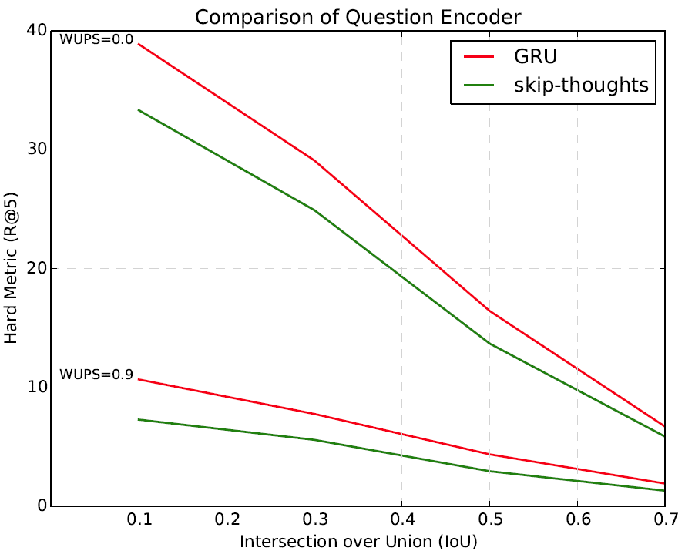
Comparison of Question Encoder
The reason might be that GRU is trained end-to-end in our model while skip-thoughts is a pretrained tool, GRU can better learn the characteristics of questions in Activity-QA during the training process.

Slide 35
Baseline Methods
We use methods proposed in the previous work for open-ended VideoQA as answer prediction module and combine with our localization module to construct some baseline methods. Besides, we use CTRL proposed for language based temporal localization as localization module and combine with our answer prediction module as another baseline method.
We also experiment with different variants of our model: whole is our proposed model, vmean and qmean use temporal mean pooling instead of visual attention or semantic attention, and noatt uses concatenation instead of attention to fuse final hidden state output by answer prediction module, global question feature and sequential clip features.

Slide 36
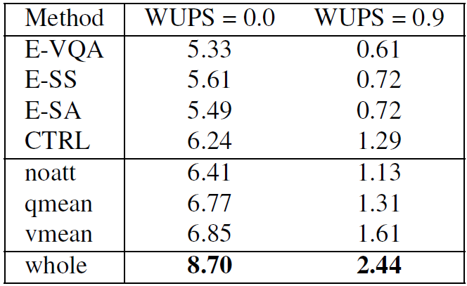
Experiments on Activity-QA
Performance on Activity-QA evaluated by soft metric.

Slide 37
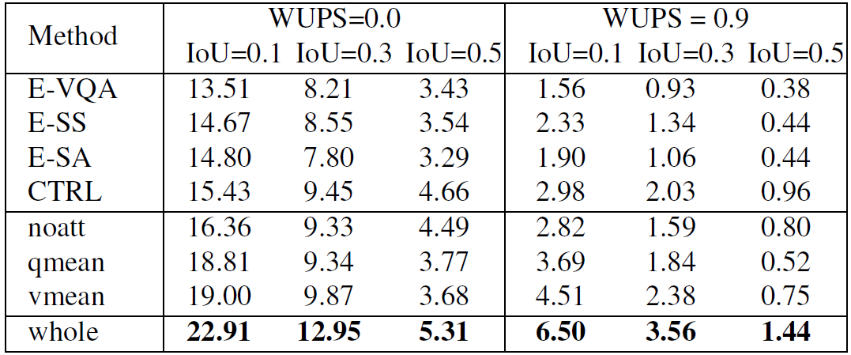
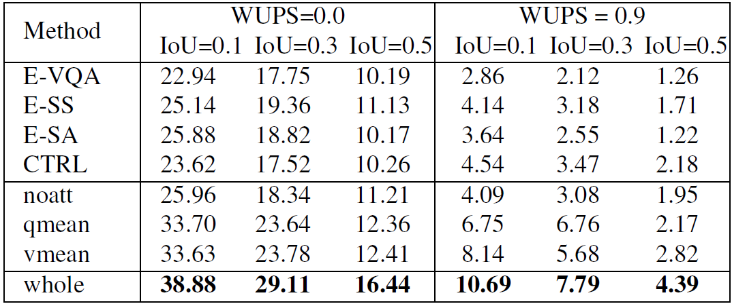
Experiments on Activity-QA
Performance on Activity-QA evaluated by hard metric (R@1).
Performance on Activity-QA evaluated by hard metric (R@5).

Slide 38
Experiments on Activity-QA
Qualitative results

Slide 39
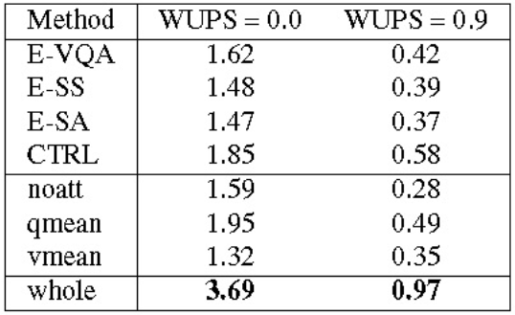
Experiments on TVQA
Performance on TVQA evaluated by soft metric.

Slide 40
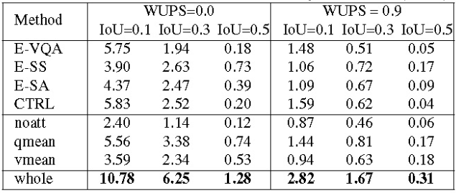
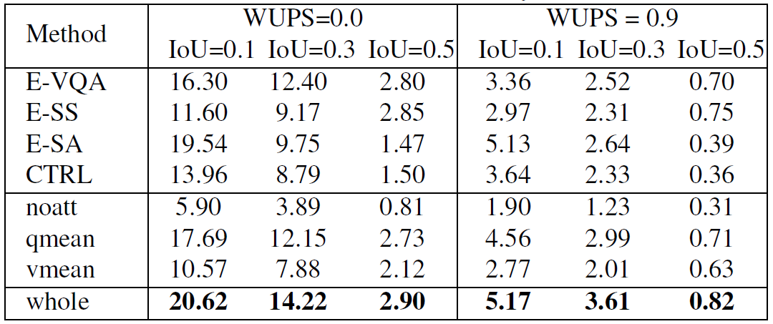
Experiments on TVQA
Performance on TVQA evaluated by hard metric (R@1).
Performance on TVQA evaluated by hard metric (R@5).

Slide 41
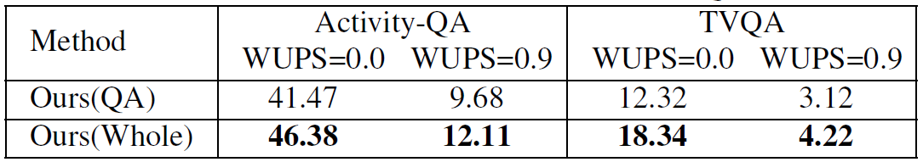
Experiments on Traditional VideoQA task
It suggests that additional supervision of visual explanations can help models achieve better performance on traditional VideoQA task.

Slide 42
Thank You
PPT模板下载：www.1ppt.com/moban/ 行业PPT模板：www.1ppt.com/hangye/
节日PPT模板：www.1ppt.com/jieri/ PPT素材下载：www.1ppt.com/sucai/
PPT背景图片：www.1ppt.com/beijing/ PPT图表下载：www.1ppt.com/tubiao/
优秀PPT下载：www.1ppt.com/xiazai/ PPT教程： www.1ppt.com/powerpoint/
Word教程： www.1ppt.com/word/ Excel教程：www.1ppt.com/excel/
资料下载：www.1ppt.com/ziliao/ PPT课件下载：www.1ppt.com/kejian/
范文下载：www.1ppt.com/fanwen/ 试卷下载：www.1ppt.com/shiti/
教案下载：www.1ppt.com/jiaoan/

