Slide 1

Predicting Employee Attrition
Jyoti Kumari, Sarah Lee, Hrishi Salitri, Vannie Sung, Milan Vaghani

Slide 2
Agenda
Problem Introduction
Exploratory Analysis
Modeling
Attrition insight

Slide 3
Companies need to understand employee attrition
High Cost
Productivity loss
Company culture

Slide 4
Employee Attrition Dataset
~ 70,000 rows of data
23 predictor variables
Target variable: Attrition
52% Stayed
Demographic
Job
Satisfaction
Work-Life Balance
Work Flexibility
Performance

Slide 5
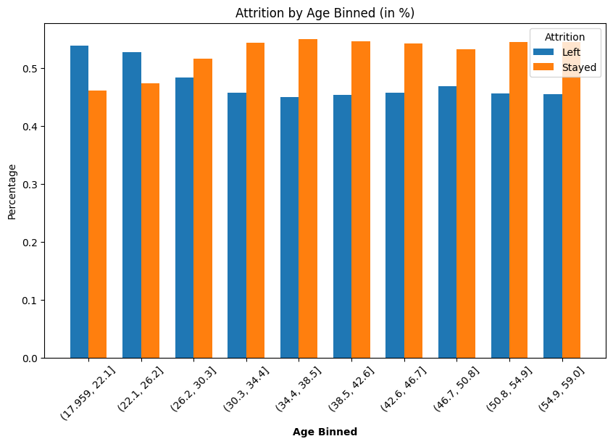
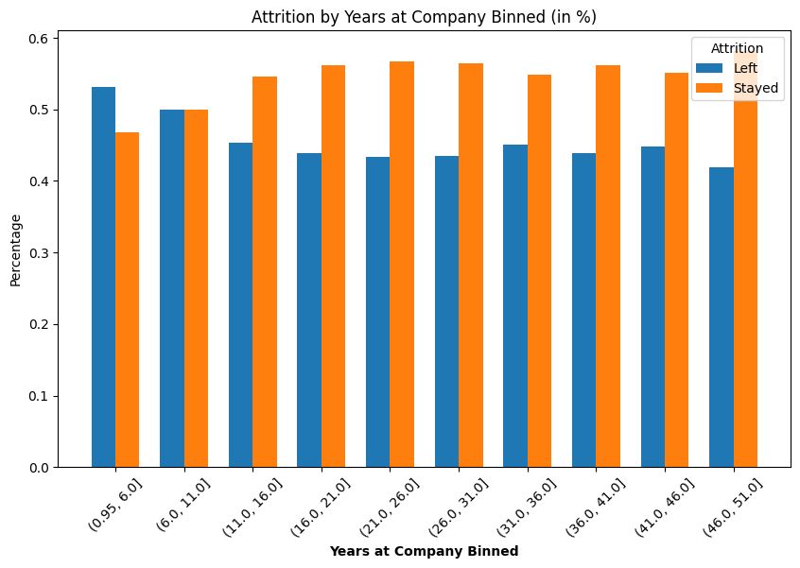
Exploratory Data Analysis(EDA)
Age vs Attrition
Older employees stay longer compared to younger employees who leave.
Older workers seek stability, resulting in longer company tenure.
Years at Company vs Attrition
Employees with higher tenure tend to stay
As these employees are invested in the company's growth and have ESOPs they tend to stay

Slide 6
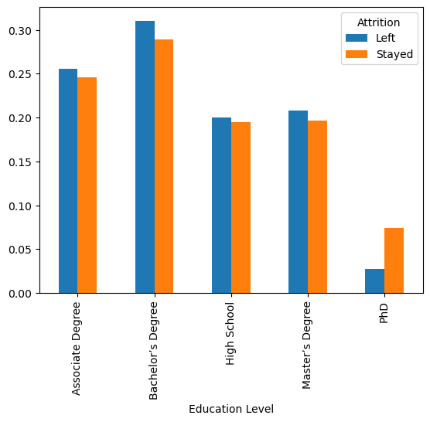
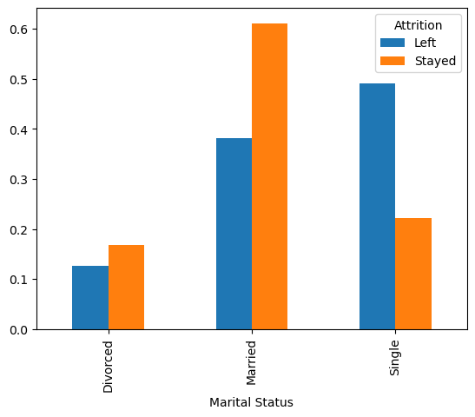
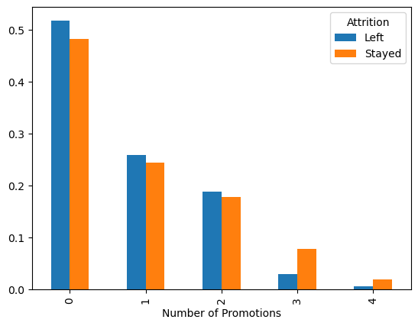
Education Level vs. Attrition
More education led to more loyalty
Employees with a bachelor’s degree exhibit the highest attrition rate
Marital Status vs. Attrition
‘Single’ tends to leave company frequently
‘Married’ tends to look for more stability, hence more likely to stay
Promotion vs. Attrition
No big impact until a certain threshold
75% of employees that stayed had at least 3 promotions.

Slide 7
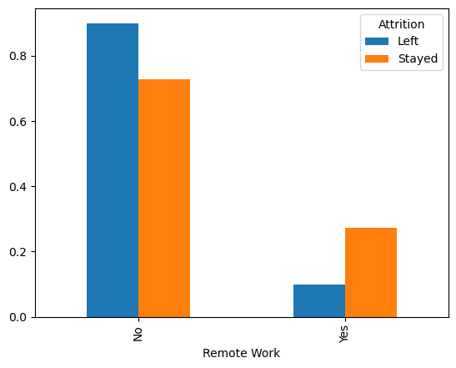
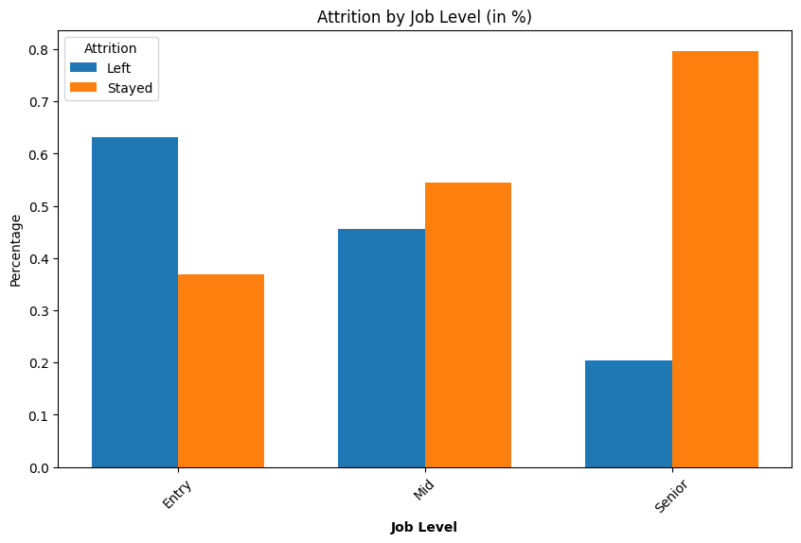
Work Environment vs. Attrition
Companies offering more flexible work-from-home arrangements have lower attrition rates
Job Level vs. Attrition
Higher up an employee was at the company, the less likely he or she are to leave

Slide 8
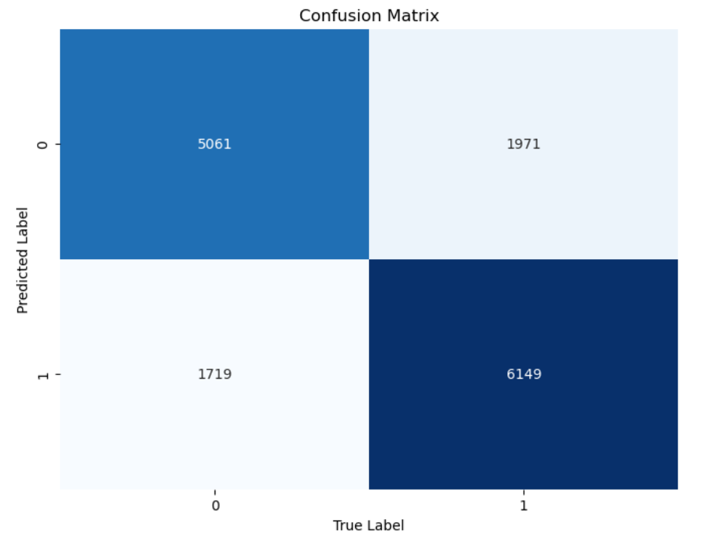
Model#1: Naïve Bayes
Variable Binning for Analysis:
Continuous variables (Age, Monthly Income, Distance from Home, Company Tenure) were binned into 5 quantiles.
Years at Company was binned into specific intervals to capture key career stages and tenure-related trends.
Model Performance:
Accuracy: 75%

Slide 9
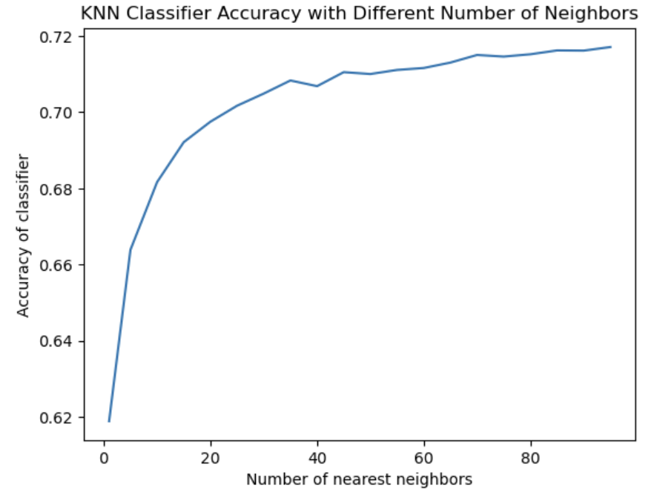
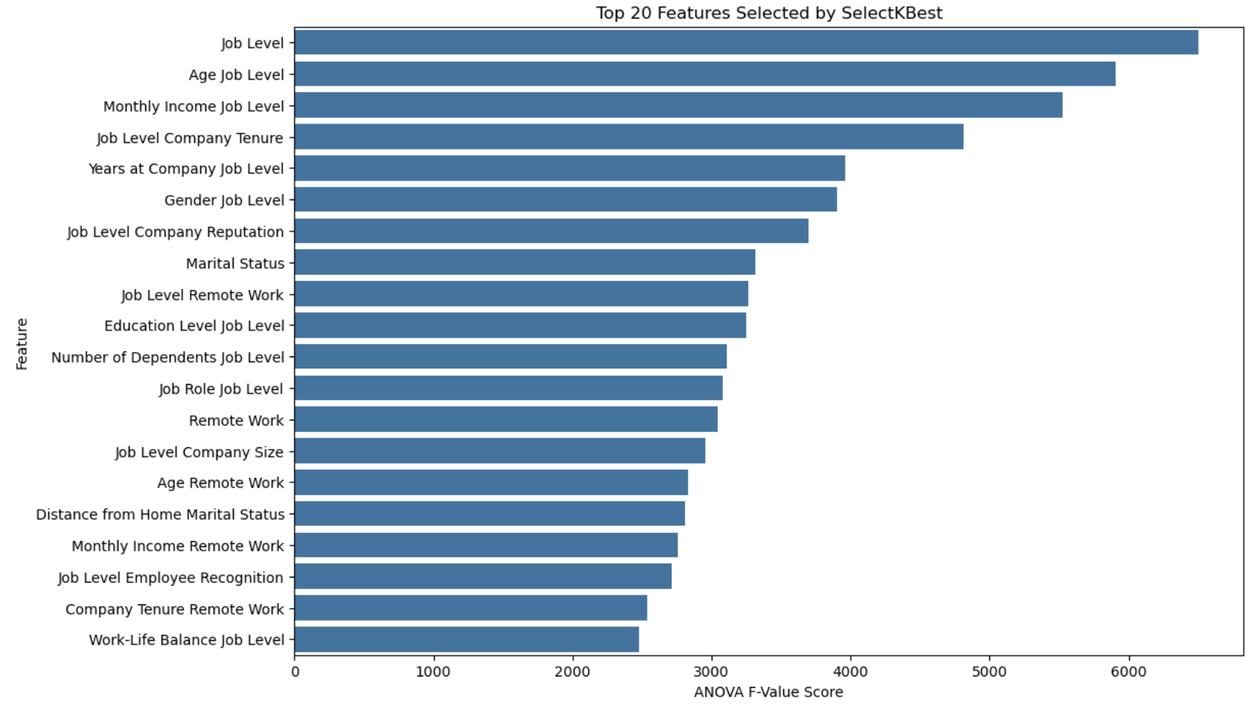
Model #2: KNN
 | Accuracy
Initial model | 67.3%
Cross Validation | 71.4%
Selected Features | 71.8%
Important features
Job level
Age
Optimal Number of Neighbors
K=95 for initial cross validation
K=50 for selected features

Slide 10
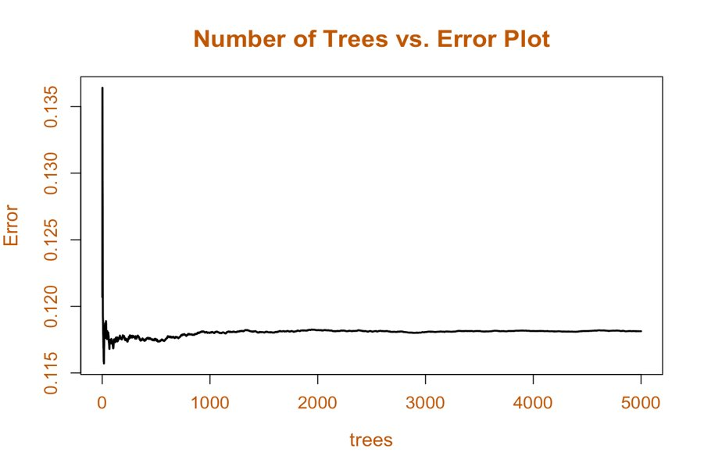
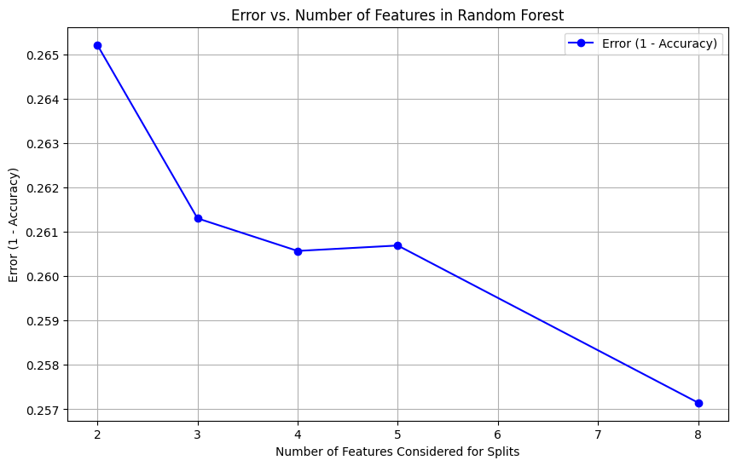
Model 3: Random Forests
Number of Trees Selection​
Used error vs number of trees plot to determine optimal tree count to​
The error stabilizes starting with 1000 trees​
The selected tree count is 1500, which balances accuracy and computational efficiency​
Number of Features
Used error vs number of features plot to determine optimal feature value
Selected 8 features to be sampled in random forest calculation

Slide 11
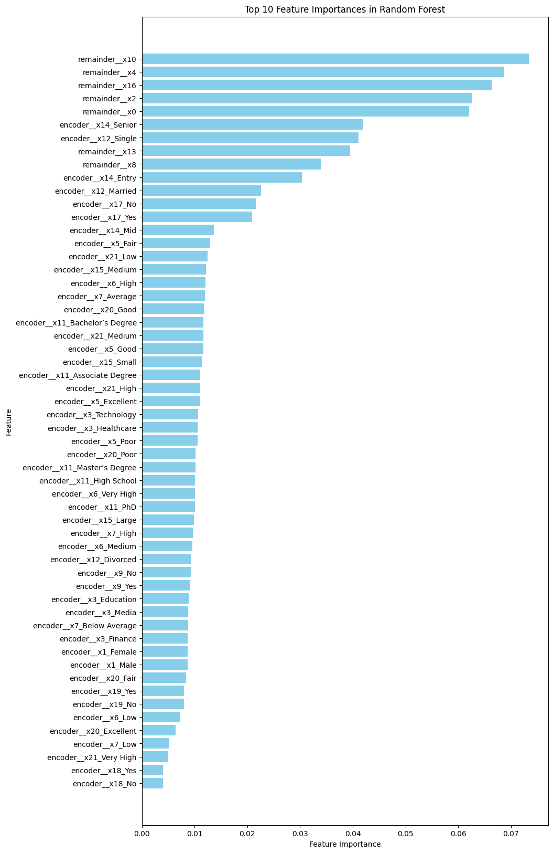
Model 4: Random Forests
Feature Importance​
As per Random Forest variable importance plot the top features were as same as expected in EDA:
Age
Years at Company
Job Level
Marital Status
Baseline Accuracy | 52.81%
Model Accuracy | 75.2%
Precision | 76%
Recall | 76%

Slide 12
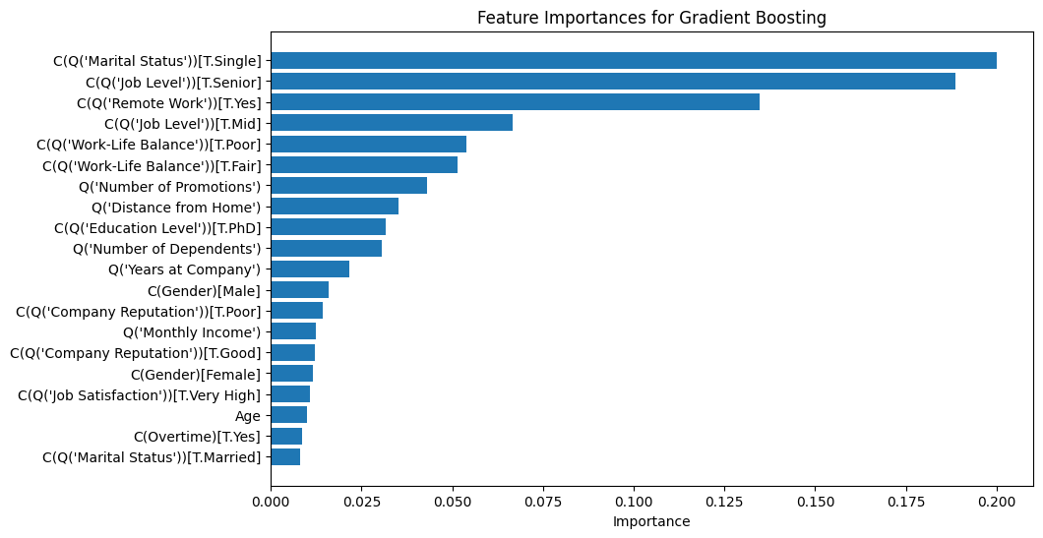
Model 5: Boosting​
Accuracy | 75.7%
Precision | 76.5%
Recall | 76.8%
Marital Status, Job Level, Work Environment
Important predictors not consistent

Slide 13
Best Predictors of Attrition
Job Level
Marital Status
Age
Years at Company

Slide 14
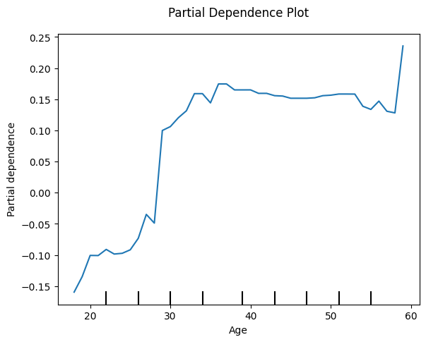
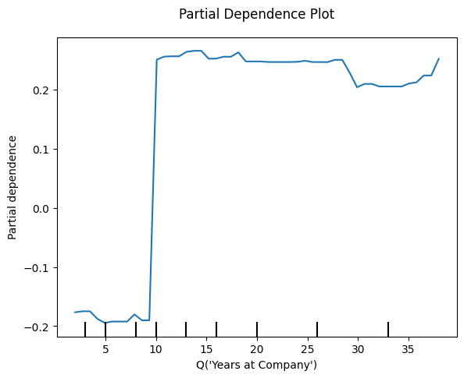
Partial Dependence
Age
Years at Company

Slide 15
Thank You!

