Slide 1
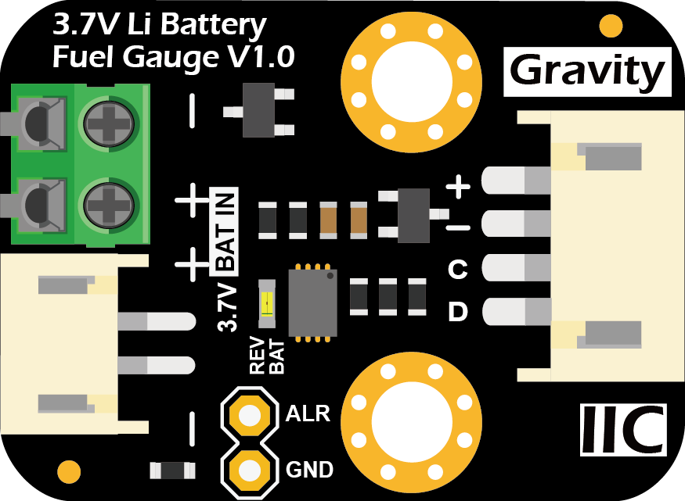

MHS-3.2inch Display
Type
C
USB 5V
IP5306
-
+
-
+

